Slide 1
Spelling Y5
Mastering spellings: building on the foundations of phonics
Spring 1
Week 4

Slide 2
These slides are slightly different - to reduce the number there are now animations used
Please use these slides in full screen slide show mode to ensure they work how they are designed with chunks of information being shown at a time to prevent overload
Thank you

Slide 3
Year 5 - Spring 1
Week 4 - Monday

Slide 4
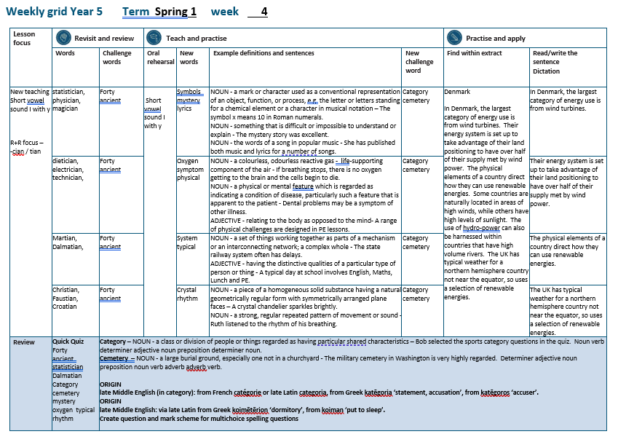

Slide 5
Let’s Revisit and Review…

Slide 6
Do you remember this challenge word?

Slide 7

The number forty has significant meaning in the bible.
forty

Slide 8
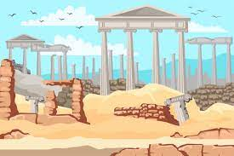
Some trees are said to be ancient and are needing protection.
ancient

Slide 9
Words with ending sound /ʃən/ –tian and -cian
-tian mean a place or origin
-cian mean occupation / job

Slide 10
-cian

Slide 11
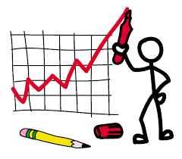
statistician

Slide 12

physician

Slide 13
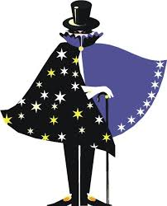
magician

Slide 14
Let’s Teach and Practise

Slide 15
y
Short vowel sound i with y

Slide 16
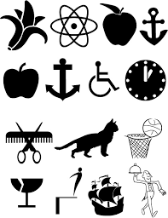
symbols

Slide 17

mystery

Slide 18
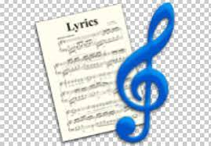
lyrics

Slide 19
symbols
NOUN
Definition - a mark or character used as a conventional representation of an object, function, or process, e.g. the letter or letters standing for a chemical element or a character in musical notation

Slide 20
mystery
NOUN
Definition - something that is difficult or impossible to understand or explain

Slide 21
Lyrics
NOUN
Definition - She has published both music and lyrics for a number of songs

Slide 22
The symbol x means 10 in Roman numerals.
______

Slide 23
The mystery story was excellent.
_______

Slide 24
She has published both music and lyrics for a number of songs.
______

Slide 25
New CHALLENGE words.

Slide 26
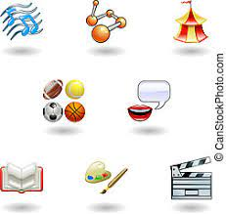
category
NOUN
Definition -a class or division of people or things regarded as having particular shared characteristics

Slide 27
Bob selected the sports category questions in the quiz.
________

Slide 28
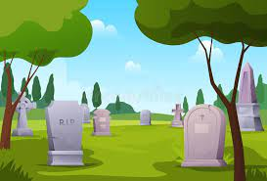
cemetery
NOUN
Definition - a large burial ground, especially one not in a churchyard

Slide 29
The military cemetery in Washington is very highly regarded.
________

Slide 30
Let’s Practise and Apply.

Slide 31
Can you spot the spelling rule words and the challenge words?

Slide 32
Denmark
In Denmark, the largest category of energy use is from wind turbines. Their energy system is set up to take advantage of their land positioning to have over half of their supply met by wind power. The physical elements of a country direct how they can use renewable energies. Some countries are naturally located in areas of high winds, while others have high levels of sunlight. The use of hydro-power can also be harnessed within countries that have high volume rivers. The UK has typical weather for a northern hemisphere country not near the equator, so uses a selection of renewable energies.

Slide 33
Denmark
In Denmark, the largest category of energy use is from wind turbines. Their energy system is set up to take advantage of their land positioning to have over half of their supply met by wind power. The physical elements of a country direct how they can use renewable energies. Some countries are naturally located in areas of high winds, while others have high levels of sunlight. The use of hydro-power can also be harnessed within countries that have high volume rivers. The UK has typical weather for a northern hemisphere country not near the equator, so uses a selection of renewable energies.

Slide 34
Write this sentence as I dictate it to you.
Notes:
In Denmark, the largest category of energy use is from wind turbines.

Slide 35
In Denmark, the largest category of energy use is from wind turbines.
Did you write it correctly?
Edit your work and make sure you have it correct.
Can you underline the spelling word that we have covered in this session?

Slide 36
Year 5 - Spring 1
Week 4 - Tuesday
Notes:
Revisit and review the words from previous teaching and challenge words – I say, we say, you say
Ask children to write words only in their spelling book
Introduce the new spelling rule
Children to write the new spelling rule words and challenge words into books when the sentences are shown with the spelling word missing.
Read the extract with the class as choral reading. Practise model of prosody etc.
Ask children to find the spelling words from the session in the text.
Then read allowed the chosen sentence for children to write fully in their books.
Show the extract and ask children to then edit their work to check they were correct in their dictation.

Slide 38
Let’s Revisit and Review…

Slide 39
Do you remember this challenge word?

Slide 40
The number forty has significant meaning in the bible.
forty

Slide 41
Some trees are said to be ancient and are needing protection.
ancient

Slide 42
Words with ending sound /ʃən/ –tian and -cian
-tian mean a place or origin
-cian mean occupation / job

Slide 43
-cian

Slide 44

dietician

Slide 45
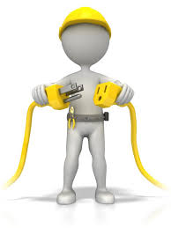
electrician

Slide 46

technician

Slide 47
Let’s Teach and Practise

Slide 48
y
Short vowel sound i with y

Slide 49
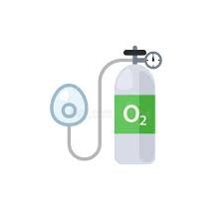
oxygen

Slide 50
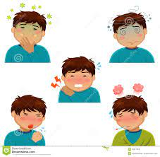
symptom

Slide 51
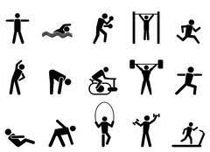
physical

Slide 52
oxygen
NOUN
Definition - a colourless, odourless reactive gas

Slide 53
symptom
NOUN
Definition - a physical or mental feature which is regarded as indicating a condition of disease, particularly such a feature that is apparent to the patient

Slide 54
physical
ADJECTIVE
Definition - relating to the body as opposed to the mind-

Slide 55
If breathing stops, there is no oxygen getting to the brain and the cells begin to die.
______

Slide 56
Dental problems may be a symptom of onther illness.
_______

Slide 57
A range of physical challenges are designed in PE lessons.
________

Slide 58
New CHALLENGE words.

Slide 59
category
NOUN
Definition -a class or division of people or things regarded as having particular shared characteristics

Slide 60
Bob selected the sports category questions in the quiz.
________

Slide 61
cemetery
NOUN
Definition - a large burial ground, especially one not in a churchyard

Slide 62
The military cemetery in Washington is very highly regarded.
________

Slide 63
Let’s Practise and Apply.

Slide 64
Can you spot the spelling rule words and the challenge words?

Slide 65
Denmark
In Denmark, the largest category of energy use is from wind turbines. Their energy system is set up to take advantage of their land positioning to have over half of their supply met by wind power. The physical elements of a country direct how they can use renewable energies. Some countries are naturally located in areas of high winds, while others have high levels of sunlight. The use of hydro-power can also be harnessed within countries that have high volume rivers. The UK has typical weather for a northern hemisphere country not near the equator, so uses a selection of renewable energies.

Slide 66
Denmark
In Denmark, the largest category of energy use is from wind turbines. Their energy system is set up to take advantage of their land positioning to have over half of their supply met by wind power. The physical elements of a country direct how they can use renewable energies. Some countries are naturally located in areas of high winds, while others have high levels of sunlight. The use of hydro-power can also be harnessed within countries that have high volume rivers. The UK has typical weather for a northern hemisphere country not near the equator, so uses a selection of renewable energies.

Slide 67
Write this sentence as I dictate it to you.
Notes:
Their energy system is set up to take advantage of their land positioning to have over half of their supply met by wind power.

Slide 68
Their energy system is set up to take advantage of their land positioning to have over half of their supply met by wind power.
Did you write it correctly?
Edit your work and make sure you have it correct.
Can you underline the spelling word that we have covered in this session?

Slide 69
Year 5 - Spring 1
Week 4 - Wednesday
Notes:
Revisit and review the words from previous teaching and challenge words – I say, we say, you say
Ask children to write words only in their spelling book
Introduce the new spelling rule
Children to write the new spelling rule words and challenge words into books when the sentences are shown with the spelling word missing.
Read the extract with the class as choral reading. Practise model of prosody etc.
Ask children to find the spelling words from the session in the text.
Then read allowed the chosen sentence for children to write fully in their books.
Show the extract and ask children to then edit their work to check they were correct in their dictation.

Slide 71
Let’s Revisit and Review…

Slide 72
Do you remember this challenge word?

Slide 73
The number forty has significant meaning in the bible.
forty

Slide 74
Some trees are said to be ancient and are needing protection.
ancient

Slide 75
Words with ending sound /ʃən/ –tian and -cian
-tian mean a place or origin
-cian mean occupation / job

Slide 76
-tian

Slide 77

Martian

Slide 78

Dalmatian

Slide 79
Let’s Teach and Practise

Slide 80
y
Short vowel sound i with y

Slide 81
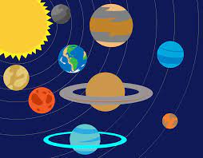
system

Slide 82
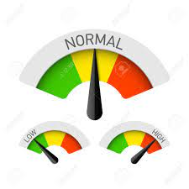
typical

Slide 83
system
NOUN
Definition - a set of things working together as parts of a mechanism or an interconnecting network; a complex whole

Slide 84
typical
ADJECTIVE
Definition - having the distinctive qualities of a particular type of person or thing

Slide 85
The state railway system often has delays.
______

Slide 86
A typical day at school involves English, Maths, Lunch and PE.
_______

Slide 87
New CHALLENGE words.

Slide 88
category
NOUN
Definition -a class or division of people or things regarded as having particular shared characteristics

Slide 89
Bob selected the sports category questions in the quiz.
________

Slide 90
cemetery
NOUN
Definition - a large burial ground, especially one not in a churchyard

Slide 91
The military cemetery in Washington is very highly regarded.
________

Slide 92
Let’s Practise and Apply.

Slide 93
Can you spot the spelling rule words and the challenge words?

Slide 94
Denmark
In Denmark, the largest category of energy use is from wind turbines. Their energy system is set up to take advantage of their land positioning to have over half of their supply met by wind power. The physical elements of a country direct how they can use renewable energies. Some countries are naturally located in areas of high winds, while others have high levels of sunlight. The use of hydro-power can also be harnessed within countries that have high volume rivers. The UK has typical weather for a northern hemisphere country not near the equator, so uses a selection of renewable energies.

Slide 95
Denmark
In Denmark, the largest category of energy use is from wind turbines. Their energy system is set up to take advantage of their land positioning to have over half of their supply met by wind power. The physical elements of a country direct how they can use renewable energies. Some countries are naturally located in areas of high winds, while others have high levels of sunlight. The use of hydro-power can also be harnessed within countries that have high volume rivers. The UK has typical weather for a northern hemisphere country not near the equator, so uses a selection of renewable energies.

Slide 96
Write this sentence as I dictate it to you.
Notes:
The physical elements of a country direct how they can use renewable energies.

Slide 97
The physical elements of a country direct how they can use renewable energies.
Did you write it correctly?
Edit your work and make sure you have it correct.
Can you underline the spelling word that we have covered in this session?

Slide 98
Year 5 - Spring 1
Week 4 - Thursday
Notes:
Revisit and review the words from previous teaching and challenge words – I say, we say, you say
Ask children to write words only in their spelling book
Introduce the new spelling rule
Children to write the new spelling rule words and challenge words into books when the sentences are shown with the spelling word missing.
Read the extract with the class as choral reading. Practise model of prosody etc.
Ask children to find the spelling words from the session in the text.
Then read allowed the chosen sentence for children to write fully in their books.
Show the extract and ask children to then edit their work to check they were correct in their dictation.

Slide 100
Let’s Revisit and Review…

Slide 101
Do you remember this challenge word?

Slide 102
The number forty has significant meaning in the bible.
forty

Slide 103
Some trees are said to be ancient and are needing protection.
ancient

Slide 104
Words with ending sound /ʃən/ –tian and -cian
-tian mean a place or origin
-cian mean occupation / job

Slide 105
-tian

Slide 106

Christian

Slide 107
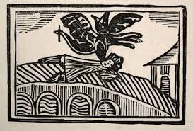
Faustian

Slide 108
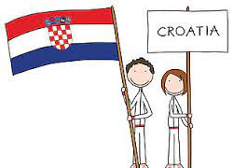
Croatian

Slide 109
Let’s Teach and Practise

Slide 110
y
Short vowel sound i with y

Slide 111

crystal

Slide 112
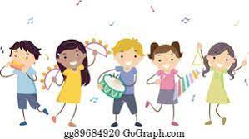
rhythm

Slide 113
crystal
NOUN
Definition - a piece of a homogeneous solid substance having a natural geometrically regular form with symmetrically arranged plane faces

Slide 114
rhythm
NOUN
Definition - a strong, regular repeated pattern of movement or sound

Slide 115
A crystal chandelier sparkles brightly.
_______

Slide 116
Ruth listened to the rhythm of his breathing.
______

Slide 117
New CHALLENGE words.

Slide 118
category
NOUN
Definition -a class or division of people or things regarded as having particular shared characteristics

Slide 119
Bob selected the sports category questions in the quiz.
________

Slide 120
cemetery
NOUN
Definition - a large burial ground, especially one not in a churchyard

Slide 121
The military cemetery in Washington is very highly regarded.
________

Slide 122
Let’s Practise and Apply.

Slide 123
Can you spot the spelling rule words and the challenge words?

Slide 124
Denmark
In Denmark, the largest category of energy use is from wind turbines. Their energy system is set up to take advantage of their land positioning to have over half of their supply met by wind power. The physical elements of a country direct how they can use renewable energies. Some countries are naturally located in areas of high winds, while others have high levels of sunlight. The use of hydro-power can also be harnessed within countries that have high volume rivers. The UK has typical weather for a northern hemisphere country not near the equator, so uses a selection of renewable energies.

Slide 125
Denmark
In Denmark, the largest category of energy use is from wind turbines. Their energy system is set up to take advantage of their land positioning to have over half of their supply met by wind power. The physical elements of a country direct how they can use renewable energies. Some countries are naturally located in areas of high winds, while others have high levels of sunlight. The use of hydro-power can also be harnessed within countries that have high volume rivers. The UK has typical weather for a northern hemisphere country not near the equator, so uses a selection of renewable energies.

Slide 126
Write this sentence as I dictate it to you.
Notes:
The UK has typical weather for a northern hemisphere country not near the equator, so uses a selection of renewable energies.

Slide 127
The UK has typical weather for a northern hemisphere country not near the equator, so uses a selection of renewable energies.
Did you write it correctly?
Edit your work and make sure you have it correct.
Can you underline the spelling word that we have covered in this session?

Slide 128
Year 5 - Spring 1
Week 4 - Friday
Notes:
Click through the slides for all the R+R words for the week (both the focus and the challenge words)
Click through the slides for all the new learning this week

Slide 130
Old challenge words…

Slide 131
forty

Slide 132
ancient

Slide 133
Old spelling rule words…

Slide 134
statistician

Slide 135
physician

Slide 136
magician

Slide 137
dietician

Slide 138
electrician

Slide 139
technician

Slide 140
Martian

Slide 141
Dalmatian

Slide 142
Christian

Slide 143
Faustian

Slide 144
Croatian

Slide 145
New spelling rule words…

Slide 146
symbols

Slide 147
mystery

Slide 148
lyrics

Slide 149
oxygen

Slide 150
symptom

Slide 151
physical

Slide 152
system

Slide 153
typical

Slide 154
crystal

Slide 155
rhythm

Slide 156
New challenge words…

Slide 157
category

Slide 158
cemetery

Slide 159
Quick Quiz time…
Notes:
Say these words for the quiz
forty ancient statistician Dalmatian Category cemetery mystery oxygen typical rhythm

Slide 160
Did you get them correct?
Edit your work.
forty ancient statistician dalmatian category cemetery mystery oxygen typical rhythm

Slide 161
Word class time…

Slide 162
Bob selected the sports category questions in the quiz.
Noun verb déterminer adjective adjective noun preposition determiner noun.
Notes:
Ask for these words to be classed

Slide 163
The military cemetery in Washington is very highly regarded
Determiner adjective noun preposition noun verb adverb adverb verb.
Notes:
Ask for these words to be classed

Slide 164
Etymology
The history of a word….

Slide 165
Category
late Middle English (in category): from French catégorie or late Latin categoria, from Greek katēgoria ‘statement, accusation’, from katēgoros ‘accuser’.
Cemetery
late Middle English: via late Latin from Greek koimētērion ‘dormitory’, from koiman ‘put to sleep’.

Slide 166
Let’s investigate….
Write spelling questions for the challenge words and then a mark scheme to show where children may go wrong.

