Slide 1
Spelling Y5
Mastering spellings: building on the foundations of phonics
Spring 1
Week 5

Slide 2
These slides are slightly different - to reduce the number there are now animations used
Please use these slides in full screen slide show mode to ensure they work how they are designed with chunks of information being shown at a time to prevent overload
Thank you

Slide 3
Year 5 - Spring 1
Week 5 - Monday

Slide 4
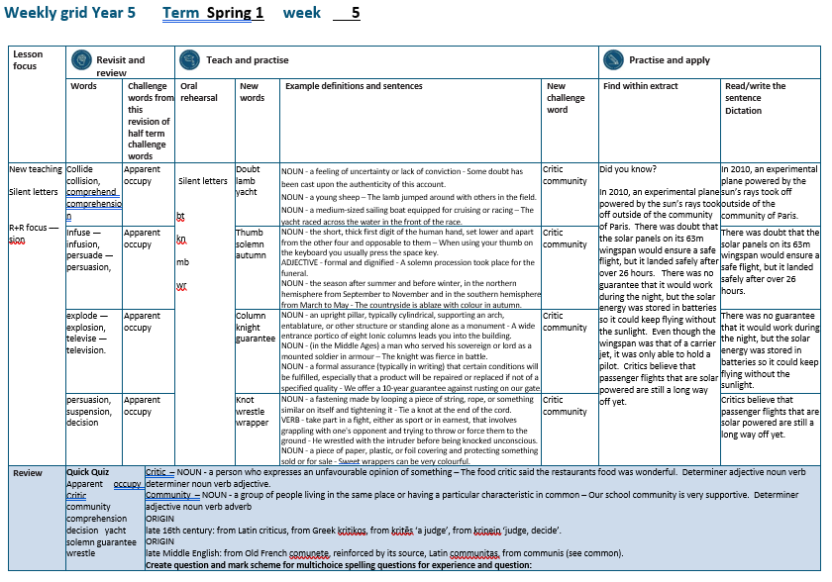

Slide 5
Let’s Revisit and Review…

Slide 6
Do you remember this challenge word?

Slide 7
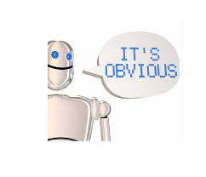
The solution was apparent to all except the teacher.
apparent

Slide 8
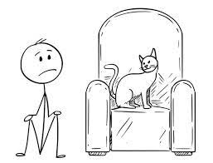
To occupy the top office in the country is to be Prime Minister.
occupy

Slide 9
Words with ending sound /ʃən/
–sion
–sion is used if the root word ends in d or se.
Exceptions: attend – attention, intend – intention

Slide 10
-sion

Slide 11
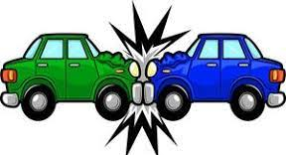
collision

Slide 12

comprehension

Slide 13
Let’s Teach and Practise

Slide 14
bt kn mb wr
Silent letters

Slide 15

doubt

Slide 16
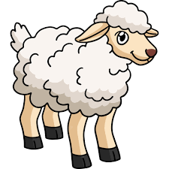
lamb

Slide 17
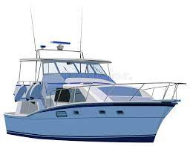
yacht

Slide 18
doubt
NOUN
Definition - a feeling of uncertainty or lack of conviction

Slide 19
lamb
NOUN
Definition - a young sheep

Slide 20
yacht
NOUN
Definition - a medium-sized sailing boat equipped for cruising or racing

Slide 21
Some doubt has been cast upon the authenticity of this account.
_____

Slide 22
The lamb jumped around with others in the field.
____

Slide 23
The yacht raced across the water in the front of the race.
_____

Slide 24
New CHALLENGE words.

Slide 25
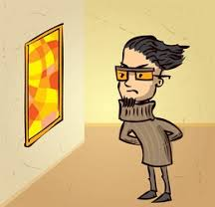
critic
NOUN
Definition - a person who expresses an unfavourable opinion of something

Slide 26
The food critic said the restaurants food was wonderful.
______

Slide 27

community
NOUN
Definition - a group of people living in the same place or having a particular characteristic in common

Slide 28
Our school community is very supportive.
_________

Slide 29
Let’s Practise and Apply.

Slide 30
Can you spot the spelling rule words and the challenge words?

Slide 31
Did you know?
In 2010, an experimental plane powered by the sun’s rays took off outside of the community of Paris. There was doubt that the solar panels on its 63m wingspan would ensure a safe flight, but it landed safely after over 26 hours. There was no guarantee that it would work during the night, but the solar energy was stored in batteries so it could keep flying without the sunlight. Even though the wingspan was that of a carrier jet, it was only able to hold a pilot. Critics believe that passenger flights that are solar powered are still a long way off yet.

Slide 32
Did you know?
In 2010, an experimental plane powered by the sun’s rays took off outside of the community of Paris. There was doubt that the solar panels on its 63m wingspan would ensure a safe flight, but it landed safely after over 26 hours. There was no guarantee that it would work during the night, but the solar energy was stored in batteries so it could keep flying without the sunlight. Even though the wingspan was that of a carrier jet, it was only able to hold a pilot. Critics believe that passenger flights that are solar powered are still a long way off yet.

Slide 33
Write this sentence as I dictate it to you.
Notes:
In 2010, an experimental plane powered by the sun’s rays took off outside of the community of Paris.

Slide 34
In 2010, an experimental plane powered by the sun’s rays took off outside of the community of Paris.
Did you write it correctly?
Edit your work and make sure you have it correct.
Can you underline the spelling word that we have covered in this session?

Slide 35
Year 5 - Spring 1
Week 5 - Tuesday
Notes:
Revisit and review the words from previous teaching and challenge words – I say, we say, you say
Ask children to write words only in their spelling book
Introduce the new spelling rule
Children to write the new spelling rule words and challenge words into books when the sentences are shown with the spelling word missing.
Read the extract with the class as choral reading. Practise model of prosody etc.
Ask children to find the spelling words from the session in the text.
Then read allowed the chosen sentence for children to write fully in their books.
Show the extract and ask children to then edit their work to check they were correct in their dictation.

Slide 37
Let’s Revisit and Review…

Slide 38
Do you remember this challenge word?

Slide 39
The solution was apparent to all except the teacher.
apparent

Slide 40
To occupy the top office in the country is to be Prime Minister.
occupy

Slide 41
Words with ending sound /ʃən/
–sion
–sion is used if the root word ends in d or se.
Exceptions: attend – attention, intend – intention

Slide 42
-sion

Slide 43
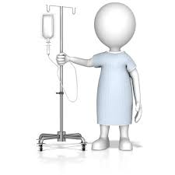
infusion

Slide 44

persuasion

Slide 45
Let’s Teach and Practise

Slide 46
bt kn mb wr
Silent letters

Slide 47

thumb

Slide 48

solemn

Slide 49

autumn

Slide 50
thumb
NOUN
Definition - the short, thick first digit of the human hand, set lower and apart from the other four and opposable to them

Slide 51
solemn
ADJECTIVE
Definition – formal, sad and dignified

Slide 52
autumn
NOUN
Definition - - the season after summer and before winter, in the northern hemisphere from September to November and in the southern hemisphere from March to May

Slide 53
When using your thumb on the keyboard you usually press the space key.
_____

Slide 54
A solemn procession took place for the funeral.
______

Slide 55
The countryside is ablaze with colour in autumn.
______

Slide 56
New CHALLENGE words.

Slide 57
critic
NOUN
Definition - a person who expresses an unfavourable opinion of something

Slide 58
The food critic said the restaurants food was wonderful.
______

Slide 59
community
NOUN
Definition - a group of people living in the same place or having a particular characteristic in common

Slide 60
Our school community is very supportive.
_________

Slide 61
Let’s Practise and Apply.

Slide 62
Can you spot the spelling rule words and the challenge words?

Slide 63
Did you know?
In 2010, an experimental plane powered by the sun’s rays took off outside of the community of Paris. There was doubt that the solar panels on its 63m wingspan would ensure a safe flight, but it landed safely after over 26 hours. There was no guarantee that it would work during the night, but the solar energy was stored in batteries so it could keep flying without the sunlight. Even though the wingspan was that of a carrier jet, it was only able to hold a pilot. Critics believe that passenger flights that are solar powered are still a long way off yet.

Slide 64
Did you know?
In 2010, an experimental plane powered by the sun’s rays took off outside of the community of Paris. There was doubt that the solar panels on its 63m wingspan would ensure a safe flight, but it landed safely after over 26 hours. There was no guarantee that it would work during the night, but the solar energy was stored in batteries so it could keep flying without the sunlight. Even though the wingspan was that of a carrier jet, it was only able to hold a pilot. Critics believe that passenger flights that are solar powered are still a long way off yet.

Slide 65
Write this sentence as I dictate it to you.
Notes:
There was doubt that the solar panels on its 63m wingspan would ensure a safe flight, but it landed safely after over 26 hours.

Slide 66
There was doubt that the solar panels on its 63m wingspan would ensure a safe flight, but it landed safely after over 26 hours.
Did you write it correctly?
Edit your work and make sure you have it correct.
Can you underline the spelling word that we have covered in this session?

Slide 67
Year 5 - Spring 1
Week 5 - Wednesday
Notes:
Revisit and review the words from previous teaching and challenge words – I say, we say, you say
Ask children to write words only in their spelling book
Introduce the new spelling rule
Children to write the new spelling rule words and challenge words into books when the sentences are shown with the spelling word missing.
Read the extract with the class as choral reading. Practise model of prosody etc.
Ask children to find the spelling words from the session in the text.
Then read allowed the chosen sentence for children to write fully in their books.
Show the extract and ask children to then edit their work to check they were correct in their dictation.

Slide 69
Let’s Revisit and Review…

Slide 70
Do you remember this challenge word?

Slide 71
The solution was apparent to all except the teacher.
apparent

Slide 72
To occupy the top office in the country is to be Prime Minister.
occupy

Slide 73
Words with ending sound /ʃən/
–sion
–sion is used if the root word ends in d or se.
Exceptions: attend – attention, intend – intention

Slide 74
-sion

Slide 75

explosion

Slide 76

television

Slide 77
Let’s Teach and Practise

Slide 78
bt kn mb wr
Silent letters

Slide 79

column

Slide 80
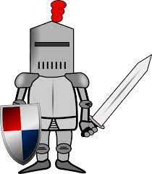
knight

Slide 81

guarantee

Slide 82
column
NOUN
Definition - an upright pillar, typically cylindrical, supporting an arch, entablature, or other structure or standing alone as a monument

Slide 83
knight
NOUN
Definition - (in the Middle Ages) a man who served his sovereign or lord as a mounted soldier in armour

Slide 84
guarantee
NOUN
Definition - a formal assurance (typically in writing) that certain conditions will be fulfilled, especially that a product will be repaired or replaced if not of a specified quality

Slide 85
A wide entrance portico of eight Ionic columns leads you into the building.
_______

Slide 86
The knight was fierce in battle.
______

Slide 87
We offer a 10-year guarantee against rusting on our gate.
_________

Slide 88
New CHALLENGE words.

Slide 89
critic
NOUN
Definition - a person who expresses an unfavourable opinion of something

Slide 90
The food critic said the restaurants food was wonderful.
______

Slide 91
community
NOUN
Definition - a group of people living in the same place or having a particular characteristic in common

Slide 92
Our school community is very supportive.
_________

Slide 93
Let’s Practise and Apply.

Slide 94
Can you spot the spelling rule words and the challenge words?

Slide 95
Did you know?
In 2010, an experimental plane powered by the sun’s rays took off outside of the community of Paris. There was doubt that the solar panels on its 63m wingspan would ensure a safe flight, but it landed safely after over 26 hours. There was no guarantee that it would work during the night, but the solar energy was stored in batteries so it could keep flying without the sunlight. Even though the wingspan was that of a carrier jet, it was only able to hold a pilot. Critics believe that passenger flights that are solar powered are still a long way off yet.

Slide 96
Did you know?
In 2010, an experimental plane powered by the sun’s rays took off outside of the community of Paris. There was doubt that the solar panels on its 63m wingspan would ensure a safe flight, but it landed safely after over 26 hours. There was no guarantee that it would work during the night, but the solar energy was stored in batteries so it could keep flying without the sunlight. Even though the wingspan was that of a carrier jet, it was only able to hold a pilot. Critics believe that passenger flights that are solar powered are still a long way off yet.

Slide 97
Write this sentence as I dictate it to you.
Notes:
There was no guarantee that it would work during the night, but the solar energy was stored in batteries so it could keep flying without the sunlight.

Slide 98
There was no guarantee that it would work during the night, but the solar energy was stored in batteries so it could keep flying without the sunlight.
Did you write it correctly?
Edit your work and make sure you have it correct.
Can you underline the spelling word that we have covered in this session?

Slide 99
Year 5 - Spring 1
Week 5 - Thursday
Notes:
Revisit and review the words from previous teaching and challenge words – I say, we say, you say
Ask children to write words only in their spelling book
Introduce the new spelling rule
Children to write the new spelling rule words and challenge words into books when the sentences are shown with the spelling word missing.
Read the extract with the class as choral reading. Practise model of prosody etc.
Ask children to find the spelling words from the session in the text.
Then read allowed the chosen sentence for children to write fully in their books.
Show the extract and ask children to then edit their work to check they were correct in their dictation.

Slide 101
Let’s Revisit and Review…

Slide 102
Do you remember this challenge word?

Slide 103
The solution was apparent to all except the teacher.
apparent

Slide 104
To occupy the top office in the country is to be Prime Minister.
occupy

Slide 105
Words with ending sound /ʃən/
–sion
–sion is used if the root word ends in d or se.
Exceptions: attend – attention, intend – intention

Slide 106
-sion

Slide 107

decision

Slide 108

suspension

Slide 109
Let’s Teach and Practise

Slide 110
bt kn mb wr
Silent letters

Slide 111
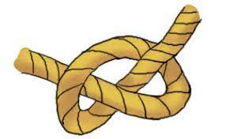
knot

Slide 112

wrestle

Slide 113
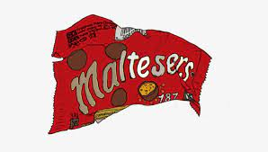
wrapper

Slide 114
knot
NOUN
Definition - a fastening made by looping a piece of string, rope, or something similar on itself and tightening it

Slide 115
wrestle
VERB
Definition - take part in a fight, either as sport or in earnest, that involves grappling with one's opponent and trying to throw or force them to the ground

Slide 116
wrapper
NOUN
Definition - a piece of paper, plastic, or foil covering and protecting something sold or for sale

Slide 117
Tie a knot at the end of the cord.
____

Slide 118
He wrestled with the intruder before being knocked unconscious.
________

Slide 119
Sweet wrappers can be very colourful.
________

Slide 120
New CHALLENGE words.

Slide 121
critic
NOUN
Definition - a person who expresses an unfavourable opinion of something

Slide 122
The food critic said the restaurants food was wonderful.
______

Slide 123
community
NOUN
Definition - a group of people living in the same place or having a particular characteristic in common

Slide 124
Our school community is very supportive.
_________

Slide 125
Let’s Practise and Apply.

Slide 126
Can you spot the spelling rule words and the challenge words?

Slide 127
Did you know?
In 2010, an experimental plane powered by the sun’s rays took off outside of the community of Paris. There was doubt that the solar panels on its 63m wingspan would ensure a safe flight, but it landed safely after over 26 hours. There was no guarantee that it would work during the night, but the solar energy was stored in batteries so it could keep flying without the sunlight. Even though the wingspan was that of a carrier jet, it was only able to hold a pilot. Critics believe that passenger flights that are solar powered are still a long way off yet.

Slide 128
Did you know?
In 2010, an experimental plane powered by the sun’s rays took off outside of the community of Paris. There was doubt that the solar panels on its 63m wingspan would ensure a safe flight, but it landed safely after over 26 hours. There was no guarantee that it would work during the night, but the solar energy was stored in batteries so it could keep flying without the sunlight. Even though the wingspan was that of a carrier jet, it was only able to hold a pilot. Critics believe that passenger flights that are solar powered are still a long way off yet.

Slide 129
Write this sentence as I dictate it to you.
Notes:
Critics believe that passenger flights that are solar powered are still a long way off yet.

Slide 130
Critics believe that passenger flights that are solar powered are still a long way off yet.
Did you write it correctly?
Edit your work and make sure you have it correct.
Can you underline the spelling word that we have covered in this session?

Slide 131
Year 5 - Spring 1
Week 5 - Friday
Notes:
Click through the slides for all the R+R words for the week (both the focus and the challenge words)
Click through the slides for all the new learning this week

Slide 133
Old challenge words…

Slide 134
apparent

Slide 135
occupy

Slide 136
Old spelling rule words…

Slide 137
collide

Slide 138
collision

Slide 139
comprehend

Slide 140
comprehension

Slide 141
infuse

Slide 142
infusion

Slide 143
persuade

Slide 144
persuasion

Slide 145
explode

Slide 146
explosion

Slide 147
televise

Slide 148
television

Slide 149
decide

Slide 150
decision

Slide 151
suspend

Slide 152
suspension

Slide 153
New spelling rule words…

Slide 154
doubt

Slide 155
lamb

Slide 156
yacht

Slide 157
thumb

Slide 158
solemn

Slide 159
autumn

Slide 160
column

Slide 161
knight

Slide 162
guarantee

Slide 163
knot

Slide 164
wrestle

Slide 165
wrapper

Slide 166
New challenge words…

Slide 167
critic

Slide 168
community

Slide 169
Quick Quiz time…
Notes:
Say these words for the quiz
forty ancient statistician Dalmatian Category cemetery mystery oxygen typical rhythm

Slide 170
Did you get them correct?
Edit your work.
apparent occupy critic community comprehension decision yacht solemn guarantee wrestle

Slide 171
Word class time…

Slide 172
The food critic said the restaurants food was wonderful.
Determiner adjective noun verb determiner noun verb adjective.
Notes:
Ask for these words to be classed

Slide 173
Our school community is very supportive.
Determiner adjective noun verb adverb
Notes:
Ask for these words to be classed

Slide 174
Etymology
The history of a word….

Slide 175
Critic
late 16th century: from Latin criticus, from Greek kritikos, from kritēs ‘a judge’, from krinein ‘judge, decide’.
Community
late Middle English: from Old French comunete, reinforced by its source, Latin communitas, from communis (see common).

Slide 176
Let’s investigate….
Find synonyms and antonyms of the challenge words.

