Slide 1
Spelling Y5
Mastering spellings: building on the foundations of phonics
Spring 1
Week 6

Slide 2
Year 5 - Spring 1
Week 6 - Monday

Slide 3
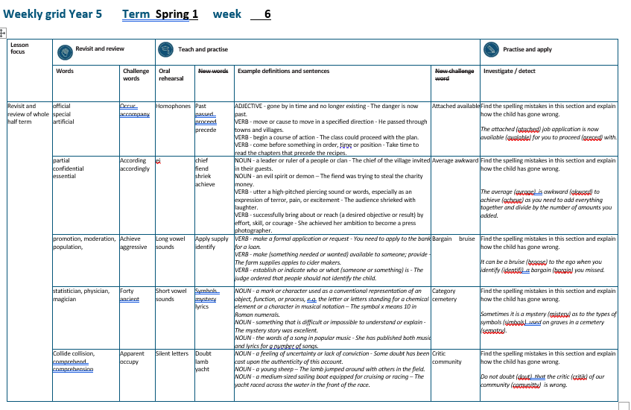

Slide 4
Let’s Revisit and Review…

Slide 5
Do you remember this challenge word?

Slide 6

occur
For the event to occur, the rain had to stop.

Slide 7
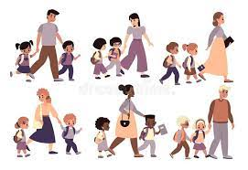
accompany
Ishmael had to accompany his dad to work.

Slide 8
Words with ending sound /shuhl/ after a vowel letter
-cial

Slide 9
-cial

Slide 10
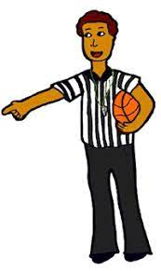
official

Slide 11

special

Slide 12
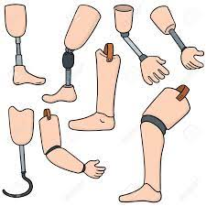
artificial

Slide 13
Let’s Teach and Practise

Slide 14
homo – same phone – sound
homophone –
same sound but different meaning

Slide 15
homophones

Slide 16
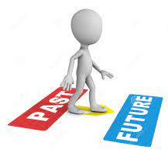
past

Slide 17
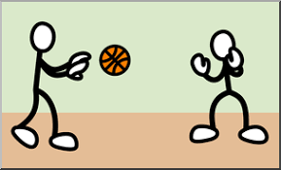
passed

Slide 18
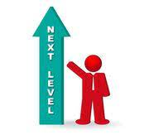
proceed

Slide 19
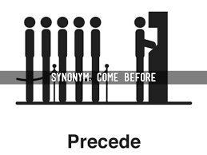
precede

Slide 20
past
ADJECTIVE
Definition - gone by in time and no longer existing

Slide 21
passed
VERB
Definition - move or cause to move in a specified direction

Slide 22
proceed
VERB
Definition - begin a course of action

Slide 23
precede
VERB
Definition - come before something in order, time or position

Slide 24
The danger is now past.
____

Slide 25
He passed through towns and villages.
______

Slide 26
The class could proceed with the plan.
_______

Slide 27
Take time to read the chapters that precede the recipes.
_______

Slide 28
New CHALLENGE words.

Slide 29

attached
ADJECTIVE
Definition - joined, fastened, or connected to something

Slide 30
Please complete the attached form.
________

Slide 31

available
ADJECTIVE
Definition - able to be used or obtained; at someone's disposal

Slide 32
Refreshments will be available all afternoon.
_________

Slide 33
Let’s investigate.

Slide 34
Can you spot the spelling errors in these sentences?
Write the correct spelling and explain where they went wrong.

Slide 35
The atached job application is now avalable for you to preced with.

Slide 36
The atached job application is now avalable for you to preced with.

Slide 37
The atached job application is now avalable for you to preced with. attached – double t

Slide 38
The atached job application is now avalable for you to preced with. available – ai not just a

Slide 39
The atached job application is now avalable for you to preced with. proceed – homophone of precede

Slide 40
The attached job application is now available for you to proceed with.

Slide 41
Year 5 - Spring 1
Week 6 - Tuesday

Slide 43
Let’s Revisit and Review…

Slide 44
Do you remember this challenge word?

Slide 45

According to the weather report, there will be sunshine today.
according

Slide 46
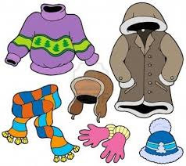
If there is rain, then I dress accordingly.
accordingly

Slide 47
Words with ending sound /shuhl/ after a consonant letter
-tial

Slide 48
-tial

Slide 49

partial

Slide 50

confidential

Slide 51
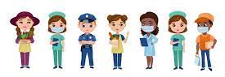
essential

Slide 52
Let’s Teach and Practise

Slide 53
(and exceptions)
Words with a long
/e/ sound spelt ‘ie’
or ‘ei’ after c

Slide 54
ie or ei

Slide 55

chief

Slide 56

fiend

Slide 57
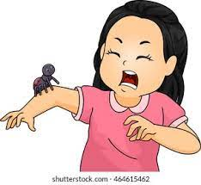
shriek

Slide 58

achieve

Slide 59
chief
NOUN
Definition - a leader or ruler of a people or clan

Slide 60
fiend
NOUN
Definition - an evil spirit or demon

Slide 61
shriek
VERB
Definition - utter a high-pitched piercing sound or words, especially as an expression of terror, pain, or excitement

Slide 62
achieve
VERB
Definition - successfully bring about or reach (a desired objective or result) by effort, skill, or courage

Slide 63
The chief of the village invited in their guests.
_____

Slide 64
The fiend was trying to steal the charity money.
_____

Slide 65
The audience shrieked with laughter.
_______

Slide 66
She achieved her ambition to become a press photographer.
________

Slide 67
New CHALLENGE words.

Slide 68
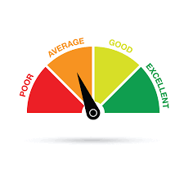
average
ADJECTIVE
Definition -constituting the result obtained by adding together several amounts and then dividing this total by the number of amounts

Slide 69
The average temperature in May was 4°C below normal.
_______

Slide 70
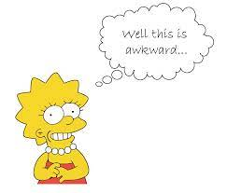
awkward
ADJECTIVE
Definition - causing difficulty; hard to do or deal with

Slide 71
Some questions are awkward to answer.
_______

Slide 72
Let’s investigate.

Slide 73
Can you spot the spelling errors in these sentences?
Write the correct spelling and explain where they went wrong.

Slide 74
The avrage is akword to acheve as you need to add everything together and divide by the number of amounts you added.

Slide 75
The avrage is akword to acheve as you need to add everything together and divide by the number of amounts you added.

Slide 76
The avrage is akword to acheve as you need to add everything together and divide by the number of amounts you added. average – e missing

Slide 77
The avrage is akword to acheve as you need to add everything together and divide by the number of amounts you added. awkward – missing w and a not o

Slide 78
The avrage is akword to acheve as you need to add everything together and divide by the number of amounts you added. achieve – ie not just e

Slide 79
The average is awkward to achieve as you need to add everything together and divide by the number of amounts you added.

Slide 80
Year 5 - Spring 1
Week 6 - Wednesday

Slide 82
Let’s Revisit and Review…

Slide 83
Do you remember this challenge word?

Slide 84
If you believe in yourself, you can achieve anything.
achieve

Slide 85
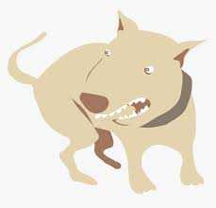
Some animals, when provoked, can become aggressive.
aggressive

Slide 86
It is used if the root word ends in t or te.
Words with ending sound /ʃən/ –tion is the most common spelling.

Slide 87
-tion

Slide 88
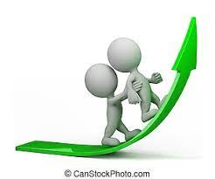
promotion

Slide 89
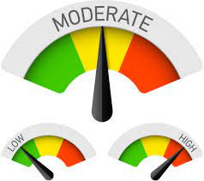
moderation

Slide 90

population

Slide 91
Let’s Teach and Practise

Slide 92
y
Long vowel sound i with y

Slide 93

apply

Slide 94
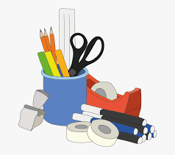
supply

Slide 95

identify

Slide 96
apply
VERB
Definition - make a formal application or request

Slide 97
supply
VERB
Definition - make (something needed or wanted) available to someone; provide

Slide 98
identify
VERB
Definition - establish or indicate who or what (someone or something) is

Slide 99
You need to apply to the bank for a loan.
_____

Slide 100
The farm can supply apples to make cider.
______

Slide 101
The judge ordered that people should not identify the child.
________

Slide 102
New CHALLENGE words.

Slide 103

bargain
NOUN
Definition -a thing bought or offered for sale much more cheaply than is usual or expected

Slide 104
The table was a real bargain.
_______

Slide 105
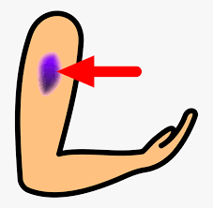
bruise
NOUN
Definition - an injury appearing as an area of discoloured skin on the body, caused by a blow or impact rupturing underlying blood vessels

Slide 106
The body was a mass of bruises after the attack.
_______

Slide 107
Let’s investigate.

Slide 108
Can you spot the spelling errors in these sentences?
Write the correct spelling and explain where they went wrong.

Slide 109
It can be a broose to the ego when you identifi a bargin you missed.

Slide 110
It can be a broose to the ego when you identifi a bargin you missed.

Slide 111
It can be a broose to the ego when you identifi a bargin you missed. bruise – ui not oo

Slide 112
It can be a broose to the ego when you identifi a bargin you missed. identify – y used for long vowel i sound

Slide 113
It can be a broose to the ego when you identifi a bargin you missed. bargain – ai not i

Slide 114
It can be a bruise to the ego when you identify a bargain you missed.

Slide 115
Year 5 - Spring 1
Week 6 - Thursday

Slide 117
Let’s Revisit and Review…

Slide 118
Do you remember this challenge word?

Slide 119
Do you remember this challenge word?

Slide 120

The number forty has significant meaning in the bible.
forty

Slide 121
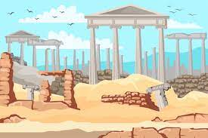
Some trees are said to be ancient and are needing protection.
ancient

Slide 122
Words with ending sound /ʃən/ –tian and -cian
-tian mean a place or origin
-cian mean occupation / job

Slide 123
-cian

Slide 124
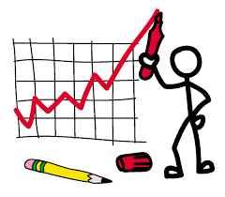
statistician

Slide 125

physician

Slide 126
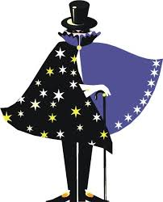
magician

Slide 127
Let’s Teach and Practise

Slide 128
y
Short vowel sound i with y

Slide 129

symbols

Slide 130

mystery

Slide 131
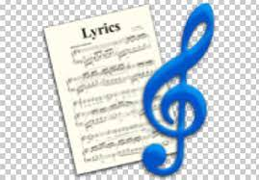
lyrics

Slide 132
symbols
NOUN
Definition - a mark or character used as a conventional representation of an object, function, or process, e.g. the letter or letters standing for a chemical element or a character in musical notation

Slide 133
mystery
NOUN
Definition - something that is difficult or impossible to understand or explain

Slide 134
Lyrics
NOUN
Definition - She has published both music and lyrics for a number of songs

Slide 135
The symbol x means 10 in Roman numerals.
______

Slide 136
The mystery story was excellent.
_______

Slide 137
She has published both music and lyrics for a number of songs.
______

Slide 138
New CHALLENGE words.

Slide 139

category
NOUN
Definition -a class or division of people or things regarded as having particular shared characteristics

Slide 140
Bob selected the sports category questions in the quiz.
________

Slide 141
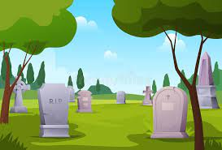
cemetery
NOUN
Definition - a large burial ground, especially one not in a churchyard

Slide 142
The military cemetery in Washington is very highly regarded.
________

Slide 143
Let’s investigate.

Slide 144
Can you spot the spelling errors in these sentences?
Write the correct spelling and explain where they went wrong.

Slide 145
Sometimes it is a mistery as to the types of simbols used on graves in a semetery.

Slide 146
Sometimes it is a mistery as to the types of simbols used on graves in a semetery.

Slide 147
Sometimes it is a mistery as to the types of simbols used on graves in a semetery. mystery – y as a short i sound

Slide 148
Sometimes it is a mistery as to the types of simbols used on graves in a semetery. symbols – y as a short i sound

Slide 149
Sometimes it is a mistery as to the types of simbols used on graves in a semetery. cemetery – soft c at start

Slide 150
Sometimes it is a mystery as to the types of symbols used on graves in a cemetery.

Slide 151
Year 5 - Spring 1
Week 6 - Friday

Slide 153
Let’s Revisit and Review…

Slide 154
Do you remember this challenge word?

Slide 155

The solution was apparent to all except the teacher.
apparent

Slide 156
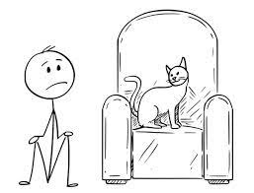
To occupy the top office in the country is to be Prime Minister.
occupy

Slide 157
Words with ending sound /ʃən/
–sion
–sion is used if the root word ends in d or se.
Exceptions: attend – attention, intend – intention

Slide 158
-sion

Slide 159
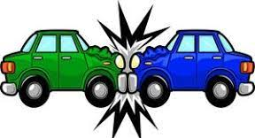
collision

Slide 160
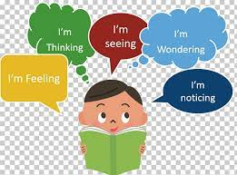
comprehension

Slide 161
Let’s Teach and Practise

Slide 162
bt kn mb wr
Silent letters

Slide 163

doubt

Slide 164
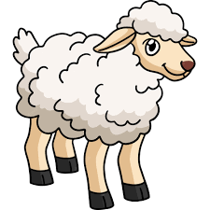
lamb

Slide 165
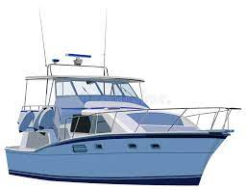
yacht

Slide 166
doubt
NOUN
Definition - a feeling of uncertainty or lack of conviction

Slide 167
lamb
NOUN
Definition - a young sheep

Slide 168
yacht
NOUN
Definition - a medium-sized sailing boat equipped for cruising or racing

Slide 169
Some doubt has been cast upon the authenticity of this account.
_____

Slide 170
The lamb jumped around with others in the field.
____

Slide 171
The yacht raced across the water in the front of the race.
_____

Slide 172
New CHALLENGE words.

Slide 173
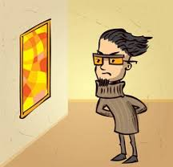
critic
NOUN
Definition - a person who expresses an unfavourable opinion of something

Slide 174
The food critic said the restaurants food was wonderful.
______

Slide 175

community
NOUN
Definition - a group of people living in the same place or having a particular characteristic in common

Slide 176
Our school community is very supportive.
_________

Slide 177
Let’s investigate.

Slide 178
Can you spot the spelling errors in these sentences?
Write the correct spelling and explain where they went wrong.

Slide 179
Do not dout that the critik of our comunitty is wrong.

Slide 180
Do not dout that the critik of our comunitty is wrong.

Slide 181
Do not dout that the critik of our comunitty is wrong. doubt – silent letter b

Slide 182
Do not dout that the critik of our comunitty is wrong. critic – hard c sound at the end

Slide 183
Do not dout that the critik of our comunitty is wrong. community – double c not t

Slide 184
Do not doubt that the critic of our community is wrong.

