Slide 1
Spelling Y5
Mastering spellings: building on the foundations of phonics
Spring 2
Week 1

Slide 2
Year 5 - Spring 2
Week 1 - Monday

Slide 3
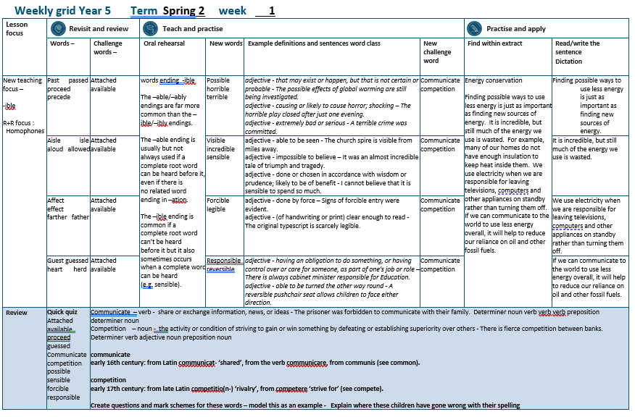

Slide 4
Let’s Revisit and Review…

Slide 5
Do you remember this challenge word?

Slide 6

attached
ADJECTIVE
Definition - joined, fastened, or connected to something

Slide 7

available
ADJECTIVE
Definition - able to be used or obtained; at someone's disposal

Slide 8
homo – same phone – sound
homophone –
same sound but different meaning

Slide 9
homophones

Slide 10
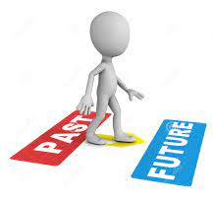
past

Slide 11
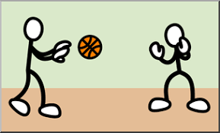
passed

Slide 12

proceed

Slide 13
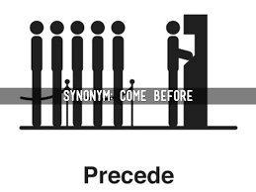
precede

Slide 14
Let’s Teach and Practise

Slide 15
words ending
-ible
The –able/–ably endings are far more common than the
–ible/–ibly endings.

Slide 16
The –able ending is usually but not always used if a complete root word can be heard before it, even if there is no related word ending in –ation.

Slide 17
The –ible ending is common if a
complete root word can’t be heard
before it but it also sometimes occurs when a complete word can be heard
(e.g. sensible).

Slide 18

possible

Slide 19

horrible

Slide 20

terrible

Slide 21
possible
poss (not a real word) + ible = possible
ADJECTIVE
Definition - that may exist or happen, but that is not certain or probable

Slide 22
horrible
horr (not a real word) + ible = horrible
ADJECTIVE
Definition - causing or likely to cause horror; shocking

Slide 23
terrible
terr (not a real word) + ible = terrible
ADJECTIVE
Definition - extremely bad or serious

Slide 24
The possible effects of global warming are still being investigated.
________

Slide 25
The horrible play closed after just one evening.
________

Slide 26
A terrible crime was committed.
________

Slide 27
New CHALLENGE words.

Slide 28

communicate
VERB
Definition - share or exchange information, news, or ideas

Slide 29
The prisoner was forbidden to communicate with their family.
___________

Slide 30
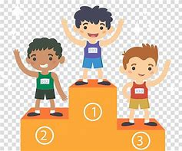
competition
NOUN
Definition - the activity or condition of striving to gain or win something by defeating or establishing superiority over others

Slide 31
There is fierce competition between banks.
___________

Slide 32
Let’s Practise and Apply.

Slide 33
Can you spot the spelling rule words and the challenge words?

Slide 34
Energy conservation
Finding possible ways to use less energy is just as important as finding new sources of energy. It is incredible, but still much of the energy we use is wasted. For example, many of our homes do not have enough insulation to keep heat inside them. We use electricity when we are responsible for leaving televisions, computers and other appliances on standby rather than turning them off. If we can communicate to the world to use less energy overall, it will help to reduce our reliance on oil and other fossil fuels.

Slide 35
Energy conservation
Finding possible ways to use less energy is just as important as finding new sources of energy. It is incredible, but still much of the energy we use is wasted. For example, many of our homes do not have enough insulation to keep heat inside them. We use electricity when we are responsible for leaving televisions, computers and other appliances on standby rather than turning them off. If we can communicate to the world to use less energy overall, it will help to reduce our reliance on oil and other fossil fuels.

Slide 36
Write this sentence as I dictate it to you.
Notes:
Finding possible ways to use less energy is just as important as finding new sources of energy.

Slide 37
Finding possible ways to use less energy is just as important as finding new sources of energy.
Did you write it correctly?
Edit your work and make sure you have it correct.
Can you underline the spelling word that we have covered in this session?

Slide 38
Year 5 - Spring 2
Week 1 - Tuesday
Notes:
Revisit and review the words from previous teaching and challenge words – I say, we say, you say
Ask children to write words only in their spelling book
Introduce the new spelling rule
Children to write the new spelling rule words and challenge words into books when the sentences are shown with the spelling word missing.
Read the extract with the class as choral reading. Practise model of prosody etc.
Ask children to find the spelling words from the session in the text.
Then read allowed the chosen sentence for children to write fully in their books.
Show the extract and ask children to then edit their work to check they were correct in their dictation.

Slide 40
Let’s Revisit and Review…

Slide 41
Do you remember this challenge word?

Slide 42
attached
ADJECTIVE
Definition - joined, fastened, or connected to something

Slide 43
available
ADJECTIVE
Definition - able to be used or obtained; at someone's disposal

Slide 44
homo – same phone – sound
homophone –
same sound but different meaning

Slide 45
homophones

Slide 46
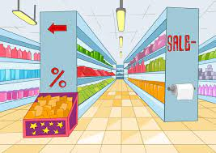
aisle

Slide 47

isle

Slide 48

aloud

Slide 49

allowed

Slide 50
Let’s Teach and Practise

Slide 51
words ending
-ible
The –able/–ably endings are far more common than the
–ible/–ibly endings.

Slide 52
The –able ending is usually but not always used if a complete root word can be heard before it, even if there is no related word ending in –ation.

Slide 53
The –ible ending is common if a
complete root word can’t be heard
before it but it also sometimes occurs when a complete word can be heard
(e.g. sensible).

Slide 54
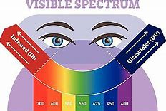
visible

Slide 55
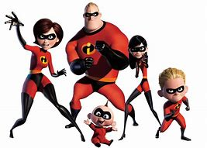
incredible

Slide 56

sensible

Slide 57
visible
vis (not a real word) + ible = visible
ADJECTIVE
Definition - able to be seen

Slide 58
incredible
incred (not a real word) + ible = horrible
ADJECTIVE
Definition - impossible to believe

Slide 59
sensible
sense (-e) + ible = sensible
ADJECTIVE
Definition - done or chosen in accordance with wisdom or prudence; likely to be of benefit

Slide 60
The church spire is visible from miles away.
_______

Slide 61
It was an almost incredible tale of triumph and tragedy.
__________

Slide 62
I cannot believe that it is sensible to spend so much.
________

Slide 63
New CHALLENGE words.

Slide 64
communicate
VERB
Definition - share or exchange information, news, or ideas

Slide 65
The prisoner was forbidden to communicate with their family.
___________

Slide 66
competition
NOUN
Definition - the activity or condition of striving to gain or win something by defeating or establishing superiority over others

Slide 67
There is fierce competition between banks.
___________

Slide 68
Let’s Practise and Apply.

Slide 69
Can you spot the spelling rule words and the challenge words?

Slide 70
Energy conservation
Finding possible ways to use less energy is just as important as finding new sources of energy. It is incredible, but still much of the energy we use is wasted. For example, many of our homes do not have enough insulation to keep heat inside them. We use electricity when we are responsible for leaving televisions, computers and other appliances on standby rather than turning them off. If we can communicate to the world to use less energy overall, it will help to reduce our reliance on oil and other fossil fuels.

Slide 71
Energy conservation
Finding possible ways to use less energy is just as important as finding new sources of energy. It is incredible, but still much of the energy we use is wasted. For example, many of our homes do not have enough insulation to keep heat inside them. We use electricity when we are responsible for leaving televisions, computers and other appliances on standby rather than turning them off. If we can communicate to the world to use less energy overall, it will help to reduce our reliance on oil and other fossil fuels.

Slide 72
Write this sentence as I dictate it to you.
Notes:
It is incredible, but still much of the energy we use is wasted.

Slide 73
It is incredible, but still much of the energy we use is wasted.
Did you write it correctly?
Edit your work and make sure you have it correct.
Can you underline the spelling word that we have covered in this session?

Slide 74
Year 5 - Spring 2
Week 1 - Wednesday
Notes:
Revisit and review the words from previous teaching and challenge words – I say, we say, you say
Ask children to write words only in their spelling book
Introduce the new spelling rule
Children to write the new spelling rule words and challenge words into books when the sentences are shown with the spelling word missing.
Read the extract with the class as choral reading. Practise model of prosody etc.
Ask children to find the spelling words from the session in the text.
Then read allowed the chosen sentence for children to write fully in their books.
Show the extract and ask children to then edit their work to check they were correct in their dictation.

Slide 76
Let’s Revisit and Review…

Slide 77
Do you remember this challenge word?

Slide 78
attached
ADJECTIVE
Definition - joined, fastened, or connected to something

Slide 79
available
ADJECTIVE
Definition - able to be used or obtained; at someone's disposal

Slide 80
homo – same phone – sound
homophone –
same sound but different meaning

Slide 81
homophones

Slide 82

affect

Slide 83
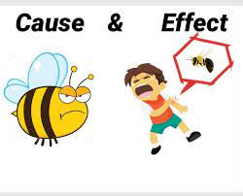
effect

Slide 84
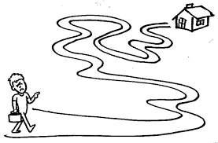
farther

Slide 85
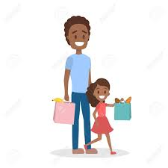
father

Slide 86
Let’s Teach and Practise

Slide 87
words ending
-ible
The –able/–ably endings are far more common than the
–ible/–ibly endings.

Slide 88
The –able ending is usually but not always used if a complete root word can be heard before it, even if there is no related word ending in –ation.

Slide 89
The –ible ending is common if a
complete root word can’t be heard
before it but it also sometimes occurs when a complete word can be heard
(e.g. sensible).

Slide 90
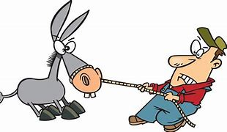
forcible

Slide 91

legible

Slide 92
forcible
force (-e) + ible = forcible
ADJECTIVE
Definition - done by force

Slide 93
legible
leg (not a real related word) + ible = legible
ADJECTIVE
Definition - (of handwriting or print) clear enough to read

Slide 94
Signs of forcible entry were evident.
________

Slide 95
The original typescript is scarcely legible.
_______

Slide 96
New CHALLENGE words.

Slide 97
communicate
VERB
Definition - share or exchange information, news, or ideas

Slide 98
The prisoner was forbidden to communicate with their family.
___________

Slide 99
competition
NOUN
Definition - the activity or condition of striving to gain or win something by defeating or establishing superiority over others

Slide 100
There is fierce competition between banks.
___________

Slide 101
Let’s Practise and Apply.

Slide 102
Can you spot the spelling rule words and the challenge words?

Slide 103
Energy conservation
Finding possible ways to use less energy is just as important as finding new sources of energy. It is incredible, but still much of the energy we use is wasted. For example, many of our homes do not have enough insulation to keep heat inside them. We use electricity when we are responsible for leaving televisions, computers and other appliances on standby rather than turning them off. If we can communicate to the world to use less energy overall, it will help to reduce our reliance on oil and other fossil fuels.

Slide 104
Energy conservation
Finding possible ways to use less energy is just as important as finding new sources of energy. It is incredible, but still much of the energy we use is wasted. For example, many of our homes do not have enough insulation to keep heat inside them. We use electricity when we are responsible for leaving televisions, computers and other appliances on standby rather than turning them off. If we can communicate to the world to use less energy overall, it will help to reduce our reliance on oil and other fossil fuels.

Slide 105
Write this sentence as I dictate it to you.
Notes:
We use electricity when we are responsible for leaving televisions, computers and other appliances on standby rather than turning them off.

Slide 106
We use electricity when we are responsible for leaving televisions, computers and other appliances on standby rather than turning them off.
Did you write it correctly?
Edit your work and make sure you have it correct.
Can you underline the spelling word that we have covered in this session?

Slide 107
Year 5 - Spring 2
Week 1 - Thursday
Notes:
Revisit and review the words from previous teaching and challenge words – I say, we say, you say
Ask children to write words only in their spelling book
Introduce the new spelling rule
Children to write the new spelling rule words and challenge words into books when the sentences are shown with the spelling word missing.
Read the extract with the class as choral reading. Practise model of prosody etc.
Ask children to find the spelling words from the session in the text.
Then read allowed the chosen sentence for children to write fully in their books.
Show the extract and ask children to then edit their work to check they were correct in their dictation.

Slide 109
Let’s Revisit and Review…

Slide 110
Do you remember this challenge word?

Slide 111
attached
ADJECTIVE
Definition - joined, fastened, or connected to something

Slide 112
available
ADJECTIVE
Definition - able to be used or obtained; at someone's disposal

Slide 113
homo – same phone – sound
homophone –
same sound but different meaning

Slide 114
homophones

Slide 115
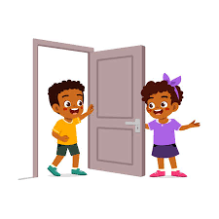
guest

Slide 116

guessed

Slide 117

heard

Slide 118
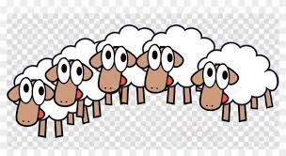
herd

Slide 119
Let’s Teach and Practise

Slide 120
words ending
-ible
The –able/–ably endings are far more common than the
–ible/–ibly endings.

Slide 121
The –able ending is usually but not always used if a complete root word can be heard before it, even if there is no related word ending in –ation.

Slide 122
The –ible ending is common if a
complete root word can’t be heard
before it but it also sometimes occurs when a complete word can be heard
(e.g. sensible).

Slide 123
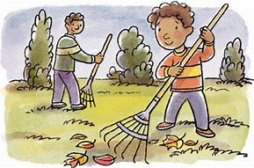
responsible

Slide 124

reversible

Slide 125
responsible
response (-e) + ible = responsible
ADJECTIVE
Definition - having an obligation to do something, or having control over or care for someone, as part of one's job or role

Slide 126
reversible
reverse (-e) + ible = horrible
ADJECTIVE
Definition - able to be turned the other way round

Slide 127
There is always cabinet minister responsible for Education.
___________

Slide 128
A reversible pushchair seat allows children to face either direction.
__________

Slide 129
New CHALLENGE words.

Slide 130
communicate
VERB
Definition - share or exchange information, news, or ideas

Slide 131
The prisoner was forbidden to communicate with their family.
___________

Slide 132
competition
NOUN
Definition - the activity or condition of striving to gain or win something by defeating or establishing superiority over others

Slide 133
There is fierce competition between banks.
___________

Slide 134
Let’s Practise and Apply.

Slide 135
Can you spot the spelling rule words and the challenge words?

Slide 136
Energy conservation
Finding possible ways to use less energy is just as important as finding new sources of energy. It is incredible, but still much of the energy we use is wasted. For example, many of our homes do not have enough insulation to keep heat inside them. We use electricity when we are responsible for leaving televisions, computers and other appliances on standby rather than turning them off. If we can communicate to the world to use less energy overall, it will help to reduce our reliance on oil and other fossil fuels.

Slide 137
Energy conservation
Finding possible ways to use less energy is just as important as finding new sources of energy. It is incredible, but still much of the energy we use is wasted. For example, many of our homes do not have enough insulation to keep heat inside them. We use electricity when we are responsible for leaving televisions, computers and other appliances on standby rather than turning them off. If we can communicate to the world to use less energy overall, it will help to reduce our reliance on oil and other fossil fuels.

Slide 138
Write this sentence as I dictate it to you.
Notes:
If we can communicate to the world to use less energy overall, it will help to reduce our reliance on oil and other fossil fuels.

Slide 139
If we can communicate to the world to use less energy overall, it will help to reduce our reliance on oil and other fossil fuels.
Did you write it correctly?
Edit your work and make sure you have it correct.
Can you underline the spelling word that we have covered in this session?

Slide 140
Year 5 - Spring 2
Week 1 - Friday
Notes:
Click through the slides for all the R+R words for the week (both the focus and the challenge words)
Click through the slides for all the new learning this week

Slide 142
Old challenge words…

Slide 143
attached

Slide 144
available

Slide 145
Old spelling rule words…

Slide 146
past

Slide 147
passed

Slide 148
proceed

Slide 149
precede

Slide 150
aisle

Slide 151
isle

Slide 152
aloud

Slide 153
allowed

Slide 154
affect

Slide 155
effect

Slide 156
farther

Slide 157
father

Slide 158
guest

Slide 159
guessed

Slide 160
heard

Slide 161
herd

Slide 162
New spelling rule words…

Slide 163
possible

Slide 164
horrible

Slide 165
terrible

Slide 166
visible

Slide 167
incredible

Slide 168
sensible

Slide 169
forcible

Slide 170
legible

Slide 171
responsible

Slide 172
reversible

Slide 173
New challenge words…

Slide 174
communicate

Slide 175
competition

Slide 176
Quick Quiz time…
Notes:
Say these words for the quiz
Attached available proceed guessed Communicate competition possible sensible forcible responsible

Slide 177
Did you get them correct?
Edit your work.
attached available proceed guessed communicate competition possible sensible forcible responsible

Slide 178
Word class time…

Slide 179
The prisoner was forbidden to communicate with their family.
Determiner noun verb verb verb preposition determiner noun
Notes:
Ask for these words to be classed

Slide 180
There is fierce competition between banks
Determiner verb adjective noun preposition noun
Notes:
Ask for these words to be classed

Slide 181
Etymology
The history of a word….

Slide 182
communicate
early 16th century: from Latin communicat- ‘shared’, from the verb communicare, from communis (see common).
competition
early 17th century: from late Latin competitio(n-) ‘rivalry’, from competere ‘strive for’ (see compete).

Slide 183
Let’s investigate….
Create questions and mark schemes for these words.

