Slide 1
Spelling Y5
Mastering spellings: building on the foundations of phonics
Spring 2
Week 2

Slide 2
Year 5 - Spring 2
Week 2 - Monday

Slide 4
Let’s Revisit and Review…

Slide 5
Do you remember this challenge word?

Slide 6
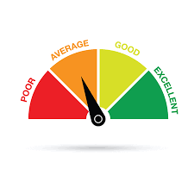
average
ADJECTIVE
Definition -constituting the result obtained by adding together several amounts and then dividing this total by the number of amounts

Slide 7
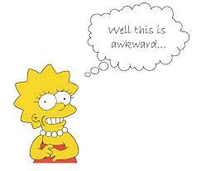
awkward
ADJECTIVE
Definition - causing difficulty; hard to do or deal with

Slide 8
(and exceptions)
Words with a long
/e/ sound spelt ‘ie’
or ‘ei’ after c

Slide 9
ie or ei

Slide 10
chief

Slide 11
fiend

Slide 12
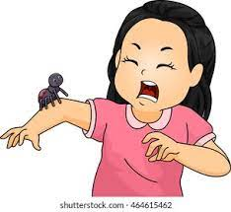
shriek

Slide 13
achieve

Slide 14
Let’s Teach and Practise

Slide 15
words ending
-able
The –able/–ably endings are far more common than the
–ible/–ibly endings.

Slide 16
If the –able ending is added to a word ending in –ce or –ge, the e after the c or g must be kept as those letters would otherwise have their ‘hard’ sounds (as in cap and gap) before the a of the –able ending.

Slide 17
The –able ending is usually but not always used if a complete root word can be heard before it, even if there is no related word ending in –ation.

Slide 18
applicable

Slide 19
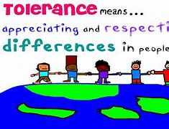
tolerable

Slide 20
operable

Slide 21
applicable
application (-ation) + able = applicable
NOUN -> ADJECTIVE
Definition - relevant or appropriate

Slide 22
tolerable
tolerance (-ance) + able = tolerable
NOUN -> ADJECTIVE
Definition - fairly good; mediocre

Slide 23
operable
operation (-ation) + able = operable
NOUN -> ADJECTIVE
Definition - able to be used

Slide 24
The same considerations are equally applicable to accident claims.
__________

Slide 25
He was fond of music and had a tolerable voice.
_________

Slide 26
Less than half the rail network was operable.
________

Slide 27
New CHALLENGE words.

Slide 28
conscience
NOUN
Definition - a person's moral sense of right and wrong, viewed as acting as a guide to one's behaviour

Slide 29
Ben was suffering a pang of conscience.
_________

Slide 30
conscious
ADJECTIVE
Definition - aware of and responding to one's surroundings

Slide 31
Although I was in pain, I was conscious.
_________

Slide 32
Let’s Practise and Apply.

Slide 33
Can you spot the spelling rule words and the challenge words?

Slide 34
Water Power Water or hydroelectric power is considerable as it is the most widely used renewable energy for generating electricity. Dependable water flowing towards the sea in rivers can generate large amounts of energy. However, we need to be conscience that building dams to harness this energy is expensive and involves flooding large areas of land. The valuable energy in waves and tides can also be captured, although this is much more difficult.

Slide 35
Water Power Water or hydroelectric power is considerable as it is the most widely used renewable energy for generating electricity. Dependable water flowing towards the sea in rivers can generate large amounts of energy. However, we need to be conscience that building dams to harness this energy is expensive and involves flooding large areas of land. The valuable energy in waves and tides can also be captured, although this is much more difficult.

Slide 36
Write this sentence as I dictate it to you.
Notes:
Water or hydroelectric power is considerable as it is the most widely used renewable energy for generating electricity.

Slide 37
Water or hydroelectric power is considerable as it is the most widely used renewable energy for generating electricity.
Did you write it correctly?
Edit your work and make sure you have it correct.
Can you underline the spelling word that we have covered in this session?

Slide 38
Year 5 - Spring 2
Week 2 - Tuesday
Notes:
Revisit and review the words from previous teaching and challenge words – I say, we say, you say
Ask children to write words only in their spelling book
Introduce the new spelling rule
Children to write the new spelling rule words and challenge words into books when the sentences are shown with the spelling word missing.
Read the extract with the class as choral reading. Practise model of prosody etc.
Ask children to find the spelling words from the session in the text.
Then read allowed the chosen sentence for children to write fully in their books.
Show the extract and ask children to then edit their work to check they were correct in their dictation.

Slide 40
Let’s Revisit and Review…

Slide 41
Do you remember this challenge word?

Slide 42
average
ADJECTIVE
Definition -constituting the result obtained by adding together several amounts and then dividing this total by the number of amounts

Slide 43
awkward
ADJECTIVE
Definition - causing difficulty; hard to do or deal with

Slide 44
(and exceptions)
Words with a long
/e/ sound spelt ‘ie’
or ‘ei’ after c

Slide 45
ie or ei

Slide 46
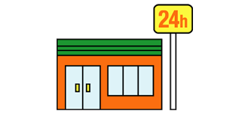
convenience

Slide 47
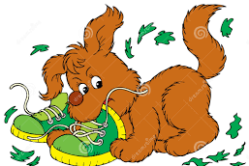
mischievous

Slide 48
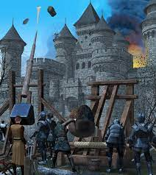
siege

Slide 49
Let’s Teach and Practise

Slide 50
words ending
-able
The –able/–ably endings are far more common than the
–ible/–ibly endings.

Slide 51
If the –able ending is added to a word ending in –ce or –ge, the e after the c or g must be kept as those letters would otherwise have their ‘hard’ sounds (as in cap and gap) before the a of the –able ending.

Slide 52
The –able ending is usually but not always used if a complete root word can be heard before it, even if there is no related word ending in –ation.

Slide 53
considerable

Slide 54
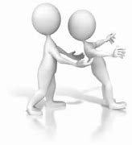
dependable

Slide 55
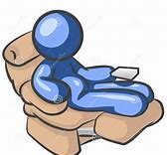
comfortable

Slide 56
considerable
consider + able = considerable
VERB -> ADJECTIVE
Definition - notably large in size, amount, or extent

Slide 57
dependable
depend + able = dependable
VERB -> ADJECTIVE
Definition - trustworthy and reliable

Slide 58
comfortable
comfort + able = operable
VERB -> ADJECTIVE
Definition - (especially of clothes or furnishings) providing physical ease and relaxation

Slide 59
A position of considerable influence was being offered.
____________

Slide 60
A dependable donkey carried Mary and her baby to Bethlehem.
__________

Slide 61
Now time to relax in a comfortable chair.
___________

Slide 62
New CHALLENGE words.

Slide 63
conscience
NOUN
Definition - a person's moral sense of right and wrong, viewed as acting as a guide to one's behaviour

Slide 64
Ben was suffering a pang of conscience.
_________

Slide 65
conscious
ADJECTIVE
Definition - aware of and responding to one's surroundings

Slide 66
Although I was in pain, I was conscious.
_________

Slide 67
Let’s Practise and Apply.

Slide 68
Can you spot the spelling rule words and the challenge words?

Slide 69
Water Power Water or hydroelectric power is considerable as it is the most widely used renewable energy for generating electricity. Dependable water flowing towards the sea in rivers can generate large amounts of energy. However, we need to be conscience that building dams to harness this energy is expensive and involves flooding large areas of land. The valuable energy in waves and tides can also be captured, although this is much more difficult.

Slide 70
Water Power Water or hydroelectric power is considerable as it is the most widely used renewable energy for generating electricity. Dependable water flowing towards the sea in rivers can generate large amounts of energy. However, we need to be conscience that building dams to harness this energy is expensive and involves flooding large areas of land. The valuable energy in waves and tides can also be captured, although this is much more difficult.

Slide 71
Write this sentence as I dictate it to you.
Notes:
Dependable water flowing towards the sea in rivers can generate large amounts of energy.

Slide 72
Dependable water flowing towards the sea in rivers can generate large amounts of energy.
Did you write it correctly?
Edit your work and make sure you have it correct.
Can you underline the spelling word that we have covered in this session?

Slide 73
Year 5 - Spring 2
Week 2 - Wednesday
Notes:
Revisit and review the words from previous teaching and challenge words – I say, we say, you say
Ask children to write words only in their spelling book
Introduce the new spelling rule
Children to write the new spelling rule words and challenge words into books when the sentences are shown with the spelling word missing.
Read the extract with the class as choral reading. Practise model of prosody etc.
Ask children to find the spelling words from the session in the text.
Then read allowed the chosen sentence for children to write fully in their books.
Show the extract and ask children to then edit their work to check they were correct in their dictation.

Slide 75
Let’s Revisit and Review…

Slide 76
Do you remember this challenge word?

Slide 77
average
ADJECTIVE
Definition -constituting the result obtained by adding together several amounts and then dividing this total by the number of amounts

Slide 78
awkward
ADJECTIVE
Definition - causing difficulty; hard to do or deal with

Slide 79
(and exceptions)
Words with a long
/e/ sound spelt ‘ie’
or ‘ei’ after c

Slide 80
ie or ei

Slide 81
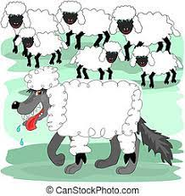
deceive

Slide 82
conceive

Slide 83
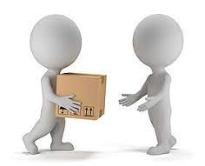
receive

Slide 84
perceive

Slide 85
Let’s Teach and Practise

Slide 86
words ending
-able
The –able/–ably endings are far more common than the
–ible/–ibly endings.

Slide 87
If the –able ending is added to a word ending in –ce or –ge, the e after the c or g must be kept as those letters would otherwise have their ‘hard’ sounds (as in cap and gap) before the a of the –able ending.

Slide 88
The –able ending is usually but not always used if a complete root word can be heard before it, even if there is no related word ending in –ation.

Slide 89
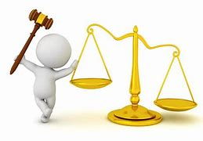
reasonable

Slide 90
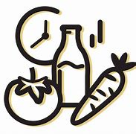
perishable

Slide 91
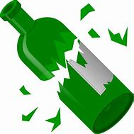
breakable

Slide 92
reasonable
reason + able = reasonable
VERB -> ADJECTIVE
Definition - having sound judgement; fair and sensible

Slide 93
perishable
perish + able = perishable
VERB -> ADJECTIVE
Definition - (especially of food) likely to decay or go bad quickly

Slide 94
breakable
break + able = breakable
VERB -> ADJECTIVE
Definition - capable of breaking or being broken easily

Slide 95
No reasonable person could have objected.
__________

Slide 96
Caviar is extremely perishable.
__________

Slide 97
An encrypted password isn't easily breakable.
_________

Slide 98
New CHALLENGE words.

Slide 99
conscience
NOUN
Definition - a person's moral sense of right and wrong, viewed as acting as a guide to one's behaviour

Slide 100
Ben was suffering a pang of conscience.
_________

Slide 101
conscious
ADJECTIVE
Definition - aware of and responding to one's surroundings

Slide 102
Although I was in pain, I was conscious.
_________

Slide 103
Let’s Practise and Apply.

Slide 104
Can you spot the spelling rule words and the challenge words?

Slide 105
Water Power Water or hydroelectric power is considerable as it is the most widely used renewable energy for generating electricity. Dependable water flowing towards the sea in rivers can generate large amounts of energy. However, we need to be conscience that building dams to harness this energy is expensive and involves flooding large areas of land. The valuable energy in waves and tides can also be captured, although this is much more difficult.

Slide 106
Water Power Water or hydroelectric power is considerable as it is the most widely used renewable energy for generating electricity. Dependable water flowing towards the sea in rivers can generate large amounts of energy. However, we need to be conscience that building dams to harness this energy is expensive and involves flooding large areas of land. The valuable energy in waves and tides can also be captured, although this is much more difficult.

Slide 107
Write this sentence as I dictate it to you.
Notes:
However, we need to be conscience that building dams to harness this energy is expensive and involves flooding large areas of land.

Slide 108
However, we need to be conscience that building dams to harness this energy is expensive and involves flooding large areas of land.
Did you write it correctly?
Edit your work and make sure you have it correct.
Can you underline the spelling word that we have covered in this session?

Slide 109
Year 5 - Spring 2
Week 2 - Thursday
Notes:
Revisit and review the words from previous teaching and challenge words – I say, we say, you say
Ask children to write words only in their spelling book
Introduce the new spelling rule
Children to write the new spelling rule words and challenge words into books when the sentences are shown with the spelling word missing.
Read the extract with the class as choral reading. Practise model of prosody etc.
Ask children to find the spelling words from the session in the text.
Then read allowed the chosen sentence for children to write fully in their books.
Show the extract and ask children to then edit their work to check they were correct in their dictation.

Slide 111
Let’s Revisit and Review…

Slide 112
Do you remember this challenge word?

Slide 113
average
ADJECTIVE
Definition -constituting the result obtained by adding together several amounts and then dividing this total by the number of amounts

Slide 114
awkward
ADJECTIVE
Definition - causing difficulty; hard to do or deal with

Slide 115
(and exceptions)
Words with a long
/e/ sound spelt ‘ie’
or ‘ei’ after c

Slide 116
ie or ei

Slide 117
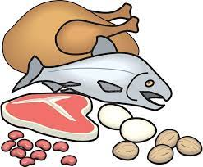
protein

Slide 118
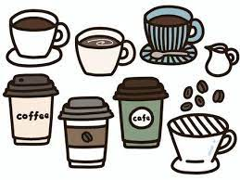
caffeine

Slide 119
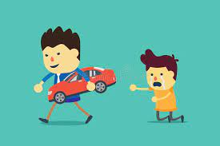
seize

Slide 120
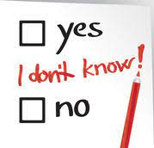
neither

Slide 121
Let’s Teach and Practise

Slide 122
words ending
-able
The –able/–ably endings are far more common than the
–ible/–ibly endings.

Slide 123
If the –able ending is added to a word ending in –ce or –ge, the e after the c or g must be kept as those letters would otherwise have their ‘hard’ sounds (as in cap and gap) before the a of the –able ending.

Slide 124
The –able ending is usually but not always used if a complete root word can be heard before it, even if there is no related word ending in –ation.

Slide 125
fashionable

Slide 126
adorable

Slide 127
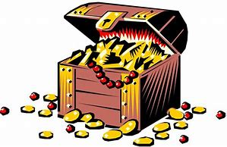
valuable

Slide 128
fashionable
fashion + able = fashionable
NOUN -> ADJECTIVE
Definition - characteristic of, influenced by, or representing a current popular style

Slide 129
adorable
adore (-e) + able = adorable
VERB -> ADJECTIVE
Definition - inspiring great affection or delight

Slide 130
valuable
value (-e) + able = valuable
NOUN -> ADJECTIVE
Definition - worth a great deal of money

Slide 131
Fashionable clothes can be purchased in stores or online.
___________

Slide 132
I have four adorable Siamese cats.
________

Slide 133
A valuable antique sold for millions last week.
________

Slide 134
New CHALLENGE words.

Slide 135
conscience
NOUN
Definition - a person's moral sense of right and wrong, viewed as acting as a guide to one's behaviour

Slide 136
Ben was suffering a pang of conscience.
_________

Slide 137
conscious
ADJECTIVE
Definition - aware of and responding to one's surroundings

Slide 138
Although I was in pain, I was conscious.
_________

Slide 139
Let’s Practise and Apply.

Slide 140
Can you spot the spelling rule words and the challenge words?

Slide 141
Water Power Water or hydroelectric power is considerable as it is the most widely used renewable energy for generating electricity. Dependable water flowing towards the sea in rivers can generate large amounts of energy. However, we need to be conscience that building dams to harness this energy is expensive and involves flooding large areas of land. The valuable energy in waves and tides can also be captured, although this is much more difficult.

Slide 142
Water Power Water or hydroelectric power is considerable as it is the most widely used renewable energy for generating electricity. Dependable water flowing towards the sea in rivers can generate large amounts of energy. However, we need to be conscience that building dams to harness this energy is expensive and involves flooding large areas of land. The valuable energy in waves and tides can also be captured, although this is much more difficult.

Slide 143
Write this sentence as I dictate it to you.
Notes:
The valuable energy in waves and tides can also be captured, although this is much more difficult.

Slide 144
The valuable energy in waves and tides can also be captured, although this is much more difficult.
Did you write it correctly?
Edit your work and make sure you have it correct.
Can you underline the spelling word that we have covered in this session?

Slide 145
Year 5 - Spring 2
Week 2 - Friday
Notes:
Click through the slides for all the R+R words for the week (both the focus and the challenge words)
Click through the slides for all the new learning this week

Slide 147
Old challenge words…

Slide 148
average

Slide 149
awkward

Slide 150
Old spelling rule words…

Slide 151
chief

Slide 152
fiend

Slide 153
shriek

Slide 154
achieve

Slide 155
convenience

Slide 156
mischievous

Slide 157
siege

Slide 158
deceive

Slide 159
conceive

Slide 160
receive

Slide 161
protein

Slide 162
caffeine

Slide 163
seize

Slide 164
neither

Slide 165
New spelling rule words…

Slide 166
applicable

Slide 167
tolerable

Slide 168
operable

Slide 169
considerable

Slide 170
dependable

Slide 171
comfortable

Slide 172
reasonable

Slide 173
perishable

Slide 174
breakable

Slide 175
fashionable

Slide 176
adorable

Slide 177
valuable

Slide 178
New challenge words…

Slide 179
conscience

Slide 180
conscious

Slide 181
Quick Quiz time…
Notes:
Say these words for the quiz
Average awkward mischievous receive Conscience conscious applicable dependable perishable adorable

Slide 182
Did you get them correct?
Edit your work.
average awkward mischievous receive conscience conscious applicable dependable perishable adorable

Slide 183
Word class time…

Slide 184
Ben was suffering a pang of conscience.
Noun verb verb determiner adjective noun
Notes:
Ask for these words to be classed

Slide 185
Although I was in pain, I was conscious.
Preposition pronoun verb preposition noun pronoun verb adjective
Notes:
Ask for these words to be classed

Slide 186
Etymology
The history of a word….

Slide 187
conscience
Middle English (also in the sense ‘inner thoughts or knowledge’): via Old French from Latin conscientia, from conscient- ‘being privy to’, from the verb conscire, from con- ‘with’ + scire ‘know’.
conscious
late 16th century (in the sense ‘being aware of wrongdoing’): from Latin conscius ‘knowing with others or in oneself’ (from conscire ‘be privy to’) + -ous.

Slide 188
Let’s investigate….
Find antonyms and synonyms of the challenge words.

