Slide 1
Spelling Y5
Mastering spellings: building on the foundations of phonics
Spring 2
Week 3

Slide 2
Year 5 - Spring 2
Week 3 - Monday

Slide 3
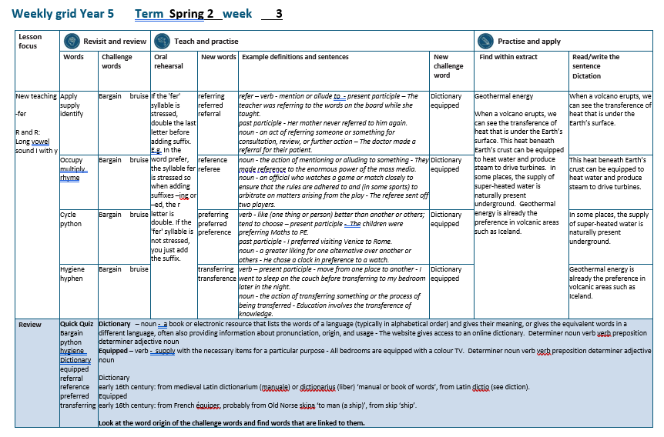

Slide 4
Let’s Revisit and Review…

Slide 5
Do you remember this challenge word?

Slide 6

bargain
NOUN
Definition -a thing bought or offered for sale much more cheaply than is usual or expected

Slide 7
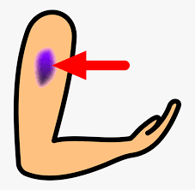
bruise
NOUN
Definition - an injury appearing as an area of discoloured skin on the body, caused by a blow or impact rupturing underlying blood vessels

Slide 8
y
Long vowel sound i with y

Slide 9

apply

Slide 10
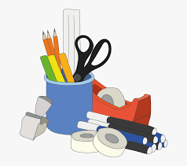
supply

Slide 11

identify

Slide 12
Let’s Teach and Practise

Slide 13
words ending
-fer
If the 'fer' syllable is stressed, double the last letter before adding suffix.

Slide 14
E.g. In the word prefer, the syllable fer is stressed so when adding suffixes –ing or –ed, the r letter is double.

Slide 15
If the 'fer' syllable is not stressed, you just add the suffix.

Slide 16

refer

Slide 17
referring

Slide 18
referred

Slide 19
referral

Slide 20
referring
refer (+r) + ing = referring
VERB – present participle
Definition - mention or allude to

Slide 21
referred
refer (+r) + ed = referred
VERB – past participle
Definition - mention or allude to

Slide 22
referral
refer (+r) + al = referral
NOUN
Definition - an act of referring someone or something for consultation, review, or further action

Slide 23
The teacher was referring to the words on the board while she taught.
_________

Slide 24
Her mother never referred to him again.
________

Slide 25
The doctor made a referral for their patient.
________

Slide 26
New CHALLENGE words.

Slide 27

dictionary
NOUN
Definition - a book or electronic resource that lists the words of a language (typically in alphabetical order) and gives their meaning, or gives the equivalent words in a different language, often also providing information about pronunciation, origin, and usage

Slide 28
The website gives access to an online dictionary.
__________

Slide 29
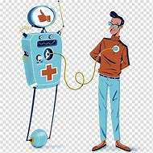
equipped
VERB
Definition - supply with the necessary items for a particular purpose

Slide 30
All bedrooms are equipped with a colour TV.
________

Slide 31
Let’s Practise and Apply.

Slide 32
Can you spot the spelling rule words and the challenge words?

Slide 33
Geothermal energy
When a volcano erupts, we can see the transference of heat that is under the Earth’s surface. This heat beneath Earth’s crust can be equipped to heat water and produce steam to drive turbines. In some places, the supply of super-heated water is naturally present underground. Geothermal energy is already the preference in volcanic areas such as Iceland.

Slide 34
Geothermal energy
When a volcano erupts, we can see the transference of heat that is under the Earth’s surface. This heat beneath Earth’s crust can be equipped to heat water and produce steam to drive turbines. In some places, the supply of super-heated water is naturally present underground. Geothermal energy is already the preference in volcanic areas such as Iceland.

Slide 35
Write this sentence as I dictate it to you.
Notes:
When a volcano erupts, we can see the transference of heat that is under the Earth’s surface.

Slide 36
When a volcano erupts, we can see the transference of heat that is under the Earth’s surface.
Did you write it correctly?
Edit your work and make sure you have it correct.
Can you underline the spelling word that we have covered in this session?

Slide 37
Year 5 - Spring 2
Week 3 - Tuesday
Notes:
Revisit and review the words from previous teaching and challenge words – I say, we say, you say
Ask children to write words only in their spelling book
Introduce the new spelling rule
Children to write the new spelling rule words and challenge words into books when the sentences are shown with the spelling word missing.
Read the extract with the class as choral reading. Practise model of prosody etc.
Ask children to find the spelling words from the session in the text.
Then read allowed the chosen sentence for children to write fully in their books.
Show the extract and ask children to then edit their work to check they were correct in their dictation.

Slide 39
Let’s Revisit and Review…

Slide 40
Do you remember this challenge word?

Slide 41
bargain
NOUN
Definition -a thing bought or offered for sale much more cheaply than is usual or expected

Slide 42
bruise
NOUN
Definition - an injury appearing as an area of discoloured skin on the body, caused by a blow or impact rupturing underlying blood vessels

Slide 43
y
Long vowel sound i with y

Slide 44
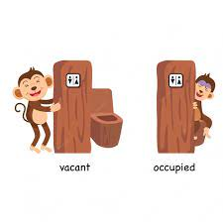
occupy

Slide 45

multiply

Slide 46

rhyme

Slide 47
Let’s Teach and Practise

Slide 48
words ending
-fer
If the 'fer' syllable is stressed, double the last letter before adding suffix.

Slide 49
E.g. In the word prefer, the syllable fer is stressed so when adding suffixes –ing or –ed, the r letter is double.

Slide 50
If the 'fer' syllable is not stressed, you just add the suffix.

Slide 51
refer

Slide 52

reference

Slide 53
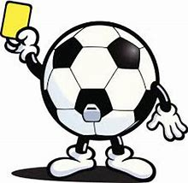
referee

Slide 54
reference
refer + ence = reference
NOUN
Definition - the action of mentioning or alluding to something

Slide 55
referee
refer + ee = referee
NOUN
Definition - an official who watches a game or match closely to ensure that the rules are adhered to and (in some sports) to arbitrate on matters arising from the play

Slide 56
They made reference to the enormous power of the mass media.
_________

Slide 57
The referee sent off two players.
_______

Slide 58
New CHALLENGE words.

Slide 59
dictionary
NOUN
Definition - a book or electronic resource that lists the words of a language (typically in alphabetical order) and gives their meaning, or gives the equivalent words in a different language, often also providing information about pronunciation, origin, and usage

Slide 60
The website gives access to an online dictionary.
__________

Slide 61
equipped
VERB
Definition - supply with the necessary items for a particular purpose

Slide 62
All bedrooms are equipped with a colour TV.
________

Slide 63
Let’s Practise and Apply.

Slide 64
Can you spot the spelling rule words and the challenge words?

Slide 65
Geothermal energy
When a volcano erupts, we can see the transference of heat that is under the Earth’s surface. This heat beneath Earth’s crust can be equipped to heat water and produce steam to drive turbines. In some places, the supply of super-heated water is naturally present underground. Geothermal energy is already the preference in volcanic areas such as Iceland.

Slide 66
Geothermal energy
When a volcano erupts, we can see the transference of heat that is under the Earth’s surface. This heat beneath Earth’s crust can be equipped to heat water and produce steam to drive turbines. In some places, the supply of super-heated water is naturally present underground. Geothermal energy is already the preference in volcanic areas such as Iceland.

Slide 67
Write this sentence as I dictate it to you.
Notes:
This heat beneath Earth’s crust can be equipped to heat water and produce steam to drive turbines.

Slide 68
This heat beneath Earth’s crust can be equipped to heat water and produce steam to drive turbines.
Did you write it correctly?
Edit your work and make sure you have it correct.
Can you underline the spelling word that we have covered in this session?

Slide 69
Year 5 - Spring 2
Week 3 - Wednesday
Notes:
Revisit and review the words from previous teaching and challenge words – I say, we say, you say
Ask children to write words only in their spelling book
Introduce the new spelling rule
Children to write the new spelling rule words and challenge words into books when the sentences are shown with the spelling word missing.
Read the extract with the class as choral reading. Practise model of prosody etc.
Ask children to find the spelling words from the session in the text.
Then read allowed the chosen sentence for children to write fully in their books.
Show the extract and ask children to then edit their work to check they were correct in their dictation.

Slide 71
Let’s Revisit and Review…

Slide 72
Do you remember this challenge word?

Slide 73
bargain
NOUN
Definition -a thing bought or offered for sale much more cheaply than is usual or expected

Slide 74
bruise
NOUN
Definition - an injury appearing as an area of discoloured skin on the body, caused by a blow or impact rupturing underlying blood vessels

Slide 75
y
Long vowel sound i with y

Slide 76
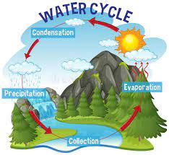
cycle

Slide 77
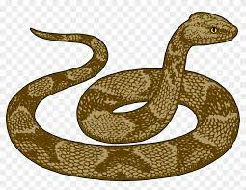
python

Slide 78
Let’s Teach and Practise

Slide 79
words ending
-fer
If the 'fer' syllable is stressed, double the last letter before adding suffix.

Slide 80
E.g. In the word prefer, the syllable fer is stressed so when adding suffixes –ing or –ed, the r letter is double.

Slide 81
If the 'fer' syllable is not stressed, you just add the suffix.

Slide 82
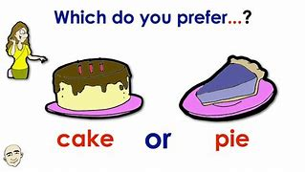
prefer

Slide 83
preferring

Slide 84
preferred

Slide 85
preference

Slide 86
preferring
prefer (+r) + ing = preferring
VERB – present participle
Definition - like (one thing or person) better than another or others; tend to choose

Slide 87
preferred
prefer (+r) + ed = preferred
VERB – past participle
Definition - like (one thing or person) better than another or others; tend to choose

Slide 88
preference
prefer + ence = preference
NOUN
Definition - a greater liking for one alternative over another or others

Slide 89
The children were preferring Maths to PE.
__________

Slide 90
I preferred visiting Venice to Rome.
_________

Slide 91
He chose a clock in preference to a watch.
__________

Slide 92
New CHALLENGE words.

Slide 93
dictionary
NOUN
Definition - a book or electronic resource that lists the words of a language (typically in alphabetical order) and gives their meaning, or gives the equivalent words in a different language, often also providing information about pronunciation, origin, and usage

Slide 94
The website gives access to an online dictionary.
__________

Slide 95
equipped
VERB
Definition - supply with the necessary items for a particular purpose

Slide 96
All bedrooms are equipped with a colour TV.
________

Slide 97
Let’s Practise and Apply.

Slide 98
Can you spot the spelling rule words and the challenge words?

Slide 99
Geothermal energy
When a volcano erupts, we can see the transference of heat that is under the Earth’s surface. This heat beneath Earth’s crust can be equipped to heat water and produce steam to drive turbines. In some places, the supply of super-heated water is naturally present underground. Geothermal energy is already the preference in volcanic areas such as Iceland.

Slide 100
Geothermal energy
When a volcano erupts, we can see the transference of heat that is under the Earth’s surface. This heat beneath Earth’s crust can be equipped to heat water and produce steam to drive turbines. In some places, the supply of super-heated water is naturally present underground. Geothermal energy is already the preference in volcanic areas such as Iceland.

Slide 101
Write this sentence as I dictate it to you.
Notes:
In some places, the supply of super-heated water is naturally present underground.

Slide 102
In some places, the supply of super-heated water is naturally present underground.
Did you write it correctly?
Edit your work and make sure you have it correct.
Can you underline the spelling word that we have covered in this session?

Slide 103
Year 5 - Spring 2
Week 3 - Thursday
Notes:
Revisit and review the words from previous teaching and challenge words – I say, we say, you say
Ask children to write words only in their spelling book
Introduce the new spelling rule
Children to write the new spelling rule words and challenge words into books when the sentences are shown with the spelling word missing.
Read the extract with the class as choral reading. Practise model of prosody etc.
Ask children to find the spelling words from the session in the text.
Then read allowed the chosen sentence for children to write fully in their books.
Show the extract and ask children to then edit their work to check they were correct in their dictation.

Slide 105
Let’s Revisit and Review…

Slide 106
Do you remember this challenge word?

Slide 107
bargain
NOUN
Definition -a thing bought or offered for sale much more cheaply than is usual or expected

Slide 108
bruise
NOUN
Definition - an injury appearing as an area of discoloured skin on the body, caused by a blow or impact rupturing underlying blood vessels

Slide 109
y
Long vowel sound i with y

Slide 110

hygiene

Slide 111

hyphen

Slide 112
Let’s Teach and Practise

Slide 113
words ending
-fer
If the 'fer' syllable is stressed, double the last letter before adding suffix.

Slide 114
E.g. In the word prefer, the syllable fer is stressed so when adding suffixes –ing or –ed, the r letter is double.

Slide 115
If the 'fer' syllable is not stressed, you just add the suffix.

Slide 116
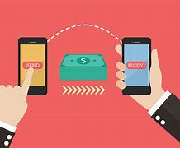
transfer

Slide 117
transferring

Slide 118
transference

Slide 119
transferring
transfer (+r) + ing = transferring
VERB – present participle
Definition - move from one place to another

Slide 120
transference
transfer + ence = transference
NOUN
Definition - the action of transferring something or the process of being transferred

Slide 121
I went to sleep on the couch before transferring to my bedroom later in the night.
____________

Slide 122
Education involves the transference of knowledge.
____________

Slide 123
New CHALLENGE words.

Slide 124
dictionary
NOUN
Definition - a book or electronic resource that lists the words of a language (typically in alphabetical order) and gives their meaning, or gives the equivalent words in a different language, often also providing information about pronunciation, origin, and usage

Slide 125
The website gives access to an online dictionary.
__________

Slide 126
equipped
VERB
Definition - supply with the necessary items for a particular purpose

Slide 127
All bedrooms are equipped with a colour TV.
________

Slide 128
Let’s Practise and Apply.

Slide 129
Can you spot the spelling rule words and the challenge words?

Slide 130
Geothermal energy
When a volcano erupts, we can see the transference of heat that is under the Earth’s surface. This heat beneath Earth’s crust can be equipped to heat water and produce steam to drive turbines. In some places, the supply of super-heated water is naturally present underground. Geothermal energy is already the preference in volcanic areas such as Iceland.

Slide 131
Geothermal energy
When a volcano erupts, we can see the transference of heat that is under the Earth’s surface. This heat beneath Earth’s crust can be equipped to heat water and produce steam to drive turbines. In some places, the supply of super-heated water is naturally present underground. Geothermal energy is already the preference in volcanic areas such as Iceland.

Slide 132
Write this sentence as I dictate it to you.
Notes:
Geothermal energy is already the preference in volcanic areas such as Iceland.

Slide 133
Geothermal energy is already the preference in volcanic areas such as Iceland.
Did you write it correctly?
Edit your work and make sure you have it correct.
Can you underline the spelling word that we have covered in this session?

Slide 134
Year 5 - Spring 2
Week 3 - Friday
Notes:
Click through the slides for all the R+R words for the week (both the focus and the challenge words)
Click through the slides for all the new learning this week

Slide 136
Old challenge words…

Slide 137
bargain

Slide 138
bruise

Slide 139
Old spelling rule words…

Slide 140
apply

Slide 141
supply

Slide 142
identify

Slide 143
occupy

Slide 144
multiply

Slide 145
rhyme

Slide 146
cycle

Slide 147
python

Slide 148
hygiene

Slide 149
hyphen

Slide 150
New spelling rule words…

Slide 151
referring

Slide 152
referred

Slide 153
referral

Slide 154
reference

Slide 155
referee

Slide 156
preferring

Slide 157
preferred

Slide 158
preference

Slide 159
transferring

Slide 160
tranference

Slide 161
New challenge words…

Slide 162
dictionary

Slide 163
equipped

Slide 164
Quick Quiz time…
Notes:
Say these words for the quiz
Bargain bruise python hygiene Dictionary equipped referral reference preferred transferring

Slide 165
Did you get them correct?
Edit your work.
bargain bruise python hygiene dictionary equipped referral reference preferred transferring

Slide 166
Word class time…

Slide 167
The website gives access to an online dictionary.
Determiner noun verb verb preposition determiner adjective noun
Notes:
Ask for these words to be classed

Slide 168
All bedrooms are equipped with a colour TV.
Determiner noun verb verb preposition determiner adjective noun
Notes:
Ask for these words to be classed

Slide 169
Etymology
The history of a word….

Slide 170
Dictionary
early 16th century: from medieval Latin dictionarium (manuale) or dictionarius (liber) ‘manual or book of words’, from Latin dictio (see diction).
Equipped
early 16th century: from French équiper, probably from Old Norse skipa ‘to man (a ship)’, from skip ‘ship’.

Slide 171
Let’s investigate….
Look at the word origin of the challenge words and find words that are linked to them.

