Slide 1
Spelling Y5
Mastering spellings: building on the foundations of phonics
Spring 2
Week 5

Slide 2
Year 5 - Spring 2
Week 5 - Monday

Slide 3
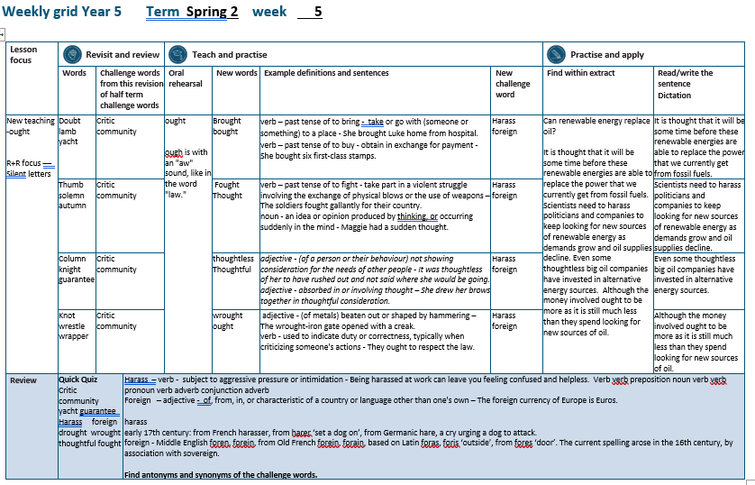

Slide 4
Let’s Revisit and Review…

Slide 5
Do you remember this challenge word?

Slide 6
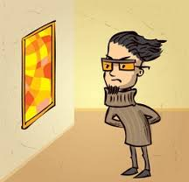
critic
NOUN
Definition - a person who expresses an unfavourable opinion of something

Slide 7

community
NOUN
Definition - a group of people living in the same place or having a particular characteristic in common

Slide 8
bt kn mb wr
Silent letters

Slide 9

doubt

Slide 10
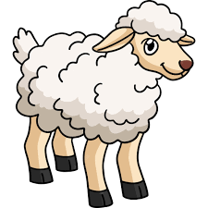
lamb

Slide 11
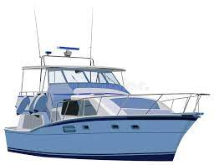
yacht

Slide 12
Let’s Teach and Practise

Slide 13
words ending
-ought

Slide 14
-ought

Slide 15
-ought
- ought is pronounced with an "aw" sound, like in the word "law."

Slide 16
(b) -ought
Notes:
Plough
Rough
Though

Slide 17
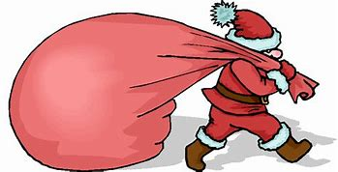
brought

Slide 18
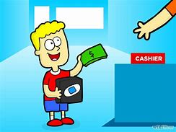
bought

Slide 19
brought
br + ought = brought
VERB – past tense of ‘to bring’
Definition - take or go with (someone or something) to a place

Slide 20
bought
b + ought = bought
VERB – past tense of ‘to buy’
Definition - obtain in exchange for payment

Slide 21
She brought Luke home from hospital.
_______

Slide 22
She bought six first-class stamps.
______

Slide 23
New CHALLENGE words.

Slide 24
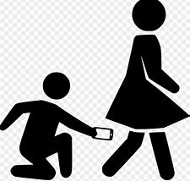
harass
VERB
Definition - subject to aggressive pressure or intimidation

Slide 25
People should not harass each other.
______

Slide 26

foreign
ADJECTIVE
Definition - of, from, in, or characteristic of a country or language other than one's own

Slide 27
The foreign currency of Europe is Euros.
_______

Slide 28
Let’s Practise and Apply.

Slide 29
Can you spot the spelling rule words and the challenge words?

Slide 30
Can renewable energy replace oil?
It is thought that it will be some time before these renewable energies are able to replace the power that we currently get from fossil fuels. Scientists need to harass politicians and companies to keep looking for new sources of renewable energy as demands grow and oil supplies decline. Even some thoughtless big oil companies have invested in alternative energy sources. Although the money involved ought to be more as it is still much less than they spend looking for new sources of oil.

Slide 31
Can renewable energy replace oil?
It is thought that it will be some time before these renewable energies are able to replace the power that we currently get from fossil fuels. Scientists need to harass politicians and companies to keep looking for new sources of renewable energy as demands grow and oil supplies decline. Even some thoughtless big oil companies have invested in alternative energy sources. Although the money involved ought to be more as it is still much less than they spend looking for new sources of oil.

Slide 32
Write this sentence as I dictate it to you.
Notes:
It is thought that it will be some time before these renewable energies are able to replace the power that we currently get from fossil fuels.

Slide 33
It is thought that it will be some time before these renewable energies are able to replace the power that we currently get from fossil fuels.
Did you write it correctly?
Edit your work and make sure you have it correct.
Can you underline the spelling word that we have covered in this session?

Slide 34
Year 5 - Spring 2
Week 5 - Tuesday
Notes:
Revisit and review the words from previous teaching and challenge words – I say, we say, you say
Ask children to write words only in their spelling book
Introduce the new spelling rule
Children to write the new spelling rule words and challenge words into books when the sentences are shown with the spelling word missing.
Read the extract with the class as choral reading. Practise model of prosody etc.
Ask children to find the spelling words from the session in the text.
Then read allowed the chosen sentence for children to write fully in their books.
Show the extract and ask children to then edit their work to check they were correct in their dictation.

Slide 36
Let’s Revisit and Review…

Slide 37
Do you remember this challenge word?

Slide 38
critic
NOUN
Definition - a person who expresses an unfavourable opinion of something

Slide 39
community
NOUN
Definition - a group of people living in the same place or having a particular characteristic in common

Slide 40
bt kn mb wr
Silent letters

Slide 41

thumb

Slide 42

solemn

Slide 43

autumn

Slide 44
Let’s Teach and Practise

Slide 45
words ending
-ought

Slide 46
-ought

Slide 47
-ought
- ought is pronounced with an "aw" sound, like in the word "law."

Slide 48
(b) -ought
Notes:
Plough
Rough
Though

Slide 49
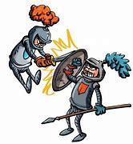
fought

Slide 50

thought

Slide 51
fought
f + ought = fought
VERB – past tense of ‘to fight’
Definition - take part in a violent struggle involving the exchange of physical blows or the use of weapons

Slide 52
thought
th + ought = bought
VERB – past tense of ‘to think’
Definition - an idea or opinion produced by thinking, or occurring suddenly in the mind

Slide 53
The soldiers fought gallantly for their country.
______

Slide 54
Megan thought she had left her door unlocked.
_______

Slide 55
New CHALLENGE words.

Slide 56
harass
VERB
Definition - subject to aggressive pressure or intimidation

Slide 57
People should not harass each other.
______

Slide 58
foreign
ADJECTIVE
Definition - of, from, in, or characteristic of a country or language other than one's own

Slide 59
The foreign currency of Europe is Euros.
_______

Slide 60
Let’s Practise and Apply.

Slide 61
Can you spot the spelling rule words and the challenge words?

Slide 62
Can renewable energy replace oil?
It is thought that it will be some time before these renewable energies are able to replace the power that we currently get from fossil fuels. Scientists need to harass politicians and companies to keep looking for new sources of renewable energy as demands grow and oil supplies decline. Even some thoughtless big oil companies have invested in alternative energy sources. Although the money involved ought to be more as it is still much less than they spend looking for new sources of oil.

Slide 63
Can renewable energy replace oil?
It is thought that it will be some time before these renewable energies are able to replace the power that we currently get from fossil fuels. Scientists need to harass politicians and companies to keep looking for new sources of renewable energy as demands grow and oil supplies decline. Even some thoughtless big oil companies have invested in alternative energy sources. Although the money involved ought to be more as it is still much less than they spend looking for new sources of oil.

Slide 64
Write this sentence as I dictate it to you.
Notes:
Scientists need to harass politicians and companies to keep looking for new sources of renewable energy as demands grow and oil supplies decline..

Slide 65
Scientists need to harass politicians and companies to keep looking for new sources of renewable energy as demands grow and oil supplies decline.
Did you write it correctly?
Edit your work and make sure you have it correct.
Can you underline the spelling word that we have covered in this session?

Slide 66
Year 5 - Spring 2
Week 5 - Wednesday
Notes:
Revisit and review the words from previous teaching and challenge words – I say, we say, you say
Ask children to write words only in their spelling book
Introduce the new spelling rule
Children to write the new spelling rule words and challenge words into books when the sentences are shown with the spelling word missing.
Read the extract with the class as choral reading. Practise model of prosody etc.
Ask children to find the spelling words from the session in the text.
Then read allowed the chosen sentence for children to write fully in their books.
Show the extract and ask children to then edit their work to check they were correct in their dictation.

Slide 68
Let’s Revisit and Review…

Slide 69
Do you remember this challenge word?

Slide 70
critic
NOUN
Definition - a person who expresses an unfavourable opinion of something

Slide 71
community
NOUN
Definition - a group of people living in the same place or having a particular characteristic in common

Slide 72
bt kn mb wr
Silent letters

Slide 73

column

Slide 74

knight

Slide 75

guarantee

Slide 76
Let’s Teach and Practise

Slide 77
words ending
-ought

Slide 78
-ought

Slide 79
-ought
- ought is pronounced with an "aw" sound, like in the word "law."

Slide 80
(b) -ought
Notes:
Plough
Rough
Though

Slide 81
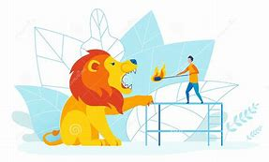
thoughtless

Slide 82
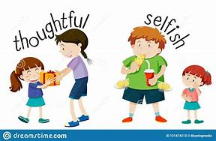
thoughtful

Slide 83
thoughtless
th + ought + less = thoughtless
ADJECTIVE
Definition - (of a person or their behaviour) not showing consideration for the needs of other people

Slide 84
thoughtful
th + ought + ful = thoughtful
ADJECTIVE
Definition - absorbed in or involving thought; thinking of others with kindness

Slide 85
It was thoughtless of her to have rushed out and not said where she would be going.
___________

Slide 86
She drew her brows together in thoughtful consideration.
__________

Slide 87
New CHALLENGE words.

Slide 88
harass
VERB
Definition - subject to aggressive pressure or intimidation

Slide 89
People should not harass each other.
______

Slide 90
foreign
ADJECTIVE
Definition - of, from, in, or characteristic of a country or language other than one's own

Slide 91
The foreign currency of Europe is Euros.
_______

Slide 92
Let’s Practise and Apply.

Slide 93
Can you spot the spelling rule words and the challenge words?

Slide 94
Can renewable energy replace oil?
It is thought that it will be some time before these renewable energies are able to replace the power that we currently get from fossil fuels. Scientists need to harass politicians and companies to keep looking for new sources of renewable energy as demands grow and oil supplies decline. Even some thoughtless big oil companies have invested in alternative energy sources. Although the money involved ought to be more as it is still much less than they spend looking for new sources of oil.

Slide 95
Can renewable energy replace oil?
It is thought that it will be some time before these renewable energies are able to replace the power that we currently get from fossil fuels. Scientists need to harass politicians and companies to keep looking for new sources of renewable energy as demands grow and oil supplies decline. Even some thoughtless big oil companies have invested in alternative energy sources. Although the money involved ought to be more as it is still much less than they spend looking for new sources of oil.

Slide 96
Write this sentence as I dictate it to you.
Notes:
Even some thoughtless big oil companies have invested in alternative energy sources.

Slide 97
Even some thoughtless big oil companies have invested in alternative energy sources.
Did you write it correctly?
Edit your work and make sure you have it correct.
Can you underline the spelling word that we have covered in this session?

Slide 98
Year 5 - Spring 2
Week 5 - Thursday
Notes:
Revisit and review the words from previous teaching and challenge words – I say, we say, you say
Ask children to write words only in their spelling book
Introduce the new spelling rule
Children to write the new spelling rule words and challenge words into books when the sentences are shown with the spelling word missing.
Read the extract with the class as choral reading. Practise model of prosody etc.
Ask children to find the spelling words from the session in the text.
Then read allowed the chosen sentence for children to write fully in their books.
Show the extract and ask children to then edit their work to check they were correct in their dictation.

Slide 100
Let’s Revisit and Review…

Slide 101
Do you remember this challenge word?

Slide 102
critic
NOUN
Definition - a person who expresses an unfavourable opinion of something

Slide 103
community
NOUN
Definition - a group of people living in the same place or having a particular characteristic in common

Slide 104
bt kn mb wr
Silent letters

Slide 105
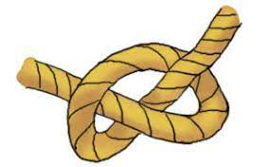
knot

Slide 106

wrestle

Slide 107

wrapper

Slide 108
Let’s Teach and Practise

Slide 109
words ending
-ought

Slide 110
-ought

Slide 111
-ought
- ought is pronounced with an "aw" sound, like in the word "law."

Slide 112
(b) -ought
Notes:
Plough
Rough
Though

Slide 113

wrought

Slide 114

ought

Slide 115
wrought
wr + ought = wrought
ADJECTIVE
Definition - (of metals) beaten out or shaped by hammering

Slide 116
ought
ought = ought
VERB
Definition - used to indicate duty or correctness, typically when criticizing someone's actions

Slide 117
The wrought-iron gate opened with a creak.
_______

Slide 118
They ought to respect the law.
_____

Slide 119
New CHALLENGE words.

Slide 120
harass
VERB
Definition - subject to aggressive pressure or intimidation

Slide 121
People should not harass each other.
______

Slide 122
foreign
ADJECTIVE
Definition - of, from, in, or characteristic of a country or language other than one's own

Slide 123
The foreign currency of Europe is Euros.
_______

Slide 124
Let’s Practise and Apply.

Slide 125
Can you spot the spelling rule words and the challenge words?

Slide 126
Can renewable energy replace oil?
It is thought that it will be some time before these renewable energies are able to replace the power that we currently get from fossil fuels. Scientists need to harass politicians and companies to keep looking for new sources of renewable energy as demands grow and oil supplies decline. Even some thoughtless big oil companies have invested in alternative energy sources. Although the money involved ought to be more as it is still much less than they spend looking for new sources of oil.

Slide 127
Can renewable energy replace oil?
It is thought that it will be some time before these renewable energies are able to replace the power that we currently get from fossil fuels. Scientists need to harass politicians and companies to keep looking for new sources of renewable energy as demands grow and oil supplies decline. Even some thoughtless big oil companies have invested in alternative energy sources. Although the money involved ought to be more as it is still much less than they spend looking for new sources of oil.

Slide 128
Write this sentence as I dictate it to you.
Notes:
Although the money involved ought to be more as it is still much less than they spend looking for new sources of oil.

Slide 129
Although the money involved ought to be more as it is still much less than they spend looking for new sources of oil.
Did you write it correctly?
Edit your work and make sure you have it correct.
Can you underline the spelling word that we have covered in this session?

Slide 130
Year 5 - Spring 2
Week 5 - Friday
Notes:
Click through the slides for all the R+R words for the week (both the focus and the challenge words)
Click through the slides for all the new learning this week

Slide 132
Old challenge words…

Slide 133
critic

Slide 134
community

Slide 135
Old spelling rule words…

Slide 136
doubt

Slide 137
lamb

Slide 138
yacht

Slide 139
thumb

Slide 140
solemn

Slide 141
autumn

Slide 142
column

Slide 143
knight

Slide 144
guarantee

Slide 145
knot

Slide 146
wrestle

Slide 147
wrapper

Slide 148
New spelling rule words…

Slide 149
brought

Slide 150
bought

Slide 151
fought

Slide 152
thought

Slide 153
thoughtless

Slide 154
thoughtful

Slide 155
wrought

Slide 156
ought

Slide 157
New challenge words…

Slide 158
harass

Slide 159
foreign

Slide 160
Quick Quiz time…
Notes:
Say these words for the quiz
Critic community yacht guarantee Harass foreign drought wrought thoughtful fought

Slide 161
Did you get them correct?
Edit your work.
critic community yacht guarantee harass foreign drought wrought thoughtful fought

Slide 162
Word class time…

Slide 163
People shouldn’t harass other people.
noun verb verb determiner noun
Notes:
Ask for these words to be classed

Slide 164
The foreign currency of Europe is Euros.
determiner adjective noun propostion noun verb noun
Notes:
Ask for these words to be classed

Slide 165
Etymology
The history of a word….

Slide 166
Harass
early 17th century: from French harasser, from harer ‘set a dog on’, from Germanic hare, a cry urging a dog to attack.
Foreign
Middle English foren, forein, from Old French forein, forain, based on Latin foras, foris ‘outside’, from fores ‘door’. The current spelling arose in the 16th century, by association with sovereign.

Slide 167
Let’s investigate….
Find antonyms and synonyms of the challenge words.

