Slide 1
Spelling Y5
Mastering spellings: building on the foundations of phonics
Spring 2
Week 6

Slide 2
Year 5 - Spring 2
Week 6 - Monday

Slide 3
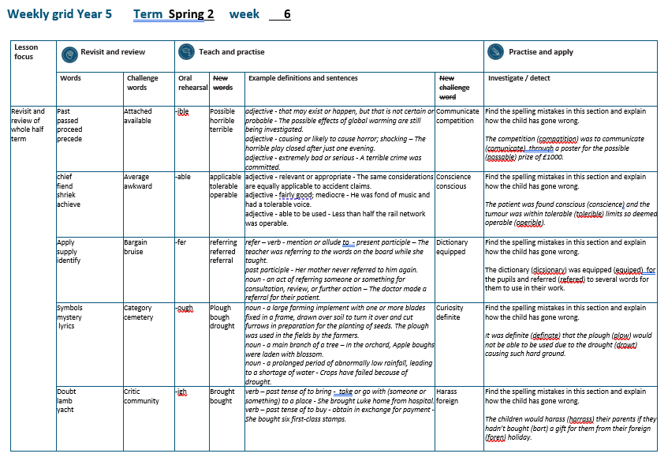

Slide 4
Let’s Revisit and Review…

Slide 5
Do you remember this challenge word?

Slide 6

attached
ADJECTIVE
Definition - joined, fastened, or connected to something

Slide 7

available
ADJECTIVE
Definition - able to be used or obtained; at someone's disposal

Slide 8
homo – same phone – sound
homophone –
same sound but different meaning

Slide 9
homophones

Slide 10
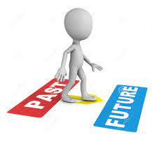
past

Slide 11
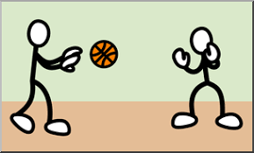
passed

Slide 12

proceed

Slide 13
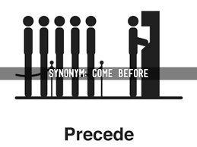
precede

Slide 14
Let’s Teach and Practise

Slide 15
words ending
-ible
The –able/–ably endings are far more common than the
–ible/–ibly endings.

Slide 16
The –able ending is usually but not always used if a complete root word can be heard before it, even if there is no related word ending in –ation.

Slide 17
The –ible ending is common if a
complete root word can’t be heard
before it but it also sometimes occurs when a complete word can be heard
(e.g. sensible).

Slide 18

possible

Slide 19

horrible

Slide 20

terrible

Slide 21
possible
poss (not a real word) + ible = possible
ADJECTIVE
Definition - that may exist or happen, but that is not certain or probable

Slide 22
horrible
horr (not a real word) + ible = horrible
ADJECTIVE
Definition - causing or likely to cause horror; shocking

Slide 23
terrible
terr (not a real word) + ible = terrible
ADJECTIVE
Definition - extremely bad or serious

Slide 24
The possible effects of global warming are still being investigated.
________

Slide 25
The horrible play closed after just one evening.
________

Slide 26
A terrible crime was committed.
________

Slide 27
New CHALLENGE words.

Slide 28

communicate
VERB
Definition - share or exchange information, news, or ideas

Slide 29
The prisoner was forbidden to communicate with their family.
___________

Slide 30
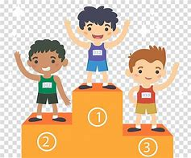
competition
NOUN
Definition - the activity or condition of striving to gain or win something by defeating or establishing superiority over others

Slide 31
There is fierce competition between banks.
___________

Slide 32
Let’s investigate.

Slide 33
Can you spot the spelling errors in these sentences?
Write the correct spelling and explain where they went wrong.

Slide 34
The compatition was to comunicate through a poster for the possable prize of £1000.

Slide 35
The compatition was to comunicate through a poster for the possable prize of £1000.

Slide 36
The compatition was to comunicate through a poster for the possable prize of £1000. competition – e not a

Slide 37
The compatition was to comunicate through a poster for the possable prize of £1000. communicate – double m

Slide 38
The compatition was to comunicate through a poster for the possable prize of £1000. possible – ible not able

Slide 39
The competition was to communicate through a poster for the possible prize of £1000.

Slide 40
Year 5 - Spring 2
Week 6 - Tuesday

Slide 42
Let’s Revisit and Review…

Slide 43
Do you remember this challenge word?

Slide 44
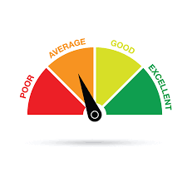
average
ADJECTIVE
Definition -constituting the result obtained by adding together several amounts and then dividing this total by the number of amounts

Slide 45
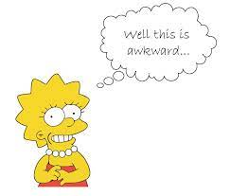
awkward
ADJECTIVE
Definition - causing difficulty; hard to do or deal with

Slide 46
(and exceptions)
Words with a long
/e/ sound spelt ‘ie’
or ‘ei’ after c

Slide 47
ie or ei

Slide 48

chief

Slide 49

fiend

Slide 50
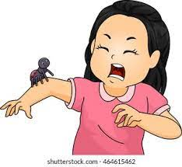
shriek

Slide 51

achieve

Slide 52
Let’s Teach and Practise

Slide 53
words ending
-able
The –able/–ably endings are far more common than the
–ible/–ibly endings.

Slide 54
If the –able ending is added to a word ending in –ce or –ge, the e after the c or g must be kept as those letters would otherwise have their ‘hard’ sounds (as in cap and gap) before the a of the –able ending.

Slide 55
The –able ending is usually but not always used if a complete root word can be heard before it, even if there is no related word ending in –ation.

Slide 56

applicable

Slide 57
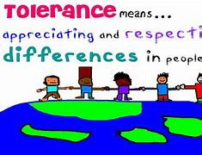
tolerable

Slide 58
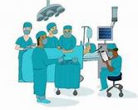
operable

Slide 59
applicable
application (-ation) + able = applicable
NOUN -> ADJECTIVE
Definition - relevant or appropriate

Slide 60
tolerable
tolerance (-ance) + able = tolerable
NOUN -> ADJECTIVE
Definition - fairly good; mediocre

Slide 61
operable
operation (-ation) + able = operable
NOUN -> ADJECTIVE
Definition - able to be used

Slide 62
The same considerations are equally applicable to accident claims.
__________

Slide 63
He was fond of music and had a tolerable voice.
_________

Slide 64
Less than half the rail network was operable.
________

Slide 65
New CHALLENGE words.

Slide 66
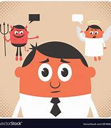
conscience
NOUN
Definition - a person's moral sense of right and wrong, viewed as acting as a guide to one's behaviour

Slide 67
Ben was suffering a pang of conscience.
_________

Slide 68

conscious
ADJECTIVE
Definition - aware of and responding to one's surroundings

Slide 69
Although I was in pain, I was conscious.
_________

Slide 70
Let’s investigate.

Slide 71
Can you spot the spelling errors in these sentences?
Write the correct spelling and explain where they went wrong.

Slide 72
The patient was found conscience and the tumour was within tolerible limits so deemed operible.

Slide 73
The patient was found conscience and the tumour was within tolerible limits so deemed operible.

Slide 74
The patient was found conscience and the tumour was within tolerible limits so deemed operible. conscious – conscience is noun and conscious is adjective

Slide 75
The patient was found conscience and the tumour was within tolerible limits so deemed operible. tolerable – able not ible

Slide 76
The patient was found conscience and the tumour was within tolerible limits so deemed operible. operable – able not ible

Slide 77
The patient was found conscious and the tumour was within tolerable limits so deemed operable.

Slide 78
Year 5 - Spring 2
Week 6 - Wednesday

Slide 80
Let’s Revisit and Review…

Slide 81
Do you remember this challenge word?

Slide 82

bargain
NOUN
Definition -a thing bought or offered for sale much more cheaply than is usual or expected

Slide 83
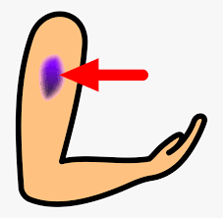
bruise
NOUN
Definition - an injury appearing as an area of discoloured skin on the body, caused by a blow or impact rupturing underlying blood vessels

Slide 84
y
Long vowel sound i with y

Slide 85

apply

Slide 86
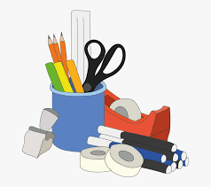
supply

Slide 87

identify

Slide 88
Let’s Teach and Practise

Slide 89
words ending
-fer
If the 'fer' syllable is stressed, double the last letter before adding suffix.

Slide 90
E.g. In the word prefer, the syllable fer is stressed so when adding suffixes –ing or –ed, the r letter is double.

Slide 91
If the 'fer' syllable is not stressed, you just add the suffix.

Slide 92

refer

Slide 93
referring

Slide 94
referred

Slide 95
referral

Slide 96
referring
refer (+r) + ing = referring
VERB – present participle
Definition - mention or allude to

Slide 97
referred
refer (+r) + ed = referred
VERB – past participle
Definition - mention or allude to

Slide 98
referral
refer (+r) + al = referral
NOUN
Definition - an act of referring someone or something for consultation, review, or further action

Slide 99
The teacher was referring to the words on the board while she taught.
_________

Slide 100
Her mother never referred to him again.
________

Slide 101
The doctor made a referral for their patient.
________

Slide 102
New CHALLENGE words.

Slide 103

dictionary
NOUN
Definition - a book or electronic resource that lists the words of a language (typically in alphabetical order) and gives their meaning, or gives the equivalent words in a different language, often also providing information about pronunciation, origin, and usage

Slide 104
The website gives access to an online dictionary.
__________

Slide 105
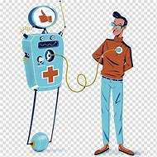
equipped
VERB
Definition - supply with the necessary items for a particular purpose

Slide 106
All bedrooms are equipped with a colour TV.
________

Slide 107
Let’s investigate.

Slide 108
Can you spot the spelling errors in these sentences?
Write the correct spelling and explain where they went wrong.

Slide 109
The dicsionary was equiped for the pupils and refered to several words for them to use in their work.

Slide 110
The dicsionary was equiped for the pupils and refered to several words for them to use in their work.

Slide 111
The dicsionary was equiped for the pupils and refered to several words for them to use in their work. dictionary – tion not sion

Slide 112
The dicsionary was equiped for the pupils and refered to several words for them to use in their work. equipped – short vowel sound so double the consonant + ed

Slide 113
The dicsionary was equiped for the pupils and refered to several words for them to use in their work. referred – ‘fer’ stressed in root of refer, so double the r

Slide 114
The dictionary was equipped for the pupils and referred to several words for them to use in their work.

Slide 115
Year 5 - Spring 2
Week 6 - Thursday

Slide 117
Let’s Revisit and Review…

Slide 118
Do you remember this challenge word?

Slide 119

category
NOUN
Definition -a class or division of people or things regarded as having particular shared characteristics

Slide 120
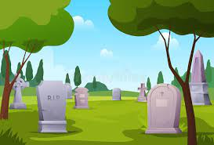
cemetery
NOUN
Definition - a large burial ground, especially one not in a churchyard

Slide 121
y
Short vowel sound i with y

Slide 122

symbols

Slide 123

mystery

Slide 124
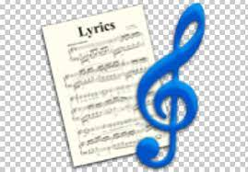
lyrics

Slide 125
Let’s Teach and Practise

Slide 126
words ending
-ough

Slide 127
-ough
ough is one of the trickiest spellings in English – it can be used to spell a
number of different sounds

Slide 128
(pl) -ough
(r) -ough
(th) -ough
Notes:
Plough
Rough
Though

Slide 129
pronounce -ough with an "ow" sound, like in the word "now."

Slide 130
pronounce -ough with an "uff" sound, like in the word "stuff."

Slide 131
pronounce -ough with an "oh" sound, like in the word "go."

Slide 132
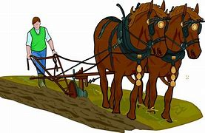
plough

Slide 133

bough

Slide 134
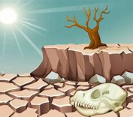
drought

Slide 135
plough
pl + ough = plough
NOUN
Definition - a large farming implement with one or more blades fixed in a frame, drawn over soil to turn it over and cut furrows in preparation for the planting of seeds

Slide 136
bough
b + ough = bough
NOUN
Definition - a main branch of a tree

Slide 137
drought
dr + ough + t = drought
NOUN
Definition - a prolonged period of abnormally low rainfall, leading to a shortage of water

Slide 138
The plough was used in the fields by the farmers.
______

Slide 139
In the orchard, Apple boughs were laden with blossom.
______

Slide 140
Crops have failed because of drought.
_______

Slide 141
New CHALLENGE words.

Slide 142
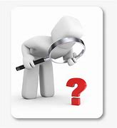
curiosity
NOUN
Definition - a strong desire to know or learn

Slide 143
Filled with curiosity, she peered through the window.
_________

Slide 144

definite
ADJECTIVE
Definition - clearly stated or decided; not vague or doubtful

Slide 145
We had no definite plans.
________

Slide 146
Let’s investigate.

Slide 147
Can you spot the spelling errors in these sentences?
Write the correct spelling and explain where they went wrong.

Slide 148
It was definate that the plow would not be able to be used due to the drowt causing such hard ground.

Slide 149
It was definate that the plow would not be able to be used due to the drowt causing such hard ground.

Slide 150
It was definate that the plow would not be able to be used due to the drowt causing such hard ground. definite – i not a

Slide 151
It was definate that the plow would not be able to be used due to the drowt causing such hard ground. plough – pl + ough

Slide 152
It was definate that the plow would not be able to be used due to the drowt causing such hard ground. drought – dr + ought

Slide 153
It was definite that the plough would not be able to be used due to the drought causing such hard ground.

Slide 154
Year 5 - Spring 2
Week 6 - Friday

Slide 156
Let’s Revisit and Review…

Slide 157
Do you remember this challenge word?

Slide 158
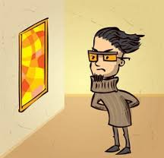
critic
NOUN
Definition - a person who expresses an unfavourable opinion of something

Slide 159

community
NOUN
Definition - a group of people living in the same place or having a particular characteristic in common

Slide 160
bt kn mb wr
Silent letters

Slide 161

doubt

Slide 162
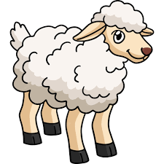
lamb

Slide 163
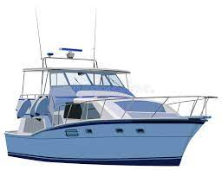
yacht

Slide 164
Let’s Teach and Practise

Slide 165
words ending
-ought

Slide 166
-ought

Slide 167
-ought
- ought is pronounced with an "aw" sound, like in the word "law."

Slide 168
(b) -ought
Notes:
Plough
Rough
Though

Slide 169
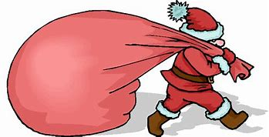
brought

Slide 170
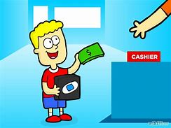
bought

Slide 171
brought
br + ought = brought
VERB – past tense of ‘to bring’
Definition - take or go with (someone or something) to a place

Slide 172
bought
b + ought = bought
VERB – past tense of ‘to buy’
Definition - obtain in exchange for payment

Slide 173
She brought Luke home from hospital.
_______

Slide 174
She bought six first-class stamps.
______

Slide 175
New CHALLENGE words.

Slide 176
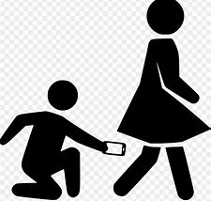
harass
VERB
Definition - subject to aggressive pressure or intimidation

Slide 177
People should not harass each other.
______

Slide 178

foreign
ADJECTIVE
Definition - of, from, in, or characteristic of a country or language other than one's own

Slide 179
The foreign currency of Europe is Euros.
_______

Slide 180
Let’s investigate.

Slide 181
Can you spot the spelling errors in these sentences?
Write the correct spelling and explain where they went wrong.

Slide 182
The children would harrass their parents if they hadn’t bort a gift for them from their foren holiday.

Slide 183
The children would harrass their parents if they hadn’t bort a gift for them from their foren holiday.

Slide 184
The children would harras their parents if they hadn’t bort a gift for them from their foren holiday. harass – single r and double s

Slide 185
The children would harrass their parents if they hadn’t bort a gift for them from their foren holiday. bought – b + ought

Slide 186
The children would harrass their parents if they hadn’t bort a gift for them from their foren holiday. foreign – ign not just n

Slide 187
The children would harass their parents if they hadn’t bought a gift for them from their foreign holiday.

