Slide 1
Spelling Y5
Mastering spellings: building on the foundations of phonics
Summer 1
Week 3

Slide 2
Year 5 - Summer 1
Week 3 - Monday

Slide 3
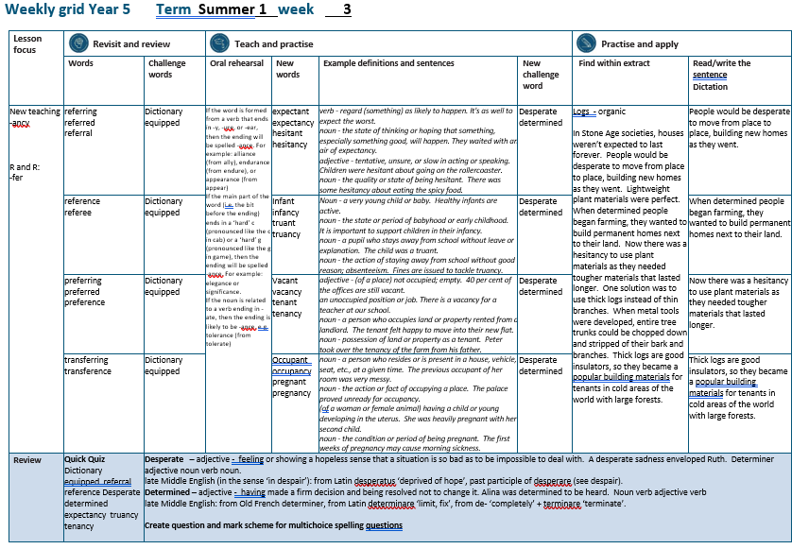

Slide 4
Let’s Revisit and Review…

Slide 5
Do you remember this challenge word?

Slide 6

dictionary
NOUN
Definition - a book or electronic resource that lists the words of a language (typically in alphabetical order) and gives their meaning, or gives the equivalent words in a different language, often also providing information about pronunciation, origin, and usage

Slide 7
The website gives access to an online dictionary.
__________

Slide 8
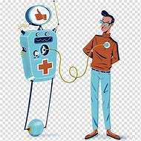
equipped
VERB
Definition - supply with the necessary items for a particular purpose

Slide 9
All bedrooms are equipped with a colour TV.
________

Slide 10
words ending
-fer
If the 'fer' syllable is stressed, double the last letter before adding suffix.

Slide 11
E.g. In the word prefer, the syllable fer is stressed so when adding suffixes –ing or –ed, the r letter is double.

Slide 12
If the 'fer' syllable is not stressed, you just add the suffix.

Slide 13

refer

Slide 14
referring

Slide 15
referred

Slide 16
referral

Slide 17
Let’s Teach and Practise

Slide 18
words ending
-ancy
If the word is formed from a verb that ends in -y, -ure, or -ear, then the ending will be spelled -ancy.

Slide 19
If the main part of the word ends in a ‘hard’ c or a ‘hard’ g, then the ending will be spelled -ancy.

Slide 20
-ancy

Slide 21
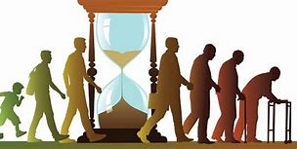
expectancy

Slide 22

hesitancy

Slide 23
expectancy
expectant → expectancy
VERB → NOUN
Definition - the state of thinking or hoping that something, especially something good, will happen.

Slide 24
hesitancy
hesitant → hesitancy
VERB → NOUN
Definition - the quality or state of being hesitant; unsure

Slide 25
They waited with an air of expectancy.
__________

Slide 26
There was some hesitancy about eating the spicy food.
__________

Slide 27
New CHALLENGE words.

Slide 28

desperate
ADJECTIVE
Definition - feeling or showing a hopeless sense that a situation is so bad as to be impossible to deal with

Slide 29
A desperate sadness enveloped Ruth.
_________

Slide 30
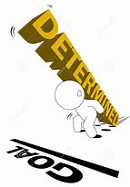
determined
ADJECTIVE
Definition - having made a firm decision and being resolved not to change it

Slide 31
Alina was determined to be heard.
__________

Slide 32
Let’s Practise and Apply.

Slide 33
Can you spot the spelling rule words and the challenge words?

Slide 34
Logs - organic
In Stone Age societies, houses weren’t expected to last forever. People would be desperate to move from place to place, building new homes as they went. Lightweight plant materials were perfect. When determined people began farming, they wanted to build permanent homes next to their land. Now there was a hesitancy to use plant materials as they needed tougher materials that lasted longer. One solution was to use thick logs instead of thin branches. When metal tools were developed, entire tree trunks could be chopped down and stripped of their bark and branches. Thick logs are good insulators, so they became a popular building material for tenants in cold areas of the world with large forests.

Slide 35
Logs - organic
In Stone Age societies, houses weren’t expected to last forever. People would be desperate to move from place to place, building new homes as they went. Lightweight plant materials were perfect. When determined people began farming, they wanted to build permanent homes next to their land. Now there was a hesitancy to use plant materials as they needed tougher materials that lasted longer. One solution was to use thick logs instead of thin branches. When metal tools were developed, entire tree trunks could be chopped down and stripped of their bark and branches. Thick logs are good insulators, so they became a popular building material for tenants in cold areas of the world with large forests.

Slide 36
Write this sentence as I dictate it to you.
Notes:
People would be desperate to move from place to place, building new homes as they went.

Slide 37
People would be desperate to move from place to place, building new homes as they went.
Did you write it correctly?
Edit your work and make sure you have it correct.
Can you underline the spelling word that we have covered in this session?

Slide 38
Year 5 - Summer 1
Week 3 - Tuesday
Notes:
Revisit and review the words from previous teaching and challenge words – I say, we say, you say
Ask children to write words only in their spelling book
Introduce the new spelling rule
Children to write the new spelling rule words and challenge words into books when the sentences are shown with the spelling word missing.
Read the extract with the class as choral reading. Practise model of prosody etc.
Ask children to find the spelling words from the session in the text.
Then read allowed the chosen sentence for children to write fully in their books.
Show the extract and ask children to then edit their work to check they were correct in their dictation.

Slide 40
Let’s Revisit and Review…

Slide 41
Do you remember this challenge word?

Slide 42
dictionary
NOUN
Definition - a book or electronic resource that lists the words of a language (typically in alphabetical order) and gives their meaning, or gives the equivalent words in a different language, often also providing information about pronunciation, origin, and usage

Slide 43
The website gives access to an online dictionary.
__________

Slide 44
equipped
VERB
Definition - supply with the necessary items for a particular purpose

Slide 45
All bedrooms are equipped with a colour TV.
________

Slide 46
words ending
-fer
If the 'fer' syllable is stressed, double the last letter before adding suffix.

Slide 47
E.g. In the word prefer, the syllable fer is stressed so when adding suffixes –ing or –ed, the r letter is double.

Slide 48
If the 'fer' syllable is not stressed, you just add the suffix.

Slide 49
refer

Slide 50

reference

Slide 51
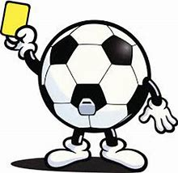
referee

Slide 52
Let’s Teach and Practise

Slide 53
words ending
-ancy
If the word is formed from a verb that ends in -y, -ure, or -ear, then the ending will be spelled -ancy.

Slide 54
If the main part of the word ends in a ‘hard’ c or a ‘hard’ g, then the ending will be spelled -ancy.

Slide 55
-ancy

Slide 56
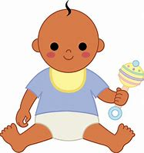
infancy

Slide 57

truancy

Slide 58
infancy
infant → infancy
NOUN → NOUN
Definition - the state or period of babyhood or early childhood

Slide 59
truancy
truant → truancy
NOUN → NOUN
Definition - the action of staying away from school without good reason; absenteeism

Slide 60
It is important to support children in their infancy.
_______

Slide 61
Fines are issued to tackle truancy.
_______

Slide 62
New CHALLENGE words.

Slide 63
desperate
ADJECTIVE
Definition - feeling or showing a hopeless sense that a situation is so bad as to be impossible to deal with

Slide 64
A desperate sadness enveloped Ruth.
_________

Slide 65
determined
ADJECTIVE
Definition - having made a firm decision and being resolved not to change it

Slide 66
Alina was determined to be heard.
__________

Slide 67
Let’s Practise and Apply.

Slide 68
Can you spot the spelling rule words and the challenge words?

Slide 69
Logs - organic
In Stone Age societies, houses weren’t expected to last forever. People would be desperate to move from place to place, building new homes as they went. Lightweight plant materials were perfect. When determined people began farming, they wanted to build permanent homes next to their land. Now there was a hesitancy to use plant materials as they needed tougher materials that lasted longer. One solution was to use thick logs instead of thin branches. When metal tools were developed, entire tree trunks could be chopped down and stripped of their bark and branches. Thick logs are good insulators, so they became a popular building material for tenants in cold areas of the world with large forests.

Slide 70
Logs - organic
In Stone Age societies, houses weren’t expected to last forever. People would be desperate to move from place to place, building new homes as they went. Lightweight plant materials were perfect. When determined people began farming, they wanted to build permanent homes next to their land. Now there was a hesitancy to use plant materials as they needed tougher materials that lasted longer. One solution was to use thick logs instead of thin branches. When metal tools were developed, entire tree trunks could be chopped down and stripped of their bark and branches. Thick logs are good insulators, so they became a popular building material for tenants in cold areas of the world with large forests.

Slide 71
Write this sentence as I dictate it to you.
Notes:
When determined people began farming, they wanted to build permanent homes next to their land.

Slide 72
When determined people began farming, they wanted to build permanent homes next to their land.
Did you write it correctly?
Edit your work and make sure you have it correct.
Can you underline the spelling word that we have covered in this session?

Slide 73
Year 5 - Summer 1
Week 3 - Wednesday
Notes:
Revisit and review the words from previous teaching and challenge words – I say, we say, you say
Ask children to write words only in their spelling book
Introduce the new spelling rule
Children to write the new spelling rule words and challenge words into books when the sentences are shown with the spelling word missing.
Read the extract with the class as choral reading. Practise model of prosody etc.
Ask children to find the spelling words from the session in the text.
Then read allowed the chosen sentence for children to write fully in their books.
Show the extract and ask children to then edit their work to check they were correct in their dictation.

Slide 75
Let’s Revisit and Review…

Slide 76
Do you remember this challenge word?

Slide 77
dictionary
NOUN
Definition - a book or electronic resource that lists the words of a language (typically in alphabetical order) and gives their meaning, or gives the equivalent words in a different language, often also providing information about pronunciation, origin, and usage

Slide 78
The website gives access to an online dictionary.
__________

Slide 79
equipped
VERB
Definition - supply with the necessary items for a particular purpose

Slide 80
All bedrooms are equipped with a colour TV.
________

Slide 81
words ending
-fer
If the 'fer' syllable is stressed, double the last letter before adding suffix.

Slide 82
E.g. In the word prefer, the syllable fer is stressed so when adding suffixes –ing or –ed, the r letter is double.

Slide 83
If the 'fer' syllable is not stressed, you just add the suffix.

Slide 84
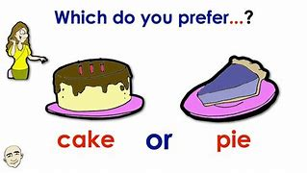
prefer

Slide 85
preferring

Slide 86
preferred

Slide 87
preference

Slide 88
Let’s Teach and Practise

Slide 89
words ending
-ancy
If the word is formed from a verb that ends in -y, -ure, or -ear, then the ending will be spelled -ancy.

Slide 90
If the main part of the word ends in a ‘hard’ c or a ‘hard’ g, then the ending will be spelled -ancy.

Slide 91
-ancy

Slide 92

vacancy

Slide 93

tenancy

Slide 94
vacancy
vacant → vacancy
ADJECTIVE → NOUN
Definition - an unoccupied position or job

Slide 95
tenancy
tenant → tenancy
NOUN → NOUN
Definition - possession of land or property as a tenant

Slide 96
There is a vacancy for a teacher at our school.
_______

Slide 97
Peter took over the tenancy of the farm from his father.
_______

Slide 98
New CHALLENGE words.

Slide 99
desperate
ADJECTIVE
Definition - feeling or showing a hopeless sense that a situation is so bad as to be impossible to deal with

Slide 100
A desperate sadness enveloped Ruth.
_________

Slide 101
determined
ADJECTIVE
Definition - having made a firm decision and being resolved not to change it

Slide 102
Alina was determined to be heard.
__________

Slide 103
Let’s Practise and Apply.

Slide 104
Can you spot the spelling rule words and the challenge words?

Slide 105
Logs - organic
In Stone Age societies, houses weren’t expected to last forever. People would be desperate to move from place to place, building new homes as they went. Lightweight plant materials were perfect. When determined people began farming, they wanted to build permanent homes next to their land. Now there was a hesitancy to use plant materials as they needed tougher materials that lasted longer. One solution was to use thick logs instead of thin branches. When metal tools were developed, entire tree trunks could be chopped down and stripped of their bark and branches. Thick logs are good insulators, so they became a popular building material for tenants in cold areas of the world with large forests.

Slide 106
Logs - organic
In Stone Age societies, houses weren’t expected to last forever. People would be desperate to move from place to place, building new homes as they went. Lightweight plant materials were perfect. When determined people began farming, they wanted to build permanent homes next to their land. Now there was a hesitancy to use plant materials as they needed tougher materials that lasted longer. One solution was to use thick logs instead of thin branches. When metal tools were developed, entire tree trunks could be chopped down and stripped of their bark and branches. Thick logs are good insulators, so they became a popular building material for tenants in cold areas of the world with large forests.

Slide 107
Write this sentence as I dictate it to you.
Notes:
Now there was a hesitancy to use plant materials as they needed tougher materials that lasted longer.

Slide 108
Now there was a hesitancy to use plant materials as they needed tougher materials that lasted longer.
Did you write it correctly?
Edit your work and make sure you have it correct.
Can you underline the spelling word that we have covered in this session?

Slide 109
Year 5 - Summer 1
Week 3 - Thursday
Notes:
Revisit and review the words from previous teaching and challenge words – I say, we say, you say
Ask children to write words only in their spelling book
Introduce the new spelling rule
Children to write the new spelling rule words and challenge words into books when the sentences are shown with the spelling word missing.
Read the extract with the class as choral reading. Practise model of prosody etc.
Ask children to find the spelling words from the session in the text.
Then read allowed the chosen sentence for children to write fully in their books.
Show the extract and ask children to then edit their work to check they were correct in their dictation.

Slide 111
Let’s Revisit and Review…

Slide 112
Do you remember this challenge word?

Slide 113
dictionary
NOUN
Definition - a book or electronic resource that lists the words of a language (typically in alphabetical order) and gives their meaning, or gives the equivalent words in a different language, often also providing information about pronunciation, origin, and usage

Slide 114
The website gives access to an online dictionary.
__________

Slide 115
equipped
VERB
Definition - supply with the necessary items for a particular purpose

Slide 116
All bedrooms are equipped with a colour TV.
________

Slide 117
words ending
-fer
If the 'fer' syllable is stressed, double the last letter before adding suffix.

Slide 118
E.g. In the word prefer, the syllable fer is stressed so when adding suffixes –ing or –ed, the r letter is double.

Slide 119
If the 'fer' syllable is not stressed, you just add the suffix.

Slide 120
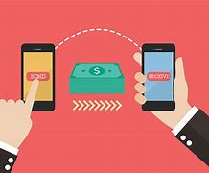
transfer

Slide 121
transferring

Slide 122
transference

Slide 123
Let’s Teach and Practise

Slide 124
words ending
-ancy
If the word is formed from a verb that ends in -y, -ure, or -ear, then the ending will be spelled -ancy.

Slide 125
If the main part of the word ends in a ‘hard’ c or a ‘hard’ g, then the ending will be spelled -ancy.

Slide 126
-ancy

Slide 127
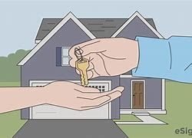
occupancy

Slide 128
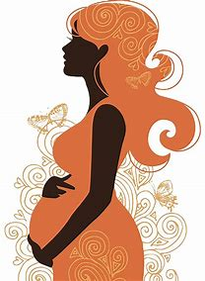
pregnancy

Slide 129
occupancy
occupant → occupancy
NOUN → NOUN
Definition - the action or fact of occupying a place

Slide 130
pregnancy
pregnant → pregnancy
ADJECTIVE → NOUN
Definition - the condition or period of being pregnant

Slide 131
The palace proved unready for occupancy.
_________

Slide 132
The first weeks of pregnancy may cause morning sickness.
_________

Slide 133
New CHALLENGE words.

Slide 134
desperate
ADJECTIVE
Definition - feeling or showing a hopeless sense that a situation is so bad as to be impossible to deal with

Slide 135
A desperate sadness enveloped Ruth.
_________

Slide 136
determined
ADJECTIVE
Definition - having made a firm decision and being resolved not to change it

Slide 137
Alina was determined to be heard.
__________

Slide 138
Let’s Practise and Apply.

Slide 139
Can you spot the spelling rule words and the challenge words?

Slide 140
Logs - organic
In Stone Age societies, houses weren’t expected to last forever. People would be desperate to move from place to place, building new homes as they went. Lightweight plant materials were perfect. When determined people began farming, they wanted to build permanent homes next to their land. Now there was a hesitancy to use plant materials as they needed tougher materials that lasted longer. One solution was to use thick logs instead of thin branches. When metal tools were developed, entire tree trunks could be chopped down and stripped of their bark and branches. Thick logs are good insulators, so they became a popular building material for tenants in cold areas of the world with large forests.

Slide 141
Logs - organic
In Stone Age societies, houses weren’t expected to last forever. People would be desperate to move from place to place, building new homes as they went. Lightweight plant materials were perfect. When determined people began farming, they wanted to build permanent homes next to their land. Now there was a hesitancy to use plant materials as they needed tougher materials that lasted longer. One solution was to use thick logs instead of thin branches. When metal tools were developed, entire tree trunks could be chopped down and stripped of their bark and branches. Thick logs are good insulators, so they became a popular building material for tenants in cold areas of the world with large forests.

Slide 142
Write this sentence as I dictate it to you.
Notes:
Thick logs are good insulators, so they became a popular building materials for tenants in cold areas of the world with large forests.

Slide 143
Thick logs are good insulators, so they became a popular building materials for tenants in cold areas of the world with large forests.
Did you write it correctly?
Edit your work and make sure you have it correct.
Can you underline the spelling word that we have covered in this session?

Slide 144
Year 5 - Summer 1
Week 3 - Friday
Notes:
Click through the slides for all the R+R words for the week (both the focus and the challenge words)
Click through the slides for all the new learning this week

Slide 146
Old challenge words…

Slide 147
dictionary

Slide 148
equipped

Slide 149
Old spelling rule words…

Slide 150
referring

Slide 151
referred

Slide 152
referral

Slide 153
reference

Slide 154
referee

Slide 155
preferring

Slide 156
preferred

Slide 157
preference

Slide 158
transferring

Slide 159
tranference

Slide 160
New spelling rule words…

Slide 161
expectancy

Slide 162
hesitancy

Slide 163
infancy

Slide 164
truancy

Slide 165
occupancy

Slide 166
pregnancy

Slide 167
New challenge words…

Slide 168
desperate

Slide 169
determined

Slide 170
Quick Quiz time…
Notes:
Say these words for the quiz
Dictionary equipped referral reference Desperate determined expectancy truancy tenancy

Slide 171
Did you get them correct?
Edit your work.
dictionary equipped referral reference desperate determined expectancy truancy tenancy

Slide 172
Word class time…

Slide 173
A desperate sadness enveloped Ruth.
Determiner adjective noun verb noun.
Notes:
Ask for these words to be classed

Slide 174
Alina was determined to be heard.
Noun verb adjective verb
Notes:
Ask for these words to be classed

Slide 175
Etymology
The history of a word….

Slide 176
Determined
late Middle English: from Old French determiner, from Latin determinare ‘limit, fix’, from de- ‘completely’ + terminare ‘terminate’
Desperate
late Middle English (in the sense ‘in despair’): from Latin desperatus ‘deprived of hope’, past participle of desperare (see despair).

Slide 177
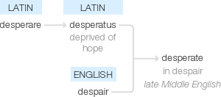

Slide 178
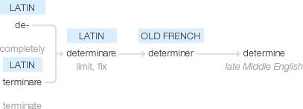

Slide 179
Let’s investigate….
Look at the word origin of the challenge words and find words that are linked to them.

