Slide 1
Spelling Y5
Mastering spellings: building on the foundations of phonics
Summer 1
Week 1

Slide 2
Year 5 - Summer 1
Week 1 - Monday

Slide 3
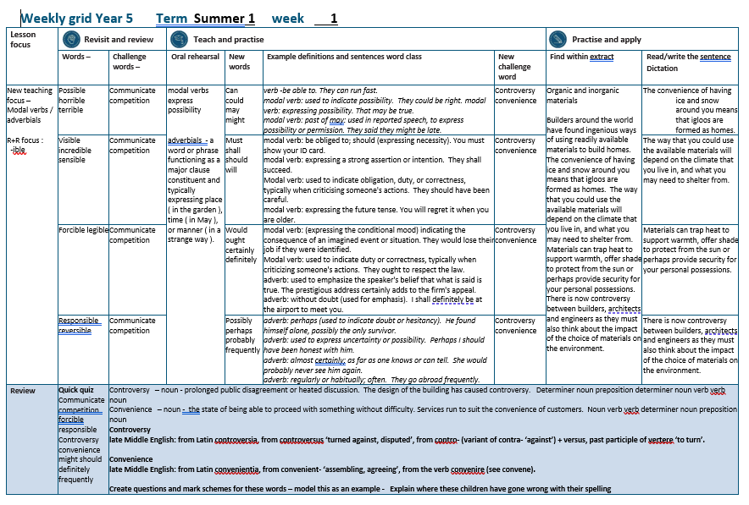

Slide 4
Let’s Revisit and Review…

Slide 5
Do you remember this challenge word?

Slide 6
communicate
VERB
Definition - share or exchange information, news, or ideas

Slide 7
The prisoner was forbidden to communicate with their family.
___________

Slide 8
competition
NOUN
Definition - the activity or condition of striving to gain or win something by defeating or establishing superiority over others

Slide 9
There is fierce competition between banks.
___________

Slide 10
words ending
-ible
The –able/–ably endings are far more common than the
–ible/–ibly endings.

Slide 11
The –able ending is usually but not always used if a complete root word can be heard before it, even if there is no related word ending in –ation.

Slide 12
The –ible ending is common if a complete root word can’t be heard before it but it also sometimes occurs when a complete word can be heard (e.g. sensible).

Slide 13
possible

Slide 14
horrible

Slide 15
terrible

Slide 16
Let’s Teach and Practise

Slide 17
Modal verbs
Adverbials

Slide 18
modal verbs express possibility

Slide 19
Adverbials - a word or phrase functioning as a major clause constituent and typically expressing place ( in the garden ),
time ( in May ),
or manner ( in a strange way ).

Slide 20
can

Slide 21
could

Slide 22
may

Slide 23
might

Slide 24
can
MODAL VERB
Definition - be able to

Slide 25
could
MODAL VERB
Definition - used to indicate possibility

Slide 26
may
MODAL VERB
Definition - expressing possibility

Slide 27
might
MODAL VERB
Definition - past of may

Slide 28
They can run fast.
___

Slide 29
They could be right.
_____

Slide 30
That may be true.
___

Slide 31
They said they might be late.
_____

Slide 32
New CHALLENGE words.

Slide 33
controversy
NOUN
Definition - prolonged public disagreement or heated discussion

Slide 34
The design of the building has caused controversy.
___________

Slide 35
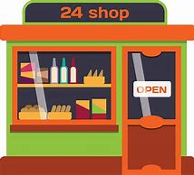
convenience
NOUN
Definition - the state of being able to proceed with something without difficulty.

Slide 36
Services run to suit the convenience of customers.
___________

Slide 37
Let’s Practise and Apply.

Slide 38
Can you spot the spelling rule words and the challenge words?

Slide 39
Organic and inorganic materials Builders around the world have found ingenious ways of using readily available materials to build homes. The convenience of having ice and snow around you means that igloos are formed as homes. The way that you could use the available materials will depend on the climate that you live in, and what you may need to shelter from. Materials can trap heat to support warmth, offer shade to protect from the sun or perhaps provide security for your personal possessions. There is now controversy between builders, architects and engineers as they must also think about the impact of the choice of materials on the environment.

Slide 40
Organic and inorganic materials Builders around the world have found ingenious ways of using readily available materials to build homes. The convenience of having ice and snow around you means that igloos are formed as homes. The way that you could use the available materials will depend on the climate that you live in, and what you may need to shelter from. Materials can trap heat to support warmth, offer shade to protect from the sun or perhaps provide security for your personal possessions. There is now controversy between builders, architects and engineers as they must also think about the impact of the choice of materials on the environment.

Slide 41
Write this sentence as I dictate it to you.
Notes:
The convenience of having ice and snow around you means that igloos are formed as homes.

Slide 42
The convenience of having ice and snow around you means that igloos are formed as homes.
Did you write it correctly?
Edit your work and make sure you have it correct.
Can you underline the spelling word that we have covered in this session?

Slide 43
Year 5 - Summer 1
Week 1 - Tuesday
Notes:
Revisit and review the words from previous teaching and challenge words – I say, we say, you say
Ask children to write words only in their spelling book
Introduce the new spelling rule
Children to write the new spelling rule words and challenge words into books when the sentences are shown with the spelling word missing.
Read the extract with the class as choral reading. Practise model of prosody etc.
Ask children to find the spelling words from the session in the text.
Then read allowed the chosen sentence for children to write fully in their books.
Show the extract and ask children to then edit their work to check they were correct in their dictation.

Slide 45
Let’s Revisit and Review…

Slide 46
Do you remember this challenge word?

Slide 47
communicate
VERB
Definition - share or exchange information, news, or ideas

Slide 48
The prisoner was forbidden to communicate with their family.
___________

Slide 49
competition
NOUN
Definition - the activity or condition of striving to gain or win something by defeating or establishing superiority over others

Slide 50
There is fierce competition between banks.
___________

Slide 51
words ending
-ible
The –able/–ably endings are far more common than the
–ible/–ibly endings.

Slide 52
The –able ending is usually but not always used if a complete root word can be heard before it, even if there is no related word ending in –ation.

Slide 53
The –ible ending is common if a complete root word can’t be heard before it but it also sometimes occurs when a complete word can be heard (e.g. sensible).

Slide 54
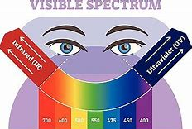
visible

Slide 55
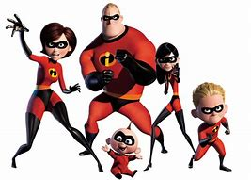
incredible

Slide 56
sensible

Slide 57
Let’s Teach and Practise

Slide 58
Modal verbs
Adverbials

Slide 59
modal verbs express possibility

Slide 60
Adverbials - a word or phrase functioning as a major clause constituent and typically expressing place ( in the garden ),
time ( in May ),
or manner ( in a strange way ).

Slide 61
must

Slide 62
shall

Slide 63
should

Slide 64
will

Slide 65
must
MODAL VERB
Definition - be obliged to; should (expressing necessity)

Slide 66
shall
MODAL VERB
Definition - expressing a strong assertion or intention

Slide 67
should
MODAL VERB
Definition - used to indicate obligation, duty, or correctness, typically when criticising someone's actions

Slide 68
will
MODAL VERB
Definition - expressing the future tense

Slide 69
You must show your ID card.
____

Slide 70
They shall succeed.
_____

Slide 71
They should have been careful.
______

Slide 72
You will regret it when you are older.
____

Slide 73
New CHALLENGE words.

Slide 74
controversy
NOUN
Definition - prolonged public disagreement or heated discussion

Slide 75
The design of the building has caused controversy.
___________

Slide 76
convenience
NOUN
Definition - the state of being able to proceed with something without difficulty.

Slide 77
Services run to suit the convenience of customers.
___________

Slide 78
Let’s Practise and Apply.

Slide 79
Can you spot the spelling rule words and the challenge words?

Slide 80
Organic and inorganic materials Builders around the world have found ingenious ways of using readily available materials to build homes. The convenience of having ice and snow around you means that igloos are formed as homes. The way that you could use the available materials will depend on the climate that you live in, and what you may need to shelter from. Materials can trap heat to support warmth, offer shade to protect from the sun or perhaps provide security for your personal possessions. There is now controversy between builders, architects and engineers as they must also think about the impact of the choice of materials on the environment.

Slide 81
Organic and inorganic materials Builders around the world have found ingenious ways of using readily available materials to build homes. The convenience of having ice and snow around you means that igloos are formed as homes. The way that you could use the available materials will depend on the climate that you live in, and what you may need to shelter from. Materials can trap heat to support warmth, offer shade to protect from the sun or perhaps provide security for your personal possessions. There is now controversy between builders, architects and engineers as they must also think about the impact of the choice of materials on the environment.

Slide 82
Write this sentence as I dictate it to you.
Notes:
The way that you could use the available materials will depend on the climate that you live in, and what you may need to shelter from.

Slide 83
The way that you could use the available materials will depend on the climate that you live in, and what you may need to shelter from.
Did you write it correctly?
Edit your work and make sure you have it correct.
Can you underline the spelling word that we have covered in this session?

Slide 84
Year 5 - Summer 1
Week 1 - Wednesday
Notes:
Revisit and review the words from previous teaching and challenge words – I say, we say, you say
Ask children to write words only in their spelling book
Introduce the new spelling rule
Children to write the new spelling rule words and challenge words into books when the sentences are shown with the spelling word missing.
Read the extract with the class as choral reading. Practise model of prosody etc.
Ask children to find the spelling words from the session in the text.
Then read allowed the chosen sentence for children to write fully in their books.
Show the extract and ask children to then edit their work to check they were correct in their dictation.

Slide 86
Let’s Revisit and Review…

Slide 87
Do you remember this challenge word?

Slide 88
communicate
VERB
Definition - share or exchange information, news, or ideas

Slide 89
The prisoner was forbidden to communicate with their family.
___________

Slide 90
competition
NOUN
Definition - the activity or condition of striving to gain or win something by defeating or establishing superiority over others

Slide 91
There is fierce competition between banks.
___________

Slide 92
words ending
-ible
The –able/–ably endings are far more common than the
–ible/–ibly endings.

Slide 93
The –able ending is usually but not always used if a complete root word can be heard before it, even if there is no related word ending in –ation.

Slide 94
The –ible ending is common if a complete root word can’t be heard before it but it also sometimes occurs when a complete word can be heard (e.g. sensible).

Slide 95
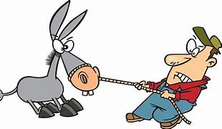
forcible

Slide 96
legible

Slide 97
Let’s Teach and Practise

Slide 98
Modal verbs
Adverbials

Slide 99
modal verbs express possibility

Slide 100
Adverbials - a word or phrase functioning as a major clause constituent and typically expressing place ( in the garden ),
time ( in May ),
or manner ( in a strange way ).

Slide 101
would

Slide 102
ought

Slide 103
certainly

Slide 104
definitely

Slide 105
would
MODAL VERB
Definition - (expressing the conditional mood) indicating the consequence of an imagined event or situation

Slide 106
ought
MODAL VERB
Definition - used to indicate duty or correctness, typically when criticising someone's actions

Slide 107
certainly
ADVERB
Definition - used to emphasise the speaker's belief that what is said is true

Slide 108
definitely
ADVERB
Definition - without doubt (used for emphasis)

Slide 109
They would lose their job if they were identified.
_____

Slide 110
They ought to respect the law.
_____

Slide 111
The prestigious address certainly adds to the firm's appeal.
_________

Slide 112
I shall definitely be at the airport to meet you.
__________

Slide 113
New CHALLENGE words.

Slide 114
controversy
NOUN
Definition - prolonged public disagreement or heated discussion

Slide 115
The design of the building has caused controversy.
___________

Slide 116
convenience
NOUN
Definition - the state of being able to proceed with something without difficulty.

Slide 117
Services run to suit the convenience of customers.
___________

Slide 118
Let’s Practise and Apply.

Slide 119
Can you spot the spelling rule words and the challenge words?

Slide 120
Organic and inorganic materials Builders around the world have found ingenious ways of using readily available materials to build homes. The convenience of having ice and snow around you means that igloos are formed as homes. The way that you could use the available materials will depend on the climate that you live in, and what you may need to shelter from. Materials can trap heat to support warmth, offer shade to protect from the sun or perhaps provide security for your personal possessions. There is now controversy between builders, architects and engineers as they must also think about the impact of the choice of materials on the environment.

Slide 121
Organic and inorganic materials Builders around the world have found ingenious ways of using readily available materials to build homes. The convenience of having ice and snow around you means that igloos are formed as homes. The way that you could use the available materials will depend on the climate that you live in, and what you may need to shelter from. Materials can trap heat to support warmth, offer shade to protect from the sun or perhaps provide security for your personal possessions. There is now controversy between builders, architects and engineers as they must also think about the impact of the choice of materials on the environment.

Slide 122
Write this sentence as I dictate it to you.
Notes:
Materials can trap heat to support warmth, offer shade to protect from the sun or perhaps provide security for your personal possessions.

Slide 123
Materials can trap heat to support warmth, offer shade to protect from the sun or perhaps provide security for your personal possessions.
Did you write it correctly?
Edit your work and make sure you have it correct.
Can you underline the spelling word that we have covered in this session?

Slide 124
Year 5 - Summer 1
Week 1 - Thursday
Notes:
Revisit and review the words from previous teaching and challenge words – I say, we say, you say
Ask children to write words only in their spelling book
Introduce the new spelling rule
Children to write the new spelling rule words and challenge words into books when the sentences are shown with the spelling word missing.
Read the extract with the class as choral reading. Practise model of prosody etc.
Ask children to find the spelling words from the session in the text.
Then read allowed the chosen sentence for children to write fully in their books.
Show the extract and ask children to then edit their work to check they were correct in their dictation.

Slide 126
Let’s Revisit and Review…

Slide 127
Do you remember this challenge word?

Slide 128
communicate
VERB
Definition - share or exchange information, news, or ideas

Slide 129
The prisoner was forbidden to communicate with their family.
___________

Slide 130
competition
NOUN
Definition - the activity or condition of striving to gain or win something by defeating or establishing superiority over others

Slide 131
There is fierce competition between banks.
___________

Slide 132
words ending
-ible
The –able/–ably endings are far more common than the
–ible/–ibly endings.

Slide 133
The –able ending is usually but not always used if a complete root word can be heard before it, even if there is no related word ending in –ation.

Slide 134
The –ible ending is common if a complete root word can’t be heard before it but it also sometimes occurs when a complete word can be heard (e.g. sensible).

Slide 135
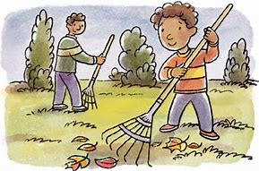
responsible

Slide 136
reversible

Slide 137
Let’s Teach and Practise

Slide 138
Modal verbs
Adverbials

Slide 139
modal verbs express possibility

Slide 140
Adverbials - a word or phrase functioning as a major clause constituent and typically expressing place ( in the garden ),
time ( in May ),
or manner ( in a strange way ).

Slide 141
possibly

Slide 142
perhaps

Slide 143
probably

Slide 144
frequently

Slide 145
possibly
ADVERB
Definition - perhaps (used to indicate doubt or hesitancy)

Slide 146
perhaps
ADVERB
Definition - used to express uncertainty or possibility

Slide 147
probably
ADVERB
Definition - almost certainly; as far as one knows or can tell

Slide 148
frequently
MODAL VERB
Definition - regularly or habitually; often

Slide 149
He found himself alone, possibly the only survivor.
________

Slide 150
Perhaps I should have been honest with him.
_______

Slide 151
She would probably never see him again.
________

Slide 152
They go abroad frequently.
__________

Slide 153
New CHALLENGE words.

Slide 154
controversy
NOUN
Definition - prolonged public disagreement or heated discussion

Slide 155
The design of the building has caused controversy.
___________

Slide 156
convenience
NOUN
Definition - the state of being able to proceed with something without difficulty.

Slide 157
Services run to suit the convenience of customers.
___________

Slide 158
Let’s Practise and Apply.

Slide 159
Can you spot the spelling rule words and the challenge words?

Slide 160
Organic and inorganic materials Builders around the world have found ingenious ways of using readily available materials to build homes. The convenience of having ice and snow around you means that igloos are formed as homes. The way that you could use the available materials will depend on the climate that you live in, and what you may need to shelter from. Materials can trap heat to support warmth, offer shade to protect from the sun or perhaps provide security for your personal possessions. There is now controversy between builders, architects and engineers as they must also think about the impact of the choice of materials on the environment.

Slide 161
Organic and inorganic materials Builders around the world have found ingenious ways of using readily available materials to build homes. The convenience of having ice and snow around you means that igloos are formed as homes. The way that you could use the available materials will depend on the climate that you live in, and what you may need to shelter from. Materials can trap heat to support warmth, offer shade to protect from the sun or perhaps provide security for your personal possessions. There is now controversy between builders, architects and engineers as they must also think about the impact of the choice of materials on the environment.

Slide 162
Write this sentence as I dictate it to you.
Notes:
There is now controversy between builders, architects and engineers as they must also think about the impact of the choice of materials on the environment.

Slide 163
There is now controversy between builders, architects and engineers as they must also think about the impact of the choice of materials on the environment.
Did you write it correctly?
Edit your work and make sure you have it correct.
Can you underline the spelling word that we have covered in this session?

Slide 164
Year 5 - Summer 1
Week 1 - Friday
Notes:
Click through the slides for all the R+R words for the week (both the focus and the challenge words)
Click through the slides for all the new learning this week

Slide 166
Old challenge words…

Slide 167
communicate

Slide 168
competition

Slide 169
Old spelling rule words…

Slide 170
possible

Slide 171
horrible

Slide 172
terrible

Slide 173
visible

Slide 174
incredible

Slide 175
sensible

Slide 176
forcible

Slide 177
legible

Slide 178
responsible

Slide 179
reversible

Slide 180
New spelling rule words…

Slide 181
can

Slide 182
could

Slide 183
may

Slide 184
might

Slide 185
must

Slide 186
shall

Slide 187
should

Slide 188
will

Slide 189
would

Slide 190
ought

Slide 191
certainly

Slide 192
definitely

Slide 193
possibly

Slide 194
perhaps

Slide 195
probably

Slide 196
frequently

Slide 197
New challenge words…

Slide 198
controversy

Slide 199
convenience

Slide 200
Quick Quiz time…
Notes:
Say these words for the quiz
Communicate competition forcible responsible Controversy convenience might should definitely frequently

Slide 201
Did you get them correct?
Edit your work.
communicate competition forcible responsible controversy convenience might should definitely frequently

Slide 202
Word class time…

Slide 203
The design of the building has caused controversy.
Determiner noun preposition determiner noun verb verb noun
Notes:
Ask for these words to be classed

Slide 204
Services run to suit the convenience of customers.
Noun verb verb determiner noun preposition noun
Notes:
Ask for these words to be classed

Slide 205
Etymology
The history of a word….

Slide 206
Controversy
late Middle English: from Latin controversia, from controversus ‘turned against, disputed’, from contro- (variant of contra- ‘against’) + versus, past participle of vertere ‘to turn’.
Convenience
late Middle English: from Latin convenientia, from convenient- ‘assembling, agreeing’, from the verb convenire (see convene).

Slide 209
Let’s investigate….
Create questions and mark schemes for these words.

