Slide 1
Spelling Y5
Mastering spellings: building on the foundations of phonics
Summer 1
Week 2

Slide 2
Year 5 - Summer 1
Week 2 - Monday

Slide 3
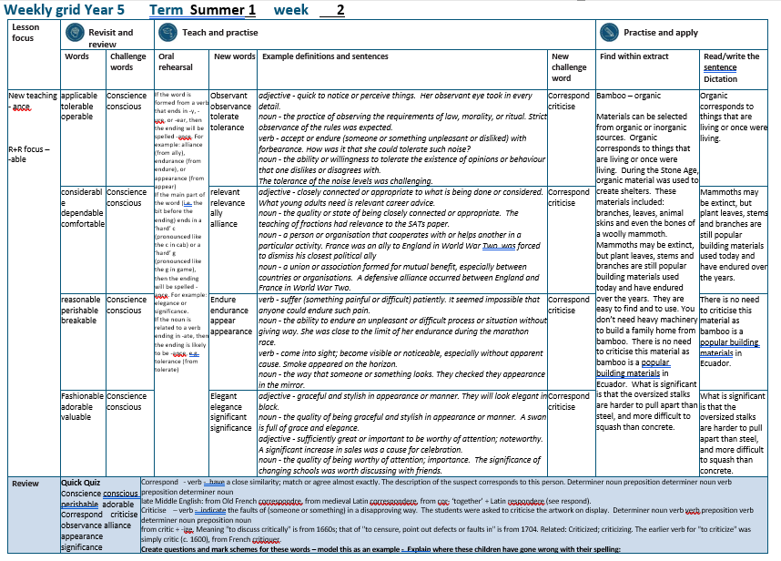

Slide 4
Let’s Revisit and Review…

Slide 5
Do you remember this challenge word?

Slide 6
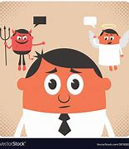
conscience
NOUN
Definition - a person's moral sense of right and wrong, viewed as acting as a guide to one's behaviour

Slide 7
Ben was suffering a pang of conscience.
_________

Slide 8

conscious
ADJECTIVE
Definition - aware of and responding to one's surroundings

Slide 9
Although I was in pain, I was conscious.
_________

Slide 10
words ending
-able
The –able/–ably endings are far more common than the
–ible/–ibly endings.

Slide 11
If the –able ending is added to a word ending in –ce or –ge, the e after the c or g must be kept as those letters would otherwise have their ‘hard’ sounds (as in cap and gap) before the a of the –able ending.

Slide 12
The –able ending is usually but not always used if a complete root word can be heard before it, even if there is no related word ending in –ation.

Slide 13

applicable

Slide 14
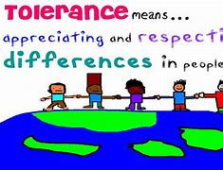
tolerable

Slide 15

operable

Slide 16
Let’s Teach and Practise

Slide 17
words ending
-ance
If the word is formed from a verb that ends in -y, -ure, or -ear, then the ending will be spelled -ance.

Slide 18
For example:
alliance (from ally),
endurance (from endure),
or
appearance (from appear)

Slide 19
If the main part of the word ends in a ‘hard’ c or a ‘hard’ g, then the ending will be spelled -ance.
For example: elegance or significance.

Slide 20
If the noun is related to a verb ending in -ate, then the ending is likely to be -ance, e.g. tolerance (from tolerate)

Slide 21
-ance

Slide 22

observance

Slide 23
tolerance

Slide 24
observance
observant → observance
ADJECTIVE → NOUN
Definition - the practice of observing the requirements of law, morality, or ritual.

Slide 25
tolerance
tolerant → tolerance
ADJECTIVE → NOUN
Definition - the ability or willingness to tolerate the existence of opinions or behaviour that one dislikes or disagrees with.

Slide 26
Strict observance of the rules was expected.
__________

Slide 27
The tolerance of the noise levels was challenging.
__________

Slide 28
New CHALLENGE words.

Slide 29
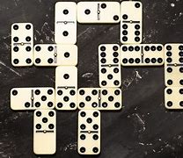
correspond
VERB
Definition - have a close similarity; match or agree almost exactly.

Slide 30
The description of the suspect corresponds to this person.
___________

Slide 31
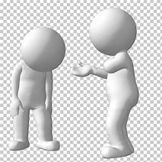
criticise
VERB
Definition - indicate the faults of (someone or something) in a disapproving way

Slide 32
The students were asked to criticise the artwork on display.
_________

Slide 33
Let’s Practise and Apply.

Slide 34
Can you spot the spelling rule words and the challenge words?

Slide 35
Bamboo – organic
Materials can be selected from organic or inorganic sources. Organic corresponds to things that are living or once were living. During the Stone Age, organic material was used to create shelters. These materials included: branches, leaves, animal skins and even the bones of a woolly mammoth. Mammoths may be extinct, but plant leaves, stems and branches are still popular building materials used today and have endured over the years. They are easy to find and to use. You don’t need heavy machinery to build a family home from bamboo. There is no need to criticise this material as bamboo is a popular building materials in Ecuador. What is significant is that the oversized stalks are harder to pull apart than steel, and more difficult to squash than concrete.

Slide 36
Bamboo – organic
Materials can be selected from organic or inorganic sources. Organic corresponds to things that are living or once were living. During the Stone Age, organic material was used to create shelters. These materials included: branches, leaves, animal skins and even the bones of a woolly mammoth. Mammoths may be extinct, but plant leaves, stems and branches are still popular building materials used today and have endured over the years. They are easy to find and to use. You don’t need heavy machinery to build a family home from bamboo. There is no need to criticise this material as bamboo is a popular building materials in Ecuador. What is significant is that the oversized stalks are harder to pull apart than steel, and more difficult to squash than concrete.

Slide 37
Write this sentence as I dictate it to you.
Notes:
Organic corresponds to things that are living or once were living.

Slide 38
Organic corresponds to things that are living or once were living.
Did you write it correctly?
Edit your work and make sure you have it correct.
Can you underline the spelling word that we have covered in this session?

Slide 39
Year 5 - Summer 1
Week 2 - Tuesday
Notes:
Revisit and review the words from previous teaching and challenge words – I say, we say, you say
Ask children to write words only in their spelling book
Introduce the new spelling rule
Children to write the new spelling rule words and challenge words into books when the sentences are shown with the spelling word missing.
Read the extract with the class as choral reading. Practise model of prosody etc.
Ask children to find the spelling words from the session in the text.
Then read allowed the chosen sentence for children to write fully in their books.
Show the extract and ask children to then edit their work to check they were correct in their dictation.

Slide 41
Let’s Revisit and Review…

Slide 42
Do you remember this challenge word?

Slide 43
conscience
NOUN
Definition - a person's moral sense of right and wrong, viewed as acting as a guide to one's behaviour

Slide 44
Ben was suffering a pang of conscience.
_________

Slide 45
conscious
ADJECTIVE
Definition - aware of and responding to one's surroundings

Slide 46
Although I was in pain, I was conscious.
_________

Slide 47
words ending
-able
The –able/–ably endings are far more common than the
–ible/–ibly endings.

Slide 48
If the –able ending is added to a word ending in –ce or –ge, the e after the c or g must be kept as those letters would otherwise have their ‘hard’ sounds (as in cap and gap) before the a of the –able ending.

Slide 49
The –able ending is usually but not always used if a complete root word can be heard before it, even if there is no related word ending in –ation.

Slide 50

considerable

Slide 51
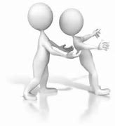
dependable

Slide 52
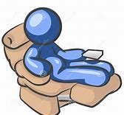
comfortable

Slide 53
Let’s Teach and Practise

Slide 54
words ending
-ance
If the word is formed from a verb that ends in -y, -ure, or -ear, then the ending will be spelled -ance.

Slide 55
For example:
alliance (from ally),
endurance (from endure),
or
appearance (from appear)

Slide 56
If the main part of the word ends in a ‘hard’ c or a ‘hard’ g, then the ending will be spelled -ance.
For example: elegance or significance.

Slide 57
If the noun is related to a verb ending in -ate, then the ending is likely to be -ance, e.g. tolerance (from tolerate)

Slide 58
-ance

Slide 59

relevance

Slide 60

alliance

Slide 61
relevance
relevant → relevance
ADJECTIVE → NOUN
Definition - the quality or state of being closely connected or appropriate

Slide 62
alliance
ally → alliance
NOUN → NOUN
Definition - a union or association formed for mutual benefit, especially between countries or organisations

Slide 63
The teaching of fractions had relevance to the SATs paper.
_________

Slide 64
A defensive alliance occurred between England and France in World War Two.
________

Slide 65
New CHALLENGE words.

Slide 66
correspond
VERB
Definition - have a close similarity; match or agree almost exactly.

Slide 67
The description of the suspect corresponds to this person.
___________

Slide 68
criticise
VERB
Definition - indicate the faults of (someone or something) in a disapproving way

Slide 69
The students were asked to criticise the artwork on display.
_________

Slide 70
Let’s Practise and Apply.

Slide 71
Can you spot the spelling rule words and the challenge words?

Slide 72
Bamboo – organic
Materials can be selected from organic or inorganic sources. Organic corresponds to things that are living or once were living. During the Stone Age, organic material was used to create shelters. These materials included: branches, leaves, animal skins and even the bones of a woolly mammoth. Mammoths may be extinct, but plant leaves, stems and branches are still popular building materials used today and have endured over the years. They are easy to find and to use. You don’t need heavy machinery to build a family home from bamboo. There is no need to criticise this material as bamboo is a popular building materials in Ecuador. What is significant is that the oversized stalks are harder to pull apart than steel, and more difficult to squash than concrete.

Slide 73
Bamboo – organic
Materials can be selected from organic or inorganic sources. Organic corresponds to things that are living or once were living. During the Stone Age, organic material was used to create shelters. These materials included: branches, leaves, animal skins and even the bones of a woolly mammoth. Mammoths may be extinct, but plant leaves, stems and branches are still popular building materials used today and have endured over the years. They are easy to find and to use. You don’t need heavy machinery to build a family home from bamboo. There is no need to criticise this material as bamboo is a popular building materials in Ecuador. What is significant is that the oversized stalks are harder to pull apart than steel, and more difficult to squash than concrete.

Slide 74
Write this sentence as I dictate it to you.
Notes:
Mammoths may be extinct, but plant leaves, stems and branches are still popular building materials used today and have endured over the years.

Slide 75
Mammoths may be extinct, but plant leaves, stems and branches are still popular building materials used today and have endured over the years.
Did you write it correctly?
Edit your work and make sure you have it correct.
Can you underline the spelling word that we have covered in this session?

Slide 76
Year 5 - Summer 1
Week 2 - Wednesday
Notes:
Revisit and review the words from previous teaching and challenge words – I say, we say, you say
Ask children to write words only in their spelling book
Introduce the new spelling rule
Children to write the new spelling rule words and challenge words into books when the sentences are shown with the spelling word missing.
Read the extract with the class as choral reading. Practise model of prosody etc.
Ask children to find the spelling words from the session in the text.
Then read allowed the chosen sentence for children to write fully in their books.
Show the extract and ask children to then edit their work to check they were correct in their dictation.

Slide 78
Let’s Revisit and Review…

Slide 79
Do you remember this challenge word?

Slide 80
conscience
NOUN
Definition - a person's moral sense of right and wrong, viewed as acting as a guide to one's behaviour

Slide 81
Ben was suffering a pang of conscience.
_________

Slide 82
conscious
ADJECTIVE
Definition - aware of and responding to one's surroundings

Slide 83
Although I was in pain, I was conscious.
_________

Slide 84
words ending
-able
The –able/–ably endings are far more common than the
–ible/–ibly endings.

Slide 85
If the –able ending is added to a word ending in –ce or –ge, the e after the c or g must be kept as those letters would otherwise have their ‘hard’ sounds (as in cap and gap) before the a of the –able ending.

Slide 86
The –able ending is usually but not always used if a complete root word can be heard before it, even if there is no related word ending in –ation.

Slide 87
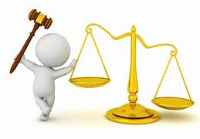
reasonable

Slide 88
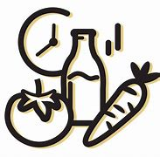
perishable

Slide 89
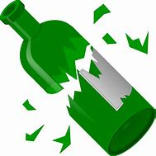
breakable

Slide 90
Let’s Teach and Practise

Slide 91
words ending
-ance
If the word is formed from a verb that ends in -y, -ure, or -ear, then the ending will be spelled -ance.

Slide 92
For example:
alliance (from ally),
endurance (from endure),
or
appearance (from appear)

Slide 93
If the main part of the word ends in a ‘hard’ c or a ‘hard’ g, then the ending will be spelled -ance.
For example: elegance or significance.

Slide 94
If the noun is related to a verb ending in -ate, then the ending is likely to be -ance, e.g. tolerance (from tolerate)

Slide 95
-ance

Slide 96
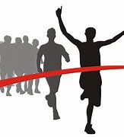
endurance

Slide 97
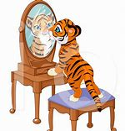
appearance

Slide 98
endurance
endure → endurance
VERB → NOUN
Definition - the ability to endure an unpleasant or difficult process or situation without giving way

Slide 99
appearance
appear → appearance
VERB → NOUN
Definition - the way that someone or something looks

Slide 100
She was close to the limit of her endurance during the marathon race.
_________

Slide 101
They checked they appearance in the mirror.
__________

Slide 102
New CHALLENGE words.

Slide 103
correspond
VERB
Definition - have a close similarity; match or agree almost exactly.

Slide 104
The description of the suspect corresponds to this person.
___________

Slide 105
criticise
VERB
Definition - indicate the faults of (someone or something) in a disapproving way

Slide 106
The students were asked to criticise the artwork on display.
_________

Slide 107
Let’s Practise and Apply.

Slide 108
Can you spot the spelling rule words and the challenge words?

Slide 109
Bamboo – organic
Materials can be selected from organic or inorganic sources. Organic corresponds to things that are living or once were living. During the Stone Age, organic material was used to create shelters. These materials included: branches, leaves, animal skins and even the bones of a woolly mammoth. Mammoths may be extinct, but plant leaves, stems and branches are still popular building materials used today and have endured over the years. They are easy to find and to use. You don’t need heavy machinery to build a family home from bamboo. There is no need to criticise this material as bamboo is a popular building materials in Ecuador. What is significant is that the oversized stalks are harder to pull apart than steel, and more difficult to squash than concrete.

Slide 110
Bamboo – organic
Materials can be selected from organic or inorganic sources. Organic corresponds to things that are living or once were living. During the Stone Age, organic material was used to create shelters. These materials included: branches, leaves, animal skins and even the bones of a woolly mammoth. Mammoths may be extinct, but plant leaves, stems and branches are still popular building materials used today and have endured over the years. They are easy to find and to use. You don’t need heavy machinery to build a family home from bamboo. There is no need to criticise this material as bamboo is a popular building materials in Ecuador. What is significant is that the oversized stalks are harder to pull apart than steel, and more difficult to squash than concrete.

Slide 111
Write this sentence as I dictate it to you.
Notes:
There is no need to criticise this material as bamboo is a popular building materials in Ecuador.

Slide 112
There is no need to criticise this material as bamboo is a popular building materials in Ecuador.
Did you write it correctly?
Edit your work and make sure you have it correct.
Can you underline the spelling word that we have covered in this session?

Slide 113
Year 5 - Summer 1
Week 2 - Thursday
Notes:
Revisit and review the words from previous teaching and challenge words – I say, we say, you say
Ask children to write words only in their spelling book
Introduce the new spelling rule
Children to write the new spelling rule words and challenge words into books when the sentences are shown with the spelling word missing.
Read the extract with the class as choral reading. Practise model of prosody etc.
Ask children to find the spelling words from the session in the text.
Then read allowed the chosen sentence for children to write fully in their books.
Show the extract and ask children to then edit their work to check they were correct in their dictation.

Slide 115
Let’s Revisit and Review…

Slide 116
Do you remember this challenge word?

Slide 117
conscience
NOUN
Definition - a person's moral sense of right and wrong, viewed as acting as a guide to one's behaviour

Slide 118
Ben was suffering a pang of conscience.
_________

Slide 119
conscious
ADJECTIVE
Definition - aware of and responding to one's surroundings

Slide 120
Although I was in pain, I was conscious.
_________

Slide 121
words ending
-able
The –able/–ably endings are far more common than the
–ible/–ibly endings.

Slide 122
If the –able ending is added to a word ending in –ce or –ge, the e after the c or g must be kept as those letters would otherwise have their ‘hard’ sounds (as in cap and gap) before the a of the –able ending.

Slide 123
The –able ending is usually but not always used if a complete root word can be heard before it, even if there is no related word ending in –ation.

Slide 124

fashionable

Slide 125

adorable

Slide 126
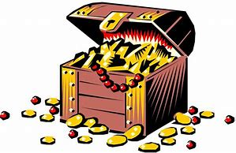
valuable

Slide 127
Let’s Teach and Practise

Slide 128
words ending
-ance
If the word is formed from a verb that ends in -y, -ure, or -ear, then the ending will be spelled -ance.

Slide 129
For example:
alliance (from ally),
endurance (from endure),
or
appearance (from appear)

Slide 130
If the main part of the word ends in a ‘hard’ c or a ‘hard’ g, then the ending will be spelled -ance.
For example: elegance or significance.

Slide 131
If the noun is related to a verb ending in -ate, then the ending is likely to be -ance, e.g. tolerance (from tolerate)

Slide 132
-ance

Slide 133

elegance

Slide 134
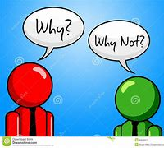
significance

Slide 135
elegance
elegant → elegance
ADJECTIVE → NOUN
Definition - the quality of being graceful and stylish in appearance or manner

Slide 136
significance
significant → significance
ADJECTIVE → NOUN
Definition - the quality of being worthy of attention; importance

Slide 137
A swan is full of grace and elegance.
________

Slide 138
The significance of changing schools was worth discussing with friends.
____________

Slide 139
New CHALLENGE words.

Slide 140
correspond
VERB
Definition - have a close similarity; match or agree almost exactly.

Slide 141
The description of the suspect corresponds to this person.
___________

Slide 142
criticise
VERB
Definition - indicate the faults of (someone or something) in a disapproving way

Slide 143
The students were asked to criticise the artwork on display.
_________

Slide 144
Let’s Practise and Apply.

Slide 145
Can you spot the spelling rule words and the challenge words?

Slide 146
Bamboo – organic
Materials can be selected from organic or inorganic sources. Organic corresponds to things that are living or once were living. During the Stone Age, organic material was used to create shelters. These materials included: branches, leaves, animal skins and even the bones of a woolly mammoth. Mammoths may be extinct, but plant leaves, stems and branches are still popular building materials used today and have endured over the years. They are easy to find and to use. You don’t need heavy machinery to build a family home from bamboo. There is no need to criticise this material as bamboo is a popular building materials in Ecuador. What is significant is that the oversized stalks are harder to pull apart than steel, and more difficult to squash than concrete.

Slide 147
Bamboo – organic
Materials can be selected from organic or inorganic sources. Organic corresponds to things that are living or once were living. During the Stone Age, organic material was used to create shelters. These materials included: branches, leaves, animal skins and even the bones of a woolly mammoth. Mammoths may be extinct, but plant leaves, stems and branches are still popular building materials used today and have endured over the years. They are easy to find and to use. You don’t need heavy machinery to build a family home from bamboo. There is no need to criticise this material as bamboo is a popular building materials in Ecuador. What is significant is that the oversized stalks are harder to pull apart than steel, and more difficult to squash than concrete.

Slide 148
Write this sentence as I dictate it to you.
Notes:
What is significant is that the oversized stalks are harder to pull apart than steel, and more difficult to squash than concrete.

Slide 149
What is significant is that the oversized stalks are harder to pull apart than steel, and more difficult to squash than concrete.
Did you write it correctly?
Edit your work and make sure you have it correct.
Can you underline the spelling word that we have covered in this session?

Slide 150
Year 5 - Summer 1
Week 2 - Friday
Notes:
Click through the slides for all the R+R words for the week (both the focus and the challenge words)
Click through the slides for all the new learning this week

Slide 152
Old challenge words…

Slide 153
conscience

Slide 154
conscious

Slide 155
Old spelling rule words…

Slide 156
applicable

Slide 157
tolerable

Slide 158
operable

Slide 159
considerable

Slide 160
dependable

Slide 161
comfortable

Slide 162
reasonable

Slide 163
perishable

Slide 164
breakable

Slide 165
fashionable

Slide 166
adorable

Slide 167
valuable

Slide 168
New spelling rule words…

Slide 169
observance

Slide 170
tolerance

Slide 171
relevance

Slide 172
alliance

Slide 173
endurance

Slide 174
appearance

Slide 175
elegance

Slide 176
significance

Slide 177
New challenge words…

Slide 178
correspond

Slide 179
criticise

Slide 180
Quick Quiz time…
Notes:
Say these words for the quiz
Conscience conscious perishable adorable Correspond criticise observance alliance appearance significance

Slide 181
Did you get them correct?
Edit your work.
conscience conscious perishable adorable correspond criticise observance alliance appearance significance

Slide 182
Word class time…

Slide 183
The description of the suspect corresponds to this person.
Determiner noun preposition determiner noun verb preposition determiner noun
Notes:
Ask for these words to be classed

Slide 184
The students were asked to criticise the artwork on display.
Determiner noun verb verb preposition verb determiner noun preposition noun
Notes:
Ask for these words to be classed

Slide 185
Etymology
The history of a word….

Slide 186
Criticise
from critic + -ize. Meaning "to discuss critically" is from 1660s; that of "to censure, point out defects or faults in" is from 1704. Related: Criticized; criticizing. The earlier verb for "to criticize" was simply critic (c. 1600), from French critiquer.
Correspond
late Middle English: from Old French correspondre, from medieval Latin correspondere, from cor- ‘together’ + Latin respondere (see respond).

Slide 187
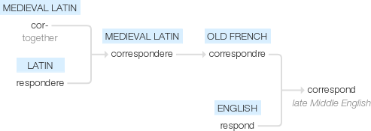

Slide 188
Let’s investigate….
Find antonyms and synonyms of the challenge words.

