Slide 1
Spelling Y5
Mastering spellings: building on the foundations of phonics
Summer 1
Week 4

Slide 2
Year 5 - Summer 1
Week 4 - Monday

Slide 3
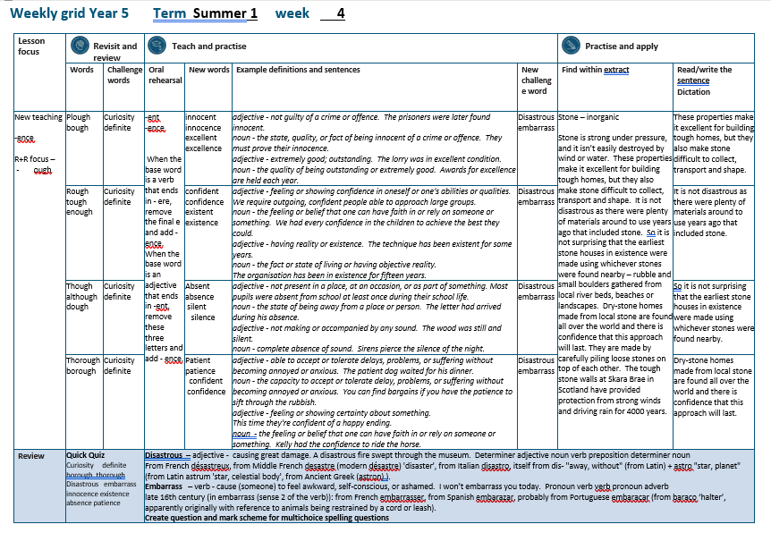

Slide 4
Let’s Revisit and Review…

Slide 5
Do you remember this challenge word?

Slide 6

curiosity
NOUN
Definition - a strong desire to know or learn

Slide 7
Filled with curiosity, she peered through the window.
_________

Slide 8

definite
ADJECTIVE
Definition - clearly stated or decided; not vague or doubtful

Slide 9
We had no definite plans.
________

Slide 10
words ending
-ough

Slide 11
-ough
ough is one of the trickiest spellings in English – it can be used to spell a
number of different sounds

Slide 12
(pl) -ough
(r) -ough
(th) -ough
Notes:
Plough
Rough
Though

Slide 13
pronounce -ough with an "ow" sound, like in the word "now."

Slide 14
pronounce -ough with an "uff" sound, like in the word "stuff."

Slide 15
pronounce -ough with an "oh" sound, like in the word "go."

Slide 16
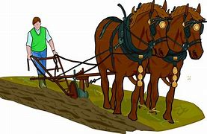
plough

Slide 17
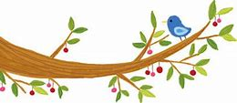
bough

Slide 18
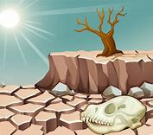
drought

Slide 19
Let’s Teach and Practise

Slide 20
words ending
-ent
-ence

Slide 21
-ent and -ence
When the base word is a verb that ends in - ere, remove the final e and add - ence. When the base word is an adjective that ends in -ent, remove these three letters and add - ence.

Slide 22
-ent → -ence

Slide 23

innocence

Slide 24

excellence

Slide 25
innocence
innocent → innocence
ADJECTIVE → NOUN
Definition - the state, quality, or fact of being innocent of a crime or offence

Slide 26
excellence
excellent → excellence
ADJECTIVE → NOUN
Definition - the state, quality, or fact of being innocent of a crime or offence

Slide 27
They must prove their innocence.
_________

Slide 28
Awards for excellence are held each year.
__________

Slide 29
New CHALLENGE words.

Slide 30
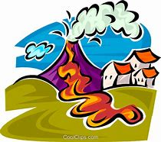
disastrous
ADJECTIVE
Definition - causing great damage

Slide 31
A disastrous fire swept through the museum.
_________

Slide 32

embarrass
VERB
Definition - cause (someone) to feel awkward, self-conscious, or ashamed

Slide 33
I won’t embarrass you today.
_________

Slide 34
Let’s Practise and Apply.

Slide 35
Can you spot the spelling rule words and the challenge words?

Slide 36
Stone – inorganic
Stone is strong under pressure, and it isn’t easily destroyed by wind or water. These properties make it excellent for building tough homes, but they also make stone difficult to collect, transport and shape. It is not disastrous as there were plenty of materials around to use years ago that included stone. So it is not surprising that the earliest stone houses in existence were made using whichever stones were found nearby – rubble and small boulders gathered from local river beds, beaches or landscapes. Dry-stone homes made from local stone are found all over the world and there is confidence that this approach will last. They are made by carefully piling loose stones on top of each other. The tough stone walls at Skara Brae in Scotland have provided protection from strong winds and driving rain for 4000 years.

Slide 37
Stone – inorganic
Stone is strong under pressure, and it isn’t easily destroyed by wind or water. These properties make it excellent for building tough homes, but they also make stone difficult to collect, transport and shape. It is not disastrous as there were plenty of materials around to use years ago that included stone. So it is not surprising that the earliest stone houses in existence were made using whichever stones were found nearby – rubble and small boulders gathered from local river beds, beaches or landscapes. Dry-stone homes made from local stone are found all over the world and there is confidence that this approach will last. They are made by carefully piling loose stones on top of each other. The tough stone walls at Skara Brae in Scotland have provided protection from strong winds and driving rain for 4000 years.

Slide 38
Write this sentence as I dictate it to you.
Notes:
These properties make it excellent for building tough homes, but they also make stone difficult to collect, transport and shape.

Slide 39
These properties make it excellent for building tough homes, but they also make stone difficult to collect, transport and shape.
Did you write it correctly?
Edit your work and make sure you have it correct.
Can you underline the spelling word that we have covered in this session?

Slide 40
Year 5 - Summer 1
Week 4 - Tuesday
Notes:
Revisit and review the words from previous teaching and challenge words – I say, we say, you say
Ask children to write words only in their spelling book
Introduce the new spelling rule
Children to write the new spelling rule words and challenge words into books when the sentences are shown with the spelling word missing.
Read the extract with the class as choral reading. Practise model of prosody etc.
Ask children to find the spelling words from the session in the text.
Then read allowed the chosen sentence for children to write fully in their books.
Show the extract and ask children to then edit their work to check they were correct in their dictation.

Slide 42
Let’s Revisit and Review…

Slide 43
Do you remember this challenge word?

Slide 44
curiosity
NOUN
Definition - a strong desire to know or learn

Slide 45
Filled with curiosity, she peered through the window.
_________

Slide 46
definite
ADJECTIVE
Definition - clearly stated or decided; not vague or doubtful

Slide 47
We had no definite plans.
________

Slide 48
words ending
-ough

Slide 49
-ough
ough is one of the trickiest spellings in English – it can be used to spell a
number of different sounds

Slide 50
(pl) -ough
(r) -ough
(th) -ough
Notes:
Plough
Rough
Though

Slide 51
pronounce -ough with an "ow" sound, like in the word "now."

Slide 52
pronounce -ough with an "uff" sound, like in the word "stuff."

Slide 53
pronounce -ough with an "oh" sound, like in the word "go."

Slide 54
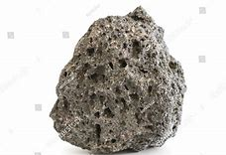
rough

Slide 55

tough

Slide 56
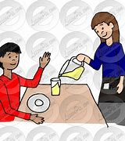
enough

Slide 57
Let’s Teach and Practise

Slide 58
words ending
-ent
-ence

Slide 59
-ent and -ence
When the base word is a verb that ends in - ere, remove the final e and add - ence. When the base word is an adjective that ends in -ent, remove these three letters and add - ence.

Slide 60
-ent → -ence

Slide 61

confidence

Slide 62
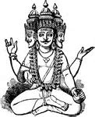
existence

Slide 63
confidence
confident → confidence
ADJECTIVE → NOUN
Definition - the feeling or belief that one can have faith in or rely on someone or something

Slide 64
existence
existent → existence
ADJECTIVE → NOUN
Definition - the fact or state of living or having objective reality

Slide 65
We had every confidence in the children to achieve the best they could.
__________

Slide 66
The organisation has been in existence for fifteen years.
_________

Slide 67
New CHALLENGE words.

Slide 68
disastrous
ADJECTIVE
Definition - causing great damage

Slide 69
A disastrous fire swept through the museum.
_________

Slide 70
embarrass
VERB
Definition - cause (someone) to feel awkward, self-conscious, or ashamed

Slide 71
I won’t embarrass you today.
_________

Slide 72
Let’s Practise and Apply.

Slide 73
Can you spot the spelling rule words and the challenge words?

Slide 74
Stone – inorganic
Stone is strong under pressure, and it isn’t easily destroyed by wind or water. These properties make it excellent for building tough homes, but they also make stone difficult to collect, transport and shape. It is not disastrous as there were plenty of materials around to use years ago that included stone. So it is not surprising that the earliest stone houses in existence were made using whichever stones were found nearby – rubble and small boulders gathered from local river beds, beaches or landscapes. Dry-stone homes made from local stone are found all over the world and there is confidence that this approach will last. They are made by carefully piling loose stones on top of each other. The tough stone walls at Skara Brae in Scotland have provided protection from strong winds and driving rain for 4000 years.

Slide 75
Stone – inorganic
Stone is strong under pressure, and it isn’t easily destroyed by wind or water. These properties make it excellent for building tough homes, but they also make stone difficult to collect, transport and shape. It is not disastrous as there were plenty of materials around to use years ago that included stone. So it is not surprising that the earliest stone houses in existence were made using whichever stones were found nearby – rubble and small boulders gathered from local river beds, beaches or landscapes. Dry-stone homes made from local stone are found all over the world and there is confidence that this approach will last. They are made by carefully piling loose stones on top of each other. The tough stone walls at Skara Brae in Scotland have provided protection from strong winds and driving rain for 4000 years.

Slide 76
Write this sentence as I dictate it to you.
Notes:
It is not disastrous as there were plenty of materials around to use years ago that included stone.

Slide 77
It is not disastrous as there were plenty of materials around to use years ago that included stone.
Did you write it correctly?
Edit your work and make sure you have it correct.
Can you underline the spelling word that we have covered in this session?

Slide 78
Year 5 - Summer 1
Week 4 - Wednesday
Notes:
Revisit and review the words from previous teaching and challenge words – I say, we say, you say
Ask children to write words only in their spelling book
Introduce the new spelling rule
Children to write the new spelling rule words and challenge words into books when the sentences are shown with the spelling word missing.
Read the extract with the class as choral reading. Practise model of prosody etc.
Ask children to find the spelling words from the session in the text.
Then read allowed the chosen sentence for children to write fully in their books.
Show the extract and ask children to then edit their work to check they were correct in their dictation.

Slide 80
Let’s Revisit and Review…

Slide 81
Do you remember this challenge word?

Slide 82
curiosity
NOUN
Definition - a strong desire to know or learn

Slide 83
Filled with curiosity, she peered through the window.
_________

Slide 84
definite
ADJECTIVE
Definition - clearly stated or decided; not vague or doubtful

Slide 85
We had no definite plans.
________

Slide 86
words ending
-ough

Slide 87
-ough
ough is one of the trickiest spellings in English – it can be used to spell a
number of different sounds

Slide 88
(pl) -ough
(r) -ough
(th) -ough
Notes:
Plough
Rough
Though

Slide 89
pronounce -ough with an "ow" sound, like in the word "now."

Slide 90
pronounce -ough with an "uff" sound, like in the word "stuff."

Slide 91
pronounce -ough with an "oh" sound, like in the word "go."

Slide 92

though

Slide 93
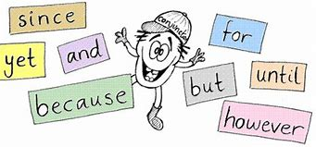
although

Slide 94
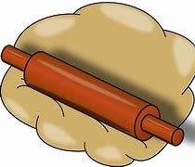
dough

Slide 95
Let’s Teach and Practise

Slide 96
words ending
-ent
-ence

Slide 97
-ent and -ence
When the base word is a verb that ends in - ere, remove the final e and add - ence. When the base word is an adjective that ends in -ent, remove these three letters and add - ence.

Slide 98
-ent → -ence

Slide 99
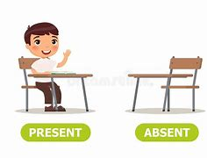
absence

Slide 100

silence

Slide 101
absence
absent → absence
ADJECTIVE → NOUN
Definition - the state of being away from a place or person

Slide 102
silence
silent → silence
ADJECTIVE → NOUN
Definition - complete absence of sound

Slide 103
The letter had arrived during his absence.
_______

Slide 104
Sirens pierce the silence of the night.
_______

Slide 105
New CHALLENGE words.

Slide 106
disastrous
ADJECTIVE
Definition - causing great damage

Slide 107
A disastrous fire swept through the museum.
_________

Slide 108
embarrass
VERB
Definition - cause (someone) to feel awkward, self-conscious, or ashamed

Slide 109
I won’t embarrass you today.
_________

Slide 110
Let’s Practise and Apply.

Slide 111
Can you spot the spelling rule words and the challenge words?

Slide 112
Stone – inorganic
Stone is strong under pressure, and it isn’t easily destroyed by wind or water. These properties make it excellent for building tough homes, but they also make stone difficult to collect, transport and shape. It is not disastrous as there were plenty of materials around to use years ago that included stone. So it is not surprising that the earliest stone houses in existence were made using whichever stones were found nearby – rubble and small boulders gathered from local river beds, beaches or landscapes. Dry-stone homes made from local stone are found all over the world and there is confidence that this approach will last. They are made by carefully piling loose stones on top of each other. The tough stone walls at Skara Brae in Scotland have provided protection from strong winds and driving rain for 4000 years.

Slide 113
Stone – inorganic
Stone is strong under pressure, and it isn’t easily destroyed by wind or water. These properties make it excellent for building tough homes, but they also make stone difficult to collect, transport and shape. It is not disastrous as there were plenty of materials around to use years ago that included stone. So it is not surprising that the earliest stone houses in existence were made using whichever stones were found nearby – rubble and small boulders gathered from local river beds, beaches or landscapes. Dry-stone homes made from local stone are found all over the world and there is confidence that this approach will last. They are made by carefully piling loose stones on top of each other. The tough stone walls at Skara Brae in Scotland have provided protection from strong winds and driving rain for 4000 years.

Slide 114
Write this sentence as I dictate it to you.
Notes:
So it is not surprising that the earliest stone houses in existence were made using whichever stones were found nearby.

Slide 115
So it is not surprising that the earliest stone houses in existence were made using whichever stones were found nearby.
Did you write it correctly?
Edit your work and make sure you have it correct.
Can you underline the spelling word that we have covered in this session?

Slide 116
Year 5 - Summer 1
Week 4 - Thursday
Notes:
Revisit and review the words from previous teaching and challenge words – I say, we say, you say
Ask children to write words only in their spelling book
Introduce the new spelling rule
Children to write the new spelling rule words and challenge words into books when the sentences are shown with the spelling word missing.
Read the extract with the class as choral reading. Practise model of prosody etc.
Ask children to find the spelling words from the session in the text.
Then read allowed the chosen sentence for children to write fully in their books.
Show the extract and ask children to then edit their work to check they were correct in their dictation.

Slide 118
Let’s Revisit and Review…

Slide 119
Do you remember this challenge word?

Slide 120
curiosity
NOUN
Definition - a strong desire to know or learn

Slide 121
Filled with curiosity, she peered through the window.
_________

Slide 122
definite
ADJECTIVE
Definition - clearly stated or decided; not vague or doubtful

Slide 123
We had no definite plans.
________

Slide 124
words ending
-ough

Slide 125
-ough
ough is one of the trickiest spellings in English – it can be used to spell a
number of different sounds

Slide 126
(pl) -ough
(r) -ough
(th) -ough
Notes:
Plough
Rough
Though

Slide 127
pronounce -ough with an "ow" sound, like in the word "now."

Slide 128
pronounce -ough with an "uff" sound, like in the word "stuff."

Slide 129
pronounce -ough with an "oh" sound, like in the word "go."

Slide 130
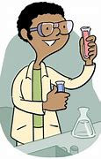
thorough

Slide 131
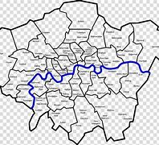
borough

Slide 132
Let’s Teach and Practise

Slide 133
words ending
-ent
-ence

Slide 134
-ent and -ence
When the base word is a verb that ends in - ere, remove the final e and add - ence. When the base word is an adjective that ends in -ent, remove these three letters and add - ence.

Slide 135
-ent → -ence

Slide 136
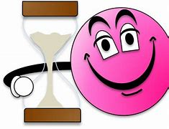
patience

Slide 137
patience
patient → patience
ADJECTIVE → NOUN
Definition - the capacity to accept or tolerate delay, problems, or suffering without becoming annoyed or anxious

Slide 138
You can find bargains if you have the patience to sift through the rubbish.
________

Slide 139
New CHALLENGE words.

Slide 140
disastrous
ADJECTIVE
Definition - causing great damage

Slide 141
A disastrous fire swept through the museum.
_________

Slide 142
embarrass
VERB
Definition - cause (someone) to feel awkward, self-conscious, or ashamed

Slide 143
I won’t embarrass you today.
_________

Slide 144
Let’s Practise and Apply.

Slide 145
Can you spot the spelling rule words and the challenge words?

Slide 146
Stone – inorganic
Stone is strong under pressure, and it isn’t easily destroyed by wind or water. These properties make it excellent for building tough homes, but they also make stone difficult to collect, transport and shape. It is not disastrous as there were plenty of materials around to use years ago that included stone. So it is not surprising that the earliest stone houses in existence were made using whichever stones were found nearby – rubble and small boulders gathered from local river beds, beaches or landscapes. Dry-stone homes made from local stone are found all over the world and there is confidence that this approach will last. They are made by carefully piling loose stones on top of each other. The tough stone walls at Skara Brae in Scotland have provided protection from strong winds and driving rain for 4000 years.

Slide 147
Stone – inorganic
Stone is strong under pressure, and it isn’t easily destroyed by wind or water. These properties make it excellent for building tough homes, but they also make stone difficult to collect, transport and shape. It is not disastrous as there were plenty of materials around to use years ago that included stone. So it is not surprising that the earliest stone houses in existence were made using whichever stones were found nearby – rubble and small boulders gathered from local river beds, beaches or landscapes. Dry-stone homes made from local stone are found all over the world and there is confidence that this approach will last. They are made by carefully piling loose stones on top of each other. The tough stone walls at Skara Brae in Scotland have provided protection from strong winds and driving rain for 4000 years.

Slide 148
Write this sentence as I dictate it to you.
Notes:
Dry-stone homes made from local stone are found all over the world and there is confidence that this approach will last.

Slide 149
Dry-stone homes made from local stone are found all over the world and there is confidence that this approach will last.
Did you write it correctly?
Edit your work and make sure you have it correct.
Can you underline the spelling word that we have covered in this session?

Slide 150
Year 5 - Summer 1
Week 4 - Friday
Notes:
Click through the slides for all the R+R words for the week (both the focus and the challenge words)
Click through the slides for all the new learning this week

Slide 152
Old challenge words…

Slide 153
curiosity

Slide 154
definite

Slide 155
Old spelling rule words…

Slide 156
plough

Slide 157
bough

Slide 158
drought

Slide 159
rough

Slide 160
tough

Slide 161
enough

Slide 162
though

Slide 163
although

Slide 164
dough

Slide 165
thorough

Slide 166
borough

Slide 167
New spelling rule words…

Slide 168
innocence

Slide 169
excellence

Slide 170
confidence

Slide 171
existence

Slide 172
absence

Slide 173
silence

Slide 174
patience

Slide 175
confidence

Slide 176
New challenge words…

Slide 177
disastrous

Slide 178
embarrass

Slide 179
Quick Quiz time…
Notes:
Say these words for the quiz
Curiosity definite borough thorough Disastrous embarrass innocence existence absence patience

Slide 180
Did you get them correct?
Edit your work.
curiosity definite borough thorough disastrous embarrass innocence existence absence patience

Slide 181
Word class time…

Slide 182
A disastrous fire swept through the museum.
Determiner adjective noun verb preposition determiner noun
Notes:
Ask for these words to be classed

Slide 183
I won’t embarrass you today.
Pronoun verb verb pronoun adverb
Notes:
Ask for these words to be classed

Slide 184
Etymology
The history of a word….

Slide 185
Disastrous
From French désastreux, from Middle French desastre (modern désastre) 'disaster', from Italian disastro, itself from dis- "away, without" (from Latin) + astro "star, planet" (from Latin astrum 'star, celestial body', from Ancient Greek (astron) ).
Embarrass
late 16th century (in embarrass (sense 2 of the verb)): from French embarrasser, from Spanish embarazar, probably from Portuguese embaraçar (from baraço ‘halter’, apparently originally with reference to animals being restrained by a cord or leash).

Slide 186
Let’s investigate….
Create question and mark scheme for multichoice spelling questions.

