Slide 1
Spelling Y5
Mastering spellings: building on the foundations of phonics
Summer 1
Week 5

Slide 2
Year 5 - Summer 1
Week 5 - Monday

Slide 3
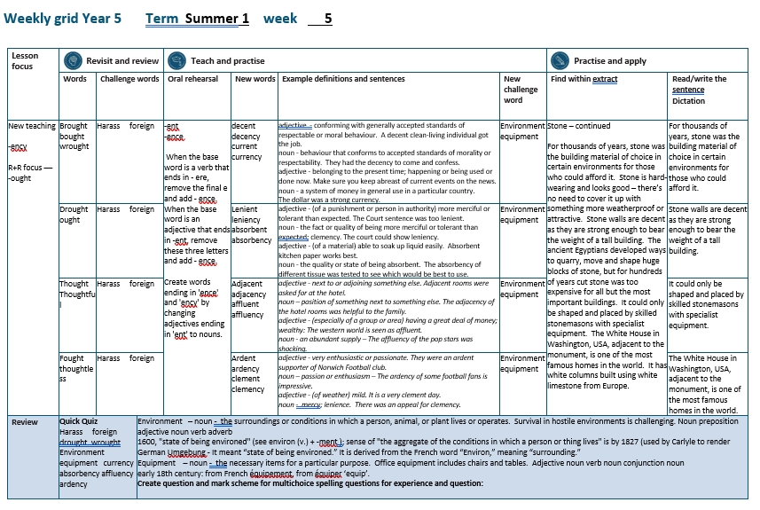

Slide 4
Let’s Revisit and Review…

Slide 5
Do you remember this challenge word?

Slide 6
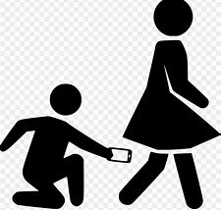
harass
VERB
Definition - subject to aggressive pressure or intimidation

Slide 7
People should not harass each other.
______

Slide 8

foreign
ADJECTIVE
Definition - of, from, in, or characteristic of a country or language other than one's own

Slide 9
The foreign currency of Europe is Euros.
_______

Slide 10
words ending
-ought

Slide 11
-ought

Slide 12
-ought
- ought is pronounced with an "aw" sound, like in the word "law."

Slide 13
(b) -ought
Notes:
Plough
Rough
Though

Slide 14
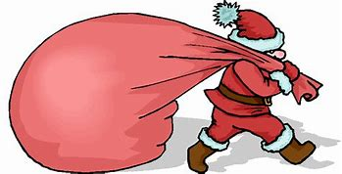
brought

Slide 15
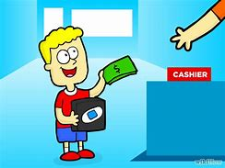
bought

Slide 16
Let’s Teach and Practise

Slide 17
words ending
-ent
-ency

Slide 18
When the base word is a verb that ends in - ere, remove the final e and add - ence. When the base word is an adjective that ends in -ent, remove these three letters and add - ence.

Slide 19
Create words ending in 'ence' and 'ency' by changing adjectives ending in 'ent' to nouns.

Slide 20
-ency
Notes:
Plough
Rough
Though

Slide 21
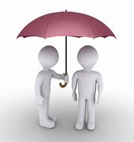
decency

Slide 22
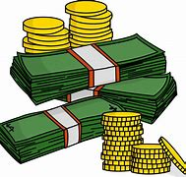

currency

Slide 23
decency
decent → decency
ADJECTIVE → NOUN
Definition - behaviour that conforms to accepted standards of morality or respectability.

Slide 24
currency
current → currency
ADJECTIVE → NOUN
Definition - a system of money in general use in a particular country

Slide 25
They had the decency to come and confess.
_______

Slide 26
The dollar was a strong currency.
______

Slide 27
New CHALLENGE words.

Slide 28

environment
NOUN
Definition - the surroundings or conditions in which a person, animal, or plant lives or operates

Slide 29
Survival in hostile environments is challenging.
____________

Slide 30
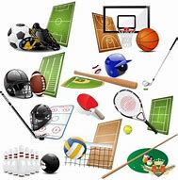
equipment
NOUN
Definition - the necessary items for a particular purpose

Slide 31
Office equipment includes chairs and tables.
_________

Slide 32
Let’s Practise and Apply.

Slide 33
Can you spot the spelling rule words and the challenge words?

Slide 34
Stone – continued
For thousands of years, stone was the building material of choice in certain environments for those who could afford it. Stone is hard-wearing and looks good – there’s no need to cover it up with something more weatherproof or attractive. Stone walls are decent as they are strong enough to bear the weight of a tall building. The ancient Egyptians developed ways to quarry, move and shape huge blocks of stone, but for hundreds of years cut stone was too expensive for all but the most important buildings. It could only be shaped and placed by skilled stonemasons with specialist equipment. The White House in Washington, USA, adjacent to the monument, is one of the most famous homes in the world. It has white columns built using white limestone from Europe.

Slide 35
Stone – continued
For thousands of years, stone was the building material of choice in certain environments for those who could afford it. Stone is hard-wearing and looks good – there’s no need to cover it up with something more weatherproof or attractive. Stone walls are decent as they are strong enough to bear the weight of a tall building. The ancient Egyptians developed ways to quarry, move and shape huge blocks of stone, but for hundreds of years cut stone was too expensive for all but the most important buildings. It could only be shaped and placed by skilled stonemasons with specialist equipment. The White House in Washington, USA, adjacent to the monument, is one of the most famous homes in the world. It has white columns built using white limestone from Europe.

Slide 36
Write this sentence as I dictate it to you.
Notes:
For thousands of years, stone was the building material of choice in certain environments for those who could afford it.

Slide 37
For thousands of years, stone was the building material of choice in certain environments for those who could afford it.
Did you write it correctly?
Edit your work and make sure you have it correct.
Can you underline the spelling word that we have covered in this session?

Slide 38
Year 5 - Summer 1
Week 5 - Tuesday
Notes:
Revisit and review the words from previous teaching and challenge words – I say, we say, you say
Ask children to write words only in their spelling book
Introduce the new spelling rule
Children to write the new spelling rule words and challenge words into books when the sentences are shown with the spelling word missing.
Read the extract with the class as choral reading. Practise model of prosody etc.
Ask children to find the spelling words from the session in the text.
Then read allowed the chosen sentence for children to write fully in their books.
Show the extract and ask children to then edit their work to check they were correct in their dictation.

Slide 40
Let’s Revisit and Review…

Slide 41
Do you remember this challenge word?

Slide 42
harass
VERB
Definition - subject to aggressive pressure or intimidation

Slide 43
People should not harass each other.
______

Slide 44
foreign
ADJECTIVE
Definition - of, from, in, or characteristic of a country or language other than one's own

Slide 45
The foreign currency of Europe is Euros.
_______

Slide 46
words ending
-ought

Slide 47
-ought

Slide 48
-ought
- ought is pronounced with an "aw" sound, like in the word "law."

Slide 49
(b) -ought
Notes:
Plough
Rough
Though

Slide 50
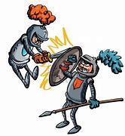
fought

Slide 51

thought

Slide 52
Let’s Teach and Practise

Slide 53
words ending
-ent
-ency

Slide 54
When the base word is a verb that ends in - ere, remove the final e and add - ence. When the base word is an adjective that ends in -ent, remove these three letters and add - ence.

Slide 55
Create words ending in 'ence' and 'ency' by changing adjectives ending in 'ent' to nouns.

Slide 56
-ency
Notes:
Plough
Rough
Though

Slide 57
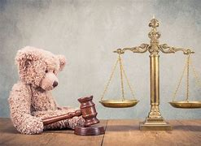
leniency

Slide 58

absorbency

Slide 59
leniency
lenient → leniency
ADJECTIVE → NOUN
Definition - the fact or quality of being more merciful or tolerant than expected; clemency

Slide 60
absorbency
absorbent → absorbency
ADJECTIVE → NOUN
Definition - the quality or state of being absorbent; ability to soak up liquid

Slide 61
The court could show leniency.
________

Slide 62
The absorbency of different tissue was tested to see which would be best to use.
___________

Slide 63
New CHALLENGE words.

Slide 64
environment
NOUN
Definition - the surroundings or conditions in which a person, animal, or plant lives or operates

Slide 65
Survival in hostile environments is challenging.
____________

Slide 66
equipment
NOUN
Definition - the necessary items for a particular purpose

Slide 67
Office equipment includes chairs and tables.
_________

Slide 68
Let’s Practise and Apply.

Slide 69
Can you spot the spelling rule words and the challenge words?

Slide 70
Stone – continued
For thousands of years, stone was the building material of choice in certain environments for those who could afford it. Stone is hard-wearing and looks good – there’s no need to cover it up with something more weatherproof or attractive. Stone walls are decent as they are strong enough to bear the weight of a tall building. The ancient Egyptians developed ways to quarry, move and shape huge blocks of stone, but for hundreds of years cut stone was too expensive for all but the most important buildings. It could only be shaped and placed by skilled stonemasons with specialist equipment. The White House in Washington, USA, adjacent to the monument, is one of the most famous homes in the world. It has white columns built using white limestone from Europe.

Slide 71
Stone – continued
For thousands of years, stone was the building material of choice in certain environments for those who could afford it. Stone is hard-wearing and looks good – there’s no need to cover it up with something more weatherproof or attractive. Stone walls are decent as they are strong enough to bear the weight of a tall building. The ancient Egyptians developed ways to quarry, move and shape huge blocks of stone, but for hundreds of years cut stone was too expensive for all but the most important buildings. It could only be shaped and placed by skilled stonemasons with specialist equipment. The White House in Washington, USA, adjacent to the monument, is one of the most famous homes in the world. It has white columns built using white limestone from Europe.

Slide 72
Write this sentence as I dictate it to you.
Notes:
Stone walls are decent as they are strong enough to bear the weight of a tall building.

Slide 73
Stone walls are decent as they are strong enough to bear the weight of a tall building.
Did you write it correctly?
Edit your work and make sure you have it correct.
Can you underline the spelling word that we have covered in this session?

Slide 74
Year 5 - Summer 1
Week 5 - Wednesday
Notes:
Revisit and review the words from previous teaching and challenge words – I say, we say, you say
Ask children to write words only in their spelling book
Introduce the new spelling rule
Children to write the new spelling rule words and challenge words into books when the sentences are shown with the spelling word missing.
Read the extract with the class as choral reading. Practise model of prosody etc.
Ask children to find the spelling words from the session in the text.
Then read allowed the chosen sentence for children to write fully in their books.
Show the extract and ask children to then edit their work to check they were correct in their dictation.

Slide 76
Let’s Revisit and Review…

Slide 77
Do you remember this challenge word?

Slide 78
harass
VERB
Definition - subject to aggressive pressure or intimidation

Slide 79
People should not harass each other.
______

Slide 80
foreign
ADJECTIVE
Definition - of, from, in, or characteristic of a country or language other than one's own

Slide 81
The foreign currency of Europe is Euros.
_______

Slide 82
words ending
-ought

Slide 83
-ought

Slide 84
-ought
- ought is pronounced with an "aw" sound, like in the word "law."

Slide 85
(b) -ought
Notes:
Plough
Rough
Though

Slide 86
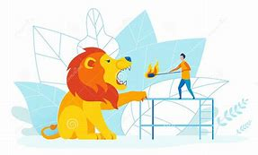
thoughtless

Slide 87
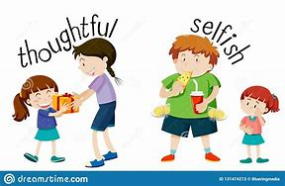
thoughtful

Slide 88
Let’s Teach and Practise

Slide 89
words ending
-ent
-ency

Slide 90
When the base word is a verb that ends in - ere, remove the final e and add - ence. When the base word is an adjective that ends in -ent, remove these three letters and add - ence.

Slide 91
Create words ending in 'ence' and 'ency' by changing adjectives ending in 'ent' to nouns.

Slide 92
-ency
Notes:
Plough
Rough
Though

Slide 93
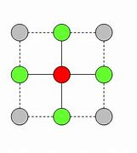
adjacency

Slide 94
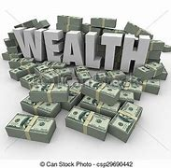
affluency

Slide 95
adjacency
adjacent → adjacency
ADJECTIVE → NOUN
Definition - position of something next to something else

Slide 96
affluency
affluent → affluency
ADJECTIVE → NOUN
Definition - an abundant supply

Slide 97
The adjacency of the hotel rooms was helpful to the family.
_________

Slide 98
The affluency of the pop stars was shocking.
_________

Slide 99
New CHALLENGE words.

Slide 100
environment
NOUN
Definition - the surroundings or conditions in which a person, animal, or plant lives or operates

Slide 101
Survival in hostile environments is challenging.
____________

Slide 102
equipment
NOUN
Definition - the necessary items for a particular purpose

Slide 103
Office equipment includes chairs and tables.
_________

Slide 104
Let’s Practise and Apply.

Slide 105
Can you spot the spelling rule words and the challenge words?

Slide 106
Stone – continued
For thousands of years, stone was the building material of choice in certain environments for those who could afford it. Stone is hard-wearing and looks good – there’s no need to cover it up with something more weatherproof or attractive. Stone walls are decent as they are strong enough to bear the weight of a tall building. The ancient Egyptians developed ways to quarry, move and shape huge blocks of stone, but for hundreds of years cut stone was too expensive for all but the most important buildings. It could only be shaped and placed by skilled stonemasons with specialist equipment. The White House in Washington, USA, adjacent to the monument, is one of the most famous homes in the world. It has white columns built using white limestone from Europe.

Slide 107
Stone – continued
For thousands of years, stone was the building material of choice in certain environments for those who could afford it. Stone is hard-wearing and looks good – there’s no need to cover it up with something more weatherproof or attractive. Stone walls are decent as they are strong enough to bear the weight of a tall building. The ancient Egyptians developed ways to quarry, move and shape huge blocks of stone, but for hundreds of years cut stone was too expensive for all but the most important buildings. It could only be shaped and placed by skilled stonemasons with specialist equipment. The White House in Washington, USA, adjacent to the monument, is one of the most famous homes in the world. It has white columns built using white limestone from Europe.

Slide 108
Write this sentence as I dictate it to you.
Notes:
It could only be shaped and placed by skilled stonemasons with specialist equipment.

Slide 109
It could only be shaped and placed by skilled stonemasons with specialist equipment.
Did you write it correctly?
Edit your work and make sure you have it correct.
Can you underline the spelling word that we have covered in this session?

Slide 110
Year 5 - Summer 1
Week 5 - Thursday
Notes:
Revisit and review the words from previous teaching and challenge words – I say, we say, you say
Ask children to write words only in their spelling book
Introduce the new spelling rule
Children to write the new spelling rule words and challenge words into books when the sentences are shown with the spelling word missing.
Read the extract with the class as choral reading. Practise model of prosody etc.
Ask children to find the spelling words from the session in the text.
Then read allowed the chosen sentence for children to write fully in their books.
Show the extract and ask children to then edit their work to check they were correct in their dictation.

Slide 112
Let’s Revisit and Review…

Slide 113
Do you remember this challenge word?

Slide 114
harass
VERB
Definition - subject to aggressive pressure or intimidation

Slide 115
People should not harass each other.
______

Slide 116
foreign
ADJECTIVE
Definition - of, from, in, or characteristic of a country or language other than one's own

Slide 117
The foreign currency of Europe is Euros.
_______

Slide 118
words ending
-ought

Slide 119
-ought

Slide 120
-ought
- ought is pronounced with an "aw" sound, like in the word "law."

Slide 121
(b) -ought
Notes:
Plough
Rough
Though

Slide 122
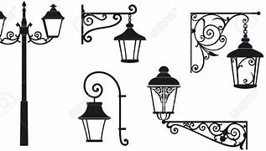
wrought

Slide 123

ought

Slide 124
Let’s Teach and Practise

Slide 125
words ending
-ent
-ency

Slide 126
When the base word is a verb that ends in - ere, remove the final e and add - ence. When the base word is an adjective that ends in -ent, remove these three letters and add - ence.

Slide 127
Create words ending in 'ence' and 'ency' by changing adjectives ending in 'ent' to nouns.

Slide 128
-ency
Notes:
Plough
Rough
Though

Slide 129
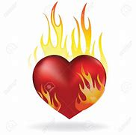
ardency

Slide 130
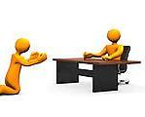
clemency

Slide 131
ardency
ardent → ardency
ADJECTIVE → NOUN
Definition - passion or enthusiasm

Slide 132
clemency
clement → clemency
ADJECTIVE → NOUN
Definition - mercy; lenience

Slide 133
The ardency of some football fans is impressive.
_______

Slide 134
There was an appeal for clemency.
________

Slide 135
New CHALLENGE words.

Slide 136
environment
NOUN
Definition - the surroundings or conditions in which a person, animal, or plant lives or operates

Slide 137
Survival in hostile environments is challenging.
____________

Slide 138
equipment
NOUN
Definition - the necessary items for a particular purpose

Slide 139
Office equipment includes chairs and tables.
_________

Slide 140
Let’s Practise and Apply.

Slide 141
Can you spot the spelling rule words and the challenge words?

Slide 142
Stone – continued
For thousands of years, stone was the building material of choice in certain environments for those who could afford it. Stone is hard-wearing and looks good – there’s no need to cover it up with something more weatherproof or attractive. Stone walls are decent as they are strong enough to bear the weight of a tall building. The ancient Egyptians developed ways to quarry, move and shape huge blocks of stone, but for hundreds of years cut stone was too expensive for all but the most important buildings. It could only be shaped and placed by skilled stonemasons with specialist equipment. The White House in Washington, USA, adjacent to the monument, is one of the most famous homes in the world. It has white columns built using white limestone from Europe.

Slide 143
Stone – continued
For thousands of years, stone was the building material of choice in certain environments for those who could afford it. Stone is hard-wearing and looks good – there’s no need to cover it up with something more weatherproof or attractive. Stone walls are decent as they are strong enough to bear the weight of a tall building. The ancient Egyptians developed ways to quarry, move and shape huge blocks of stone, but for hundreds of years cut stone was too expensive for all but the most important buildings. It could only be shaped and placed by skilled stonemasons with specialist equipment. The White House in Washington, USA, adjacent to the monument, is one of the most famous homes in the world. It has white columns built using white limestone from Europe.

Slide 144
Write this sentence as I dictate it to you.
Notes:
The White House in Washington, USA, adjacent to the monument, is one of the most famous homes in the world.

Slide 145
The White House in Washington, USA, adjacent to the monument, is one of the most famous homes in the world.
Did you write it correctly?
Edit your work and make sure you have it correct.
Can you underline the spelling word that we have covered in this session?

Slide 146
Year 5 - Summer 1
Week 5 - Friday
Notes:
Click through the slides for all the R+R words for the week (both the focus and the challenge words)
Click through the slides for all the new learning this week

Slide 148
Old challenge words…

Slide 149
harass

Slide 150
foreign

Slide 151
Old spelling rule words…

Slide 152
brought

Slide 153
bought

Slide 154
fought

Slide 155
thought

Slide 156
thoughtless

Slide 157
thoughtful

Slide 158
wrought

Slide 159
ought

Slide 160
New spelling rule words…

Slide 161
decency

Slide 162
currency

Slide 163
leniency

Slide 164
absorbency

Slide 165
adjacency

Slide 166
affluency

Slide 167
ardency

Slide 168
clemency

Slide 169
New challenge words…

Slide 170
environment

Slide 171
equipment

Slide 172
Quick Quiz time…
Notes:
Say these words for the quiz
Harass foreign drought wrought Environment equipment currency absorbency affluency ardency

Slide 173
Did you get them correct?
Edit your work.
harass foreign drought wrought environment equipment currency absorbency affluency ardency

Slide 174
Word class time…

Slide 175
Survival in hostile environments is challenging.
Noun preposition adjective noun verb adverb
Notes:
Ask for these words to be classed

Slide 176
Office equipment includes chairs and tables.
Adjective noun verb noun conjunction noun
Notes:
Ask for these words to be classed

Slide 177
Etymology
The history of a word….

Slide 178
Environment
1600, "state of being environed" (see environ (v.) + -ment ); sense of "the aggregate of the conditions in which a person or thing lives" is by 1827 (used by Carlyle to render German Umgebung - It meant “state of being environed.” It is derived from the French word “Environ,” meaning “surrounding.”
Equipment
early 18th century: from French équipement, from équiper ‘equip’.

Slide 179


Slide 180
Let’s investigate….
Find antonyms and synonyms of the challenge words.

