Slide 1
Spelling Y5
Mastering spellings: building on the foundations of phonics
Summer 1
Week 6

Slide 2
Year 5 - Summer 1
Week 6 - Monday

Slide 3
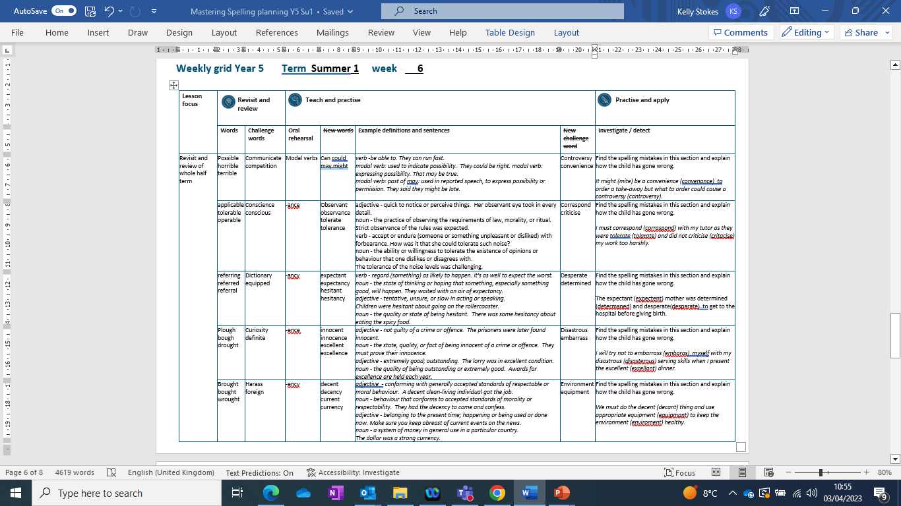

Slide 4
Let’s Revisit and Review…

Slide 5
Do you remember this challenge word?

Slide 6
Let’s investigate.

Slide 7
Can you spot the spelling errors in these sentences?
Write the correct spelling and explain where they went wrong.

Slide 8
It mite be a convenance to order a take-away but what to order could cause a contraversy.

Slide 9
It mite be a convenance to order a take-away but what to order could cause a contraversy.

Slide 10
It mite be a convenance to order a take-away but what to order could cause a contraversy. might – incorrect homophone used

Slide 11
It mite be a convenance to order a take-away but what to order could cause a contraversy. convenience – ‘ie’ not ‘a’

Slide 12
It mite be a convenance to order a take-away but what to order could cause a contraversy. controversy – ‘o’ not ‘a’

Slide 13
It might be a convenience to order a take-away but what to order could cause a controversy.

Slide 14
Year 5 - Summer 1
Week 6 - Tuesday

Slide 16
Let’s Revisit and Review…

Slide 17
Do you remember this challenge word?

Slide 18
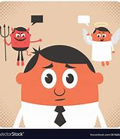
conscience
NOUN
Definition - a person's moral sense of right and wrong, viewed as acting as a guide to one's behaviour

Slide 19
Ben was suffering a pang of conscience.
_________

Slide 20

conscious
ADJECTIVE
Definition - aware of and responding to one's surroundings

Slide 21
Although I was in pain, I was conscious.
_________

Slide 22
words ending
-able
The –able/–ably endings are far more common than the
–ible/–ibly endings.

Slide 23
If the –able ending is added to a word ending in –ce or –ge, the e after the c or g must be kept as those letters would otherwise have their ‘hard’ sounds (as in cap and gap) before the a of the –able ending.

Slide 24
The –able ending is usually but not always used if a complete root word can be heard before it, even if there is no related word ending in –ation.

Slide 25

applicable

Slide 26
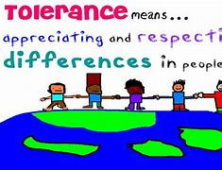
tolerable

Slide 27
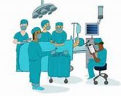
operable

Slide 28
Let’s Teach and Practise

Slide 29
words ending
-ance
If the word is formed from a verb that ends in -y, -ure, or -ear, then the ending will be spelled -ance.

Slide 30
For example:
alliance (from ally),
endurance (from endure),
or
appearance (from appear)

Slide 31
If the main part of the word ends in a ‘hard’ c or a ‘hard’ g, then the ending will be spelled -ance.
For example: elegance or significance.

Slide 32
If the noun is related to a verb ending in -ate, then the ending is likely to be -ance, e.g. tolerance (from tolerate)

Slide 33
-ance

Slide 34

observance

Slide 35
tolerance

Slide 36
observance
observant → observance
ADJECTIVE → NOUN
Definition - the practice of observing the requirements of law, morality, or ritual.

Slide 37
tolerance
tolerant → tolerance
ADJECTIVE → NOUN
Definition - the ability or willingness to tolerate the existence of opinions or behaviour that one dislikes or disagrees with.

Slide 38
Strict observance of the rules was expected.
__________

Slide 39
The tolerance of the noise levels was challenging.
__________

Slide 40
New CHALLENGE words.

Slide 41
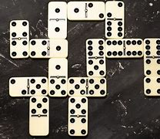
correspond
VERB
Definition - have a close similarity; match or agree almost exactly.

Slide 42
The description of the suspect corresponds to this person.
___________

Slide 43
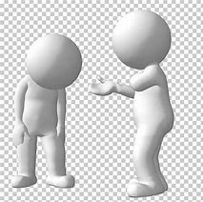
criticise
VERB
Definition - indicate the faults of (someone or something) in a disapproving way

Slide 44
The students were asked to criticise the artwork on display.
_________

Slide 45
Let’s investigate.

Slide 46
Can you spot the spelling errors in these sentences?
Write the correct spelling and explain where they went wrong.

Slide 47
I must corraspond with my tutor as they were tolarate and did not critacise my work too harshly.

Slide 48
I must corraspond with my tutor as they were tolarate and did not critacise my work too harshly.

Slide 49
I must corraspond with my tutor as they were tolarate and did not critacise my work too harshly. correspond – ‘e’ not ‘a’

Slide 50
I must corraspond with my tutor as they were tolarate and did not critacise my work too harshly. tolerate – ‘e’ not ‘a’

Slide 51
I must corraspond with my tutor as they were tolarate and did not critacise my work too harshly. criticise – ‘i’ not ‘a’

Slide 52
I must correspond with my tutor as they were tolerate and did not criticise my work too harshly.

Slide 53
Year 5 - Summer 1
Week 6 - Wednesday

Slide 55
Let’s Revisit and Review…

Slide 56
Do you remember this challenge word?

Slide 57
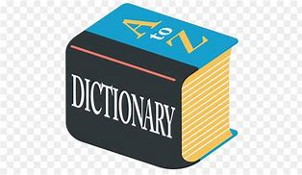
dictionary
NOUN
Definition - a book or electronic resource that lists the words of a language (typically in alphabetical order) and gives their meaning, or gives the equivalent words in a different language, often also providing information about pronunciation, origin, and usage

Slide 58
The website gives access to an online dictionary.
__________

Slide 59
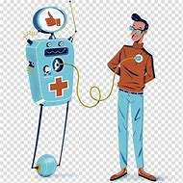
equipped
VERB
Definition - supply with the necessary items for a particular purpose

Slide 60
All bedrooms are equipped with a colour TV.
________

Slide 61
words ending
-fer
If the 'fer' syllable is stressed, double the last letter before adding suffix.

Slide 62
E.g. In the word prefer, the syllable fer is stressed so when adding suffixes –ing or –ed, the r letter is double.

Slide 63
If the 'fer' syllable is not stressed, you just add the suffix.

Slide 64

refer

Slide 65
referring

Slide 66
referred

Slide 67
referral

Slide 68
Let’s Teach and Practise

Slide 69
words ending
-ancy
If the word is formed from a verb that ends in -y, -ure, or -ear, then the ending will be spelled -ancy.

Slide 70
If the main part of the word ends in a ‘hard’ c or a ‘hard’ g, then the ending will be spelled -ancy.

Slide 71
-ancy

Slide 72
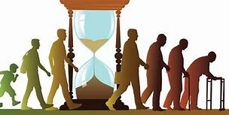
expectancy

Slide 73

hesitancy

Slide 74
expectancy
expectant → expectancy
VERB → NOUN
Definition - the state of thinking or hoping that something, especially something good, will happen.

Slide 75
hesitancy
hesitant → hesitancy
VERB → NOUN
Definition - the quality or state of being hesitant; unsure

Slide 76
They waited with an air of expectancy.
__________

Slide 77
There was some hesitancy about eating the spicy food.
__________

Slide 78
New CHALLENGE words.

Slide 79

desperate
ADJECTIVE
Definition - feeling or showing a hopeless sense that a situation is so bad as to be impossible to deal with

Slide 80
A desperate sadness enveloped Ruth.
_________

Slide 81
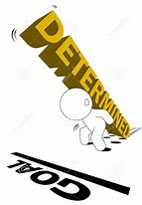
determined
ADJECTIVE
Definition - having made a firm decision and being resolved not to change it

Slide 82
Alina was determined to be heard.
__________

Slide 83
Let’s investigate.

Slide 84
Can you spot the spelling errors in these sentences?
Write the correct spelling and explain where they went wrong.

Slide 85
The expectent mother was determaned and desparate to get to the hospital before giving birth.

Slide 86
The expectent mother was determaned and desparate to get to the hospital before giving birth.

Slide 87
The expectent mother was determaned and desparate to get to the hospital before giving birth. expectant – ‘ant’ not ‘ent’

Slide 88
The expectent mother was determaned and desparate to get to the hospital before giving birth. determined – ‘i’ not ‘a’

Slide 89
The expectent mother was determaned and desparate to get to the hospital before giving birth. desperate – ‘e’ not ‘a’

Slide 90
The expectant mother was determined and desperate to get to the hospital before giving birth.

Slide 91
Year 5 - Summer 1
Week 6 - Thursday

Slide 93
Let’s Revisit and Review…

Slide 94
Do you remember this challenge word?

Slide 95
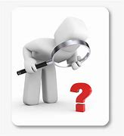
curiosity
NOUN
Definition - a strong desire to know or learn

Slide 96
Filled with curiosity, she peered through the window.
_________

Slide 97

definite
ADJECTIVE
Definition - clearly stated or decided; not vague or doubtful

Slide 98
We had no definite plans.
________

Slide 99
words ending
-ough

Slide 100
-ough
ough is one of the trickiest spellings in English – it can be used to spell a
number of different sounds

Slide 101
(pl) -ough
(r) -ough
(th) -ough
Notes:
Plough
Rough
Though

Slide 102
pronounce -ough with an "ow" sound, like in the word "now."

Slide 103
pronounce -ough with an "uff" sound, like in the word "stuff."

Slide 104
pronounce -ough with an "oh" sound, like in the word "go."

Slide 105
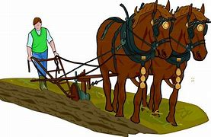
plough

Slide 106

bough

Slide 107
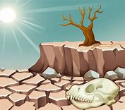
drought

Slide 108
Let’s Teach and Practise

Slide 109
words ending
-ent
-ence

Slide 110
-ent and -ence
When the base word is a verb that ends in - ere, remove the final e and add - ence. When the base word is an adjective that ends in -ent, remove these three letters and add - ence.

Slide 111
-ent → -ence

Slide 112

innocence

Slide 113

excellence

Slide 114
innocence
innocent → innocence
ADJECTIVE → NOUN
Definition - the state, quality, or fact of being innocent of a crime or offence

Slide 115
excellence
excellent → excellence
ADJECTIVE → NOUN
Definition - the state, quality, or fact of being innocent of a crime or offence

Slide 116
They must prove their innocence.
_________

Slide 117
Awards for excellence are held each year.
__________

Slide 118
New CHALLENGE words.

Slide 119
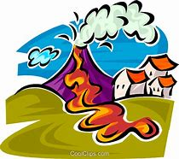
disastrous
ADJECTIVE
Definition - causing great damage

Slide 120
A disastrous fire swept through the museum.
_________

Slide 121

embarrass
VERB
Definition - cause (someone) to feel awkward, self-conscious, or ashamed

Slide 122
I won’t embarrass you today.
_________

Slide 123
Let’s investigate.

Slide 124
Can you spot the spelling errors in these sentences?
Write the correct spelling and explain where they went wrong.

Slide 125
I will try not to embaras myself with my disasterous serving skills when I present the excellant dinner.

Slide 126
I will try not to embaras myself with my disasterous serving skills when I present the excellant dinner.

Slide 127
I will try not to embaras myself with my disasterous serving skills when I present the excellant dinner. embarrass – double ‘r’ and ‘s’

Slide 128
I will try not to embaras myself with my disasterous serving skills when I present the excellant dinner. disastrous – no ‘e’

Slide 129
I will try not to embaras myself with my disasterous serving skills when I present the excellant dinner. excellent – ‘ent’ not ‘ant’

Slide 130
I will try not to embarrass myself with my disastrous serving skills when I present the excellent dinner.

Slide 131
Year 5 - Summer 1
Week 6 - Friday

Slide 133
Let’s Revisit and Review…

Slide 134
Do you remember this challenge word?

Slide 135
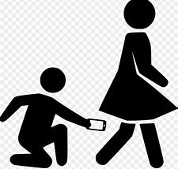
harass
VERB
Definition - subject to aggressive pressure or intimidation

Slide 136
People should not harass each other.
______

Slide 137

foreign
ADJECTIVE
Definition - of, from, in, or characteristic of a country or language other than one's own

Slide 138
The foreign currency of Europe is Euros.
_______

Slide 139
words ending
-ought

Slide 140
-ought

Slide 141
-ought
- ought is pronounced with an "aw" sound, like in the word "law."

Slide 142
(b) -ought
Notes:
Plough
Rough
Though

Slide 143
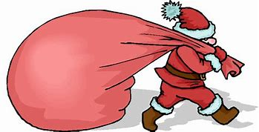
brought

Slide 144
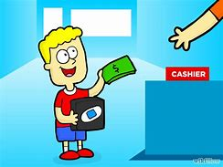
bought

Slide 145
Let’s Teach and Practise

Slide 146
words ending
-ent
-ency

Slide 147
When the base word is a verb that ends in - ere, remove the final e and add - ence. When the base word is an adjective that ends in -ent, remove these three letters and add - ence.

Slide 148
Create words ending in 'ence' and 'ency' by changing adjectives ending in 'ent' to nouns.

Slide 149
-ency
Notes:
Plough
Rough
Though

Slide 150
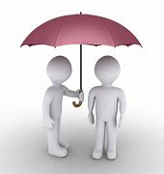
decency

Slide 151
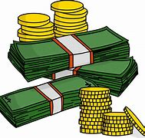

currency

Slide 152
decency
decent → decency
ADJECTIVE → NOUN
Definition - behaviour that conforms to accepted standards of morality or respectability.

Slide 153
currency
current → currency
ADJECTIVE → NOUN
Definition - a system of money in general use in a particular country

Slide 154
They had the decency to come and confess.
_______

Slide 155
The dollar was a strong currency.
______

Slide 156
New CHALLENGE words.

Slide 157

environment
NOUN
Definition - the surroundings or conditions in which a person, animal, or plant lives or operates

Slide 158
Survival in hostile environments is challenging.
____________

Slide 159
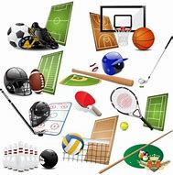
equipment
NOUN
Definition - the necessary items for a particular purpose

Slide 160
Office equipment includes chairs and tables.
_________

Slide 161
Let’s investigate.

Slide 162
Can you spot the spelling errors in these sentences?
Write the correct spelling and explain where they went wrong.

Slide 163
We must do the decant thing and use appropriate equipmant to keep the enviroment healthy.

Slide 164
We must do the decant thing and use appropriate equipmant to keep the enviroment healthy.

Slide 165
We must do the decant thing and use appropriate equipmant to keep the enviroment healthy. decent – ‘e’ not ‘a’

Slide 166
We must do the decant thing and use appropriate equipmant to keep the enviroment healthy. equipment – ‘ent’ not ‘ant’

Slide 167
We must do the decant thing and use appropriate equipmant to keep the enviroment healthy. environment – ‘n’ missing

Slide 168
We must do the decent thing and use appropriate equipment to keep the environment healthy.

