Slide 1
Spelling Y5
Mastering spellings: building on the foundations of phonics
Summer 2
Week 1
Notes:
These slides are the same as Y5 Summer 2 as this is a revisit and review half term

Slide 2
Year 5 - Summer 2
Week 1 - Monday

Slide 3
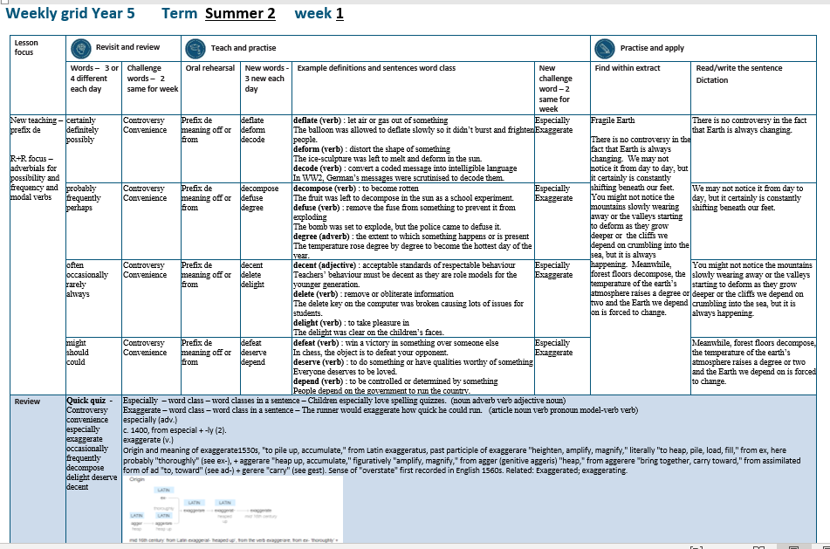

Slide 4
Let’s Revisit and Review…

Slide 5
Do you remember this challenge word?

Slide 6

Definition – prolonged public disagreement or heated discussion
controversy
NOUN

Slide 7
There was controversy over the lead role for the Y6 performance.
___________

Slide 8
Do you remember this challenge word?

Slide 9
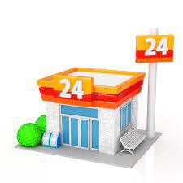
Definition – the state of being able to proceed with something without difficulty
convenience
NOUN

Slide 10
People enjoy the convenience of the local store being open 24 hours.
___________

Slide 11
Adverbials
-possibility
–frequency
–modal verbs

Slide 12
adverbials

Slide 13
-adverbials add detail of where, when, how, frequency of the verb

Slide 14
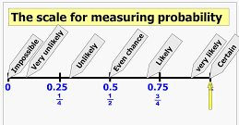
certainly

Slide 15
definitely

Slide 16
possibly

Slide 17
Let’s Teach and Practise

Slide 18
The prefix de-

Slide 19
de-

Slide 20
de- meaning ‘off’ or ‘from’

Slide 21
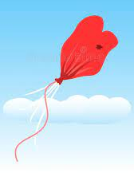
deflate

Slide 22
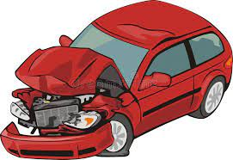
deform

Slide 23
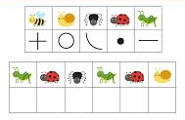
decode

Slide 24
Definition – let air or gas out of something
deflate
de + flate = deflate
VERB

Slide 25
Definition – distort the shape of something
deform
de + form = deform
VERB

Slide 26
Definition – convert a coded message into intelligible language
decode
de + code = decode
VERB

Slide 27
The balloon was allowed to deflate slowly so it didn’t burst and frighten people.
_______

Slide 28
The ice-sculpture was left to melt and deform in the sun.
______

Slide 29
In WW2, German messages were scrutinised to decode them.
______

Slide 30
New CHALLENGE words.

Slide 31

Definition – used to single out one person or thing over all others
especially
ADVERB

Slide 32
Children especially love spelling quizzes.
__________

Slide 33
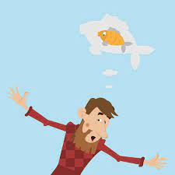
Definition - represent (something) as being larger, better, or worse than it really is
exaggerate
VERB

Slide 34
The fisherman would exaggerate how big his catch was.
__________

Slide 35
Let’s Practise and Apply.

Slide 36
Can you spot the spelling rule words and the challenge words?

Slide 37
Fragile Earth
There is no controversy in the fact that Earth is always changing. We may not notice it from day to day, but it certainly is constantly shifting beneath our feet. You might not notice the mountains slowly wearing away or the valleys starting to deform as they grow deeper or the cliffs we depend on crumbling into the sea, but it is always happening. Meanwhile, forest floors decompose, the temperature of the earth’s atmosphere raises a degree or two and the Earth we depend on is forced to change.

Slide 38
Fragile Earth
There is no controversy in the fact that Earth is always changing. We may not notice it from day to day, but it certainly is constantly shifting beneath our feet. You might not notice the mountains slowly wearing away or the valleys starting to deform as they grow deeper or the cliffs we depend on crumbling into the sea, but it is always happening. Meanwhile, forest floors decompose, the temperature of the earth’s atmosphere raises a degree or two and the Earth we depend on is forced to change.

Slide 39
Write this sentence as I dictate it to you.
Notes:
There is no controversy in the fact that Earth is always changing.

Slide 40
There is no controversy in the fact that Earth is always changing.
Did you write it correctly?
Edit your work and make sure you have it correct.
Can you underline the spelling word that we have covered in this session?

Slide 41
Year 5 - Summer 2
Week 1 - Tuesday

Slide 43
Let’s Revisit and Review…

Slide 44
Do you remember this challenge word?

Slide 45
Definition – prolonged public disagreement or heated discussion
controversy
NOUN

Slide 46
There was controversy over the lead role for the Y6 performance.
___________

Slide 47
Do you remember this challenge word?

Slide 48
Definition – the state of being able to proceed with something without difficulty
convenience
NOUN

Slide 49
People enjoy the convenience of the local store being open 24 hours.
___________

Slide 50
Adverbials
-possibility
–frequency
–modal verbs

Slide 51
adverbials

Slide 52
-adverbials add detail of where, when, how, frequency of the verb

Slide 53
probably

Slide 54
frequently

Slide 55
perhaps

Slide 56
Let’s Teach and Practise

Slide 57
The prefix de-

Slide 58
de-

Slide 59
de- meaning ‘off’ or ‘from’

Slide 60
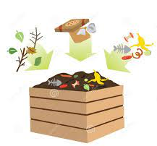
decompose

Slide 61
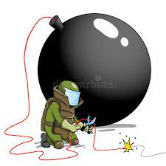
defuse

Slide 62
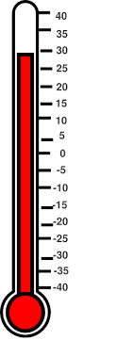
degree

Slide 63
Definition – to become rotten
decompose
de + compose = decompose
VERB

Slide 64
Definition – remove the fuse from something to prevent it from exploding
defuse
de + fuse = defuse
VERB

Slide 65
Definition – a unit of measure e.g. temperature / angle
degree
de + gree = degree
NOUN

Slide 66
The fruit was left to decompose in the sun as a school experiment.
_________

Slide 67
The bomb was set to explode, but the police came to defuse it.
______

Slide 68
The temperature rose degree by degree to become the hottest day of the year.
______
______

Slide 69
New CHALLENGE words.

Slide 70
Definition – used to single out one person or thing over all others
especially
ADVERB

Slide 71
Children especially love spelling quizzes.
__________

Slide 72
Definition - represent (something) as being larger, better, or worse than it really is
exaggerate
VERB

Slide 73
The fisherman would exaggerate how big his catch was.
__________

Slide 74
Let’s Practise and Apply.

Slide 75
Can you spot the spelling rule words and the challenge words?

Slide 76
Fragile Earth
There is no controversy in the fact that Earth is always changing. We may not notice it from day to day, but it certainly is constantly shifting beneath our feet. You might not notice the mountains slowly wearing away or the valleys starting to deform as they grow deeper or the cliffs we depend on crumbling into the sea, but it is always happening. Meanwhile, forest floors decompose, the temperature of the earth’s atmosphere raises a degree or two and the Earth we depend on is forced to change.

Slide 77
Fragile Earth
There is no controversy in the fact that Earth is always changing. We may not notice it from day to day, but it certainly is constantly shifting beneath our feet. You might not notice the mountains slowly wearing away or the valleys starting to deform as they grow deeper or the cliffs we depend on crumbling into the sea, but it is always happening. Meanwhile, forest floors decompose, the temperature of the earth’s atmosphere raises a degree or two and the Earth we depend on is forced to change.

Slide 78
Write this sentence as I dictate it to you.
Notes:
We may not notice it from day to day, but it certainly is constantly shifting beneath our feet.

Slide 79
We may not notice it from day to day, but it certainly is constantly shifting beneath our feet.
Did you write it correctly?
Edit your work and make sure you have it correct.
Can you underline the spelling word that we have covered in this session?

Slide 80
Year 5 - Summer 2
Week 1 - Wednesday

Slide 82
Let’s Revisit and Review…

Slide 83
Do you remember this challenge word?

Slide 84
Definition – prolonged public disagreement or heated discussion
controversy
NOUN

Slide 85
There was controversy over the lead role for the Y6 performance.
___________

Slide 86
Do you remember this challenge word?

Slide 87
Definition – the state of being able to proceed with something without difficulty
convenience
NOUN

Slide 88
People enjoy the convenience of the local store being open 24 hours.
___________

Slide 89
Adverbials
-possibility
–frequency
–modal verbs

Slide 90
adverbials

Slide 91
-adverbials add detail of where, when, how, frequency of the verb

Slide 92
often

Slide 93
occasionally

Slide 94
rarely

Slide 95
always

Slide 96
Let’s Teach and Practise

Slide 97
The prefix de-

Slide 98
de-

Slide 99
de- meaning ‘off’ or ‘from’

Slide 100

decent

Slide 101
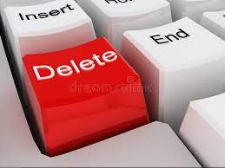
delete

Slide 102

delight

Slide 103
Definition – acceptable standards of respectable behaviour
decent
de + cent = decent
ADJECTIVE

Slide 104
Definition – remove or obliterate information
delete
de + lete = delete
VERB

Slide 105
Definition – to take pleasure in
delight
de + light = delight
VERB

Slide 106
Teachers’ behaviour must be decent as they are role models for the younger generation.
______

Slide 107
The delete key on the computer was broken causing lots of issues for students.
______

Slide 108
The delight was clear on the children’s faces.
_______

Slide 109
New CHALLENGE words.

Slide 110
Definition – used to single out one person or thing over all others
especially
ADVERB

Slide 111
Children especially love spelling quizzes.
__________

Slide 112
Definition - represent (something) as being larger, better, or worse than it really is
exaggerate
VERB

Slide 113
The fisherman would exaggerate how big his catch was.
__________

Slide 114
Let’s Practise and Apply.

Slide 115
Can you spot the spelling rule words and the challenge words?

Slide 116
Fragile Earth
There is no controversy in the fact that Earth is always changing. We may not notice it from day to day, but it certainly is constantly shifting beneath our feet. You might not notice the mountains slowly wearing away or the valleys starting to deform as they grow deeper or the cliffs we depend on crumbling into the sea, but it is always happening. Meanwhile, forest floors decompose, the temperature of the earth’s atmosphere raises a degree or two and the Earth we depend on is forced to change.

Slide 117
Fragile Earth
There is no controversy in the fact that Earth is always changing. We may not notice it from day to day, but it certainly is constantly shifting beneath our feet. You might not notice the mountains slowly wearing away or the valleys starting to deform as they grow deeper or the cliffs we depend on crumbling into the sea, but it is always happening. Meanwhile, forest floors decompose, the temperature of the earth’s atmosphere raises a degree or two and the Earth we depend on is forced to change.

Slide 118
Write this sentence as I dictate it to you.
Notes:
You might not notice the mountains slowly wearing away or the valleys starting to deform as they grow deeper or the cliffs we depend on crumbling into the sea, but it is always happening.

Slide 119
You might not notice the mountains slowly wearing away or the valleys starting to deform as they grow deeper or the cliffs we depend on crumbling into the sea, but it is always happening.
Did you write it correctly?
Edit your work and make sure you have it correct.
Can you underline the spelling word that we have covered in this session?

Slide 120
Year 5 - Summer 2
Week 1 - Thursday

Slide 122
Let’s Revisit and Review…

Slide 123
Do you remember this challenge word?

Slide 124
Definition – prolonged public disagreement or heated discussion
controversy
NOUN

Slide 125
There was controversy over the lead role for the Y6 performance.
___________

Slide 126
Do you remember this challenge word?

Slide 127
Definition – the state of being able to proceed with something without difficulty
convenience
NOUN

Slide 128
People enjoy the convenience of the local store being open 24 hours.
___________

Slide 129
Adverbials
-possibility
–frequency
–modal verbs

Slide 130
adverbials

Slide 131
-adverbials add detail of where, when, how, frequency of the verb

Slide 132
might

Slide 133
should

Slide 134
could

Slide 135
Let’s Teach and Practise

Slide 136
The prefix de-

Slide 137
de-

Slide 138
de- meaning ‘off’ or ‘from’

Slide 139
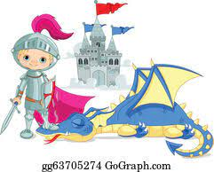
defeat

Slide 140

deserve

Slide 141
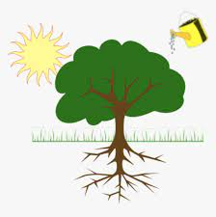
depend

Slide 142
Definition – win a victory in something over someone else
defeat
de + feat = defeat
VERB

Slide 143
Definition – to do something or have qualities worthy of something
deserve
de + serve = deserve
VERB

Slide 144
Definition – to be controlled or determined by something
depend
de + pend = depend
VERB

Slide 145
In chess, the object is to defeat your opponent.
______

Slide 146
Everyone deserves to be loved.
________

Slide 147
People depend on the government to run the country.
______

Slide 148
New CHALLENGE words.

Slide 149
Definition – used to single out one person or thing over all others
especially
ADVERB

Slide 150
Children especially love spelling quizzes.
__________

Slide 151
Definition - represent (something) as being larger, better, or worse than it really is
exaggerate
VERB

Slide 152
The fisherman would exaggerate how big his catch was.
__________

Slide 153
Let’s Practise and Apply.

Slide 154
Can you spot the spelling rule words and the challenge words?

Slide 155
Fragile Earth
There is no controversy in the fact that Earth is always changing. We may not notice it from day to day, but it certainly is constantly shifting beneath our feet. You might not notice the mountains slowly wearing away or the valleys starting to deform as they grow deeper or the cliffs we depend on crumbling into the sea, but it is always happening. Meanwhile, forest floors decompose, the temperature of the earth’s atmosphere raises a degree or two and the Earth we depend on is forced to change.

Slide 156
Fragile Earth
There is no controversy in the fact that Earth is always changing. We may not notice it from day to day, but it certainly is constantly shifting beneath our feet. You might not notice the mountains slowly wearing away or the valleys starting to deform as they grow deeper or the cliffs we depend on crumbling into the sea, but it is always happening. Meanwhile, forest floors decompose, the temperature of the earth’s atmosphere raises a degree or two and the Earth we depend on is forced to change.

Slide 157
Write this sentence as I dictate it to you.
Notes:
Meanwhile, forest floors decompose, the temperature of the earth’s atmosphere raises a degree or two and the Earth we depend on is forced to change.

Slide 158
Meanwhile, forest floors decompose, the temperature of the earth’s atmosphere raises a degree or two and the Earth we depend on is forced to change.
Did you write it correctly?
Edit your work and make sure you have it correct.
Can you underline the spelling word that we have covered in this session?

Slide 159
Year 5 - Summer 2
Week 1 - Friday
Notes:
Click through the slides for all the R+R words for the week (both the focus and the challenge words)
Click through the slides for all the new learning this week

Slide 161
Old challenge words…

Slide 162
controversy

Slide 163
convenience

Slide 164
Old spelling rule words…

Slide 165
certainly

Slide 166
definitely

Slide 167
possibly

Slide 168
probably

Slide 169
frequently

Slide 170
perhaps

Slide 171
often

Slide 172
occasionally

Slide 173
rarely

Slide 174
always

Slide 175
might

Slide 176
should

Slide 177
could

Slide 178
New spelling rule words…

Slide 179
deflate

Slide 180
deform

Slide 181
decode

Slide 182
decompose

Slide 183
defuse

Slide 184
degree

Slide 185
decent

Slide 186
delete

Slide 187
delight

Slide 188
defeat

Slide 189
deserve

Slide 190
depend

Slide 191
New challenge words…

Slide 192
especially

Slide 193
exaggerate

Slide 194
Quick Quiz time…
Notes:
Say these words for the quiz
Controversy convenience especially exaggerate occasionally frequently decompose delight deserve decent

Slide 195
Did you get them correct?
Edit your work.
controversy convenience especially exaggerate occasionally frequently decompose delight deserve decent
Notes:
Say these words for the quiz
unhappy undress unable actual learn mishap mistreat misprint mislead mistrust

Slide 196
Word class time…

Slide 197
Children especially love spelling quizzes.
noun adverb verb adjective noun
Notes:
Ask for these words to be classed

Slide 198
The runner would exaggerate how quick he could run.
determiner noun (m)verb pronoun (m)verb verb
Notes:
Ask for these words to be classed

Slide 199
Etymology
The history of a word….

Slide 200
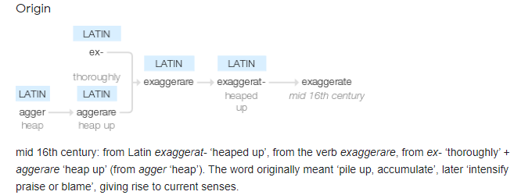
exaggerate (v.)
Origin and meaning of exaggerate1530s, "to pile up, accumulate," from Latin exaggeratus, past participle of exaggerare "heighten, amplify, magnify," literally "to heap, pile, load, fill," from ex, here probably "thoroughly" (see ex-), + aggerare "heap up, accumulate," figuratively "amplify, magnify," from agger (genitive aggeris) "heap," from aggerere "bring together, carry toward," from assimilated form of ad "to, toward" (see ad-) + gerere "carry" (see gest). Sense of "overstate" first recorded in English 1560s. Related: Exaggerated; exaggerating.
especially (adv.)
c. 1400, from especial + -ly (2).

Slide 201
Let’s investigate….
Can you find synonyms and antonyms for exaggerate?

Slide 202
Synonyms of exaggerate…
overstate · overemphasize · overstress · overestimate · overvalue · magnify · amplify · aggrandize · inflate · embellish · embroider · colour · elaborate · over-elaborate · oversell · overdraw · overplay · dramatize · hyperbolize · add colour · stretch the truth · catastrophize · overpitch · draw the longbow

Slide 203
Antonyms of exaggerate…
Play down
Understate

Slide 204
Let’s investigate….
Can you find synonyms and antonyms for especially?

Slide 205
Synonyms of especially…
mainly · mostly · chiefly · principally · for the most part · in the main · on the whole · largely · by and large · to a large extent · to a great degree · predominantly · above all · first and foremost · basically · substantially · overall · in general · particularly · in particular · primarily · generally · usually · typically · commonly · as a rule · expressly · specially · specifically · exclusively · just · uniquely · precisely · explicitly · purposefully · on purpose · with someone/something in mind

Slide 206
Antonyms of especially…
Somewhat
Slightly
Generally

