Slide 1
Spelling Y5
Mastering spellings: building on the foundations of phonics
Summer 2
Week 2

Slide 2
Year 5 - Summer 2
Week 2 - Monday

Slide 3
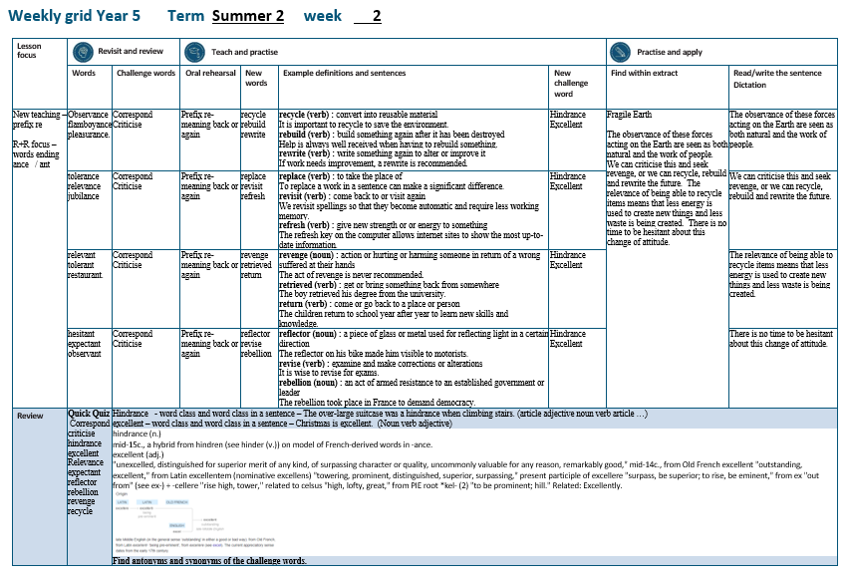

Slide 4
Let’s Revisit and Review…

Slide 5
Do you remember this challenge word?

Slide 6

Definition – communicate by exchanging letters, emails and other messages
correspond
VERB

Slide 7
Adults tend to correspond with work colleagues through emails.
___________

Slide 8
Do you remember this challenge word?

Slide 9
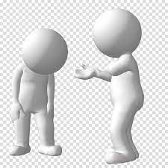
Definition – indicate the faults of (someone or something) in a disapproving way
criticise
VERB

Slide 10
Always be respectful when you criticise a piece of writing.
________

Slide 11
Words ending
-ance and -ant

Slide 12
-ance

Slide 13
-ance
Use –ant and –ance/–ancy if there is a related word with a
/æ/ or /eɪ/ sound in the right position;
–ation endings are often a clue.

Slide 14

observance

Slide 15
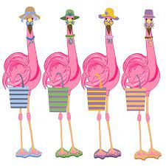
flamboyance

Slide 16
Let’s Teach and Practise

Slide 17
The prefix re-

Slide 18
re-

Slide 19
re- meaning ‘back’ or ‘again’

Slide 20
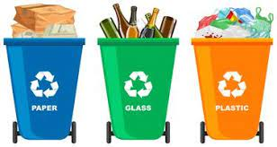
recycle

Slide 21
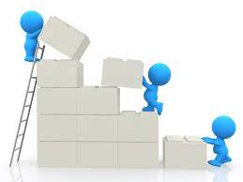
rebuild n

Slide 22
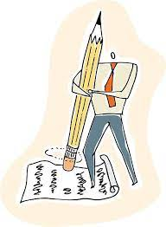
rewrite

Slide 23
Definition – convert into usable material
recycle
re + cycle = recycle
VERB

Slide 24
Definition – build something again after it has been destroyed
rebuild
re + build = rebuild
VERB

Slide 25
Definition – write something again or alter or improve it
rewrite
re + write = rewrite
VERB

Slide 26
It is important to recycle to save the environment.
_______

Slide 27
Help is always well received when having to rebuild something.
_______

Slide 28
If work needs improvement, a rewrite is recommended.
_______

Slide 29
New CHALLENGE words.

Slide 30
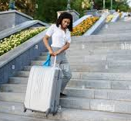
Definition - a thing that provides resistance, delay, or obstruction to something or someone
hindrance
NOUN

Slide 31
The over-large suitcase was a hindrance when climbing the stairs.
_________

Slide 32
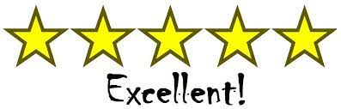
Definition - extremely good; outstanding
excellent
ADJECTIVE

Slide 33
Christmas is excellent.
_________

Slide 34
Let’s Practise and Apply.

Slide 35
Can you spot the spelling rule words and the challenge words?

Slide 36
Fragile Earth
The observance of these forces acting on the Earth are seen as both natural and the work of people. We can criticise this and seek revenge, or we can recycle, rebuild and rewrite the future. The relevance of being able to recycle items means that less energy is used to create new things and less waste is being created. There is no time to be hesitant about this change of attitude.

Slide 37
Fragile Earth
The observance of these forces acting on the Earth are seen as both natural and the work of people. We can criticise this and seek revenge, or we can recycle, rebuild and rewrite the future. The relevance of being able to recycle items means that less energy is used to create new things and less waste is being created. There is no time to be hesitant about this change of attitude.

Slide 38
Write this sentence as I dictate it to you.
Notes:
The observance of these forces acting on the Earth are seen as both natural and the work of people.

Slide 39
The observance of these forces acting on the Earth are seen as both natural and the work of people.
Did you write it correctly?
Edit your work and make sure you have it correct.
Can you underline the spelling word that we have covered in this session?

Slide 40
Year 5 - Summer 2
Week 2 - Tuesday

Slide 42
Let’s Revisit and Review…

Slide 43
Do you remember this challenge word?

Slide 44
Definition – communicate by exchanging letters, emails and other messages
correspond
VERB

Slide 45
Adults tend to correspond with work colleagues through emails.
___________

Slide 46
Do you remember this challenge word?

Slide 47
Definition – indicate the faults of (someone or something) in a disapproving way
criticise
VERB

Slide 48
Always be respectful when you criticise a piece of writing.
________

Slide 49
Words ending
-ance and -ant

Slide 50
-ance

Slide 51
-ance
Use –ant and –ance/–ancy if there is a related word with a
/æ/ or /eɪ/ sound in the right position;
–ation endings are often a clue.

Slide 52
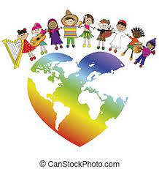
tolerance

Slide 53
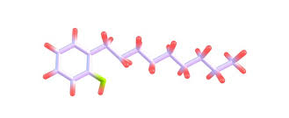
relevance

Slide 54
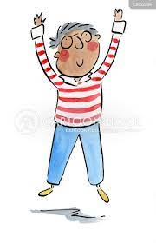
jubilance

Slide 55
Let’s Teach and Practise

Slide 56
The prefix re-

Slide 57
re-

Slide 58
re- meaning ‘back’ or ‘again’

Slide 59
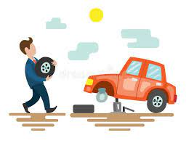
replace

Slide 60

revisit n

Slide 61

refresh

Slide 62
Definition – to take the place of
replace
re + place = replace
VERB

Slide 63
Definition – come back or visit again
revisit
re + visit = revisit
VERB

Slide 64
Definition – give new strength or energy to something
refresh
re + fresh = refresh
VERB

Slide 65
To replace a word in a sentence can make a significant difference.
_______

Slide 66
We revisit spellings so that they become automatic and require less working memory.
_______

Slide 67
The refresh key on the computer allows internet sites to show the most up-to-date information.
_______

Slide 68
New CHALLENGE words.

Slide 69
Definition - a thing that provides resistance, delay, or obstruction to something or someone
hindrance
NOUN

Slide 70
The over-large suitcase was a hindrance when climbing the stairs.
_________

Slide 71
Definition - extremely good; outstanding
excellent
ADJECTIVE

Slide 72
Christmas is excellent.
_________

Slide 73
Let’s Practise and Apply.

Slide 74
Can you spot the spelling rule words and the challenge words?

Slide 75
Fragile Earth
The observance of these forces acting on the Earth are seen as both natural and the work of people. We can criticise this and seek revenge, or we can recycle, rebuild and rewrite the future. The relevance of being able to recycle items means that less energy is used to create new things and less waste is being created. There is no time to be hesitant about this change of attitude.

Slide 76
Fragile Earth
The observance of these forces acting on the Earth are seen as both natural and the work of people. We can criticise this and seek revenge, or we can recycle, rebuild and rewrite the future. The relevance of being able to recycle items means that less energy is used to create new things and less waste is being created. There is no time to be hesitant about this change of attitude.

Slide 77
Write this sentence as I dictate it to you.
Notes:
We can criticise this and seek revenge, or we can recycle, rebuild and rewrite the future.

Slide 78
We can criticise this and seek revenge, or we can recycle, rebuild and rewrite the future.
Did you write it correctly?
Edit your work and make sure you have it correct.
Can you underline the spelling word that we have covered in this session?

Slide 79
Year 5 - Summer 2
Week 2 - Wednesday

Slide 81
Let’s Revisit and Review…

Slide 82
Do you remember this challenge word?

Slide 83
Definition – communicate by exchanging letters, emails and other messages
correspond
VERB

Slide 84
Adults tend to correspond with work colleagues through emails.
___________

Slide 85
Do you remember this challenge word?

Slide 86
Definition – indicate the faults of (someone or something) in a disapproving way
criticise
VERB

Slide 87
Always be respectful when you criticise a piece of writing.
________

Slide 88
Words ending
-ance and -ant

Slide 89
-ance

Slide 90
-ance
Use –ant and –ance/–ancy if there is a related word with a
/æ/ or /eɪ/ sound in the right position;
–ation endings are often a clue.

Slide 91

relevant

Slide 92

tolerant

Slide 93
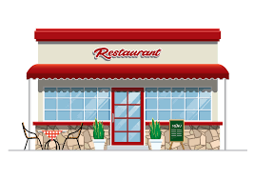
restaurant

Slide 94
Let’s Teach and Practise

Slide 95
The prefix re-

Slide 96
re-

Slide 97
re- meaning ‘back’ or ‘again’

Slide 98
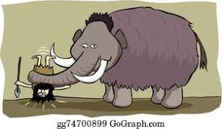
revenge

Slide 99

retrieved n

Slide 100

return

Slide 101
Definition – action or hurting or harming someone in return of a wrong suffered at their hands
revenge
re + venge = revenge
NOUN

Slide 102
Definition – get or bring something back from somewhere
retrieved
re + trieved = retrieved
VERB

Slide 103
Definition – come or go back to a place or person
return
re + turn = return
VERB

Slide 104
The act of revenge is never recommended.
_______

Slide 105
The boy retrieved his degree from the university.
_________

Slide 106
The children return to school year after year to learn new skills and knowledge.
______

Slide 107
New CHALLENGE words.

Slide 108
Definition - a thing that provides resistance, delay, or obstruction to something or someone
hindrance
NOUN

Slide 109
The over-large suitcase was a hindrance when climbing the stairs.
_________

Slide 110
Definition - extremely good; outstanding
excellent
ADJECTIVE

Slide 111
Christmas is excellent.
_________

Slide 112
Let’s Practise and Apply.

Slide 113
Can you spot the spelling rule words and the challenge words?

Slide 114
Fragile Earth
The observance of these forces acting on the Earth are seen as both natural and the work of people. We can criticise this and seek revenge, or we can recycle, rebuild and rewrite the future. The relevance of being able to recycle items means that less energy is used to create new things and less waste is being created. There is no time to be hesitant about this change of attitude.

Slide 115
Fragile Earth
The observance of these forces acting on the Earth are seen as both natural and the work of people. We can criticise this and seek revenge, or we can recycle, rebuild and rewrite the future. The relevance of being able to recycle items means that less energy is used to create new things and less waste is being created. There is no time to be hesitant about this change of attitude.

Slide 116
Write this sentence as I dictate it to you.
Notes:
The relevance of being able to recycle items means that less energy is used to create new things and less waste is being created.

Slide 117
The relevance of being able to recycle items means that less energy is used to create new things and less waste is being created.
Did you write it correctly?
Edit your work and make sure you have it correct.
Can you underline the spelling word that we have covered in this session?

Slide 118
Year 5 - Summer 2
Week 2 - Thursday

Slide 120
Let’s Revisit and Review…

Slide 121
Do you remember this challenge word?

Slide 122
Definition – communicate by exchanging letters, emails and other messages
correspond
VERB

Slide 123
Adults tend to correspond with work colleagues through emails.
___________

Slide 124
Do you remember this challenge word?

Slide 125
Definition – indicate the faults of (someone or something) in a disapproving way
criticise
VERB

Slide 126
Always be respectful when you criticise a piece of writing.
________

Slide 127
Words ending
-ance and -ant

Slide 128
-ance

Slide 129
-ance
Use –ant and –ance/–ancy if there is a related word with a
/æ/ or /eɪ/ sound in the right position;
–ation endings are often a clue.

Slide 130
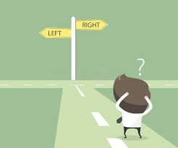
hesitant

Slide 131

expectant

Slide 132

observant

Slide 133
Let’s Teach and Practise

Slide 134
The prefix re-

Slide 135
re-

Slide 136
re- meaning ‘back’ or ‘again’

Slide 137

reflector

Slide 138

revise n

Slide 139
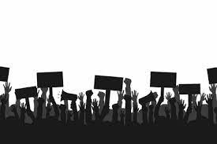
rebellion

Slide 140
Definition – a piece of material used for reflecting light in a certain direction
reflector
re + flector = reflector
NOUN

Slide 141
Definition – examine and make corrections or alterations
revise
re + vise = revise
VERB

Slide 142
Definition – an act of armed resistance to an established government or leader
rebellion
re + bellion = rebellion
NOUN

Slide 143
The reflector on his bike made him visible to motorists.
________

Slide 144
It is wise to revise for exams.
______

Slide 145
The rebellion took place in France to demand democracy.
________

Slide 146
New CHALLENGE words.

Slide 147
Definition - a thing that provides resistance, delay, or obstruction to something or someone
hindrance
NOUN

Slide 148
The over-large suitcase was a hindrance when climbing the stairs.
_________

Slide 149
Definition - extremely good; outstanding
excellent
ADJECTIVE

Slide 150
Christmas is excellent.
_________

Slide 151
Let’s Practise and Apply.

Slide 152
Can you spot the spelling rule words and the challenge words?

Slide 153
Fragile Earth
The observance of these forces acting on the Earth are seen as both natural and the work of people. We can criticise this and seek revenge, or we can recycle, rebuild and rewrite the future. The relevance of being able to recycle items means that less energy is used to create new things and less waste is being created. There is no time to be hesitant about this change of attitude.

Slide 154
Fragile Earth
The observance of these forces acting on the Earth are seen as both natural and the work of people. We can criticise this and seek revenge, or we can recycle, rebuild and rewrite the future. The relevance of being able to recycle items means that less energy is used to create new things and less waste is being created. There is no time to be hesitant about this change of attitude.

Slide 155
Write this sentence as I dictate it to you.
Notes:
There is no time to be hesitant about this change of attitude.

Slide 156
There is no time to be hesitant about this change of attitude.
Did you write it correctly?
Edit your work and make sure you have it correct.
Can you underline the spelling word that we have covered in this session?

Slide 157
Year 5 - Summer 2
Week 2 - Friday
Notes:
Click through the slides for all the R+R words for the week (both the focus and the challenge words)
Click through the slides for all the new learning this week

Slide 159
Old challenge words…

Slide 160
correspond

Slide 161
criticise

Slide 162
Old spelling rule words…

Slide 163
observance

Slide 164
flamboyance

Slide 165
tolerance

Slide 166
relevance

Slide 167
jubilance

Slide 168
relevant

Slide 169
tolerant

Slide 170
restaurant

Slide 171
hesitant

Slide 172
expectant

Slide 173
observant

Slide 174
New spelling rule words…

Slide 175
recycle

Slide 176
rebuild

Slide 177
rewrite

Slide 178
replace

Slide 179
revisit

Slide 180
refresh

Slide 181
revenge

Slide 182
retired

Slide 183
return

Slide 184
reflector

Slide 185
revise

Slide 186
rebellion

Slide 187
New challenge words…

Slide 188
hindrance

Slide 189
excellent

Slide 190
Quick Quiz time…
Notes:
Say these words for the quiz
Correspond criticise hindrance excellent relevance expectant reflector rebellion revenge recycle

Slide 191
Did you get them correct?
Edit your work.
correspond criticise hindrance excellent relevance expectant reflector rebellion revenge recycle
Notes:
Say these words for the quiz
unhappy undress unable actual learn mishap mistreat misprint mislead mistrust

Slide 192
Word class time…

Slide 193
The over-large suitcase was a hindrance when climbing the stairs.
determiner adjective noun verb article noun adverb verb article noun
Notes:
Ask for these words to be classed

Slide 194
Christmas is excellent.
noun verb adjective

Slide 195
Etymology
The history of a word….

Slide 196
hindrance (n.)
mid-15c., a hybrid from hindren (see hinder (v.)) on model of French-derived words in -ance.

Slide 197
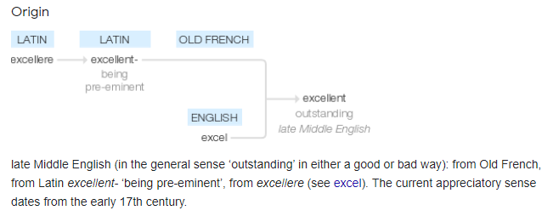
excellent (adj.)
"unexcelled, distinguished for superior merit of any kind, of surpassing character or quality, uncommonly valuable for any reason, remarkably good," mid-14c., from Old French excellent "outstanding, excellent," from Latin excellentem (nominative excellens) "towering, prominent, distinguished, superior, surpassing," present participle of excellere "surpass, be superior; to rise, be eminent," from ex "out from" (see ex-) + -cellere "rise high, tower," related to celsus "high, lofty, great," from PIE root *kel- (2) "to be prominent; hill." Related: Excellently

Slide 198
Let’s investigate….
Can you create SATs style questions for the words hindrance and excellent?
Can you produce a mark scheme to support your questions?

