Slide 1
Spelling Y5
Mastering spellings: building on the foundations of phonics
Summer 2
Week 5

Slide 2
Year 5 - Summer 2
Week 5 - Monday

Slide 3
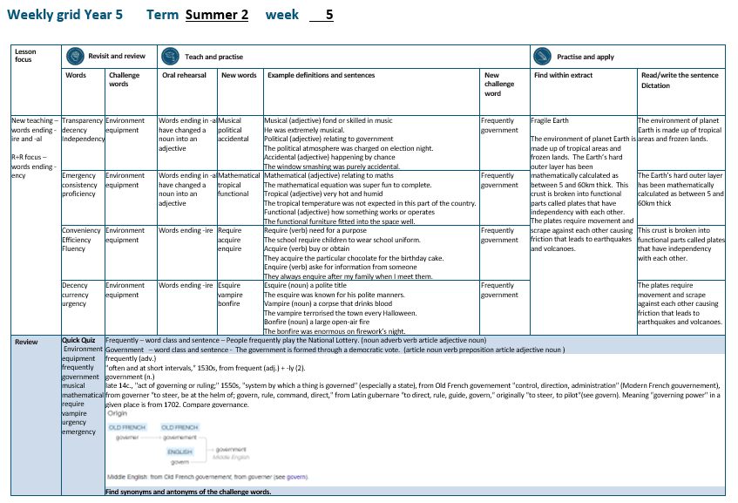

Slide 4
Let’s Revisit and Review…

Slide 5
Do you remember this challenge word?

Slide 6

Definition – surroundings or conditions in which a person, animal or plant lives
environment
NOUN

Slide 7
The environment needs to be protected for future generations.
___________

Slide 8
Do you remember this challenge word?

Slide 9

Definition – the necessary items for a particular purpose
equipment
NOUN

Slide 10
The equipment needed for secondary school was published as a list on the website.
_________

Slide 11
Can you remember this spelling rule?
Words ending in -ency

Slide 12
Words ending
-ency

Slide 13
-ency
Notes:
Sound of aI

Slide 14
-ency
Use –ent and –ence/–ency after soft c (/s/ sound), soft g (/dʒ/ sound) and qu, or if there is a related word with a clear /ɛ/ sound in the right position.

Slide 15

transparency

Slide 16
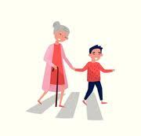
decency

Slide 17
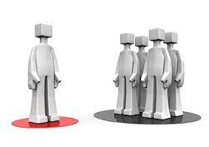
independency

Slide 18
Let’s Teach and Practise

Slide 19
Words ending
-al

Slide 20
-al
Notes:
Sound of aI

Slide 21
-al
Every syllable needs a vowel. So, if you hear 'l' at the end of a word and you can't hear a vowel sound, most commonly you will use 'al' or 'le'. You use 'al' if you are adding a suffix onto a base or root word (e.g., magic – magical). You use 'le' if it is a part of the word (e.g., little, candle).

Slide 22
-al words ending in al have changed a noun into an adjective music (noun) musical (adjective)

Slide 23
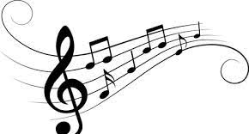
musical

Slide 24

political

Slide 25

accidental

Slide 26
Definition – fond or skilled at music
musical
music + al = musical
ADJECTIVE

Slide 27
Definition – relating to the government
political
politic + al = political
ADJECTIVE

Slide 28
Definition – happening by chance
accidental
accident + al = accidental
ADJECTIVE

Slide 29
He was extremely musical.
_______

Slide 30
The political atmosphere was charged on election night.
________

Slide 31
The window smashing was purely accidental.
__________

Slide 32
New CHALLENGE words.

Slide 33
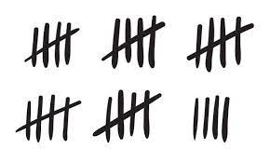
Definition - regularly or habitually; often
frequently
ADVERB

Slide 34
People frequently play the National Lottery.
__________

Slide 35
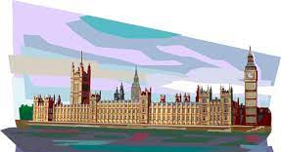
Definition - the group of people with the authority to govern a country or state; a particular ministry in office
government
NOUN

Slide 36
The government is formed through a democratic vote.
__________

Slide 37
Let’s Practise and Apply.

Slide 38
Can you spot the spelling rule words and the challenge words?

Slide 39
Fragile Earth
The environment of planet Earth is made up of tropical areas and frozen lands. The Earth’s hard outer layer has been mathematically calculated as between 5 and 60km thick. This crust is broken into functional parts called plates that have independency with each other. The plates require movement and scrape against each other causing friction that leads to earthquakes and volcanoes.

Slide 40
Fragile Earth
The environment of planet Earth is made up of tropical areas and frozen lands. The Earth’s hard outer layer has been mathematically calculated as between 5 and 60km thick. This crust is broken into functional parts called plates that have independency with each other. The plates require movement and scrape against each other causing friction that leads to earthquakes and volcanoes.

Slide 41
Write this sentence as I dictate it to you.
Notes:
The environment of planet Earth is made up of tropical areas and frozen lands.

Slide 42
The environment of planet Earth is made up of tropical areas and frozen lands.
Did you write it correctly?
Edit your work and make sure you have it correct.
Can you underline the spelling word that we have covered in this session?

Slide 43
Year 5 - Summer 2
Week 5 - Tuesday

Slide 45
Let’s Revisit and Review…

Slide 46
Do you remember this challenge word?

Slide 47
Definition – surroundings or conditions in which a person, animal or plant lives
environment
NOUN

Slide 48
The environment needs to be protected for future generations.
___________

Slide 49
Do you remember this challenge word?

Slide 50
Definition – the necessary items for a particular purpose
equipment
NOUN

Slide 51
The equipment needed for secondary school was published as a list on the website.
_________

Slide 52
Can you remember this spelling rule?
Words ending in -ency

Slide 53
Words ending
-ency

Slide 54
-ency
Notes:
Sound of aI

Slide 55
-ency
Use –ent and –ence/–ency after soft c (/s/ sound), soft g (/dʒ/ sound) and qu, or if there is a related word with a clear /ɛ/ sound in the right position.

Slide 56

emergency

Slide 57

consistency

Slide 58

proficiency

Slide 59
Let’s Teach and Practise

Slide 60
Words ending
-al

Slide 61
-al
Notes:
Sound of aI

Slide 62
-al
Every syllable needs a vowel. So, if you hear 'l' at the end of a word and you can't hear a vowel sound, most commonly you will use 'al' or 'le'. You use 'al' if you are adding a suffix onto a base or root word (e.g., magic – magical). You use 'le' if it is a part of the word (e.g., little, candle).

Slide 63
-al words ending in al have changed a noun into an adjective music (noun) musical (adjective)

Slide 64

mathematical

Slide 65

tropical

Slide 66
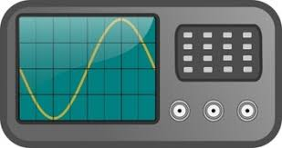
functional

Slide 67
Definition – relating to maths
mathematical
mathematic + al = mathematical
ADJECTIVE

Slide 68
Definition – very hot and humid
tropical
tropic + al = tropical
ADJECTIVE

Slide 69
Definition – how something works or operates
functional
function + al = functional
ADJECTIVE

Slide 70
The mathematical equation was super fun to complete.
____________

Slide 71
The tropical temperature was not expected in this part of the country.
_______

Slide 72
The functional furniture fitted into the space well.
_________

Slide 73
New CHALLENGE words.

Slide 74
Definition - regularly or habitually; often
frequently
ADVERB

Slide 75
People frequently play the National Lottery.
__________

Slide 76
Definition - the group of people with the authority to govern a country or state; a particular ministry in office
government
NOUN

Slide 77
The government is formed through a democratic vote.
__________

Slide 78
Let’s Practise and Apply.

Slide 79
Can you spot the spelling rule words and the challenge words?

Slide 80
Fragile Earth
The environment of planet Earth is made up of tropical areas and frozen lands. The Earth’s hard outer layer has been mathematically calculated as between 5 and 60km thick. This crust is broken into functional parts called plates that have independency with each other. The plates require movement and scrape against each other causing friction that leads to earthquakes and volcanoes.

Slide 81
Fragile Earth
The environment of planet Earth is made up of tropical areas and frozen lands. The Earth’s hard outer layer has been mathematically calculated as between 5 and 60km thick. This crust is broken into functional parts called plates that have independency with each other. The plates require movement and scrape against each other causing friction that leads to earthquakes and volcanoes.

Slide 82
Write this sentence as I dictate it to you.
Notes:
The Earth’s hard outer layer has been mathematically calculated as between 5 and 60km thick.

Slide 83
The Earth’s hard outer layer has been mathematically calculated as between 5 and 60km thick.
Did you write it correctly?
Edit your work and make sure you have it correct.
Can you underline the spelling word that we have covered in this session?

Slide 84
Year 5 - Summer 2
Week 5 - Wednesday

Slide 86
Let’s Revisit and Review…

Slide 87
Do you remember this challenge word?

Slide 88
Definition – surroundings or conditions in which a person, animal or plant lives
environment
NOUN

Slide 89
The environment needs to be protected for future generations.
___________

Slide 90
Do you remember this challenge word?

Slide 91
Definition – the necessary items for a particular purpose
equipment
NOUN

Slide 92
The equipment needed for secondary school was published as a list on the website.
_________

Slide 93
Can you remember this spelling rule?
Words ending in -ency

Slide 94
Words ending
-ency

Slide 95
-ency
Notes:
Sound of aI

Slide 96
-ency
Use –ent and –ence/–ency after soft c (/s/ sound), soft g (/dʒ/ sound) and qu, or if there is a related word with a clear /ɛ/ sound in the right position.

Slide 97
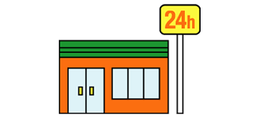
conveniency

Slide 98
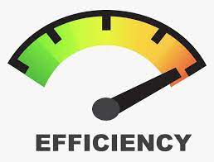
efficiency

Slide 99

fluency

Slide 100
Let’s Teach and Practise

Slide 101
Words ending
-ire

Slide 102
-ire
Notes:
Sound of aI

Slide 103

require

Slide 104
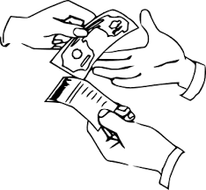
acquire

Slide 105

enquire

Slide 106
Definition – need for a purpose
require
VERB

Slide 107
Definition – buy or obtain
acquire
VERB

Slide 108
Definition – ask for information from someone
enquire
VERB

Slide 109
The school require children to wear school uniform.
_______

Slide 110
They need to acquire a particular chocolate cake for the birthday party.
_______

Slide 111
They always enquire after my family when I meet with them.
_______

Slide 112
New CHALLENGE words.

Slide 113
Definition - regularly or habitually; often
frequently
ADVERB

Slide 114
People frequently play the National Lottery.
__________

Slide 115
Definition - the group of people with the authority to govern a country or state; a particular ministry in office
government
NOUN

Slide 116
The government is formed through a democratic vote.
__________

Slide 117
Let’s Practise and Apply.

Slide 118
Can you spot the spelling rule words and the challenge words?

Slide 119
Fragile Earth
The environment of planet Earth is made up of tropical areas and frozen lands. The Earth’s hard outer layer has been mathematically calculated as between 5 and 60km thick. This crust is broken into functional parts called plates that have independency with each other. The plates require movement and scrape against each other causing friction that leads to earthquakes and volcanoes.

Slide 120
Fragile Earth
The environment of planet Earth is made up of tropical areas and frozen lands. The Earth’s hard outer layer has been mathematically calculated as between 5 and 60km thick. This crust is broken into functional parts called plates that have independency with each other. The plates require movement and scrape against each other causing friction that leads to earthquakes and volcanoes.

Slide 121
Write this sentence as I dictate it to you.
Notes:
This crust is broken into functional parts called plates that have independency with each other.

Slide 122
This crust is broken into functional parts called plates that have independency with each other.
Did you write it correctly?
Edit your work and make sure you have it correct.
Can you underline the spelling word that we have covered in this session?

Slide 123
Year 5 - Summer 2
Week 5 - Thursday

Slide 125
Let’s Revisit and Review…

Slide 126
Do you remember this challenge word?

Slide 127
Definition – surroundings or conditions in which a person, animal or plant lives
environment
NOUN

Slide 128
The environment needs to be protected for future generations.
___________

Slide 129
Do you remember this challenge word?

Slide 130
Definition – the necessary items for a particular purpose
equipment
NOUN

Slide 131
The equipment needed for secondary school was published as a list on the website.
_________

Slide 132
Can you remember this spelling rule?
Words ending in -ency

Slide 133
Words ending
-ency

Slide 134
-ency
Notes:
Sound of aI

Slide 135
-ency
Use –ent and –ence/–ency after soft c (/s/ sound), soft g (/dʒ/ sound) and qu, or if there is a related word with a clear /ɛ/ sound in the right position.

Slide 136
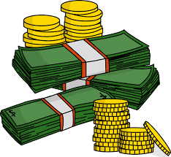
currency

Slide 137

urgency

Slide 138
Let’s Teach and Practise

Slide 139
Words ending
-ire

Slide 140
-ire
Notes:
Sound of aI

Slide 141

esquire

Slide 142

vampire

Slide 143
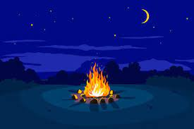
bonfire

Slide 144
Definition – a polite title
esquire
NOUN

Slide 145
Definition – a corpse that drinks blood
vampire
NOUN

Slide 146
Definition – a large open-air fire
bonfire
NOUN

Slide 147
The esquire was known for his polite manners.
_______

Slide 148
The vampire terrorised the town every Halloween.
_______

Slide 149
The bonfire was enormous on firework’s night.
_______

Slide 150
New CHALLENGE words.

Slide 151
Definition - regularly or habitually; often
frequently
ADVERB

Slide 152
People frequently play the National Lottery.
__________

Slide 153
Definition - the group of people with the authority to govern a country or state; a particular ministry in office
government
NOUN

Slide 154
The government is formed through a democratic vote.
__________

Slide 155
Let’s Practise and Apply.

Slide 156
Can you spot the spelling rule words and the challenge words?

Slide 157
Fragile Earth
The environment of planet Earth is made up of tropical areas and frozen lands. The Earth’s hard outer layer has been mathematically calculated as between 5 and 60km thick. This crust is broken into functional parts called plates that have independency with each other. The plates require movement and scrape against each other causing friction that leads to earthquakes and volcanoes.

Slide 158
Fragile Earth
The environment of planet Earth is made up of tropical areas and frozen lands. The Earth’s hard outer layer has been mathematically calculated as between 5 and 60km thick. This crust is broken into functional parts called plates that have independency with each other. The plates require movement and scrape against each other causing friction that leads to earthquakes and volcanoes.

Slide 159
Write this sentence as I dictate it to you.
Notes:
The plates require movement and scrape against each other causing friction that leads to earthquakes and volcanoes.

Slide 160
The plates require movement and scrape against each other causing friction that leads to earthquakes and volcanoes.
Did you write it correctly?
Edit your work and make sure you have it correct.
Can you underline the spelling word that we have covered in this session?

Slide 161
Year 5 - Summer 2
Week 5 - Friday
Notes:
Click through the slides for all the R+R words for the week (both the focus and the challenge words)
Click through the slides for all the new learning this week

Slide 163
Old challenge words…

Slide 164
environment

Slide 165
equipment

Slide 166
Old spelling rule words…

Slide 167
transparency

Slide 168
decency

Slide 169
independency

Slide 170
emergency

Slide 171
consistency

Slide 172
proficiency

Slide 173
conveniency

Slide 174
efficiency

Slide 175
fluency

Slide 176
currency

Slide 177
urgency

Slide 178
New spelling rule words…

Slide 179
musical

Slide 180
political

Slide 181
accidental

Slide 182
mathematical

Slide 183
tropical

Slide 184
functional

Slide 185
require

Slide 186
acquire

Slide 187
enquire

Slide 188
esquire

Slide 189
vampire

Slide 190
bonfire

Slide 191
New challenge words…

Slide 192
frequently

Slide 193
government

Slide 194
Quick Quiz time…
Notes:
Say these words for the quiz
Environment equipment frequently government musical mathematical require vampire urgency emergency

Slide 195
Did you get them correct?
Edit your work.
environment equipment frequently government musical mathematical require vampire urgency emergency

Slide 196
Word class time…

Slide 197
People frequently play the National Lottery.
Notes:
Ask for these words to be classed

Slide 198
People frequently play the National Lottery.
noun adverb verb article adjective noun
Notes:
Ask for these words to be classed

Slide 199
People frequently play the National Lottery.
noun adverb verb article adjective noun
Notes:
Ask for these words to be classed

Slide 200
The government is formed through a democratic vote.
Notes:
Ask for these words to be classed

Slide 201
The government is formed through a democratic vote.
article noun verb preposition article adjective noun

Slide 202
The government is formed through a democratic vote.
article noun verb preposition article adjective noun

Slide 203
Etymology
The history of a word….

Slide 204
frequently (adv.)
"often and at short intervals," 1530s, from frequent (adj.) + -ly (2).

Slide 205
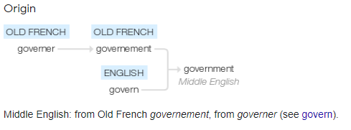
government (n.)
late 14c., "act of governing or ruling;" 1550s, "system by which a thing is governed" (especially a state), from Old French governement "control, direction, administration" (Modern French gouvernement), from governer "to steer, be at the helm of; govern, rule, command, direct," from Latin gubernare "to direct, rule, guide, govern," originally "to steer, to pilot"(see govern). Meaning "governing power" in a given place is from 1702. Compare governance.

Slide 206
Let’s investigate….
Can you find words synonyms and antonyms of government and frequently?

Slide 207
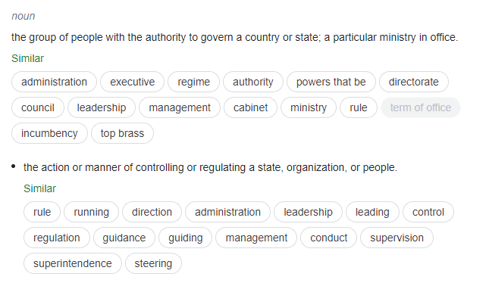
Synonyms of government…

Slide 208
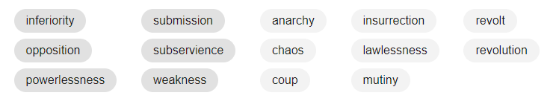
Antonyms of government…

Slide 209
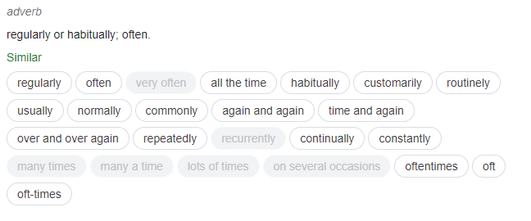
Synonyms of frequently…

Slide 210
Antonyms of frequently…
infrequently
little
rarely
seldom

