Slide 1
Spelling Y5
Mastering spellings: building on the foundations of phonics
Summer 2
Week 6

Slide 2
Year 5 - Summer 2
Week 6 - Monday

Slide 3
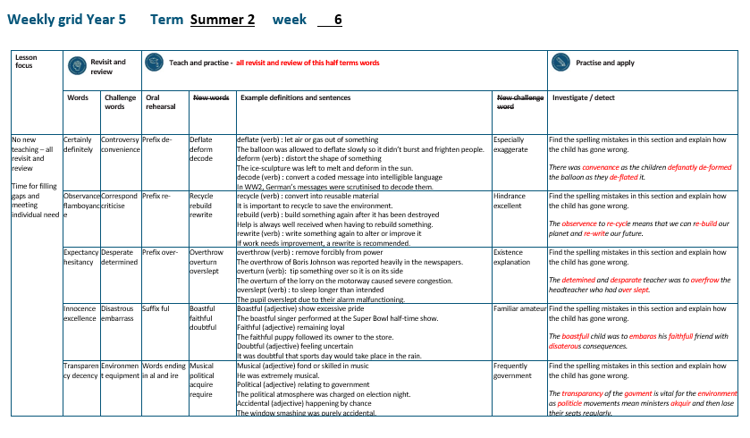

Slide 4
Let’s Revisit and Review…

Slide 5
Do you remember this challenge word?

Slide 6

Definition – prolonged public disagreement or heated discussion
controversy
NOUN

Slide 7
There was controversy over the lead role for the Y6 performance.
___________

Slide 8
Do you remember this challenge word?

Slide 9
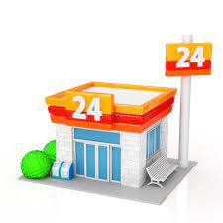
Definition – the state of being able to proceed with something without difficulty
convenience
NOUN

Slide 10
People enjoy the convenience of the local store being open 24 hours.
___________

Slide 11
Adverbials
-possibility
–frequency
–modal verbs

Slide 12
adverbials

Slide 13
-adverbials add detail of where, when, how, frequency of the verb

Slide 14
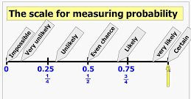
certainly

Slide 15
definitely

Slide 16
possibly

Slide 17
Let’s Teach and Practise

Slide 18
The prefix de-

Slide 19
de-

Slide 20
de- meaning ‘off’ or ‘from’

Slide 21
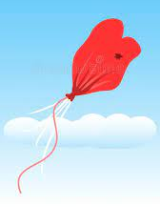
deflate

Slide 22
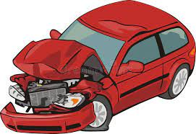
deform

Slide 23
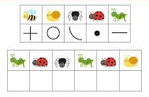
decode

Slide 24
Definition – let air or gas out of something
deflate
de + flate = deflate
VERB

Slide 25
Definition – distort the shape of something
deform
de + form = deform
VERB

Slide 26
Definition – convert a coded message into intelligible language
decode
de + code = decode
VERB

Slide 27
The balloon was allowed to deflate slowly so it didn’t burst and frighten people.
_______

Slide 28
The ice-sculpture was left to melt and deform in the sun.
______

Slide 29
In WW2, German messages were scrutinised to decode them.
______

Slide 30
New CHALLENGE words.

Slide 31

Definition – used to single out one person or thing over all others
especially
ADVERB

Slide 32
Children especially love spelling quizzes.
__________

Slide 33
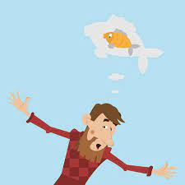
Definition - represent (something) as being larger, better, or worse than it really is
exaggerate
VERB

Slide 34
The fisherman would exaggerate how big his catch was.
__________

Slide 35
Let’s investigate and detect…

Slide 36
Look at this sentence.
Change the spellings that are incorrect.
Explain how each one is wrong and how to remember to get it right next time.
There was convenance as the children defanatly de-formed the balloon as they de-flated it.

Slide 37
There was convenance as the children defanatly de-formed the balloon as they de-flated it. convenience – ence ending convenient => ence

Slide 38
There was convenance as the children defanatly de-formed the balloon as they de-flated it.
Definitely – finite (unstressed vowel)

Slide 39
There was convenance as the children defanatly de-formed the balloon as they de-flated it. deformed – one word not hyphenated

Slide 40
There was convenance as the children defanatly de-formed the balloon as they de-flated it. deflated – one word not hyphenated

Slide 41
There was convenience as the children definitely deformed the balloon as they deflated it.

Slide 42
Year 5 - Summer 2
Week 6 - Tuesday

Slide 44
Let’s Revisit and Review…

Slide 45
Do you remember this challenge word?

Slide 46

Definition – communicate by exchanging letters, emails and other messages
correspond
VERB

Slide 47
Adults tend to correspond with work colleagues through emails.
___________

Slide 48
Do you remember this challenge word?

Slide 49
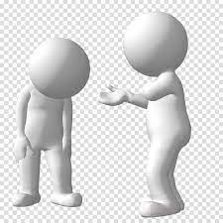
Definition – indicate the faults of (someone or something) in a disapproving way
criticise
VERB

Slide 50
Always be respectful when you criticise a piece of writing.
________

Slide 51
Words ending
-ance and -ant

Slide 52
-ance

Slide 53
-ance
Use –ant and –ance/–ancy if there is a related word with a
/æ/ or /eɪ/ sound in the right position;
–ation endings are often a clue.

Slide 54

observance

Slide 55
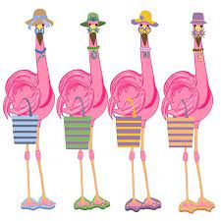
flamboyance

Slide 56
Let’s Teach and Practise

Slide 57
The prefix re-

Slide 58
re-

Slide 59
re- meaning ‘back’ or ‘again’

Slide 60
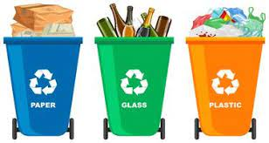
recycle

Slide 61
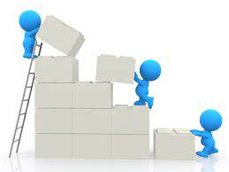
rebuild n

Slide 62
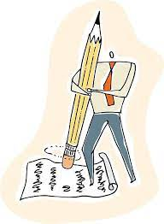
rewrite

Slide 63
Definition – convert into usable material
recycle
re + cycle = recycle
VERB

Slide 64
Definition – build something again after it has been destroyed
rebuild
re + build = rebuild
VERB

Slide 65
Definition – write something again or alter or improve it
rewrite
re + write = rewrite
VERB

Slide 66
It is important to recycle to save the environment.
_______

Slide 67
Help is always well received when having to rebuild something.
_______

Slide 68
If work needs improvement, a rewrite is recommended.
_______

Slide 69
New CHALLENGE words.

Slide 70
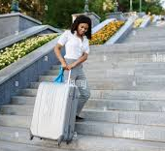
Definition - a thing that provides resistance, delay, or obstruction to something or someone
hindrance
NOUN

Slide 71
The over-large suitcase was a hindrance when climbing the stairs.
_________

Slide 72
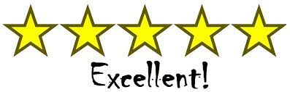
Definition - extremely good; outstanding
excellent
ADJECTIVE

Slide 73
Christmas is excellent.
_________

Slide 74
Let’s investigate and detect…

Slide 75
Look at this sentence.
Change the spellings that are incorrect.
Explain how each one is wrong and how to remember to get it right next time.
The observence to re-cycle means that we can re-build our planet and re-write our future.

Slide 76
The observence to re-cycle means that we can re-build our planet and re-write our future. observance – ance ending observe => ance

Slide 77
The observence to re-cycle means that we can re-build our planet and re-write our future. recycle – one word (not hyphenated)

Slide 78
The observence to re-cycle means that we can re-build our planet and re-write our future. rebuild – one word (not hyphenated)

Slide 79
The observence to re-cycle means that we can re-build our planet and re-write our future. rewrite– one word (not hyphenated)

Slide 80
The observance to recycle means that we can rebuild our planet and rewrite our future.

Slide 81
Year 5 - Summer 2
Week 6 - Wednesday

Slide 83
Let’s Revisit and Review…

Slide 84
Do you remember this challenge word?

Slide 85
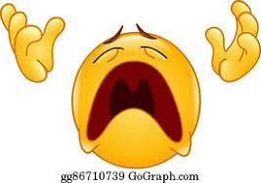
Definition – (of an act) tried in despair or when everything else has failed
desperate
ADJECTIVE

Slide 86
The dog was desperate to find his buried bone.
_________

Slide 87
Do you remember this challenge word?

Slide 88
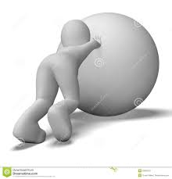
Definition – having made a firm decision and being resolved not to change it
determined
ADJECTIVE

Slide 89
The dog was determined to find his buried bone.
__________

Slide 90
Words ending
-ancy

Slide 91
-ancy

Slide 92
-ancy
Use –ant and –ance/–ancy if there is a related word with a /æ/ or /eɪ/ sound in the right position;
–ation endings are often a clue.

Slide 93
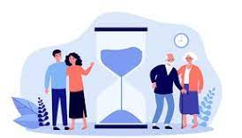
expectancy

Slide 94

hesitancy

Slide 95
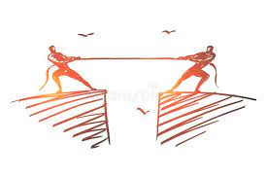
discrepancy

Slide 96
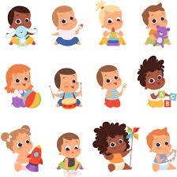
infancy

Slide 97
Let’s Teach and Practise

Slide 98
The prefix over-

Slide 99
over-

Slide 100
over- meaning ‘too much’ or ‘more than enough’

Slide 101

overthrow

Slide 102

overturn n

Slide 103
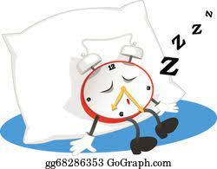
overslept

Slide 104
Definition – remove forcibly from power
overthrow
over + throw = overthrow
VERB

Slide 105
Definition – tip something over so its on its side
overturn
over + turn = overturn
VERB

Slide 106
Definition – to sleep longer than intended
overslept
over + slept = overslept
VERB

Slide 107
The overthrow of Boris Johnson was reported heavily in the papers.
_________

Slide 108
The overturn of the lorry on the motorway caused severe congestion.
________

Slide 109
The pupil overslept due to their alarm malfunctioning.
_________

Slide 110
New CHALLENGE words.

Slide 111

Definition - the fact or state of living or having objective reality
existence
NOUN

Slide 112
Christians believe in the existence of God.
__________

Slide 113
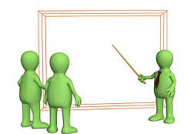
Definition - a statement or account that makes something clear
explanation
NOUN

Slide 114
An explanation text is useful in science lessons.
___________

Slide 115
Let’s investigate and detect…

Slide 116
Look at this sentence.
Change the spellings that are incorrect.
Explain how each one is wrong and how to remember to get it right next time.
The detemined and desparate teacher was to overfrow the headteacher who had over slept.

Slide 117
The detemined and desparate teacher was to overfrow the headteacher who had over slept. determined – r missed

Slide 118
The detemined and desparate teacher was to overfrow the headteacher who had over slept. desperate – e not a on unstressed vowel

Slide 119
The detemined and desparate teacher was to overfrow the headteacher who had over slept. overthrow – throw (th not f)

Slide 120
The detemined and desparate teacher was to overfrow the headteacher who had over slept. overslept – one word, not two

Slide 121
The determined and desperate teacher was to overthrow the headteacher who had overslept.

Slide 122
Year 5 - Summer 2
Week 6 - Thursday

Slide 124
Let’s Revisit and Review…

Slide 125
Do you remember this challenge word?

Slide 126
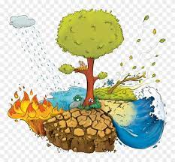
Definition – causing great damage
disastrous
ADJECTIVE

Slide 127
It is disastrous when an earthquake happens.
__________

Slide 128
Do you remember this challenge word?

Slide 129

Definition – cause (someone) to feel awkward, self-conscious or ashamed
embarrass
VERB

Slide 130
Parents love to embarrass their children.
_________

Slide 131
Words ending
-ence and -ent

Slide 132
-ence
Notes:
Sound of aI

Slide 133
-ence
Use –ent and –ence/–ency after soft c (/s/ sound), soft g (/dʒ/ sound) and qu, or if there is a related word with a clear /ɛ/ sound in the right position.

Slide 134

innocence

Slide 135
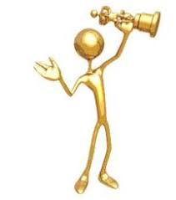
excellence

Slide 136
Let’s Teach and Practise

Slide 137
The suffix -ful

Slide 138
-ful

Slide 139
Suffix –ful meaning full of

Slide 140

boastful

Slide 141

faithful

Slide 142

doubtful

Slide 143
Definition – shows excessive pride
boastful
boast + ful = boastful
ADJECTIVE

Slide 144
Definition – remaining loyal
faithful
faith + ful = faithful
ADJECTIVE

Slide 145
Definition – feeling uncertain
doubtful
doubt + ful = doubtful
ADJECTIVE

Slide 146
The boastful singer performed at the Super Bowl half-time show.
________

Slide 147
The faithful puppy followed its owner to the store.
________

Slide 148
It was doubtful that sports day would take place in the rain.
________

Slide 149
New CHALLENGE words.

Slide 150
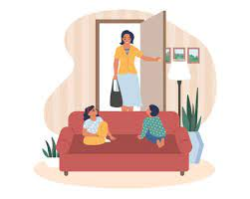
Definition - well known from long or close association
familiar
ADJECTIVE

Slide 151
The familiar feeling came over her as she entered her old home.
________

Slide 152
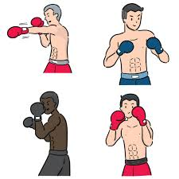
Definition - engaging or engaged in without payment; non-professional
amateur
ADJECTIVE

Slide 153
The Olympics were incredible for the amateur boxer.
_______

Slide 154
Let’s investigate and detect…

Slide 155
Look at this sentence.
Change the spellings that are incorrect.
Explain how each one is wrong and how to remember to get it right next time.
The boastfull child was to embaras his faithfull friend with disaterous consequences.

Slide 156
The boastfull child was to embaras his faithfull friend with disaterous consequences. boastful – ful as a suffix
(only one l)

Slide 157
The boastfull child was to embaras his faithfull friend with disaterous consequences. embarrass – double r and s

Slide 158
The boastfull child was to embaras his faithfull friend with disaterous consequences. faithful – ful suffix (only 1 l)

Slide 159
The boastfull child was to embaras his faithfull friend with disaterous consequences. disastrous – no ‘er’ stress in middle

Slide 160
The boastful child was to embarrass his faithful friend with disastrous consequences.

Slide 161
Year 5 - Summer 2
Week 6 - Friday

Slide 163
Let’s Revisit and Review…

Slide 164
Do you remember this challenge word?

Slide 165

Definition – surroundings or conditions in which a person, animal or plant lives
environment
NOUN

Slide 166
The environment needs to be protected for future generations.
___________

Slide 167
Do you remember this challenge word?

Slide 168

Definition – the necessary items for a particular purpose
equipment
NOUN

Slide 169
The equipment needed for secondary school was published as a list on the website.
_________

Slide 170
Can you remember this spelling rule?
Words ending in -ency

Slide 171
Words ending
-ency

Slide 172
-ency
Notes:
Sound of aI

Slide 173
-ency
Use –ent and –ence/–ency after soft c (/s/ sound), soft g (/dʒ/ sound) and qu, or if there is a related word with a clear /ɛ/ sound in the right position.

Slide 174

transparency

Slide 175
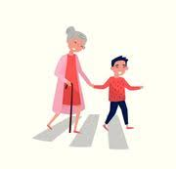
decency

Slide 176
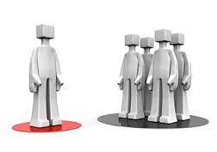
independency

Slide 177
Let’s Teach and Practise

Slide 178
Words ending
-al

Slide 179
-al
Notes:
Sound of aI

Slide 180
-al
Every syllable needs a vowel. So, if you hear 'l' at the end of a word and you can't hear a vowel sound, most commonly you will use 'al' or 'le'. You use 'al' if you are adding a suffix onto a base or root word (e.g., magic – magical). You use 'le' if it is a part of the word (e.g., little, candle).

Slide 181
-al words ending in al have changed a noun into an adjective music (noun) musical (adjective)

Slide 182
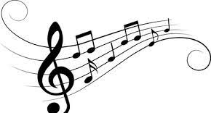
musical

Slide 183
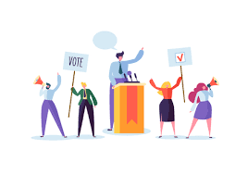
political

Slide 184
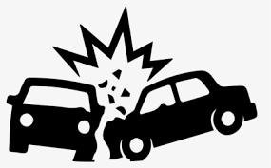
accidental

Slide 185
Definition – fond or skilled at music
musical
music + al = musical
ADJECTIVE

Slide 186
Definition – relating to the government
political
politic + al = political
ADJECTIVE

Slide 187
Definition – happening by chance
accidental
accident + al = accidental
ADJECTIVE

Slide 188
He was extremely musical.
_______

Slide 189
The political atmosphere was charged on election night.
________

Slide 190
The window smashing was purely accidental.
__________

Slide 191
New CHALLENGE words.

Slide 192
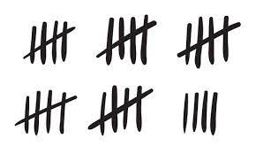
Definition - regularly or habitually; often
frequently
ADVERB

Slide 193
People frequently play the National Lottery.
__________

Slide 194
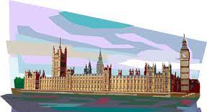
Definition - the group of people with the authority to govern a country or state; a particular ministry in office
government
NOUN

Slide 195
The government is formed through a democratic vote.
__________

Slide 196
Let’s investigate and detect…

Slide 197
Look at this sentence.
Change the spellings that are incorrect.
Explain how each one is wrong and how to remember to get it right next time.
The transparancy of the govment is vital for the environment as politicle movements mean ministers akquir and then lose their seats regularly.

Slide 198
The transparancy of the govment is vital for the environment as politicle movements mean ministers akquir and then lose their seats regularly. transparency – ency ending transparent => ency

Slide 199
The transparancy of the govment is vital for the environment as politicle movements mean ministers akquir and then lose their seats regularly. government – ern missing from middle

Slide 200
The transparancy of the govment is vital for the environment as politicle movements mean ministers akquir and then lose their seats regularly. political – al ending politic -> political

Slide 201
The transparancy of the govment is vital for the environment as politicle movements mean ministers akquir and then lose their seats regularly. acquire – ire ending

Slide 202
The transparency of the government is vital for the environment as political movements mean ministers acquire and then lose their seats regularly.

