Slide 1
Spelling Y5
Mastering spellings: building on the foundations of phonics
Summer 2
Week 3

Slide 2
Year 5 - Summer 2
Week 3 - Monday

Slide 3
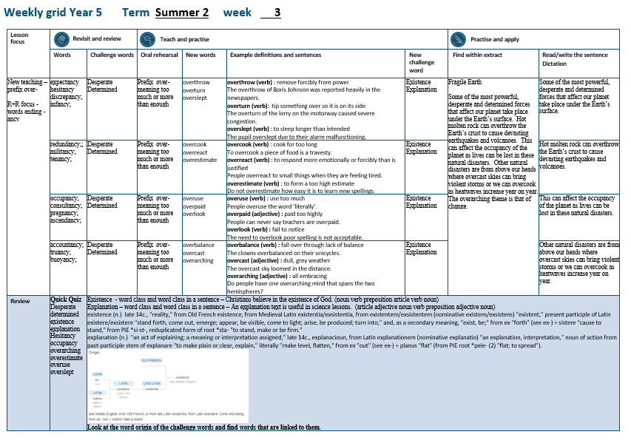

Slide 4
Let’s Revisit and Review…

Slide 5
Do you remember this challenge word?

Slide 6

Definition – (of an act) tried in despair or when everything else has failed
desperate
ADJECTIVE

Slide 7
The dog was desperate to find his buried bone.
_________

Slide 8
Do you remember this challenge word?

Slide 9
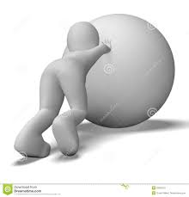
Definition – having made a firm decision and being resolved not to change it
determined
ADJECTIVE

Slide 10
The dog was determined to find his buried bone.
__________

Slide 11
Words ending
-ancy

Slide 12
-ancy

Slide 13
-ancy
Use –ant and –ance/–ancy if there is a related word with a /æ/ or /eɪ/ sound in the right position;
–ation endings are often a clue.

Slide 14
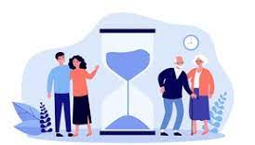
expectancy

Slide 15

hesitancy

Slide 16
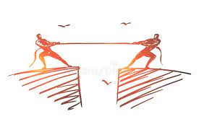
discrepancy

Slide 17
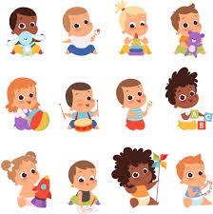
infancy

Slide 18
Let’s Teach and Practise

Slide 19
The prefix over-

Slide 20
over-

Slide 21
over- meaning ‘too much’ or ‘more than enough’

Slide 22

overthrow

Slide 23

overturn n

Slide 24
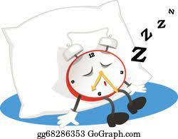
overslept

Slide 25
Definition – remove forcibly from power
overthrow
over + throw = overthrow
VERB

Slide 26
Definition – tip something over so its on its side
overturn
over + turn = overturn
VERB

Slide 27
Definition – to sleep longer than intended
overslept
over + slept = overslept
VERB

Slide 28
The overthrow of Boris Johnson was reported heavily in the papers.
_________

Slide 29
The overturn of the lorry on the motorway caused severe congestion.
________

Slide 30
The pupil overslept due to their alarm malfunctioning.
_________

Slide 31
New CHALLENGE words.

Slide 32

Definition - the fact or state of living or having objective reality
existence
NOUN

Slide 33
Christians believe in the existence of God.
__________

Slide 34
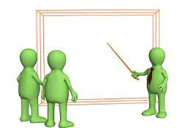
Definition - a statement or account that makes something clear
explanation
NOUN

Slide 35
An explanation text is useful in science lessons.
___________

Slide 36
Let’s Practise and Apply.

Slide 37
Can you spot the spelling rule words and the challenge words?

Slide 38
Global Warming – weather
Fragile Earth
Some of the most powerful, desperate and determined forces that affect our planet take place under the Earth’s surface. Hot molten rock can overthrow the Earth’s crust to cause devasting earthquakes and volcanoes. This can affect the occupancy of the planet as lives can be lost in these natural disasters. Other natural disasters are from above our heads where overcast skies can bring violent storms or we can overcook as heatwaves increase year on year. The overarching theme is that of change.

Slide 39
Global Warming – weather
Fragile Earth
Some of the most powerful, desperate and determined forces that affect our planet take place under the Earth’s surface. Hot molten rock can overthrow the Earth’s crust to cause devasting earthquakes and volcanoes. This can affect the occupancy of the planet as lives can be lost in these natural disasters. Other natural disasters are from above our heads where overcast skies can bring violent storms or we can overcook as heatwaves increase year on year. The overarching theme is that of change.

Slide 40
Write this sentence as I dictate it to you.
Notes:
Some of the most powerful, desperate and determined forces that affect our planet take place under the Earth’s surface.

Slide 41
Some of the most powerful, desperate and determined forces that affect our planet take place under the Earth’s surface.
Did you write it correctly?
Edit your work and make sure you have it correct.
Can you underline the spelling word that we have covered in this session?

Slide 42
Year 5 - Summer 2
Week 3 - Tuesday

Slide 44
Let’s Revisit and Review…

Slide 45
Do you remember this challenge word?

Slide 46
Definition – (of an act) tried in despair or when everything else has failed
desperate
ADJECTIVE

Slide 47
The dog was desperate to find his buried bone.
_________

Slide 48
Do you remember this challenge word?

Slide 49
Definition – having made a firm decision and being resolved not to change it
determined
ADJECTIVE

Slide 50
The dog was determined to find his buried bone.
__________

Slide 51
Words ending
-ancy

Slide 52
-ancy

Slide 53
-ancy
Use –ant and –ance/–ancy if there is a related word with a /æ/ or /eɪ/ sound in the right position;
–ation endings are often a clue.

Slide 54

redundancy

Slide 55
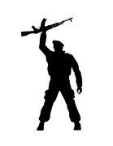
militancy

Slide 56

tenancy

Slide 57
Let’s Teach and Practise

Slide 58
The prefix over-

Slide 59
over-

Slide 60
over- meaning ‘too much’ or ‘more than enough’

Slide 61
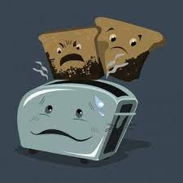
overcook

Slide 62
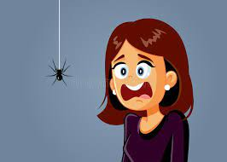
overreact n

Slide 63

overestimate

Slide 64
Definition – cook for too long
overcook
over + cook = overcook
VERB

Slide 65
Definition – to respond more emotionally or forcibly than is justified
overreact
over + react = overreact
VERB

Slide 66
Definition – to form a too high estimate
overestimate
over + estimate = overestimate
VERB

Slide 67
To overcook a piece of food is a travesty.
________

Slide 68
People overreact to small things when they are tired.
_________

Slide 69
Do not overestimate how easy it is to learn new spellings.
____________

Slide 70
New CHALLENGE words.

Slide 71
Definition - the fact or state of living or having objective reality
existence
NOUN

Slide 72
Christians believe in the existence of God.
__________

Slide 73
Definition - a statement or account that makes something clear
explanation
NOUN

Slide 74
An explanation text is useful in science lessons.
___________

Slide 75
Let’s Practise and Apply.

Slide 76
Can you spot the spelling rule words and the challenge words?

Slide 77
Global Warming – weather
Fragile Earth
Some of the most powerful, desperate and determined forces that affect our planet take place under the Earth’s surface. Hot molten rock can overthrow the Earth’s crust to cause devasting earthquakes and volcanoes. This can affect the occupancy of the planet as lives can be lost in these natural disasters. Other natural disasters are from above our heads where overcast skies can bring violent storms or we can overcook as heatwaves increase year on year. The overarching theme is that of change.

Slide 78
Global Warming – weather
Fragile Earth
Some of the most powerful, desperate and determined forces that affect our planet take place under the Earth’s surface. Hot molten rock can overthrow the Earth’s crust to cause devasting earthquakes and volcanoes. This can affect the occupancy of the planet as lives can be lost in these natural disasters. Other natural disasters are from above our heads where overcast skies can bring violent storms or we can overcook as heatwaves increase year on year. The overarching theme is that of change.

Slide 79
Write this sentence as I dictate it to you.
Notes:
Hot molten rock can overthrow the Earth’s crust to cause devasting earthquakes and volcanoes.

Slide 80
Hot molten rock can overthrow the Earth’s crust to cause devasting earthquakes and volcanoes.
Did you write it correctly?
Edit your work and make sure you have it correct.
Can you underline the spelling word that we have covered in this session?

Slide 81
Year 5 - Summer 2
Week 3 - Wednesday

Slide 83
Let’s Revisit and Review…

Slide 84
Do you remember this challenge word?

Slide 85
Definition – (of an act) tried in despair or when everything else has failed
desperate
ADJECTIVE

Slide 86
The dog was desperate to find his buried bone.
_________

Slide 87
Do you remember this challenge word?

Slide 88
Definition – having made a firm decision and being resolved not to change it
determined
ADJECTIVE

Slide 89
The dog was determined to find his buried bone.
__________

Slide 90
Words ending
-ancy

Slide 91
-ancy

Slide 92
-ancy
Use –ant and –ance/–ancy if there is a related word with a /æ/ or /eɪ/ sound in the right position;
–ation endings are often a clue.

Slide 93
expectancy

Slide 94
hesitancy

Slide 95
discrepancy

Slide 96
infancy

Slide 97
Let’s Teach and Practise

Slide 98
The prefix over-

Slide 99
over-

Slide 100
over- meaning ‘too much’ or ‘more than enough’

Slide 101
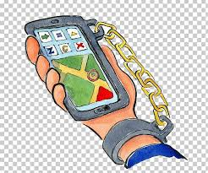
overuse

Slide 102

overpaid n

Slide 103
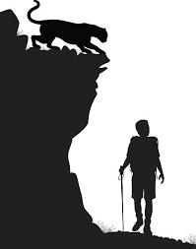
overlook

Slide 104
Definition – use too much
overuse
over + use = overuse
VERB

Slide 105
Definition – paid too highly
overpaid
over + paid = overpaid
VERB

Slide 106
Definition – fail to notice
overlook
over + look = overlook
VERB

Slide 107
People overuse the word ‘literally’.
_______

Slide 108
People can never say teachers are overpaid.
________

Slide 109
The need to overlook poor spelling is not acceptable.
________

Slide 110
New CHALLENGE words.

Slide 111
Definition - the fact or state of living or having objective reality
existence
NOUN

Slide 112
Christians believe in the existence of God.
__________

Slide 113
Definition - a statement or account that makes something clear
explanation
NOUN

Slide 114
An explanation text is useful in science lessons.
___________

Slide 115
Let’s Practise and Apply.

Slide 116
Can you spot the spelling rule words and the challenge words?

Slide 117
Global Warming – weather
Fragile Earth
Some of the most powerful, desperate and determined forces that affect our planet take place under the Earth’s surface. Hot molten rock can overthrow the Earth’s crust to cause devasting earthquakes and volcanoes. This can affect the occupancy of the planet as lives can be lost in these natural disasters. Other natural disasters are from above our heads where overcast skies can bring violent storms or we can overcook as heatwaves increase year on year. The overarching theme is that of change.

Slide 118
Global Warming – weather
Fragile Earth
Some of the most powerful, desperate and determined forces that affect our planet take place under the Earth’s surface. Hot molten rock can overthrow the Earth’s crust to cause devasting earthquakes and volcanoes. This can affect the occupancy of the planet as lives can be lost in these natural disasters. Other natural disasters are from above our heads where overcast skies can bring violent storms or we can overcook as heatwaves increase year on year. The overarching theme is that of change.

Slide 119
Write this sentence as I dictate it to you.
Notes:
This can affect the occupancy of the planet as lives can be lost in these natural disasters.

Slide 120
This can affect the occupancy of the planet as lives can be lost in these natural disasters.
Did you write it correctly?
Edit your work and make sure you have it correct.
Can you underline the spelling word that we have covered in this session?

Slide 121
Year 5 - Summer 2
Week 3 - Thursday

Slide 123
Let’s Revisit and Review…

Slide 124
Do you remember this challenge word?

Slide 125
Definition – (of an act) tried in despair or when everything else has failed
desperate
ADJECTIVE

Slide 126
The dog was desperate to find his buried bone.
_________

Slide 127
Do you remember this challenge word?

Slide 128
Definition – having made a firm decision and being resolved not to change it
determined
ADJECTIVE

Slide 129
The dog was determined to find his buried bone.
__________

Slide 130
Words ending
-ancy

Slide 131
-ancy

Slide 132
-ancy
Use –ant and –ance/–ancy if there is a related word with a /æ/ or /eɪ/ sound in the right position;
–ation endings are often a clue.

Slide 133

accountancy

Slide 134

truancy

Slide 135
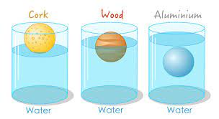
buoyancy

Slide 136
Let’s Teach and Practise

Slide 137
The prefix over-

Slide 138
over-

Slide 139
over- meaning ‘too much’ or ‘more than enough’

Slide 140

overbalance

Slide 141

overcast n

Slide 142
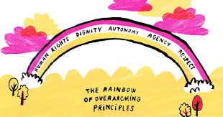
overarching

Slide 143
Definition – fall over through a lack of balance
overbalance
over + balance = overbalance
VERB

Slide 144
Definition – dull, grey weather
overcast
over + cast = overcast
VERB

Slide 145
Definition – all embracing
overarching
over + arching = overarching
VERB

Slide 146
The clowns overbalance on their unicycles.
___________

Slide 147
The overcast sky loomed in the distance.
________

Slide 148
Do people have one overarching mind that spans two hemispheres?
___________

Slide 149
New CHALLENGE words.

Slide 150
Definition - the fact or state of living or having objective reality
existence
NOUN

Slide 151
Christians believe in the existence of God.
__________

Slide 152
Definition - a statement or account that makes something clear
explanation
NOUN

Slide 153
An explanation text is useful in science lessons.
___________

Slide 154
Let’s Practise and Apply.

Slide 155
Can you spot the spelling rule words and the challenge words?

Slide 156
Global Warming – weather
Fragile Earth
Some of the most powerful, desperate and determined forces that affect our planet take place under the Earth’s surface. Hot molten rock can overthrow the Earth’s crust to cause devasting earthquakes and volcanoes. This can affect the occupancy of the planet as lives can be lost in these natural disasters. Other natural disasters are from above our heads where overcast skies can bring violent storms or we can overcook as heatwaves increase year on year. The overarching theme is that of change.

Slide 157
Global Warming – weather
Fragile Earth
Some of the most powerful, desperate and determined forces that affect our planet take place under the Earth’s surface. Hot molten rock can overthrow the Earth’s crust to cause devasting earthquakes and volcanoes. This can affect the occupancy of the planet as lives can be lost in these natural disasters. Other natural disasters are from above our heads where overcast skies can bring violent storms or we can overcook as heatwaves increase year on year. The overarching theme is that of change.

Slide 158
Write this sentence as I dictate it to you.
Notes:
Other natural disasters are from above our heads where overcast skies can bring violent storms or we can overcook as heatwaves increase year on year.

Slide 159
Other natural disasters are from above our heads where overcast skies can bring violent storms or we can overcook as heatwaves increase year on year.
Did you write it correctly?
Edit your work and make sure you have it correct.
Can you underline the spelling word that we have covered in this session?

Slide 160
Year 5 - Summer 2
Week 3 - Friday
Notes:
Click through the slides for all the R+R words for the week (both the focus and the challenge words)
Click through the slides for all the new learning this week

Slide 162
Old challenge words…

Slide 163
desperate

Slide 164
determined

Slide 165
Old spelling rule words…

Slide 166
expectancy

Slide 167
hesitancy

Slide 168
discrepancy

Slide 169
infancy

Slide 170
redundancy

Slide 171
militancy

Slide 172
tenancy

Slide 173
occupancy

Slide 174
consultancy

Slide 175
pregnancy

Slide 176
ascendancy

Slide 177
accountancy

Slide 178
truancy

Slide 179
buoyancy

Slide 180
New spelling rule words…

Slide 181
overthrow

Slide 182
overturn

Slide 183
overslept

Slide 184
overcook

Slide 185
overreact

Slide 186
overestimate

Slide 187
overuse

Slide 188
overpaid

Slide 189
overlook

Slide 190
overbalance

Slide 191
overcast

Slide 192
overarching

Slide 193
New challenge words…

Slide 194
existence

Slide 195
explanation

Slide 196
Quick Quiz time…
Notes:
Say these words for the quiz
Desperate determined existence explanation hesitancy occupancy overarching overestimate overuse overslept

Slide 197
Did you get them correct?
Edit your work.
desperate determined existence explanation hesitancy occupancy overarching overestimate overuse overslept

Slide 198
Word class time…

Slide 199
Christians believe in the existence of God.
noun verb preposition article noun determiner noun
Notes:
Ask for these words to be classed

Slide 200
An explanation text is useful in science lessons.
article adjective noun verb preposition adjective noun

Slide 201
Etymology
The history of a word….

Slide 202
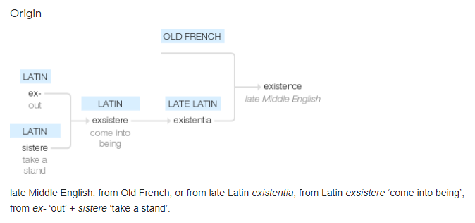
existence (n.)
late 14c., "reality," from Old French existence, from Medieval Latin existentia/exsistentia, from existentem/exsistentem (nominative existens/exsistens) "existent," present participle of Latin existere/exsistere "stand forth, come out, emerge; appear, be visible, come to light; arise, be produced; turn into," and, as a secondary meaning, "exist, be;" from ex "forth" (see ex-) + sistere "cause to stand," from PIE *si-st-, reduplicated form of root *sta- "to stand, make or be firm."

Slide 203
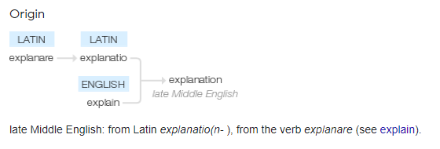
explanation (n.)
"an act of explaining; a meaning or interpretation assigned," late 14c., explanacioun, from Latin explanationem (nominative explanatio) "an explanation, interpretation," noun of action from past-participle stem of explanare "to make plain or clear, explain," literally "make level, flatten," from ex "out" (see ex-) + planus "flat" (from PIE root *pele- (2) "flat; to spread").

Slide 204
Let’s investigate….
Can you find words linked to existence and explanation?

Slide 205
Words linked to existence…
Exist
Coexistence
Existent
Existential
Non-existent
Pre-existent

Slide 206
Words linked to explanation…
Explanatory
Interpretation
Misinterpretation
Notation

