Slide 1
Spelling Y6
Mastering spellings: building on the foundations of phonics
Autumn 1
Week 4

Slide 2
Year 6 - Autumn 1
Week 4 - Monday

Slide 3
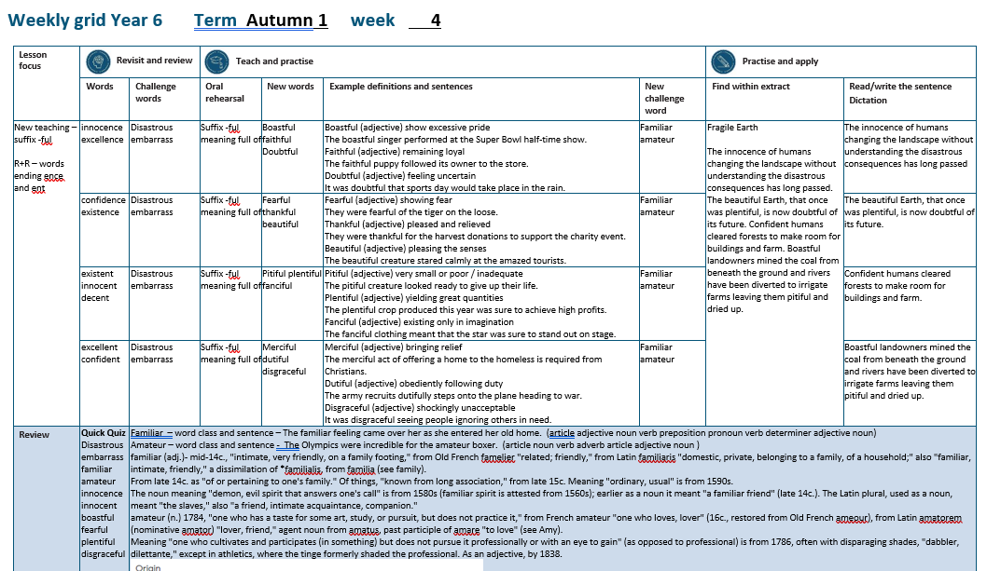

Slide 4
Let’s Revisit and Review…

Slide 5
Do you remember this challenge word?

Slide 6
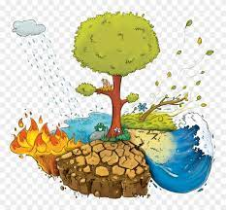
Definition – causing great damage
disastrous
ADJECTIVE

Slide 7
It is disastrous when an earthquake happens.
__________

Slide 8
Do you remember this challenge word?

Slide 9

Definition – cause (someone) to feel awkward, self-conscious or ashamed
embarrass
VERB

Slide 10
Parents love to embarrass their children.
_________

Slide 11
Words ending
-ence and -ent

Slide 12
-ence
Notes:
Sound of aI

Slide 13
-ence
Use –ent and –ence/–ency after soft c (/s/ sound), soft g (/dʒ/ sound) and qu, or if there is a related word with a clear /ɛ/ sound in the right position.

Slide 14
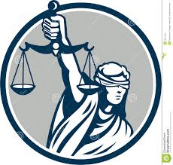
innocence

Slide 15
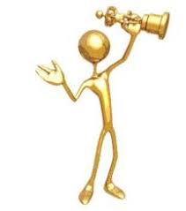
excellence

Slide 16
Let’s Teach and Practise

Slide 17
The suffix -ful

Slide 18
-ful

Slide 19
Suffix –ful meaning full of

Slide 20

boastful

Slide 21
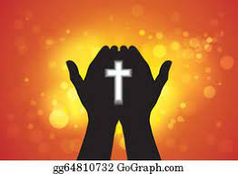
faithful

Slide 22

doubtful

Slide 23
Definition – shows excessive pride
boastful
boast + ful = boastful
ADJECTIVE

Slide 24
Definition – remaining loyal
faithful
faith + ful = faithful
ADJECTIVE

Slide 25
Definition – feeling uncertain
doubtful
doubt + ful = doubtful
ADJECTIVE

Slide 26
The boastful singer performed at the Super Bowl half-time show.
________

Slide 27
The faithful puppy followed its owner to the store.
________

Slide 28
It was doubtful that sports day would take place in the rain.
________

Slide 29
New CHALLENGE words.

Slide 30
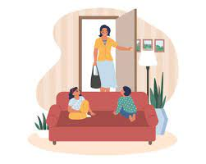
Definition - well known from long or close association
familiar
ADJECTIVE

Slide 31
The familiar feeling came over her as she entered her old home.
________

Slide 32
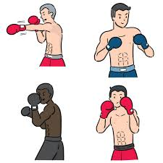
Definition - engaging or engaged in without payment; non-professional
amateur
ADJECTIVE

Slide 33
The Olympics were incredible for the amateur boxer.
_______

Slide 34
Let’s Practise and Apply.

Slide 35
Can you spot the spelling rule words and the challenge words?

Slide 36
Fragile Earth
The innocence of humans changing the landscape without understanding the disastrous consequences has long passed. The beautiful Earth, that once was plentiful, is now doubtful of its future. Confident humans cleared forests to make room for buildings and farm. Boastful landowners mined the coal from beneath the ground and rivers have been diverted to irrigate farms leaving them pitiful and dried up.

Slide 37
Fragile Earth
The innocence of humans changing the landscape without understanding the disastrous consequences has long passed. The beautiful Earth, that once was plentiful, is now doubtful of its future. Confident humans cleared forests to make room for buildings and farm. Boastful landowners mined the coal from beneath the ground and rivers have been diverted to irrigate farms leaving them pitiful and dried up.

Slide 38
Write this sentence as I dictate it to you.
Notes:
The innocence of humans changing the landscape without understanding the disastrous consequences has long passed.

Slide 39
The innocence of humans changing the landscape without understanding the disastrous consequences has long passed.
Did you write it correctly?
Edit your work and make sure you have it correct.
Can you underline the spelling word that we have covered in this session?

Slide 40
Year 6 - Autumn 1
Week 4 - Tuesday

Slide 42
Let’s Revisit and Review…

Slide 43
Do you remember this challenge word?

Slide 44
Definition – causing great damage
disastrous
ADJECTIVE

Slide 45
It is disastrous when an earthquake happens.
__________

Slide 46
Do you remember this challenge word?

Slide 47
Definition – cause (someone) to feel awkward, self-conscious or ashamed
embarrass
VERB

Slide 48
Parents love to embarrass their children.
_________

Slide 49
Words ending
-ence and -ent

Slide 50
-ence
Notes:
Sound of aI

Slide 51
-ence
Use –ent and –ence/–ency after soft c (/s/ sound), soft g (/dʒ/ sound) and qu, or if there is a related word with a clear /ɛ/ sound in the right position.

Slide 52

confidence

Slide 53

existence

Slide 54
Let’s Teach and Practise

Slide 55
The suffix -ful

Slide 56
-ful

Slide 57
Suffix -ful meaning full of

Slide 58
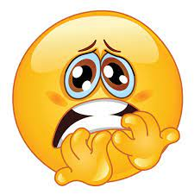
fearful

Slide 59
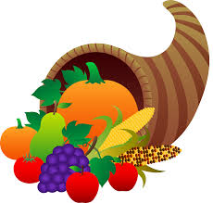
thankful

Slide 60
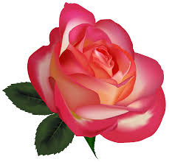
beautiful

Slide 61
Definition – showing fear
fearful
fear + ful = fearful
ADJECTIVE

Slide 62
Definition – pleased and relieved
thankful
thank + ful = thankful
ADJECTIVE

Slide 63
Definition – pleasing to the senses
beautiful
beauty (–y +i) + ful = beautiful
ADJECTIVE

Slide 64
They were fearful of the tiger on the loose.
_______

Slide 65
They were thankful for the harvest donations to support the charity event.
________

Slide 66
The beautiful creature stared calmly at the amazed tourists.
_________

Slide 67
New CHALLENGE words.

Slide 68
Definition - well known from long or close association
familiar
ADJECTIVE

Slide 69
The familiar feeling came over her as she entered her old home.
________

Slide 70
Definition - engaging or engaged in without payment; non-professional
amateur
ADJECTIVE

Slide 71
The Olympics were incredible for the amateur boxer.
_______

Slide 72
Let’s Practise and Apply.

Slide 73
Can you spot the spelling rule words and the challenge words?

Slide 74
Fragile Earth
The innocence of humans changing the landscape without understanding the disastrous consequences has long passed. The beautiful Earth, that once was plentiful, is now doubtful of its future. Confident humans cleared forests to make room for buildings and farm. Boastful landowners mined the coal from beneath the ground and rivers have been diverted to irrigate farms leaving them pitiful and dried up.

Slide 75
Fragile Earth
The innocence of humans changing the landscape without understanding the disastrous consequences has long passed. The beautiful Earth, that once was plentiful, is now doubtful of its future. Confident humans cleared forests to make room for buildings and farm. Boastful landowners mined the coal from beneath the ground and rivers have been diverted to irrigate farms leaving them pitiful and dried up.

Slide 76
Write this sentence as I dictate it to you.
Notes:
The beautiful Earth, that once was plentiful, is now doubtful of its future.

Slide 77
The beautiful Earth, that once was plentiful, is now doubtful of its future.
Did you write it correctly?
Edit your work and make sure you have it correct.
Can you underline the spelling word that we have covered in this session?

Slide 78
Year 6 - Autumn 1
Week 4 - Wednesday
Notes:
Revisit and review the words from Y5 and challenge words – I say, we say, you say
Ask children to write words only in their spelling book
Introduce the new spelling rule
Children to write the new spelling rule words and challenge words into books when the sentences are shown with the spelling word missing.
Read the extract with the class as choral reading. Practise model of prosody etc.
Ask children to find the spelling words from the session in the text.
Then read allowed the chosen sentence for children to write fully in their books.
Show the extract and ask children to then edit their work to check they were correct in their dictation.

Slide 80
Let’s Revisit and Review…

Slide 81
Do you remember this challenge word?

Slide 82
Definition – causing great damage
disastrous
ADJECTIVE

Slide 83
It is disastrous when an earthquake happens.
__________

Slide 84
Do you remember this challenge word?

Slide 85
Definition – cause (someone) to feel awkward, self-conscious or ashamed
embarrass
VERB

Slide 86
Parents love to embarrass their children.
_________

Slide 87
Words ending
-ence and -ent

Slide 88
-ent
Notes:
Sound of aI

Slide 89
-ent
Use –ent and –ence/–ency after soft c (/s/ sound), soft g (/dʒ/ sound) and qu, or if there is a related word with a clear /ɛ/ sound in the right position.

Slide 90
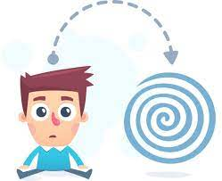
existent

Slide 91

innocent

Slide 92

decent

Slide 93
Let’s Teach and Practise

Slide 94
The suffix -ful

Slide 95
-ful

Slide 96
Suffix -ful meaning full of

Slide 97
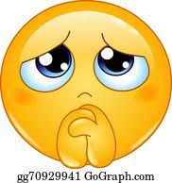
pitiful

Slide 98
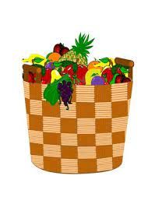
plentiful

Slide 99
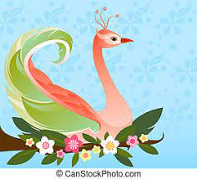
fanciful

Slide 100
Definition – very small or poor / inadequate
pitiful
pity (-y +i) + ful = pitiful
ADJECTIVE

Slide 101
Definition – yielding great quantities
plentiful
plenty (-y +i) + ful = plentiful
ADJECTIVE

Slide 102
Definition – existing only in imagination
fanciful
fancy (-y +i) + ful = fanciful
ADJECTIVE

Slide 103
The pitiful creature looked ready to give up their life.
_______

Slide 104
The plentiful crop produced this year was sure to achieve high profits.
_________

Slide 105
The fanciful clothing meant that the star was sure to stand out on stage.
________

Slide 106
New CHALLENGE words.

Slide 107
Definition - well known from long or close association
familiar
ADJECTIVE

Slide 108
The familiar feeling came over her as she entered her old home.
________

Slide 109
Definition - engaging or engaged in without payment; non-professional
amateur
ADJECTIVE

Slide 110
The Olympics were incredible for the amateur boxer.
_______

Slide 111
Let’s Practise and Apply.

Slide 112
Can you spot the spelling rule words and the challenge words?

Slide 113
Fragile Earth
The innocence of humans changing the landscape without understanding the disastrous consequences has long passed. The beautiful Earth, that once was plentiful, is now doubtful of its future. Confident humans cleared forests to make room for buildings and farm. Boastful landowners mined the coal from beneath the ground and rivers have been diverted to irrigate farms leaving them pitiful and dried up.

Slide 114
Fragile Earth
The innocence of humans changing the landscape without understanding the disastrous consequences has long passed. The beautiful Earth, that once was plentiful, is now doubtful of its future. Confident humans cleared forests to make room for buildings and farm. Boastful landowners mined the coal from beneath the ground and rivers have been diverted to irrigate farms leaving them pitiful and dried up.

Slide 115
Write this sentence as I dictate it to you.
Notes:
Confident humans cleared forests to make room for buildings and farm.

Slide 116
Confident humans cleared forests to make room for buildings and farm.
Did you write it correctly?
Edit your work and make sure you have it correct.
Can you underline the spelling word that we have covered in this session?

Slide 117
Year 6 - Autumn 1
Week 4 - Thursday

Slide 119
Let’s Revisit and Review…

Slide 120
Do you remember this challenge word?

Slide 121
Definition – causing great damage
disastrous
ADJECTIVE

Slide 122
It is disastrous when an earthquake happens.
__________

Slide 123
Do you remember this challenge word?

Slide 124
Definition – cause (someone) to feel awkward, self-conscious or ashamed
embarrass
VERB

Slide 125
Parents love to embarrass their children.
_________

Slide 126
Words ending
-ence and -ent

Slide 127
-ent
Notes:
Sound of aI

Slide 128
-ent
Use –ent and –ence/–ency after soft c (/s/ sound), soft g (/dʒ/ sound) and qu, or if there is a related word with a clear /ɛ/ sound in the right position.

Slide 129

excellent

Slide 130

confident

Slide 131
Let’s Teach and Practise

Slide 132
The suffix -ful

Slide 133
-ful

Slide 134
Suffix -ful meaning full of

Slide 135

merciful

Slide 136
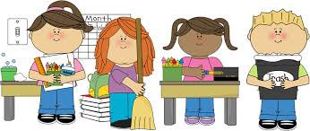
dutiful

Slide 137

disgraceful

Slide 138
Definition – bringing relief
merciful
mercy (-y +i) + ful = merciful
ADJECTIVE

Slide 139
Definition – obediently following duty
dutiful
duty (-y +i) + ful = dutiful
ADJECTIVE

Slide 140
Definition – shockingly unacceptable
disgraceful
disgrace + ful = disgraceful
ADJECTIVE

Slide 141
The merciful act of offering a home to the homeless is required of Christians.
________

Slide 142
The army recruits are dutiful as they step onto the plane heading to war.
_______

Slide 143
It was disgraceful seeing people ignoring others in need.
___________

Slide 144
New CHALLENGE words.

Slide 145
Definition - well known from long or close association
familiar
ADJECTIVE

Slide 146
The familiar feeling came over her as she entered her old home.
________

Slide 147
Definition - engaging or engaged in without payment; non-professional
amateur
ADJECTIVE

Slide 148
The Olympics were incredible for the amateur boxer.
_______

Slide 149
Let’s Practise and Apply.

Slide 150
Can you spot the spelling rule words and the challenge words?

Slide 151
Fragile Earth
The innocence of humans changing the landscape without understanding the disastrous consequences has long passed. The beautiful Earth, that once was plentiful, is now doubtful of its future. Confident humans cleared forests to make room for buildings and farm. Boastful landowners mined the coal from beneath the ground and rivers have been diverted to irrigate farms leaving them pitiful and dried up.

Slide 152
Fragile Earth
The innocence of humans changing the landscape without understanding the disastrous consequences has long passed. The beautiful Earth, that once was plentiful, is now doubtful of its future. Confident humans cleared forests to make room for buildings and farm. Boastful landowners mined the coal from beneath the ground and rivers have been diverted to irrigate farms leaving them pitiful and dried up.

Slide 153
Write this sentence as I dictate it to you.
Notes:
Boastful landowners mined the coal from beneath the ground and rivers have been diverted to irrigate farms leaving them pitiful and dried up.

Slide 154
Boastful landowners mined the coal from beneath the ground and rivers have been diverted to irrigate farms leaving them pitiful and dried up.
Did you write it correctly?
Edit your work and make sure you have it correct.
Can you underline the spelling word that we have covered in this session?

Slide 155
Year 6 - Autumn 1
Week 4 - Friday
Notes:
Click through the slides for all the R+R words for the week (both the focus and the challenge words)
Click through the slides for all the new learning this week

Slide 157
Old challenge words…

Slide 158
disastrous

Slide 159
embarrass

Slide 160
Old spelling rule words…

Slide 161
innocence

Slide 162
excellence

Slide 163
confidence

Slide 164
existence

Slide 165
existent

Slide 166
innocent

Slide 167
decent

Slide 168
excellent

Slide 169
confident

Slide 170
New spelling rule words…

Slide 171
boastful

Slide 172
faithful

Slide 173
doubtful

Slide 174
fearful

Slide 175
thankful

Slide 176
beautiful

Slide 177
pitiful

Slide 178
plentiful

Slide 179
fanciful

Slide 180
merciful

Slide 181
dutiful

Slide 182
disgraceful

Slide 183
New challenge words…

Slide 184
familiar

Slide 185
amateur

Slide 186
Quick Quiz time…
Notes:
Say these words for the quiz
Disastrous embarrass familiar amateur innocence innocent boastful fearful plentiful disgraceful

Slide 187
Did you get them correct?
Edit your work.
disastrous embarrass familiar amateur innocence innocent boastful fearful plentiful disgraceful

Slide 188
Word class time…

Slide 189
The familiar feeling came over her as she entered her old home.
Notes:
Ask for these words to be classed

Slide 190
The familiar feeling came over her as she entered her old home.
article adjective noun verb preposition pronoun verb determiner adjective noun
Notes:
Ask for these words to be classed

Slide 191
The familiar feeling came over her as she entered her old home.
article adjective noun verb preposition pronoun verb determiner adjective noun
Notes:
Ask for these words to be classed

Slide 192
The Olympics were incredible for the amateur boxer.
Notes:
Ask for these words to be classed

Slide 193
The Olympics were incredible for the amateur boxer.
article noun verb adverb article adjective noun

Slide 194
The Olympics were incredible for the amateur boxer.
article noun verb adverb article adjective noun

Slide 195
Etymology
The history of a word….

Slide 196
familiar (adj.)- mid-14c., "intimate, very friendly, on a family footing," from Old French famelier "related; friendly," from Latin familiaris "domestic, private, belonging to a family, of a household;" also "familiar, intimate, friendly," a dissimilation of *familialis, from familia (see family).
From late 14c. as "of or pertaining to one's family." Of things, "known from long association," from late 15c. Meaning "ordinary, usual" is from 1590s.
The noun meaning "demon, evil spirit that answers one's call" is from 1580s (familiar spirit is attested from 1560s); earlier as a noun it meant "a familiar friend" (late 14c.). The Latin plural, used as a noun, meant "the slaves," also "a friend, intimate acquaintance, companion."

Slide 197
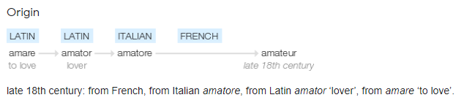
amateur (n.) 1784, "one who has a taste for some art, study, or pursuit, but does not practice it," from French amateur "one who loves, lover" (16c., restored from Old French ameour), from Latin amatorem (nominative amator) "lover, friend," agent noun from amatus, past participle of amare "to love" (see Amy).
Meaning "one who cultivates and participates (in something) but does not pursue it professionally or with an eye to gain" (as opposed to professional) is from 1786, often with disparaging shades, "dabbler, dilettante," except in athletics, where the tinge formerly shaded the professional. As an adjective, by 1838.

Slide 198
Let’s investigate….
Can you write spelling questions, with a mark scheme, related to amateur and familiar?

