Slide 1
Spelling Y6
Mastering spellings: building on the foundations of phonics
Autumn 2
Week 1
Notes:
These slides are the same as Y5 Summer 2 as this is a revisit and review half term

Slide 2
Year 6 - Autumn 2
Week 1 - Monday
Notes:
Revisit and review the words from Y5 and challenge words – I say, we say, you say
Ask children to write words only in their spelling book
Introduce the new spelling rule
Children to write the new spelling rule words and challenge words into books when the sentences are shown with the spelling word missing.
Read the extract with the class as choral reading. Practise model of prosody etc.
Ask children to find the spelling words from the session in the text.
Then read allowed the chosen sentence for children to write fully in their books.
Show the extract and ask children to then edit their work to check they were correct in their dictation.

Slide 3
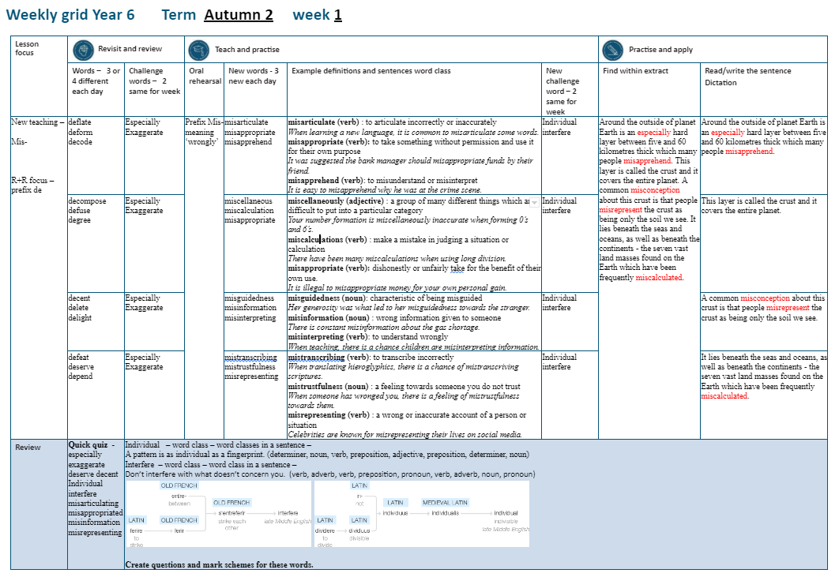

Slide 4
Let’s Revisit and Review…

Slide 5
Do you remember this challenge word?

Slide 6
especially

Slide 7

especially
(adverb)
Definition – used to single out one person or thing over others

Slide 8
especially
(adverb)
I like lots of fruit and vegetables, especially bananas.

Slide 9
Do you remember this challenge word?

Slide 10
exaggerate

Slide 11
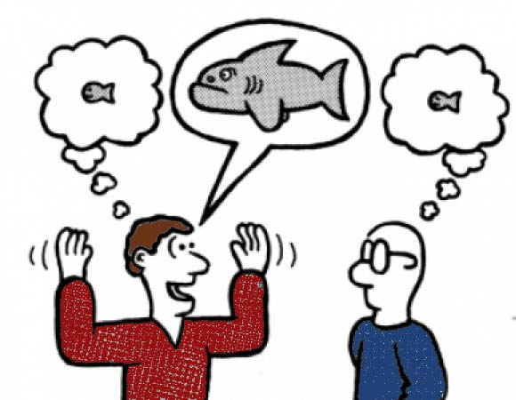
exaggerate
(verb)
Definition – to represent something as being larger, better or worse than it is.

Slide 12
exaggerate
(verb)
He tends to exaggerate when talking about his accomplishments.

Slide 13
Can you remember this spelling rule? prefix de-

Slide 14
prefix de-

Slide 15
de-
Meaning off or from

Slide 16
deflate

Slide 17
deflate

Slide 18
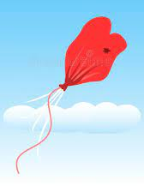
deflate

Slide 19
deform

Slide 20
deform

Slide 21
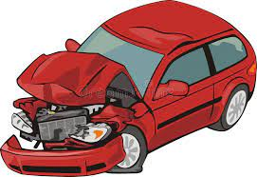
deform

Slide 22
decode

Slide 23
decode

Slide 24
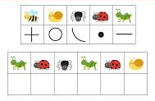
decode

Slide 25
Let’s Teach and Practise

Slide 26
Prefix mis-

Slide 27
mis-
Notes:
Sound of aI

Slide 28
mis- meaning wrongly

Slide 29
misarticulate

Slide 30
misarticulate

Slide 31
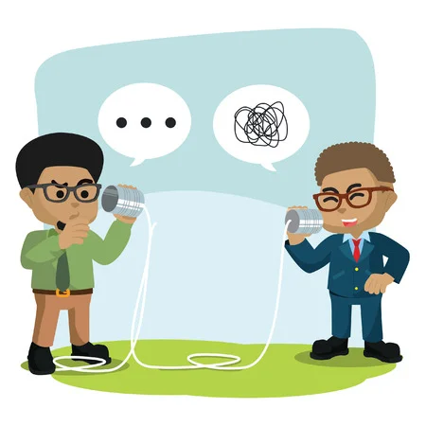
misarticulate

Slide 32
misappropriate

Slide 33
misappropriate

Slide 34
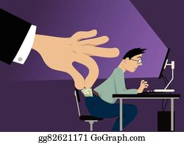
misappropriate

Slide 35
misapprehend

Slide 36
misapprehend

Slide 37

misapprehend

Slide 38
misarticulate

Slide 39
misarticulate mis + articulate = misarticulate

Slide 40
misarticulate mis + articulate = misarticulate
verb
Definition: to speak incorrectly or unclearly

Slide 41
misappropriate

Slide 42
misappropriate mis + appropriate = misappropriate

Slide 43
misappropriate mis + appropriate = misappropriate
verb
Definition – to take something without permission and use it for your own purpose

Slide 44
misapprehend

Slide 45
misapprehend mis + apprehend = misapprehend

Slide 46
misapprehend mis + apprehend = misapprehend verb
Definition – fail to understand a person or their words correctly

Slide 47
When learning a new language, it is common to misarticulate some words.

Slide 48
When learning a new language, it is common to _ _ _ _ _ _ _ _ _ _ _ _ _ some words.

Slide 49
When learning a new language, it is common to misarticulate some words.

Slide 50
It was suggested the bank manage should misappropriate funds by their friend.

Slide 51
It was suggested the bank manage should _ _ _ _ _ _ _ _ _ _ _ _ _ _ funds by their friend.

Slide 52
It was suggested the bank manage should misappropriate funds by their friend.

Slide 53
My parents misapprehend my choice of clothes.

Slide 54
My parents _ _ _ _ _ _ _ _ _ _ _ _ my choice of clothes.

Slide 55
My parents misapprehend my choice of clothes.

Slide 56
New CHALLENGE words.

Slide 57
individual

Slide 58
individual
Every one of us is individual and unique.

Slide 59

Every one of us is individual and unique.

Slide 60
Every one of us is individual and unique.

Slide 61
Every one of us is _ _ _ _ _ _ _ _ _ _ and unique.

Slide 62
Every one of us is individual and unique.

Slide 63
interfere

Slide 64
interfere
Do not interfere with business which doesn’t concern you.

Slide 65

interfere
Do not interfere with business which doesn’t concern you.

Slide 66
Do not interfere with business which doesn’t concern you.

Slide 67
Do not _ _ _ _ _ _ _ _ _ with business which doesn’t concern you.

Slide 68
Do not interfere with business which doesn’t concern you.

Slide 69
Let’s Practise and Apply.

Slide 70
Can you spot the spelling rule words and the challenge words?

Slide 71
Fragile Earth
Around the outside of planet Earth is an especially hard layer between 5 and 60km thick which many people misapprehend. This layer is called the crust and it covers the entire planet. A common misconception about this crust is that people misrepresent it as being the soil we see. It lies beneath the seas and oceans, as well as beneath the continents - the seven vast land masses found on the Earth which have been frequently miscalculated.

Slide 72
Fragile Earth
Around the outside of planet Earth is an especially hard layer between 5 and 60km thick which many people misapprehend. This layer is called the crust and it covers the entire planet. A common misconception about this crust is that people misrepresent it as being the soil we see. It lies beneath the seas and oceans, as well as beneath the continents - the seven vast land masses found on the Earth which have been frequently miscalculated.

Slide 73
Write this sentence as I dictate it to you.
Notes:
The environment of planet Earth is made up of tropical areas and frozen lands.

Slide 74
Around the outside of planet Earth is an especially hard layer between 5 and 60km thick which many people misapprehend.
Did you write it correctly?
Edit your work and make sure you have it correct.
Can you underline the spelling word that we have covered in this session?

Slide 75
Year 6 - Autumn 2
Week 1 - Tuesday
Notes:
Revisit and review the words from Y5 and challenge words – I say, we say, you say
Ask children to write words only in their spelling book
Introduce the new spelling rule
Children to write the new spelling rule words and challenge words into books when the sentences are shown with the spelling word missing.
Read the extract with the class as choral reading. Practise model of prosody etc.
Ask children to find the spelling words from the session in the text.
Then read allowed the chosen sentence for children to write fully in their books.
Show the extract and ask children to then edit their work to check they were correct in their dictation.

Slide 77
Let’s Revisit and Review…

Slide 78
Do you remember this challenge word?

Slide 79
especially

Slide 80
especially
(adverb)
Definition – used to single out one person or thing over others

Slide 81
especially
(adverb)
I like lots of fruit and vegetables, especially bananas.

Slide 82
Do you remember this challenge word?

Slide 83
exaggerate

Slide 84
exaggerate
(verb)
Definition – to represent something as being larger, better or worse than it is.

Slide 85
exaggerate
(verb)
He tends to exaggerate when talking about his accomplishments.

Slide 86
Can you remember this spelling rule?
Prefix de-

Slide 87
prefix de-

Slide 88
de-
Meaning off or from

Slide 89
decompose

Slide 90
decompose

Slide 91
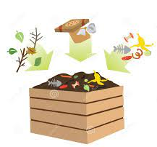
decompose

Slide 92
defuse

Slide 93
defuse

Slide 94
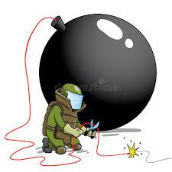
defuse

Slide 95
degree

Slide 96
degree

Slide 97
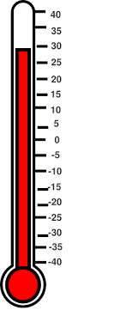

degree

Slide 98
Let’s Teach and Practise

Slide 99
prefix mis-

Slide 100
mis-
Notes:
Sound of aI

Slide 101
mis- meaning wrongly

Slide 102
miscellaneous

Slide 103
miscellaneous

Slide 104
miscalculation

Slide 105
miscalculation

Slide 106
misbehave

Slide 107
misbehave

Slide 108

miscellaneous mis + cellaneous

Slide 109
miscellaneous mis + cellaneous = miscellaneous adjective
Definition – a group of many different things which are difficult to put into a category

Slide 110
miscalculation

Slide 111
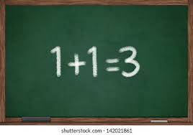
miscalculation mis + calculation = miscalculation

Slide 112
miscalculation mis + calculation = miscalculation
verb
Definition – to make a mistake when judging a situation or answering a calculation

Slide 113
misbehave

Slide 114
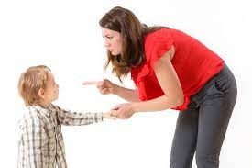
misbehave mis + behave = misbehave

Slide 115
misbehave mis + behave = misbehave verb
Definition – to conduct yourself in an unacceptable way

Slide 116
Your number formation is miscellaneous when forming 0’s and 6’s.

Slide 117
Your number formation is
_ _ _ _ _ _ _ _ _ _ _ _ _ when forming 0’s and 6’s.

Slide 118
Your number formation is miscellaneous when forming 0’s and 6’s.

Slide 119
Recording times tables for long division involves the greatest chance of miscalculation.

Slide 120
Recording times tables for long division involves the greatest chance of _ _ _ _ _ _ _ _ _ _ _ _ _ _.

Slide 121
Recording times tables for long division involves the greatest chance of miscalculation.

Slide 122
I have to take my puppy training as he is beginning to misbehave.

Slide 123
I have to take my puppy training as he is beginning to _ _ _ _ _ _ _ _ _.

Slide 124
I have to take my puppy training as he is beginning to misbehave.

Slide 125
New CHALLENGE words.

Slide 126
individual

Slide 127
individual
Every one of us is individual and unique.

Slide 128
Every one of us is individual and unique.

Slide 129
Every one of us is individual and unique.

Slide 130
Every one of us is _ _ _ _ _ _ _ _ _ _ and unique.

Slide 131
Every one of us is individual and unique.

Slide 132
interfere

Slide 133
interfere
Do not interfere with business which doesn’t concern you.

Slide 134
interfere
Do not interfere with business which doesn’t concern you.

Slide 135
Do not interfere with business which doesn’t concern you.

Slide 136
Do not _ _ _ _ _ _ _ _ _ with business which doesn’t concern you.

Slide 137
Do not interfere with business which doesn’t concern you.

Slide 138
Let’s Practise and Apply.

Slide 139
Can you spot the spelling rule words and the challenge words?

Slide 140
Fragile Earth
Around the outside of planet Earth is an especially hard layer between 5 and 60km thick which many people misapprehend. This layer is called the crust and it covers the entire planet. A common misconception about this crust is that people misrepresent it as being the soil we see. It lies beneath the seas and oceans, as well as beneath the continents - the seven vast land masses found on the Earth which have been frequently miscalculated.

Slide 141
Fragile Earth
Around the outside of planet Earth is an especially hard layer between 5 and 60km thick which many people misapprehend. This layer is called the crust and it covers the entire planet. A common misconception about this crust is that people misrepresent it as being the soil we see. It lies beneath the seas and oceans, as well as beneath the continents - the seven vast land masses found on the Earth which have been frequently miscalculated.

Slide 142
Write this sentence as I dictate it to you.
Notes:
The Earth’s hard outer layer has been mathematically calculated as between 5 and 60km thick.

Slide 143
This layer is called the crust and it covers the entire planet.
Did you write it correctly?
Edit your work and make sure you have it correct.
Can you underline the spelling word that we have covered in this session?

Slide 144
Year 6 - Autumn 2
Week 1 - Wednesday
Notes:
Revisit and review the words from Y5 and challenge words – I say, we say, you say
Ask children to write words only in their spelling book
Introduce the new spelling rule
Children to write the new spelling rule words and challenge words into books when the sentences are shown with the spelling word missing.
Read the extract with the class as choral reading. Practise model of prosody etc.
Ask children to find the spelling words from the session in the text.
Then read allowed the chosen sentence for children to write fully in their books.
Show the extract and ask children to then edit their work to check they were correct in their dictation.

Slide 146
Let’s Revisit and Review…

Slide 147
Do you remember this challenge word?

Slide 148
especially

Slide 149
especially
(adverb)
Definition – used to single out one person or thing over others

Slide 150
especially
(adverb)
I like lots of fruit and vegetables, especially bananas.

Slide 151
Do you remember this challenge word?

Slide 152
exaggerate

Slide 153
exaggerate
(verb)
Definition – to represent something as being larger, better or worse than it is.

Slide 154
exaggerate
(verb)
He tends to exaggerate when talking about his accomplishments.

Slide 155
Can you remember this spelling rule? prefix in de-

Slide 156
prefix de-

Slide 157
de-
Meaning off or from

Slide 158
decent

Slide 159
decent

Slide 160

decent

Slide 161
delete

Slide 162
delete

Slide 163

delete

Slide 164
delete

Slide 165
delete

Slide 166
delete

Slide 167
Let’s Teach and Practise

Slide 168
Prefix mis-

Slide 169
mis-
Notes:
Sound of aI

Slide 170
misguidedness

Slide 171
misguidedness

Slide 172
misinformation

Slide 173
misinformation

Slide 174
misinterpreting

Slide 175
misinterpreting

Slide 176
misguidedness

Slide 177
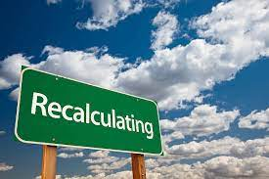
misguidedness
(noun)
Definition – to show fault in judgement or reasoning of someone or something

Slide 178
misinformation

Slide 179
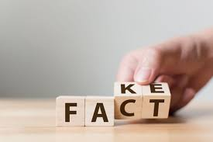
misinformation
(noun)
Definition – false information share with someone deliberately

Slide 180
misinterpreting

Slide 181
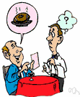
misinterpreting
(verb)
Definition – to wrongly understand

Slide 182
Her generosity was what led to her misguidedness towards the stranger.

Slide 183
Her generosity was what led to her _ _ _ _ _ _ _ _ _ _ _ _ _ towards the stranger.

Slide 184
Her generosity was what led to her misguidedness towards the stranger.

Slide 185
The media constantly feed us misinformation to create a reaction.

Slide 186
The media constantly feed us
_ _ _ _ _ _ _ _ _ _ _ _ _ _ to create a reaction.

Slide 187
The media constantly feed us misinformation to create a reaction.

Slide 188
When in a classroom, there is a chance children are misinterpreting information from each other.

Slide 189
When in a classroom, there is a chance children are
_ _ _ _ _ _ _ _ _ _ _ _ _ _ information from each other.

Slide 190
When in a classroom, there is a chance children are misinterpreting information from each other.

Slide 191
New CHALLENGE words.

Slide 192
individual

Slide 193
individual
Every one of us is individual and unique.

Slide 194
Every one of us is individual and unique.

Slide 195
Every one of us is individual and unique.

Slide 196
Every one of us is _ _ _ _ _ _ _ _ _ _ and unique.

Slide 197
Every one of us is individual and unique.

Slide 198
interfere

Slide 199
interfere
Do not interfere with business which doesn’t concern you.

Slide 200
interfere
Do not interfere with business which doesn’t concern you.

Slide 201
Do not interfere with business which doesn’t concern you.

Slide 202
Do not _ _ _ _ _ _ _ _ _ with business which doesn’t concern you.

Slide 203
Do not interfere with business which doesn’t concern you.

Slide 204
Let’s Practise and Apply.

Slide 205
Can you spot the spelling rule words and the challenge words?

Slide 206
Fragile Earth
Around the outside of planet Earth is an especially hard layer between 5 and 60km thick which many people misapprehend. This layer is called the crust and it covers the entire planet. A common misconception about this crust is that people misrepresent it as being the soil we see. It lies beneath the seas and oceans, as well as beneath the continents - the seven vast land masses found on the Earth which have been frequently miscalculated.

Slide 207
Fragile Earth
Around the outside of planet Earth is an especially hard layer between 5 and 60km thick which many people misapprehend. This layer is called the crust and it covers the entire planet. A common misconception about this crust is that people misrepresent it as being the soil we see. It lies beneath the seas and oceans, as well as beneath the continents - the seven vast land masses found on the Earth which have been frequently miscalculated.

Slide 208
Write this sentence as I dictate it to you.
Notes:
The environment of planet Earth is made up of tropical areas and frozen lands.

Slide 209
A common misconception about this crust is that people misrepresent it as being the soil we see.
Did you write it correctly?
Edit your work and make sure you have it correct.
Can you underline the spelling word that we have covered in this session?

Slide 210
Year 6 - Autumn 2
Week 1 - Thursday
Notes:
Revisit and review the words from Y5 and challenge words – I say, we say, you say
Ask children to write words only in their spelling book
Introduce the new spelling rule
Children to write the new spelling rule words and challenge words into books when the sentences are shown with the spelling word missing.
Read the extract with the class as choral reading. Practise model of prosody etc.
Ask children to find the spelling words from the session in the text.
Then read allowed the chosen sentence for children to write fully in their books.
Show the extract and ask children to then edit their work to check they were correct in their dictation.

Slide 212
Let’s Revisit and Review…

Slide 213
Do you remember this challenge word?

Slide 214
especially

Slide 215
especially
(adverb)
Definition – used to single out one person or thing over others

Slide 216
especially
(adverb)
I like lots of fruit and vegetables, especially bananas.

Slide 217
Do you remember this challenge word?

Slide 218
exaggerate

Slide 219
exaggerate
(verb)
Definition – to represent something as being larger, better or worse than it is.

Slide 220
exaggerate
(verb)
He tends to exaggerate when talking about his accomplishments.

Slide 221
Can you remember this spelling rule?
Prefix de-

Slide 222
prefix de-

Slide 223
de-
Meaning off or from

Slide 224
defeat

Slide 225
defeat

Slide 226
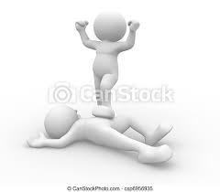
defeat

Slide 227
deserve

Slide 228
deserve

Slide 229

deserve

Slide 230
depend

Slide 231
depend

Slide 232
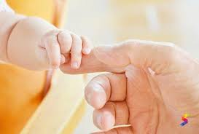
depend

Slide 233
Let’s Teach and Practise

Slide 234
Prefix mis-

Slide 235
mis-
Notes:
Sound of aI

Slide 236
mistranscribe

Slide 237
mistranscribe

Slide 238
mistrustfulness

Slide 239
mistrustfulness

Slide 240
misrepresenting

Slide 241
misrepresenting

Slide 242
mistranscribe

Slide 243
mistranscribe
(verb)
Definition – to make a mistake when writing something that’s been said or done

Slide 244
mistrustfulness

Slide 245

mistrustfulness
(noun)
Definition – a feeling towards someone you do not trust

Slide 246
misrepresenting

Slide 247
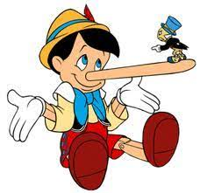
misrepresenting
(verb)
Definition – a wrong or inaccurate account of a person or situation

Slide 248
When translating hieroglyphics, historians need to be sure they do not mistranscribe any scriptures.

Slide 249
When translating hieroglyphics, historians need to be sure they do not _ _ _ _ _ _ _ _ _ _ _ _ _ any scriptures.

Slide 250
When translating hieroglyphics, historians need to be sure they do not mistranscribe any scriptures.

Slide 251
When someone has wronged you, there is a feeling of mistrustfulness towards them.

Slide 252
When someone has wronged you, there is a feeling of
_ _ _ _ _ _ _ _ _ _ _ _ _ _ _ towards them.

Slide 253
When someone has wronged you, there is a feeling of mistrustfulness towards them.

Slide 254
Celebrities are known for misrepresenting their lives on social media.

Slide 255
Celebrities are known for
_ _ _ _ _ _ _ _ _ _ _ _ _ _ _ their lives on social media.

Slide 256
Celebrities are known for misrepresenting their lives on social media.

Slide 257
New CHALLENGE words.

Slide 258
individual

Slide 259
individual
Every one of us is individual and unique.

Slide 260
Every one of us is individual and unique.

Slide 261
Every one of us is individual and unique.

Slide 262
Every one of us is _ _ _ _ _ _ _ _ _ _ and unique.

Slide 263
Every one of us is individual and unique.

Slide 264
interfere

Slide 265
interfere
Do not interfere with business which doesn’t concern you.

Slide 266
interfere
Do not interfere with business which doesn’t concern you.

Slide 267
Do not interfere with business which doesn’t concern you.

Slide 268
Do not _ _ _ _ _ _ _ _ _ with business which doesn’t concern you.

Slide 269
Do not interfere with business which doesn’t concern you.

Slide 270
Let’s Practise and Apply.

Slide 271
Can you spot the spelling rule words and the challenge words?

Slide 272
Fragile Earth
Around the outside of planet Earth is an especially hard layer between 5 and 60km thick which many people misapprehend. This layer is called the crust and it covers the entire planet. A common misconception about this crust is that people misrepresent it as being the soil we see. It lies beneath the seas and oceans, as well as beneath the continents - the seven vast land masses found on the Earth which have been frequently miscalculated.

Slide 273
Fragile Earth
Around the outside of planet Earth is an especially hard layer between 5 and 60km thick which many people misapprehend. This layer is called the crust and it covers the entire planet. A common misconception about this crust is that people misrepresent it as being the soil we see. It lies beneath the seas and oceans, as well as beneath the continents - the seven vast land masses found on the Earth which have been frequently miscalculated.

Slide 274
Write this sentence as I dictate it to you.
Notes:
The environment of planet Earth is made up of tropical areas and frozen lands.

Slide 275
It lies beneath the seas and oceans, as well as beneath the continents - the seven vast land masses found on the Earth which have been frequently miscalculated.
Did you write it correctly?
Edit your work and make sure you have it correct.
Can you underline the spelling word that we have covered in this session?

Slide 276
Year 6 - Autumn 2
Week 1 - Friday
Notes:
Click through the slides for all the R+R words for the week (both the focus and the challenge words)
Click through the slides for all the new learning this week

Slide 278
Old challenge words…

Slide 279
especially

Slide 280
exaggerate

Slide 281
Old spelling rule words…

Slide 282
deflate

Slide 283
deform

Slide 284
decode

Slide 285
decompose

Slide 286
defuse

Slide 287
degree

Slide 288
decent

Slide 289
delete

Slide 290
delight

Slide 291
defeat

Slide 292
deserve

Slide 293
depend

Slide 294
New spelling rule words…

Slide 295
misarticulate

Slide 296
misappropriate

Slide 297
misapprehend

Slide 298
miscellaneously

Slide 299
miscalculations

Slide 300
misbehave

Slide 301
misguidedness

Slide 302
misinformation

Slide 303
misinterpreting

Slide 304
mistranscribe

Slide 305
mistrustfulness

Slide 306
misrepresenting

Slide 307
New challenge words…

Slide 308
individual

Slide 309
interfere

Slide 310
Quick Quiz time…
Notes:
Say these words for the quiz
Environment equipment frequently government musical mathematical require vampire urgency emergency

Slide 311
Did you get them correct?
Edit your work.
especially exaggerate deserve decent individual interfere misarticulate misappropriate misinformation misrepresenting

Slide 312
Word class time…

Slide 313
A pattern is as individual as a fingerprint.
Notes:
Ask for these words to be classed

Slide 314
A pattern is as individual as a fingerprint.
determiner, noun, verb, preposition, adjective, preposition, determiner, noun
Notes:
Ask for these words to be classed

Slide 315
A pattern is as individual as a fingerprint.
determiner, noun, verb, preposition, adjective, preposition, determiner, noun
Notes:
Ask for these words to be classed

Slide 316
Don’t interfere with what doesn’t concern you.
Notes:
Ask for these words to be classed

Slide 317
Don’t interfere with what doesn’t concern you.
verb, adverb, verb, preposition, pronoun, verb, adverb, noun, pronoun

Slide 318
Don’t interfere with what doesn’t concern you.
noun, verb, preposition, pronoun, verb, noun, pronoun

Slide 319
Etymology
The history of a word….

Slide 320
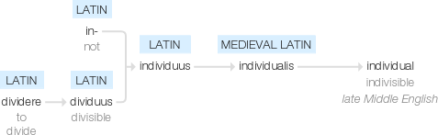
Individual

Slide 321
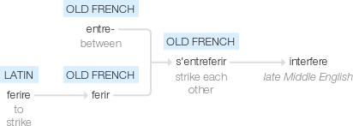
interfere

Slide 322
Let’s investigate….
Create questions and mark schemes for the two challenge words.

