Slide 1
Spelling Y6
Mastering spellings: building on the foundations of phonics
Autumn 2
Week 2
Notes:
These slides are the same as Y5 Summer 2 as this is a revisit and review half term

Slide 2
Year 6 - Autumn 2
Week 2 - Monday
Notes:
Revisit and review the words from Y5 and challenge words – I say, we say, you say
Ask children to write words only in their spelling book
Introduce the new spelling rule
Children to write the new spelling rule words and challenge words into books when the sentences are shown with the spelling word missing.
Read the extract with the class as choral reading. Practise model of prosody etc.
Ask children to find the spelling words from the session in the text.
Then read allowed the chosen sentence for children to write fully in their books.
Show the extract and ask children to then edit their work to check they were correct in their dictation.

Slide 3
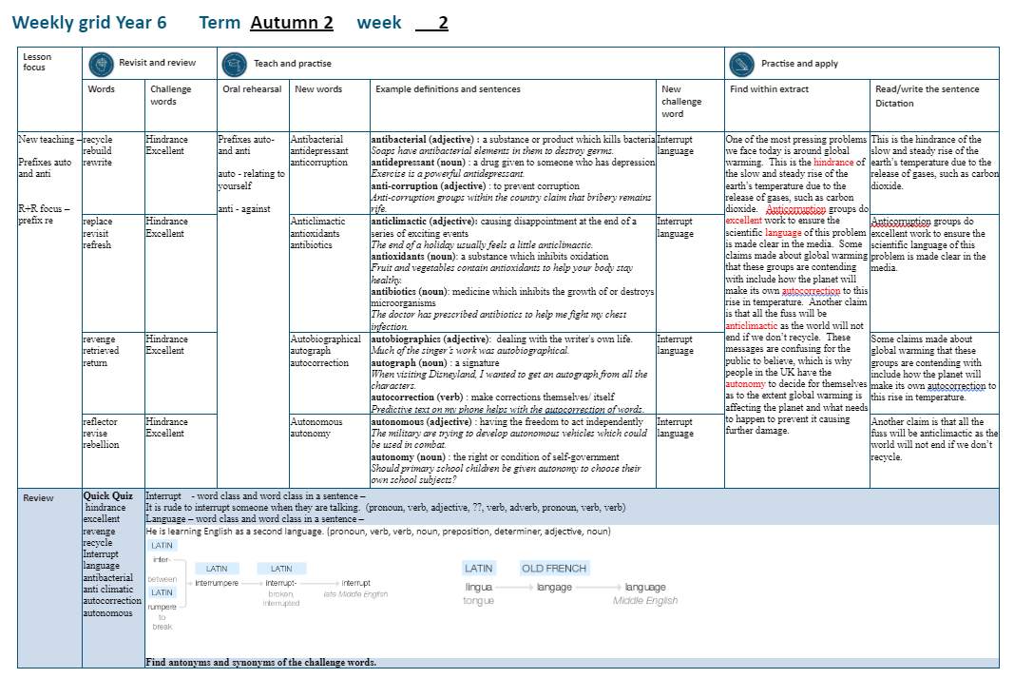

Slide 4
Let’s Revisit and Review…

Slide 5
Do you remember this challenge word?

Slide 6
hindrance

Slide 7
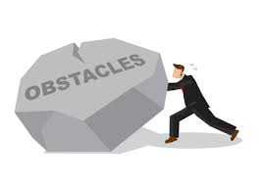
hindrance
(noun)
Definition – a person or thing which makes it more difficult for you to do something

Slide 8
hindrance
(noun)
I’m afraid you’re more of a hindrance than a help to me at this point.

Slide 9
Do you remember this challenge word?

Slide 10
excellent

Slide 11
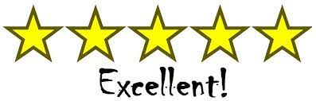
Excellent
(adjective)
Definition: extremely good; outstanding

Slide 12
excellent
Christmas is excellent.

Slide 13
Can you remember this spelling rule? prefix re-

Slide 14
prefix re-

Slide 15
re-
Meaning back or again

Slide 16
recycle

Slide 17
recycle

Slide 18
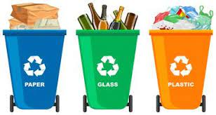
recycle re + cycle = recycle

Slide 19
rebuild

Slide 20
rebuild n

Slide 21
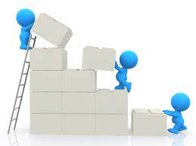
rebuild re + build = rebuild

Slide 22
rewrite

Slide 23
rewrite

Slide 24
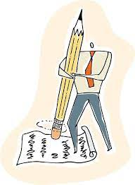
rewrite re + write = rewrite

Slide 25
Let’s Teach and Practise

Slide 26
Prefixes auto- and anti-

Slide 27
auto-
meaning relating to yourself
Notes:
Sound of aI

Slide 28
anti- meaning against

Slide 29
antibacterial

Slide 30
antibacterial

Slide 31
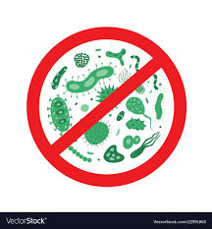
antibacterial

Slide 32
antidepressant

Slide 33
antidepressant

Slide 34
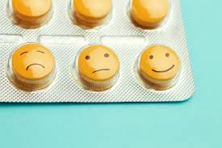
antidepressant

Slide 35
anti-corruption

Slide 36
anti-corruption

Slide 37
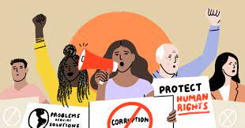
anti-corruption

Slide 38
antibacterial

Slide 39
antibacterial anti + bacterial = antibacterial

Slide 40
antibacterial anti + bacterial = antibacterial
adjective
Definition: a substance or product which skills germs and bacteria

Slide 41
antidepressant

Slide 42
antidepressant
anti + depressant = antidepressant

Slide 43
antidepressant
anti + depressant = antidepressant
noun
Definition – actions or medication given to someone who is feeling unhappy

Slide 44
anti-corruption

Slide 45
anti-corruption anti + corruption = anti-corruption

Slide 46
anti-corruption anti + corruption = anti-corruption noun
Definition – to prevent corruption (dishonest and illegal behaviour)

Slide 47
Soaps have antibacterial elements in them to destroy germs.

Slide 48
Soaps have _ _ _ _ _ _ _ _ _ _ _ _ _ elements in them to destroy germs.

Slide 49
Soaps have antibacterial elements in them to destroy germs.

Slide 50
Exercise is a powerful antidepressant.

Slide 51
Exercise is a powerful
_ _ _ _ _ _ _ _ _ _ _ _ _ _.

Slide 52
Exercise is a powerful antidepressant.

Slide 53
Anti-corruption groups within the country claim that bribery remains rife.

Slide 54
_ _ _ _ -_ _ _ _ _ _ _ _ _ _ groups within the country claim that bribery remains rife.

Slide 55
Anti-corruption groups within the country claim that bribery remains rife.

Slide 56
New CHALLENGE words.

Slide 57
interrupt

Slide 58
interrupt
It is extremely rude to interrupt someone when they are talking.

Slide 59
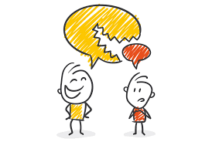
It is extremely rude to interrupt someone when they are talking.

Slide 60
It is extremely rude to _ _ _ _ _ _ _ _ _ _ someone when they are talking.

Slide 61
It is extremely rude to interrupt someone when they are talking.

Slide 62
language

Slide 63
language
Harry Potter and the Philosopher’s Stone has been translated into a different language at least 79 times.

Slide 64
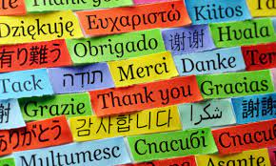
language
Harry Potter and the Philosopher’s Stone has been translated into a different language at least 79 times.

Slide 65
Harry Potter and the Philosopher’s Stone has been translated into a different
_ _ _ _ _ _ _ _ at least 79 times.

Slide 66
Harry Potter and the Philosopher’s Stone has been translated into a different language at least 79 times.

Slide 67
Let’s Practise and Apply.

Slide 68
Can you spot the spelling rule words and the challenge words?

Slide 69
Fragile Earth
One of the most pressing problems we face today is around global warming. This is the hindrance of the slow and steady rise of the Earth’s temperature due to the release of gases, such as carbon dioxide. Anti-corruption groups do excellent work to ensure the scientific language of this problem is made clear in the media. Some claims made about global warming that these groups are contending with include how the planet will make its own auto-correction to this rise in temperature. Another claim is that all the fuss will be anticlimactic as the world will not end if we do not recycle. These messages are confusing for the public to believe, which is why people in the UK have the autonomy to decide for themselves as to the extent global warming is affecting the planet and what needs to happen to prevent it causing further damage.

Slide 70
Fragile Earth
One of the most pressing problems we face today is around global warming. This is the hindrance of the slow and steady rise of the Earth’s temperature due to the release of gases, such as carbon dioxide. Anti-corruption groups do excellent work to ensure the scientific language of this problem is made clear in the media. Some claims made about global warming that these groups are contending with include how the planet will make its own auto-correction to this rise in temperature. Another claim is that all the fuss will be anticlimactic as the world will not end if we do not recycle. These messages are confusing for the public to believe, which is why people in the UK have the autonomy to decide for themselves as to the extent global warming is affecting the planet and what needs to happen to prevent it causing further damage.

Slide 71
Write this sentence as I dictate it to you.
Notes:
The environment of planet Earth is made up of tropical areas and frozen lands.

Slide 72
One of the most pressing problems we face today is around global warming.
Did you write it correctly?
Edit your work and make sure you have it correct.
Can you underline the spelling word that we have covered in this session?

Slide 73
Year 6 - Autumn 2
Week 2 - Tuesday
Notes:
Revisit and review the words from Y5 and challenge words – I say, we say, you say
Ask children to write words only in their spelling book
Introduce the new spelling rule
Children to write the new spelling rule words and challenge words into books when the sentences are shown with the spelling word missing.
Read the extract with the class as choral reading. Practise model of prosody etc.
Ask children to find the spelling words from the session in the text.
Then read allowed the chosen sentence for children to write fully in their books.
Show the extract and ask children to then edit their work to check they were correct in their dictation.

Slide 75
Let’s Revisit and Review…

Slide 76
Do you remember this challenge word?

Slide 77
hindrance

Slide 78
hindrance
(noun)
Definition – a person or thing which makes it more difficult for you to do something

Slide 79
hindrance
(noun)
I’m afraid you’re more of a hindrance than a help to me at this point.

Slide 80
Do you remember this challenge word?

Slide 81
excellent

Slide 82
Excellent
(adjective)
Definition: extremely good; outstanding

Slide 83
excellent
Christmas is excellent.

Slide 84
Can you remember this spelling rule? prefix re-

Slide 85
prefix re-

Slide 86
re-
Meaning back or again

Slide 87
replace

Slide 88
replace

Slide 89
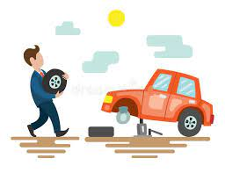
replace re + place = replace

Slide 90
revisit

Slide 91
revisit n

Slide 92

revisit re + visit = revisit

Slide 93
refresh

Slide 94
refresh

Slide 95

refresh re + fresh = refresh

Slide 96
Let’s Teach and Practise

Slide 97
Prefixes auto- and anti-

Slide 98
auto-
meaning relating to yourself
Notes:
Sound of aI

Slide 99
anti- meaning against

Slide 100
anticlimactic

Slide 101
anticlimactic

Slide 102
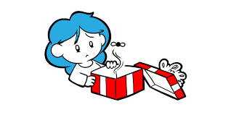
anticlimactic

Slide 103
antioxidants

Slide 104
antioxidants

Slide 105
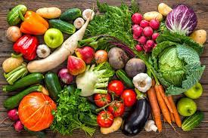
antioxidants

Slide 106
antibiotics

Slide 107
antibiotics

Slide 108

antibiotics

Slide 109
anticlimactic

Slide 110
anticlimactic anti + climactic = anticlimactic

Slide 111
anticlimactic anti + climactic = anticlimactic
adjective
Definition: causing disappointment at the end of a series of exciting events

Slide 112
antioxidants

Slide 113
antioxidants
anti + oxidants = antioxidants

Slide 114
antioxidants
anti + oxidants = antioxidants
noun
Definition – a substance that can prevent damage to cells in your body

Slide 115
antibiotics

Slide 116
antibiotics anti + biotics = antibiotics

Slide 117
antibiotics
anti + biotics = antibiotics noun
Definition – medicine to treat infections

Slide 118
The end of a holiday usually feels anticlimactic.

Slide 119
The end of a holiday usually feels
_ _ _ _ _ _ _ _ _ _ _ _ _.

Slide 120
The end of a holiday usually feels anticlimactic.

Slide 121
Fruit and vegetables contain antioxidants which help your body stay healthy.

Slide 122
Fruit and vegetables contain
_ _ _ _ _ _ _ _ _ _ _ _ which help your body stay healthy.

Slide 123
Fruit and vegetables contain antioxidants which help your body stay healthy.

Slide 124
The doctor has prescribed antibiotics to help me fight my chest infection.

Slide 125
The doctor has prescribed
_ _ _ _ _ _ _ _ _ _ _ to help me fight my chest infection.

Slide 126
The doctor has prescribed antibiotics to help me fight my chest infection.

Slide 127
New CHALLENGE words.

Slide 128
interrupt

Slide 129
interrupt
It is extremely rude to interrupt someone when they are talking.

Slide 130
It is extremely rude to interrupt someone when they are talking.

Slide 131
It is extremely rude to _ _ _ _ _ _ _ _ _ _ someone when they are talking.

Slide 132
It is extremely rude to interrupt someone when they are talking.

Slide 133
language

Slide 134
language
Harry Potter and the Philosopher’s Stone has been translated into a different language at least 79 times.

Slide 135
language
Harry Potter and the Philosopher’s Stone has been translated into a different language at least 79 times.

Slide 136
Harry Potter and the Philosopher’s Stone has been translated into a different
_ _ _ _ _ _ _ _ at least 79 times.

Slide 137
Harry Potter and the Philosopher’s Stone has been translated into a different language at least 79 times.

Slide 138
Let’s Practise and Apply.

Slide 139
Can you spot the spelling rule words and the challenge words?

Slide 140
Fragile Earth
One of the most pressing problems we face today is around global warming. This is the hindrance of the slow and steady rise of the Earth’s temperature due to the release of gases, such as carbon dioxide. Anti-corruption groups do excellent work to ensure the scientific language of this problem is made clear in the media. Some claims made about global warming that these groups are contending with include how the planet will make its own auto-correction to this rise in temperature. Another claim is that all the fuss will be anticlimactic as the world will not end if we do not recycle. These messages are confusing for the public to believe, which is why people in the UK have the autonomy to decide for themselves as to the extent global warming is affecting the planet and what needs to happen to prevent it causing further damage.

Slide 141
Fragile Earth
One of the most pressing problems we face today is around global warming. This is the hindrance of the slow and steady rise of the Earth’s temperature due to the release of gases, such as carbon dioxide. Anti-corruption groups do excellent work to ensure the scientific language of this problem is made clear in the media. Some claims made about global warming that these groups are contending with include how the planet will make its own auto-correction to this rise in temperature. Another claim is that all the fuss will be anticlimactic as the world will not end if we do not recycle. These messages are confusing for the public to believe, which is why people in the UK have the autonomy to decide for themselves as to the extent global warming is affecting the planet and what needs to happen to prevent it causing further damage.

Slide 142
Write this sentence as I dictate it to you.
Notes:
The environment of planet Earth is made up of tropical areas and frozen lands.

Slide 143
This is the hindrance of the slow and steady rise of the Earth’s temperature due to the release of gases, such as carbon dioxide.
Did you write it correctly?
Edit your work and make sure you have it correct.
Can you underline the spelling word that we have covered in this session?

Slide 144
Year 6 - Autumn 2
Week 2 - Wednesday
Notes:
Revisit and review the words from Y5 and challenge words – I say, we say, you say
Ask children to write words only in their spelling book
Introduce the new spelling rule
Children to write the new spelling rule words and challenge words into books when the sentences are shown with the spelling word missing.
Read the extract with the class as choral reading. Practise model of prosody etc.
Ask children to find the spelling words from the session in the text.
Then read allowed the chosen sentence for children to write fully in their books.
Show the extract and ask children to then edit their work to check they were correct in their dictation.

Slide 146
Let’s Revisit and Review…

Slide 147
Do you remember this challenge word?

Slide 148
hindrance

Slide 149
hindrance
(noun)
Definition – a person or thing which makes it more difficult for you to do something

Slide 150
hindrance
(noun)
I’m afraid you’re more of a hindrance than a help to me at this point.

Slide 151
Do you remember this challenge word?

Slide 152
excellent

Slide 153
Excellent
(adjective)
Definition: extremely good; outstanding

Slide 154
excellent
Christmas is excellent.

Slide 155
Can you remember this spelling rule? prefix re-

Slide 156
prefix re-

Slide 157
re-
Meaning back or again

Slide 158
revenge

Slide 159
revenge

Slide 160
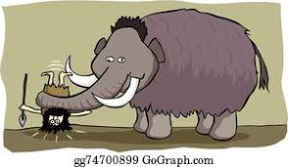
revenge re + venge = revenge

Slide 161
retrieved

Slide 162
retrieved n

Slide 163
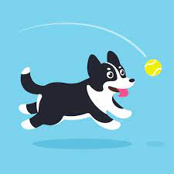
retrieved re + trieved = retrieved

Slide 164
return

Slide 165
return

Slide 166

return re + turn = return

Slide 167
Let’s Teach and Practise

Slide 168
Prefixes auto- and anti-

Slide 169
auto-
meaning relating to yourself
Notes:
Sound of aI

Slide 170
anti- meaning against

Slide 171
autobiographical

Slide 172
autobiographical

Slide 173

autobiographical

Slide 174
autograph

Slide 175
autograph

Slide 176
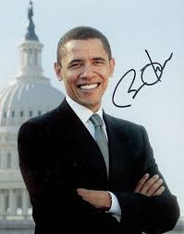
autograph

Slide 177
auto-correction

Slide 178
auto-correction

Slide 179
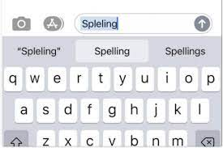
auto-correction

Slide 180
autobiographical

Slide 181
autobiographical auto + biographical = autobiographical

Slide 182
autobiographical auto + biographical = autobiographical
adjective
Definition: writing about the author’s own life

Slide 183
autograph

Slide 184
autograph
auto + graph = autograph

Slide 185
autograph
auto + graph = autograph
noun
Definition – a signature

Slide 186
auto-correction

Slide 187
auto-correction auto + correction = auto-correction

Slide 188
auto-correction auto + correction = auto-correction verb
Definition – to make predictions and corrections itself

Slide 189
Much of the singer’s work was autobiographical.

Slide 190
Much of the singer’s work was
_ _ _ _ _ _ _ _ _ _ _ _ _ _ _ _.

Slide 191
Much of the singer’s work was autobiographical.

Slide 192
When visiting Disneyland, I wanted to get an autograph from all the characters.

Slide 193
When visiting Disneyland, I wanted to get an _ _ _ _ _ _ _ _ _ from all the characters.

Slide 194
When visiting Disneyland, I wanted to get an autograph from all the characters.

Slide 195
Predictive text helps with the auto-correction of my message.

Slide 196
Predictive text helps with the
_ _ _ _ -_ _ _ _ _ _ _ _ _ _ of my message.

Slide 197
Predictive text helps with the auto-correction of my message.

Slide 198
New CHALLENGE words.

Slide 199
interrupt

Slide 200
interrupt
It is extremely rude to interrupt someone when they are talking.

Slide 201
It is extremely rude to interrupt someone when they are talking.

Slide 202
It is extremely rude to _ _ _ _ _ _ _ _ _ _ someone when they are talking.

Slide 203
It is extremely rude to interrupt someone when they are talking.

Slide 204
language

Slide 205
language
Harry Potter and the Philosopher’s Stone has been translated into a different language at least 79 times.

Slide 206
language
Harry Potter and the Philosopher’s Stone has been translated into a different language at least 79 times.

Slide 207
Harry Potter and the Philosopher’s Stone has been translated into a different
_ _ _ _ _ _ _ _ at least 79 times.

Slide 208
Harry Potter and the Philosopher’s Stone has been translated into a different language at least 79 times.

Slide 209
Let’s Practise and Apply.

Slide 210
Can you spot the spelling rule words and the challenge words?

Slide 211
Fragile Earth
One of the most pressing problems we face today is around global warming. This is the hindrance of the slow and steady rise of the Earth’s temperature due to the release of gases, such as carbon dioxide. Anti-corruption groups do excellent work to ensure the scientific language of this problem is made clear in the media. Some claims made about global warming that these groups are contending with include how the planet will make its own auto-correction to this rise in temperature. Another claim is that all the fuss will be anticlimactic as the world will not end if we do not recycle. These messages are confusing for the public to believe, which is why people in the UK have the autonomy to decide for themselves as to the extent global warming is affecting the planet and what needs to happen to prevent it causing further damage.

Slide 212
Fragile Earth
One of the most pressing problems we face today is around global warming. This is the hindrance of the slow and steady rise of the Earth’s temperature due to the release of gases, such as carbon dioxide. Anti-corruption groups do excellent work to ensure the scientific language of this problem is made clear in the media. Some claims made about global warming that these groups are contending with include how the planet will make its own auto-correction to this rise in temperature. Another claim is that all the fuss will be anticlimactic as the world will not end if we do not recycle. These messages are confusing for the public to believe, which is why people in the UK have the autonomy to decide for themselves as to the extent global warming is affecting the planet and what needs to happen to prevent it causing further damage.

Slide 213
Write this sentence as I dictate it to you.
Notes:
The environment of planet Earth is made up of tropical areas and frozen lands.

Slide 214
Anti-corruption groups do excellent work to ensure the scientific language of this problem is made clear in the media.
Did you write it correctly?
Edit your work and make sure you have it correct.
Can you underline the spelling word that we have covered in this session?

Slide 215
Year 6 - Autumn 2
Week 2 - Thursday
Notes:
Revisit and review the words from Y5 and challenge words – I say, we say, you say
Ask children to write words only in their spelling book
Introduce the new spelling rule
Children to write the new spelling rule words and challenge words into books when the sentences are shown with the spelling word missing.
Read the extract with the class as choral reading. Practise model of prosody etc.
Ask children to find the spelling words from the session in the text.
Then read allowed the chosen sentence for children to write fully in their books.
Show the extract and ask children to then edit their work to check they were correct in their dictation.

Slide 217
Let’s Revisit and Review…

Slide 218
Do you remember this challenge word?

Slide 219
hindrance

Slide 220
hindrance
(noun)
Definition – a person or thing which makes it more difficult for you to do something

Slide 221
hindrance
(noun)
I’m afraid you’re more of a hindrance than a help to me at this point.

Slide 222
Do you remember this challenge word?

Slide 223
excellent

Slide 224
Excellent
(adjective)
Definition: extremely good; outstanding

Slide 225
excellent
Christmas is excellent.

Slide 226
Can you remember this spelling rule? prefix re-

Slide 227
prefix re-

Slide 228
re-
Meaning back or again

Slide 229
reflector

Slide 230
reflector

Slide 231

reflector re + flector = reflector

Slide 232
revise

Slide 233
revise n

Slide 234

revise re + vise = revise

Slide 235
rebellion

Slide 236
rebellion

Slide 237

rebellion re + bellion = rebellion

Slide 238
Let’s Teach and Practise

Slide 239
Prefixes auto- and anti-

Slide 240
auto-
meaning relating to yourself
Notes:
Sound of aI

Slide 241
anti- meaning against

Slide 242
autonomous

Slide 243
autonomous

Slide 244
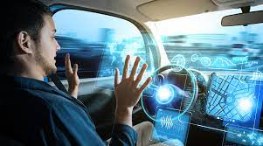
autonomous

Slide 245
autonomy

Slide 246
autonomy

Slide 247
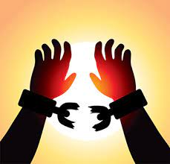
autonomy

Slide 248
autonomous

Slide 249
autonomous
auto + nomous = autonomous

Slide 250
autonomous
auto + nomous = autonomous
adjective
Definition: to control itself without interventions

Slide 251
autonomy

Slide 252
autonomy
auto + nomy = autonomy

Slide 253
autonomy
auto + nomy = autonomy
noun
Definition – the right to make your own choices

Slide 254
The military are trying to develop autonomous vehicles which could be used in combat.

Slide 255
The military are trying to develop
_ _ _ _ _ _ _ _ _ _ vehicles which could be used in combat.

Slide 256
The military are trying to develop autonomous vehicles which could be used in combat.

Slide 257
Should primary school children be given autonomy to choose their own school subjects?

Slide 258
Should primary school children be given _ _ _ _ _ _ _ _ to choose their own school subjects?

Slide 259
Should primary school children be given autonomy to choose their own school subjects?

Slide 260
New CHALLENGE words.

Slide 261
interrupt

Slide 262
interrupt
It is extremely rude to interrupt someone when they are talking.

Slide 263
It is extremely rude to interrupt someone when they are talking.

Slide 264
It is extremely rude to _ _ _ _ _ _ _ _ _ _ someone when they are talking.

Slide 265
It is extremely rude to interrupt someone when they are talking.

Slide 266
language

Slide 267
language
Harry Potter and the Philosopher’s Stone has been translated into a different language at least 79 times.

Slide 268
language
Harry Potter and the Philosopher’s Stone has been translated into a different language at least 79 times.

Slide 269
Harry Potter and the Philosopher’s Stone has been translated into a different
_ _ _ _ _ _ _ _ at least 79 times.

Slide 270
Harry Potter and the Philosopher’s Stone has been translated into a different language at least 79 times.

Slide 271
Let’s Practise and Apply.

Slide 272
Can you spot the spelling rule words and the challenge words?

Slide 273
Fragile Earth
One of the most pressing problems we face today is around global warming. This is the hindrance of the slow and steady rise of the Earth’s temperature due to the release of gases, such as carbon dioxide. Anti-corruption groups do excellent work to ensure the scientific language of this problem is made clear in the media. Some claims made about global warming that these groups are contending with include how the planet will make its own auto-correction to this rise in temperature. Another claim is that all the fuss will be anticlimactic as the world will not end if we do not recycle. These messages are confusing for the public to believe, which is why people in the UK have the autonomy to decide for themselves as to the extent global warming is affecting the planet and what needs to happen to prevent it causing further damage.

Slide 274
Fragile Earth
One of the most pressing problems we face today is around global warming. This is the hindrance of the slow and steady rise of the Earth’s temperature due to the release of gases, such as carbon dioxide. Anti-corruption groups do excellent work to ensure the scientific language of this problem is made clear in the media. Some claims made about global warming that these groups are contending with include how the planet will make its own auto-correction to this rise in temperature. Another claim is that all the fuss will be anticlimactic as the world will not end if we do not recycle. These messages are confusing for the public to believe, which is why people in the UK have the autonomy to decide for themselves as to the extent global warming is affecting the planet and what needs to happen to prevent it causing further damage.

Slide 275
Write this sentence as I dictate it to you.
Notes:
The environment of planet Earth is made up of tropical areas and frozen lands.

Slide 276
Some claims made about global warming that these groups are contending with include how the planet will make its own auto-correction to this rise in temperature.
Did you write it correctly?
Edit your work and make sure you have it correct.
Can you underline the spelling word that we have covered in this session?

Slide 277
Year 6 - Autumn 2
Week 2 - Friday
Notes:
Click through the slides for all the R+R words for the week (both the focus and the challenge words)
Click through the slides for all the new learning this week

Slide 279
Old challenge words…

Slide 280
hindrance

Slide 281
excellent

Slide 282
Old spelling rule words…

Slide 283
recycle

Slide 284
rebuild

Slide 285
rewrite

Slide 286
replace

Slide 287
revisit

Slide 288
refresh

Slide 289
revenge

Slide 290
retrieve

Slide 291
return

Slide 292
reflector

Slide 293
revise

Slide 294
rebellion

Slide 295
New spelling rule words…

Slide 296
antibacterial

Slide 297
antidepressant

Slide 298
anti-corruption

Slide 299
anticlimactic

Slide 300
antioxidants

Slide 301
antibiotics

Slide 302
autobiographical

Slide 303
autograph

Slide 304
autocorrection

Slide 305
autonomous

Slide 306
autonomy

Slide 307
New challenge words…

Slide 308
interrupt

Slide 309
language

Slide 310
Quick Quiz time…
Notes:
Say these words for the quiz
Environment equipment frequently government musical mathematical require vampire urgency emergency

Slide 311
Did you get them correct?
Edit your work.
hindrance excellent revenge
recycle interrupt language
antibacterial anticlimactic autocorrection autonomous

Slide 312
Word class time…

Slide 313
It is rude to interrupt someone when they are talking.
Notes:
Ask for these words to be classed

Slide 314
It’s rude to interrupt someone when they are talking.
pronoun, adjective, preposition, verb, noun, adverb, pronoun, verb, verb.
Notes:
Ask for these words to be classed

Slide 315
It’s rude to interrupt someone when they are talking.
pronoun, adjective, preposition, verb, noun, adverb, pronoun, verb, verb.
Notes:
Ask for these words to be classed

Slide 316
He is learning English as a second language.
Notes:
Ask for these words to be classed

Slide 317
He is learning English as a second language.
pronoun, verb, verb, noun, preposition, determiner, adjective, noun.

Slide 318
He is learning English as a second language.
pronoun, verb, verb, noun, preposition, determiner, adjective, noun.

Slide 319
Etymology
The history of a word….

Slide 320
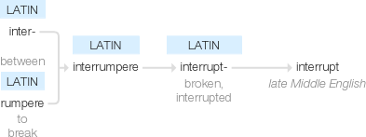
interrupt

Slide 321

language

Slide 322
Let’s investigate….
Find synonyms and antonyms of the challenge words: interrupt and language

