Slide 1
Spelling Y6
Mastering spellings: building on the foundations of phonics
Autumn 2
Week 3
Notes:
These slides are the same as Y5 Summer 2 as this is a revisit and review half term

Slide 2
Year 6 - Autumn 2
Week 3 - Monday
Notes:
Revisit and review the words from Y5 and challenge words – I say, we say, you say
Ask children to write words only in their spelling book
Introduce the new spelling rule
Children to write the new spelling rule words and challenge words into books when the sentences are shown with the spelling word missing.
Read the extract with the class as choral reading. Practise model of prosody etc.
Ask children to find the spelling words from the session in the text.
Then read allowed the chosen sentence for children to write fully in their books.
Show the extract and ask children to then edit their work to check they were correct in their dictation.

Slide 3
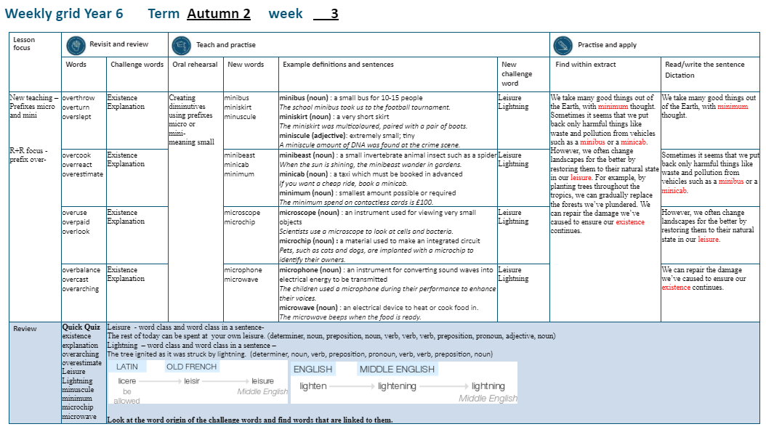

Slide 4
Let’s Revisit and Review…

Slide 5
Do you remember this challenge word?

Slide 6
existence

Slide 7

existence
(noun)
definition: a state of living

Slide 8
existence
Christians believe in the existence of God.

Slide 9
explanation

Slide 10
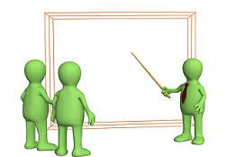
explanation
(noun)
definition: a statement or account which makes everything clear

Slide 11
explanation
An explanation text is useful in science lessons.

Slide 12
Can you remember this spelling rule? prefix over-

Slide 13
The prefix over-

Slide 14
over- meaning ‘too much’ or ‘more than enough’

Slide 15
overthrow

Slide 16
overthrow

Slide 17

overthrow over + throw = overthrow

Slide 18
overturn

Slide 19
overturn n

Slide 20
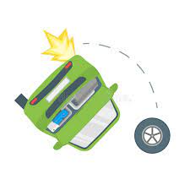
overturn over + turn = overturn

Slide 21
overslept

Slide 22
overslept

Slide 23
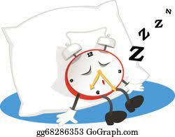
overslept over + slept = overslept

Slide 24
Let’s Teach and Practise

Slide 25
Creating diminutives using prefixes micro- or mini- meaning small.

Slide 26
Prefixes micro- and mini-

Slide 27
minibus

Slide 28
minibus

Slide 29
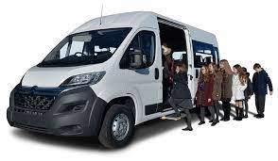
minibus

Slide 30
miniskirt

Slide 31
miniskirt

Slide 32
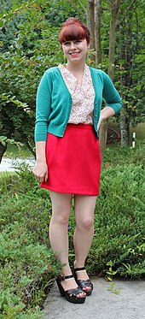
miniskirt

Slide 33
minuscule

Slide 34
minuscule

Slide 35
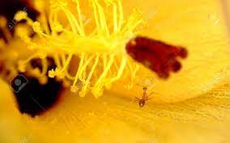
minuscule

Slide 36
minibus

Slide 37
minibus mini + bus = minibus

Slide 38
minibus mini + bus = minibus
noun
Definition: a small bus for 10-15 people

Slide 39
miniskirt

Slide 40
miniskirt mini + skirt = miniskirt

Slide 41
miniskirt mini + skirt = miniskirt
noun
Definition: a short skirt above the knee

Slide 42
minuscule

Slide 43
minuscle minu + scule = minuscule

Slide 44
minuscle minu + scule = minuscule
noun
Definition: extremely small; tiny

Slide 45
The school minibus took us to the football tournament.

Slide 46
The school _ _ _ _ _ _ _ took us to the football tournament.

Slide 47
The school minibus took us to the football tournament.

Slide 48
The miniskirt was multicoloured, matched with a pair of boots.

Slide 49
The _ _ _ _ _ _ _ _ _ was multicoloured, matched with a pair of boots.

Slide 50
The miniskirt was multicoloured, matched with a pair of boots.

Slide 51
A minuscule amount of DNA was found at the crime scene.

Slide 52
A _ _ _ _ _ _ _ _ _ amount of DNA was found at the crime scene.

Slide 53
A minuscule amount of DNA was found at the crime scene.

Slide 54
New CHALLENGE words.

Slide 55
leisure

Slide 56
leisure
The most common leisure activity in Britain is going for a walk.

Slide 57
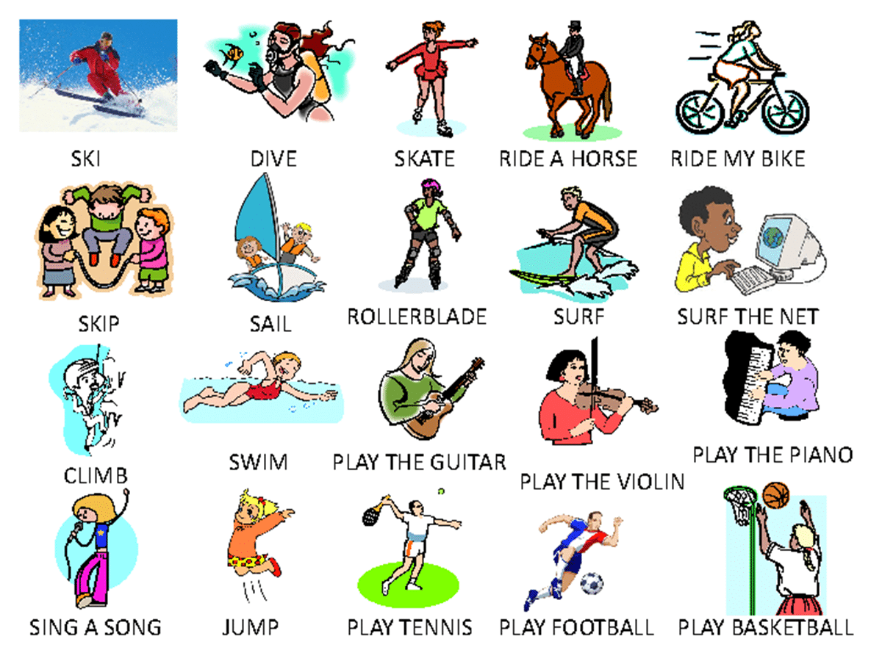
The most common leisure activity in Britain is going for a walk.

Slide 58
The most common _ _ _ _ _ _ _ activity in Britain is going for a walk.

Slide 59
The most common leisure activity in Britain is going for a walk.

Slide 60
lightning

Slide 61
lightning
The tree ignited as it was struck by lightning.

Slide 62
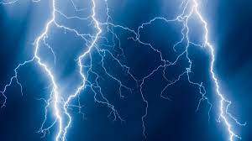
The tree ignited as it was struck by lightning.

Slide 63
The tree ignited as it was struck by _ _ _ _ _ _ _ _ _.

Slide 64
The tree ignited as it was struck by lightning.

Slide 65
Let’s Practise and Apply.

Slide 66
Can you spot the spelling rule words and the challenge words?

Slide 67
Fragile Earth
We take many good things out of the Earth, with minimum thought. Sometimes it seems that we overthrow the atmosphere with harmful substances, such as waste and pollution. This is due to the overuse of vehicles such as a minibus or a minicab. However, we often change landscapes for the better by restoring them to their natural state in our leisure. For example, by planting trees throughout the tropics, we can gradually replace the forests we’ve plundered. As a minimum, we must repair the damage we’ve caused to ensure our existence continues protecting species and minibeasts.

Slide 68
Fragile Earth
We take many good things out of the Earth, with minimum thought. Sometimes it seems that we overthrow the atmosphere with harmful substances, such as waste and pollution. This is due to the overuse of vehicles such as a minibus or a minicab. However, we often change landscapes for the better by restoring them to their natural state in our leisure. For example, by planting trees throughout the tropics, we can gradually replace the forests we’ve plundered. As a minimum, we must repair the damage we’ve caused to ensure our existence continues protecting species and minibeasts.

Slide 69
Write this sentence as I dictate it to you.
Notes:
The environment of planet Earth is made up of tropical areas and frozen lands.

Slide 70
We take many good things out of the Earth, with minimum thought.
Did you write it correctly?
Edit your work and make sure you have it correct.
Can you underline the spelling word that we have covered in this session?

Slide 71
Year 6 - Autumn 2
Week 3 - Tuesday
Notes:
Revisit and review the words from Y5 and challenge words – I say, we say, you say
Ask children to write words only in their spelling book
Introduce the new spelling rule
Children to write the new spelling rule words and challenge words into books when the sentences are shown with the spelling word missing.
Read the extract with the class as choral reading. Practise model of prosody etc.
Ask children to find the spelling words from the session in the text.
Then read allowed the chosen sentence for children to write fully in their books.
Show the extract and ask children to then edit their work to check they were correct in their dictation.

Slide 73
Let’s Revisit and Review…

Slide 74
Do you remember this challenge word?

Slide 75
existence

Slide 76
existence
(noun)
definition: a state of living

Slide 77
existence
Christians believe in the existence of God.

Slide 78
explanation

Slide 79
explanation
(noun)
definition: a statement or account which makes everything clear

Slide 80
explanation
An explanation text is useful in science lessons.

Slide 81
Can you remember this spelling rule? prefix over-

Slide 82
The prefix over-

Slide 83
over- meaning ‘too much’ or ‘more than enough’

Slide 84
overcook

Slide 85
overcook

Slide 86
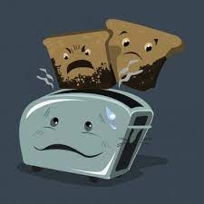
overcook over + cook = overcook

Slide 87
overreact

Slide 88
overreact n

Slide 89
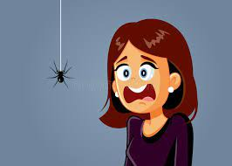
overreact over + react = overreact

Slide 90
overestimate

Slide 91
overestimate

Slide 92
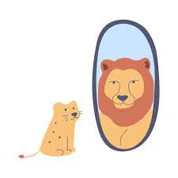
overestimate over + estimate = overestimate

Slide 93
Let’s Teach and Practise

Slide 94
Creating diminutives using prefixes micro- or mini- meaning small.

Slide 95
Prefixes micro- and mini-

Slide 96
minibeast

Slide 97
minibeast

Slide 98
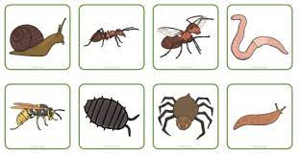
minibeast

Slide 99
minicab

Slide 100
minicab

Slide 101
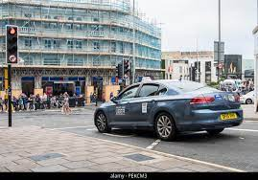
minicab

Slide 102
minimum

Slide 103
minimum

Slide 104
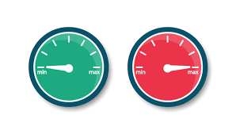
minimum

Slide 105
minibeast

Slide 106
minibeast mini + beast = minibeast

Slide 107
minibeast mini + beast = minibeast
noun
Definition: a small invertebrate animal insect such as a spider

Slide 108
minicab

Slide 109
minicab mini + cab = minicab

Slide 110
minicab mini + cab = minicab
noun
Definition: a taxi which must be booked in advance

Slide 111
minimum

Slide 112
minimum mini + mum = minimum

Slide 113
minimum mini + mum = minimum
noun
Definition: the smallest amount possible

Slide 114
When the sun is shining, the minibeast roam freely in gardens.

Slide 115
When the sun is shining, the minibeast roam freely in gardens.

Slide 116
When the sun is shining, the
_ _ _ _ _ _ _ _ _ roam freely in gardens.

Slide 117
When the sun is shining, the minibeast roam freely in gardens.

Slide 118
If you want a cheap fare, book a minicab.

Slide 119
If you want a cheap fare, book a _ _ _ _ _ _ _.

Slide 120
If you want a cheap fare, book a minicab.

Slide 121
The minimum spend on a contactless card is £100.

Slide 122
The _ _ _ _ _ _ _ spend on a contactless card is £100.

Slide 123
The minimum spend on a contactless card is £100.

Slide 124
New CHALLENGE words.

Slide 125
leisure

Slide 126
leisure
The most common leisure activity in Britain is going for a walk.

Slide 127
The most common leisure activity in Britain is going for a walk.

Slide 128
The most common _ _ _ _ _ _ _ activity in Britain is going for a walk.

Slide 129
The most common leisure activity in Britain is going for a walk.

Slide 130
lightning

Slide 131
lightning
The tree ignited as it was struck by lightning.

Slide 132
The tree ignited as it was struck by lightning.

Slide 133
The tree ignited as it was struck by _ _ _ _ _ _ _ _ _.

Slide 134
The tree ignited as it was struck by lightning.

Slide 135
Let’s Practise and Apply.

Slide 136
Can you spot the spelling rule words and the challenge words?

Slide 137
Fragile Earth
We take many good things out of the Earth, with minimum thought. Sometimes it seems that we overthrow the atmosphere with harmful substances, such as waste and pollution. This is due to the overuse of vehicles such as a minibus or a minicab. However, we often change landscapes for the better by restoring them to their natural state in our leisure. For example, by planting trees throughout the tropics, we can gradually replace the forests we’ve plundered. As a minimum, we must repair the damage we’ve caused to ensure our existence continues protecting species and minibeasts.

Slide 138
Fragile Earth
We take many good things out of the Earth, with minimum thought. Sometimes it seems that we overthrow the atmosphere with harmful substances, such as waste and pollution. This is due to the overuse of vehicles such as a minibus or a minicab. However, we often change landscapes for the better by restoring them to their natural state in our leisure. For example, by planting trees throughout the tropics, we can gradually replace the forests we’ve plundered. As a minimum, we must repair the damage we’ve caused to ensure our existence continues protecting species and minibeasts.

Slide 139
Write this sentence as I dictate it to you.
Notes:
The environment of planet Earth is made up of tropical areas and frozen lands.

Slide 140
Sometimes it seems that we overthrow the atmosphere with harmful substances, such as waste and pollution.
Did you write it correctly?
Edit your work and make sure you have it correct.
Can you underline the spelling word that we have covered in this session?

Slide 141
Year 6 - Autumn 2
Week 3 - Wednesday
Notes:
Revisit and review the words from Y5 and challenge words – I say, we say, you say
Ask children to write words only in their spelling book
Introduce the new spelling rule
Children to write the new spelling rule words and challenge words into books when the sentences are shown with the spelling word missing.
Read the extract with the class as choral reading. Practise model of prosody etc.
Ask children to find the spelling words from the session in the text.
Then read allowed the chosen sentence for children to write fully in their books.
Show the extract and ask children to then edit their work to check they were correct in their dictation.

Slide 143
Let’s Revisit and Review…

Slide 144
Do you remember this challenge word?

Slide 145
existence

Slide 146
existence
(noun)
definition: a state of living

Slide 147
existence
Christians believe in the existence of God.

Slide 148
explanation

Slide 149
explanation
(noun)
definition: a statement or account which makes everything clear

Slide 150
explanation
An explanation text is useful in science lessons.

Slide 151
Can you remember this spelling rule? prefix over-

Slide 152
The prefix over-

Slide 153
over- meaning ‘too much’ or ‘more than enough’

Slide 154
overuse

Slide 155
overuse

Slide 156
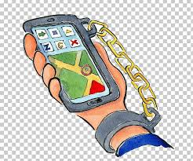
overuse over + use = overuse

Slide 157
overpaid

Slide 158
overpaid n

Slide 159
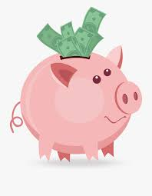
overpaid over + paid = overpaid

Slide 160
overlook

Slide 161
overlook

Slide 162

overlook over + look = overlook

Slide 163
Let’s Teach and Practise

Slide 164
Creating diminutives using prefixes micro- or mini- meaning small.

Slide 165
Prefixes micro- and mini-

Slide 166
microscope

Slide 167
microscope

Slide 168

microscope

Slide 169
microchip

Slide 170
microchip

Slide 171
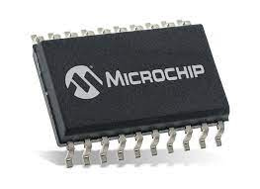
microchip

Slide 172
microscope

Slide 173
microscope
micro + scope = microscope

Slide 174
microscope
micro + scope = microscope
noun
Definition – an instrument used for viewing very small objects

Slide 175
microchip

Slide 176
microchip
micro + chip = microchip

Slide 177
microchip
micro + chip = microchip
noun
Definition – a material used to make an integrated ciruit

Slide 178
Scientists use a microscope to look at cells and bacteria.

Slide 179
Scientists use a _ _ _ _ _ _ _ _ _ _ to look at cells and bacteria.

Slide 180
Scientists use a microscope to look at cells and bacteria.

Slide 181
Pets, such as cats and dogs, are implanted with a microchip to identify their owners.

Slide 182
Pets, such as cats and dogs, are implanted with a _ _ _ _ _ _ _ _ _ to identify their owners.

Slide 183
Pets, such as cats and dogs, are implanted with a microchip to identify their owners.

Slide 184
New CHALLENGE words.

Slide 185
leisure

Slide 186
leisure
The most common leisure activity in Britain is going for a walk.

Slide 187
The most common leisure activity in Britain is going for a walk.

Slide 188
The most common _ _ _ _ _ _ _ activity in Britain is going for a walk.

Slide 189
The most common leisure activity in Britain is going for a walk.

Slide 190
lightning

Slide 191
lightning
The tree ignited as it was struck by lightning.

Slide 192
The tree ignited as it was struck by lightning.

Slide 193
The tree ignited as it was struck by _ _ _ _ _ _ _ _ _.

Slide 194
The tree ignited as it was struck by lightning.

Slide 195
Let’s Practise and Apply.

Slide 196
Can you spot the spelling rule words and the challenge words?

Slide 197
Fragile Earth
We take many good things out of the Earth, with minimum thought. Sometimes it seems that we overthrow the atmosphere with harmful substances, such as waste and pollution. This is due to the overuse of vehicles such as a minibus or a minicab. However, we often change landscapes for the better by restoring them to their natural state in our leisure. For example, by planting trees throughout the tropics, we can gradually replace the forests we’ve plundered. As a minimum, we must repair the damage we’ve caused to ensure our existence continues protecting species and minibeasts.

Slide 198
Fragile Earth
We take many good things out of the Earth, with minimum thought. Sometimes it seems that we overthrow the atmosphere with harmful substances, such as waste and pollution. This is due to the overuse of vehicles such as a minibus or a minicab. However, we often change landscapes for the better by restoring them to their natural state in our leisure. For example, by planting trees throughout the tropics, we can gradually replace the forests we’ve plundered. As a minimum, we must repair the damage we’ve caused to ensure our existence continues protecting species and minibeasts.

Slide 199
Write this sentence as I dictate it to you.
Notes:
The environment of planet Earth is made up of tropical areas and frozen lands.

Slide 200
This is due to the overuse of vehicles such as a minibus or a minicab.
Did you write it correctly?
Edit your work and make sure you have it correct.
Can you underline the spelling word that we have covered in this session?

Slide 201
Year 6 - Autumn 2
Week 3 - Thursday
Notes:
Revisit and review the words from Y5 and challenge words – I say, we say, you say
Ask children to write words only in their spelling book
Introduce the new spelling rule
Children to write the new spelling rule words and challenge words into books when the sentences are shown with the spelling word missing.
Read the extract with the class as choral reading. Practise model of prosody etc.
Ask children to find the spelling words from the session in the text.
Then read allowed the chosen sentence for children to write fully in their books.
Show the extract and ask children to then edit their work to check they were correct in their dictation.

Slide 203
Let’s Revisit and Review…

Slide 204
Do you remember this challenge word?

Slide 205
existence

Slide 206
existence
(noun)
definition: a state of living

Slide 207
existence
Christians believe in the existence of God.

Slide 208
explanation

Slide 209
explanation
(noun)
definition: a statement or account which makes everything clear

Slide 210
explanation
An explanation text is useful in science lessons.

Slide 211
Can you remember this spelling rule? prefix over-

Slide 212
The prefix over-

Slide 213
over- meaning ‘too much’ or ‘more than enough’

Slide 214
overbalance

Slide 215
overbalance

Slide 216

overbalance over + balance = overbalance

Slide 217
overcast

Slide 218
overcast n

Slide 219

overcast over + cast = overcast

Slide 220
overarching

Slide 221
overarching

Slide 222
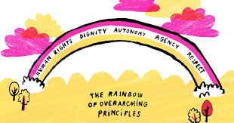
overarching over + arching = overarching

Slide 223
Let’s Teach and Practise

Slide 224
Creating diminutives using prefixes micro- or mini- meaning small.

Slide 225
Prefixes micro- and mini-

Slide 226
microphone

Slide 227
microphone

Slide 228
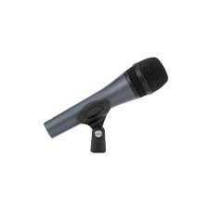
microphone

Slide 229
microwave

Slide 230
microwave

Slide 231
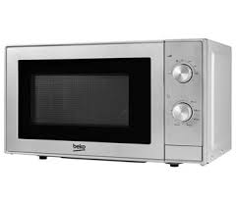
microwave

Slide 232
microphone

Slide 233
microphone
micro + phone = microphone

Slide 234
microphone
micro + phone = microphone
noun
Definition – an instrument for converting sound waves into electrical signals

Slide 235
microwave

Slide 236
microwave
micro + wave = microwave

Slide 237
microwave
micro + wave = microwave
noun
Definition – an electrical device to heat or cook food in

Slide 238
The children used a microphone during their performance to enhance their voices.

Slide 239
The children used a
_ _ _ _ _ _ _ _ _ _ during their performance to enhance their voices.

Slide 240
The children used a microphone during their performance to enhance their voices.

Slide 241
The microwave beeps when the food is ready.

Slide 242
The _ _ _ _ _ _ _ _ _ beeps when the food is ready.

Slide 243
The microwave beeps when the food is ready.

Slide 244
New CHALLENGE words.

Slide 245
leisure

Slide 246
leisure
The most common leisure activity in Britain is going for a walk.

Slide 247
The most common leisure activity in Britain is going for a walk.

Slide 248
The most common _ _ _ _ _ _ _ activity in Britain is going for a walk.

Slide 249
The most common leisure activity in Britain is going for a walk.

Slide 250
lightning

Slide 251
lightning
The tree ignited as it was struck by lightning.

Slide 252
The tree ignited as it was struck by lightning.

Slide 253
The tree ignited as it was struck by _ _ _ _ _ _ _ _ _.

Slide 254
The tree ignited as it was struck by lightning.

Slide 255
Let’s Practise and Apply.

Slide 256
Can you spot the spelling rule words and the challenge words?

Slide 257
Fragile Earth
We take many good things out of the Earth, with minimum thought. Sometimes it seems that we overthrow the atmosphere with harmful substances, such as waste and pollution. This is due to the overuse of vehicles such as a minibus or a minicab. However, we often change landscapes for the better by restoring them to their natural state in our leisure. For example, by planting trees throughout the tropics, we can gradually replace the forests we’ve plundered. As a minimum, we must repair the damage we’ve caused to ensure our existence continues protecting species and minibeasts.

Slide 258
Fragile Earth
We take many good things out of the Earth, with minimum thought. Sometimes it seems that we overthrow the atmosphere with harmful substances, such as waste and pollution. This is due to the overuse of vehicles such as a minibus or a minicab. However, we often change landscapes for the better by restoring them to their natural state in our leisure. For example, by planting trees throughout the tropics, we can gradually replace the forests we’ve plundered. As a minimum, we must repair the damage we’ve caused to ensure our existence continues protecting species and minibeasts.

Slide 259
Write this sentence as I dictate it to you.
Notes:
The environment of planet Earth is made up of tropical areas and frozen lands.

Slide 260
However, we often change landscapes for the better by restoring them to their natural state in our leisure.
Did you write it correctly?
Edit your work and make sure you have it correct.
Can you underline the spelling word that we have covered in this session?

Slide 261
Year 6 - Autumn 2
Week 3 - Friday
Notes:
Click through the slides for all the R+R words for the week (both the focus and the challenge words)
Click through the slides for all the new learning this week

Slide 263
Old challenge words…

Slide 264
existence

Slide 265
explanation

Slide 266
Old spelling rule words…

Slide 267
overthrow

Slide 268
overturn

Slide 269
overslept

Slide 270
overcook

Slide 271
overreact

Slide 272
overestimate

Slide 273
overuse

Slide 274
overpaid

Slide 275
overlook

Slide 276
overbalance

Slide 277
overcast

Slide 278
overarching

Slide 279
New spelling rule words…

Slide 280
minibus

Slide 281
miniskirt

Slide 282
minuscule

Slide 283
minibeast

Slide 284
minicab

Slide 285
minimum

Slide 286
microscope

Slide 287
microchip

Slide 288
microphone

Slide 289
microwave

Slide 290
New challenge words…

Slide 291
leisure

Slide 292
lightning

Slide 293
Quick Quiz time…
Notes:
Say these words for the quiz
Desperate determined existence explanation hesitancy occupancy overarching overestimate overuse overslept

Slide 294
Did you get them correct?
Edit your work.
existence explanation overarching overestimate leisure lightning minuscule minimum microchip microwave

Slide 295
Word class time…

Slide 296
The rest of today can be spent at your own leisure.
Notes:
Ask for these words to be classed

Slide 297
The rest of today can be spent at your own leisure.
determiner, noun, preposition, noun, verb, verb, verb, preposition, pronoun, adjective, noun
Notes:
Ask for these words to be classed

Slide 298
The tree ignited as it was struck by lightning.
Notes:
Ask for these words to be classed

Slide 299
The tree ignited as it was struck by lightning.
determiner, noun, verb, preposition, pronoun, verb, verb, preposition, noun.
Notes:
Ask for these words to be classed

Slide 300
Etymology
The history of a word….

Slide 301

leisure

Slide 302

lightning

Slide 303
Let’s investigate….
Can you find words linked to leisure and lightning?

