Slide 1
Spelling Y6
Mastering spellings: building on the foundations of phonics
Autumn 2
Week 4
Notes:
These slides are the same as Y5 Summer 2 as this is a revisit and review half term

Slide 2
Year 6 - Autumn 2
Week 4 - Monday
Notes:
Revisit and review the words from Y5 and challenge words – I say, we say, you say
Ask children to write words only in their spelling book
Introduce the new spelling rule
Children to write the new spelling rule words and challenge words into books when the sentences are shown with the spelling word missing.
Read the extract with the class as choral reading. Practise model of prosody etc.
Ask children to find the spelling words from the session in the text.
Then read allowed the chosen sentence for children to write fully in their books.
Show the extract and ask children to then edit their work to check they were correct in their dictation.

Slide 3
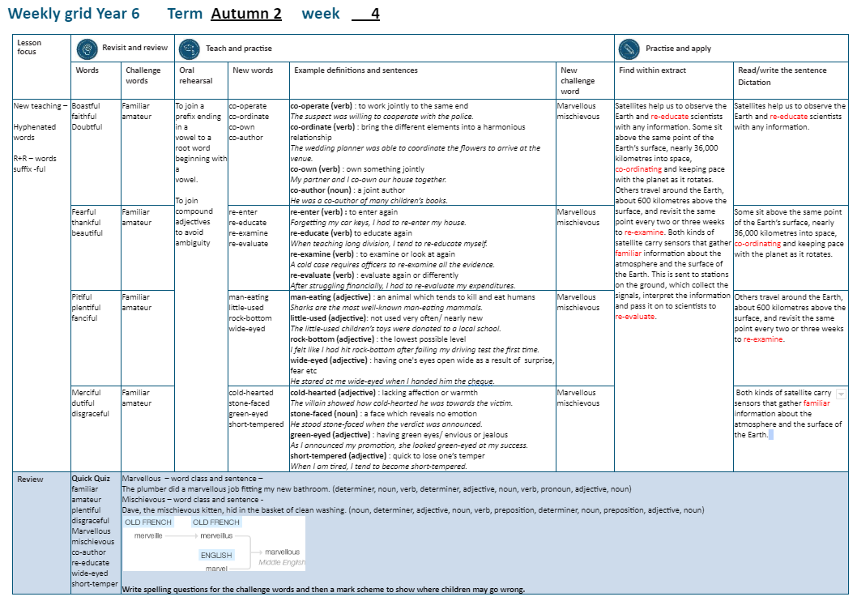

Slide 4
Let’s Revisit and Review…

Slide 5
Do you remember this challenge word?

Slide 6
familiar

Slide 7
familiar
(adjective)
Definition: well known

Slide 8
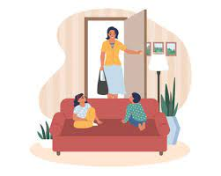
familiar
The familiar feeling came over her as she entered her old home.

Slide 9
amateur

Slide 10
amateur
(noun)
Definition: to engage in something, particularly a sport, on a non professional level without getting paid

Slide 11
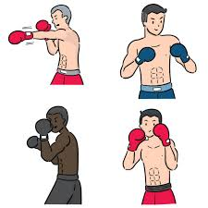
amateur
The Olympics were incredible for the amateur boxer.

Slide 12
Can you remember this spelling rule? suffix -ful

Slide 13
-ful

Slide 14
Suffix -ful meaning full of

Slide 15
boastful

Slide 16
boastful

Slide 17

boastful boast + ful = boastful

Slide 18
faithful

Slide 19
faithful

Slide 20
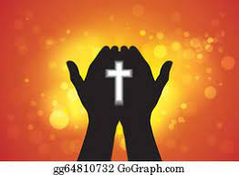
faithful faith + ful = faithful

Slide 21
doubtful

Slide 22
doubtful

Slide 23

doubtful doubt + ful = doubtful

Slide 24
Let’s Teach and Practise

Slide 25
To join a prefix ending in a vowel to a root word beginning with a vowel.

Slide 26
co-operate

Slide 27
co-operate

Slide 28
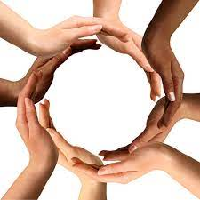
co-operate

Slide 29
co-ordinate

Slide 30
co-ordinate

Slide 31

co-ordinate

Slide 32
co-own

Slide 33
co-own

Slide 34
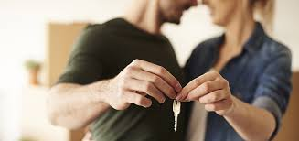
co-own

Slide 35
co-author

Slide 36
co-author

Slide 37
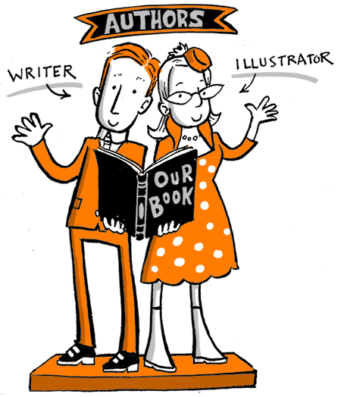
co-author

Slide 38
co-operate

Slide 39
co-operate co- + operate = co-operate

Slide 40
co-operate co- + operate = co-operate
verb
Definition: to work jointly to achieve something

Slide 41
co-ordinate

Slide 42
co-ordinate co- + ordinate = co-ordinate

Slide 43
co-ordinate co- + ordinate = co-ordinate
verb
Definition: to bring different elements together to achieve an outcome

Slide 44
co-own

Slide 45
co-own co- + own = co-own

Slide 46
co-own co- + own = co-own
verb
Definition: to own something jointly

Slide 47
co-author

Slide 48
co-author co- + author = co-author

Slide 49
co-author co- + author = co-author
noun
Definition: two or more people who create a paper or book

Slide 50
The suspect was willing to co-operate with the police.

Slide 51
The suspect was willing to
_ _ _ _ _ _ _ _ _ with the police.

Slide 52
The suspect was willing to co-operate with the police.

Slide 53
The wedding planner was able to co-ordinate the flowers to arrive at the venue on time.

Slide 54
The wedding planner was able to _ _ _ _ _ _ _ _ _ _ the flowers to arrive at the venue on time.

Slide 55
The wedding planner was able to co-ordinate the flowers to arrive at the venue on time.

Slide 56
My partner and I co-own our house.

Slide 57
My partner and I _ _ _ _ _ our house.

Slide 58
My partner and I co-own our house.

Slide 59
He was a co-author of many children’s books.

Slide 60
He was a _ _ _ _ _ _ _ _ of many children’s books.

Slide 61
He was a co-author of many children’s books.

Slide 62
New CHALLENGE words.

Slide 63
marvellous

Slide 64
marvellous
We saw the most marvellous firework display.

Slide 65

We saw the most marvellous firework display.

Slide 66
We saw the most
_ _ _ _ _ _ _ _ _ _ firework display.

Slide 67
We saw the most marvellous firework display.

Slide 68
mischievous

Slide 69
mischievous
Dave, the mischievous kitten, hid in the basket of clean washing.

Slide 70

mischievous
Dave, the mischievous kitten, hid in the basket of clean washing.

Slide 71
Dave, the _ _ _ _ _ _ _ _ _ _ _ kitten, hid in the basket of clean washing.

Slide 72
Dave, the mischievous kitten, hid in the basket of clean washing.

Slide 73
Let’s Practise and Apply.

Slide 74
Can you spot the spelling rule words and the challenge words?

Slide 75
Fragile Earth
Satellites help us to observe our marvellous Earth and re-educate scientists of changes. Some sit above the same point of Earth’s surface, nearly 36,000 km into space, so they can co-ordinate and keep pace with the planet as it rotates. Others travel around the Earth, about 600km above the surface, and re-enter the same point every two or three weeks to re-examine. Both kinds of satellite carry sensors which gather familiar information about the atmosphere and the surface of the Earth. This is sent to stations on the ground, which collect signals, interpret the information and pass it on to wide-eyed scientists to re-examine.

Slide 76
Fragile Earth
Satellites help us to observe our marvellous Earth and re-educate scientists of changes. Some sit above the same point of Earth’s surface, nearly 36,000 km into space, so they can co-ordinate and keep pace with the planet as it rotates. Others travel around the Earth, about 600km above the surface, and re-enter the same point every two or three weeks to re-examine. Both kinds of satellite carry sensors which gather familiar information about the atmosphere and the surface of the Earth. This is sent to stations on the ground, which collect signals, interpret the information and pass it on to wide-eyed scientists to re-examine.

Slide 77
Write this sentence as I dictate it to you.
Notes:
The environment of planet Earth is made up of tropical areas and frozen lands.

Slide 78
Satellites help us to observe our marvellous Earth and re-educate scientists of changes.
Did you write it correctly?
Edit your work and make sure you have it correct.
Can you underline the spelling word that we have covered in this session?

Slide 79
Year 6 - Autumn 2
Week 4 - Tuesday
Notes:
Revisit and review the words from Y5 and challenge words – I say, we say, you say
Ask children to write words only in their spelling book
Introduce the new spelling rule
Children to write the new spelling rule words and challenge words into books when the sentences are shown with the spelling word missing.
Read the extract with the class as choral reading. Practise model of prosody etc.
Ask children to find the spelling words from the session in the text.
Then read allowed the chosen sentence for children to write fully in their books.
Show the extract and ask children to then edit their work to check they were correct in their dictation.

Slide 81
Let’s Revisit and Review…

Slide 82
Do you remember this challenge word?

Slide 83
familiar

Slide 84
familiar
(adjective)
Definition: well known

Slide 85
familiar
The familiar feeling came over her as she entered her old home.

Slide 86
amateur

Slide 87
amateur
(noun)
Definition: to engage in something, particularly a sport, on a non professional level without getting paid

Slide 88
amateur
The Olympics were incredible for the amateur boxer.

Slide 89
Can you remember this spelling rule? suffix -ful

Slide 90
-ful

Slide 91
Suffix -ful meaning full of

Slide 92
fearful

Slide 93
fearful

Slide 94
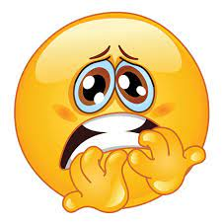
fearful fear + ful = fearful

Slide 95
thankful

Slide 96
thankful

Slide 97
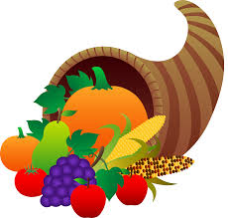
thankful thank + ful = thankful

Slide 98
beautiful

Slide 99
beautiful

Slide 100

beautiful beauty (–y +i) + ful = beautiful

Slide 101
Let’s Teach and Practise

Slide 102
To join a prefix ending in a vowel to a root word beginning with a vowel.

Slide 103
re-enter

Slide 104
re-enter

Slide 105
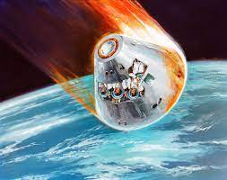
re-enter

Slide 106
re-educate

Slide 107
re-educate

Slide 108

re-educate

Slide 109
re-examine

Slide 110
re-examine

Slide 111

re-examine

Slide 112
re-evaluate

Slide 113
re-evaluate

Slide 114
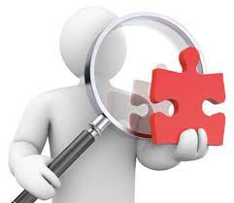
re-evaluate

Slide 115
re-enter

Slide 116
re-enter re + enter = re-enter

Slide 117
re-enter re + enter = re-enter
verb
Definition: to enter again

Slide 118
re-educate

Slide 119
re-educate re + educate = re-educate

Slide 120
re-educate re + educate = re-educate
verb
Definition: to learn something again

Slide 121
re-examine

Slide 122
re-examine re + examine = re-examine

Slide 123
re-examine re + examine = re-examine
verb
Definition: to examine or look at something again

Slide 124
re-evaluate

Slide 125
re-evaluate re + evaluate = re-evaluate

Slide 126
re-evaluate re + evaluate = re-evaluate
verb
Definition: to evaluate again or differently

Slide 127
Forgetting my car keys, I had to re-enter my house.

Slide 128
Forgetting my car keys, I had to
_ _ _ _ _ _ _ my house.

Slide 129
Forgetting my car keys, I had to re-enter my house.

Slide 130
When teaching long division, I have to re-educate myself of the steps involved.

Slide 131
When teaching long division, I have to _ _ _ _ _ _ _ _ _ myself of the steps involved.

Slide 132
When teaching long division, I have to re-educate myself of the steps involved.

Slide 133
A cold case requires officers to re-examine all the evidence.

Slide 134
A cold case requires officers to
_ _ _ _ _ _ _ _ _ all the evidence.

Slide 135
A cold case requires officers to re-examine all the evidence.

Slide 136
After struggling financially, I had to re-evaluate my expenditures.

Slide 137
After struggling financially, I had to _ _ _ _ _ _ _ _ _ _ my expenditures.

Slide 138
After struggling financially, I had to re-evaluate my expenditures.

Slide 139
New CHALLENGE words.

Slide 140
marvellous

Slide 141
marvellous
We saw the most marvellous firework display.

Slide 142
We saw the most marvellous firework display.

Slide 143
We saw the most
_ _ _ _ _ _ _ _ _ _ firework display.

Slide 144
We saw the most marvellous firework display.

Slide 145
mischievous

Slide 146
mischievous
Dave, the mischievous kitten, hid in the basket of clean washing.

Slide 147
mischievous
Dave, the mischievous kitten, hid in the basket of clean washing.

Slide 148
Dave, the _ _ _ _ _ _ _ _ _ _ _ kitten, hid in the basket of clean washing.

Slide 149
Dave, the mischievous kitten, hid in the basket of clean washing.

Slide 150
Let’s Practise and Apply.

Slide 151
Can you spot the spelling rule words and the challenge words?

Slide 152
Fragile Earth
Satellites help us to observe our marvellous Earth and re-educate scientists of changes. Some sit above the same point of Earth’s surface, nearly 36,000 km into space, so they can co-ordinate and keep pace with the planet as it rotates. Others travel around the Earth, about 600km above the surface, and re-enter the same point every two or three weeks to re-examine. Both kinds of satellite carry sensors which gather familiar information about the atmosphere and the surface of the Earth. This is sent to stations on the ground, which collect signals, interpret the information and pass it on to wide-eyed scientists to re-examine.

Slide 153
Fragile Earth
Satellites help us to observe our marvellous Earth and re-educate scientists of changes. Some sit above the same point of Earth’s surface, nearly 36,000 km into space, so they can co-ordinate and keep pace with the planet as it rotates. Others travel around the Earth, about 600km above the surface, and re-enter the same point every two or three weeks to re-examine. Both kinds of satellite carry sensors which gather familiar information about the atmosphere and the surface of the Earth. This is sent to stations on the ground, which collect signals, interpret the information and pass it on to wide-eyed scientists to re-examine.

Slide 154
Write this sentence as I dictate it to you.
Notes:
The environment of planet Earth is made up of tropical areas and frozen lands.

Slide 155
Some sit above the same point of Earth’s surface, nearly 36,000 km into space, so they can co-ordinate and keep pace with the planet as it rotates.
Did you write it correctly?
Edit your work and make sure you have it correct.
Can you underline the spelling word that we have covered in this session?

Slide 156
Year 6 - Autumn 2
Week 4 - Wednesday
Notes:
Revisit and review the words from Y5 and challenge words – I say, we say, you say
Ask children to write words only in their spelling book
Introduce the new spelling rule
Children to write the new spelling rule words and challenge words into books when the sentences are shown with the spelling word missing.
Read the extract with the class as choral reading. Practise model of prosody etc.
Ask children to find the spelling words from the session in the text.
Then read allowed the chosen sentence for children to write fully in their books.
Show the extract and ask children to then edit their work to check they were correct in their dictation.

Slide 158
Let’s Revisit and Review…

Slide 159
Do you remember this challenge word?

Slide 160
familiar

Slide 161
familiar
(adjective)
Definition: well known

Slide 162
familiar
The familiar feeling came over her as she entered her old home.

Slide 163
amateur

Slide 164
amateur
(noun)
Definition: to engage in something, particularly a sport, on a non professional level without getting paid

Slide 165
amateur
The Olympics were incredible for the amateur boxer.

Slide 166
Can you remember this spelling rule? suffix -ful

Slide 167
-ful

Slide 168
Suffix -ful meaning full of

Slide 169
pitiful

Slide 170
pitiful

Slide 171

pitiful pity (-y +i) + ful = pitiful

Slide 172
plentiful

Slide 173
plentiful

Slide 174
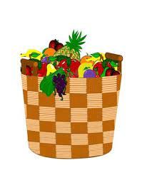
plentiful plenty (-y +i) + ful = plentiful

Slide 175
fanciful

Slide 176
fanciful

Slide 177
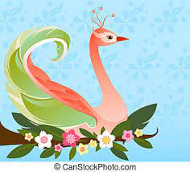
fanciful fancy (-y +i) + ful = fanciful

Slide 178
Let’s Teach and Practise

Slide 179
To join compound adjectives to avoid ambiguity.

Slide 180
man-eating

Slide 181

man-eating

Slide 182
little-used

Slide 183
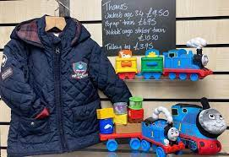
little-used

Slide 184
rock-bottom

Slide 185
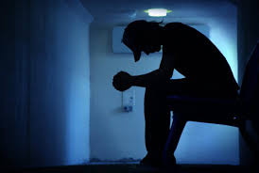
rock-bottom

Slide 186
wide-eyed

Slide 187
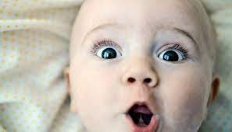
wide-eyed

Slide 188
man-eating

Slide 189
man-eating
man + eating = man-eating

Slide 190
man-eating
man + eating = man-eating
adjective
Definition – an animal which tends to eat humans

Slide 191
little-used

Slide 192
little-used
little + used = little-used

Slide 193
little-used
little + used = little-used
adjective
Definition – not used much, nearly new

Slide 194
rock-bottom

Slide 195
rock-bottom
rock + bottom = rock-bottom

Slide 196
rock-bottom
rock + bottom = rock-bottom
adjective
Definition – the lowest possible level physically or feelings

Slide 197
wide-eyed

Slide 198
wide-eyed
wide + eyed = wide-eyed

Slide 199
wide-eyed
wide + eyed = wide-eyed
adjective
Definition – eyes open wide as a result of fear or surprise

Slide 200
Sharks are the most infamous man-eating mammals.

Slide 201
Sharks are the most infamous
_ _ _ _ _ _ _ _ _ mammals.

Slide 202
Sharks are the most infamous man-eating mammals.

Slide 203
The little-used children’s toys were donated to the local school.

Slide 204
The _ _ _ _ _ _ _ _ _ _ children’s toys were donated to the local school.

Slide 205
The little-used children’s toys were donated to the local school.

Slide 206
I felt like I had hit rock-bottom after failing my driving test the first time.

Slide 207
I felt like I had hit _ _ _ _ _ _ _ _ _ _ after failing my driving test the first time.

Slide 208
I felt like I had hit rock-bottom after failing my driving test the first time.

Slide 209
He stared at me wide-eyed when I handed him the substantial cheque.

Slide 210
He stared at me _ _ _ _ _ _ _ _ when I handed him the substantial cheque.

Slide 211
He stared at me wide-eyed when I handed him the substantial cheque.

Slide 212
New CHALLENGE words.

Slide 213
marvellous

Slide 214
marvellous
We saw the most marvellous firework display.

Slide 215
We saw the most marvellous firework display.

Slide 216
We saw the most
_ _ _ _ _ _ _ _ _ _ firework display.

Slide 217
We saw the most marvellous firework display.

Slide 218
mischievous

Slide 219
mischievous
Dave, the mischievous kitten, hid in the basket of clean washing.

Slide 220
mischievous
Dave, the mischievous kitten, hid in the basket of clean washing.

Slide 221
Dave, the _ _ _ _ _ _ _ _ _ _ _ kitten, hid in the basket of clean washing.

Slide 222
Dave, the mischievous kitten, hid in the basket of clean washing.

Slide 223
Let’s Practise and Apply.

Slide 224
Can you spot the spelling rule words and the challenge words?

Slide 225
Fragile Earth
Satellites help us to observe our marvellous Earth and re-educate scientists of changes. Some sit above the same point of Earth’s surface, nearly 36,000 km into space, so they can co-ordinate and keep pace with the planet as it rotates. Others travel around the Earth, about 600km above the surface, and re-enter the same point every two or three weeks to re-examine. Both kinds of satellite carry sensors which gather familiar information about the atmosphere and the surface of the Earth. This is sent to stations on the ground, which collect signals, interpret the information and pass it on to wide-eyed scientists to re-examine.

Slide 226
Fragile Earth
Satellites help us to observe our marvellous Earth and re-educate scientists of changes. Some sit above the same point of Earth’s surface, nearly 36,000 km into space, so they can co-ordinate and keep pace with the planet as it rotates. Others travel around the Earth, about 600km above the surface, and re-enter the same point every two or three weeks to re-examine. Both kinds of satellite carry sensors which gather familiar information about the atmosphere and the surface of the Earth. This is sent to stations on the ground, which collect signals, interpret the information and pass it on to wide-eyed scientists to re-examine.

Slide 227
Write this sentence as I dictate it to you.
Notes:
The environment of planet Earth is made up of tropical areas and frozen lands.

Slide 228
Others travel around the Earth, about 600km above the surface, and re-enter the same point every two or three weeks to re-examine.
Did you write it correctly?
Edit your work and make sure you have it correct.
Can you underline the spelling word that we have covered in this session?

Slide 229
Year 6 - Autumn 2
Week 4 - Thursday
Notes:
Revisit and review the words from Y5 and challenge words – I say, we say, you say
Ask children to write words only in their spelling book
Introduce the new spelling rule
Children to write the new spelling rule words and challenge words into books when the sentences are shown with the spelling word missing.
Read the extract with the class as choral reading. Practise model of prosody etc.
Ask children to find the spelling words from the session in the text.
Then read allowed the chosen sentence for children to write fully in their books.
Show the extract and ask children to then edit their work to check they were correct in their dictation.

Slide 231
Let’s Revisit and Review…

Slide 232
Do you remember this challenge word?

Slide 233
familiar

Slide 234
familiar
(adjective)
Definition: well known

Slide 235
familiar
The familiar feeling came over her as she entered her old home.

Slide 236
amateur

Slide 237
amateur
(noun)
Definition: to engage in something, particularly a sport, on a non professional level without getting paid

Slide 238
amateur
The Olympics were incredible for the amateur boxer.

Slide 239
Can you remember this spelling rule? suffix -ful

Slide 240
-ful

Slide 241
Suffix -ful meaning full of

Slide 242
merciful

Slide 243
merciful

Slide 244

merciful mercy (-y +i) + ful = merciful

Slide 245
dutiful

Slide 246
dutiful

Slide 247
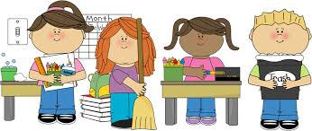
dutiful duty (-y +i) + ful = dutiful

Slide 248
disgraceful

Slide 249
disgraceful

Slide 250

disgraceful disgrace + ful = disgraceful

Slide 251
Let’s Teach and Practise

Slide 252
To join compound adjectives to avoid ambiguity.

Slide 253
cold-hearted

Slide 254
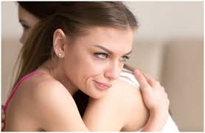
cold-hearted

Slide 255
stone-faced

Slide 256
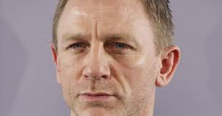
stone-faced

Slide 257
green-eyed

Slide 258
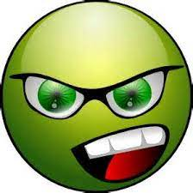
green-eyed

Slide 259
short-tempered

Slide 260
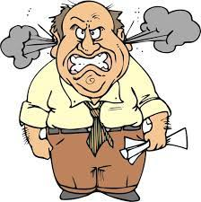
short-tempered

Slide 261
cold-hearted

Slide 262
cold-hearted
cold + hearted = cold-hearted

Slide 263
cold-hearted
cold + hearted = cold-hearted
adjective
Definition – lacking affection or warmth

Slide 264
stone-faced

Slide 265
stone-faced
stone + faced = stone-faced

Slide 266
stone-faced
stone + faced = stone-faced
adjective
Definition – a face which reveals no emotion

Slide 267
green-eyed

Slide 268
green-eyed
green + eyed = green-eyed

Slide 269
green-eyed
green + eyed = green-eyed
adjective
Definition – a feeling of jealousy or being envious of someone or something

Slide 270
short-tempered

Slide 271
short-tempered
short + tempered = short-tempered

Slide 272
short-tempered
short + tempered = short-tempered
adjective
Definition – quick to lose one’s temper

Slide 273
The villain showed how cold-hearted he was towards the victim.

Slide 274
The villain showed how
_ _ _ _ _ _ _ _ _ _ _ he was towards the victim.

Slide 275
The villain showed how cold-hearted he was towards the victim.

Slide 276
He stood stone-faced as the verdict was announced.

Slide 277
He stood _ _ _ _ _ _ _ _ _ _ as the verdict was announced.

Slide 278
He stood stone-faced as the verdict was announced.

Slide 279
As I announced my promotion, she looked on green-eyed at my success.

Slide 280
As I announced my promotion, she looked on _ _ _ _ _ _ _ _ _ at my success.

Slide 281
As I announced my promotion, she looked on green-eyed at my success.

Slide 282
When I am tired, I tend to become short-tempered.

Slide 283
When I am tired, I tend to become _ _ _ _ _ _ _ _ _ _ _ _ _.

Slide 284
When I am tired, I tend to become short-tempered.

Slide 285
New CHALLENGE words.

Slide 286
marvellous

Slide 287
marvellous
We saw the most marvellous firework display.

Slide 288
We saw the most marvellous firework display.

Slide 289
We saw the most
_ _ _ _ _ _ _ _ _ _ firework display.

Slide 290
We saw the most marvellous firework display.

Slide 291
mischievous

Slide 292
mischievous
Dave, the mischievous kitten, hid in the basket of clean washing.

Slide 293
mischievous
Dave, the mischievous kitten, hid in the basket of clean washing.

Slide 294
Dave, the _ _ _ _ _ _ _ _ _ _ _ kitten, hid in the basket of clean washing.

Slide 295
Dave, the mischievous kitten, hid in the basket of clean washing.

Slide 296
Let’s Practise and Apply.

Slide 297
Can you spot the spelling rule words and the challenge words?

Slide 298
Fragile Earth
Satellites help us to observe our marvellous Earth and re-educate scientists of changes. Some sit above the same point of Earth’s surface, nearly 36,000 km into space, so they can co-ordinate and keep pace with the planet as it rotates. Others travel around the Earth, about 600km above the surface, and re-enter the same point every two or three weeks to re-examine. Both kinds of satellite carry sensors which gather familiar information about the atmosphere and the surface of the Earth. This is sent to stations on the ground, which collect signals, interpret the information and pass it on to wide-eyed scientists to re-examine.

Slide 299
Fragile Earth
Satellites help us to observe our marvellous Earth and re-educate scientists of changes. Some sit above the same point of Earth’s surface, nearly 36,000 km into space, so they can co-ordinate and keep pace with the planet as it rotates. Others travel around the Earth, about 600km above the surface, and re-enter the same point every two or three weeks to re-examine. Both kinds of satellite carry sensors which gather familiar information about the atmosphere and the surface of the Earth. This is sent to stations on the ground, which collect signals, interpret the information and pass it on to wide-eyed scientists to re-examine.

Slide 300
Write this sentence as I dictate it to you.
Notes:
The environment of planet Earth is made up of tropical areas and frozen lands.

Slide 301
Both kinds of satellite carry sensors which gather familiar information about the atmosphere and the surface of the Earth.
Did you write it correctly?
Edit your work and make sure you have it correct.
Can you underline the spelling word that we have covered in this session?

Slide 302
Year 6 - Autumn 2
Week 4 - Friday
Notes:
Click through the slides for all the R+R words for the week (both the focus and the challenge words)
Click through the slides for all the new learning this week

Slide 304
Old challenge words…

Slide 305
familiar

Slide 306
amateur

Slide 307
Old spelling rule words…

Slide 308
boastful

Slide 309
faithful

Slide 310
doubtful

Slide 311
fearful

Slide 312
thankful

Slide 313
beautiful

Slide 314
pitiful

Slide 315
plentiful

Slide 316
fanciful

Slide 317
merciful

Slide 318
dutiful

Slide 319
disgraceful

Slide 320
New spelling rule words…

Slide 321
co-operate

Slide 322
co-ordinate

Slide 323
co-own

Slide 324
co-author

Slide 325
re-enter

Slide 326
re-educate

Slide 327
re-examine

Slide 328
re-evaluate

Slide 329
man-eating

Slide 330
little-used

Slide 331
rock-bottom

Slide 332
wide-eyed

Slide 333
cold-hearted

Slide 334
stone-faced

Slide 335
green-eyed

Slide 336
short-tempered

Slide 337
New challenge words…

Slide 338
marvellous

Slide 339
mischievous

Slide 340
Quick Quiz time…

Slide 341
Did you get them correct?
Edit your work.
familiar amateur plentiful disgraceful marvellous mischievous co-author re-educate wide-eyed short-tempered

Slide 342
Word class time…

Slide 343
The plumber did a marvellous job fitting my new bathroom.
Notes:
Ask for these words to be classed

Slide 344
The plumber did a marvellous job fitting my new bathroom.
determiner, noun, verb, determiner, adjective, noun, verb, pronoun, adjective, noun
Notes:
Ask for these words to be classed

Slide 345
Dave, the mischievous kitten, hid in the basket of clean washing.
Notes:
Ask for these words to be classed

Slide 346
Dave, the mischievous kitten, hid in the basket of clean washing.
noun, determiner, adjective, noun, verb, preposition, determiner, noun, preposition, adjective, noun
Notes:
Ask for these words to be classed

Slide 347
Etymology
The history of a word….

Slide 348

marvellous

Slide 349
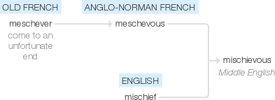
mischievous

Slide 350
Let’s investigate….
Can you write spelling questions, with a mark scheme, related to marvellous and mischievous?

