Slide 1
Spelling Y6
Mastering spellings: building on the foundations of phonics
Autumn 2
Week 5
Notes:
These slides are the same as Y5 Summer 2 as this is a revisit and review half term

Slide 2
Year 6 - Autumn 2
Week 5 - Monday
Notes:
Revisit and review the words from Y5 and challenge words – I say, we say, you say
Ask children to write words only in their spelling book
Introduce the new spelling rule
Children to write the new spelling rule words and challenge words into books when the sentences are shown with the spelling word missing.
Read the extract with the class as choral reading. Practise model of prosody etc.
Ask children to find the spelling words from the session in the text.
Then read allowed the chosen sentence for children to write fully in their books.
Show the extract and ask children to then edit their work to check they were correct in their dictation.

Slide 3
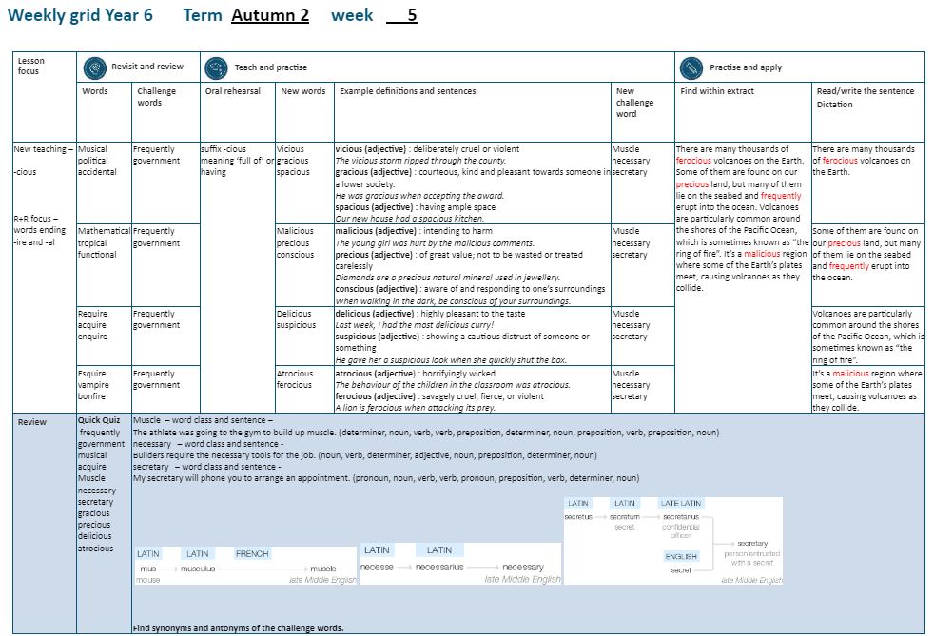

Slide 4
Let’s Revisit and Review…

Slide 5
Do you remember this challenge word?

Slide 6
frequently

Slide 7
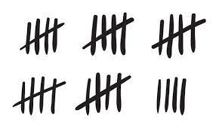
frequently
(adverb)
Definition: often

Slide 8
People frequently play the National Lottery.

Slide 9
Do you remember this challenge word?

Slide 10
government

Slide 11
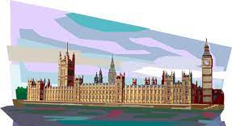
government
(noun)
Definition: a group of people with authority to govern a country or state

Slide 12
The government is formed through a democratic vote.

Slide 13
Can you remember this spelling rule? suffixes -ire and -al

Slide 14
musical

Slide 15
musical

Slide 16
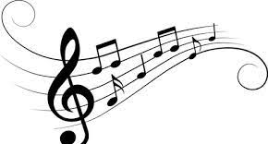
musical music + al = musical

Slide 17
political

Slide 18
political

Slide 19
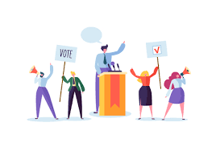
political politic + al = political

Slide 20
accidental

Slide 21
accidental

Slide 22

accidental accident + al = accidental

Slide 23
Let’s Teach and Practise

Slide 24
Word ending in the suffix -cious
meaning ‘full of’ or having

Slide 25
vicious

Slide 26
vicious

Slide 27
frequently

Slide 28
frequently
(adverb)
Definition: often

Slide 29
People frequently play the National Lottery.

Slide 30
Do you remember this challenge word?

Slide 31
government

Slide 32
government
(noun)
Definition: a group of people with authority to govern a country or state

Slide 33
The government is formed through a democratic vote.

Slide 34
Can you remember this spelling rule? suffixes -ire and -al

Slide 35
musical

Slide 36
musical

Slide 37
musical music + al = musical

Slide 38
political

Slide 39
political

Slide 40
political politic + al = political

Slide 41
accidental

Slide 42
accidental

Slide 43
accidental accident + al = accidental

Slide 44
Let’s Teach and Practise

Slide 45
Word ending in the suffix -cious
meaning ‘full of’ or having

Slide 46
vicious

Slide 47
vicious

Slide 48
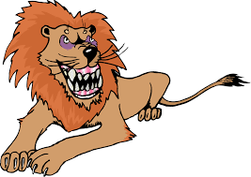
vicious

Slide 49
vicious

Slide 50
gracious

Slide 51
gracious

Slide 52
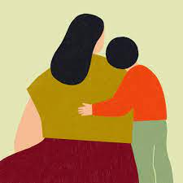
gracious

Slide 53
spacious

Slide 54
spacious

Slide 55
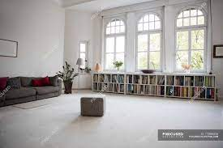
spacious

Slide 56
vicious

Slide 57
vicious
adjective
Definition: deliberately cruel or violent

Slide 58
gracious

Slide 59
gracious grace (-ce) + cious = gracious

Slide 60
gracious grace (-ce) + cious = gracious
adjective
Definition: courteous, kind and pleasant towards someone

Slide 61
spacious

Slide 62
spacious space (-ce) + cious = spacious

Slide 63
spacious space (-ce) + cious = spacious
adjective
Definition: having ample space

Slide 64
The vicious storm ripped through the country.

Slide 65
The _ _ _ _ _ _ _ storm ripped through the country.

Slide 66
The vicious storm ripped through the country.

Slide 67
He was gracious when accepting the award.

Slide 68
He was _ _ _ _ _ _ _ _ when accepting the award.

Slide 69
He was gracious when accepting the award.

Slide 70
Our new house had a spacious kitchen.

Slide 71
Our new house had a
_ _ _ _ _ _ _ _ kitchen.

Slide 72
Our new house had a spacious kitchen.

Slide 73
New CHALLENGE words.

Slide 74
muscle

Slide 75
muscle
The athlete was going to the gym to build up muscle.

Slide 76
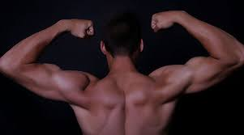
The athlete was going to the gym to build up muscle.

Slide 77
The athlete was going to the gym to build up _ _ _ _ _ _.

Slide 78
The athlete was going to the gym to build up muscle.

Slide 79
necessary

Slide 80
necessary
Builders require the necessary tools for the job.

Slide 81

Builders require the necessary tools for the job.

Slide 82
Builders require the
_ _ _ _ _ _ _ _ _ tools for the job.

Slide 83
Builders require the necessary tools for the job.

Slide 84
secretary

Slide 85
secretary
My secretary will phone you to arrange an appointment.

Slide 86
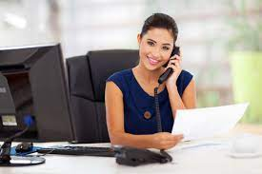
My secretary will phone you to arrange an appointment.

Slide 87
My _ _ _ _ _ _ _ _ _ will phone you to arrange an appointment.

Slide 88
My secretary will phone you to arrange an appointment.

Slide 89
Let’s Practise and Apply.

Slide 90
Can you spot the spelling rule words and the challenge words?

Slide 91
Fragile Earth
There are many thousands of ferocious volcanoes on the Earth. Some of them are found on our precious planet but many of them lie on the sea bed, which frequently erupt into the ocean. Volcanoes are particularly common around the shores of the Pacific Ocean, which is sometimes known as “the ring of fire”. It’s a malicious region where some of the Earth’s plates meet, causing volcanoes as they collide.

Slide 92
Fragile Earth
There are many thousands of ferocious volcanoes on the Earth. Some of them are found on our precious planet but many of them lie on the sea bed, which frequently erupt into the ocean. Volcanoes are particularly common around the shores of the Pacific Ocean, which is sometimes known as “the ring of fire”. It’s a malicious region where some of the Earth’s plates meet, causing volcanoes as they collide.

Slide 93
Write this sentence as I dictate it to you.
Notes:
The environment of planet Earth is made up of tropical areas and frozen lands.

Slide 94
There are many thousands of ferocious volcanoes on the Earth.
Did you write it correctly?
Edit your work and make sure you have it correct.
Can you underline the spelling word that we have covered in this session?

Slide 95
Year 6 - Autumn 2
Week 5 - Tuesday
Notes:
Revisit and review the words from Y5 and challenge words – I say, we say, you say
Ask children to write words only in their spelling book
Introduce the new spelling rule
Children to write the new spelling rule words and challenge words into books when the sentences are shown with the spelling word missing.
Read the extract with the class as choral reading. Practise model of prosody etc.
Ask children to find the spelling words from the session in the text.
Then read allowed the chosen sentence for children to write fully in their books.
Show the extract and ask children to then edit their work to check they were correct in their dictation.

Slide 97
Let’s Revisit and Review…

Slide 98
Do you remember this challenge word?

Slide 99
frequently

Slide 100
frequently
(adverb)
Definition: often

Slide 101
People frequently play the National Lottery.

Slide 102
Do you remember this challenge word?

Slide 103
government

Slide 104
government
(noun)
Definition: a group of people with authority to govern a country or state

Slide 105
The government is formed through a democratic vote.

Slide 106
Can you remember this spelling rule? suffixes -ire and -al

Slide 107
mathematical

Slide 108
mathematical

Slide 109

mathematical mathematic + al = mathematical

Slide 110
tropical

Slide 111
tropical

Slide 112

tropical tropic + al = tropical

Slide 113
functional

Slide 114
functional

Slide 115
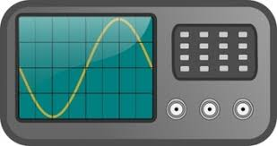
functional function + al = functional

Slide 116
Let’s Teach and Practise

Slide 117
Word ending in the suffix -cious
meaning ‘full of’ or having

Slide 118
malicious

Slide 119
malicious

Slide 120

malicious

Slide 121
precious

Slide 122
precious

Slide 123

precious

Slide 124
conscious

Slide 125
conscious

Slide 126
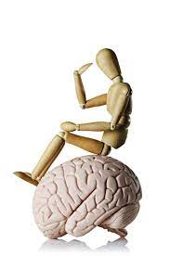
conscious

Slide 127
malicious

Slide 128
malicious malice (-ce) + cious = malicious

Slide 129
malicious malice (-ce) + cious = malicious
adjective
Definition – intending to harm

Slide 130
precious

Slide 131
precious
adjective
Definition – of great value not to be treated carelessly

Slide 132
conscious

Slide 133
conscious adjective
Definition – aware of and respond to one’s surroundings

Slide 134
The young girl was hurt by the malicious comments made.

Slide 135
The young girl was hurt by the
_ _ _ _ _ _ _ _ _ comments made.

Slide 136
The young girl was hurt by the malicious comments made.

Slide 137
Diamonds are a precious natural material used in jewellery.

Slide 138
Diamonds are a _ _ _ _ _ _ _ _ natural material used in jewellery.

Slide 139
Diamonds are a precious natural material used in jewellery.

Slide 140
When walking in the dark, be conscious of your surroundings.

Slide 141
When walking in the dark, be
_ _ _ _ _ _ _ _ _ of your surroundings.

Slide 142
When walking in the dark, be conscious of your surroundings.

Slide 143
New CHALLENGE words.

Slide 144
muscle

Slide 145
muscle
The athlete was going to the gym to build up muscle.

Slide 146
The athlete was going to the gym to build up muscle.

Slide 147
The athlete was going to the gym to build up _ _ _ _ _ _.

Slide 148
The athlete was going to the gym to build up muscle.

Slide 149
necessary

Slide 150
necessary
Builders require the necessary tools for the job.

Slide 151
Builders require the necessary tools for the job.

Slide 152
Builders require the
_ _ _ _ _ _ _ _ _ tools for the job.

Slide 153
Builders require the necessary tools for the job.

Slide 154
secretary

Slide 155
secretary
My secretary will phone you to arrange an appointment.

Slide 156
My secretary will phone you to arrange an appointment.

Slide 157
My _ _ _ _ _ _ _ _ _ will phone you to arrange an appointment.

Slide 158
My secretary will phone you to arrange an appointment.

Slide 159
Let’s Practise and Apply.

Slide 160
Can you spot the spelling rule words and the challenge words?

Slide 161
Fragile Earth
There are many thousands of ferocious volcanoes on the Earth. Some of them are found on our precious planet but many of them lie on the sea bed, which frequently erupt into the ocean. Volcanoes are particularly common around the shores of the Pacific Ocean, which is sometimes known as “the ring of fire”. It’s a malicious region where some of the Earth’s plates meet, causing volcanoes as they collide.

Slide 162
Fragile Earth
There are many thousands of ferocious volcanoes on the Earth. Some of them are found on our precious planet but many of them lie on the sea bed, which frequently erupt into the ocean. Volcanoes are particularly common around the shores of the Pacific Ocean, which is sometimes known as “the ring of fire”. It’s a malicious region where some of the Earth’s plates meet, causing volcanoes as they collide.

Slide 163
Write this sentence as I dictate it to you.
Notes:
The environment of planet Earth is made up of tropical areas and frozen lands.

Slide 164
Some of them are found on our precious planet but many of them lie on the sea bed, which frequently erupt into the ocean.
Did you write it correctly?
Edit your work and make sure you have it correct.
Can you underline the spelling word that we have covered in this session?

Slide 165
Year 6 - Autumn 2
Week 5 - Wednesday
Notes:
Revisit and review the words from Y5 and challenge words – I say, we say, you say
Ask children to write words only in their spelling book
Introduce the new spelling rule
Children to write the new spelling rule words and challenge words into books when the sentences are shown with the spelling word missing.
Read the extract with the class as choral reading. Practise model of prosody etc.
Ask children to find the spelling words from the session in the text.
Then read allowed the chosen sentence for children to write fully in their books.
Show the extract and ask children to then edit their work to check they were correct in their dictation.

Slide 167
Let’s Revisit and Review…

Slide 168
Do you remember this challenge word?

Slide 169
frequently

Slide 170
frequently
(adverb)
Definition: often

Slide 171
People frequently play the National Lottery.

Slide 172
Do you remember this challenge word?

Slide 173
government

Slide 174
government
(noun)
Definition: a group of people with authority to govern a country or state

Slide 175
The government is formed through a democratic vote.

Slide 176
Can you remember this spelling rule? suffixes -ire and -al

Slide 177
require

Slide 178
require

Slide 179
acquire

Slide 180
acquire

Slide 181
enquire

Slide 182
enquire

Slide 183
Word ending in the suffix -cious
meaning ‘full of’ or having

Slide 184
delicious

Slide 185
delicious

Slide 186

delicious

Slide 187
suspicious

Slide 188
suspicious

Slide 189

suspicious

Slide 190
delicious

Slide 191
delicious adjective
Definition – highly pleasant to the taste

Slide 192
suspicious

Slide 193
suspicious adjective
Definition – showing a cautious distrust to someone or something

Slide 194
Last week, I had the most delicious curry.

Slide 195
Last week, I had the most
_ _ _ _ _ _ _ _ _ curry.

Slide 196
Last week, I had the most delicious curry.

Slide 197
He gave her a suspicious look as she quickly shut the box.

Slide 198
He gave her a _ _ _ _ _ _ _ _ _ _ look as she quickly shut the box.

Slide 199
He gave her a suspicious look as she quickly shut the box.

Slide 200
New CHALLENGE words.

Slide 201
muscle

Slide 202
muscle
The athlete was going to the gym to build up muscle.

Slide 203
The athlete was going to the gym to build up muscle.

Slide 204
The athlete was going to the gym to build up _ _ _ _ _ _.

Slide 205
The athlete was going to the gym to build up muscle.

Slide 206
necessary

Slide 207
necessary
Builders require the necessary tools for the job.

Slide 208
Builders require the necessary tools for the job.

Slide 209
Builders require the
_ _ _ _ _ _ _ _ _ tools for the job.

Slide 210
Builders require the necessary tools for the job.

Slide 211
secretary

Slide 212
secretary
My secretary will phone you to arrange an appointment.

Slide 213
My secretary will phone you to arrange an appointment.

Slide 214
My _ _ _ _ _ _ _ _ _ will phone you to arrange an appointment.

Slide 215
My secretary will phone you to arrange an appointment.

Slide 216
Let’s Practise and Apply.

Slide 217
Can you spot the spelling rule words and the challenge words?

Slide 218
Fragile Earth
There are many thousands of ferocious volcanoes on the Earth. Some of them are found on our precious planet but many of them lie on the sea bed, which frequently erupt into the ocean. Volcanoes are particularly common around the shores of the Pacific Ocean, which is sometimes known as “the ring of fire”. It’s a malicious region where some of the Earth’s plates meet, causing volcanoes as they collide.

Slide 219
Fragile Earth
There are many thousands of ferocious volcanoes on the Earth. Some of them are found on our precious planet but many of them lie on the sea bed, which frequently erupt into the ocean. Volcanoes are particularly common around the shores of the Pacific Ocean, which is sometimes known as “the ring of fire”. It’s a malicious region where some of the Earth’s plates meet, causing volcanoes as they collide.

Slide 220
Write this sentence as I dictate it to you.
Notes:
The environment of planet Earth is made up of tropical areas and frozen lands.

Slide 221
Volcanoes are particularly common around the shores of the Pacific Ocean, which is sometimes known as “the ring of fire”.
Did you write it correctly?
Edit your work and make sure you have it correct.
Can you underline the spelling word that we have covered in this session?

Slide 222
Year 6 - Autumn 2
Week 5 - Thursday
Notes:
Revisit and review the words from Y5 and challenge words – I say, we say, you say
Ask children to write words only in their spelling book
Introduce the new spelling rule
Children to write the new spelling rule words and challenge words into books when the sentences are shown with the spelling word missing.
Read the extract with the class as choral reading. Practise model of prosody etc.
Ask children to find the spelling words from the session in the text.
Then read allowed the chosen sentence for children to write fully in their books.
Show the extract and ask children to then edit their work to check they were correct in their dictation.

Slide 224
Let’s Revisit and Review…

Slide 225
Do you remember this challenge word?

Slide 226
frequently

Slide 227
frequently
(adverb)
Definition: often

Slide 228
People frequently play the National Lottery.

Slide 229
Do you remember this challenge word?

Slide 230
government

Slide 231
government
(noun)
Definition: a group of people with authority to govern a country or state

Slide 232
The government is formed through a democratic vote.

Slide 233
Can you remember this spelling rule? suffixes -ire and -al

Slide 234
esquire

Slide 235
esquire

Slide 236
vampire

Slide 237
vampire

Slide 238
bonfire

Slide 239
bonfire

Slide 240
Word ending in the suffix -cious
meaning ‘full of’ or having

Slide 241
atrocious

Slide 242
atrocious

Slide 243
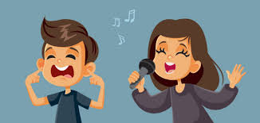
atrocious

Slide 244
ferocious

Slide 245
ferocious

Slide 246
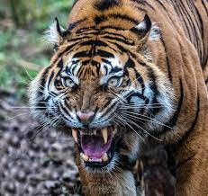
ferocious

Slide 247
atrocious

Slide 248
atrocious adjective
Definition – terrible and horrifying

Slide 249
ferocious

Slide 250
ferocious adjective
Definition – savagely cruel, fierce or violent

Slide 251
The singer thought she sounded good: the audience thought she was atrocious.

Slide 252
The singer thought she sounded good: the audience thought she was _ _ _ _ _ _ _ _ _.

Slide 253
The singer thought she sounded good: the audience thought she was atrocious.

Slide 254
A tiger is a ferocious animal when attacking its prey.

Slide 255
A tiger is a _ _ _ _ _ _ _ _ _ animal when attacking its prey.

Slide 256
A tiger is a ferocious animal when attacking its prey.

Slide 257
New CHALLENGE words.

Slide 258
muscle

Slide 259
muscle
The athlete was going to the gym to build up muscle.

Slide 260
The athlete was going to the gym to build up muscle.

Slide 261
The athlete was going to the gym to build up _ _ _ _ _ _.

Slide 262
The athlete was going to the gym to build up muscle.

Slide 263
necessary

Slide 264
necessary
Builders require the necessary tools for the job.

Slide 265
Builders require the necessary tools for the job.

Slide 266
Builders require the
_ _ _ _ _ _ _ _ _ tools for the job.

Slide 267
Builders require the necessary tools for the job.

Slide 268
secretary

Slide 269
secretary
My secretary will phone you to arrange an appointment.

Slide 270
My secretary will phone you to arrange an appointment.

Slide 271
My _ _ _ _ _ _ _ _ _ will phone you to arrange an appointment.

Slide 272
My secretary will phone you to arrange an appointment.

Slide 273
Let’s Practise and Apply.

Slide 274
Can you spot the spelling rule words and the challenge words?

Slide 275
Fragile Earth
There are many thousands of ferocious volcanoes on the Earth. Some of them are found on our precious planet but many of them lie on the sea bed, which frequently erupt into the ocean. Volcanoes are particularly common around the shores of the Pacific Ocean, which is sometimes known as “the ring of fire”. It’s a malicious region where some of the Earth’s plates meet, causing volcanoes as they collide.

Slide 276
Fragile Earth
There are many thousands of ferocious volcanoes on the Earth. Some of them are found on our precious planet but many of them lie on the sea bed, which frequently erupt into the ocean. Volcanoes are particularly common around the shores of the Pacific Ocean, which is sometimes known as “the ring of fire”. It’s a malicious region where some of the Earth’s plates meet, causing volcanoes as they collide.

Slide 277
Write this sentence as I dictate it to you.
Notes:
The environment of planet Earth is made up of tropical areas and frozen lands.

Slide 278
It’s a malicious region where some of the Earth’s plates meet, causing volcanoes as they collide.
Did you write it correctly?
Edit your work and make sure you have it correct.
Can you underline the spelling word that we have covered in this session?

Slide 279
Year 6 - Autumn 2
Week 5 - Friday
Notes:
Revisit and review the words from Y5 and challenge words – I say, we say, you say
Ask children to write words only in their spelling book
Introduce the new spelling rule
Children to write the new spelling rule words and challenge words into books when the sentences are shown with the spelling word missing.
Read the extract with the class as choral reading. Practise model of prosody etc.
Ask children to find the spelling words from the session in the text.
Then read allowed the chosen sentence for children to write fully in their books.
Show the extract and ask children to then edit their work to check they were correct in their dictation.

Slide 281
Old challenge words…

Slide 282
frequently

Slide 283
government

Slide 284
Old spelling rule words…

Slide 285
musical

Slide 286
political

Slide 287
accidental

Slide 288
mathematical

Slide 289
tropical

Slide 290
functional

Slide 291
require

Slide 292
acquire

Slide 293
enquire

Slide 294
esquire

Slide 295
vampire

Slide 296
bonfire

Slide 297
New spelling rule words…

Slide 298
vicious

Slide 299
gracious

Slide 300
spacious

Slide 301
malicious

Slide 302
precious

Slide 303
conscious

Slide 304
delicious

Slide 305
suspicious

Slide 306
atrocious

Slide 307
ferocious

Slide 308
New challenge words…

Slide 309
muscle

Slide 310
necessary

Slide 311
secretary

Slide 312
Quick Quiz time…
Notes:
Say these words for the quiz
Environment equipment frequently government musical mathematical require vampire urgency emergency

Slide 313
Did you get them correct?
Edit your work.
frequently government musical acquire muscle necessary secretary gracious precious delicious atrocious

Slide 314
Word class time…

Slide 315
The athlete was going to the gym to build up muscle.
Notes:
Ask for these words to be classed

Slide 316
The athlete was going to the gym to build up muscle.
determiner, noun, verb, verb, preposition, determiner, noun, preposition, verb, preposition, noun.
Notes:
Ask for these words to be classed

Slide 317
Builders require the necessary tools for the job.
Notes:
Ask for these words to be classed

Slide 318
Builders require the necessary tools for the job.
noun, verb, determiner, adjective, noun, preposition, determiner, noun.
Notes:
Ask for these words to be classed

Slide 319
My secretary will phone you to arrange an appointment.
Notes:
Ask for these words to be classed

Slide 320
My secretary will phone you to arrange an appointment.
pronoun, noun, verb, verb, pronoun, preposition, verb, determiner, noun.
Notes:
Ask for these words to be classed

Slide 321
Etymology
The history of a word….

Slide 322

muscle

Slide 323

necessary

Slide 324
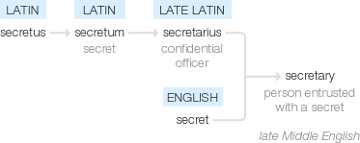
secretary

Slide 325
Let’s investigate….
Can you find words synonyms and antonyms of muscle, necessary and secretary?

