Slide 1
Spelling Y6
Mastering spellings: building on the foundations of phonics
Autumn 2
Week 6
Notes:
These slides are the same as Y5 Summer 2 as this is a revisit and review half term

Slide 2
Year 6 - Autumn 2
Week 6 - Monday
Notes:
Week 6 is a revisit and review week of the half term.
Each day revisits learning from one of the weeks in the half term.
Go through the words as a recap – explain the teaching rule again and children to write words that are missing from sentences into their books.
The main chunk of the lesson is to investigate and detect.
Sentences are given with the spellings from the session misspelt. Children to correct the spellings and explain where the sentence spellings went wrong and how they would support someone to get it right the next time.

Slide 3
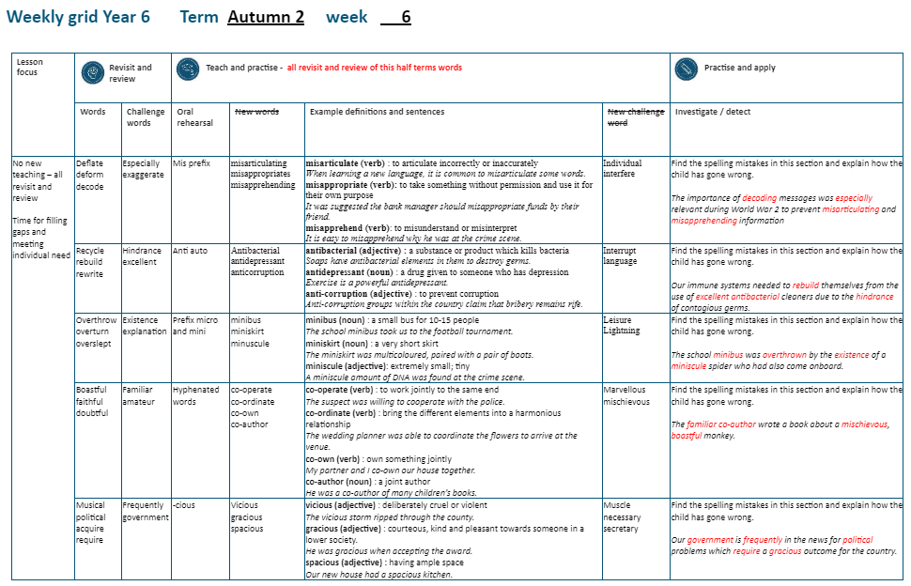

Slide 4
Revisit and Review of A2 Week 1

Slide 5
Challenge words

Slide 6
especially

Slide 7

especially
(adverb)
Definition – used to single out one person or thing over others

Slide 8
especially
(adverb)
I like lots of fruit and vegetables, especially bananas.

Slide 9
I like lots of fruit and vegetables, _ _ _ _ _ _ _ _ _ bananas.

Slide 10
I like lots of fruit and vegetables, especially bananas.

Slide 11
Do you remember this challenge word?

Slide 12
exaggerate

Slide 13
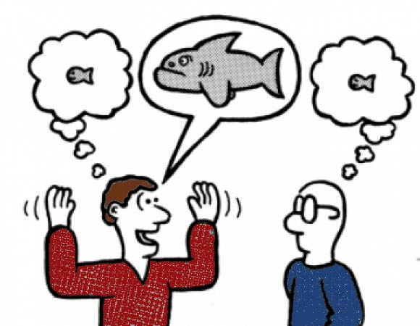
exaggerate
(verb)
Definition – to represent something as being larger, better or worse than it is.

Slide 14
exaggerate
(verb)
He tends to exaggerate when talking about his accomplishments.

Slide 15
He tends to _ _ _ _ _ _ _ _ _ _ when talking about his accomplishments.

Slide 16
He tends to exaggerate when talking about his accomplishments.

Slide 17
The prefix de-

Slide 18
de-

Slide 19
de- meaning ‘off’ or ‘from’

Slide 20
deflate

Slide 21
deflate

Slide 22
deform

Slide 23
deform

Slide 24
decode

Slide 25
decode

Slide 26
Prefix mis-

Slide 27
mis- meaning wrongly

Slide 28
misarticulate

Slide 29
misarticulate

Slide 30
misappropriate

Slide 31
misappropriate

Slide 32
misapprehend

Slide 33
misapprehend

Slide 34
misarticulate

Slide 35
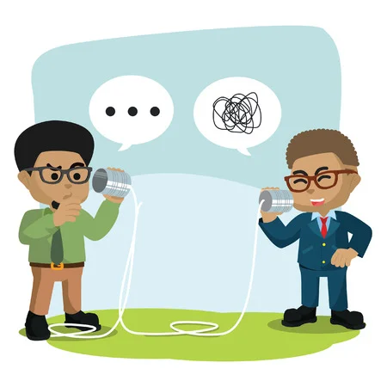
misarticulate mis + articulate = misarticulate

Slide 36
misarticulate mis + articulate = misarticulate
verb
Definition: to speak incorrectly or unclearly

Slide 37
misappropriate

Slide 38
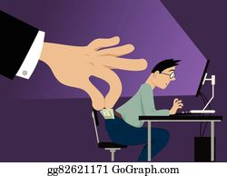
misappropriate mis + appropriate = misappropriate

Slide 39
misappropriate mis + appropriate = misappropriate
verb
Definition – to take something without permission and use it for your own purpose

Slide 40
misapprehend

Slide 41

misapprehend mis + apprehend = misapprehend

Slide 42
misapprehend mis + apprehend = misapprehend verb
Definition – fail to understand a person or their words correctly

Slide 43
When learning a new language, it is common to misarticulate some words.

Slide 44
When learning a new language, it is common to _ _ _ _ _ _ _ _ _ _ _ _ _ some words.

Slide 45
When learning a new language, it is common to misarticulate some words.

Slide 46
It was suggested the bank manage should misappropriate funds by their friend.

Slide 47
It was suggested the bank manage should _ _ _ _ _ _ _ _ _ _ _ _ _ _ funds by their friend.

Slide 48
It was suggested the bank manage should misappropriate funds by their friend.

Slide 49
My parents misapprehend my choice of clothes.

Slide 50
My parents _ _ _ _ _ _ _ _ _ _ _ _ my choice of clothes.

Slide 51
My parents misapprehend my choice of clothes.

Slide 52
New CHALLENGE words.

Slide 53
individual

Slide 54

Every one of us is individual and unique.

Slide 55
Every one of us is _ _ _ _ _ _ _ _ _ _ and unique.

Slide 56
Every one of us is individual and unique.

Slide 57
interfere

Slide 58

interfere
Do not interfere with business which doesn’t concern you.

Slide 59
Do not _ _ _ _ _ _ _ _ _ with business which doesn’t concern you.

Slide 60
Do not interfere with business which doesn’t concern you.

Slide 61
Let’s investigate and detect…

Slide 62
Look at this sentence.
Change the spellings that are incorrect.
Explain how each one is wrong and how to remember to get it right next time.
The importance of de-coding messages was espechally relevant during World War 2 to prevent misartickulating and misaprehending information.

Slide 63
The importance of de-coding messages was espechally relevant during World War 2 to prevent misartickulating and misaprehending information. decoding – one word not hyphenated

Slide 64
The importance of de-coding messages was espeshally relevant during World War 2 to prevent misartickulating and misaprehending information. especially – no c makes a sh sound
missing the i

Slide 65
The importance of de-coding messages was espechally relevant during World War 2 to prevent misartickulating and misaprehending information. misarticulating – c makes the ck sound

Slide 66
The importance of de-coding messages was espechally relevant during World War 2 to prevent misartickulating and misaprehending information. misapprehending – double p

Slide 67
The importance of decoding messages was especially relevant during World War 2 to prevent misarticulating and misapprehending information.

Slide 68
Year 6 - Autumn 2
Week 6 - Tuesday
Notes:
Week 6 is a revisit and review week of the half term.
Each day revisits learning from one of the weeks in the half term.
Go through the words as a recap – explain the teaching rule again and children to write words that are missing from sentences into their books.
The main chunk of the lesson is to investigate and detect.
Sentences are given with the spellings from the session misspelt. Children to correct the spellings and explain where the sentence spellings went wrong and how they would support someone to get it right the next time.

Slide 70
Revisit and Review of A2 Week 2

Slide 71
Challenge words

Slide 72
hindrance

Slide 73
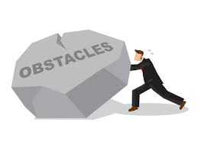
hindrance
(noun)
Definition – a person or thing which makes it more difficult for you to do something

Slide 74
hindrance
(noun)
I’m afraid you’re more of a hindrance than a help to me at this point.

Slide 75
I’m afraid you’re more of a
_ _ _ _ _ _ _ _ _ than a help to me at this point.

Slide 76
I’m afraid you’re more of a hindrance than a help to me at this point.

Slide 77
excellent

Slide 78
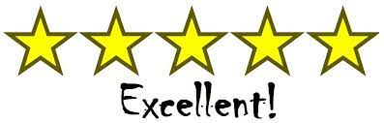
Excellent
(adjective)
Definition: extremely good; outstanding

Slide 79
excellent
Christmas is excellent.

Slide 80
Christmas is _ _ _ _ _ _ _ _ _.

Slide 81
Christmas is excellent.

Slide 82
Can you remember this spelling rule? prefix re-

Slide 83
prefix re-

Slide 84
re-
Meaning back or again

Slide 85
recycle

Slide 86
recycle

Slide 87
rebuild

Slide 88
rebuild n

Slide 89
rewrite

Slide 90
rewrite

Slide 91
auto-
meaning relating to yourself
Notes:
Sound of aI

Slide 92
anti- meaning against

Slide 93
antibacterial

Slide 94
antibacterial

Slide 95

antibacterial

Slide 96
antidepressant

Slide 97
antidepressant

Slide 98
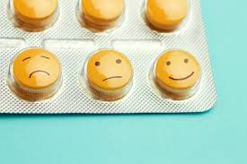
antidepressant

Slide 99
anti-corruption

Slide 100
anti-corruption

Slide 101

anti-corruption

Slide 102
antibacterial

Slide 103
antibacterial anti + bacterial = antibacterial

Slide 104
antibacterial anti + bacterial = antibacterial
adjective
Definition: a substance or product which skills germs and bacteria

Slide 105
antidepressant

Slide 106
antidepressant
anti + depressant = antidepressant

Slide 107
antidepressant
anti + depressant = antidepressant
noun
Definition – actions or medication given to someone who is feeling unhappy

Slide 108
anti-corruption

Slide 109
anti-corruption anti + corruption = anti-corruption

Slide 110
anti-corruption anti + corruption = anti-corruption noun
Definition – to prevent corruption (dishonest and illegal behaviour)

Slide 111
Soaps have antibacterial elements in them to destroy germs.

Slide 112
Soaps have _ _ _ _ _ _ _ _ _ _ _ _ _ elements in them to destroy germs.

Slide 113
Soaps have antibacterial elements in them to destroy germs.

Slide 114
Exercise is a powerful antidepressant.

Slide 115
Exercise is a powerful
_ _ _ _ _ _ _ _ _ _ _ _ _ _.

Slide 116
Exercise is a powerful antidepressant.

Slide 117
Anti-corruption groups within the country claim that bribery remains rife.

Slide 118
_ _ _ _ -_ _ _ _ _ _ _ _ _ _ groups within the country claim that bribery remains rife.

Slide 119
Anti-corruption groups within the country claim that bribery remains rife.

Slide 120
New CHALLENGE words.

Slide 121
interrupt

Slide 122
interrupt
It is extremely rude to interrupt someone when they are talking.

Slide 123
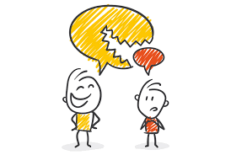
It is extremely rude to interrupt someone when they are talking.

Slide 124
It is extremely rude to _ _ _ _ _ _ _ _ _ _ someone when they are talking.

Slide 125
It is extremely rude to interrupt someone when they are talking.

Slide 126
language

Slide 127
language
Harry Potter and the Philosopher’s Stone has been translated into a different language at least 79 times.

Slide 128
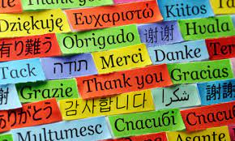
language
Harry Potter and the Philosopher’s Stone has been translated into a different language at least 79 times.

Slide 129
Harry Potter and the Philosopher’s Stone has been translated into a different
_ _ _ _ _ _ _ _ at least 79 times.

Slide 130
Harry Potter and the Philosopher’s Stone has been translated into a different language at least 79 times.

Slide 131
Let’s investigate and detect…

Slide 132
Look at this sentence.
Change the spellings that are incorrect.
Explain how each one is wrong and how to remember to get it right next time.
Our immune systems needed to re-build themselves from the use of exellent antibackterial cleaners due to the hinderance of contagious germs.

Slide 133
Our immune systems needed to re-build themselves from the use of exellent antibackterial cleaners due to the hinderance of contagious germs. rebuild – not hyphenated, one word

Slide 134
Our immune systems needed to re-build themselves from the use of exellent antibackterial cleaners due to the hinderance of contagious germs. excellent – missing the letter c

Slide 135
Our immune systems needed to re-build themselves from the use of exellent antibackterial cleaners due to the hinderance of contagious germs. antibacterial – c not ck

Slide 136
Our immune systems needed to re-build themselves from the use of exellent antibackterial cleaners due to the hinderance of contagious germs. hindrance– no e

Slide 137
Our immune systems needed to rebuild themselves from the use of excellent antibacterial cleaners due to the hindrance of contagious germs.

Slide 138
Year 6 - Autumn 2
Week 6 - Wednesday
Notes:
Week 6 is a revisit and review week of the half term.
Each day revisits learning from one of the weeks in the half term.
Go through the words as a recap – explain the teaching rule again and children to write words that are missing from sentences into their books.
The main chunk of the lesson is to investigate and detect.
Sentences are given with the spellings from the session misspelt. Children to correct the spellings and explain where the sentence spellings went wrong and how they would support someone to get it right the next time.

Slide 140
Revisit and Review of A2 Week 3

Slide 141
Challenge words

Slide 142
existence

Slide 143

existence
(noun)
definition: a state of living

Slide 144
existence
Christians believe in the existence of God.

Slide 145
Christians believe in the
_ _ _ _ _ _ _ _ _ of God.

Slide 146
Christians believe in the existence of God.

Slide 147
explanation

Slide 148
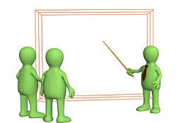
explanation
(noun)
definition: a statement or account which makes everything clear

Slide 149
explanation
An explanation text is useful in science lessons.

Slide 150
An _ _ _ _ _ _ _ _ _ _ _ text is useful in science lessons.

Slide 151
An explanation text is useful in science lessons.

Slide 152
Let’s recap

Slide 153
The prefix over-

Slide 154
over- meaning ‘too much’ or ‘more than enough’

Slide 155
overthrow

Slide 156
overthrow

Slide 157

overthrow over + throw = overthrow

Slide 158
overturn

Slide 159
overturn n

Slide 160

overturn over + turn = overturn

Slide 161
overslept

Slide 162
overslept

Slide 163
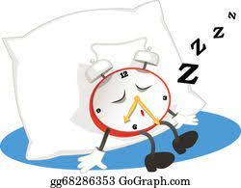
overslept over + slept = overslept

Slide 164
Let’s recap

Slide 165
minibus

Slide 166
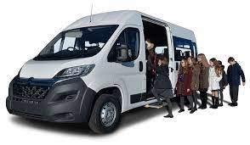
minibus

Slide 167
miniskirt

Slide 168
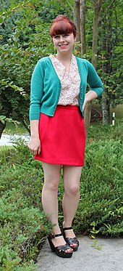
miniskirt

Slide 169
minuscule

Slide 170
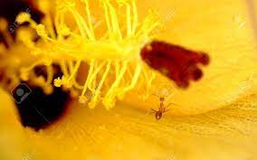
minuscule

Slide 171
The school minibus took us to the football tournament.

Slide 172
The school _ _ _ _ _ _ _ took us to the football tournament.

Slide 173
The school minibus took us to the football tournament.

Slide 174
The miniskirt was multicoloured, matched with a pair of boots.

Slide 175
The _ _ _ _ _ _ _ _ _ was multicoloured, matched with a pair of boots.

Slide 176
The miniskirt was multicoloured, matched with a pair of boots.

Slide 177
A minuscule amount of DNA was found at the crime scene.

Slide 178
A _ _ _ _ _ _ _ _ _ amount of DNA was found at the crime scene.

Slide 179
A minuscule amount of DNA was found at the crime scene.

Slide 180
New CHALLENGE words.

Slide 181
leisure

Slide 182
leisure
The most common leisure activity in Britain is going for a walk.

Slide 183
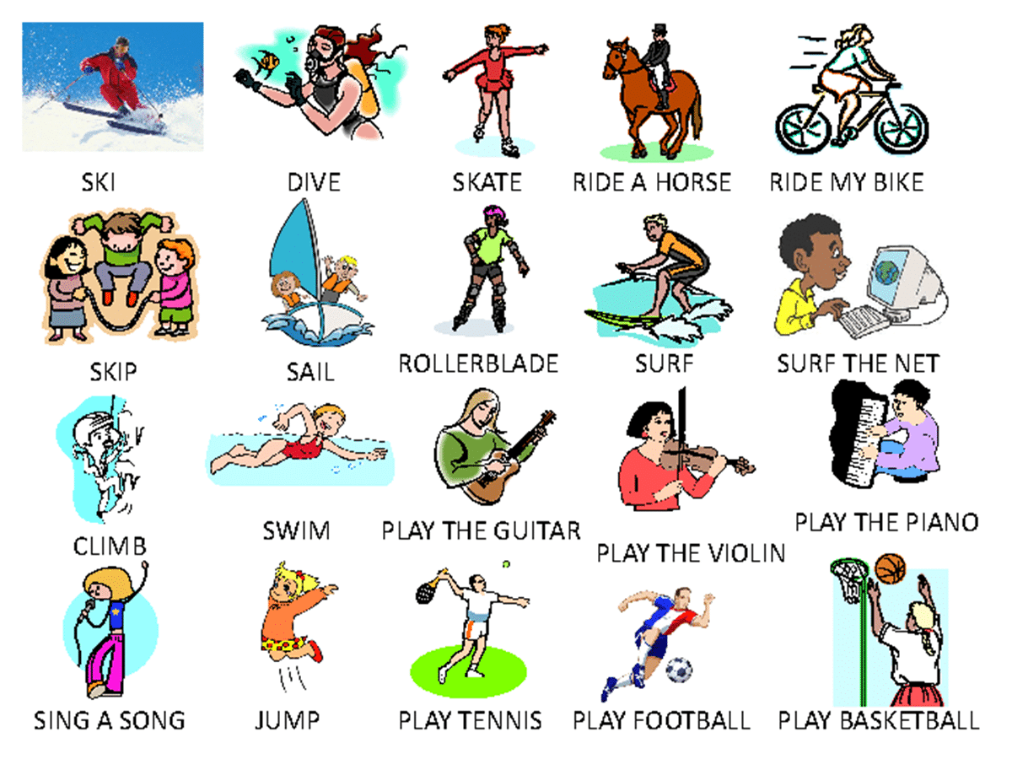
The most common leisure activity in Britain is going for a walk.

Slide 184
The most common _ _ _ _ _ _ _ activity in Britain is going for a walk.

Slide 185
The most common leisure activity in Britain is going for a walk.

Slide 186
lightning

Slide 187
lightning
The tree ignited as it was struck by lightning.

Slide 188
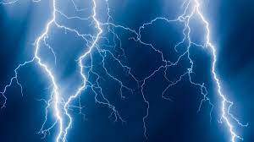
The tree ignited as it was struck by lightning.

Slide 189
The tree ignited as it was struck by _ _ _ _ _ _ _ _ _.

Slide 190
The tree ignited as it was struck by lightning.

Slide 191
Let’s investigate and detect…

Slide 192
Look at this sentence.
Change the spellings that are incorrect.
Explain how each one is wrong and how to remember to get it right next time.
The school minniebus was overthrone by the existance of a minischool spider who had also come onboard.

Slide 193
The school minniebus was overthrone by the existance of a minischool spider who had also come onboard. minibus – no double n or e

Slide 194
The school minniebus was overthrone by the existance of a minischool spider who had also come onboard. overthrone – own ending, not ‘one’

Slide 195
The school minniebus was overthrone by the existance of a minischool spider who had also come onboard. existence – a not e

Slide 196
The school minniebus was overthrone by the existance of a minischool spider who had also come onboard. miniscule – scule ending not ‘school’

Slide 197
The school minibus was overthrown by the existence of a miniscule spider who had also come onboard.

Slide 198
Year 6 - Autumn 2
Week 6 - Thursday
Notes:
Week 6 is a revisit and review week of the half term.
Each day revisits learning from one of the weeks in the half term.
Go through the words as a recap – explain the teaching rule again and children to write words that are missing from sentences into their books.
The main chunk of the lesson is to investigate and detect.
Sentences are given with the spellings from the session misspelt. Children to correct the spellings and explain where the sentence spellings went wrong and how they would support someone to get it right the next time.

Slide 200
Revisit and Review of A2 Week 4

Slide 201
Challenge words

Slide 202
familair

Slide 203
familiar
(adjective)
Definition: well known

Slide 204
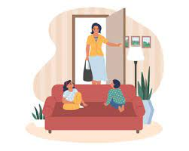
familiar
The familiar feeling came over her as she entered her old home.

Slide 205
amateur

Slide 206
amateur
(noun)
Definition: to engage in something, particularly a sport, on a non professional level without getting paid

Slide 207
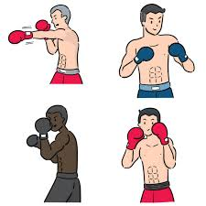
amateur
The Olympics were incredible for the amateur boxer.

Slide 208
Can you remember this spelling rule? suffix -ful

Slide 209
-ful

Slide 210
Suffix -ful meaning full of

Slide 211
boastful

Slide 212
boastful

Slide 213
faithful

Slide 214
faithful

Slide 215
doubtful

Slide 216
doubtful

Slide 217
-ence
Notes:
Sound of aI

Slide 218
Let’s Teach and Practise

Slide 219
The suffix -ful

Slide 220
-ful

Slide 221
Suffix -ful meaning full of

Slide 222
boastful

Slide 223
boastful

Slide 224

boastful boast + ful = boastful

Slide 225
faithful

Slide 226
faithful

Slide 227
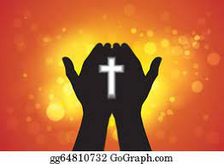
faithful faith + ful = faithful

Slide 228
doubtful

Slide 229
doubtful

Slide 230

doubtful doubt + ful = doubtful

Slide 231
To join a prefix ending in a vowel to a root word beginning with a vowel.

Slide 232
co-operate

Slide 233
co-operate

Slide 234

co-operate

Slide 235
co-ordinate

Slide 236
co-ordinate

Slide 237

co-ordinate

Slide 238
co-own

Slide 239
co-own

Slide 240
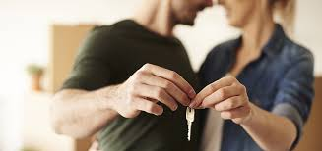
co-own

Slide 241
co-author

Slide 242
co-author

Slide 243
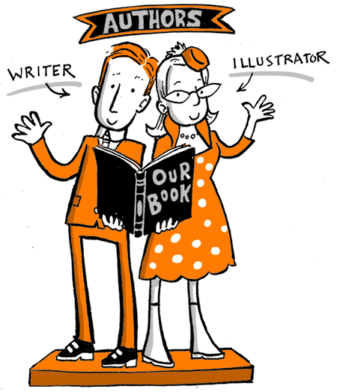
co-author

Slide 244
co-operate

Slide 245
co-operate co- + operate = co-operate

Slide 246
co-operate co- + operate = co-operate
verb
Definition: to work jointly to achieve something

Slide 247
co-ordinate

Slide 248
co-ordinate co- + ordinate = co-ordinate

Slide 249
co-ordinate co- + ordinate = co-ordinate
verb
Definition: to bring different elements together to achieve an outcome

Slide 250
co-own

Slide 251
co-own co- + own = co-own

Slide 252
co-own co- + own = co-own
verb
Definition: to own something jointly

Slide 253
co-author

Slide 254
co-author co- + author = co-author

Slide 255
co-author co- + author = co-author
noun
Definition: two or more people who create a paper or book

Slide 256
The suspect was willing to co-operate with the police.

Slide 257
The suspect was willing to
_ _ _ _ _ _ _ _ _ with the police.

Slide 258
The suspect was willing to co-operate with the police.

Slide 259
The wedding planner was able to co-ordinate the flowers to arrive at the venue on time.

Slide 260
The wedding planner was able to _ _ _ _ _ _ _ _ _ _ the flowers to arrive at the venue on time.

Slide 261
The wedding planner was able to co-ordinate the flowers to arrive at the venue on time.

Slide 262
My partner and I co-own our house.

Slide 263
My partner and I _ _ _ _ _ our house.

Slide 264
My partner and I co-own our house.

Slide 265
He was a co-author of many children’s books.

Slide 266
He was a _ _ _ _ _ _ _ _ of many children’s books.

Slide 267
He was a co-author of many children’s books.

Slide 268
New CHALLENGE words.

Slide 269
marvellous

Slide 270
marvellous
We saw the most marvellous firework display.

Slide 271

We saw the most marvellous firework display.

Slide 272
We saw the most
_ _ _ _ _ _ _ _ _ _ firework display.

Slide 273
We saw the most marvellous firework display.

Slide 274
mischievous

Slide 275
mischievous
Dave, the mischievous kitten, hid in the basket of clean washing.

Slide 276

mischievous
Dave, the mischievous kitten, hid in the basket of clean washing.

Slide 277
Dave, the _ _ _ _ _ _ _ _ _ _ _ kitten, hid in the basket of clean washing.

Slide 278
Dave, the mischievous kitten, hid in the basket of clean washing.

Slide 279
Let’s investigate and detect…

Slide 280
Look at this sentence.
Change the spellings that are incorrect.
Explain how each one is wrong and how to remember to get it right next time.
The familier co-aufour wrote a book about a mischevous, boastfull monkey.

Slide 281
The familier co-aufour wrote a book about a mischevous, boastfull monkey. familiar – a not e

Slide 282
The familier co-aufour wrote a book about a mischevous, boastfull monkey. co-author– thor not four

Slide 283
The familier co-aufour wrote a book about a mischevous, boastfull monkey. mischievous – missing the i before the e

Slide 284
The familier co-aufour wrote a book about a mischevous, boastfull monkey. boastful – ful as a suffix
(only one l)

Slide 285
The familiar co-author wrote a book about a mischievous, boastful monkey.

Slide 286
Year 6 - Autumn 2
Week 6 - Friday
Notes:
Week 6 is a revisit and review week of the half term.
Each day revisits learning from one of the weeks in the half term.
Go through the words as a recap – explain the teaching rule again and children to write words that are missing from sentences into their books.
The main chunk of the lesson is to investigate and detect.
Sentences are given with the spellings from the session misspelt. Children to correct the spellings and explain where the sentence spellings went wrong and how they would support someone to get it right the next time.

Slide 288
Revisit and Review of A2 Week 5

Slide 289
Challenge words

Slide 290
frequently

Slide 291
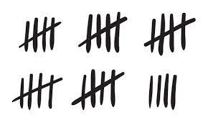
frequently
(adverb)
Definition: often

Slide 292
People frequently play the National Lottery.

Slide 293
Do you remember this challenge word?

Slide 294
government

Slide 295
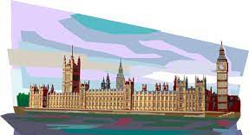
government
(noun)
Definition: a group of people with authority to govern a country or state

Slide 296
The government is formed through a democratic vote.

Slide 297
Can you remember this spelling rule? suffixes -ire and -al

Slide 298
musical

Slide 299
musical

Slide 300
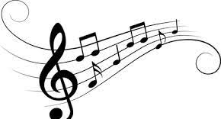
musical music + al = musical

Slide 301
political

Slide 302
political

Slide 303

political politic + al = political

Slide 304
accidental

Slide 305
accidental

Slide 306

accidental accident + al = accidental

Slide 307
Let’s Teach and Practise

Slide 308
Word ending in the suffix -cious
meaning ‘full of’ or having

Slide 309
vicious

Slide 310
vicious

Slide 311
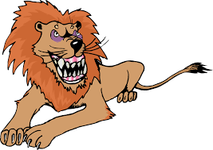
vicious

Slide 312
vicious

Slide 313
gracious

Slide 314
gracious

Slide 315
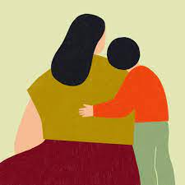
gracious

Slide 316
spacious

Slide 317
spacious

Slide 318
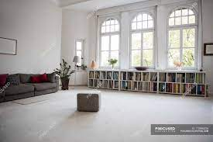
spacious

Slide 319
The vicious storm ripped through the country.

Slide 320
The _ _ _ _ _ _ _ storm ripped through the country.

Slide 321
The vicious storm ripped through the country.

Slide 322
He was gracious when accepting the award.

Slide 323
He was _ _ _ _ _ _ _ _ when accepting the award.

Slide 324
He was gracious when accepting the award.

Slide 325
Our new house had a spacious kitchen.

Slide 326
Our new house had a
_ _ _ _ _ _ _ _ kitchen.

Slide 327
Our new house had a spacious kitchen.

Slide 328
New CHALLENGE words.

Slide 329
muscle

Slide 330
muscle
The athlete was going to the gym to build up muscle.

Slide 331
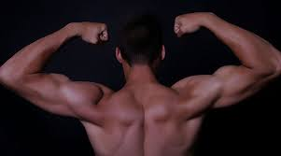
The athlete was going to the gym to build up muscle.

Slide 332
The athlete was going to the gym to build up _ _ _ _ _ _.

Slide 333
The athlete was going to the gym to build up muscle.

Slide 334
necessary

Slide 335
necessary
Builders require the necessary tools for the job.

Slide 336

Builders require the necessary tools for the job.

Slide 337
Builders require the
_ _ _ _ _ _ _ _ _ tools for the job.

Slide 338
Builders require the necessary tools for the job.

Slide 339
secretary

Slide 340
secretary
My secretary will phone you to arrange an appointment.

Slide 341
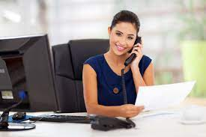
My secretary will phone you to arrange an appointment.

Slide 342
My _ _ _ _ _ _ _ _ _ will phone you to arrange an appointment.

Slide 343
My secretary will phone you to arrange an appointment.

Slide 344
Let’s investigate and detect…

Slide 345
Look at this sentence.
Change the spellings that are incorrect.
Explain how each one is wrong and how to remember to get it right next time.
Our goverment is freakquently in the news for politikal problems which recuire a grashious outcome for the country.

Slide 346
Our goverment is freakquently in the news for politikal problems which recuire a grashious outcome for the country. government – missing the n

Slide 347
Our goverment is freakquently in the news for politikal problems which recuire a grashious outcome for the country. frequently – a and k sound not needed to make qu

Slide 348
Our goverment is freakquently in the news for politikal problems which recuire a grashious outcome for the country. political – c needed not k

Slide 349
Our goverment is freakquently in the news for politikal problems which recuire a grashious outcome for the country. require – needs qu sound, not c

Slide 350
Our goverment is freakquently in the news for politikal problems which recuire a grashious outcome for the country. gracious – c to make an s sound, not sh

Slide 351
Our government is frequently in the news for political problems which require a gracious outcome for the country.

