Slide 1
Spelling Y6
Mastering spellings: building on the foundations of phonics
Spring 1
Week 1

Slide 2
These slides are slightly different - to reduce the number there are now animations used
Please use these slides in full screen slide show mode to ensure they work how they are designed with chunks of information being shown at a time to prevent overload
Thank you

Slide 3
Year 6 - Spring 1
Week 1 - Monday

Slide 4
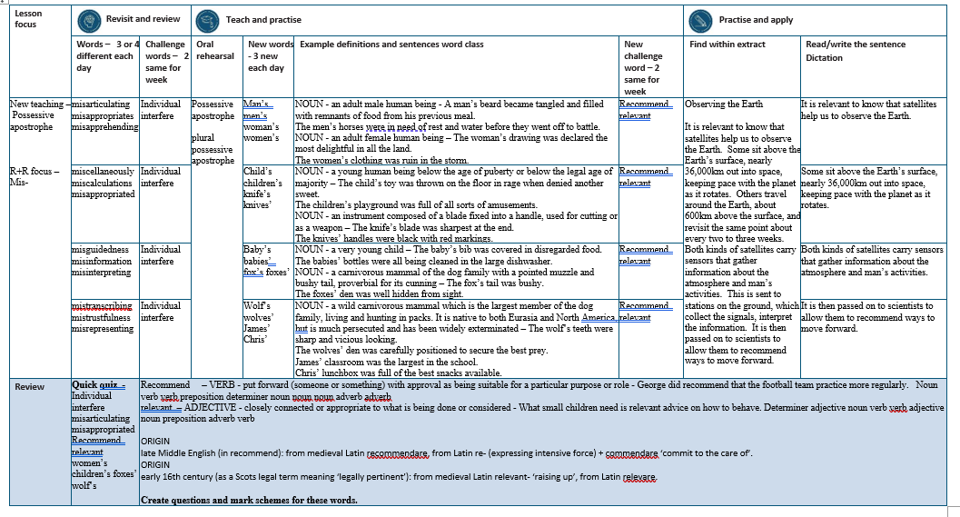

Slide 5
Let’s Revisit and Review…

Slide 6
Do you remember this challenge word?

Slide 7

unique
(adjective)
Every one of us is individual and unique.

Slide 8

interfere
(verb)
Do not interfere with business which doesn’t concern you.

Slide 9
Prefix mis-

Slide 10
mis-
Notes:
Sound of aI

Slide 11
mis- meaning wrongly

Slide 12
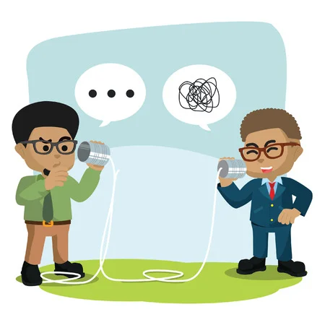
misarticulate

Slide 13
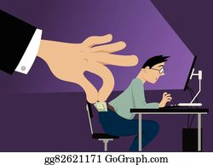
misappropriate

Slide 14

misapprehend

Slide 15
Let’s Teach and Practise

Slide 16
Possessive apostrophe
Plural possessive apostrophe
_’

Slide 17
-’

Slide 18
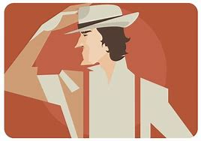
man’s

Slide 19
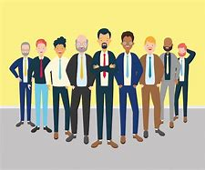
men’s

Slide 20
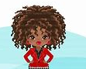
woman’s

Slide 21
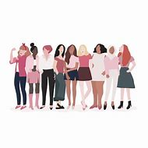
women’s

Slide 22
man’s
man + ’ + s = man’s
NOUN
Definition - an adult male human being
one man owns a hat.

Slide 23
men’s
men + ’ + s = men’s
PLURAL NOUN
Definition – a group of adult male human being
several men own several hats

Slide 24
woman’s
woman + ’ + s = woman’s
NOUN
Definition - an adult female human being
one woman owns a hat

Slide 25
women’s
women + ’ + s = women’s
PLURAL NOUN
Definition – a group of adult female human being
several women own several hats

Slide 26
A man’s beard became tangled and filled with remnants of food from his previous meal.
_____

Slide 27
The men’s horses were in need of rest and water before they went off to battle.
_____

Slide 28
The woman’s drawing was declared the most delightful in all the land.
_______

Slide 29
The women’s clothing was ruin in the storm.
_______

Slide 30
New CHALLENGE words.

Slide 31

recommend
VERB
Definition - - put forward (someone or something) with approval as being suitable for a particular purpose or role

Slide 32
George did recommend that the football team practice more regularly.
_________

Slide 33

relevant
ADJECTIVE
Definition - closely connected or appropriate to what is being done or considered

Slide 34
What small children need is relevant advice on how to behave.
________

Slide 35
Let’s Practise and Apply.

Slide 36
Observing the Earth
It is relevant to know that satellites help us to observe the Earth. Some sit above the Earth’s surface, nearly 36,000km out into space, keeping pace with the planet as it rotates. Others travel around the Earth, about 600km above the surface, and revisit the same point about every two to three weeks. Both kinds of satellites carry sensors that gather information about the atmosphere and man’s activities. This is sent to stations on the ground, which collect the signals, interpret the information. It is then passed on to scientists to allow them to recommend ways to move forward.

Slide 37
Observing the Earth
It is relevant to know that satellites help us to observe the Earth. Some sit above the Earth’s surface, nearly 36,000km out into space, keeping pace with the planet as it rotates. Others travel around the Earth, about 600km above the surface, and revisit the same point about every two to three weeks. Both kinds of satellites carry sensors that gather information about the atmosphere and man’s activities. This is sent to stations on the ground, which collect the signals, interpret the information. It is then passed on to scientists to allow them to recommend ways to move forward.

Slide 38
Write this sentence as I dictate it to you.
Notes:
It is relevant to know that satellites help us to observe the Earth.

Slide 39
It is relevant to know that satellites help us to observe the Earth.
Did you write it correctly?
Edit your work and make sure you have it correct.
Can you underline the spelling word that we have covered in this session?

Slide 40
Year 6 - Spring 1
Week 1 - Tuesday
Notes:
Revisit and review the words from previous teaching and challenge words – I say, we say, you say
Ask children to write words only in their spelling book
Introduce the new spelling rule
Children to write the new spelling rule words and challenge words into books when the sentences are shown with the spelling word missing.
Read the extract with the class as choral reading. Practise model of prosody etc.
Ask children to find the spelling words from the session in the text.
Then read allowed the chosen sentence for children to write fully in their books.
Show the extract and ask children to then edit their work to check they were correct in their dictation.

Slide 42
Let’s Revisit and Review…

Slide 43
Do you remember this challenge word?

Slide 44
unique
(adjective)
Every one of us is individual and unique.

Slide 45
interfere
(verb)
Do not interfere with business which doesn’t concern you.

Slide 46
Prefix mis-

Slide 47
mis-
Notes:
Sound of aI

Slide 48
mis- meaning wrongly

Slide 49

miscellaneous

Slide 50
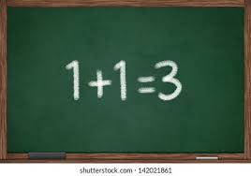
miscalculation

Slide 51
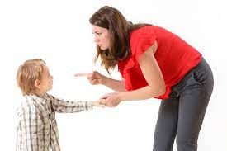
misbehave

Slide 52
Let’s Teach and Practise

Slide 53
Possessive apostrophe
Plural possessive apostrophe
_’

Slide 54
-’

Slide 55
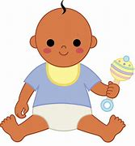
child’s

Slide 56
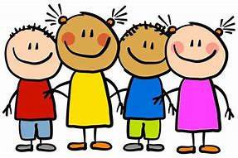
children’s

Slide 57

knife’s

Slide 58

knives’

Slide 59
child’s
child + ’ + s = child’s
NOUN
Definition - a young human being below the age of puberty or below the legal age of majority
one child owns a rattle

Slide 60
children’s
children + ’ + s = children’s
PLURAL NOUN
Definition – a group of a young human being
several children own several rattles

Slide 61
knife’s
knife + ’ + s = knife’s
NOUN
Definition - an instrument composed of a blade fixed into a handle, used for cutting or as a weapon
one knife owning a sharp blade

Slide 62
knives’
knives + ’ = knives’
PLURAL NOUN
Definition – a group of instruments used for cutting or as a weapon
several knives owning several sharp blades

Slide 63
The child’s toy was thrown on the floor in rage when denied another sweet.
_______

Slide 64
The children’s playground was full of all sorts of amusements.
__________

Slide 65
The knife’s blade was sharpest at the end.
_______

Slide 66
The knives’ handles were black with red markings.
_______

Slide 67
New CHALLENGE words.

Slide 68
recommend
VERB
Definition - - put forward (someone or something) with approval as being suitable for a particular purpose or role

Slide 69
George did recommend that the football team practice more regularly.
_________

Slide 70
relevant
ADJECTIVE
Definition - closely connected or appropriate to what is being done or considered

Slide 71
What small children need is relevant advice on how to behave.
________

Slide 72
Let’s Practise and Apply.

Slide 73
Observing the Earth
It is relevant to know that satellites help us to observe the Earth. Some sit above the Earth’s surface, nearly 36,000km out into space, keeping pace with the planet as it rotates. Others travel around the Earth, about 600km above the surface, and revisit the same point about every two to three weeks. Both kinds of satellites carry sensors that gather information about the atmosphere and man’s activities. This is sent to stations on the ground, which collect the signals, interpret the information. It is then passed on to scientists to allow them to recommend ways to move forward.

Slide 74
Observing the Earth
It is relevant to know that satellites help us to observe the Earth. Some sit above the Earth’s surface, nearly 36,000km out into space, keeping pace with the planet as it rotates. Others travel around the Earth, about 600km above the surface, and revisit the same point about every two to three weeks. Both kinds of satellites carry sensors that gather information about the atmosphere and man’s activities. This is sent to stations on the ground, which collect the signals, interpret the information. It is then passed on to scientists to allow them to recommend ways to move forward.

Slide 75
Write this sentence as I dictate it to you.
Notes:
Some sit above the Earth’s surface, nearly 36,000km out into space, keeping pace with the planet as it rotates.

Slide 76
Some sit above the Earth’s surface, nearly 36,000km out into space, keeping pace with the planet as it rotates.
Did you write it correctly?
Edit your work and make sure you have it correct.
Can you underline the spelling word that we have covered in this session?

Slide 77
Year 6 - Spring 1
Week 1 - Wednesday
Notes:
Revisit and review the words from previous teaching and challenge words – I say, we say, you say
Ask children to write words only in their spelling book
Introduce the new spelling rule
Children to write the new spelling rule words and challenge words into books when the sentences are shown with the spelling word missing.
Read the extract with the class as choral reading. Practise model of prosody etc.
Ask children to find the spelling words from the session in the text.
Then read allowed the chosen sentence for children to write fully in their books.
Show the extract and ask children to then edit their work to check they were correct in their dictation.

Slide 79
Let’s Revisit and Review…

Slide 80
Do you remember this challenge word?

Slide 81
unique
(adjective)
Every one of us is individual and unique.

Slide 82
interfere
(verb)
Do not interfere with business which doesn’t concern you.

Slide 83
Prefix mis-

Slide 84
mis-
Notes:
Sound of aI

Slide 85
mis- meaning wrongly

Slide 86
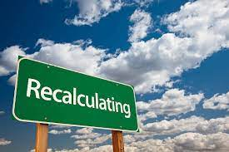
misguidedness

Slide 87
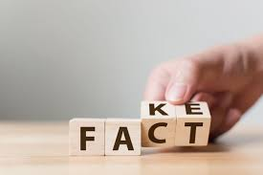
misinformation

Slide 88
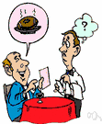
misinterpreting

Slide 89
Let’s Teach and Practise

Slide 90
Possessive apostrophe
Plural possessive apostrophe
_’

Slide 91
-’

Slide 92
baby’s

Slide 93
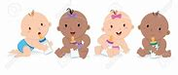
babies’

Slide 94
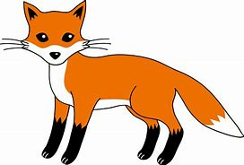
fox’s

Slide 95
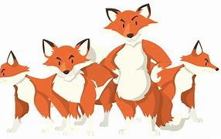
foxes’

Slide 96
baby’s
baby + ’ + s = baby’s
NOUN
Definition - - a very young child
one baby owns a rattle

Slide 97
babies’
babies + ’ = babies’
PLURAL NOUN
Definition – a group of very young children
several babies own several rattles

Slide 98
fox’s
fox + ’ + s = fox’s
NOUN
Definition - a carnivorous mammal of the dog family with a pointed muzzle and bushy tail, proverbial for its cunning
one fox owning a den

Slide 99
foxes’
foxes + ’ = foxes’
PLURAL NOUN
Definition – a group of carnivorous mammals
several foxes owning a den

Slide 100
The baby’s bib was covered in disregarded food.
______

Slide 101
The babies’ bottles were all being cleaned in the large dishwasher.
_______

Slide 102
The fox’s tail was bushy.
_____

Slide 103
The foxes’ den was well hidden from sight.
______

Slide 104
New CHALLENGE words.

Slide 105
recommend
VERB
Definition - - put forward (someone or something) with approval as being suitable for a particular purpose or role

Slide 106
George did recommend that the football team practice more regularly.
_________

Slide 107
relevant
ADJECTIVE
Definition - closely connected or appropriate to what is being done or considered

Slide 108
What small children need is relevant advice on how to behave.
________

Slide 109
Let’s Practise and Apply.

Slide 110
Observing the Earth
It is relevant to know that satellites help us to observe the Earth. Some sit above the Earth’s surface, nearly 36,000km out into space, keeping pace with the planet as it rotates. Others travel around the Earth, about 600km above the surface, and revisit the same point about every two to three weeks. Both kinds of satellites carry sensors that gather information about the atmosphere and man’s activities. This is sent to stations on the ground, which collect the signals, interpret the information. It is then passed on to scientists to allow them to recommend ways to move forward.

Slide 111
Observing the Earth
It is relevant to know that satellites help us to observe the Earth. Some sit above the Earth’s surface, nearly 36,000km out into space, keeping pace with the planet as it rotates. Others travel around the Earth, about 600km above the surface, and revisit the same point about every two to three weeks. Both kinds of satellites carry sensors that gather information about the atmosphere and man’s activities. This is sent to stations on the ground, which collect the signals, interpret the information. It is then passed on to scientists to allow them to recommend ways to move forward.

Slide 112
Write this sentence as I dictate it to you.
Notes:
Both kinds of satellites carry sensors that gather information about the atmosphere and man’s activities.

Slide 113
Both kinds of satellites carry sensors that gather information about the atmosphere and man’s activities.
Did you write it correctly?
Edit your work and make sure you have it correct.
Can you underline the spelling word that we have covered in this session?

Slide 114
Year 6 - Spring 1
Week 1 - Thursday
Notes:
Revisit and review the words from previous teaching and challenge words – I say, we say, you say
Ask children to write words only in their spelling book
Introduce the new spelling rule
Children to write the new spelling rule words and challenge words into books when the sentences are shown with the spelling word missing.
Read the extract with the class as choral reading. Practise model of prosody etc.
Ask children to find the spelling words from the session in the text.
Then read allowed the chosen sentence for children to write fully in their books.
Show the extract and ask children to then edit their work to check they were correct in their dictation.

Slide 116
Let’s Revisit and Review…

Slide 117
Do you remember this challenge word?

Slide 118
unique
(adjective)
Every one of us is individual and unique.

Slide 119
interfere
(verb)
Do not interfere with business which doesn’t concern you.

Slide 120
Prefix mis-

Slide 121
mis-
Notes:
Sound of aI

Slide 122
mis- meaning wrongly

Slide 123
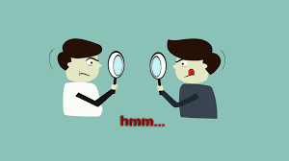
mistrustfulness

Slide 124

misrepresenting

Slide 125
Let’s Teach and Practise

Slide 126
Possessive apostrophe
Plural possessive apostrophe
_’

Slide 127
-’

Slide 128
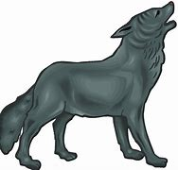
wolf’s

Slide 129
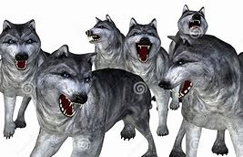
wolves’

Slide 130
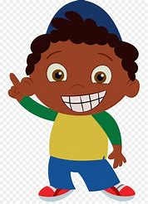
James’

Slide 131
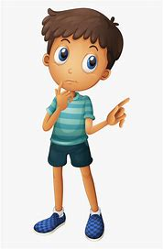
Chris’

Slide 132
wolf’s
wolf + ’ + s = wolf’s
NOUN
Definition - a wild carnivorous mammal which is the largest member of the dog family, living and hunting in packs. It is native to both Eurasia and North America, but is much persecuted and has been widely exterminated.
one wolf owns a howl

Slide 133
wolves’
wolves + ’ = wolves’
PLURAL NOUN
Definition – a group of wild carnivorous mammals
several wolves own a den

Slide 134
James’
James + ’ = James’
NOUN
Definition – name of a person
one James owning a hat

Slide 135
Chris’
Chris + ’ = Chris’
NOUN
Definition – name of a person
One Chris owning a top

Slide 136
The wolf’s teeth were sharp and vicious looking.
______

Slide 137
The wolves’ den was carefully positioned to secure the best prey.
_______

Slide 138
James’ classroom was the largest in the school.
______

Slide 139
Chris’ lunchbox was full of the best snacks available.
______

Slide 140
New CHALLENGE words.

Slide 141
recommend
VERB
Definition - - put forward (someone or something) with approval as being suitable for a particular purpose or role

Slide 142
George did recommend that the football team practice more regularly.
_________

Slide 143
relevant
ADJECTIVE
Definition - closely connected or appropriate to what is being done or considered

Slide 144
What small children need is relevant advice on how to behave.
________

Slide 145
Let’s Practise and Apply.

Slide 146
Observing the Earth
It is relevant to know that satellites help us to observe the Earth. Some sit above the Earth’s surface, nearly 36,000km out into space, keeping pace with the planet as it rotates. Others travel around the Earth, about 600km above the surface, and revisit the same point about every two to three weeks. Both kinds of satellites carry sensors that gather information about the atmosphere and man’s activities. This is sent to stations on the ground, which collect the signals, interpret the information. It is then passed on to scientists to allow them to recommend ways to move forward.

Slide 147
Observing the Earth
It is relevant to know that satellites help us to observe the Earth. Some sit above the Earth’s surface, nearly 36,000km out into space, keeping pace with the planet as it rotates. Others travel around the Earth, about 600km above the surface, and revisit the same point about every two to three weeks. Both kinds of satellites carry sensors that gather information about the atmosphere and man’s activities. This is sent to stations on the ground, which collect the signals, interpret the information. It is then passed on to scientists to allow them to recommend ways to move forward.

Slide 148
Write this sentence as I dictate it to you.
Notes:
It is then passed on to scientists to allow them to recommend ways to move forward.

Slide 149
It is then passed on to scientists to allow them to recommend ways to move forward.
Did you write it correctly?
Edit your work and make sure you have it correct.
Can you underline the spelling word that we have covered in this session?

Slide 150
Year 6 - Spring 1
Week 1 - Friday
Notes:
Click through the slides for all the R+R words for the week (both the focus and the challenge words)
Click through the slides for all the new learning this week

Slide 152
Old challenge words…

Slide 153
individual

Slide 154
interfere

Slide 155
Old spelling rule words…

Slide 156
misarticulate

Slide 157
misappropriate

Slide 158
misapprehend

Slide 159
miscellaneously

Slide 160
miscalculations

Slide 161
misbehave

Slide 162
misguidedness

Slide 163
misinformation

Slide 164
misinterpreting

Slide 165
mistranscribe

Slide 166
mistrustfulness

Slide 167
misrepresenting

Slide 168
New spelling rule words…

Slide 169
man’s

Slide 170
men’s

Slide 171
woman’s

Slide 172
women’s

Slide 173
child’s

Slide 174
children’s

Slide 175
knife’s

Slide 176
knive’s

Slide 177
baby’s

Slide 178
babies’

Slide 179
fox’s

Slide 180
foxes’

Slide 181
wolf’s

Slide 182
wolves’

Slide 183
James’

Slide 184
Chris’

Slide 185
New challenge words…

Slide 186
relevant

Slide 187
recommend

Slide 188
Quick Quiz time…
Notes:
Say these words for the quiz
Individual interfere misarticulating misappropriated
Recommend relevant women’s children’s foxes’ wolf’s

Slide 189
Did you get them correct?
Edit your work.
individual interfere misarticulating misappropriated
recommend relevant women’s children’s foxes’ wolf’s

Slide 190
Word class time…

Slide 191
George did recommend that the football team practice more regularly.
Noun verb verb preposition determiner noun noun noun adverb adverb
Notes:
Ask for these words to be classed

Slide 192
What small children need is relevant advice on how to behave.
Determiner adjective noun verb verb adjective noun preposition adverb verb
Notes:
Ask for these words to be classed

Slide 193
Etymology
The history of a word….

Slide 194
Recommend
late Middle English (in recommend): from medieval Latin recommendare, from Latin re- (expressing intensive force) + commendare ‘commit to the care of’.
Relevant
early 16th century (as a Scots legal term meaning ‘legally pertinent’): from medieval Latin relevant- ‘raising up’, from Latin relevare.

Slide 195
Let’s investigate….
Create questions and mark schemes for these words.

