Slide 1
Spelling Y6
Mastering spellings: building on the foundations of phonics
Spring 1
Week 2

Slide 2
These slides are slightly different - to reduce the number there are now animations used
Please use these slides in full screen slide show mode to ensure they work how they are designed with chunks of information being shown at a time to prevent overload
Thank you

Slide 3
Year 6 - Spring 1
Week 2 - Monday

Slide 4
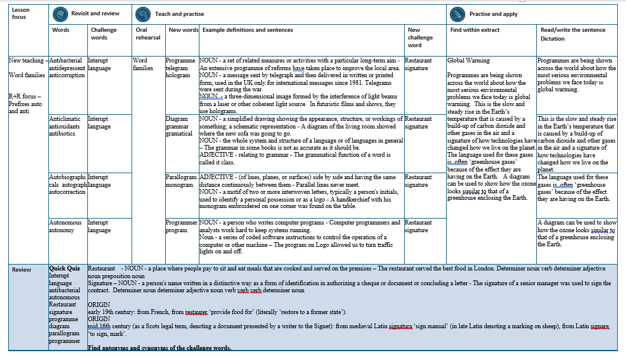

Slide 5
Let’s Revisit and Review…

Slide 6
Do you remember this challenge word?

Slide 7
Prefixes auto- and anti-

Slide 8
auto-
meaning relating to yourself
Notes:
Sound of aI

Slide 9
anti- meaning against

Slide 10

antibacterial

Slide 11
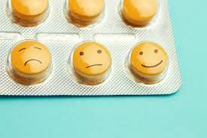
antidepressant

Slide 12

anti-corruption

Slide 13
Let’s Teach and Practise

Slide 14
Word families gram small weight

Slide 15
gram

Slide 16

programme

Slide 17
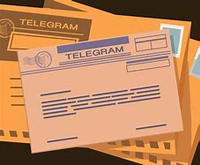
telegram

Slide 18

hologram

Slide 19
programme
pro + gram + me = programme
NOUN
Definition - a set of related measures or activities with a particular long-term aim

Slide 20
telegram
tele + gram = telegram
NOUN
Definition – a message sent by telegraph and then delivered in written or printed form, used in the UK only for international messages since 1981.

Slide 21
woman’s
woman + ’ + s = woman’s
NOUN
Definition - a three-dimensional image formed by the interference of light beams from a laser or other coherent light source.

Slide 22
An extensive programme of reforms have taken place to improve the local area.
_________

Slide 23
Telegrams were sent during the war.
_________

Slide 24
In futuristic films and shows, they use holograms.
_________

Slide 25
New CHALLENGE words.

Slide 26

restaurant
NOUN
Definition - a place where people pay to sit and eat meals that are cooked and served on the premises

Slide 27
The restaurant served the best food in London.
__________

Slide 28

signature
NOUN
Definition - a person's name written in a distinctive way as a form of identification in authorizing a cheque or document or concluding a letter

Slide 29
The signature of a senior manager was used to sign the contract.
_________

Slide 30
Let’s Practise and Apply.

Slide 31
Global Warming
Programmes are being shown across the world about how the most serious environmental problems we face today is global warming. This is the slow and steady rise in the Earth’s temperature that is caused by a build-up of carbon dioxide and other gases in the air and a signature of how technologies have changed how we live on the planet. The language used for these gases is often ‘greenhouse gases’ because of the effect they are having on the Earth. A diagram can be used to show how the ozone looks similar to that of a greenhouse enclosing the Earth.

Slide 32
Global Warming
Programmes are being shown across the world about how the most serious environmental problems we face today is global warming. This is the slow and steady rise in the Earth’s temperature that is caused by a build-up of carbon dioxide and other gases in the air and a signature of how technologies have changed how we live on the planet. The language used for these gases is often ‘greenhouse gases’ because of the effect they are having on the Earth. A diagram can be used to show how the ozone looks similar to that of a greenhouse enclosing the Earth.

Slide 33
Write this sentence as I dictate it to you.
Notes:
Programmes are being shown across the world about how the most serious environmental problems we face today is global warming.

Slide 34
Programmes are being shown across the world about how the most serious environmental problems we face today is global warming.
Did you write it correctly?
Edit your work and make sure you have it correct.
Can you underline the spelling word that we have covered in this session?

Slide 35
Year 6 - Spring 1
Week 2 - Tuesday
Notes:
Revisit and review the words from previous teaching and challenge words – I say, we say, you say
Ask children to write words only in their spelling book
Introduce the new spelling rule
Children to write the new spelling rule words and challenge words into books when the sentences are shown with the spelling word missing.
Read the extract with the class as choral reading. Practise model of prosody etc.
Ask children to find the spelling words from the session in the text.
Then read allowed the chosen sentence for children to write fully in their books.
Show the extract and ask children to then edit their work to check they were correct in their dictation.

Slide 37
Let’s Revisit and Review…

Slide 38
Do you remember this challenge word?

Slide 39
Prefixes auto- and anti-

Slide 40
auto-
meaning relating to yourself
Notes:
Sound of aI

Slide 41
anti- meaning against

Slide 42
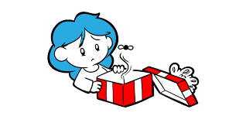
anticlimactic

Slide 43
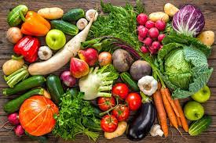
antioxidants

Slide 44

antibiotics

Slide 45
Let’s Teach and Practise

Slide 46
Word families gram small weight

Slide 47
gram

Slide 48

diagram

Slide 49

grammar

Slide 50
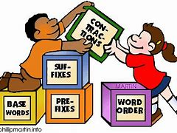
grammatical

Slide 51
diagram
dia + gram = diagram
NOUN
Definition - a simplified drawing showing the appearance, structure, or workings of something; a schematic representation

Slide 52
grammar
gram + mar = grammar
NOUN
Definition – the whole system and structure of a language or of languages in general

Slide 53
grammatical
gram + matical = grammatical
ADJECTIVE
Definition - relating to grammar

Slide 54
A diagram of the living room showed where the new sofa was going to go.
_______

Slide 55
The grammar in some books is not as accurate as it should be.
_______

Slide 56
The grammatical function of a word is called it class.
___________

Slide 57
New CHALLENGE words.

Slide 58
restaurant
NOUN
Definition - a place where people pay to sit and eat meals that are cooked and served on the premises

Slide 59
The restaurant served the best food in London.
__________

Slide 60
signature
NOUN
Definition - a person's name written in a distinctive way as a form of identification in authorizing a cheque or document or concluding a letter

Slide 61
The signature of a senior manager was used to sign the contract.
_________

Slide 62
Let’s Practise and Apply.

Slide 63
Global Warming
Programmes are being shown across the world about how the most serious environmental problems we face today is global warming. This is the slow and steady rise in the Earth’s temperature that is caused by a build-up of carbon dioxide and other gases in the air and a signature of how technologies have changed how we live on the planet. The language used for these gases is often ‘greenhouse gases’ because of the effect they are having on the Earth. A diagram can be used to show how the ozone looks similar to that of a greenhouse enclosing the Earth.

Slide 64
Global Warming
Programmes are being shown across the world about how the most serious environmental problems we face today is global warming. This is the slow and steady rise in the Earth’s temperature that is caused by a build-up of carbon dioxide and other gases in the air and a signature of how technologies have changed how we live on the planet. The language used for these gases is often ‘greenhouse gases’ because of the effect they are having on the Earth. A diagram can be used to show how the ozone looks similar to that of a greenhouse enclosing the Earth.

Slide 65
Write this sentence as I dictate it to you.
Notes:
This is the slow and steady rise in the Earth’s temperature that is caused by a build-up of carbon dioxide and other gases in the air and a signature of how technologies have changed how we live on the planet.

Slide 66
This is the slow and steady rise in the Earth’s temperature that is caused by a build-up of carbon dioxide and other gases in the air and a signature of how technologies have changed how we live on the planet.
Did you write it correctly?
Edit your work and make sure you have it correct.
Can you underline the spelling word that we have covered in this session?

Slide 67
Year 6 - Spring 1
Week 2 - Wednesday
Notes:
Revisit and review the words from previous teaching and challenge words – I say, we say, you say
Ask children to write words only in their spelling book
Introduce the new spelling rule
Children to write the new spelling rule words and challenge words into books when the sentences are shown with the spelling word missing.
Read the extract with the class as choral reading. Practise model of prosody etc.
Ask children to find the spelling words from the session in the text.
Then read allowed the chosen sentence for children to write fully in their books.
Show the extract and ask children to then edit their work to check they were correct in their dictation.

Slide 69
Let’s Revisit and Review…

Slide 70
Do you remember this challenge word?

Slide 71
Prefixes auto- and anti-

Slide 72
auto-
meaning relating to yourself
Notes:
Sound of aI

Slide 73
anti- meaning against

Slide 74

autobiographical

Slide 75
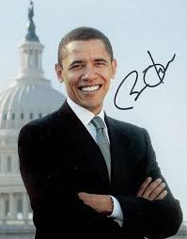
autograph

Slide 76
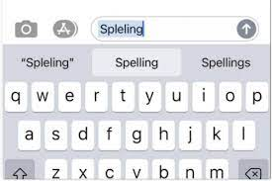
auto-correction

Slide 77
Let’s Teach and Practise

Slide 78
Word families gram small weight

Slide 79
gram

Slide 80

Parallelogram

Slide 81

monogram

Slide 82
parallelogram
parallelo + gram = parallelogram
NOUN
Definition - (of lines, planes, or surfaces) side by side and having the same distance continuously between them

Slide 83
monogram
mono + gram = monogram
NOUN
Definition – a motif of two or more interwoven letters, typically a person's initials, used to identify a personal possession or as a logo

Slide 84
A parallelogram has pairs of lines opposite each other that never meet.
_____________

Slide 85
A handkerchief, with his monogram embroidered on one corner, was found on the table.
________

Slide 86
New CHALLENGE words.

Slide 87
restaurant
NOUN
Definition - a place where people pay to sit and eat meals that are cooked and served on the premises

Slide 88
The restaurant served the best food in London.
__________

Slide 89
signature
NOUN
Definition - a person's name written in a distinctive way as a form of identification in authorizing a cheque or document or concluding a letter

Slide 90
The signature of a senior manager was used to sign the contract.
_________

Slide 91
Let’s Practise and Apply.

Slide 92
Global Warming
Programmes are being shown across the world about how the most serious environmental problems we face today is global warming. This is the slow and steady rise in the Earth’s temperature that is caused by a build-up of carbon dioxide and other gases in the air and a signature of how technologies have changed how we live on the planet. The language used for these gases is often ‘greenhouse gases’ because of the effect they are having on the Earth. A diagram can be used to show how the ozone looks similar to that of a greenhouse enclosing the Earth.

Slide 93
Global Warming
Programmes are being shown across the world about how the most serious environmental problems we face today is global warming. This is the slow and steady rise in the Earth’s temperature that is caused by a build-up of carbon dioxide and other gases in the air and a signature of how technologies have changed how we live on the planet. The language used for these gases is often ‘greenhouse gases’ because of the effect they are having on the Earth. A diagram can be used to show how the ozone looks similar to that of a greenhouse enclosing the Earth.

Slide 94
Write this sentence as I dictate it to you.
Notes:
The language used for these gases is often ‘greenhouse gases’ because of the effect they are having on the Earth.

Slide 95
The language used for these gases is often ‘greenhouse gases’ because of the effect they are having on the Earth.
Did you write it correctly?
Edit your work and make sure you have it correct.
Can you underline the spelling word that we have covered in this session?

Slide 96
Year 6 - Spring 1
Week 2 – Thursday
Notes:
Revisit and review the words from previous teaching and challenge words – I say, we say, you say
Ask children to write words only in their spelling book
Introduce the new spelling rule
Children to write the new spelling rule words and challenge words into books when the sentences are shown with the spelling word missing.
Read the extract with the class as choral reading. Practise model of prosody etc.
Ask children to find the spelling words from the session in the text.
Then read allowed the chosen sentence for children to write fully in their books.
Show the extract and ask children to then edit their work to check they were correct in their dictation.

Slide 98
Let’s Revisit and Review…

Slide 99
Do you remember this challenge word?

Slide 100
Prefixes auto- and anti-

Slide 101
auto-
meaning relating to yourself
Notes:
Sound of aI

Slide 102
anti- meaning against

Slide 103
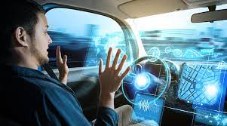
autonomous

Slide 104
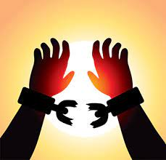
autonomy

Slide 105
Let’s Teach and Practise

Slide 106
Word families gram small weight

Slide 107
gram

Slide 108

programmer

Slide 109

program

Slide 110
programmer
pro + gram + mer = programmer
NOUN
Definition - a person who writes computer programs

Slide 111
program
pro + gram = program
NOUN
Definition – a series of coded software instructions to control the operation of a computer or other machine

Slide 112
Computer programmers and analysts work hard to keep systems running.
___________

Slide 113
The program on Logo allowed us to turn traffic lights on and off.
_______

Slide 114
New CHALLENGE words.

Slide 115
restaurant
NOUN
Definition - a place where people pay to sit and eat meals that are cooked and served on the premises

Slide 116
The restaurant served the best food in London.
__________

Slide 117
signature
NOUN
Definition - a person's name written in a distinctive way as a form of identification in authorizing a cheque or document or concluding a letter

Slide 118
The signature of a senior manager was used to sign the contract.
_________

Slide 119
Let’s Practise and Apply.

Slide 120
Global Warming
Programmes are being shown across the world about how the most serious environmental problems we face today is global warming. This is the slow and steady rise in the Earth’s temperature that is caused by a build-up of carbon dioxide and other gases in the air and a signature of how technologies have changed how we live on the planet. The language used for these gases is often ‘greenhouse gases’ because of the effect they are having on the Earth. A diagram can be used to show how the ozone looks similar to that of a greenhouse enclosing the Earth.

Slide 121
Global Warming
Programmes are being shown across the world about how the most serious environmental problems we face today is global warming. This is the slow and steady rise in the Earth’s temperature that is caused by a build-up of carbon dioxide and other gases in the air and a signature of how technologies have changed how we live on the planet. The language used for these gases is often ‘greenhouse gases’ because of the effect they are having on the Earth. A diagram can be used to show how the ozone looks similar to that of a greenhouse enclosing the Earth.

Slide 122
Write this sentence as I dictate it to you.
Notes:
A diagram can be used to show how the ozone looks similar to that of a greenhouse enclosing the Earth.

Slide 123
A diagram can be used to show how the ozone looks similar to that of a greenhouse enclosing the Earth.
Did you write it correctly?
Edit your work and make sure you have it correct.
Can you underline the spelling word that we have covered in this session?

Slide 124
Year 6 - Spring 1
Week 2 - Friday
Notes:
Click through the slides for all the R+R words for the week (both the focus and the challenge words)
Click through the slides for all the new learning this week

Slide 126
Old challenge words…

Slide 127
interrupt

Slide 128
language

Slide 129
Old spelling rule words…

Slide 130
antibacterial

Slide 131
antidepressant

Slide 132
anti-corruption

Slide 133
anticlimactic

Slide 134
antioxidants

Slide 135
antibiotics

Slide 136
autobiographical

Slide 137
autograph

Slide 138
autocorrection

Slide 139
autonomous

Slide 140
autonomy

Slide 141
New spelling rule words…

Slide 142
programme

Slide 143
telegram

Slide 144
hologram

Slide 145
diagram

Slide 146
grammar

Slide 147
gramatical

Slide 148
parallelogram

Slide 149
monogram

Slide 150
programmer

Slide 151
program

Slide 152
New challenge words…

Slide 153
restaurant

Slide 154
signature

Slide 155
Quick Quiz time…
Notes:
Say these words for the quiz
Interupt language antibacterial autonomous Restaurant signature programme diagram parallogram programmer

Slide 156
Did you get them correct?
Edit your work.
interupt language antibacterial autonomous Restaurant signature programme diagram parallogram programmer

Slide 157
Word class time…

Slide 158
The restaurant served the best food in London.
Determiner noun verb determiner adjective noun preposition noun
Notes:
Ask for these words to be classed

Slide 159
The signature of a senior manager was used to sign the contract.
Determiner noun determiner adjective noun verb verb verb determiner noun
Notes:
Ask for these words to be classed

Slide 160
Etymology
The history of a word….

Slide 161
Restaurant
early 19th century: from French, from restaurer ‘provide food for’ (literally ‘restore to a former state’).
Signature
mid 16th century (as a Scots legal term, denoting a document presented by a writer to the Signet): from medieval Latin signatura ‘sign manual’ (in late Latin denoting a marking on sheep), from Latin signare ‘to sign, mark’.

Slide 162
Let’s investigate….
Find antonyms and synonyms of the challenge words.

