Slide 1
Spelling Y6
Mastering spellings: building on the foundations of phonics
Spring 1
Week 3

Slide 2
These slides are slightly different - to reduce the number there are now animations used
Please use these slides in full screen slide show mode to ensure they work how they are designed with chunks of information being shown at a time to prevent overload
Thank you

Slide 3
Year 6 - Spring 1
Week 3 - Monday

Slide 4
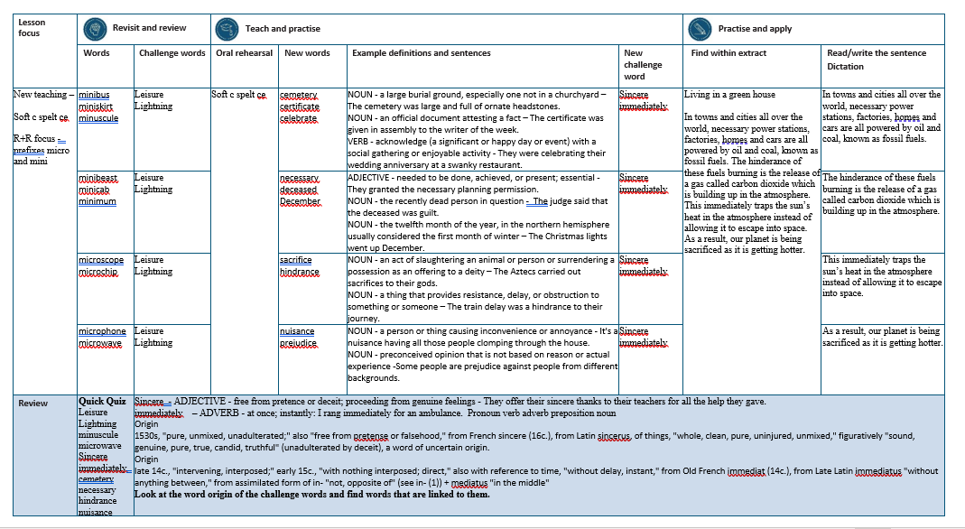

Slide 5
Let’s Revisit and Review…

Slide 6
Do you remember this challenge word?

Slide 7
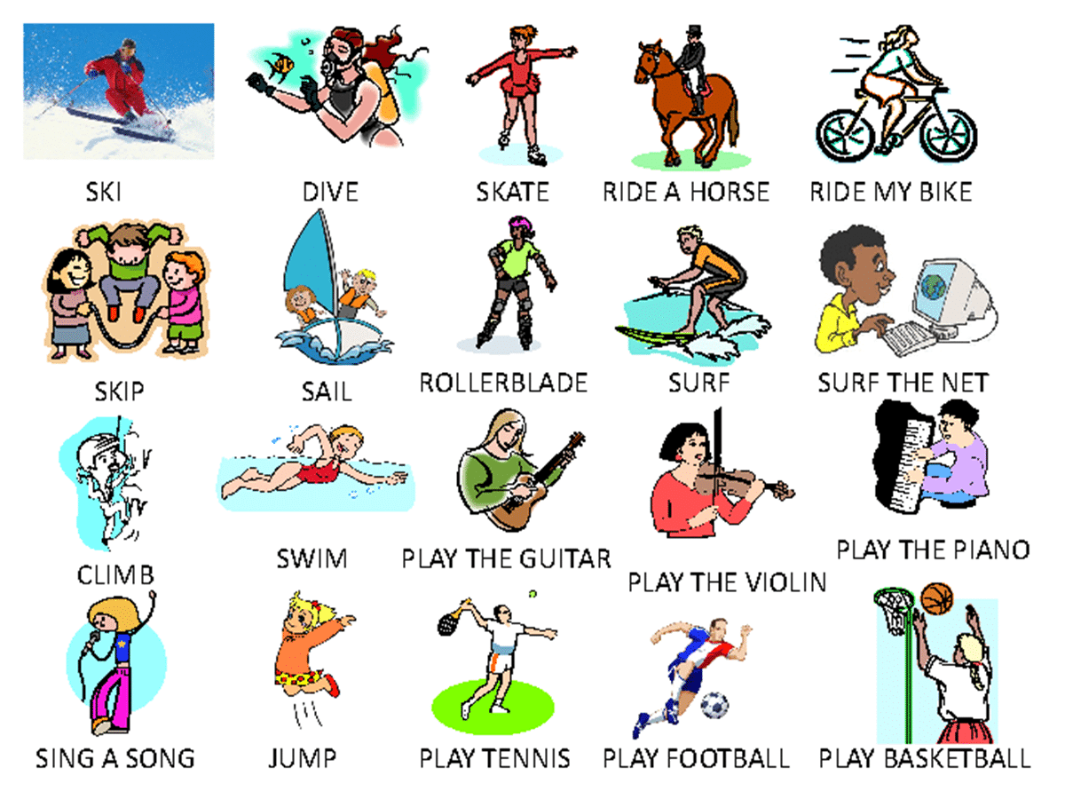
leisure
The most common leisure activity in Britain is going for a walk.

Slide 8
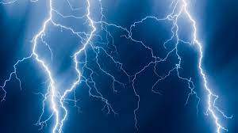
lightning
The tree ignited as it was struck by lightning.

Slide 9
Creating diminutives using prefixes micro- or mini- meaning small.

Slide 10
Prefixes micro- and mini-

Slide 11
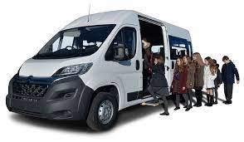
minibus

Slide 12
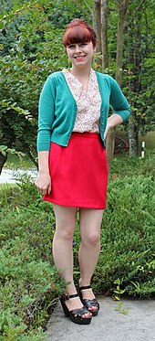
miniskirt

Slide 13
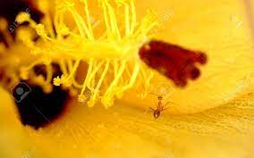
minuscule

Slide 14
Let’s Teach and Practise

Slide 15
Soft c spelt ce

Slide 16
ce

Slide 17
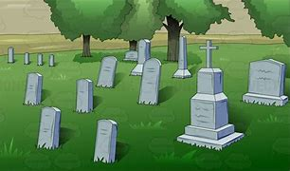
cemetery

Slide 18

certificate

Slide 19
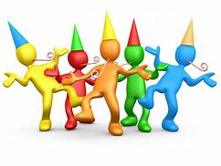
celebrate

Slide 20
cemetery
NOUN
Definition - a large burial ground, especially one not in a churchyard

Slide 21
certificate
NOUN
Definition – an official document attesting a fact

Slide 22
celebrate
VERB
Definition - acknowledge (a significant or happy day or event) with a social gathering or enjoyable activity

Slide 23
The cemetery was large and full of ornate headstones.
________

Slide 24
The certificate was given in assembly to the writer of the week.
_________

Slide 25
They were celebrating their wedding anniversary at a swanky restaurant.
___________

Slide 26
New CHALLENGE words.

Slide 27
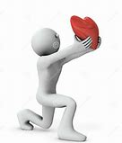
sincere
ADJECTIVE
Definition - free from pretence or deceit; proceeding from genuine feelings

Slide 28
They offer their sincere thanks to their teachers for all the help they gave.
_______

Slide 29

immediately
ADVERB
Definition - at once; instantly

Slide 30
I rang immediately for an ambulance.
___________

Slide 31
Let’s Practise and Apply.

Slide 32
Living in a green house
In towns and cities all over the world, necessary power stations, factories, homes and cars are all powered by oil and coal, known as fossil fuels. The hindrance of these fuels burning is the release of a gas called carbon dioxide which is building up in the atmosphere. This immediately traps the sun’s heat in the atmosphere instead of allowing it to escape into space. As a result, our planet is being sacrificed as it is getting hotter.

Slide 33
Living in a green house
In towns and cities all over the world, necessary power stations, factories, homes and cars are all powered by oil and coal, known as fossil fuels. The hindrance of these fuels burning is the release of a gas called carbon dioxide which is building up in the atmosphere. This immediately traps the sun’s heat in the atmosphere instead of allowing it to escape into space. As a result, our planet is being sacrificed as it is getting hotter.

Slide 34
Write this sentence as I dictate it to you.
Notes:
In towns and cities all over the world, necessary power stations, factories, homes and cars are all powered by oil and coal, known as fossil fuels.

Slide 35
In towns and cities all over the world, necessary power stations, factories, homes and cars are all powered by oil and coal, known as fossil fuels.
Did you write it correctly?
Edit your work and make sure you have it correct.
Can you underline the spelling word that we have covered in this session?

Slide 36
Year 6 - Spring 1
Week 3 - Tuesday
Notes:
Revisit and review the words from previous teaching and challenge words – I say, we say, you say
Ask children to write words only in their spelling book
Introduce the new spelling rule
Children to write the new spelling rule words and challenge words into books when the sentences are shown with the spelling word missing.
Read the extract with the class as choral reading. Practise model of prosody etc.
Ask children to find the spelling words from the session in the text.
Then read allowed the chosen sentence for children to write fully in their books.
Show the extract and ask children to then edit their work to check they were correct in their dictation.

Slide 38
Let’s Revisit and Review…

Slide 39
Do you remember this challenge word?

Slide 40
leisure
The most common leisure activity in Britain is going for a walk.

Slide 41
lightning
The tree ignited as it was struck by lightning.

Slide 42
Creating diminutives using prefixes micro- or mini- meaning small.

Slide 43
Prefixes micro- and mini-

Slide 44
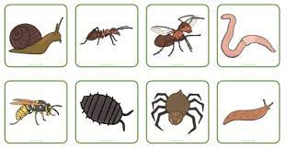
minibeast

Slide 45
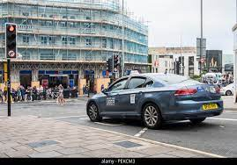
minicab

Slide 46
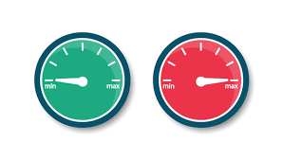
minimum

Slide 47
Let’s Teach and Practise

Slide 48
Soft c spelt ce

Slide 49
ce

Slide 50

necessary

Slide 51
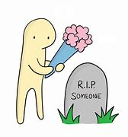
deceased

Slide 52

December

Slide 53
necessary
ADJECTIVE
Definition - needed to be done, achieved, or present; essential

Slide 54
deceased
NOUN
Definition – the recently dead person in question

Slide 55
December
NOUN
Definition - the twelfth month of the year, in the northern hemisphere usually considered the first month of winter

Slide 56
They granted the necessary planning permission.
_________

Slide 57
The judge said that the deceased was guilty.
________

Slide 58
The Christmas lights went up December.
________

Slide 59
New CHALLENGE words.

Slide 60
sincere
ADJECTIVE
Definition - free from pretence or deceit; proceeding from genuine feelings

Slide 61
They offer their sincere thanks to their teachers for all the help they gave.
_______

Slide 62
immediately
ADVERB
Definition - at once; instantly

Slide 63
I rang immediately for an ambulance.
___________

Slide 64
Let’s Practise and Apply.

Slide 65
Living in a green house
In towns and cities all over the world, necessary power stations, factories, homes and cars are all powered by oil and coal, known as fossil fuels. The hindrance of these fuels burning is the release of a gas called carbon dioxide which is building up in the atmosphere. This immediately traps the sun’s heat in the atmosphere instead of allowing it to escape into space. As a result, our planet is being sacrificed as it is getting hotter.

Slide 66
Living in a green house
In towns and cities all over the world, necessary power stations, factories, homes and cars are all powered by oil and coal, known as fossil fuels. The hindrance of these fuels burning is the release of a gas called carbon dioxide which is building up in the atmosphere. This immediately traps the sun’s heat in the atmosphere instead of allowing it to escape into space. As a result, our planet is being sacrificed as it is getting hotter.

Slide 67
Write this sentence as I dictate it to you.
Notes:
The hinderance of these fuels burning is the release of a gas called carbon dioxide which is building up in the atmosphere.

Slide 68
The hindrance of these fuels burning is the release of a gas called carbon dioxide which is building up in the atmosphere.
Did you write it correctly?
Edit your work and make sure you have it correct.
Can you underline the spelling word that we have covered in this session?

Slide 69
Year 6 - Spring 1
Week 3 - Wednesday
Notes:
Revisit and review the words from previous teaching and challenge words – I say, we say, you say
Ask children to write words only in their spelling book
Introduce the new spelling rule
Children to write the new spelling rule words and challenge words into books when the sentences are shown with the spelling word missing.
Read the extract with the class as choral reading. Practise model of prosody etc.
Ask children to find the spelling words from the session in the text.
Then read allowed the chosen sentence for children to write fully in their books.
Show the extract and ask children to then edit their work to check they were correct in their dictation.

Slide 71
Let’s Revisit and Review…

Slide 72
Do you remember this challenge word?

Slide 73
leisure
The most common leisure activity in Britain is going for a walk.

Slide 74
lightning
The tree ignited as it was struck by lightning.

Slide 75
Creating diminutives using prefixes micro- or mini- meaning small.

Slide 76
Prefixes micro- and mini-

Slide 77

microscope

Slide 78

microchip

Slide 79
Let’s Teach and Practise

Slide 80
Soft c spelt ce

Slide 81
ce

Slide 82
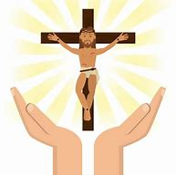
sacrifice

Slide 83
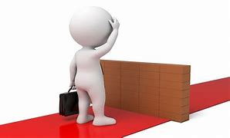
hindrance

Slide 84
sacrifice
NOUN
Definition - an act of slaughtering an animal or person or surrendering a possession as an offering to a deity

Slide 85
hindrance
NOUN
Definition – a thing that provides resistance, delay, or obstruction to something or someone

Slide 86
The Aztecs carried out sacrifices to their gods.
__________

Slide 87
The train delay was a hindrance to their journey.
__________

Slide 88
New CHALLENGE words.

Slide 89
sincere
ADJECTIVE
Definition - free from pretence or deceit; proceeding from genuine feelings

Slide 90
They offer their sincere thanks to their teachers for all the help they gave.
_______

Slide 91
immediately
ADVERB
Definition - at once; instantly

Slide 92
I rang immediately for an ambulance.
___________

Slide 93
Let’s Practise and Apply.

Slide 94
Living in a green house
In towns and cities all over the world, necessary power stations, factories, homes and cars are all powered by oil and coal, known as fossil fuels. The hindrance of these fuels burning is the release of a gas called carbon dioxide which is building up in the atmosphere. This immediately traps the sun’s heat in the atmosphere instead of allowing it to escape into space. As a result, our planet is being sacrificed as it is getting hotter.

Slide 95
Living in a green house
In towns and cities all over the world, necessary power stations, factories, homes and cars are all powered by oil and coal, known as fossil fuels. The hindrance of these fuels burning is the release of a gas called carbon dioxide which is building up in the atmosphere. This immediately traps the sun’s heat in the atmosphere instead of allowing it to escape into space. As a result, our planet is being sacrificed as it is getting hotter.

Slide 96
Write this sentence as I dictate it to you.
Notes:
This immediately traps the sun’s heat in the atmosphere instead of allowing it to escape into space.

Slide 97
This immediately traps the sun’s heat in the atmosphere instead of allowing it to escape into space.
Did you write it correctly?
Edit your work and make sure you have it correct.
Can you underline the spelling word that we have covered in this session?

Slide 98
Year 6 - Spring 1
Week 3 - Thursday
Notes:
Revisit and review the words from previous teaching and challenge words – I say, we say, you say
Ask children to write words only in their spelling book
Introduce the new spelling rule
Children to write the new spelling rule words and challenge words into books when the sentences are shown with the spelling word missing.
Read the extract with the class as choral reading. Practise model of prosody etc.
Ask children to find the spelling words from the session in the text.
Then read allowed the chosen sentence for children to write fully in their books.
Show the extract and ask children to then edit their work to check they were correct in their dictation.

Slide 100
Let’s Revisit and Review…

Slide 101
Do you remember this challenge word?

Slide 102
leisure
The most common leisure activity in Britain is going for a walk.

Slide 103
lightning
The tree ignited as it was struck by lightning.

Slide 104
Creating diminutives using prefixes micro- or mini- meaning small.

Slide 105
Prefixes micro- and mini-

Slide 106
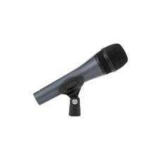
microphone

Slide 107
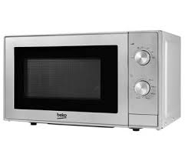
microwave

Slide 108
Let’s Teach and Practise

Slide 109
Soft c spelt ce

Slide 110
ce

Slide 111

nuisance

Slide 112
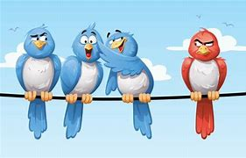
prejudice

Slide 113
nuisance
NOUN
Definition - a person or thing causing inconvenience or annoyance

Slide 114
prejudice
NOUN
Definition – preconceived opinion that is not based on reason or actual experience

Slide 115
It's a nuisance having all those people clomping through the house.
________

Slide 116
Some people are prejudice against people from different backgrounds.
_________

Slide 117
New CHALLENGE words.

Slide 118
sincere
ADJECTIVE
Definition - free from pretence or deceit; proceeding from genuine feelings

Slide 119
They offer their sincere thanks to their teachers for all the help they gave.
_______

Slide 120
immediately
ADVERB
Definition - at once; instantly

Slide 121
I rang immediately for an ambulance.
___________

Slide 122
Let’s Practise and Apply.

Slide 123
Living in a green house
In towns and cities all over the world, necessary power stations, factories, homes and cars are all powered by oil and coal, known as fossil fuels. The hindrance of these fuels burning is the release of a gas called carbon dioxide which is building up in the atmosphere. This immediately traps the sun’s heat in the atmosphere instead of allowing it to escape into space. As a result, our planet is being sacrificed as it is getting hotter.

Slide 124
Living in a green house
In towns and cities all over the world, necessary power stations, factories, homes and cars are all powered by oil and coal, known as fossil fuels. The hindrance of these fuels burning is the release of a gas called carbon dioxide which is building up in the atmosphere. This immediately traps the sun’s heat in the atmosphere instead of allowing it to escape into space. As a result, our planet is being sacrificed as it is getting hotter.

Slide 125
Write this sentence as I dictate it to you.
Notes:
As a result, our planet is being sacrificed as it is getting hotter.

Slide 126
As a result, our planet is being sacrificed as it is getting hotter
Did you write it correctly?
Edit your work and make sure you have it correct.
Can you underline the spelling word that we have covered in this session?

Slide 127
Year 6 - Spring 1
Week 3 - Friday
Notes:
Click through the slides for all the R+R words for the week (both the focus and the challenge words)
Click through the slides for all the new learning this week

Slide 129
Old challenge words…

Slide 130
leisure

Slide 131
lightning

Slide 132
Old spelling rule words…

Slide 133
minibus

Slide 134
miniskirt

Slide 135
minuscule

Slide 136
minibeast

Slide 137
minicab

Slide 138
minimum

Slide 139
microscope

Slide 140
microchip

Slide 141
microphone

Slide 142
microwave

Slide 143
New spelling rule words…

Slide 144
cemetery

Slide 145
certificate

Slide 146
celebrate

Slide 147
necessary

Slide 148
deceased

Slide 149
December

Slide 150
sacrifice

Slide 151
hindrance

Slide 152
nuisance

Slide 153
prejudice

Slide 154
New challenge words…

Slide 155
sincere

Slide 156
immediately

Slide 157
Quick Quiz time…
Notes:
Say these words for the quiz
Leisure Lightning minuscule microwave Sincere immediately cemetery necessary hindrance nuisance

Slide 158
Did you get them correct?
Edit your work.
leisure lightning minuscule microwave sincere immediately cemetery necessary hindrance nuisance

Slide 159
Word class time…

Slide 160
They offer their sincere thanks to their teachers for all the help they gave.
pronoun verb pronoun adjective noun preposition pronoun noun preposition determiner determiner noun pronoun verb
Notes:
Ask for these words to be classed

Slide 161
I rang immediately for an ambulance.
Pronoun verb adverb preposition noun
Notes:
Ask for these words to be classed

Slide 162
Etymology
The history of a word….

Slide 163
Sincere
1530s, "pure, unmixed, unadulterated;" also "free from pretense or falsehood," from French sincere (16c.), from Latin sincerus, of things, "whole, clean, pure, uninjured, unmixed," figuratively "sound, genuine, pure, true, candid, truthful" (unadulterated by deceit), a word of uncertain origin.
Immediately
late 14c., "intervening, interposed;" early 15c., "with nothing interposed; direct," also with reference to time, "without delay, instant," from Old French immediat (14c.), from Late Latin immediatus "without anything between," from assimilated form of in- "not, opposite of" (see in- (1)) + mediatus "in the middle"

Slide 164
Let’s investigate….
Look at the word origin of the challenge words and find words that are linked to them.

