Slide 1
Spelling Y6
Mastering spellings: building on the foundations of phonics
Spring 1
Week 4

Slide 2
These slides are slightly different - to reduce the number there are now animations used
Please use these slides in full screen slide show mode to ensure they work how they are designed with chunks of information being shown at a time to prevent overload
Thank you

Slide 3
Year 6 - Spring 1
Week 4 - Monday

Slide 4
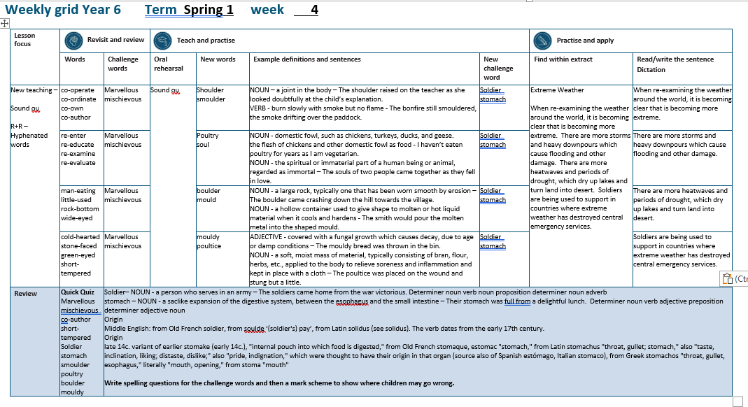

Slide 5
Let’s Revisit and Review…

Slide 6
Do you remember this challenge word?

Slide 7

marvellous
We saw the most marvellous firework display.

Slide 8

mischievous
Dave, the mischievous kitten, hid in the basket of clean washing.

Slide 9
To join a prefix ending in a vowel to a root word beginning with a vowel.

Slide 10

co-operate

Slide 11

co-ordinate

Slide 12

co-own

Slide 13
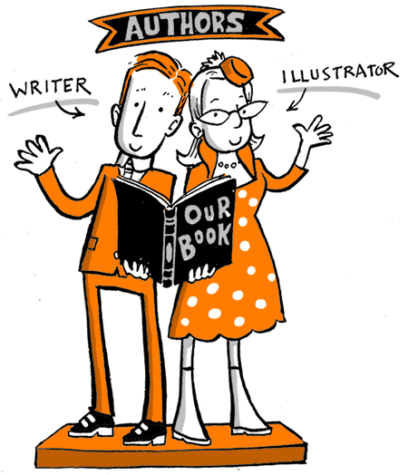
co-author

Slide 14
Let’s Teach and Practise

Slide 15
Sound ou
ou

Slide 16
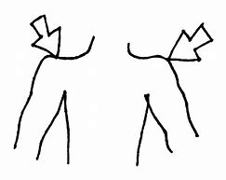
shoulder

Slide 17
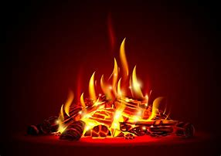
smoulder

Slide 18
shoulder
NOUN
Definition - a joint in the body

Slide 19
smoulder
VERB
Definition – burn slowly with smoke but no flame

Slide 20
The shoulder raised on the teacher as she looked doubtfully at the child’s explanation.
________

Slide 21
The bonfire still smouldered, the smoke drifting over the paddock.
__________

Slide 22
New CHALLENGE words.

Slide 23
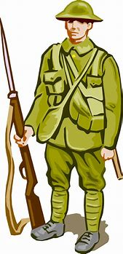
soldier
NOUN
Definition - a person who serves in an army

Slide 24
The soldiers came home from the war victorious.
________

Slide 25
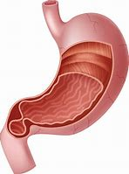
stomach
NOUN
Definition - a saclike expansion of the digestive system, between the esophagus and the small intestine

Slide 26
Their stomach was full from a delightful lunch.
_______

Slide 27
Let’s Practise and Apply.

Slide 28
Extreme Weather
When re-examining the weather around the world, it is becoming clear that is becoming more extreme. There are more storms and heavy downpours which cause flooding and other damage. There are more heatwaves and periods of drought, which dry up lakes and turn land into desert. Soldiers are being used to support in countries where extreme weather has destroyed central emergency services.

Slide 29
Extreme Weather
When re-examining the weather around the world, it is becoming clear that is becoming more extreme. There are more storms and heavy downpours which cause flooding and other damage. There are more heatwaves and periods of drought, which dry up lakes and turn land into desert. Soldiers are being used to support in countries where extreme weather has destroyed central emergency services.

Slide 30
Write this sentence as I dictate it to you.
Notes:
When re-examining the weather around the world, it is becoming clear that it is becoming more extreme.

Slide 31
When re-examining the weather around the world, it is becoming clear that it is becoming more extreme.
Did you write it correctly?
Edit your work and make sure you have it correct.
Can you underline the spelling word that we have covered in this session?

Slide 32
Year 6 - Spring 1
Week 4 - Tuesday
Notes:
Revisit and review the words from previous teaching and challenge words – I say, we say, you say
Ask children to write words only in their spelling book
Introduce the new spelling rule
Children to write the new spelling rule words and challenge words into books when the sentences are shown with the spelling word missing.
Read the extract with the class as choral reading. Practise model of prosody etc.
Ask children to find the spelling words from the session in the text.
Then read allowed the chosen sentence for children to write fully in their books.
Show the extract and ask children to then edit their work to check they were correct in their dictation.

Slide 34
Let’s Revisit and Review…

Slide 35
Do you remember this challenge word?

Slide 36
marvellous
We saw the most marvellous firework display.

Slide 37
mischievous
Dave, the mischievous kitten, hid in the basket of clean washing.

Slide 38
To join a prefix ending in a vowel to a root word beginning with a vowel.

Slide 39
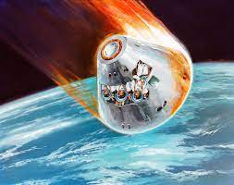
re-enter

Slide 40

re-examine

Slide 41

re-evaluate

Slide 42
Let’s Teach and Practise

Slide 43
Sound ou
ou

Slide 44
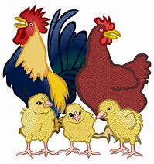
poultry

Slide 45

soul

Slide 46
poultry
NOUN
Definition - domestic fowl, such as chickens, turkeys, ducks, and geese

Slide 47
soul
NOUN
Definition – the spiritual or immaterial part of a human being or animal, regarded as immortal

Slide 48
I haven’t eaten poultry for years as I am vegetarian.
_______

Slide 49
The souls of two people came together as they fell in love.
_____

Slide 50
New CHALLENGE words.

Slide 51
soldier
NOUN
Definition - a person who serves in an army

Slide 52
The soldiers came home from the war victorious.
________

Slide 53
stomach
NOUN
Definition - a saclike expansion of the digestive system, between the esophagus and the small intestine

Slide 54
Their stomach was full from a delightful lunch.
_______

Slide 55
Let’s Practise and Apply.

Slide 56
Extreme Weather
When re-examining the weather around the world, it is becoming clear that is becoming more extreme. There are more storms and heavy downpours which cause flooding and other damage. There are more heatwaves and periods of drought, which dry up lakes and turn land into desert. Soldiers are being used to support in countries where extreme weather has destroyed central emergency services.

Slide 57
Extreme Weather
When re-examining the weather around the world, it is becoming clear that is becoming more extreme. There are more storms and heavy downpours which cause flooding and other damage. There are more heatwaves and periods of drought, which dry up lakes and turn land into desert. Soldiers are being used to support in countries where extreme weather has destroyed central emergency services.

Slide 58
Write this sentence as I dictate it to you.
Notes:
There are more storms and heavy downpours which cause flooding and other damage.

Slide 59
There are more storms and heavy downpours which cause flooding and other damage.
Did you write it correctly?
Edit your work and make sure you have it correct.
Can you underline the spelling word that we have covered in this session?

Slide 60
Year 6 - Spring 1
Week 4 - Wednesday
Notes:
Revisit and review the words from previous teaching and challenge words – I say, we say, you say
Ask children to write words only in their spelling book
Introduce the new spelling rule
Children to write the new spelling rule words and challenge words into books when the sentences are shown with the spelling word missing.
Read the extract with the class as choral reading. Practise model of prosody etc.
Ask children to find the spelling words from the session in the text.
Then read allowed the chosen sentence for children to write fully in their books.
Show the extract and ask children to then edit their work to check they were correct in their dictation.

Slide 62
Let’s Revisit and Review…

Slide 63
Do you remember this challenge word?

Slide 64
marvellous
We saw the most marvellous firework display.

Slide 65
mischievous
Dave, the mischievous kitten, hid in the basket of clean washing.

Slide 66
To join a prefix ending in a vowel to a root word beginning with a vowel.

Slide 67

man-eating

Slide 68
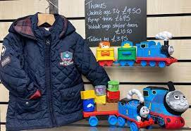
little-used

Slide 69
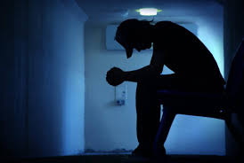
rock-bottom

Slide 70
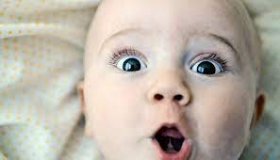
wide-eyed

Slide 71
Let’s Teach and Practise

Slide 72
Sound ou
ou

Slide 73
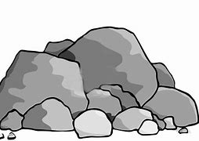
boulder

Slide 74
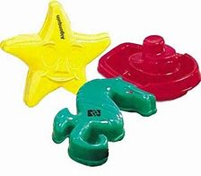
mould

Slide 75
boulder
NOUN
Definition - a large rock, typically one that has been worn smooth by erosion

Slide 76
mould
NOUN
Definition – a hollow container used to give shape to molten or hot liquid material when it cools and hardens

Slide 77
The boulder came crashing down the hill towards the village.
_______

Slide 78
The smith would pour the molten metal into the shaped mould.
_____

Slide 79
New CHALLENGE words.

Slide 80
soldier
NOUN
Definition - a person who serves in an army

Slide 81
The soldiers came home from the war victorious.
________

Slide 82
stomach
NOUN
Definition - a saclike expansion of the digestive system, between the esophagus and the small intestine

Slide 83
Their stomach was full from a delightful lunch.
_______

Slide 84
Let’s Practise and Apply.

Slide 85
Extreme Weather
When re-examining the weather around the world, it is becoming clear that is becoming more extreme. There are more storms and heavy downpours which cause flooding and other damage. There are more heatwaves and periods of drought, which dry up lakes and turn land into desert. Soldiers are being used to support in countries where extreme weather has destroyed central emergency services.

Slide 86
Extreme Weather
When re-examining the weather around the world, it is becoming clear that is becoming more extreme. There are more storms and heavy downpours which cause flooding and other damage. There are more heatwaves and periods of drought, which dry up lakes and turn land into desert. Soldiers are being used to support in countries where extreme weather has destroyed central emergency services.

Slide 87
Write this sentence as I dictate it to you.
Notes:
There are more heatwaves and periods of drought, which dry up lakes and turn land into desert.

Slide 88
There are more heatwaves and periods of drought, which dry up lakes and turn land into desert.
Did you write it correctly?
Edit your work and make sure you have it correct.
Can you underline the spelling word that we have covered in this session?

Slide 89
Year 6 - Spring 1
Week 4 - Thursday
Notes:
Revisit and review the words from previous teaching and challenge words – I say, we say, you say
Ask children to write words only in their spelling book
Introduce the new spelling rule
Children to write the new spelling rule words and challenge words into books when the sentences are shown with the spelling word missing.
Read the extract with the class as choral reading. Practise model of prosody etc.
Ask children to find the spelling words from the session in the text.
Then read allowed the chosen sentence for children to write fully in their books.
Show the extract and ask children to then edit their work to check they were correct in their dictation.

Slide 91
Let’s Revisit and Review…

Slide 92
Do you remember this challenge word?

Slide 93
marvellous
We saw the most marvellous firework display.

Slide 94
mischievous
Dave, the mischievous kitten, hid in the basket of clean washing.

Slide 95
To join a prefix ending in a vowel to a root word beginning with a vowel.

Slide 96
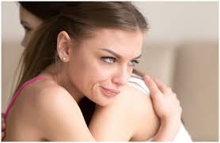
cold-hearted

Slide 97
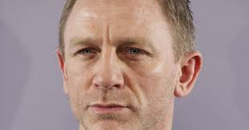
stone-faced

Slide 98

green-eyed

Slide 99
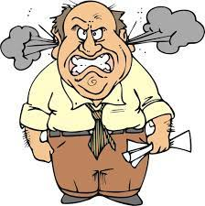
short-tempered

Slide 100
Let’s Teach and Practise

Slide 101
Sound ou
ou

Slide 102
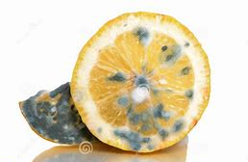
mouldy

Slide 103
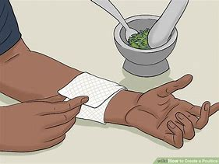
poultice

Slide 104
mouldy
ADJECTIVE
Definition - covered with a fungal growth which causes decay, due to age or damp conditions

Slide 105
poultice
NOUN
Definition – a soft, moist mass of material, typically consisting of bran, flour, herbs, etc., applied to the body to relieve soreness and inflammation and kept in place with a cloth

Slide 106
The mouldy bread was thrown in the bin.
______

Slide 107
The poultice was placed on the wound and stung but a little.
________

Slide 108
New CHALLENGE words.

Slide 109
soldier
NOUN
Definition - a person who serves in an army

Slide 110
The soldiers came home from the war victorious.
________

Slide 111
stomach
NOUN
Definition - a saclike expansion of the digestive system, between the esophagus and the small intestine

Slide 112
Their stomach was full from a delightful lunch.
_______

Slide 113
Let’s Practise and Apply.

Slide 114
Extreme Weather
When re-examining the weather around the world, it is becoming clear that is becoming more extreme. There are more storms and heavy downpours which cause flooding and other damage. There are more heatwaves and periods of drought, which dry up lakes and turn land into desert. Soldiers are being used to support in countries where extreme weather has destroyed central emergency services.

Slide 115
Extreme Weather
When re-examining the weather around the world, it is becoming clear that is becoming more extreme. There are more storms and heavy downpours which cause flooding and other damage. There are more heatwaves and periods of drought, which dry up lakes and turn land into desert. Soldiers are being used to support in countries where extreme weather has destroyed central emergency services.

Slide 116
Write this sentence as I dictate it to you.
Notes:
Soldiers are being used to support in countries where extreme weather has destroyed central emergency services.

Slide 117
Soldiers are being used to support in countries where extreme weather has destroyed central emergency services.
Did you write it correctly?
Edit your work and make sure you have it correct.
Can you underline the spelling word that we have covered in this session?

Slide 118
Year 6 - Spring 1
Week 4 - Friday
Notes:
Click through the slides for all the R+R words for the week (both the focus and the challenge words)
Click through the slides for all the new learning this week

Slide 120
Old challenge words…

Slide 121
marvellous

Slide 122
mischievous

Slide 123
Old spelling rule words…

Slide 124
co-operate

Slide 125
co-ordinate

Slide 126
co-own

Slide 127
co-author

Slide 128
re-enter

Slide 129
re-educate

Slide 130
re-examine

Slide 131
re-evaluate

Slide 132
man-eating

Slide 133
little-used

Slide 134
rock-bottom

Slide 135
wide-eyed

Slide 136
cold-hearted

Slide 137
stone-faced

Slide 138
green-eyed

Slide 139
short-tempered

Slide 140
New spelling rule words…

Slide 141
shoulder

Slide 142
smoulder

Slide 143
poultry

Slide 144
soul

Slide 145
boulder

Slide 146
mould

Slide 147
mouldy

Slide 148
poultice

Slide 149
New challenge words…

Slide 150
soldier

Slide 151
stomach

Slide 152
Quick Quiz time…
Notes:
Say these words for the quiz
Marvellous mischievous co-author short-tempered Soldier stomach smoulder poultry boulder mouldy

Slide 153
Did you get them correct?
Edit your work.
marvellous mischievous co-author short-tempered soldier stomach smoulder poultry boulder mouldy

Slide 154
Word class time…

Slide 155
The soldiers came home from the war victorious.
Determiner noun verb noun proposition determiner noun adverb
Notes:
Ask for these words to be classed

Slide 156
Their stomach was full from a delightful lunch.
Determiner noun verb adjective preposition determiner adjective noun
Notes:
Ask for these words to be classed

Slide 157
Etymology
The history of a word….

Slide 158
Soldier
Middle English: from Old French soldier, from soulde ‘(soldier's) pay’, from Latin solidus (see solidus). The verb dates from the early 17th century.
Stomach
late 14c. variant of earlier stomake (early 14c.), "internal pouch into which food is digested," from Old French stomaque, estomac "stomach," from Latin stomachus "throat, gullet; stomach," also "taste, inclination, liking; distaste, dislike;" also "pride, indignation," which were thought to have their origin in that organ (source also of Spanish estómago, Italian stomaco), from Greek stomachos "throat, gullet, esophagus," literally "mouth, opening," from stoma "mouth"

Slide 159
Let’s investigate….
Write spelling questions for the challenge words and then a mark scheme to show where children may go wrong.

