Slide 1
Spelling Y6
Mastering spellings: building on the foundations of phonics
Spring 1
Week 5

Slide 2
These slides are slightly different - to reduce the number there are now animations used
Please use these slides in full screen slide show mode to ensure they work how they are designed with chunks of information being shown at a time to prevent overload
Thank you

Slide 3
Year 6 - Spring 1
Week 5 - Monday

Slide 4
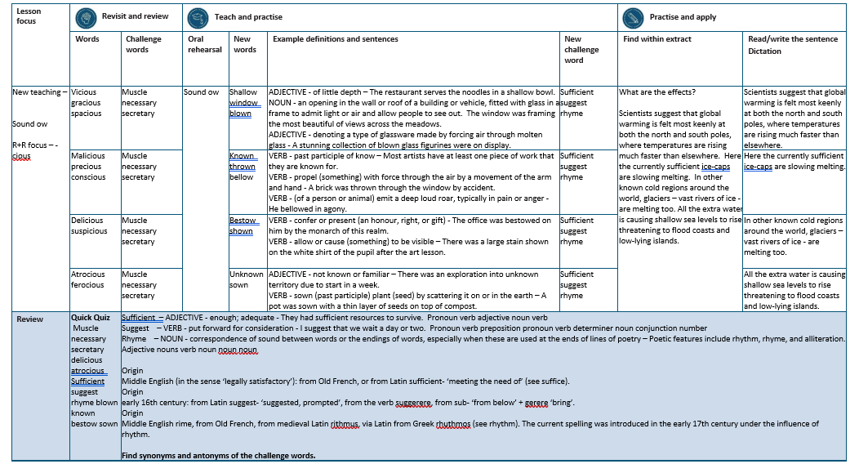

Slide 5
Let’s Revisit and Review…

Slide 6
Do you remember this challenge word?

Slide 7
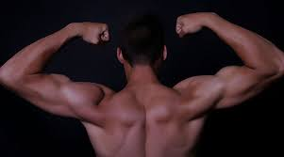
muscle
The athlete was going to the gym to build up muscle.

Slide 8

necessary
Builders require the necessary tools for the job.

Slide 9
the suffix
-cious

Slide 10

vicious

Slide 11
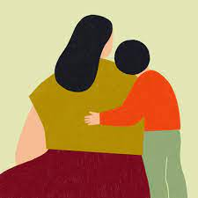
gracious

Slide 12
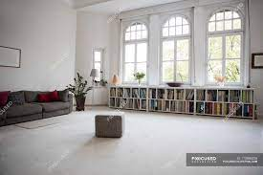
spacious

Slide 13
Let’s Teach and Practise

Slide 14
Sound ow
ow

Slide 15

shallow

Slide 16

window

Slide 17

blown

Slide 18
shallow
ADJECTIVE
Definition - of little depth

Slide 19
window
NOUN
Definition – an opening in the wall or roof of a building or vehicle, fitted with glass in a frame to admit light or air and allow people to see out

Slide 20
blown
ADJECTIVE / VERB
Definition – denoting a type of glassware made by forcing air through molten glass OR past tense of to blow

Slide 21
The restaurant serves the noodles in a shallow bowl.
_______

Slide 22
The window was framing the most beautiful of views across the meadows.
______

Slide 23
A stunning collection of blown glass figurines were on display.
_____

Slide 24
New CHALLENGE words.

Slide 25
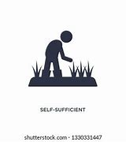
sufficient
ADJECTIVE
Definition - enough; adequate

Slide 26
They had sufficient resources to survive.
__________

Slide 27

suggest
VERB
Definition - put forward for consideration

Slide 28
I suggest that we wait a day or two.
_______

Slide 29
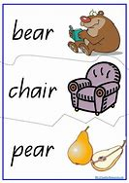
rhyme
NOUN
Definition - correspondence of sound between words or the endings of words, especially when these are used at the ends of lines of poetry

Slide 30
Poetic features include rhythm, rhyme, and alliteration.
_____

Slide 31
Let’s Practise and Apply.

Slide 32
What are the effects?
Scientists suggest that global warming is felt most keenly at both the north and south poles, where temperatures are rising much faster than elsewhere. Here the currently sufficient ice-caps are slowly melting. In other known cold regions around the world, glaciers – vast rivers of ice - are melting too. All the extra water is causing shallow sea levels to rise threatening to flood coasts and low-lying islands.

Slide 33
What are the effects?
Scientists suggest that global warming is felt most keenly at both the north and south poles, where temperatures are rising much faster than elsewhere. Here the currently sufficient ice-caps are slowly melting. In other known cold regions around the world, glaciers – vast rivers of ice - are melting too. All the extra water is causing shallow sea levels to rise threatening to flood coasts and low-lying islands.

Slide 34
Write this sentence as I dictate it to you.
Notes:
Scientists suggest that global warming is felt most keenly at both the north and south poles, where temperatures are rising much faster than elsewhere.

Slide 35
Scientists suggest that global warming is felt most keenly at both the north and south poles, where temperatures are rising much faster than elsewhere.
Did you write it correctly?
Edit your work and make sure you have it correct.
Can you underline the spelling word that we have covered in this session?

Slide 36
Year 6 - Spring 1
Week 5 - Tuesday
Notes:
Revisit and review the words from previous teaching and challenge words – I say, we say, you say
Ask children to write words only in their spelling book
Introduce the new spelling rule
Children to write the new spelling rule words and challenge words into books when the sentences are shown with the spelling word missing.
Read the extract with the class as choral reading. Practise model of prosody etc.
Ask children to find the spelling words from the session in the text.
Then read allowed the chosen sentence for children to write fully in their books.
Show the extract and ask children to then edit their work to check they were correct in their dictation.

Slide 38
Let’s Revisit and Review…

Slide 39
Do you remember this challenge word?

Slide 40
muscle
The athlete was going to the gym to build up muscle.

Slide 41
necessary
Builders require the necessary tools for the job.

Slide 42
the suffix
-cious

Slide 43

malicious

Slide 44

precious

Slide 45
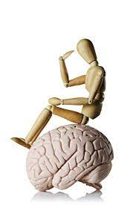
conscious

Slide 46
Let’s Teach and Practise

Slide 47
Sound ow
ow

Slide 48

known

Slide 49

thrown

Slide 50

bellow

Slide 51
known
VERB
Definition - past participle of know

Slide 52
throw
VERB
Definition – propel (something) with force through the air by a movement of the arm and hand

Slide 53
bellow
VERB
Definition – (of a person or animal) emit a deep loud roar, typically in pain or anger

Slide 54
Most artists have at least one piece of work that they are known for.
_____

Slide 55
A brick was thrown through the window by accident.
______

Slide 56
He bellowed in agony.
________

Slide 57
New CHALLENGE words.

Slide 58
sufficient
ADJECTIVE
Definition - enough; adequate

Slide 59
They had sufficient resources to survive.
__________

Slide 60
suggest
VERB
Definition - put forward for consideration

Slide 61
I suggest that we wait a day or two.
_______

Slide 62
rhyme
NOUN
Definition - correspondence of sound between words or the endings of words, especially when these are used at the ends of lines of poetry

Slide 63
Poetic features include rhythm, rhyme, and alliteration.
_____

Slide 64
Let’s Practise and Apply.

Slide 65
What are the effects?
Scientists suggest that global warming is felt most keenly at both the north and south poles, where temperatures are rising much faster than elsewhere. Here the currently sufficient ice-caps are slowly melting. In other known cold regions around the world, glaciers – vast rivers of ice - are melting too. All the extra water is causing shallow sea levels to rise threatening to flood coasts and low-lying islands.

Slide 66
What are the effects?
Scientists suggest that global warming is felt most keenly at both the north and south poles, where temperatures are rising much faster than elsewhere. Here the currently sufficient ice-caps are slowly melting. In other known cold regions around the world, glaciers – vast rivers of ice - are melting too. All the extra water is causing shallow sea levels to rise threatening to flood coasts and low-lying islands.

Slide 67
Write this sentence as I dictate it to you.
Notes:
Here the currently sufficient ice-caps are slowing melting.

Slide 68
Here the currently sufficient ice-caps are slowing melting.
Did you write it correctly?
Edit your work and make sure you have it correct.
Can you underline the spelling word that we have covered in this session?

Slide 69
Year 6 - Spring 1
Week 5 - Wednesday
Notes:
Revisit and review the words from previous teaching and challenge words – I say, we say, you say
Ask children to write words only in their spelling book
Introduce the new spelling rule
Children to write the new spelling rule words and challenge words into books when the sentences are shown with the spelling word missing.
Read the extract with the class as choral reading. Practise model of prosody etc.
Ask children to find the spelling words from the session in the text.
Then read allowed the chosen sentence for children to write fully in their books.
Show the extract and ask children to then edit their work to check they were correct in their dictation.

Slide 71
Let’s Revisit and Review…

Slide 72
Do you remember this challenge word?

Slide 73
muscle
The athlete was going to the gym to build up muscle.

Slide 74
necessary
Builders require the necessary tools for the job.

Slide 75
the suffix
-cious

Slide 76

delicious

Slide 77

suspicious

Slide 78
Let’s Teach and Practise

Slide 79
Sound ow
ow

Slide 80

bestow

Slide 81
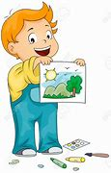
shown

Slide 82
bestow
VERB
Definition - confer or present (an honour, right, or gift)

Slide 83
window
VERB
Definition – allow or cause (something) to be visible

Slide 84
The office was bestowed on him by the monarch of this realm.
________

Slide 85
There was a large stain shown on the white shirt of the pupil after the art lesson.
_____

Slide 86
New CHALLENGE words.

Slide 87
sufficient
ADJECTIVE
Definition - enough; adequate

Slide 88
They had sufficient resources to survive.
__________

Slide 89
suggest
VERB
Definition - put forward for consideration

Slide 90
I suggest that we wait a day or two.
_______

Slide 91
rhyme
NOUN
Definition - correspondence of sound between words or the endings of words, especially when these are used at the ends of lines of poetry

Slide 92
Poetic features include rhythm, rhyme, and alliteration.
_____

Slide 93
Let’s Practise and Apply.

Slide 94
What are the effects?
Scientists suggest that global warming is felt most keenly at both the north and south poles, where temperatures are rising much faster than elsewhere. Here the currently sufficient ice-caps are slowly melting. In other known cold regions around the world, glaciers – vast rivers of ice - are melting too. All the extra water is causing shallow sea levels to rise threatening to flood coasts and low-lying islands.

Slide 95
What are the effects?
Scientists suggest that global warming is felt most keenly at both the north and south poles, where temperatures are rising much faster than elsewhere. Here the currently sufficient ice-caps are slowly melting. In other known cold regions around the world, glaciers – vast rivers of ice - are melting too. All the extra water is causing shallow sea levels to rise threatening to flood coasts and low-lying islands.

Slide 96
Write this sentence as I dictate it to you.
Notes:
In other known cold regions around the world, glaciers – vast rivers of ice - are melting too.

Slide 97
In other known cold regions around the world, glaciers – vast rivers of ice - are melting too.
Did you write it correctly?
Edit your work and make sure you have it correct.
Can you underline the spelling word that we have covered in this session?

Slide 98
Year 6 - Spring 1
Week 5 - Thursday
Notes:
Revisit and review the words from previous teaching and challenge words – I say, we say, you say
Ask children to write words only in their spelling book
Introduce the new spelling rule
Children to write the new spelling rule words and challenge words into books when the sentences are shown with the spelling word missing.
Read the extract with the class as choral reading. Practise model of prosody etc.
Ask children to find the spelling words from the session in the text.
Then read allowed the chosen sentence for children to write fully in their books.
Show the extract and ask children to then edit their work to check they were correct in their dictation.

Slide 100
Let’s Revisit and Review…

Slide 101
Do you remember this challenge word?

Slide 102
muscle
The athlete was going to the gym to build up muscle.

Slide 103
necessary
Builders require the necessary tools for the job.

Slide 104
the suffix
-cious

Slide 105

atrocious

Slide 106
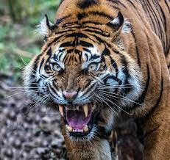
ferocious

Slide 107
Let’s Teach and Practise

Slide 108
Sound ow
ow

Slide 109

unknown

Slide 110
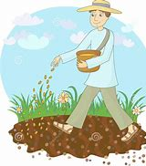
sown

Slide 111
unknown
ADJECTIVE
Definition - not known or familiar

Slide 112
sown
VERB
Definition – (past participle) plant (seed) by scattering it on or in the earth

Slide 113
There was an exploration into unknown territory due to start in a week.
_______

Slide 114
A pot was sown with a thin layer of seeds on top of compost.
____

Slide 115
New CHALLENGE words.

Slide 116
sufficient
ADJECTIVE
Definition - enough; adequate

Slide 117
They had sufficient resources to survive.
__________

Slide 118
suggest
VERB
Definition - put forward for consideration

Slide 119
I suggest that we wait a day or two.
_______

Slide 120
rhyme
NOUN
Definition - correspondence of sound between words or the endings of words, especially when these are used at the ends of lines of poetry

Slide 121
Poetic features include rhythm, rhyme, and alliteration.
_____

Slide 122
Let’s Practise and Apply.

Slide 123
What are the effects?
Scientists suggest that global warming is felt most keenly at both the north and south poles, where temperatures are rising much faster than elsewhere. Here the currently sufficient ice-caps are slowly melting. In other known cold regions around the world, glaciers – vast rivers of ice - are melting too. All the extra water is causing shallow sea levels to rise threatening to flood coasts and low-lying islands.

Slide 124
What are the effects?
Scientists suggest that global warming is felt most keenly at both the north and south poles, where temperatures are rising much faster than elsewhere. Here the currently sufficient ice-caps are slowly melting. In other known cold regions around the world, glaciers – vast rivers of ice - are melting too. All the extra water is causing shallow sea levels to rise threatening to flood coasts and low-lying islands.

Slide 125
Write this sentence as I dictate it to you.
Notes:
All the extra water is causing shallow sea levels to rise threatening to flood coasts and low-lying islands.

Slide 126
All the extra water is causing shallow sea levels to rise threatening to flood coasts and low-lying islands.
Did you write it correctly?
Edit your work and make sure you have it correct.
Can you underline the spelling word that we have covered in this session?

Slide 127
Year 6 - Spring 1
Week 5 - Friday
Notes:
Click through the slides for all the R+R words for the week (both the focus and the challenge words)
Click through the slides for all the new learning this week

Slide 129
Old challenge words…

Slide 130
muscle

Slide 131
necessary

Slide 132
Old spelling rule words…

Slide 133
vicious

Slide 134
gracious

Slide 135
spacious

Slide 136
malicious

Slide 137
precious

Slide 138
conscious

Slide 139
delicious

Slide 140
suspicious

Slide 141
atrocious

Slide 142
ferocious

Slide 143
New spelling rule words…

Slide 144
shallow

Slide 145
window

Slide 146
blown

Slide 147
known

Slide 148
thrown

Slide 149
below

Slide 150
bestow

Slide 151
shown

Slide 152
unknown

Slide 153
sown

Slide 154
New challenge words…

Slide 155
sufficient

Slide 156
suggest

Slide 157
rhyme

Slide 158
Quick Quiz time…
Notes:
Say these words for the quiz
Muscle necessary secretary delicious atrocious Sufficient suggest rhyme blown known bestow sown

Slide 159
Did you get them correct?
Edit your work.
muscle necessary secretary delicious atrocious sufficient suggest rhyme blown known bestow sown

Slide 160
Word class time…

Slide 161
They had sufficient resources to survive.
Pronoun verb adjective noun verb
Notes:
Ask for these words to be classed

Slide 162
I suggest that we wait a day or two.
Pronoun verb preposition pronoun verb determiner noun conjunction number
Notes:
Ask for these words to be classed

Slide 163
Poetic features include rhythm, rhyme, and alliteration.
Adjective nouns verb noun noun conjunction noun
Notes:
Ask for these words to be classed

Slide 164
Etymology
The history of a word….

Slide 165
Sufficient
Middle English (in the sense ‘legally satisfactory’): from Old French, or from Latin sufficient- ‘meeting the need of’ (see suffice).
Suggest
early 16th century: from Latin suggest- ‘suggested, prompted’, from the verb suggerere, from sub- ‘from below’ + gerere ‘bring’.
Rhyme
Middle English rime, from Old French, from medieval Latin rithmus, via Latin from Greek rhuthmos (see rhythm). The current spelling was introduced in the early 17th century under the influence of rhythm.

Slide 166
Let’s investigate….
Find synonyms and antonyms of the challenge words.

