Slide 1
Spelling Y6
Mastering spellings: building on the foundations of phonics
Spring 1
Week 6

Slide 2
Year 6 - Spring 1
Week 6 - Monday

Slide 3
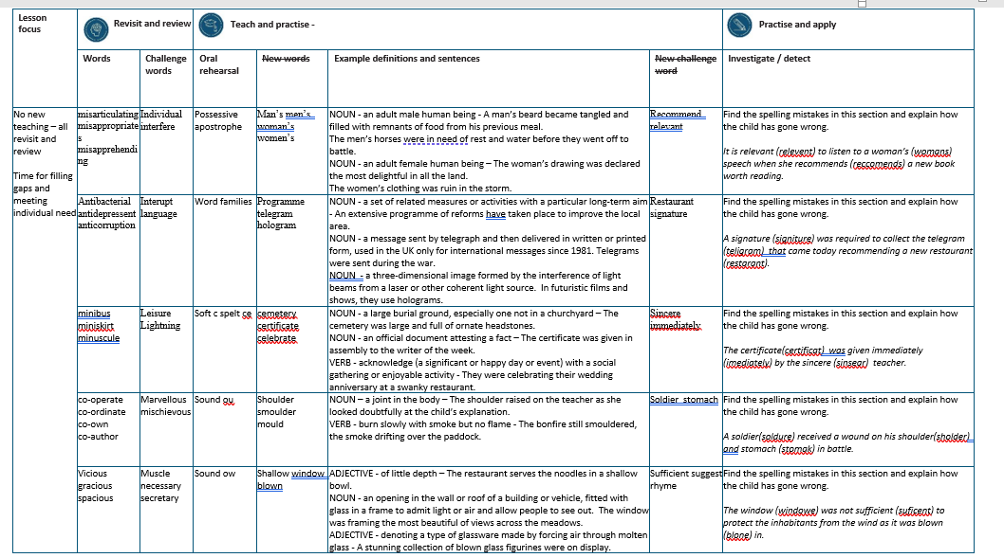

Slide 4
Let’s Revisit and Review…

Slide 5
Do you remember this challenge word?

Slide 6

unique
(adjective)
Every one of us is individual and unique.

Slide 7

interfere
(verb)
Do not interfere with business which doesn’t concern you.

Slide 8
Prefix mis-

Slide 9
mis-
Notes:
Sound of aI

Slide 10
mis- meaning wrongly

Slide 11
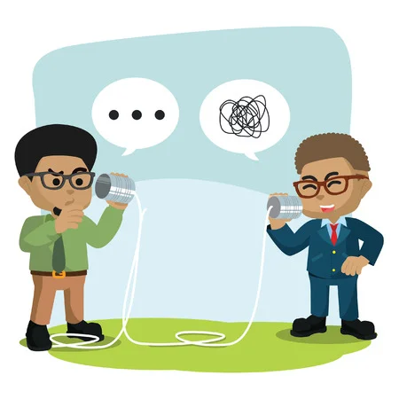
misarticulate

Slide 12
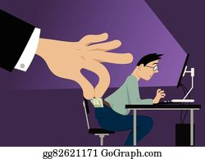
misappropriate

Slide 13

misapprehend

Slide 14
Let’s Teach and Practise

Slide 15
Possessive apostrophe
Plural possessive apostrophe
_’

Slide 16
-’

Slide 17
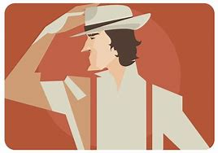
man’s

Slide 18
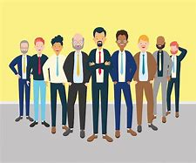
men’s

Slide 19
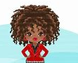
woman’s

Slide 20
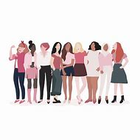
women’s

Slide 21
man’s
man + ’ + s = man’s
NOUN
Definition - an adult male human being
one man owns a hat.

Slide 22
men’s
men + ’ + s = men’s
PLURAL NOUN
Definition – a group of adult male human being
several men own several hats

Slide 23
woman’s
woman + ’ + s = woman’s
NOUN
Definition - an adult female human being
one woman owns a hat

Slide 24
women’s
women + ’ + s = women’s
PLURAL NOUN
Definition – a group of adult female human being
several women own several hats

Slide 25
A man’s beard became tangled and filled with remnants of food from his previous meal.
_____

Slide 26
The men’s horses were in need of rest and water before they went off to battle.
_____

Slide 27
The woman’s drawing was declared the most delightful in all the land.
_______

Slide 28
The women’s clothing was ruin in the storm.
_______

Slide 29
New CHALLENGE words.

Slide 30

recommend
VERB
Definition - - put forward (someone or something) with approval as being suitable for a particular purpose or role

Slide 31
George did recommend that the football team practice more regularly.
_________

Slide 32

relevant
ADJECTIVE
Definition - closely connected or appropriate to what is being done or considered

Slide 33
What small children need is relevant advice on how to behave.
________

Slide 34
Let’s investigate.

Slide 35
Can you spot the spelling errors in these sentences?
Write the correct spelling and explain where they went wrong.

Slide 36
It is relevent to listen to a womans speech when she reccomends a new book worth reading.

Slide 37
It is relevent to listen to a womans speech when she reccomends a new book worth reading.

Slide 38
It is relevent to listen to a womans speech when she reccomends a new book worth reading. relevant – ant not ent

Slide 39
It is relevent to listen to a womans speech when she reccomends a new book worth reading. woman’s – the speech belongs to the woman – single possessive apostrophe

Slide 40
It is relevent to listen to a womans speech when she reccomends a new book worth reading. recommends – prefix re + commends

Slide 41
It is relevant to listen to a woman’s speech when she recommends a new book worth reading.

Slide 42
Year 6 - Spring 1
Week 6 - Tuesday

Slide 44
Let’s Revisit and Review…

Slide 45
Do you remember this challenge word?

Slide 46
Prefixes auto- and anti-

Slide 47
auto-
meaning relating to yourself
Notes:
Sound of aI

Slide 48
anti- meaning against

Slide 49

antibacterial

Slide 50
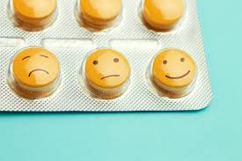
antidepressant

Slide 51
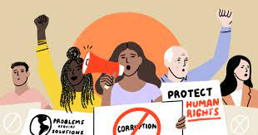
anti-corruption

Slide 52
Let’s Teach and Practise

Slide 53
Word families gram small weight

Slide 54
gram

Slide 55

programme

Slide 56
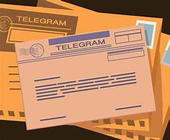
telegram

Slide 57
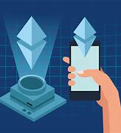
hologram

Slide 58
programme
pro + gram + me = programme
NOUN
Definition - a set of related measures or activities with a particular long-term aim

Slide 59
telegram
tele + gram = telegram
NOUN
Definition – a message sent by telegraph and then delivered in written or printed form, used in the UK only for international messages since 1981.

Slide 60
woman’s
woman + ’ + s = woman’s
NOUN
Definition - a three-dimensional image formed by the interference of light beams from a laser or other coherent light source.

Slide 61
An extensive programme of reforms have taken place to improve the local area.
_________

Slide 62
Telegrams were sent during the war.
_________

Slide 63
In futuristic films and shows, they use holograms.
_________

Slide 64
New CHALLENGE words.

Slide 65

restaurant
NOUN
Definition - a place where people pay to sit and eat meals that are cooked and served on the premises

Slide 66
The restaurant served the best food in London.
__________

Slide 67
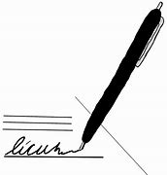
signature
NOUN
Definition - a person's name written in a distinctive way as a form of identification in authorizing a cheque or document or concluding a letter

Slide 68
The signature of a senior manager was used to sign the contract.
_________

Slide 69
Let’s investigate.

Slide 70
Can you spot the spelling errors in these sentences?
Write the correct spelling and explain where they went wrong.

Slide 71
A signiture was required to collect the teligram that came today recommending a new restarant.

Slide 72
A signiture was required to collect the teligram that came today recommending a new restarant.

Slide 73
A signiture was required to collect the teligram that came today recommending a new restarant. signature – a not i vowel

Slide 74
A signiture was required to collect the teligram that came today recommending a new restarant. telegram – tele +gram

Slide 75
A signiture was required to collect the teligram that came today recommending a new restarant. restaurant – au

Slide 76
A signature was required to collect the telegram that came today recommending a new restaurant.

Slide 77
Year 6 - Spring 1
Week 6 - Wednesday

Slide 79
Let’s Revisit and Review…

Slide 80
Do you remember this challenge word?

Slide 81
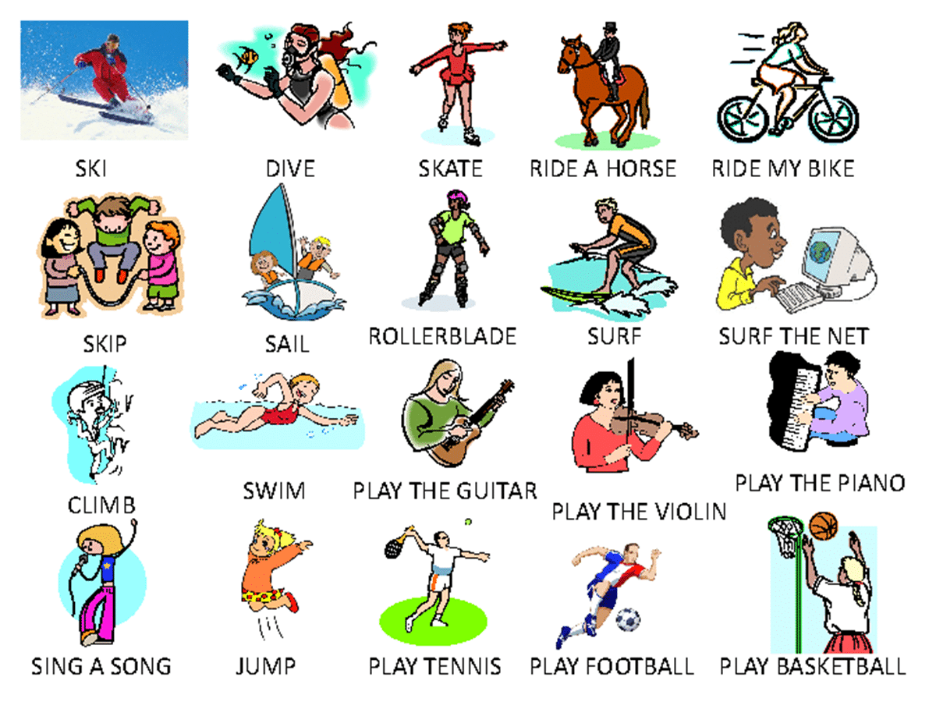
leisure
The most common leisure activity in Britain is going for a walk.

Slide 82
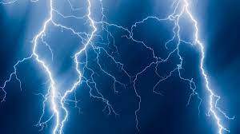
lightning
The tree ignited as it was struck by lightning.

Slide 83
Creating diminutives using prefixes micro- or mini- meaning small.

Slide 84
Prefixes micro- and mini-

Slide 85
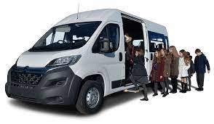
minibus

Slide 86
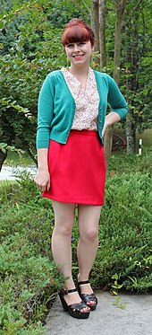
miniskirt

Slide 87
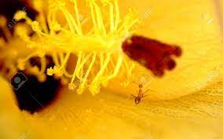
minuscule

Slide 88
Let’s Teach and Practise

Slide 89
Soft c spelt ce

Slide 90
ce

Slide 91
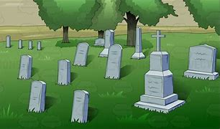
cemetery

Slide 92

certificate

Slide 93
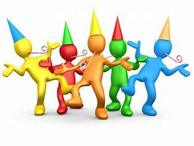
celebrate

Slide 94
cemetery
NOUN
Definition - a large burial ground, especially one not in a churchyard

Slide 95
certificate
NOUN
Definition – an official document attesting a fact

Slide 96
celebrate
VERB
Definition - acknowledge (a significant or happy day or event) with a social gathering or enjoyable activity

Slide 97
The cemetery was large and full of ornate headstones.
________

Slide 98
The certificate was given in assembly to the writer of the week.
_________

Slide 99
They were celebrating their wedding anniversary at a swanky restaurant.
___________

Slide 100
New CHALLENGE words.

Slide 101
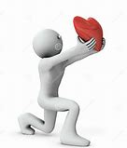
sincere
ADJECTIVE
Definition - free from pretence or deceit; proceeding from genuine feelings

Slide 102
They offer their sincere thanks to their teachers for all the help they gave.
_______

Slide 103

immediately
ADVERB
Definition - at once; instantly

Slide 104
I rang immediately for an ambulance.
___________

Slide 105
Let’s investigate.

Slide 106
Can you spot the spelling errors in these sentences?
Write the correct spelling and explain where they went wrong.

Slide 107
The certificat was given imediately by the sinsear teacher.

Slide 108
The certificat was given imediately by the sinsear teacher.

Slide 109
The certificat was given imediately by the sinsear teacher. certificate – e missing from the split digraph at the end

Slide 110
The certificat was given imediately by the sinsear teacher. immediately – im + mediate + ly

Slide 111
The certificat was given imediately by the sinsear teacher. sincerely – ce soft c sound

Slide 112
The certificate was given immediately by the sincere teacher.

Slide 113
Year 6 - Spring 1
Week 6 - Thursday

Slide 115
Let’s Revisit and Review…

Slide 116
Do you remember this challenge word?

Slide 117

marvellous
We saw the most marvellous firework display.

Slide 118

mischievous
Dave, the mischievous kitten, hid in the basket of clean washing.

Slide 119
To join a prefix ending in a vowel to a root word beginning with a vowel.

Slide 120
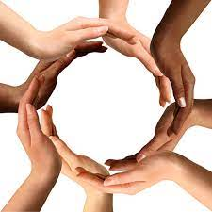
co-operate

Slide 121
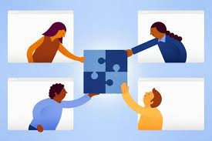
co-ordinate

Slide 122
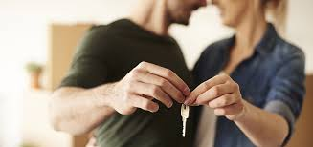
co-own

Slide 123
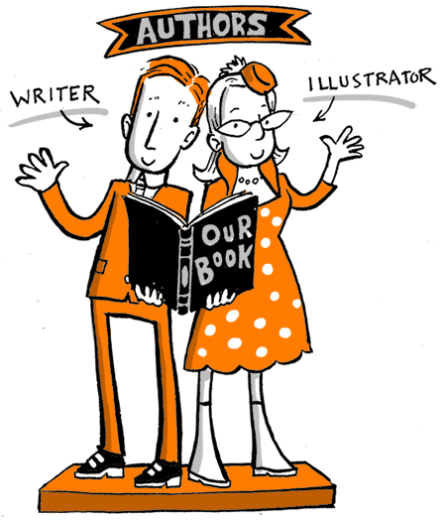
co-author

Slide 124
Let’s Teach and Practise

Slide 125
Sound ou
ou

Slide 126
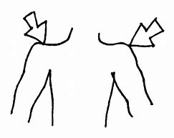
shoulder

Slide 127
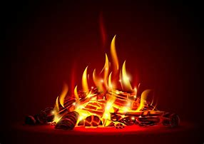
smoulder

Slide 128
shoulder
NOUN
Definition - a joint in the body

Slide 129
smoulder
VERB
Definition – burn slowly with smoke but no flame

Slide 130
The shoulder raised on the teacher as she looked doubtfully at the child’s explanation.
________

Slide 131
The bonfire still smouldered, the smoke drifting over the paddock.
__________

Slide 132
New CHALLENGE words.

Slide 133
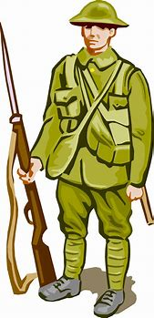
soldier
NOUN
Definition - a person who serves in an army

Slide 134
The soldiers came home from the war victorious.
________

Slide 135
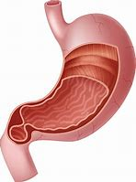
stomach
NOUN
Definition - a saclike expansion of the digestive system, between the esophagus and the small intestine

Slide 136
Their stomach was full from a delightful lunch.
_______

Slide 137
Let’s investigate.

Slide 138
Can you spot the spelling errors in these sentences?
Write the correct spelling and explain where they went wrong.

Slide 139
A soldure received a wound on his sholder and stomak in battle.

Slide 140
A soldure received a wound on his sholder and stomak in battle.

Slide 141
A soldure received a wound on his sholder and stomak in battle. soldier – ire not ure

Slide 142
A soldure received a wound on his sholder and stomak in battle. shoulder – ou not just o

Slide 143
A soldure received a wound on his sholder and stomak in battle. stomach – ch not k

Slide 144
A soldier received a wound on his shoulder and stomach in battle.

Slide 145
Year 6 - Spring 1
Week 6 - Friday

Slide 147
Let’s Revisit and Review…

Slide 148
Do you remember this challenge word?

Slide 149
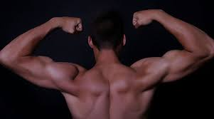
muscle
The athlete was going to the gym to build up muscle.

Slide 150

necessary
Builders require the necessary tools for the job.

Slide 151
the suffix
-cious

Slide 152
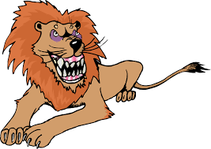
vicious

Slide 153
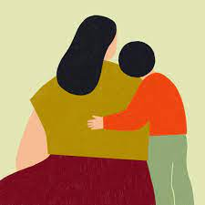
gracious

Slide 154
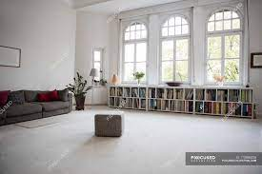
spacious

Slide 155
Let’s Teach and Practise

Slide 156
Sound ow
ow

Slide 157
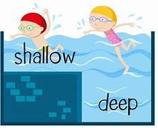
shallow

Slide 158

window

Slide 159
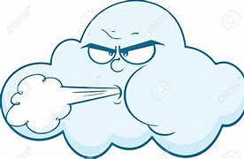
blown

Slide 160
shallow
ADJECTIVE
Definition - of little depth

Slide 161
window
NOUN
Definition – an opening in the wall or roof of a building or vehicle, fitted with glass in a frame to admit light or air and allow people to see out

Slide 162
blown
ADJECTIVE / VERB
Definition – denoting a type of glassware made by forcing air through molten glass OR past tense of to blow

Slide 163
The restaurant serves the noodles in a shallow bowl.
_______

Slide 164
The window was framing the most beautiful of views across the meadows.
______

Slide 165
A stunning collection of blown glass figurines were on display.
_____

Slide 166
New CHALLENGE words.

Slide 167
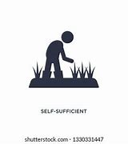
sufficient
ADJECTIVE
Definition - enough; adequate

Slide 168
They had sufficient resources to survive.
__________

Slide 169
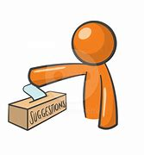
suggest
VERB
Definition - put forward for consideration

Slide 170
I suggest that we wait a day or two.
_______

Slide 171
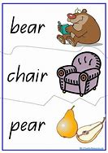
rhyme
NOUN
Definition - correspondence of sound between words or the endings of words, especially when these are used at the ends of lines of poetry

Slide 172
Poetic features include rhythm, rhyme, and alliteration.
_____

Slide 173
Let’s investigate.

Slide 174
Can you spot the spelling errors in these sentences?
Write the correct spelling and explain where they went wrong.

Slide 175
The windowe was not suficent to protect the inhabitants from the wind as it was blone in.

Slide 176
The windowe was not suficent to protect the inhabitants from the wind as it was blone in.

Slide 177
The windowe was not suficent to protect the inhabitants from the wind as it was blone in.
Window – no e on the end

Slide 178
The windowe was not suficent to protect the inhabitants from the wind as it was blone in. sufficient – double f + ient

Slide 179
The windowe was not suficent to protect the inhabitants from the wind as it was blone in. blown – ow sound

Slide 180
The window was not sufficient to protect the inhabitants from the wind as it was blown in.

