Slide 1
Spelling Y6
Mastering spellings: building on the foundations of phonics
Spring 2
Week 1

Slide 2
Year 6 - Spring 2
Week 1 - Monday

Slide 3
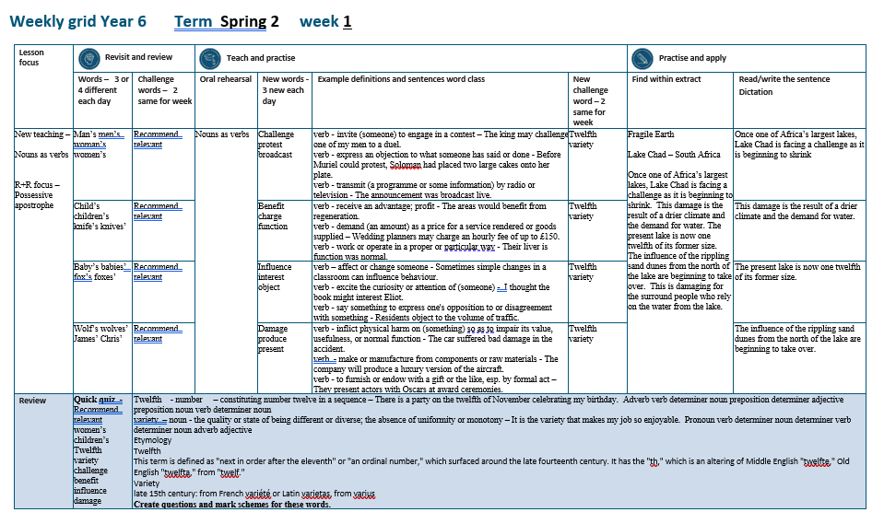

Slide 4
Let’s Revisit and Review…

Slide 5
Do you remember this challenge word?

Slide 6

recommend
VERB
Definition - - put forward (someone or something) with approval as being suitable for a particular purpose or role

Slide 7

relevant
ADJECTIVE
Definition - closely connected or appropriate to what is being done or considered

Slide 8
Possessive apostrophe
Plural possessive apostrophe
_’

Slide 9
-’

Slide 10
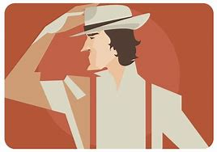
man’s

Slide 11
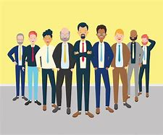
men’s

Slide 12
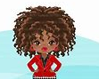
woman’s

Slide 13
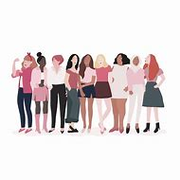
women’s

Slide 14
Let’s Teach and Practise

Slide 15
Nouns as verbs

Slide 16
Noun – person / place / thing
Verb – to do / to be

Slide 17
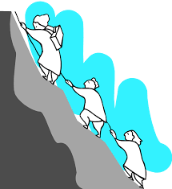
challenge
a challenge = noun
to challenge = verb

Slide 18

protest
a protest = noun
to protest = verb

Slide 19

broadcast
a broadcast = noun
to broadcast = verb

Slide 20
challenge
to challenge
VERB
Definition - invite (someone) to engage in a contest

Slide 21
protest
to protest
VERB
Definition - express an objection to what someone has said or done

Slide 22
broadcast
to broadcast
VERB
Definition - transmit (a programme or some information) by radio or television

Slide 23
The king may challenge one of my men to a duel.
_________

Slide 24
Before Muriel could protest, Soloman had placed two large cakes onto her plate.
_______

Slide 25
The announcement was broadcast live.
_________

Slide 26
New CHALLENGE words.

Slide 27
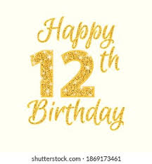
twelfth
NUMBER
Definition - constituting number twelve in a sequence

Slide 28
There is a party on the twelfth of November celebrating my birthday.
_______

Slide 29
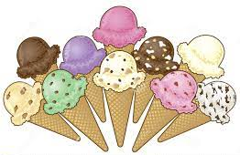
variety
NOUN
Definition - the quality or state of being different or diverse; the absence of uniformity or monotony

Slide 30
It is the variety that makes my job so enjoyable.
_______

Slide 31
Let’s Practise and Apply.

Slide 32
Fragile Earth
Lake Chad – South Africa
Once one of Africa’s largest lakes, Lake Chad is facing a challenge as it is beginning to shrink. This damage is the result of a drier climate and the demand for water. The present lake is now one twelfth of its former size. The influence of the rippling sand dunes from the north of the lake are beginning to take over. This is damaging for the surrounding people who benefit from water at the lake.

Slide 33
Fragile Earth
Lake Chad – South Africa
Once one of Africa’s largest lakes, Lake Chad is facing a challenge as it is beginning to shrink. This damage is the result of a drier climate and the demand for water. The present lake is now one twelfth of its former size. The influence of the rippling sand dunes from the north of the lake are beginning to take over. This is damaging for the surrounding people who benefit from water at the lake.

Slide 34
Write this sentence as I dictate it to you.
Notes:
Once one of Africa’s largest lakes, Lake Chad is facing a challenge as it is beginning to shrink.

Slide 35
Once one of Africa’s largest lakes, Lake Chad is facing a challenge as it is beginning to shrink.
Did you write it correctly?
Edit your work and make sure you have it correct.
Can you underline the spelling word that we have covered in this session?

Slide 36
Year 6 - Spring 2
Week 1 - Tuesday
Notes:
Revisit and review the words from previous teaching and challenge words – I say, we say, you say
Ask children to write words only in their spelling book
Introduce the new spelling rule
Children to write the new spelling rule words and challenge words into books when the sentences are shown with the spelling word missing.
Read the extract with the class as choral reading. Practise model of prosody etc.
Ask children to find the spelling words from the session in the text.
Then read allowed the chosen sentence for children to write fully in their books.
Show the extract and ask children to then edit their work to check they were correct in their dictation.

Slide 38
Let’s Revisit and Review…

Slide 39
Do you remember this challenge word?

Slide 40
recommend
VERB
Definition - - put forward (someone or something) with approval as being suitable for a particular purpose or role

Slide 41
relevant
ADJECTIVE
Definition - closely connected or appropriate to what is being done or considered

Slide 42
Possessive apostrophe
Plural possessive apostrophe
_’

Slide 43
-’

Slide 44
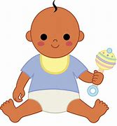
child’s

Slide 45
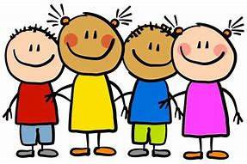
children’s

Slide 46

knife’s

Slide 47

knives’

Slide 48
Let’s Teach and Practise

Slide 49
Nouns as verbs

Slide 50
Noun – person / place / thing
Verb – to do / to be

Slide 51
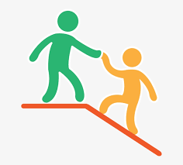
benefit
a benefit = noun
to benefit = verb

Slide 52

charge
a charge = noun
to charge = verb

Slide 53

function
a function = noun
to function = verb

Slide 54
benefit
to benefit
VERB
Definition - receive an advantage; profit

Slide 55
charge
to charge
VERB
Definition - demand (an amount) as a price for a service rendered or goods supplied

Slide 56
function
to function
VERB
Definition - work or operate in a proper or particular way

Slide 57
The areas would benefit from regeneration.
_______

Slide 58
Wedding planners may charge an hourly fee of up to £150.
______

Slide 59
Their liver function was normal.
________

Slide 60
New CHALLENGE words.

Slide 61
twelfth
NUMBER
Definition - constituting number twelve in a sequence

Slide 62
There is a party on the twelfth of November celebrating my birthday.
_______

Slide 63
variety
NOUN
Definition - the quality or state of being different or diverse; the absence of uniformity or monotony

Slide 64
It is the variety that makes my job so enjoyable.
_______

Slide 65
Let’s Practise and Apply.

Slide 66
Fragile Earth
Lake Chad – South Africa
Once one of Africa’s largest lakes, Lake Chad is facing a challenge as it is beginning to shrink. This damage is the result of a drier climate and the demand for water. The present lake is now one twelfth of its former size. The influence of the rippling sand dunes from the north of the lake are beginning to take over. This is damaging for the surrounding people who benefit from water at the lake.

Slide 67
Fragile Earth
Lake Chad – South Africa
Once one of Africa’s largest lakes, Lake Chad is facing a challenge as it is beginning to shrink. This damage is the result of a drier climate and the demand for water. The present lake is now one twelfth of its former size. The influence of the rippling sand dunes from the north of the lake are beginning to take over. This is damaging for the surrounding people who benefit from water at the lake.

Slide 68
Write this sentence as I dictate it to you.
Notes:
This damage is the result of a drier climate and the demand for water.

Slide 69
This damage is the result of a drier climate and the demand for water.
Did you write it correctly?
Edit your work and make sure you have it correct.
Can you underline the spelling word that we have covered in this session?

Slide 70
Year 6 - Spring 2
Week 1 - Wednesday
Notes:
Revisit and review the words from previous teaching and challenge words – I say, we say, you say
Ask children to write words only in their spelling book
Introduce the new spelling rule
Children to write the new spelling rule words and challenge words into books when the sentences are shown with the spelling word missing.
Read the extract with the class as choral reading. Practise model of prosody etc.
Ask children to find the spelling words from the session in the text.
Then read allowed the chosen sentence for children to write fully in their books.
Show the extract and ask children to then edit their work to check they were correct in their dictation.

Slide 72
Let’s Revisit and Review…

Slide 73
Do you remember this challenge word?

Slide 74
recommend
VERB
Definition - - put forward (someone or something) with approval as being suitable for a particular purpose or role

Slide 75
relevant
ADJECTIVE
Definition - closely connected or appropriate to what is being done or considered

Slide 76
Possessive apostrophe
Plural possessive apostrophe
_’

Slide 77
-’

Slide 78
baby’s

Slide 79
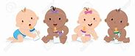
babies’

Slide 80
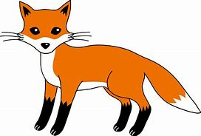
fox’s

Slide 81
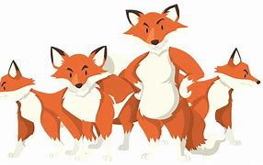
foxes’

Slide 82
Let’s Teach and Practise

Slide 83
Nouns as verbs

Slide 84
Noun – person / place / thing
Verb – to do / to be

Slide 85
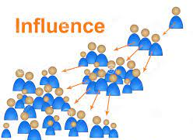
influence
an influence = noun
to influence = verb

Slide 86

interest
the interest = noun
to interest = verb

Slide 87
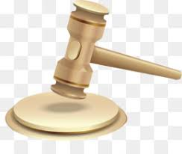
object
an object = noun
to object = verb

Slide 88
influence
to influence
VERB
Definition - affect or change someone

Slide 89
interest
to interest
VERB
Definition - excite the curiosity or attention of (someone)

Slide 90
object
object
VERB
Definition - say something to express one's opposition to or disagreement with something

Slide 91
Sometimes simple changes in a classroom can influence behaviour.
_________

Slide 92
I thought the book might interest Eliot.
________

Slide 93
Residents object to the volume of traffic.
______

Slide 94
New CHALLENGE words.

Slide 95
twelfth
NUMBER
Definition - constituting number twelve in a sequence

Slide 96
There is a party on the twelfth of November celebrating my birthday.
_______

Slide 97
variety
NOUN
Definition - the quality or state of being different or diverse; the absence of uniformity or monotony

Slide 98
It is the variety that makes my job so enjoyable.
_______

Slide 99
Let’s Practise and Apply.

Slide 100
Fragile Earth
Lake Chad – South Africa
Once one of Africa’s largest lakes, Lake Chad is facing a challenge as it is beginning to shrink. This damage is the result of a drier climate and the demand for water. The present lake is now one twelfth of its former size. The influence of the rippling sand dunes from the north of the lake are beginning to take over. This is damaging for the surrounding people who benefit from water at the lake.

Slide 101
Fragile Earth
Lake Chad – South Africa
Once one of Africa’s largest lakes, Lake Chad is facing a challenge as it is beginning to shrink. This damage is the result of a drier climate and the demand for water. The present lake is now one twelfth of its former size. The influence of the rippling sand dunes from the north of the lake are beginning to take over. This is damaging for the surrounding people who benefit from water at the lake.

Slide 102
Write this sentence as I dictate it to you.
Notes:
The present lake is now one twelfth of its former size.

Slide 103
The present lake is now one twelfth of its former size.
Did you write it correctly?
Edit your work and make sure you have it correct.
Can you underline the spelling word that we have covered in this session?

Slide 104
Year 6 - Spring 2
Week 1 - Thursday
Notes:
Revisit and review the words from previous teaching and challenge words – I say, we say, you say
Ask children to write words only in their spelling book
Introduce the new spelling rule
Children to write the new spelling rule words and challenge words into books when the sentences are shown with the spelling word missing.
Read the extract with the class as choral reading. Practise model of prosody etc.
Ask children to find the spelling words from the session in the text.
Then read allowed the chosen sentence for children to write fully in their books.
Show the extract and ask children to then edit their work to check they were correct in their dictation.

Slide 106
Let’s Revisit and Review…

Slide 107
Do you remember this challenge word?

Slide 108
recommend
VERB
Definition - - put forward (someone or something) with approval as being suitable for a particular purpose or role

Slide 109
relevant
ADJECTIVE
Definition - closely connected or appropriate to what is being done or considered

Slide 110
Possessive apostrophe
Plural possessive apostrophe
_’

Slide 111
-’

Slide 112
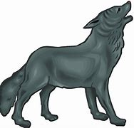
wolf’s

Slide 113
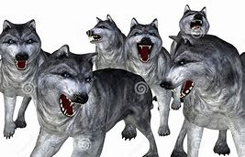
wolves’

Slide 114
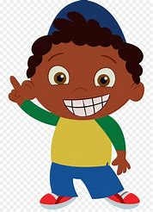
James’

Slide 115
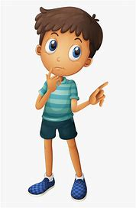
Chris’

Slide 116
Let’s Teach and Practise

Slide 117
Nouns as verbs

Slide 118
Noun – person / place / thing
Verb – to do / to be

Slide 119
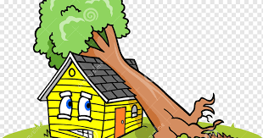
damage
the damage= noun
to damage = verb

Slide 120
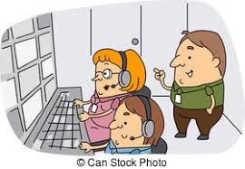
produce
The produce = noun
to produce = verb

Slide 121
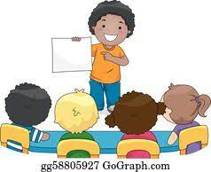
present
a present = noun
to present = verb

Slide 122
damage
to damange
VERB
Definition - inflict physical harm on (something) so as to impair its value, usefulness, or normal function

Slide 123
produce
to produce
VERB
Definition - make or manufacture from components or raw materials

Slide 124
present
to present
VERB
Definition - - to furnish or endow with a gift or the like, esp. by formal act

Slide 125
The tree was to damage the car badly.
______

Slide 126
The company will produce a luxury version of the aircraft.
_______

Slide 127
They present actors with Oscars at award ceremonies.
_______

Slide 128
New CHALLENGE words.

Slide 129
twelfth
NUMBER
Definition - constituting number twelve in a sequence

Slide 130
There is a party on the twelfth of November celebrating my birthday.
_______

Slide 131
variety
NOUN
Definition - the quality or state of being different or diverse; the absence of uniformity or monotony

Slide 132
It is the variety that makes my job so enjoyable.
_______

Slide 133
Let’s Practise and Apply.

Slide 134
Fragile Earth
Lake Chad – South Africa
Once one of Africa’s largest lakes, Lake Chad is facing a challenge as it is beginning to shrink. This damage is the result of a drier climate and the demand for water. The present lake is now one twelfth of its former size. The influence of the rippling sand dunes from the north of the lake are beginning to take over. This is damaging for the surrounding people who benefit from water at the lake.

Slide 135
Fragile Earth
Lake Chad – South Africa
Once one of Africa’s largest lakes, Lake Chad is facing a challenge as it is beginning to shrink. This damage is the result of a drier climate and the demand for water. The present lake is now one twelfth of its former size. The influence of the rippling sand dunes from the north of the lake are beginning to take over. This is damaging for the surrounding people who benefit from water at the lake.

Slide 136
Write this sentence as I dictate it to you.
Notes:
This is damaging for the surrounding people who benefit from water at the lake.

Slide 137
This is damaging for the surrounding people who benefit from water at the lake.
Did you write it correctly?
Edit your work and make sure you have it correct.
Can you underline the spelling word that we have covered in this session?

Slide 138
Year 6 - Spring 2
Week 1 - Friday
Notes:
Click through the slides for all the R+R words for the week (both the focus and the challenge words)
Click through the slides for all the new learning this week

Slide 140
Old challenge words…

Slide 141
relevant

Slide 142
recommend

Slide 143
Old spelling rule words…

Slide 144
man’s

Slide 145
men’s

Slide 146
woman’s

Slide 147
women’s

Slide 148
child’s

Slide 149
children’s

Slide 150
knife’s

Slide 151
knive’s

Slide 152
baby’s

Slide 153
babies’

Slide 154
fox’s

Slide 155
foxes’

Slide 156
wolf’s

Slide 157
wolves’

Slide 158
James’

Slide 159
Chris’

Slide 160
New spelling rule words…

Slide 161
man’s

Slide 162
men’s

Slide 163
woman’s

Slide 164
women’s

Slide 165
child’s

Slide 166
children’s

Slide 167
knife’s

Slide 168
knive’s

Slide 169
baby’s

Slide 170
babies’

Slide 171
fox’s

Slide 172
foxes’

Slide 173
wolf’s

Slide 174
wolves’

Slide 175
James’

Slide 176
Chris’

Slide 177
New challenge words…

Slide 178
twelfth

Slide 179
variety

Slide 180
Quick Quiz time…
Notes:
Say these words for the quiz
Recommend relevant women’s children’s Twelfth variety challenge benefit influence damage

Slide 181
Did you get them correct?
Edit your work.
recommend relevant women’s children’s twelfth variety challenge benefit influence damage

Slide 182
Word class time…

Slide 183
There is a party on the twelfth of November celebrating my birthday.
Adverb verb determiner noun preposition determiner adjective preposition noun verb determiner noun
Notes:
Ask for these words to be classed

Slide 184
It is the variety that makes my job so enjoyable.
Pronoun verb determiner noun determiner verb determiner noun adverb adjective
Notes:
Ask for these words to be classed

Slide 185
Etymology
The history of a word….

Slide 186
twelfth
This term is defined as "next in order after the eleventh" or "an ordinal number," which surfaced around the late fourteenth century. It has the "th," which is an altering of Middle English "twelfte," Old English "twelfta," from "twelf."
variety
late 15th century: from French variété or Latin varietas, from varius

Slide 187
Let’s investigate….
Create questions and mark schemes for these words.

