Slide 1
Spelling Y6
Mastering spellings: building on the foundations of phonics
Spring 2
Week 1

Slide 2
Year 6 - Spring 2
Week 1 - Monday

Slide 3
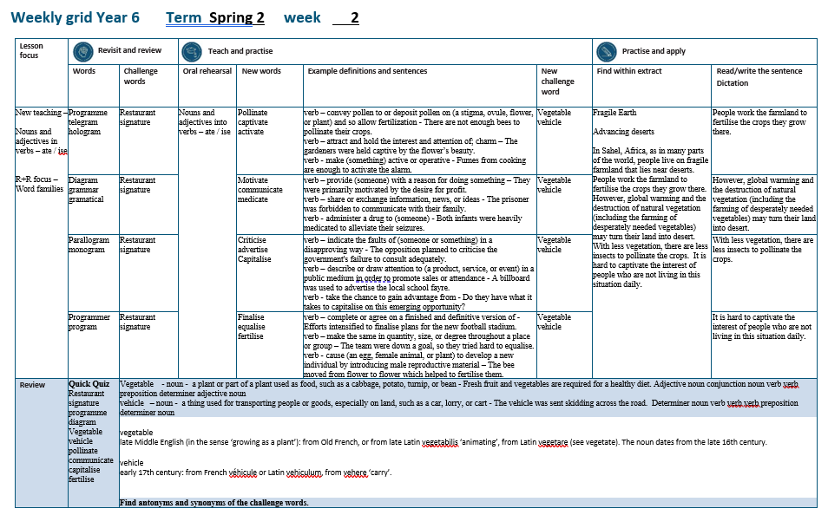

Slide 4
Let’s Revisit and Review…

Slide 5
Do you remember this challenge word?

Slide 6

restaurant
NOUN
Definition - a place where people pay to sit and eat meals that are cooked and served on the premises

Slide 7

signature
NOUN
Definition - a person's name written in a distinctive way as a form of identification in authorizing a cheque or document or concluding a letter

Slide 8
Word families gram small weight

Slide 9
gram

Slide 10

programme

Slide 11

telegram

Slide 12

hologram

Slide 13
Let’s Teach and Practise

Slide 14
Nouns and adjectives into verbs – ate / ise

Slide 15
Noun – person / place / thing
Adjective – describing a noun
Verb – to do / to be

Slide 16
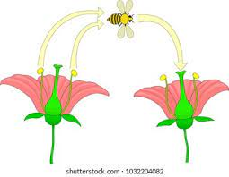
pollinate
the pollen = noun
to pollinate = verb

Slide 17

captivate
a captive = noun
to captivate = verb

Slide 18

activate
active = adjective
to activate = verb

Slide 19
pollinate
Pollen (change the e to i) + ate = pollinate
VERB
Definition - convey pollen to or deposit pollen on (a stigma, ovule, flower, or plant) and so allow fertilisation

Slide 20
captivate
captive (-e) + ate = captivate
VERB
Definition - attract and hold the interest and attention of; charm

Slide 21
activate
active (-e) + ate = activate
VERB
Definition - make (something) active or operative

Slide 22
There are not enough bees to pollinate their crops.
_________

Slide 23
The gardeners were captivated by the flower’s beauty.
__________

Slide 24
Fumes from cooking are enough to activate the alarm.
________

Slide 25
New CHALLENGE words.

Slide 26
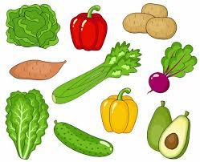
vegetable
NOUN
Definition - a plant or part of a plant used as food, such as a cabbage, potato, turnip, or bean

Slide 27
Fresh fruit and vegetables are required for a healthy diet.
__________

Slide 28
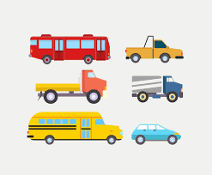
vehicle
NOUN
Definition - a thing used for transporting people or goods, especially on land, such as a car, lorry, or cart

Slide 29
The vehicle was sent skidding across the road.
_______

Slide 30
Let’s Practise and Apply.

Slide 31
Fragile Earth
Advancing deserts
In Sahel, Africa, as in many parts of the world, people live on fragile farmland that lies near deserts. People work the farmland to fertilise the crops they grow there. However, global warming and the destruction of natural vegetation (including the farming of desperately needed vegetables) may turn their land into desert. With less vegetation, there are less insects to pollinate the crops. It is hard to captivate the interest of people who are not living in this situation daily.

Slide 32
Fragile Earth
Advancing deserts
In Sahel, Africa, as in many parts of the world, people live on fragile farmland that lies near deserts. People work the farmland to fertilise the crops they grow there. However, global warming and the destruction of natural vegetation (including the farming of desperately needed vegetables) may turn their land into desert. With less vegetation, there are less insects to pollinate the crops. It is hard to captivate the interest of people who are not living in this situation daily.

Slide 33
Write this sentence as I dictate it to you.
Notes:
People work the farmland to fertilise the crops they grow there.

Slide 34
People work the farmland to fertilise the crops they grow there.
Did you write it correctly?
Edit your work and make sure you have it correct.
Can you underline the spelling word that we have covered in this session?

Slide 35
Year 6 - Spring 2
Week 2 - Tuesday
Notes:
Revisit and review the words from previous teaching and challenge words – I say, we say, you say
Ask children to write words only in their spelling book
Introduce the new spelling rule
Children to write the new spelling rule words and challenge words into books when the sentences are shown with the spelling word missing.
Read the extract with the class as choral reading. Practise model of prosody etc.
Ask children to find the spelling words from the session in the text.
Then read allowed the chosen sentence for children to write fully in their books.
Show the extract and ask children to then edit their work to check they were correct in their dictation.

Slide 37
Let’s Revisit and Review…

Slide 38
Do you remember this challenge word?

Slide 39
restaurant
NOUN
Definition - a place where people pay to sit and eat meals that are cooked and served on the premises

Slide 40
signature
NOUN
Definition - a person's name written in a distinctive way as a form of identification in authorizing a cheque or document or concluding a letter

Slide 41
Word families gram small weight

Slide 42
gram

Slide 43

diagram

Slide 44
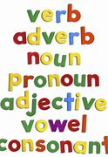
grammar

Slide 45
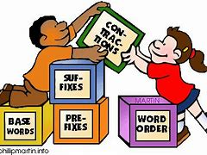
grammatical

Slide 46
Let’s Teach and Practise

Slide 47
Nouns and adjectives into verbs – ate / ise

Slide 48
Noun – person / place / thing
Adjective – describing a noun
Verb – to do / to be

Slide 49
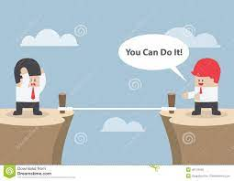
motivate
the motive = noun
to motivate = verb

Slide 50

communicate
the communication = noun
to communicate = verb

Slide 51
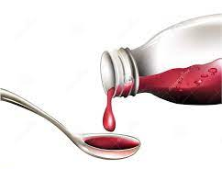
medicate
the medicine = noun
to medicate = verb

Slide 52
motivate
motive (-e) + ate = motivate
VERB
Definition - provide (someone) with a reason for doing something

Slide 53
communicate
communication (-ation) + ate = communicate
VERB
Definition - share or exchange information, news, or ideas

Slide 54
medicate
medicine (-ine) + ate = medicate
VERB
Definition - administer a drug to (someone)

Slide 55
They were primarily motivated by the desire for profit.
_________

Slide 56
The prisoner was forbidden to communicate with their family.
___________

Slide 57
Both infants were heavily medicated to alleviate their seizures.
_________

Slide 58
New CHALLENGE words.

Slide 59
vegetable
NOUN
Definition - a plant or part of a plant used as food, such as a cabbage, potato, turnip, or bean

Slide 60
Fresh fruit and vegetables are required for a healthy diet.
__________

Slide 61
vehicle
NOUN
Definition - a thing used for transporting people or goods, especially on land, such as a car, lorry, or cart

Slide 62
The vehicle was sent skidding across the road.
_______

Slide 63
Let’s Practise and Apply.

Slide 64
Fragile Earth
Advancing deserts
In Sahel, Africa, as in many parts of the world, people live on fragile farmland that lies near deserts. People work the farmland to fertilise the crops they grow there. However, global warming and the destruction of natural vegetation (including the farming of desperately needed vegetables) may turn their land into desert. With less vegetation, there are less insects to pollinate the crops. It is hard to captivate the interest of people who are not living in this situation daily.

Slide 65
Fragile Earth
Advancing deserts
In Sahel, Africa, as in many parts of the world, people live on fragile farmland that lies near deserts. People work the farmland to fertilise the crops they grow there. However, global warming and the destruction of natural vegetation (including the farming of desperately needed vegetables) may turn their land into desert. With less vegetation, there are less insects to pollinate the crops. It is hard to captivate the interest of people who are not living in this situation daily.

Slide 66
Write this sentence as I dictate it to you.
Notes:
However, global warming and the destruction of natural vegetation (including the farming of desperately needed vegetables) may turn their land into desert.

Slide 67
However, global warming and the destruction of natural vegetation (including the farming of desperately needed vegetables) may turn their land into desert.
Did you write it correctly?
Edit your work and make sure you have it correct.
Can you underline the spelling word that we have covered in this session?

Slide 68
Year 6 - Spring 2
Week 2 - Wednesday
Notes:
Revisit and review the words from previous teaching and challenge words – I say, we say, you say
Ask children to write words only in their spelling book
Introduce the new spelling rule
Children to write the new spelling rule words and challenge words into books when the sentences are shown with the spelling word missing.
Read the extract with the class as choral reading. Practise model of prosody etc.
Ask children to find the spelling words from the session in the text.
Then read allowed the chosen sentence for children to write fully in their books.
Show the extract and ask children to then edit their work to check they were correct in their dictation.

Slide 70
Let’s Revisit and Review…

Slide 71
Do you remember this challenge word?

Slide 72
restaurant
NOUN
Definition - a place where people pay to sit and eat meals that are cooked and served on the premises

Slide 73
signature
NOUN
Definition - a person's name written in a distinctive way as a form of identification in authorizing a cheque or document or concluding a letter

Slide 74
Word families gram small weight

Slide 75
gram

Slide 76
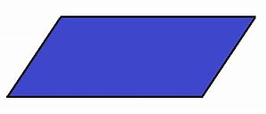
Parallelogram

Slide 77

monogram

Slide 78
Let’s Teach and Practise

Slide 79
Nouns and adjectives into verbs – ate / ise

Slide 80
Noun – person / place / thing
Adjective – describing a noun
Verb – to do / to be

Slide 81
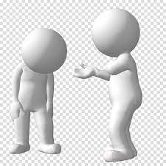
criticise
the critic = noun
to criticise = verb

Slide 82

advertise
an advert = noun
to advertise = verb

Slide 83

capitalise
the capital = adjective
to capitalise = verb

Slide 84
criticise
critic + ise = criticise
VERB
Definition - indicate the faults of (someone or something) in a disapproving way

Slide 85
advertise
advert + ise = advertise
VERB
Definition - describe or draw attention to (a product, service, or event) in a public medium in order to promote sales or attendance

Slide 86
capitalise
capital + ise = capitalise
VERB
Definition - take the chance to gain advantage from

Slide 87
The opposition planned to criticise the government's failure to consult adequately.
_________

Slide 88
A billboard was used to advertise the local school fayre.
_________

Slide 89
Do they have what it takes to capitalise on this emerging opportunity?
__________

Slide 90
New CHALLENGE words.

Slide 91
vegetable
NOUN
Definition - a plant or part of a plant used as food, such as a cabbage, potato, turnip, or bean

Slide 92
Fresh fruit and vegetables are required for a healthy diet.
__________

Slide 93
vehicle
NOUN
Definition - a thing used for transporting people or goods, especially on land, such as a car, lorry, or cart

Slide 94
The vehicle was sent skidding across the road.
_______

Slide 95
Let’s Practise and Apply.

Slide 96
Fragile Earth
Advancing deserts
In Sahel, Africa, as in many parts of the world, people live on fragile farmland that lies near deserts. People work the farmland to fertilise the crops they grow there. However, global warming and the destruction of natural vegetation (including the farming of desperately needed vegetables) may turn their land into desert. With less vegetation, there are less insects to pollinate the crops. It is hard to captivate the interest of people who are not living in this situation daily.

Slide 97
Fragile Earth
Advancing deserts
In Sahel, Africa, as in many parts of the world, people live on fragile farmland that lies near deserts. People work the farmland to fertilise the crops they grow there. However, global warming and the destruction of natural vegetation (including the farming of desperately needed vegetables) may turn their land into desert. With less vegetation, there are less insects to pollinate the crops. It is hard to captivate the interest of people who are not living in this situation daily.

Slide 98
Write this sentence as I dictate it to you.
Notes:
With less vegetation, there are less insects to pollinate the crops.

Slide 99
With less vegetation, there are less insects to pollinate the crops.
Did you write it correctly?
Edit your work and make sure you have it correct.
Can you underline the spelling word that we have covered in this session?

Slide 100
Year 6 - Spring 2
Week 2 - Thursday
Notes:
Revisit and review the words from previous teaching and challenge words – I say, we say, you say
Ask children to write words only in their spelling book
Introduce the new spelling rule
Children to write the new spelling rule words and challenge words into books when the sentences are shown with the spelling word missing.
Read the extract with the class as choral reading. Practise model of prosody etc.
Ask children to find the spelling words from the session in the text.
Then read allowed the chosen sentence for children to write fully in their books.
Show the extract and ask children to then edit their work to check they were correct in their dictation.

Slide 102
Let’s Revisit and Review…

Slide 103
Do you remember this challenge word?

Slide 104
restaurant
NOUN
Definition - a place where people pay to sit and eat meals that are cooked and served on the premises

Slide 105
signature
NOUN
Definition - a person's name written in a distinctive way as a form of identification in authorizing a cheque or document or concluding a letter

Slide 106
Word families gram small weight

Slide 107
gram

Slide 108
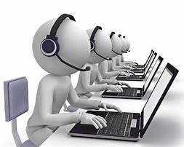
programmer

Slide 109

program

Slide 110
Let’s Teach and Practise

Slide 111
Nouns and adjectives into verbs – ate / ise

Slide 112
Noun – person / place / thing
Adjective – describing a noun
Verb – to do / to be

Slide 113
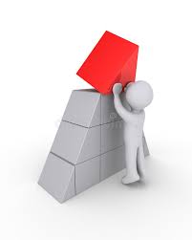
finalise
final = adjective
to finalise = verb

Slide 114
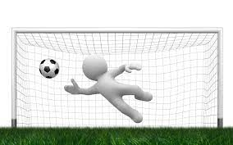
equalise
equal = adjective
to equalise = verb

Slide 115
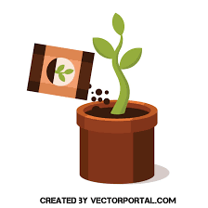
fertilise
fertile = adjective
to fertilise = verb

Slide 116
finalise
final + ise = finalise
VERB
Definition - complete or agree on a finished and definitive version of

Slide 117
equalise
equal + ise = equalise
VERB
Definition - make the same in quantity, size, or degree throughout a place or group

Slide 118
fertilise
fertile (-e) + ise = fertilise
VERB
Definition - cause (an egg, female animal, or plant) to develop a new individual by introducing male reproductive material

Slide 119
Efforts intensified to finalise plans for the new football stadium.
________

Slide 120
The team were down a goal, so they tried hard to equalise.
________

Slide 121
The bee moved from flower to flower which helped to fertilise them.
_________

Slide 122
New CHALLENGE words.

Slide 123
vegetable
NOUN
Definition - a plant or part of a plant used as food, such as a cabbage, potato, turnip, or bean

Slide 124
Fresh fruit and vegetables are required for a healthy diet.
__________

Slide 125
vehicle
NOUN
Definition - a thing used for transporting people or goods, especially on land, such as a car, lorry, or cart

Slide 126
The vehicle was sent skidding across the road.
_______

Slide 127
Let’s Practise and Apply.

Slide 128
Fragile Earth
Advancing deserts
In Sahel, Africa, as in many parts of the world, people live on fragile farmland that lies near deserts. People work the farmland to fertilise the crops they grow there. However, global warming and the destruction of natural vegetation (including the farming of desperately needed vegetables) may turn their land into desert. With less vegetation, there are less insects to pollinate the crops. It is hard to captivate the interest of people who are not living in this situation daily.

Slide 129
Fragile Earth
Advancing deserts
In Sahel, Africa, as in many parts of the world, people live on fragile farmland that lies near deserts. People work the farmland to fertilise the crops they grow there. However, global warming and the destruction of natural vegetation (including the farming of desperately needed vegetables) may turn their land into desert. With less vegetation, there are less insects to pollinate the crops. It is hard to captivate the interest of people who are not living in this situation daily.

Slide 130
Write this sentence as I dictate it to you.
Notes:
It is hard to captivate the interest of people who are not living in this situation daily.

Slide 131
It is hard to captivate the interest of people who are not living in this situation daily.
Did you write it correctly?
Edit your work and make sure you have it correct.
Can you underline the spelling word that we have covered in this session?

Slide 132
Year 6 - Spring 2
Week 2 - Friday
Notes:
Click through the slides for all the R+R words for the week (both the focus and the challenge words)
Click through the slides for all the new learning this week

Slide 134
Old challenge words…

Slide 135
restaurant

Slide 136
signature

Slide 137
Old spelling rule words…

Slide 138
programme

Slide 139
telegram

Slide 140
hologram

Slide 141
diagram

Slide 142
grammar

Slide 143
grammatical

Slide 144
parallelogram

Slide 145
monogram

Slide 146
programmer

Slide 147
program

Slide 148
New spelling rule words…

Slide 149
pollinate

Slide 150
captivate

Slide 151
activate

Slide 152
motivate

Slide 153
communicate

Slide 154
medicate

Slide 155
criticise

Slide 156
advertise

Slide 157
capitalise

Slide 158
finalise

Slide 159
equalise

Slide 160
fertilise

Slide 161
New challenge words…

Slide 162
vegetable

Slide 163
vehicle

Slide 164
Quick Quiz time…
Notes:
Say these words for the quiz
Restaurant signature programme diagram Vegetable vehicle pollinate communicate capitalise fertilise

Slide 165
Did you get them correct?
Edit your work.
restaurant signature programme diagram vegetable vehicle pollinate communicate capitalise fertilise

Slide 166
Word class time…

Slide 167
Fresh fruit and vegetables are required for a healthy diet.
Adjective noun conjunction noun verb verb preposition determiner adjective noun
Notes:
Ask for these words to be classed

Slide 168
The vehicle was sent skidding across the road.
Determiner noun verb verb verb preposition determiner noun
Notes:
Ask for these words to be classed

Slide 169
Etymology
The history of a word….

Slide 170
vegetable
late Middle English (in the sense ‘growing as a plant’): from Old French, or from late Latin vegetabilis ‘animating’, from Latin vegetare (see vegetate). The noun dates from the late 16th century.
vehicle
early 17th century: from French véhicule or Latin vehiculum, from vehere ‘carry’.

Slide 171
Let’s investigate….
Find antonyms and synonyms of the challenge words.

