Slide 1
Spelling Y6
Mastering spellings: building on the foundations of phonics
Spring 2
Week 3

Slide 2
Year 6 - Spring 2
Week 3 - Monday

Slide 3
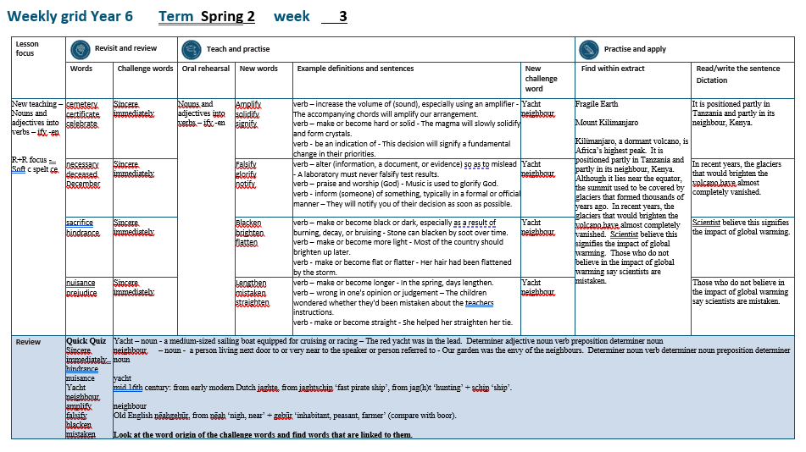

Slide 4
Let’s Revisit and Review…

Slide 5
Do you remember this challenge word?

Slide 6
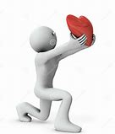
sincere
ADJECTIVE
Definition - free from pretence or deceit; proceeding from genuine feelings

Slide 7
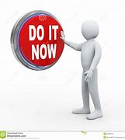
immediately
ADVERB
Definition - at once; instantly

Slide 8
Soft c spelt ce

Slide 9
ce

Slide 10
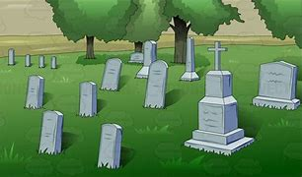
cemetery

Slide 11
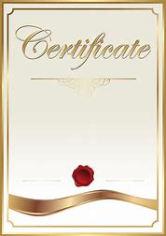
certificate

Slide 12
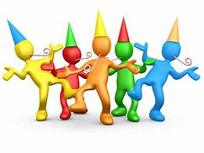
celebrate

Slide 13
Let’s Teach and Practise

Slide 14
Nouns and adjectives into verbs
–fy = to make so
-en

Slide 15
Noun – person / place / thing
Adjective – describing a noun
Verb – to do / to be

Slide 16

amplify
ample = adjective
to amplify = verb

Slide 17
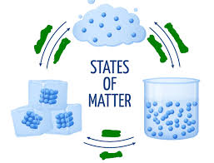
solidify
a solid = noun
to solidify = verb

Slide 18
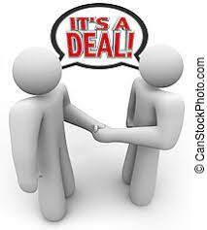
signify
a sign = noun
to signify = verb

Slide 19
amplify
ample (change the e to i) + fy = amplify
VERB
Definition - increase the volume of (sound), especially using an amplifier

Slide 20
solidify
solid (+i) + fy = solidify
VERB
Definition - make or become hard or solid

Slide 21
signify
sign (+i) + fy = signify
VERB
Definition - be an indication of

Slide 22
The accompanying chords will amplify our arrangement.
_______

Slide 23
- The magma will slowly solidify and form crystals.
________

Slide 24
This decision will signify a fundamental change in their priorities.
_______

Slide 25
New CHALLENGE words.

Slide 26
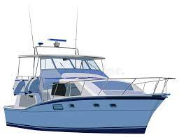
yacht
NOUN
Definition - a medium-sized sailing boat equipped for cruising or racing

Slide 27
The red yacht was in the lead.
_____

Slide 28
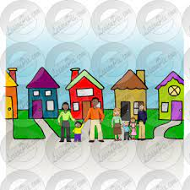
neighbour
NOUN
Definition - a person living next door to or very near to the speaker or person referred to

Slide 29
Our garden was the envy of the neighbours.
__________

Slide 30
Let’s Practise and Apply.

Slide 31
Fragile Earth
Mount Kilimanjaro
Kilimanjaro, a dormant volcano, is Africa’s highest peak. It is positioned partly in Tanzania and partly in its neighbour, Kenya. Although it lies near the equator, the summit used to be covered by glaciers that formed thousands of years ago. In recent years, the glaciers that would brighten the volcano, have almost completely vanished. Scientist believe this does signify the impact of global warming. Those who do not believe in the impact of global warming say scientists are mistaken.

Slide 32
Fragile Earth
Mount Kilimanjaro
Kilimanjaro, a dormant volcano, is Africa’s highest peak. It is positioned partly in Tanzania and partly in its neighbour, Kenya. Although it lies near the equator, the summit used to be covered by glaciers that formed thousands of years ago. In recent years, the glaciers that would brighten the volcano, have almost completely vanished. Scientist believe this does signify the impact of global warming. Those who do not believe in the impact of global warming say scientists are mistaken.

Slide 33
Write this sentence as I dictate it to you.
Notes:
It is positioned partly in Tanzania and partly in its neighbour, Kenya.

Slide 34
It is positioned partly in Tanzania and partly in its neighbour, Kenya.
Did you write it correctly?
Edit your work and make sure you have it correct.
Can you underline the spelling word that we have covered in this session?

Slide 35
Year 6 - Spring 2
Week 3 - Tuesday
Notes:
Revisit and review the words from previous teaching and challenge words – I say, we say, you say
Ask children to write words only in their spelling book
Introduce the new spelling rule
Children to write the new spelling rule words and challenge words into books when the sentences are shown with the spelling word missing.
Read the extract with the class as choral reading. Practise model of prosody etc.
Ask children to find the spelling words from the session in the text.
Then read allowed the chosen sentence for children to write fully in their books.
Show the extract and ask children to then edit their work to check they were correct in their dictation.

Slide 37
Let’s Revisit and Review…

Slide 38
Do you remember this challenge word?

Slide 39
sincere
ADJECTIVE
Definition - free from pretence or deceit; proceeding from genuine feelings

Slide 40
immediately
ADVERB
Definition - at once; instantly

Slide 41
Soft c spelt ce

Slide 42
ce

Slide 43

necessary

Slide 44
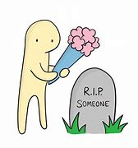
deceased

Slide 45
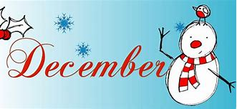
December

Slide 46
Let’s Teach and Practise

Slide 47
Nouns and adjectives into verbs
–fy = to make so
-en

Slide 48
Noun – person / place / thing
Adjective – describing a noun
Verb – to do / to be

Slide 49
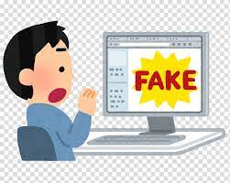
falsify
false = adjective
to falsify = verb

Slide 50
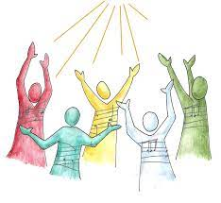
glorify
the glory = noun
to glorify = verb

Slide 51

notify
a note = noun
to notify = verb

Slide 52
falsify
false (change the e to i) + fy = falsify
VERB
Definition - alter (information, a document, or evidence) so as to mislead

Slide 53
glorify
glory (-y +i) + fy = solidify
VERB
Definition - praise and worship (God)

Slide 54
notify
note (-e +i) + fy = notify
VERB
Definition - inform (someone) of something, typically in a formal or official manner

Slide 55
A laboratory must never falsify test results.
_______

Slide 56
Music is used to glorify God.
_______

Slide 57
They will notify you of their decision as soon as possible.
______

Slide 58
New CHALLENGE words.

Slide 59
yacht
NOUN
Definition - a medium-sized sailing boat equipped for cruising or racing

Slide 60
The red yacht was in the lead.
_____

Slide 61
neighbour
NOUN
Definition - a person living next door to or very near to the speaker or person referred to

Slide 62
Our garden was the envy of the neighbours.
__________

Slide 63
Let’s Practise and Apply.

Slide 64
Fragile Earth
Mount Kilimanjaro
Kilimanjaro, a dormant volcano, is Africa’s highest peak. It is positioned partly in Tanzania and partly in its neighbour, Kenya. Although it lies near the equator, the summit used to be covered by glaciers that formed thousands of years ago. In recent years, the glaciers that would brighten the volcano, have almost completely vanished. Scientist believe this does signify the impact of global warming. Those who do not believe in the impact of global warming say scientists are mistaken.

Slide 65
Fragile Earth
Mount Kilimanjaro
Kilimanjaro, a dormant volcano, is Africa’s highest peak. It is positioned partly in Tanzania and partly in its neighbour, Kenya. Although it lies near the equator, the summit used to be covered by glaciers that formed thousands of years ago. In recent years, the glaciers that would brighten the volcano, have almost completely vanished. Scientist believe this does signify the impact of global warming. Those who do not believe in the impact of global warming say scientists are mistaken.

Slide 66
Write this sentence as I dictate it to you.
Notes:
In recent years, the glaciers that would brighten the volcano, have almost completely vanished.

Slide 67
In recent years, the glaciers that would brighten the volcano, have almost completely vanished.
Did you write it correctly?
Edit your work and make sure you have it correct.
Can you underline the spelling word that we have covered in this session?

Slide 68
Year 6 - Spring 2
Week 3 - Wednesday
Notes:
Revisit and review the words from previous teaching and challenge words – I say, we say, you say
Ask children to write words only in their spelling book
Introduce the new spelling rule
Children to write the new spelling rule words and challenge words into books when the sentences are shown with the spelling word missing.
Read the extract with the class as choral reading. Practise model of prosody etc.
Ask children to find the spelling words from the session in the text.
Then read allowed the chosen sentence for children to write fully in their books.
Show the extract and ask children to then edit their work to check they were correct in their dictation.

Slide 70
Let’s Revisit and Review…

Slide 71
Do you remember this challenge word?

Slide 72
sincere
ADJECTIVE
Definition - free from pretence or deceit; proceeding from genuine feelings

Slide 73
immediately
ADVERB
Definition - at once; instantly

Slide 74
Soft c spelt ce

Slide 75
ce

Slide 76
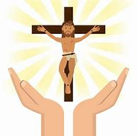
sacrifice

Slide 77
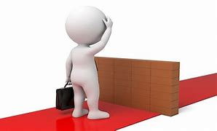
hindrance

Slide 78
Let’s Teach and Practise

Slide 79
Nouns and adjectives into verbs
–fy = to make so
-en

Slide 80
Noun – person / place / thing
Adjective – describing a noun
Verb – to do / to be

Slide 81
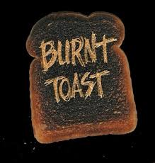
blacken
black = adjective
to blacken = verb

Slide 82
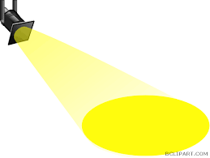
brighten
bright = adjective
to brighten = verb

Slide 83

flatten
flat = adjective
to flatten = verb

Slide 84
blacken
black + en = blacken
VERB
Definition - make or become black or dark, especially as a result of burning, decay, or bruising

Slide 85
brighten
bright + en = brighten
VERB
Definition - make or become more light

Slide 86
flatten
flat (+t) + en = flatten
VERB
Definition - make or become flat or flatter

Slide 87
Stone can blacken by soot over time.
_______

Slide 88
Most of the country should brighten up later.
________

Slide 89
They worried the storm would flatten the fence.
_______

Slide 90
New CHALLENGE words.

Slide 91
yacht
NOUN
Definition - a medium-sized sailing boat equipped for cruising or racing

Slide 92
The red yacht was in the lead.
_____

Slide 93
neighbour
NOUN
Definition - a person living next door to or very near to the speaker or person referred to

Slide 94
Our garden was the envy of the neighbours.
__________

Slide 95
Let’s Practise and Apply.

Slide 96
Fragile Earth
Mount Kilimanjaro
Kilimanjaro, a dormant volcano, is Africa’s highest peak. It is positioned partly in Tanzania and partly in its neighbour, Kenya. Although it lies near the equator, the summit used to be covered by glaciers that formed thousands of years ago. In recent years, the glaciers that would brighten the volcano, have almost completely vanished. Scientist believe this does signify the impact of global warming. Those who do not believe in the impact of global warming say scientists are mistaken.

Slide 97
Fragile Earth
Mount Kilimanjaro
Kilimanjaro, a dormant volcano, is Africa’s highest peak. It is positioned partly in Tanzania and partly in its neighbour, Kenya. Although it lies near the equator, the summit used to be covered by glaciers that formed thousands of years ago. In recent years, the glaciers that would brighten the volcano, have almost completely vanished. Scientist believe this does signify the impact of global warming. Those who do not believe in the impact of global warming say scientists are mistaken.

Slide 98
Write this sentence as I dictate it to you.
Notes:
Scientist believe this does signify the impact of global warming.

Slide 99
Scientist believe this does signify the impact of global warming.
Did you write it correctly?
Edit your work and make sure you have it correct.
Can you underline the spelling word that we have covered in this session?

Slide 100
Year 6 - Spring 2
Week 3 - Thursday
Notes:
Revisit and review the words from previous teaching and challenge words – I say, we say, you say
Ask children to write words only in their spelling book
Introduce the new spelling rule
Children to write the new spelling rule words and challenge words into books when the sentences are shown with the spelling word missing.
Read the extract with the class as choral reading. Practise model of prosody etc.
Ask children to find the spelling words from the session in the text.
Then read allowed the chosen sentence for children to write fully in their books.
Show the extract and ask children to then edit their work to check they were correct in their dictation.

Slide 102
Let’s Revisit and Review…

Slide 103
Do you remember this challenge word?

Slide 104
sincere
ADJECTIVE
Definition - free from pretence or deceit; proceeding from genuine feelings

Slide 105
immediately
ADVERB
Definition - at once; instantly

Slide 106
Soft c spelt ce

Slide 107
ce

Slide 108
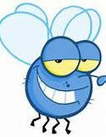
nuisance

Slide 109
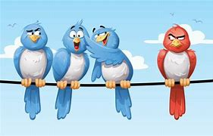
prejudice

Slide 110
Let’s Teach and Practise

Slide 111
Nouns and adjectives into verbs
–fy = to make so
-en

Slide 112
Noun – person / place / thing
Adjective – describing a noun
Verb – to do / to be

Slide 113
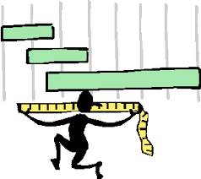
lengthen
the length = noun
to lengthen = verb

Slide 114
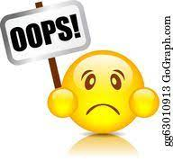
mistaken
a mistake = noun
to mistaken = verb

Slide 115
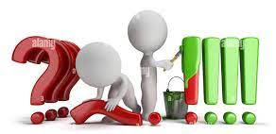
straighten
straight = adjective
to straighten = verb

Slide 116
lengthen
length + en = lengthen
VERB
Definition - make or become longer

Slide 117
mistaken
mistake (-e) + en = mistaken
VERB
Definition - wrong in one's opinion or judgement

Slide 118
straighten
straight + en = straighten
VERB
Definition - make or become straight

Slide 119
In the spring, days lengthen.
________

Slide 120
The children wondered whether they'd been mistaken about the teacher’s instructions.
________

Slide 121
She helped her straighten her tie.
__________

Slide 122
New CHALLENGE words.

Slide 123
yacht
NOUN
Definition - a medium-sized sailing boat equipped for cruising or racing

Slide 124
The red yacht was in the lead.
_____

Slide 125
neighbour
NOUN
Definition - a person living next door to or very near to the speaker or person referred to

Slide 126
Our garden was the envy of the neighbours.
__________

Slide 127
Let’s Practise and Apply.

Slide 128
Fragile Earth
Mount Kilimanjaro
Kilimanjaro, a dormant volcano, is Africa’s highest peak. It is positioned partly in Tanzania and partly in its neighbour, Kenya. Although it lies near the equator, the summit used to be covered by glaciers that formed thousands of years ago. In recent years, the glaciers that would brighten the volcano, have almost completely vanished. Scientist believe this does signify the impact of global warming. Those who do not believe in the impact of global warming say scientists are mistaken.

Slide 129
Fragile Earth
Mount Kilimanjaro
Kilimanjaro, a dormant volcano, is Africa’s highest peak. It is positioned partly in Tanzania and partly in its neighbour, Kenya. Although it lies near the equator, the summit used to be covered by glaciers that formed thousands of years ago. In recent years, the glaciers that would brighten the volcano, have almost completely vanished. Scientist believe this does signify the impact of global warming. Those who do not believe in the impact of global warming say scientists are mistaken.

Slide 130
Write this sentence as I dictate it to you.
Notes:
Those who do not believe in the impact of global warming say scientists are mistaken.

Slide 131
Those who do not believe in the impact of global warming say scientists are mistaken.
Did you write it correctly?
Edit your work and make sure you have it correct.
Can you underline the spelling word that we have covered in this session?

Slide 132
Year 6 - Spring 2
Week 3 - Friday
Notes:
Click through the slides for all the R+R words for the week (both the focus and the challenge words)
Click through the slides for all the new learning this week

Slide 134
Old challenge words…

Slide 135
sincere

Slide 136
immediately

Slide 137
Old spelling rule words…

Slide 138
cemetery

Slide 139
certificate

Slide 140
celebrate

Slide 141
necessary

Slide 142
deceased

Slide 143
December

Slide 144
sacrifice

Slide 145
hindrance

Slide 146
nuisance

Slide 147
prejudice

Slide 148
New spelling rule words…

Slide 149
amplify

Slide 150
solidify

Slide 151
signify

Slide 152
falsify

Slide 153
glorify

Slide 154
notify

Slide 155
blacken

Slide 156
brighten

Slide 157
flatten

Slide 158
lengthen

Slide 159
straighten

Slide 160
mistaken

Slide 161
New challenge words…

Slide 162
yacht

Slide 163
neighbour

Slide 164
Quick Quiz time…
Notes:
Say these words for the quiz
sincere immediately hindrance nuisance yacht neighbour amplify falsify blacken mistaken

Slide 165
Did you get them correct?
Edit your work.
sincere immediately hindrance nuisance yacht neighbour amplify falsify blacken mistaken

Slide 166
Word class time…

Slide 167
The red yacht was in the lead.
Determiner adjective noun verb preposition determiner noun
Notes:
Ask for these words to be classed

Slide 168
Our garden was the envy of the neighbours.
Determiner noun verb determiner noun preposition determiner noun
Notes:
Ask for these words to be classed

Slide 169
Etymology
The history of a word….

Slide 170
yacht
mid 16th century: from early modern Dutch jaghte, from jaghtschip ‘fast pirate ship’, from jag(h)t ‘hunting’ + schip ‘ship’.
neighbour
Old English nēahgebūr, from nēah ‘nigh, near’ + gebūr ‘inhabitant, peasant, farmer’ (compare with boor).

Slide 171
Let’s investigate….
Look at the word origin of the challenge words and find words that are linked to them.

