Slide 1
Spelling Y6
Mastering spellings: building on the foundations of phonics
Spring 2
Week 4

Slide 2
Year 6 - Spring 2
Week 4 - Monday

Slide 3
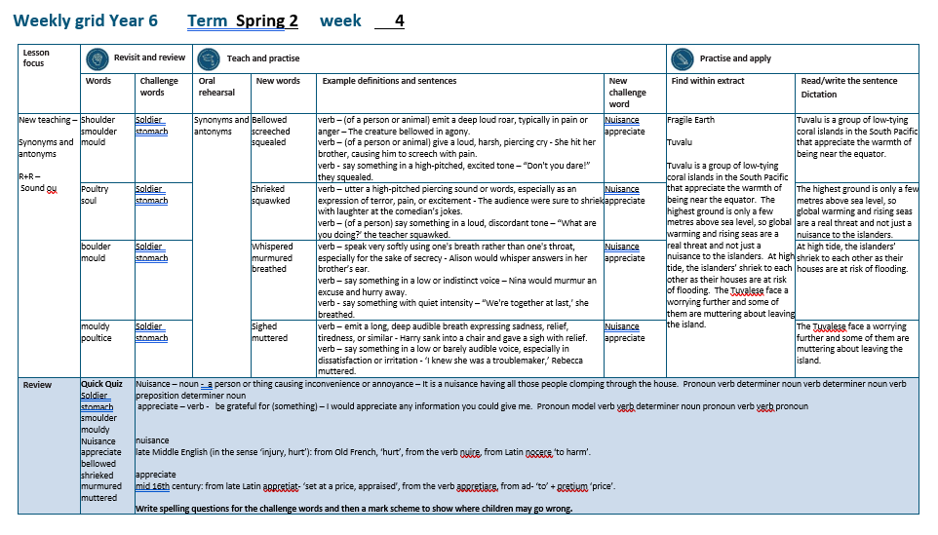

Slide 4
Let’s Revisit and Review…

Slide 5
Do you remember this challenge word?

Slide 6
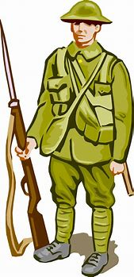
soldier
NOUN
Definition - a person who serves in an army

Slide 7
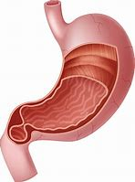
stomach
NOUN
Definition - a saclike expansion of the digestive system, between the esophagus and the small intestine

Slide 8
Sound ou
ou

Slide 9
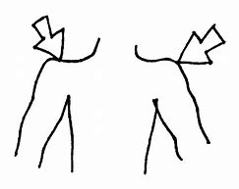
shoulder

Slide 10
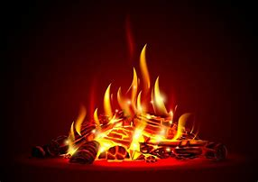
smoulder

Slide 11
Let’s Teach and Practise

Slide 12
Synonyms
Antonyms

Slide 13
Synonym -
a word or phrase that means exactly or nearly the same as another word or phrase in the same language, for example shut is a synonym of close

Slide 14
Antonym -
a word opposite in meaning to another (e.g. bad and good)

Slide 15
Synonyms and Antonyms of…
shouted

Slide 16

bellowed

Slide 17
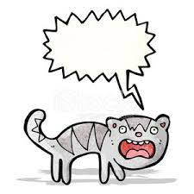
screeched

Slide 18
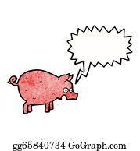
squealed

Slide 19
bellowed
synonym of shouted
VERB
Definition - (of a person or animal) emit a deep loud roar, typically in pain or anger

Slide 20
screeched
synonym of shouted
VERB
Definition - (of a person or animal) give a loud, harsh, piercing cry

Slide 21
squealed
synonym of shouted
VERB
Definition - say something in a high-pitched, excited tone

Slide 22
The creature bellowed in agony.
________

Slide 23
She hit her brother and he screeched with pain.
_________

Slide 24
“Don't you dare!” they squealed.
________

Slide 25
New CHALLENGE words.

Slide 26
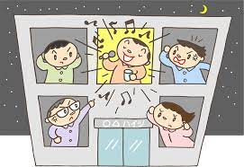
nuisance
NOUN
Definition - a person or thing causing inconvenience or annoyance

Slide 27
It is a nuisance having all those people clomping through the house.
________

Slide 28

appreciate
VERB
Definition - be grateful for (something)

Slide 29
I would appreciate any information you could give me.
__________

Slide 30
Let’s Practise and Apply.

Slide 31
Fragile Earth
Tuvalu
Tuvalu is a group of low-tying coral islands in the South Pacific that appreciate the warmth of being near the equator. The highest ground is only a few metres above sea level, so global warming and rising seas are a real threat and not just a nuisance to the islanders. At high tide, the islanders’ shriek to each other as their houses are at risk of flooding. The Tuvalese face a worrying future and some of them are muttering about leaving the island.

Slide 32
Fragile Earth
Tuvalu
Tuvalu is a group of low-tying coral islands in the South Pacific that appreciate the warmth of being near the equator. The highest ground is only a few metres above sea level, so global warming and rising seas are a real threat and not just a nuisance to the islanders. At high tide, the islanders’ shriek to each other as their houses are at risk of flooding. The Tuvalese face a worrying future and some of them are muttering about leaving the island.

Slide 33
Write this sentence as I dictate it to you.
Notes:
Tuvalu is a group of low-tying coral islands in the South Pacific that appreciate the warmth of being near the equator.

Slide 34
Tuvalu is a group of low-tying coral islands in the South Pacific that appreciate the warmth of being near the equator.
Did you write it correctly?
Edit your work and make sure you have it correct.
Can you underline the spelling word that we have covered in this session?

Slide 35
Year 6 - Spring 2
Week 4 - Tuesday
Notes:
Revisit and review the words from previous teaching and challenge words – I say, we say, you say
Ask children to write words only in their spelling book
Introduce the new spelling rule
Children to write the new spelling rule words and challenge words into books when the sentences are shown with the spelling word missing.
Read the extract with the class as choral reading. Practise model of prosody etc.
Ask children to find the spelling words from the session in the text.
Then read allowed the chosen sentence for children to write fully in their books.
Show the extract and ask children to then edit their work to check they were correct in their dictation.

Slide 37
Let’s Revisit and Review…

Slide 38
Do you remember this challenge word?

Slide 39
soldier
NOUN
Definition - a person who serves in an army

Slide 40
stomach
NOUN
Definition - a saclike expansion of the digestive system, between the oesophagus and the small intestine

Slide 41
Sound ou
ou

Slide 42
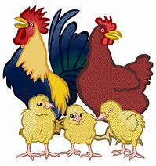
poultry

Slide 43

soul

Slide 44
Let’s Teach and Practise

Slide 45
Synonyms
Antonyms

Slide 46
Synonym -
a word or phrase that means exactly or nearly the same as another word or phrase in the same language, for example shut is a synonym of close

Slide 47
Antonym -
a word opposite in meaning to another (e.g. bad and good)

Slide 48
Synonyms and Antonyms of…
shouted

Slide 49
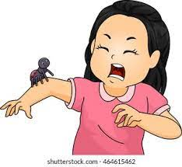
shrieked

Slide 50
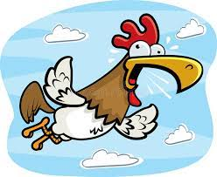
squawked

Slide 51
shrieked
synonym of shouted
VERB
Definition - utter a high-pitched piercing sound or words, especially as an expression of terror, pain, or excitement

Slide 52
squawked
synonym of shouted
VERB
Definition - (of a person) say something in a loud, discordant tone

Slide 53
The audience were sure to shriek with laughter at the comedian’s jokes.
______

Slide 54
“What are you doing?’ the teacher squawked.
________

Slide 55
New CHALLENGE words.

Slide 56
nuisance
NOUN
Definition - a person or thing causing inconvenience or annoyance

Slide 57
It is a nuisance having all those people clomping through the house.
________

Slide 58
appreciate
VERB
Definition - be grateful for (something)

Slide 59
I would appreciate any information you could give me.
__________

Slide 60
Let’s Practise and Apply.

Slide 61
Fragile Earth
Tuvalu
Tuvalu is a group of low-tying coral islands in the South Pacific that appreciate the warmth of being near the equator. The highest ground is only a few metres above sea level, so global warming and rising seas are a real threat and not just a nuisance to the islanders. At high tide, the islanders’ shriek to each other as their houses are at risk of flooding. The Tuvalese face a worrying future and some of them are muttering about leaving the island.

Slide 62
Fragile Earth
Tuvalu
Tuvalu is a group of low-tying coral islands in the South Pacific that appreciate the warmth of being near the equator. The highest ground is only a few metres above sea level, so global warming and rising seas are a real threat and not just a nuisance to the islanders. At high tide, the islanders’ shriek to each other as their houses are at risk of flooding. The Tuvalese face a worrying future and some of them are muttering about leaving the island.

Slide 63
Write this sentence as I dictate it to you.
Notes:
The highest ground is only a few metres above sea level, so global warming and rising seas are a real threat and not just a nuisance to the islanders.

Slide 64
The highest ground is only a few metres above sea level, so global warming and rising seas are a real threat and not just a nuisance to the islanders.
Did you write it correctly?
Edit your work and make sure you have it correct.
Can you underline the spelling word that we have covered in this session?

Slide 65
Year 6 - Spring 2
Week 4 - Wednesday
Notes:
Revisit and review the words from previous teaching and challenge words – I say, we say, you say
Ask children to write words only in their spelling book
Introduce the new spelling rule
Children to write the new spelling rule words and challenge words into books when the sentences are shown with the spelling word missing.
Read the extract with the class as choral reading. Practise model of prosody etc.
Ask children to find the spelling words from the session in the text.
Then read allowed the chosen sentence for children to write fully in their books.
Show the extract and ask children to then edit their work to check they were correct in their dictation.

Slide 67
Let’s Revisit and Review…

Slide 68
Do you remember this challenge word?

Slide 69
soldier
NOUN
Definition - a person who serves in an army

Slide 70
stomach
NOUN
Definition - a saclike expansion of the digestive system, between the esophagus and the small intestine

Slide 71
Sound ou
ou

Slide 72
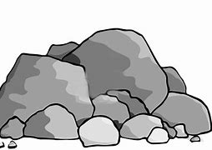
boulder

Slide 73
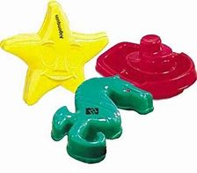
mould

Slide 74
Let’s Teach and Practise

Slide 75
Synonyms
Antonyms

Slide 76
Synonym -
a word or phrase that means exactly or nearly the same as another word or phrase in the same language, for example shut is a synonym of close

Slide 77
Antonym -
a word opposite in meaning to another (e.g. bad and good)

Slide 78
Synonyms and Antonyms of…
shouted

Slide 79
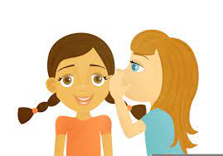
whispered

Slide 80
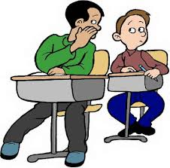
murmured

Slide 81
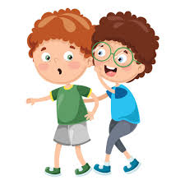
breathed

Slide 82
whispered
antonym of shouted
VERB
Definition - speak very softly using one's breath rather than one's throat, especially for the sake of secrecy

Slide 83
murmured
antonym of shouted
VERB
Definition - say something in a low or indistinct voice

Slide 84
breathed
antonym of shouted
VERB
Definition - say something with quiet intensity

Slide 85
Alison would whisper answers in her brother’s ear.
_______

Slide 86
Nina would murmur an excuse and hurry away.
______

Slide 87
“We're together at last,’ she breathed.
________

Slide 88
New CHALLENGE words.

Slide 89
nuisance
NOUN
Definition - a person or thing causing inconvenience or annoyance

Slide 90
It is a nuisance having all those people clomping through the house.
________

Slide 91
appreciate
VERB
Definition - be grateful for (something)

Slide 92
I would appreciate any information you could give me.
__________

Slide 93
Let’s Practise and Apply.

Slide 94
Fragile Earth
Tuvalu
Tuvalu is a group of low-tying coral islands in the South Pacific that appreciate the warmth of being near the equator. The highest ground is only a few metres above sea level, so global warming and rising seas are a real threat and not just a nuisance to the islanders. At high tide, the islanders’ shriek to each other as their houses are at risk of flooding. The Tuvalese face a worrying future and some of them are muttering about leaving the island.

Slide 95
Fragile Earth
Tuvalu
Tuvalu is a group of low-tying coral islands in the South Pacific that appreciate the warmth of being near the equator. The highest ground is only a few metres above sea level, so global warming and rising seas are a real threat and not just a nuisance to the islanders. At high tide, the islanders’ shriek to each other as their houses are at risk of flooding. The Tuvalese face a worrying future and some of them are muttering about leaving the island.

Slide 96
Write this sentence as I dictate it to you.
Notes:
At high tide, the islanders’ shriek to each other as their houses are at risk of flooding.

Slide 97
At high tide, the islanders’ shriek to each other as their houses are at risk of flooding.
Did you write it correctly?
Edit your work and make sure you have it correct.
Can you underline the spelling word that we have covered in this session?

Slide 98
Year 6 - Spring 2
Week 4 - Thursday
Notes:
Revisit and review the words from previous teaching and challenge words – I say, we say, you say
Ask children to write words only in their spelling book
Introduce the new spelling rule
Children to write the new spelling rule words and challenge words into books when the sentences are shown with the spelling word missing.
Read the extract with the class as choral reading. Practise model of prosody etc.
Ask children to find the spelling words from the session in the text.
Then read allowed the chosen sentence for children to write fully in their books.
Show the extract and ask children to then edit their work to check they were correct in their dictation.

Slide 100
Let’s Revisit and Review…

Slide 101
Do you remember this challenge word?

Slide 102
soldier
NOUN
Definition - a person who serves in an army

Slide 103
stomach
NOUN
Definition - a saclike expansion of the digestive system, between the esophagus and the small intestine

Slide 104
Sound ou
ou

Slide 105
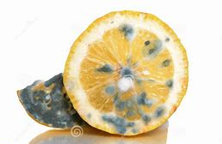
mouldy

Slide 106
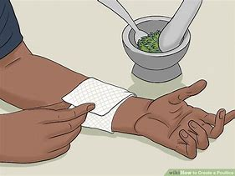
poultice

Slide 107
Let’s Teach and Practise

Slide 108
Synonyms
Antonyms

Slide 109
Synonym -
a word or phrase that means exactly or nearly the same as another word or phrase in the same language, for example shut is a synonym of close

Slide 110
Antonym -
a word opposite in meaning to another (e.g. bad and good)

Slide 111
Synonyms and Antonyms of…
shouted

Slide 112

sighed

Slide 113
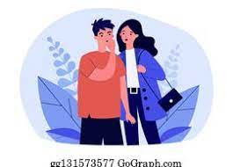
muttered

Slide 114
sighed
antonym of shouted
VERB
Definition - emit a long, deep audible breath expressing sadness, relief, tiredness, or similar

Slide 115
muttered
antonym of shouted
VERB
Definition - say something in a low or barely audible voice, especially in dissatisfaction or irritation

Slide 116
Harry sank into a chair and gave a sigh with relief.
____

Slide 117
‘I knew she was a troublemaker,’ Rebecca muttered.
________

Slide 118
New CHALLENGE words.

Slide 119
nuisance
NOUN
Definition - a person or thing causing inconvenience or annoyance

Slide 120
It is a nuisance having all those people clomping through the house.
________

Slide 121
appreciate
VERB
Definition - be grateful for (something)

Slide 122
I would appreciate any information you could give me.
__________

Slide 123
Let’s Practise and Apply.

Slide 124
Fragile Earth
Tuvalu
Tuvalu is a group of low-tying coral islands in the South Pacific that appreciate the warmth of being near the equator. The highest ground is only a few metres above sea level, so global warming and rising seas are a real threat and not just a nuisance to the islanders. At high tide, the islanders’ shriek to each other as their houses are at risk of flooding. The Tuvalese face a worrying future and some of them are muttering about leaving the island.

Slide 125
Fragile Earth
Tuvalu
Tuvalu is a group of low-tying coral islands in the South Pacific that appreciate the warmth of being near the equator. The highest ground is only a few metres above sea level, so global warming and rising seas are a real threat and not just a nuisance to the islanders. At high tide, the islanders’ shriek to each other as their houses are at risk of flooding. The Tuvalese face a worrying future and some of them are muttering about leaving the island.

Slide 126
Write this sentence as I dictate it to you.
Notes:
The Tuvalese face a worrying further and some of them are muttering about leaving the island.

Slide 127
The Tuvalese face a worrying future and some of them are muttering about leaving the island.
Did you write it correctly?
Edit your work and make sure you have it correct.
Can you underline the spelling word that we have covered in this session?

Slide 128
Year 6 - Spring 2
Week 4 - Friday
Notes:
Click through the slides for all the R+R words for the week (both the focus and the challenge words)
Click through the slides for all the new learning this week

Slide 130
Old challenge words…

Slide 131
soldier

Slide 132
stomach

Slide 133
Old spelling rule words…

Slide 134
shoulder

Slide 135
smoulder

Slide 136
poultry

Slide 137
soul

Slide 138
boulder

Slide 139
mould

Slide 140
mouldy

Slide 141
poultice

Slide 142
New spelling rule words…

Slide 143
bellowed

Slide 144
screeched

Slide 145
squealed

Slide 146
shrieked

Slide 147
squawked

Slide 148
whispered

Slide 149
murmured

Slide 150
breathed

Slide 151
sighed

Slide 152
muttered

Slide 153
New challenge words…

Slide 154
nuisance

Slide 155
appreciate

Slide 156
Quick Quiz time…
Notes:
Say these words for the quiz
soldier stomach smoulder mouldy nuisance appreciate bellowed shrieked murmured muttered

Slide 157
Did you get them correct?
Edit your work.
soldier stomach smoulder mouldy nuisance appreciate bellowed shrieked murmured muttered

Slide 158
Word class time…

Slide 159
It is a nuisance having all those people clomping through the house.
Pronoun verb determiner noun verb determiner noun verb preposition determiner noun
Notes:
Ask for these words to be classed

Slide 160
I would appreciate any information you could give me.
Pronoun model verb verb determiner noun pronoun verb verb pronoun
Notes:
Ask for these words to be classed

Slide 161
Etymology
The history of a word….

Slide 162
nuisance
late Middle English (in the sense ‘injury, hurt’): from Old French, ‘hurt’, from the verb nuire, from Latin nocere ‘to harm’.
appreciate
mid 16th century: from late Latin appretiat- ‘set at a price, appraised’, from the verb appretiare, from ad- ‘to’ + pretium ‘price’.

Slide 163
Let’s investigate….
Write spelling questions for the challenge words and then a mark scheme to show where children may go wrong.

