Slide 1
Spelling Y6
Mastering spellings: building on the foundations of phonics
Spring 2
Week 5

Slide 2
Year 6 - Spring 2
Week 5 - Monday

Slide 3
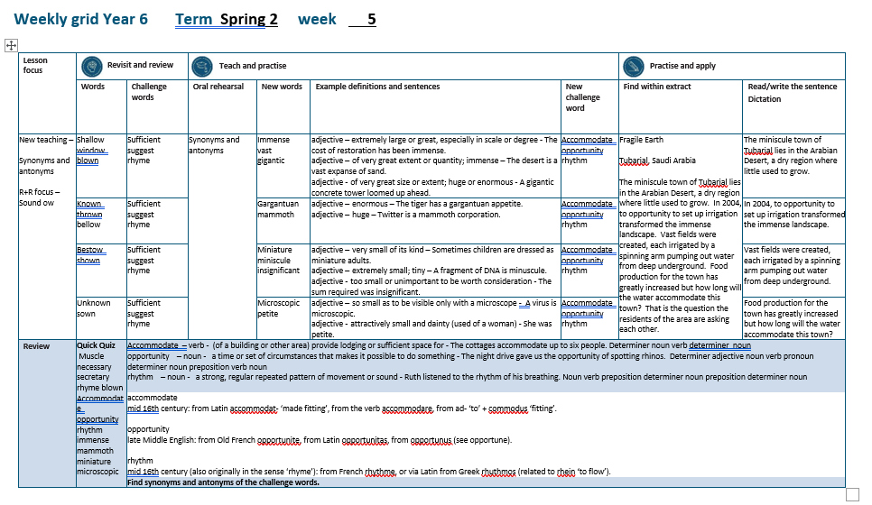

Slide 4
Let’s Revisit and Review…

Slide 5
Do you remember this challenge word?

Slide 6
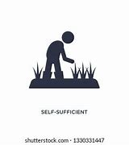
sufficient
ADJECTIVE
Definition - enough; adequate

Slide 7
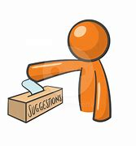
suggest
VERB
Definition - put forward for consideration

Slide 8
Sound ow
ow

Slide 9
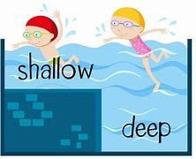
shallow

Slide 10

window

Slide 11
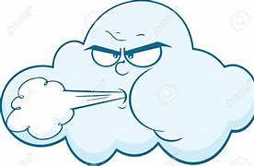
blown

Slide 12
Let’s Teach and Practise

Slide 13
Synonyms
Antonyms

Slide 14
Synonym -
a word or phrase that means exactly or nearly the same as another word or phrase in the same language, for example shut is a synonym of close

Slide 15
Antonym -
a word opposite in meaning to another (e.g. bad and good)

Slide 16
Synonyms and Antonyms of…
big

Slide 17
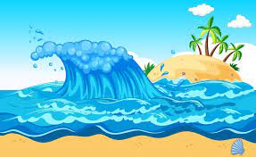
immense

Slide 18
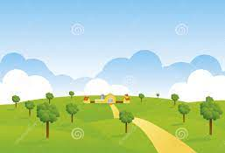
vast

Slide 19
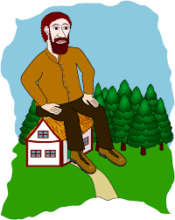
gigantic

Slide 20
immense
synonym of big
ADJECTIVE
Definition - extremely large or great, especially in scale or degree

Slide 21
vast
synonym of big
ADJECTIVE
Definition - of very great extent or quantity

Slide 22
gigantic
synonym of big
ADJECTIVE
Definition - of very great size or extent; huge or enormous

Slide 23
The cost of restoration has been immense.
_______

Slide 24
The desert is a vast expanse of sand.
____

Slide 25
A gigantic concrete tower loomed up ahead.
________

Slide 26
New CHALLENGE words.

Slide 27
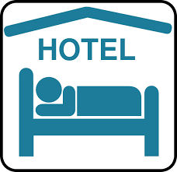
accommodate
VERB
Definition - (of a building or other area) provide lodging or sufficient space for

Slide 28
The cottages accommodate up to six people.
___________

Slide 29
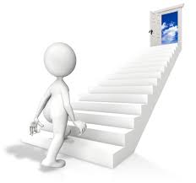
opportunity
NOUN
Definition - a time or set of circumstances that makes it possible to do something

Slide 30
The night drive gave us the opportunity of spotting rhinos.
___________

Slide 31

rhythm
NOUN
Definition - a strong, regular repeated pattern of movement or sound

Slide 32
Ruth listened to the rhythm of his breathing.
______

Slide 33
Let’s Practise and Apply.

Slide 34
Fragile Earth
Tubarjal, Saudi Arabia
The miniscule town of Tubarjal lies in the Arabian Desert, a dry region where little used to grow. In 2004, to opportunity to set up irrigation transformed the immense landscape. Vast fields were created, each irrigated by a spinning arm pumping out water from deep underground. Food production for the town has greatly increased but how long will the water accommodate this town? That is the question the residents of the area are asking each other.

Slide 35
Fragile Earth
Tubarjal, Saudi Arabia
The miniscule town of Tubarjal lies in the Arabian Desert, a dry region where little used to grow. In 2004, to opportunity to set up irrigation transformed the immense landscape. Vast fields were created, each irrigated by a spinning arm pumping out water from deep underground. Food production for the town has greatly increased but how long will the water accommodate this town? That is the question the residents of the area are asking each other.

Slide 36
Write this sentence as I dictate it to you.
Notes:
The miniscule town of Tubarjal lies in the Arabian Desert, a dry region where little used to grow.

Slide 37
The miniscule town of Tubarjal lies in the Arabian Desert, a dry region where little used to grow.
Did you write it correctly?
Edit your work and make sure you have it correct.
Can you underline the spelling word that we have covered in this session?

Slide 38
Year 6 - Spring 2
Week 5 - Tuesday
Notes:
Revisit and review the words from previous teaching and challenge words – I say, we say, you say
Ask children to write words only in their spelling book
Introduce the new spelling rule
Children to write the new spelling rule words and challenge words into books when the sentences are shown with the spelling word missing.
Read the extract with the class as choral reading. Practise model of prosody etc.
Ask children to find the spelling words from the session in the text.
Then read allowed the chosen sentence for children to write fully in their books.
Show the extract and ask children to then edit their work to check they were correct in their dictation.

Slide 40
Let’s Revisit and Review…

Slide 41
Do you remember this challenge word?

Slide 42
sufficient
ADJECTIVE
Definition - enough; adequate

Slide 43
suggest
VERB
Definition - put forward for consideration

Slide 44
Sound ow
ow

Slide 45

known

Slide 46
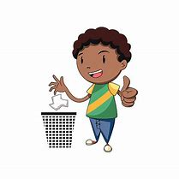
thrown

Slide 47

bellow

Slide 48
Let’s Teach and Practise

Slide 49
Synonyms
Antonyms

Slide 50
Synonym -
a word or phrase that means exactly or nearly the same as another word or phrase in the same language, for example shut is a synonym of close

Slide 51
Antonym -
a word opposite in meaning to another (e.g. bad and good)

Slide 52
Synonyms and Antonyms of…
big

Slide 53
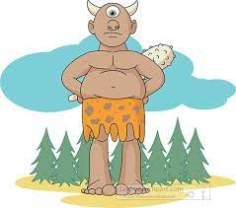
gargantuan

Slide 54
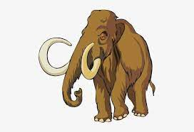
mammoth

Slide 55
gargantuan
synonym of big
ADJECTIVE
Definition - enormous

Slide 56
MAMMOTH
synonym of big
ADJECTIVE
Definition - huge

Slide 57
The tiger has a gargantuan appetite.
__________

Slide 58
Twitter is a mammoth corporation.
_______

Slide 59
New CHALLENGE words.

Slide 60
accommodate
VERB
Definition - (of a building or other area) provide lodging or sufficient space for

Slide 61
The cottages accommodate up to six people.
___________

Slide 62
opportunity
NOUN
Definition - a time or set of circumstances that makes it possible to do something

Slide 63
The night drive gave us the opportunity of spotting rhinos.
___________

Slide 64
rhythm
NOUN
Definition - a strong, regular repeated pattern of movement or sound

Slide 65
Ruth listened to the rhythm of his breathing.
______

Slide 66
Let’s Practise and Apply.

Slide 67
Fragile Earth
Tubarjal, Saudi Arabia
The miniscule town of Tubarjal lies in the Arabian Desert, a dry region where little used to grow. In 2004, to opportunity to set up irrigation transformed the immense landscape. Vast fields were created, each irrigated by a spinning arm pumping out water from deep underground. Food production for the town has greatly increased but how long will the water accommodate this town? That is the question the residents of the area are asking each other.

Slide 68
Fragile Earth
Tubarjal, Saudi Arabia
The miniscule town of Tubarjal lies in the Arabian Desert, a dry region where little used to grow. In 2004, to opportunity to set up irrigation transformed the immense landscape. Vast fields were created, each irrigated by a spinning arm pumping out water from deep underground. Food production for the town has greatly increased but how long will the water accommodate this town? That is the question the residents of the area are asking each other.

Slide 69
Write this sentence as I dictate it to you.
Notes:
In 2004, to opportunity to set up irrigation transformed the immense landscape.

Slide 70
In 2004, to opportunity to set up irrigation transformed the immense landscape.
Did you write it correctly?
Edit your work and make sure you have it correct.
Can you underline the spelling word that we have covered in this session?

Slide 71
Year 6 - Spring 2
Week 5 - Wednesday
Notes:
Revisit and review the words from previous teaching and challenge words – I say, we say, you say
Ask children to write words only in their spelling book
Introduce the new spelling rule
Children to write the new spelling rule words and challenge words into books when the sentences are shown with the spelling word missing.
Read the extract with the class as choral reading. Practise model of prosody etc.
Ask children to find the spelling words from the session in the text.
Then read allowed the chosen sentence for children to write fully in their books.
Show the extract and ask children to then edit their work to check they were correct in their dictation.

Slide 73
Let’s Revisit and Review…

Slide 74
Do you remember this challenge word?

Slide 75
sufficient
ADJECTIVE
Definition - enough; adequate

Slide 76
suggest
VERB
Definition - put forward for consideration

Slide 77
Sound ow
ow

Slide 78

bestow

Slide 79
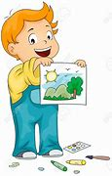
shown

Slide 80
Let’s Teach and Practise

Slide 81
Synonyms
Antonyms

Slide 82
Synonym -
a word or phrase that means exactly or nearly the same as another word or phrase in the same language, for example shut is a synonym of close

Slide 83
Antonym -
a word opposite in meaning to another (e.g. bad and good)

Slide 84
Synonyms and Antonyms of…
big

Slide 85
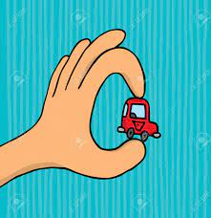
miniature

Slide 86
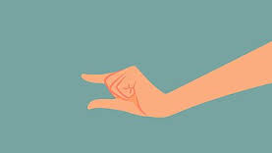
miniscule

Slide 87
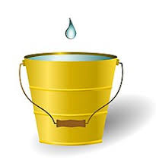
insignificant

Slide 88
miniature
antonym of big
ADJECTIVE
Definition - very small of its kind

Slide 89
miniscule
antonym of big
ADJECTIVE
Definition - extremely small; tiny

Slide 90
insignificant
antonym of big
ADJECTIVE
Definition - too small or unimportant to be worth consideration

Slide 91
Sometimes children are dressed as miniature adults.
_________

Slide 92
A fragment of DNA is minuscule.
_________

Slide 93
The sum required was insignificant.
_____________

Slide 94
New CHALLENGE words.

Slide 95
accommodate
VERB
Definition - (of a building or other area) provide lodging or sufficient space for

Slide 96
The cottages accommodate up to six people.
___________

Slide 97
opportunity
NOUN
Definition - a time or set of circumstances that makes it possible to do something

Slide 98
The night drive gave us the opportunity of spotting rhinos.
___________

Slide 99
rhythm
NOUN
Definition - a strong, regular repeated pattern of movement or sound

Slide 100
Ruth listened to the rhythm of his breathing.
______

Slide 101
Let’s Practise and Apply.

Slide 102
Fragile Earth
Tubarjal, Saudi Arabia
The miniscule town of Tubarjal lies in the Arabian Desert, a dry region where little used to grow. In 2004, to opportunity to set up irrigation transformed the immense landscape. Vast fields were created, each irrigated by a spinning arm pumping out water from deep underground. Food production for the town has greatly increased but how long will the water accommodate this town? That is the question the residents of the area are asking each other.

Slide 103
Fragile Earth
Tubarjal, Saudi Arabia
The miniscule town of Tubarjal lies in the Arabian Desert, a dry region where little used to grow. In 2004, to opportunity to set up irrigation transformed the immense landscape. Vast fields were created, each irrigated by a spinning arm pumping out water from deep underground. Food production for the town has greatly increased but how long will the water accommodate this town? That is the question the residents of the area are asking each other.

Slide 104
Write this sentence as I dictate it to you.
Notes:
Vast fields were created, each irrigated by a spinning arm pumping out water from deep underground.

Slide 105
Vast fields were created, each irrigated by a spinning arm pumping out water from deep underground.
Did you write it correctly?
Edit your work and make sure you have it correct.
Can you underline the spelling word that we have covered in this session?

Slide 106
Year 6 - Spring 2
Week 5 - Thursday
Notes:
Revisit and review the words from previous teaching and challenge words – I say, we say, you say
Ask children to write words only in their spelling book
Introduce the new spelling rule
Children to write the new spelling rule words and challenge words into books when the sentences are shown with the spelling word missing.
Read the extract with the class as choral reading. Practise model of prosody etc.
Ask children to find the spelling words from the session in the text.
Then read allowed the chosen sentence for children to write fully in their books.
Show the extract and ask children to then edit their work to check they were correct in their dictation.

Slide 108
Let’s Revisit and Review…

Slide 109
Do you remember this challenge word?

Slide 110
sufficient
ADJECTIVE
Definition - enough; adequate

Slide 111
suggest
VERB
Definition - put forward for consideration

Slide 112
Sound ow
ow

Slide 113

unknown

Slide 114
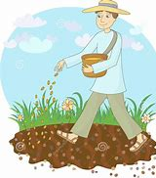
sown

Slide 115
Let’s Teach and Practise

Slide 116
Synonyms
Antonyms

Slide 117
Synonym -
a word or phrase that means exactly or nearly the same as another word or phrase in the same language, for example shut is a synonym of close

Slide 118
Antonym -
a word opposite in meaning to another (e.g. bad and good)

Slide 119
Synonyms and Antonyms of…
big

Slide 120

microscopic

Slide 121
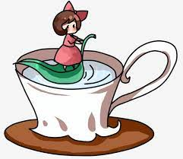
petite

Slide 122
microscopic
antonym of big
ADJECTIVE
Definition - so small as to be visible only with a microscope

Slide 123
petite
antonym of big
ADJECTIVE
Definition - attractively small and dainty (used of a woman)

Slide 124
A virus is microscopic.
___________

Slide 125
She was petite.
______

Slide 126
New CHALLENGE words.

Slide 127
accommodate
VERB
Definition - (of a building or other area) provide lodging or sufficient space for

Slide 128
The cottages accommodate up to six people.
___________

Slide 129
opportunity
NOUN
Definition - a time or set of circumstances that makes it possible to do something

Slide 130
The night drive gave us the opportunity of spotting rhinos.
___________

Slide 131
rhythm
NOUN
Definition - a strong, regular repeated pattern of movement or sound

Slide 132
Ruth listened to the rhythm of his breathing.
______

Slide 133
Let’s Practise and Apply.

Slide 134
Fragile Earth
Tubarjal, Saudi Arabia
The miniscule town of Tubarjal lies in the Arabian Desert, a dry region where little used to grow. In 2004, to opportunity to set up irrigation transformed the immense landscape. Vast fields were created, each irrigated by a spinning arm pumping out water from deep underground. Food production for the town has greatly increased but how long will the water accommodate this town? That is the question the residents of the area are asking each other.

Slide 135
Fragile Earth
Tubarjal, Saudi Arabia
The miniscule town of Tubarjal lies in the Arabian Desert, a dry region where little used to grow. In 2004, to opportunity to set up irrigation transformed the immense landscape. Vast fields were created, each irrigated by a spinning arm pumping out water from deep underground. Food production for the town has greatly increased but how long will the water accommodate this town? That is the question the residents of the area are asking each other.

Slide 136
Write this sentence as I dictate it to you.
Notes:
Food production for the town has greatly increased but how long will the water accommodate this town?

Slide 137
Food production for the town has greatly increased but how long will the water accommodate this town?
Did you write it correctly?
Edit your work and make sure you have it correct.
Can you underline the spelling word that we have covered in this session?

Slide 138
Year 6 - Spring 2
Week 5 - Friday
Notes:
Click through the slides for all the R+R words for the week (both the focus and the challenge words)
Click through the slides for all the new learning this week

Slide 140
Old challenge words…

Slide 141
sufficient

Slide 142
suggest

Slide 143
rhyme

Slide 144
Old spelling rule words…

Slide 145
shallow

Slide 146
window

Slide 147
blown

Slide 148
known

Slide 149
thrown

Slide 150
below

Slide 151
bestow

Slide 152
shown

Slide 153
unknown

Slide 154
sown

Slide 155
New spelling rule words…

Slide 156
immense

Slide 157
vast

Slide 158
gigantic

Slide 159
gargantuan

Slide 160
mammoth

Slide 161
miniature

Slide 162
miniscule

Slide 163
insignificant

Slide 164
microscopic

Slide 165
petite

Slide 166
New challenge words…

Slide 167
accommodate

Slide 168
opportunity

Slide 169
rhythm

Slide 170
Quick Quiz time…
Notes:
Say these words for the quiz
muscle necessary secretary rhyme blown accommodate opportunity rhythm immense mammoth miniature microscopic

Slide 171
Did you get them correct?
Edit your work.
muscle necessary secretary rhyme blown accommodate opportunity rhythm immense mammoth miniature microscopic

Slide 172
Word class time…

Slide 173
The cottages accommodate up to six people.
Determiner noun verb determiner noun
Notes:
Ask for these words to be classed

Slide 174
The night drive gave us the opportunity of spotting rhinos.
Determiner adjective noun verb pronoun determiner noun preposition verb noun
Notes:
Ask for these words to be classed

Slide 175
Ruth listened to the rhythm of his breathing.
Noun verb preposition determiner noun preposition determiner noun
Notes:
Ask for these words to be classed

Slide 176
Etymology
The history of a word….

Slide 177
Accommodate
mid 16th century: from Latin accommodat- ‘made fitting’, from the verb accommodare, from ad- ‘to’ + commodus ‘fitting’.
Opportunity
late Middle English: from Old French opportunite, from Latin opportunitas, from opportunus (see opportune).
Rhythm
mid 16th century (also originally in the sense ‘rhyme’): from French rhythme, or via Latin from Greek rhuthmos (related to rhein ‘to flow’).

Slide 178
Let’s investigate….
Find synonyms and antonyms of the challenge words.

