Slide 1
Spelling Y6
Mastering spellings: building on the foundations of phonics
Spring 2
Week 6

Slide 2
Year 6 - Spring 2
Week 6 - Monday

Slide 3
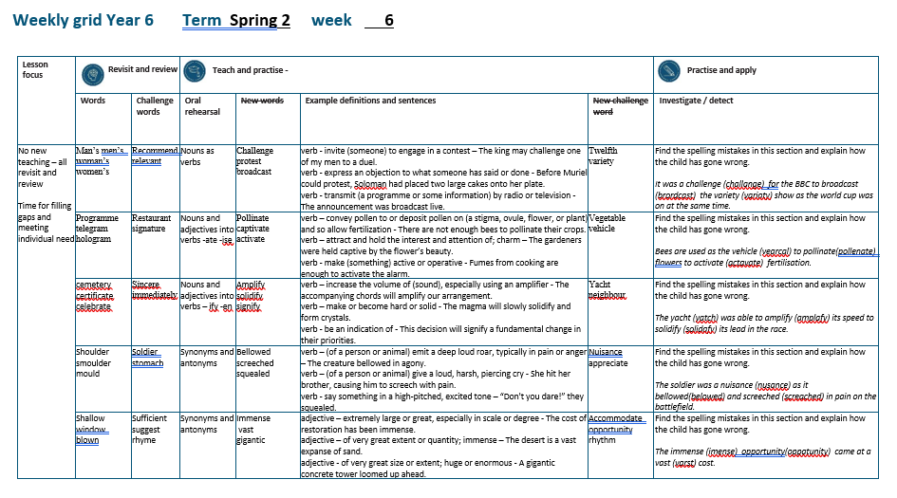

Slide 4
Let’s Revisit and Review…

Slide 5
Do you remember this challenge word?

Slide 6

recommend
VERB
Definition - - put forward (someone or something) with approval as being suitable for a particular purpose or role

Slide 7

relevant
ADJECTIVE
Definition - closely connected or appropriate to what is being done or considered

Slide 8
Possessive apostrophe
Plural possessive apostrophe
_’

Slide 9
-’

Slide 10

man’s

Slide 11
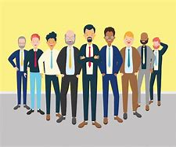
men’s

Slide 12

woman’s

Slide 13

women’s

Slide 14
Let’s Teach and Practise

Slide 15
Nouns as verbs

Slide 16
Noun – person / place / thing
Verb – to do / to be

Slide 17
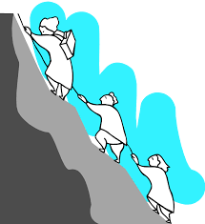
challenge
a challenge = noun
to challenge = verb

Slide 18

protest
a protest = noun
to protest = verb

Slide 19

broadcast
a broadcast = noun
to broadcast = verb

Slide 20
challenge
to challenge
VERB
Definition - invite (someone) to engage in a contest

Slide 21
protest
to protest
VERB
Definition - express an objection to what someone has said or done

Slide 22
broadcast
to broadcast
VERB
Definition - transmit (a programme or some information) by radio or television

Slide 23
The king may challenge one of my men to a duel.
_________

Slide 24
Before Muriel could protest, Soloman had placed two large cakes onto her plate.
_______

Slide 25
The announcement was broadcast live.
_________

Slide 26
New CHALLENGE words.

Slide 27

twelfth
NUMBER
Definition - constituting number twelve in a sequence

Slide 28
There is a party on the twelfth of November celebrating my birthday.
_______

Slide 29
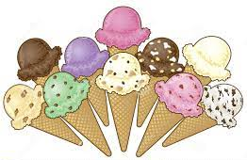
variety
NOUN
Definition - the quality or state of being different or diverse; the absence of uniformity or monotony

Slide 30
It is the variety that makes my job so enjoyable.
_______

Slide 31
Let’s investigate.

Slide 32
Can you spot the spelling errors in these sentences?
Write the correct spelling and explain where they went wrong.

Slide 33
It was a challange for the BBC to brordcast the variaty show as the world cup was on at the same time.

Slide 34
It was a challange for the BBC to brordcast the variaty show as the world cup was on at the same time.

Slide 35
It was a challange for the BBC to brordcast the variaty show as the world cup was on at the same time. challenge – e not a

Slide 36
It was a challange for the BBC to brordcast the variaty show as the world cup was on at the same time. broadcast – oa not or

Slide 37
It was a challange for the BBC to brordcast the variaty show as the world cup was on at the same time. variety – e not a

Slide 38
It was a challenge for the BBC to broadcast the variety show as the world cup was on at the same time.

Slide 39
Year 6 - Spring 2
Week 6 - Tuesday

Slide 41
Let’s Revisit and Review…

Slide 42
Do you remember this challenge word?

Slide 43

restaurant
NOUN
Definition - a place where people pay to sit and eat meals that are cooked and served on the premises

Slide 44

signature
NOUN
Definition - a person's name written in a distinctive way as a form of identification in authorizing a cheque or document or concluding a letter

Slide 45
Word families gram small weight

Slide 46
gram

Slide 47

programme

Slide 48

telegram

Slide 49

hologram

Slide 50
Let’s Teach and Practise

Slide 51
Nouns and adjectives into verbs – ate / ise

Slide 52
Noun – person / place / thing
Adjective – describing a noun
Verb – to do / to be

Slide 53
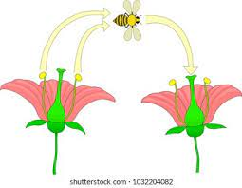
pollinate
the pollen = noun
to pollinate = verb

Slide 54

captivate
a captive = noun
to captivate = verb

Slide 55

activate
active = adjective
to activate = verb

Slide 56
pollinate
Pollen (change the e to i) + ate = pollinate
VERB
Definition - convey pollen to or deposit pollen on (a stigma, ovule, flower, or plant) and so allow fertilisation

Slide 57
captivate
captive (-e) + ate = captivate
VERB
Definition - attract and hold the interest and attention of; charm

Slide 58
activate
active (-e) + ate = activate
VERB
Definition - make (something) active or operative

Slide 59
There are not enough bees to pollinate their crops.
_________

Slide 60
The gardeners were captivated by the flower’s beauty.
__________

Slide 61
Fumes from cooking are enough to activate the alarm.
________

Slide 62
New CHALLENGE words.

Slide 63
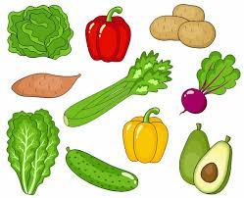
vegetable
NOUN
Definition - a plant or part of a plant used as food, such as a cabbage, potato, turnip, or bean

Slide 64
Fresh fruit and vegetables are required for a healthy diet.
__________

Slide 65
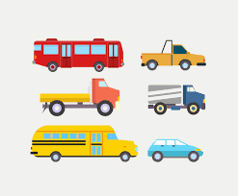
vehicle
NOUN
Definition - a thing used for transporting people or goods, especially on land, such as a car, lorry, or cart

Slide 66
The vehicle was sent skidding across the road.
_______

Slide 67
Let’s investigate.

Slide 68
Can you spot the spelling errors in these sentences?
Write the correct spelling and explain where they went wrong.

Slide 69
Bees are used as the vearcal to pollenate flowers to actavate fertilisation.

Slide 70
Bees are used as the vearcal to pollenate flowers to actavate fertilisation.

Slide 71
Bees are used as the vearcal to pollenate flowers to actavate fertilisation. vehicle – eh not ear

Slide 72
Bees are used as the vearcal to pollenate flowers to actavate fertilisation. pollinate – change the e to i + ate

Slide 73
Bees are used as the vearcal to pollenate flowers to actavate fertilisation. activate - +i + ate

Slide 74
Bees are used as the vehicle to pollinate flowers to activate fertilisation.

Slide 75
Year 6 - Spring 2
Week 6 - Wednesday

Slide 77
Let’s Revisit and Review…

Slide 78
Do you remember this challenge word?

Slide 79
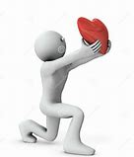
sincere
ADJECTIVE
Definition - free from pretence or deceit; proceeding from genuine feelings

Slide 80

immediately
ADVERB
Definition - at once; instantly

Slide 81
Soft c spelt ce

Slide 82
ce

Slide 83
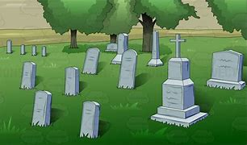
cemetery

Slide 84

certificate

Slide 85
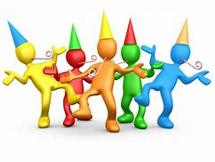
celebrate

Slide 86
Let’s Teach and Practise

Slide 87
Nouns and adjectives into verbs
–fy = to make so
-en

Slide 88
Noun – person / place / thing
Adjective – describing a noun
Verb – to do / to be

Slide 89

amplify
ample = adjective
to amplify = verb

Slide 90

solidify
a solid = noun
to solidify = verb

Slide 91
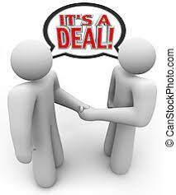
signify
a sign = noun
to signify = verb

Slide 92
amplify
ample (change the e to i) + fy = amplify
VERB
Definition - increase the volume of (sound), especially using an amplifier

Slide 93
solidify
solid (+i) + fy = solidify
VERB
Definition - make or become hard or solid

Slide 94
signify
sign (+i) + fy = signify
VERB
Definition - be an indication of

Slide 95
The accompanying chords will amplify our arrangement.
_______

Slide 96
- The magma will slowly solidify and form crystals.
________

Slide 97
This decision will signify a fundamental change in their priorities.
_______

Slide 98
New CHALLENGE words.

Slide 99
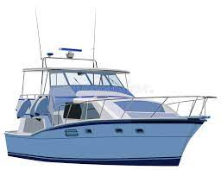
yacht
NOUN
Definition - a medium-sized sailing boat equipped for cruising or racing

Slide 100
The red yacht was in the lead.
_____

Slide 101
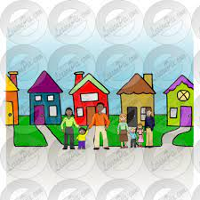
neighbour
NOUN
Definition - a person living next door to or very near to the speaker or person referred to

Slide 102
Our garden was the envy of the neighbours.
__________

Slide 103
Let’s investigate.

Slide 104
Can you spot the spelling errors in these sentences?
Write the correct spelling and explain where they went wrong.

Slide 105
The yatch was able to amplafy its speed to solidafy its lead in the race.

Slide 106
The yatch was able to amplafy its speed to solidafy its lead in the race.

Slide 107
The yatch was able to amplafy its speed to solidafy its lead in the race. yacht – cht not tch

Slide 108
The yatch was able to amplafy its speed to solidafy its lead in the race. amplify – i not a

Slide 109
The yatch was able to amplafy its speed to solidafy its lead in the race. solidify – i not a

Slide 110
The yacht was able to amplify its speed to solidify its lead in the race.

Slide 111
Year 6 - Spring 2
Week 6 - Thursday

Slide 113
Let’s Revisit and Review…

Slide 114
Do you remember this challenge word?

Slide 115
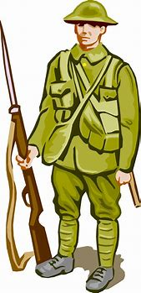
soldier
NOUN
Definition - a person who serves in an army

Slide 116
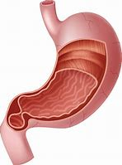
stomach
NOUN
Definition - a saclike expansion of the digestive system, between the esophagus and the small intestine

Slide 117
Sound ou
ou

Slide 118
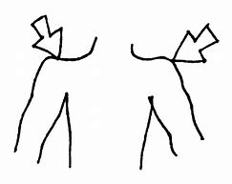
shoulder

Slide 119
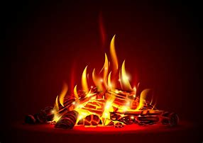
smoulder

Slide 120
Let’s Teach and Practise

Slide 121
Synonyms
Antonyms

Slide 122
Synonym -
a word or phrase that means exactly or nearly the same as another word or phrase in the same language, for example shut is a synonym of close

Slide 123
Antonym -
a word opposite in meaning to another (e.g. bad and good)

Slide 124
Synonyms and Antonyms of…
shouted

Slide 125

bellowed

Slide 126
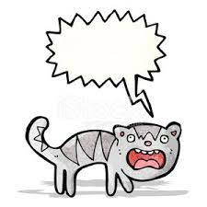
screeched

Slide 127
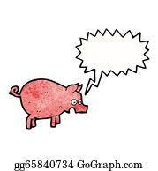
squealed

Slide 128
bellowed
synonym of shouted
VERB
Definition - (of a person or animal) emit a deep loud roar, typically in pain or anger

Slide 129
screeched
synonym of shouted
VERB
Definition - (of a person or animal) give a loud, harsh, piercing cry

Slide 130
squealed
synonym of shouted
VERB
Definition - say something in a high-pitched, excited tone

Slide 131
The creature bellowed in agony.
________

Slide 132
She hit her brother and he screeched with pain.
_________

Slide 133
“Don't you dare!” they squealed.
________

Slide 134
New CHALLENGE words.

Slide 135
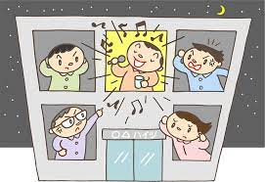
nuisance
NOUN
Definition - a person or thing causing inconvenience or annoyance

Slide 136
It is a nuisance having all those people clomping through the house.
________

Slide 137

appreciate
VERB
Definition - be grateful for (something)

Slide 138
I would appreciate any information you could give me.
__________

Slide 139
Let’s investigate.

Slide 140
Can you spot the spelling errors in these sentences?
Write the correct spelling and explain where they went wrong.

Slide 141
The soldier was a nusance as it belowed and screached in pain on the battlefield.

Slide 142
The soldier was a nusance as it belowed and screached in pain on the battlefield.

Slide 143
The soldier was a nusance as it belowed and screached in pain on the battlefield. nuisance – missing i

Slide 144
The soldier was a nusance as it belowed and screached in pain on the battlefield. bellowed – double l

Slide 145
The soldier was a nusance as it belowed and screached in pain on the battlefield. screeched – ee not ea

Slide 146
The soldier was a nuisance as it bellowed and screeched in pain on the battlefield.

Slide 147
Year 6 - Spring 2
Week 6 - Friday

Slide 149
Let’s Revisit and Review…

Slide 150
Do you remember this challenge word?

Slide 151
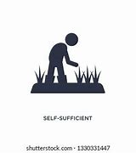
sufficient
ADJECTIVE
Definition - enough; adequate

Slide 152
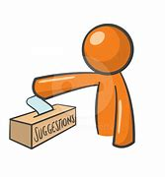
suggest
VERB
Definition - put forward for consideration

Slide 153
Sound ow
ow

Slide 154

shallow

Slide 155

window

Slide 156

blown

Slide 157
Let’s Teach and Practise

Slide 158
Synonyms
Antonyms

Slide 159
Synonym -
a word or phrase that means exactly or nearly the same as another word or phrase in the same language, for example shut is a synonym of close

Slide 160
Antonym -
a word opposite in meaning to another (e.g. bad and good)

Slide 161
Synonyms and Antonyms of…
big

Slide 162

immense

Slide 163

vast

Slide 164
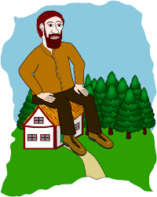
gigantic

Slide 165
immense
synonym of big
ADJECTIVE
Definition - extremely large or great, especially in scale or degree

Slide 166
vast
synonym of big
ADJECTIVE
Definition - of very great extent or quantity

Slide 167
gigantic
synonym of big
ADJECTIVE
Definition - of very great size or extent; huge or enormous

Slide 168
The cost of restoration has been immense.
_______

Slide 169
The desert is a vast expanse of sand.
____

Slide 170
A gigantic concrete tower loomed up ahead.
________

Slide 171
New CHALLENGE words.

Slide 172

accommodate
VERB
Definition - (of a building or other area) provide lodging or sufficient space for

Slide 173
The cottages accommodate up to six people.
___________

Slide 174
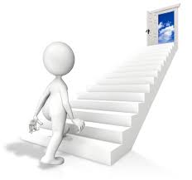
opportunity
NOUN
Definition - a time or set of circumstances that makes it possible to do something

Slide 175
The night drive gave us the opportunity of spotting rhinos.
___________

Slide 176

rhythm
NOUN
Definition - a strong, regular repeated pattern of movement or sound

Slide 177
Ruth listened to the rhythm of his breathing.
______

Slide 178
Let’s investigate.

Slide 179
Can you spot the spelling errors in these sentences?
Write the correct spelling and explain where they went wrong.

Slide 180
The imense oppatunity came at a varst cost.

Slide 181
The imense oppatunity came at a varst cost.

Slide 182
The imense oppatunity came at a varst cost. immense – double m

Slide 183
The imense oppatunity came at a varst cost. opportunity – or not a

Slide 184
The imense oppatunity came at a varst cost. vast – no r

Slide 185
The immense opportunity came at a vast cost.

