Slide 1
Spelling Y6
Mastering spellings: building on the foundations of phonics
Summer 1
Week 1

Slide 2
Year 6 - Summer 1
Week 1 - Monday

Slide 3
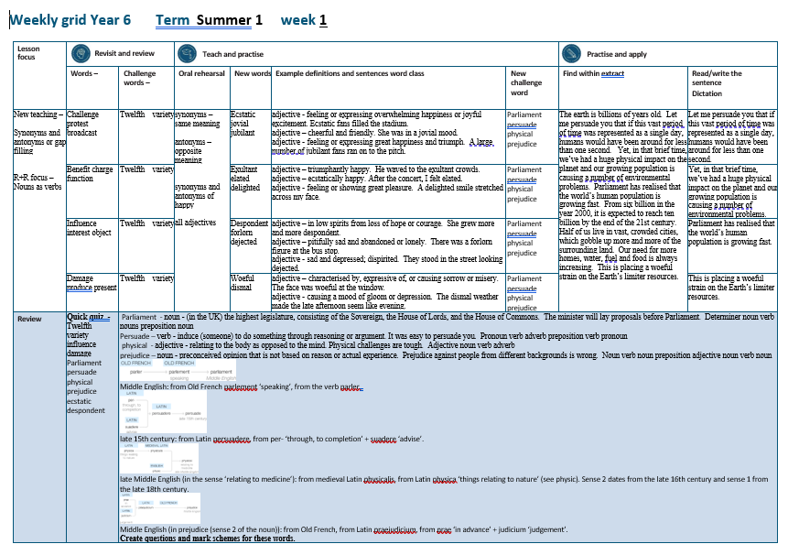

Slide 4
Let’s Revisit and Review…

Slide 5
Do you remember this challenge word?

Slide 6

twelfth
NUMBER
Definition - constituting number twelve in a sequence

Slide 7
There is a party on the twelfth of November celebrating my birthday.
_______

Slide 8
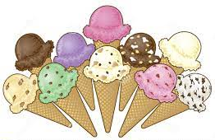
variety
NOUN
Definition - the quality or state of being different or diverse; the absence of uniformity or monotony

Slide 9
It is the variety that makes my job so enjoyable.
_______

Slide 10
Nouns as verbs

Slide 11
Noun – person / place / thing
Verb – to do / to be

Slide 12
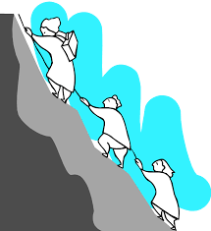
challenge
a challenge = noun
to challenge = verb

Slide 13

protest
a protest = noun
to protest = verb

Slide 14

broadcast
a broadcast = noun
to broadcast = verb

Slide 15
Let’s Teach and Practise

Slide 16
Antonyms and Synonyms

Slide 17
synonyms – same meaning
antonyms – opposite meaning

Slide 18
synonyms and antonyms of ‘happy’
happy = adjective
= all adjectives

Slide 19

ecstatic
synonym of ‘happy’

Slide 20
jovial
synonym of ‘happy’

Slide 21
jubilant
synonym of ‘happy’

Slide 22
ecstatic
ADJECTIVE
Definition - feeling or expressing overwhelming happiness or joyful excitement

Slide 23
jovial
ADJECTIVE
Definition - cheerful and friendly

Slide 24
jubilant
ADJECTIVE
Definition - feeling or expressing great happiness and triumph

Slide 25
Ecstatic fans filled the stadium.
________

Slide 26
She was in a jovial mood.
______

Slide 27
A large number of jubilant fans ran on to the pitch.
________

Slide 28
New CHALLENGE words.

Slide 29
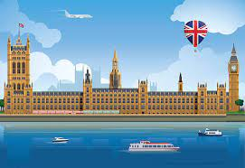
parliament
NOUN
Definition - (in the UK) the highest legislature, consisting of the Sovereign, the House of Lords, and the House of Commons

Slide 30
The minister will lay proposals before Parliament.
__________

Slide 31
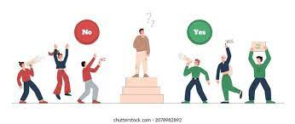
persuade
VERB
Definition - induce (someone) to do something through reasoning or argument

Slide 32
It was easy to persuade you.
________

Slide 33
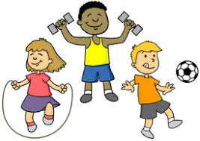
physical
ADJECTIVE
Definition - relating to the body as opposed to the mind

Slide 34
Physical challenges are tough.
________

Slide 35
prejudice
NOUN
Definition - preconceived opinion that is not based on reason or actual experience

Slide 36
Prejudice against people from different backgrounds is wrong.
_________

Slide 37
Let’s Practise and Apply.

Slide 38
The earth is billions of years old. Let me persuade you that if this vast period of time was represented as a single day, humans would have been around for less than one second. Yet, in that brief time, we’ve had a huge physical impact on the planet and our growing population is causing a number of environmental problems. Parliament has realised that the world’s human population is growing fast. From six billion in the year 2000, it is expected to reach ten billion by the end of the 21st century. Half of us live in vast, crowded cities, which gobble up more and more of the surrounding land. Our need for more homes, water, fuel and food is always increasing. This is placing a woeful strain on the Earth’s limiter resources.

Slide 39
The earth is billions of years old. Let me persuade you that if this vast period of time was represented as a single day, humans would have been around for less than one second. Yet, in that brief time, we’ve had a huge physical impact on the planet and our growing population is causing a number of environmental problems. Parliament has realised that the world’s human population is growing fast. From six billion in the year 2000, it is expected to reach ten billion by the end of the 21st century. Half of us live in vast, crowded cities, which gobble up more and more of the surrounding land. Our need for more homes, water, fuel and food is always increasing. This is placing a woeful strain on the Earth’s limiter resources.

Slide 40
Write this sentence as I dictate it to you.
Notes:
Let me persuade you that if this vast period of time was represented as a single day, humans would have been around for less than one second.

Slide 41
Let me persuade you that if this vast period of time was represented as a single day, humans would have been around for less than one second.
Did you write it correctly?
Edit your work and make sure you have it correct.
Can you underline the spelling word that we have covered in this session?

Slide 42
Year 6 - Summer 1
Week 1 - Tuesday
Notes:
Revisit and review the words from previous teaching and challenge words – I say, we say, you say
Ask children to write words only in their spelling book
Introduce the new spelling rule
Children to write the new spelling rule words and challenge words into books when the sentences are shown with the spelling word missing.
Read the extract with the class as choral reading. Practise model of prosody etc.
Ask children to find the spelling words from the session in the text.
Then read allowed the chosen sentence for children to write fully in their books.
Show the extract and ask children to then edit their work to check they were correct in their dictation.

Slide 43
twelfth
NUMBER
Definition - constituting number twelve in a sequence

Slide 44
There is a party on the twelfth of November celebrating my birthday.
_______

Slide 45
variety
NOUN
Definition - the quality or state of being different or diverse; the absence of uniformity or monotony

Slide 46
It is the variety that makes my job so enjoyable.
_______

Slide 47
Nouns as verbs

Slide 48
Noun – person / place / thing
Verb – to do / to be

Slide 49

benefit
a benefit = noun
to benefit = verb

Slide 50

charge
a charge = noun
to charge = verb

Slide 51

function
a function = noun
to function = verb

Slide 52
Let’s Teach and Practise

Slide 53
Antonyms and Synonyms

Slide 54
synonyms – same meaning
antonyms – opposite meaning

Slide 55
synonyms and antonyms of ‘happy’
happy = adjective
= all adjectives

Slide 56
exultant
synonym of ‘happy’

Slide 57
elated
synonym of ‘happy’

Slide 58
delighted
synonym of ‘happy’

Slide 59
exultant
ADJECTIVE
Definition - triumphantly happy

Slide 60
elated
ADJECTIVE
Definition - ecstatically happy

Slide 61
delighted
ADJECTIVE
Definition - feeling or showing great pleasure

Slide 62
He waved to the exultant crowds.
________

Slide 63
After the concert, I felt elated.
______

Slide 64
A delighted smile stretched across my face.
_________

Slide 65
New CHALLENGE words.

Slide 66
parliament
NOUN
Definition - (in the UK) the highest legislature, consisting of the Sovereign, the House of Lords, and the House of Commons

Slide 67
The minister will lay proposals before Parliament.
__________

Slide 68
persuade
VERB
Definition - induce (someone) to do something through reasoning or argument

Slide 69
It was easy to persuade you.
________

Slide 70
physical
ADJECTIVE
Definition - relating to the body as opposed to the mind

Slide 71
Physical challenges are tough.
________

Slide 72
prejudice
NOUN
Definition - preconceived opinion that is not based on reason or actual experience

Slide 73
Prejudice against people from different backgrounds is wrong.
_________

Slide 74
Let’s Practise and Apply.

Slide 75
The earth is billions of years old. Let me persuade you that if this vast period of time was represented as a single day, humans would have been around for less than one second. Yet, in that brief time, we’ve had a huge physical impact on the planet and our growing population is causing a number of environmental problems. Parliament has realised that the world’s human population is growing fast. From six billion in the year 2000, it is expected to reach ten billion by the end of the 21st century. Half of us live in vast, crowded cities, which gobble up more and more of the surrounding land. Our need for more homes, water, fuel and food is always increasing. This is placing a woeful strain on the Earth’s limiter resources.

Slide 76
The earth is billions of years old. Let me persuade you that if this vast period of time was represented as a single day, humans would have been around for less than one second. Yet, in that brief time, we’ve had a huge physical impact on the planet and our growing population is causing a number of environmental problems. Parliament has realised that the world’s human population is growing fast. From six billion in the year 2000, it is expected to reach ten billion by the end of the 21st century. Half of us live in vast, crowded cities, which gobble up more and more of the surrounding land. Our need for more homes, water, fuel and food is always increasing. This is placing a woeful strain on the Earth’s limiter resources.

Slide 77
Write this sentence as I dictate it to you.
Notes:
Yet, in that brief time, we’ve had a huge physical impact on the planet and our growing population is causing a number of environmental problems.

Slide 78
Yet, in that brief time, we’ve had a huge physical impact on the planet and our growing population is causing a number of environmental problems.
Did you write it correctly?
Edit your work and make sure you have it correct.
Can you underline the spelling word that we have covered in this session?

Slide 79
Year 6 - Summer 1
Week 1 - Wednesday
Notes:
Revisit and review the words from previous teaching and challenge words – I say, we say, you say
Ask children to write words only in their spelling book
Introduce the new spelling rule
Children to write the new spelling rule words and challenge words into books when the sentences are shown with the spelling word missing.
Read the extract with the class as choral reading. Practise model of prosody etc.
Ask children to find the spelling words from the session in the text.
Then read allowed the chosen sentence for children to write fully in their books.
Show the extract and ask children to then edit their work to check they were correct in their dictation.

Slide 80
twelfth
NUMBER
Definition - constituting number twelve in a sequence

Slide 81
There is a party on the twelfth of November celebrating my birthday.
_______

Slide 82
variety
NOUN
Definition - the quality or state of being different or diverse; the absence of uniformity or monotony

Slide 83
It is the variety that makes my job so enjoyable.
_______

Slide 84
Nouns as verbs

Slide 85
Noun – person / place / thing
Verb – to do / to be

Slide 86
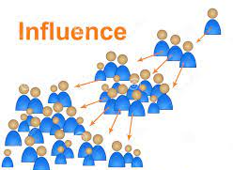
influence
an influence = noun
to influence = verb

Slide 87

interest
the interest = noun
to interest = verb

Slide 88

object
an object = noun
to object = verb

Slide 89
Let’s Teach and Practise

Slide 90
Antonyms and Synonyms

Slide 91
synonyms – same meaning
antonyms – opposite meaning

Slide 92
synonyms and antonyms of ‘happy’
happy = adjective
= all adjectives

Slide 93
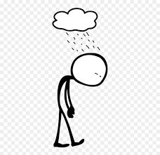
despondent
antonym of ‘happy’

Slide 94
forlorn
antonym of ‘happy’

Slide 95
dejected
antonym of ‘happy’

Slide 96
despondent
ADJECTIVE
Definition - in low spirits from loss of hope or courage

Slide 97
forlorn
ADJECTIVE
Definition - pitifully sad and abandoned or lonely

Slide 98
dejected
ADJECTIVE
Definition - sad and depressed; dispirited

Slide 99
She grew more and more despondent.
__________

Slide 100
There was a forlorn figure at the bus stop.
_______

Slide 101
They stood in the street looking dejected.
________

Slide 102
New CHALLENGE words.

Slide 103
parliament
NOUN
Definition - (in the UK) the highest legislature, consisting of the Sovereign, the House of Lords, and the House of Commons

Slide 104
The minister will lay proposals before Parliament.
__________

Slide 105
persuade
VERB
Definition - induce (someone) to do something through reasoning or argument

Slide 106
It was easy to persuade you.
________

Slide 107
physical
ADJECTIVE
Definition - relating to the body as opposed to the mind

Slide 108
Physical challenges are tough.
________

Slide 109
prejudice
NOUN
Definition - preconceived opinion that is not based on reason or actual experience

Slide 110
Prejudice against people from different backgrounds is wrong.
_________

Slide 111
Let’s Practise and Apply.

Slide 112
The earth is billions of years old. Let me persuade you that if this vast period of time was represented as a single day, humans would have been around for less than one second. Yet, in that brief time, we’ve had a huge physical impact on the planet and our growing population is causing a number of environmental problems. Parliament has realised that the world’s human population is growing fast. From six billion in the year 2000, it is expected to reach ten billion by the end of the 21st century. Half of us live in vast, crowded cities, which gobble up more and more of the surrounding land. Our need for more homes, water, fuel and food is always increasing. This is placing a woeful strain on the Earth’s limiter resources.

Slide 113
The earth is billions of years old. Let me persuade you that if this vast period of time was represented as a single day, humans would have been around for less than one second. Yet, in that brief time, we’ve had a huge physical impact on the planet and our growing population is causing a number of environmental problems. Parliament has realised that the world’s human population is growing fast. From six billion in the year 2000, it is expected to reach ten billion by the end of the 21st century. Half of us live in vast, crowded cities, which gobble up more and more of the surrounding land. Our need for more homes, water, fuel and food is always increasing. This is placing a woeful strain on the Earth’s limiter resources.

Slide 114
Write this sentence as I dictate it to you.
Notes:
Parliament has realised that the world’s human population is growing fast.

Slide 115
Parliament has realised that the world’s human population is growing fast.
Did you write it correctly?
Edit your work and make sure you have it correct.
Can you underline the spelling word that we have covered in this session?

Slide 116
Year 6 - Summer 1
Week 1 - Thursday
Notes:
Revisit and review the words from previous teaching and challenge words – I say, we say, you say
Ask children to write words only in their spelling book
Introduce the new spelling rule
Children to write the new spelling rule words and challenge words into books when the sentences are shown with the spelling word missing.
Read the extract with the class as choral reading. Practise model of prosody etc.
Ask children to find the spelling words from the session in the text.
Then read allowed the chosen sentence for children to write fully in their books.
Show the extract and ask children to then edit their work to check they were correct in their dictation.

Slide 117
twelfth
NUMBER
Definition - constituting number twelve in a sequence

Slide 118
There is a party on the twelfth of November celebrating my birthday.
_______

Slide 119
variety
NOUN
Definition - the quality or state of being different or diverse; the absence of uniformity or monotony

Slide 120
It is the variety that makes my job so enjoyable.
_______

Slide 121
Nouns as verbs

Slide 122
Noun – person / place / thing
Verb – to do / to be

Slide 123
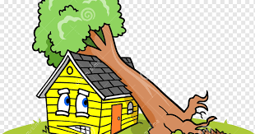
damage
the damage= noun
to damage = verb

Slide 124
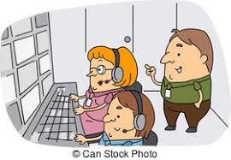
produce
The produce = noun
to produce = verb

Slide 125
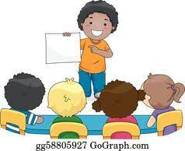
present
a present = noun
to present = verb

Slide 126
Let’s Teach and Practise

Slide 127
Antonyms and Synonyms

Slide 128
synonyms – same meaning
antonyms – opposite meaning

Slide 129
synonyms and antonyms of ‘happy’
happy = adjective
= all adjectives

Slide 130
woeful
antonym of ‘happy’

Slide 131
dismal
antonym of ‘happy’

Slide 132
woeful
ADJECTIVE
Definition - characterised by, expressive of, or causing sorrow or misery

Slide 133
dismal
ADJECTIVE
Definition - causing a mood of gloom or depression

Slide 134
The face was woeful at the window.
______

Slide 135
The dismal weather made the late afternoon seem like evening.
______

Slide 136
New CHALLENGE words.

Slide 137
parliament
NOUN
Definition - (in the UK) the highest legislature, consisting of the Sovereign, the House of Lords, and the House of Commons

Slide 138
The minister will lay proposals before Parliament.
__________

Slide 139
persuade
VERB
Definition - induce (someone) to do something through reasoning or argument

Slide 140
It was easy to persuade you.
________

Slide 141
physical
ADJECTIVE
Definition - relating to the body as opposed to the mind

Slide 142
Physical challenges are tough.
________

Slide 143
prejudice
NOUN
Definition - preconceived opinion that is not based on reason or actual experience

Slide 144
Prejudice against people from different backgrounds is wrong.
_________

Slide 145
Let’s Practise and Apply.

Slide 146
The earth is billions of years old. Let me persuade you that if this vast period of time was represented as a single day, humans would have been around for less than one second. Yet, in that brief time, we’ve had a huge physical impact on the planet and our growing population is causing a number of environmental problems. Parliament has realised that the world’s human population is growing fast. From six billion in the year 2000, it is expected to reach ten billion by the end of the 21st century. Half of us live in vast, crowded cities, which gobble up more and more of the surrounding land. Our need for more homes, water, fuel and food is always increasing. This is placing a woeful strain on the Earth’s limiter resources.

Slide 147
The earth is billions of years old. Let me persuade you that if this vast period of time was represented as a single day, humans would have been around for less than one second. Yet, in that brief time, we’ve had a huge physical impact on the planet and our growing population is causing a number of environmental problems. Parliament has realised that the world’s human population is growing fast. From six billion in the year 2000, it is expected to reach ten billion by the end of the 21st century. Half of us live in vast, crowded cities, which gobble up more and more of the surrounding land. Our need for more homes, water, fuel and food is always increasing. This is placing a woeful strain on the Earth’s limiter resources.

Slide 148
Write this sentence as I dictate it to you.
Notes:
This is placing a woeful strain on the Earth’s limiter resources.

Slide 149
This is placing a woeful strain on the Earth’s limiter resources.
Did you write it correctly?
Edit your work and make sure you have it correct.
Can you underline the spelling word that we have covered in this session?

Slide 150
Year 6 - Summer 1
Week 1 - Friday
Notes:
Click through the slides for all the R+R words for the week (both the focus and the challenge words)
Click through the slides for all the new learning this week

Slide 152
Old challenge words…

Slide 153
twelfth

Slide 154
variety

Slide 155
Old spelling rule words…

Slide 156
man’s

Slide 157
men’s

Slide 158
woman’s

Slide 159
women’s

Slide 160
child’s

Slide 161
children’s

Slide 162
knife’s

Slide 163
knives’

Slide 164
baby’s

Slide 165
babies’

Slide 166
fox’s

Slide 167
foxes’

Slide 168
wolf’s

Slide 169
wolves’

Slide 170
James’

Slide 171
Chris’

Slide 172
New spelling rule words…

Slide 173
ecstatic

Slide 174
jovial

Slide 175
jubilant

Slide 176
exultant

Slide 177
elated

Slide 178
delighted

Slide 179
dispondent

Slide 180
forlorn

Slide 181
dejected

Slide 182
woeful

Slide 183
dismal

Slide 184
New challenge words…

Slide 185
parliament

Slide 186
persuade

Slide 187
physical

Slide 188
prejudice

Slide 189
Quick Quiz time…
Notes:
Say these words for the quiz
Twelfth variety influence damage Parliament persuade physical prejudice ecstatic despondent

Slide 190
Did you get them correct?
Edit your work.
twelfth variety influence damage parliament persuade physical prejudice ecstatic despondent

Slide 191
Word class time…

Slide 192
The minister will lay proposals before Parliament.
Determiner noun verb nouns preposition noun
Notes:
Ask for these words to be classed

Slide 193
It was easy to persuade you.
Pronoun verb adverb preposition verb pronoun
Notes:
Ask for these words to be classed

Slide 194
Physical challenges are tough.
Adjective noun verb adverb
Notes:
Ask for these words to be classed

Slide 195
Prejudice against people from different backgrounds is wrong.
Noun verb noun preposition adjective noun verb noun
Notes:
Ask for these words to be classed

Slide 196
Etymology
The history of a word….

Slide 197
Parilament
Middle English: from Old French parlement ‘speaking’, from the verb parler .
Perusade
late 15th century: from Latin persuadere, from per- ‘through, to completion’ + suadere ‘advise’.
Physical
late Middle English (in the sense ‘relating to medicine’): from medieval Latin physicalis, from Latin physica ‘things relating to nature’ (see physic). Sense 2 dates from the late 16th century and sense 1 from the late 18th century.
Prejudice
Middle English (in prejudice (sense 2 of the noun)): from Old French, from Latin praejudicium, from prae ‘in advance’ + judicium ‘judgement’.

Slide 198

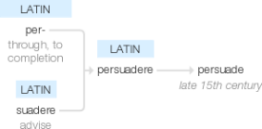

Slide 199



Slide 200
Let’s investigate….
Create questions and mark schemes for these words.

