Slide 1
Spelling Y6
Mastering spellings: building on the foundations of phonics
Summer 1
Week 2

Slide 2
Year 6 - Summer 1
Week 2 - Monday

Slide 3
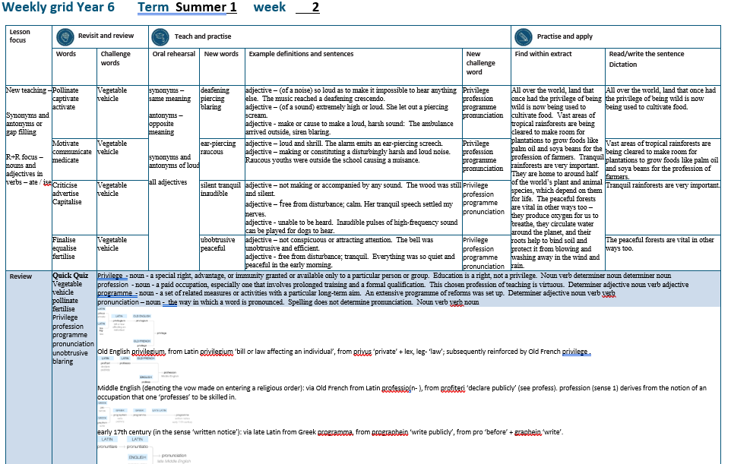

Slide 4
Let’s Revisit and Review…

Slide 5
Do you remember this challenge word?

Slide 6
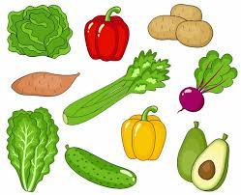
vegetable
NOUN
Definition - a plant or part of a plant used as food, such as a cabbage, potato, turnip, or bean

Slide 7
Fresh fruit and vegetables are required for a healthy diet.
__________

Slide 8
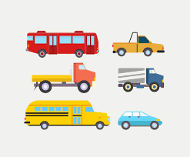
vehicle
NOUN
Definition - a thing used for transporting people or goods, especially on land, such as a car, lorry, or cart

Slide 9
The vehicle was sent skidding across the road.
_______

Slide 10
Nouns and adjectives into verbs – ate / ise

Slide 11
Noun – person / place / thing
Adjective – describing a noun
Verb – to do / to be

Slide 12
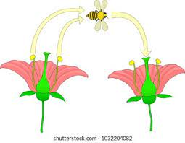
pollinate
the pollen = noun
to pollinate = verb

Slide 13

captivate
a captive = noun
to captivate = verb

Slide 14

activate
active = adjective
to activate = verb

Slide 15
Let’s Teach and Practise

Slide 16
Antonyms and Synonyms

Slide 17
synonyms – same meaning
antonyms – opposite meaning

Slide 18
synonyms and antonyms of ‘loud’
loud = adjective
= all adjectives

Slide 19

deafening
synonym of ‘loud’

Slide 20
piercing
synonym of ‘loud’

Slide 21
blaring
synonym of ‘loud’

Slide 22
deafening
ADJECTIVE
Definition - (of a noise) so loud as to make it impossible to hear anything else

Slide 23
piercing
ADJECTIVE
Definition - (of a sound) extremely high or loud

Slide 24
blaring
ADJECTIVE
Definition - make or cause to make a loud, harsh sound

Slide 25
The music reached a deafening crescendo.
__________

Slide 26
She let out a piercing scream.
________

Slide 27
The ambulance arrived outside, siren blaring.
_______

Slide 28
New CHALLENGE words.

Slide 29

privilege
NOUN
Definition - a special right, advantage, or immunity granted or available only to a particular person or group

Slide 30
Education is a right, not a privilege.
_________

Slide 31

profession
NOUN
Definition - a paid occupation, especially one that involves prolonged training and a formal qualification

Slide 32
This chosen profession of teaching is virtuous.
__________

Slide 33
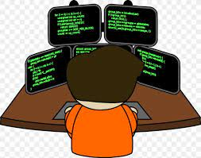
programme
NOUN
Definition - a set of related measures or activities with a particular long-term aim

Slide 34
An extensive programme of reforms was set up.
_________

Slide 35
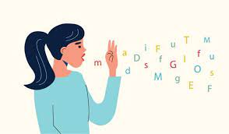
pronunciation
NOUN
Definition - the way in which a word is pronounced

Slide 36
Spelling does not determine pronunciation.
_____________

Slide 37
Let’s Practise and Apply.

Slide 38
All over the world, land that once had the privilege of being wild is now being used to cultivate food. Vast areas of tropical rainforests are being cleared to make room for plantations to grow foods like palm oil and soya beans for the profession of farmers. Tranquil rainforests are very important. They are home to around half of the world’s plant and animal species, which depend on them for life. The peaceful forests are vital in other ways too – they produce oxygen for us to breathe, they circulate water around the planet, and their roots help to bind soil and protect it from blowing and washing away in the wind and rain.

Slide 39
All over the world, land that once had the privilege of being wild is now being used to cultivate food. Vast areas of tropical rainforests are being cleared to make room for plantations to grow foods like palm oil and soya beans for the profession of farmers. Tranquil rainforests are very important. They are home to around half of the world’s plant and animal species, which depend on them for life. The peaceful forests are vital in other ways too – they produce oxygen for us to breathe, they circulate water around the planet, and their roots help to bind soil and protect it from blowing and washing away in the wind and rain.

Slide 40
Write this sentence as I dictate it to you.
Notes:
All over the world, land that once had the privilege of being wild is now being used to cultivate food.

Slide 41
All over the world, land that once had the privilege of being wild is now being used to cultivate food.
Did you write it correctly?
Edit your work and make sure you have it correct.
Can you underline the spelling word that we have covered in this session?

Slide 42
Year 6 - Summer 1
Week 2 - Tuesday
Notes:
Revisit and review the words from previous teaching and challenge words – I say, we say, you say
Ask children to write words only in their spelling book
Introduce the new spelling rule
Children to write the new spelling rule words and challenge words into books when the sentences are shown with the spelling word missing.
Read the extract with the class as choral reading. Practise model of prosody etc.
Ask children to find the spelling words from the session in the text.
Then read allowed the chosen sentence for children to write fully in their books.
Show the extract and ask children to then edit their work to check they were correct in their dictation.

Slide 44
Let’s Revisit and Review…

Slide 45
Do you remember this challenge word?

Slide 46
vegetable
NOUN
Definition - a plant or part of a plant used as food, such as a cabbage, potato, turnip, or bean

Slide 47
Fresh fruit and vegetables are required for a healthy diet.
__________

Slide 48
vehicle
NOUN
Definition - a thing used for transporting people or goods, especially on land, such as a car, lorry, or cart

Slide 49
The vehicle was sent skidding across the road.
_______

Slide 50
Nouns and adjectives into verbs – ate / ise

Slide 51
Noun – person / place / thing
Adjective – describing a noun
Verb – to do / to be

Slide 52
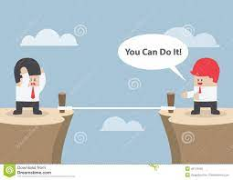
motivate
the motive = noun
to motivate = verb

Slide 53

communicate
the communication = noun
to communicate = verb

Slide 54
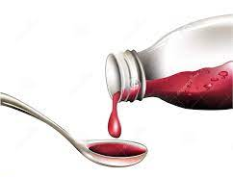
medicate
the medicine = noun
to medicate = verb

Slide 55
Let’s Teach and Practise

Slide 56
Antonyms and Synonyms

Slide 57
synonyms – same meaning
antonyms – opposite meaning

Slide 58
synonyms and antonyms of ‘loud’
loud = adjective
= all adjectives

Slide 59
ear-piercing
synonym of ‘loud’

Slide 60
raucous
synonym of ‘loud’

Slide 61
ear-piercing
ADJECTIVE
Definition - loud and shrill

Slide 62
raucous
ADJECTIVE
Definition - making or constituting a disturbingly harsh and loud noise

Slide 63
The alarm emits an ear-piercing screech.
____________

Slide 64
Raucous youths were outside the school causing a nuisance.
_______

Slide 65
New CHALLENGE words.

Slide 66
privilege
NOUN
Definition - a special right, advantage, or immunity granted or available only to a particular person or group

Slide 67
Education is a right, not a privilege.
_________

Slide 68
profession
NOUN
Definition - a paid occupation, especially one that involves prolonged training and a formal qualification

Slide 69
This chosen profession of teaching is virtuous.
__________

Slide 70
programme
NOUN
Definition - a set of related measures or activities with a particular long-term aim

Slide 71
An extensive programme of reforms was set up.
_________

Slide 72
pronunciation
NOUN
Definition - the way in which a word is pronounced

Slide 73
Spelling does not determine pronunciation.
_____________

Slide 74
Let’s Practise and Apply.

Slide 75
All over the world, land that once had the privilege of being wild is now being used to cultivate food. Vast areas of tropical rainforests are being cleared to make room for plantations to grow foods like palm oil and soya beans for the profession of farmers. Tranquil rainforests are very important. They are home to around half of the world’s plant and animal species, which depend on them for life. The peaceful forests are vital in other ways too – they produce oxygen for us to breathe, they circulate water around the planet, and their roots help to bind soil and protect it from blowing and washing away in the wind and rain.

Slide 76
All over the world, land that once had the privilege of being wild is now being used to cultivate food. Vast areas of tropical rainforests are being cleared to make room for plantations to grow foods like palm oil and soya beans for the profession of farmers. Tranquil rainforests are very important. They are home to around half of the world’s plant and animal species, which depend on them for life. The peaceful forests are vital in other ways too – they produce oxygen for us to breathe, they circulate water around the planet, and their roots help to bind soil and protect it from blowing and washing away in the wind and rain.

Slide 77
Write this sentence as I dictate it to you.
Notes:
Vast areas of tropical rainforests are being cleared to make room for plantations to grow foods like palm oil and soya beans for the profession of farmers.

Slide 78
Vast areas of tropical rainforests are being cleared to make room for plantations to grow foods like palm oil and soya beans for the profession of farmers.
Did you write it correctly?
Edit your work and make sure you have it correct.
Can you underline the spelling word that we have covered in this session?

Slide 79
Year 6 - Summer 1
Week 2 - Wednesday
Notes:
Revisit and review the words from previous teaching and challenge words – I say, we say, you say
Ask children to write words only in their spelling book
Introduce the new spelling rule
Children to write the new spelling rule words and challenge words into books when the sentences are shown with the spelling word missing.
Read the extract with the class as choral reading. Practise model of prosody etc.
Ask children to find the spelling words from the session in the text.
Then read allowed the chosen sentence for children to write fully in their books.
Show the extract and ask children to then edit their work to check they were correct in their dictation.

Slide 81
Let’s Revisit and Review…

Slide 82
Do you remember this challenge word?

Slide 83
vegetable
NOUN
Definition - a plant or part of a plant used as food, such as a cabbage, potato, turnip, or bean

Slide 84
Fresh fruit and vegetables are required for a healthy diet.
__________

Slide 85
vehicle
NOUN
Definition - a thing used for transporting people or goods, especially on land, such as a car, lorry, or cart

Slide 86
The vehicle was sent skidding across the road.
_______

Slide 87
Nouns and adjectives into verbs – ate / ise

Slide 88
Noun – person / place / thing
Adjective – describing a noun
Verb – to do / to be

Slide 89
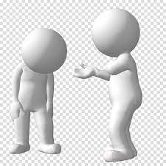
criticise
the critic = noun
to criticise = verb

Slide 90

advertise
an advert = noun
to advertise = verb

Slide 91

capitalise
the capital = adjective
to capitalise = verb

Slide 92
Let’s Teach and Practise

Slide 93
Antonyms and Synonyms

Slide 94
synonyms – same meaning
antonyms – opposite meaning

Slide 95
synonyms and antonyms of ‘loud’
loud = adjective
= all adjectives

Slide 96

silent
antonym of ‘loud’

Slide 97
tranquil
antonym of ‘loud’

Slide 98
inaudible
antonym of ‘loud’

Slide 99
silent
ADJECTIVE
Definition - not making or accompanied by any sound

Slide 100
tranquil
ADJECTIVE
Definition - free from disturbance; calm

Slide 101
inaudible
ADJECTIVE
Definition - unable to be heard

Slide 102
The wood was still and silent.
______

Slide 103
Her tranquil speech settled my nerves.
________

Slide 104
Inaudible pulses of high-frequency sound can be played for dogs to hear.
_________

Slide 105
New CHALLENGE words.

Slide 106
privilege
NOUN
Definition - a special right, advantage, or immunity granted or available only to a particular person or group

Slide 107
Education is a right, not a privilege.
_________

Slide 108
profession
NOUN
Definition - a paid occupation, especially one that involves prolonged training and a formal qualification

Slide 109
This chosen profession of teaching is virtuous.
__________

Slide 110
programme
NOUN
Definition - a set of related measures or activities with a particular long-term aim

Slide 111
An extensive programme of reforms was set up.
_________

Slide 112
pronunciation
NOUN
Definition - the way in which a word is pronounced

Slide 113
Spelling does not determine pronunciation.
_____________

Slide 114
Let’s Practise and Apply.

Slide 115
All over the world, land that once had the privilege of being wild is now being used to cultivate food. Vast areas of tropical rainforests are being cleared to make room for plantations to grow foods like palm oil and soya beans for the profession of farmers. Tranquil rainforests are very important. They are home to around half of the world’s plant and animal species, which depend on them for life. The peaceful forests are vital in other ways too – they produce oxygen for us to breathe, they circulate water around the planet, and their roots help to bind soil and protect it from blowing and washing away in the wind and rain.

Slide 116
All over the world, land that once had the privilege of being wild is now being used to cultivate food. Vast areas of tropical rainforests are being cleared to make room for plantations to grow foods like palm oil and soya beans for the profession of farmers. Tranquil rainforests are very important. They are home to around half of the world’s plant and animal species, which depend on them for life. The peaceful forests are vital in other ways too – they produce oxygen for us to breathe, they circulate water around the planet, and their roots help to bind soil and protect it from blowing and washing away in the wind and rain.

Slide 117
Write this sentence as I dictate it to you.
Notes:
Tranquil rainforests are very important.

Slide 118
Tranquil rainforests are very important.
Did you write it correctly?
Edit your work and make sure you have it correct.
Can you underline the spelling word that we have covered in this session?

Slide 119
Year 6 - Summer 1
Week 2 - Thursday
Notes:
Revisit and review the words from previous teaching and challenge words – I say, we say, you say
Ask children to write words only in their spelling book
Introduce the new spelling rule
Children to write the new spelling rule words and challenge words into books when the sentences are shown with the spelling word missing.
Read the extract with the class as choral reading. Practise model of prosody etc.
Ask children to find the spelling words from the session in the text.
Then read allowed the chosen sentence for children to write fully in their books.
Show the extract and ask children to then edit their work to check they were correct in their dictation.

Slide 121
Let’s Revisit and Review…

Slide 122
Do you remember this challenge word?

Slide 123
vegetable
NOUN
Definition - a plant or part of a plant used as food, such as a cabbage, potato, turnip, or bean

Slide 124
Fresh fruit and vegetables are required for a healthy diet.
__________

Slide 125
vehicle
NOUN
Definition - a thing used for transporting people or goods, especially on land, such as a car, lorry, or cart

Slide 126
The vehicle was sent skidding across the road.
_______

Slide 127
Nouns and adjectives into verbs – ate / ise

Slide 128
Noun – person / place / thing
Adjective – describing a noun
Verb – to do / to be

Slide 129
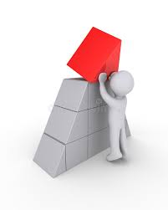
finalise
final = adjective
to finalise = verb

Slide 130
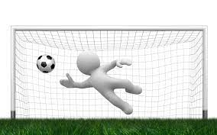
equalise
equal = adjective
to equalise = verb

Slide 131
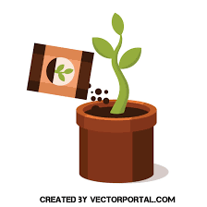
fertilise
fertile = adjective
to fertilise = verb

Slide 132
Let’s Teach and Practise

Slide 133
Antonyms and Synonyms

Slide 134
synonyms – same meaning
antonyms – opposite meaning

Slide 135
synonyms and antonyms of ‘loud’
loud = adjective
= all adjectives

Slide 136
unobtrusive
antonym of ‘loud’

Slide 137
peaceful
antonym of ‘loud’

Slide 138
unobtrusive
ADJECTIVE
Definition - not conspicuous or attracting attention

Slide 139
peaceful
ADJECTIVE
Definition - free from disturbance; tranquil

Slide 140
The bell was unobtrusive and efficient.
___________

Slide 141
Everything was so quiet and peaceful in the early morning.
________

Slide 142
New CHALLENGE words.

Slide 143
privilege
NOUN
Definition - a special right, advantage, or immunity granted or available only to a particular person or group

Slide 144
Education is a right, not a privilege.
_________

Slide 145
profession
NOUN
Definition - a paid occupation, especially one that involves prolonged training and a formal qualification

Slide 146
This chosen profession of teaching is virtuous.
__________

Slide 147
programme
NOUN
Definition - a set of related measures or activities with a particular long-term aim

Slide 148
An extensive programme of reforms was set up.
_________

Slide 149
pronunciation
NOUN
Definition - the way in which a word is pronounced

Slide 150
Spelling does not determine pronunciation.
_____________

Slide 151
Let’s Practise and Apply.

Slide 152
All over the world, land that once had the privilege of being wild is now being used to cultivate food. Vast areas of tropical rainforests are being cleared to make room for plantations to grow foods like palm oil and soya beans for the profession of farmers. Tranquil rainforests are very important. They are home to around half of the world’s plant and animal species, which depend on them for life. The peaceful forests are vital in other ways too – they produce oxygen for us to breathe, they circulate water around the planet, and their roots help to bind soil and protect it from blowing and washing away in the wind and rain.

Slide 153
All over the world, land that once had the privilege of being wild is now being used to cultivate food. Vast areas of tropical rainforests are being cleared to make room for plantations to grow foods like palm oil and soya beans for the profession of farmers. Tranquil rainforests are very important. They are home to around half of the world’s plant and animal species, which depend on them for life. The peaceful forests are vital in other ways too – they produce oxygen for us to breathe, they circulate water around the planet, and their roots help to bind soil and protect it from blowing and washing away in the wind and rain.

Slide 154
Write this sentence as I dictate it to you.
Notes:
The peaceful forests are vital in other ways too.

Slide 155
The peaceful forests are vital in other ways too.
Did you write it correctly?
Edit your work and make sure you have it correct.
Can you underline the spelling word that we have covered in this session?

Slide 156
Year 6 - Summer 1
Week 2 - Friday
Notes:
Click through the slides for all the R+R words for the week (both the focus and the challenge words)
Click through the slides for all the new learning this week

Slide 158
Old challenge words…

Slide 159
vegetable

Slide 160
vehicle

Slide 161
Old spelling rule words…

Slide 162
pollinate

Slide 163
captivate

Slide 164
activate

Slide 165
motivate

Slide 166
communicate

Slide 167
medicate

Slide 168
criticise

Slide 169
advertise

Slide 170
capitalise

Slide 171
finalise

Slide 172
equalise

Slide 173
fertilise

Slide 174
New spelling rule words…

Slide 175
deafening

Slide 176
piercing

Slide 177
blaring

Slide 178
ear-piercing

Slide 179
raucous

Slide 180
silent

Slide 181
tranquil

Slide 182
inaudible

Slide 183
unobtrusive

Slide 184
peaceful

Slide 185
New challenge words…

Slide 186
privilege

Slide 187
profession

Slide 188
programme

Slide 189
pronunciation

Slide 190
Quick Quiz time…
Notes:
Say these words for the quiz
Vegetable vehicle pollinate fertilise
Privilege profession programme pronunciation unobtrusive blaring

Slide 191
Did you get them correct?
Edit your work.
vegetable vehicle pollinate fertilise
privilege profession programme pronunciation unobtrusive blaring

Slide 192
Word class time…

Slide 193
Education is a right, not a privilege.
Noun verb determiner noun determiner noun
Notes:
Ask for these words to be classed

Slide 194
This chosen profession of teaching is virtuous.
Determiner adjective noun verb adjective
Notes:
Ask for these words to be classed

Slide 195
An extensive programme of reforms was set up.
Determiner adjective noun verb verb
Notes:
Ask for these words to be classed

Slide 196
Spelling does not determine pronunciation.
Noun verb verb noun
Notes:
Ask for these words to be classed

Slide 197
Etymology
The history of a word….

Slide 198
Privilege
Old English privilegium, from Latin privilegium ‘bill or law affecting an individual’, from privus ‘private’ + lex, leg- ‘law’; subsequently reinforced by Old French privilege .
Profession
Middle English (denoting the vow made on entering a religious order): via Old French from Latin professio(n- ), from profiteri ‘declare publicly’ (see profess). profession (sense 1) derives from the notion of an occupation that one ‘professes’ to be skilled in.
Programme
early 17th century (in the sense ‘written notice’): via late Latin from Greek programma, from prographein ‘write publicly’, from pro ‘before’ + graphein ‘write’.
Pronunciation
late Middle English: from Latin pronuntiatio(n- ), from the verb pronuntiare (see pronounce).

Slide 199
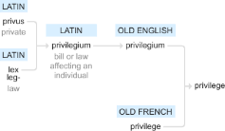




Slide 200
Let’s investigate….
Find antonyms and synonyms of the challenge words.

