Slide 1
Spelling Y6
Mastering spellings: building on the foundations of phonics
Summer 1
Week 3

Slide 2
Year 6 - Summer 1
Week 3 - Monday

Slide 3
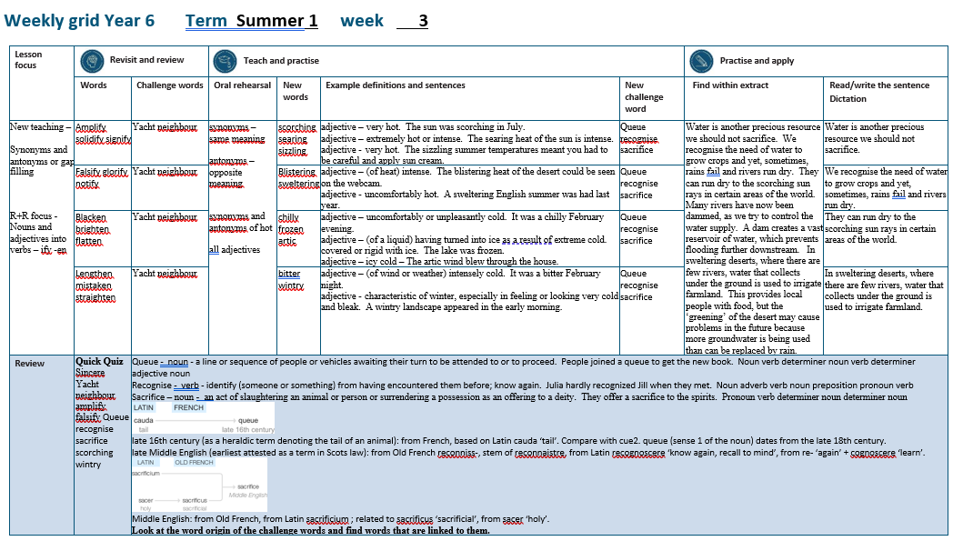

Slide 4
Let’s Revisit and Review…

Slide 5
Do you remember this challenge word?

Slide 6
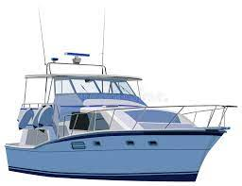
yacht
NOUN
Definition - a medium-sized sailing boat equipped for cruising or racing

Slide 7
The red yacht was in the lead.
_____

Slide 8
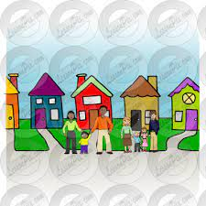
neighbour
NOUN
Definition - a person living next door to or very near to the speaker or person referred to

Slide 9
Our garden was the envy of the neighbours.
__________

Slide 10
Nouns and adjectives into verbs –fy = to make so -en

Slide 11
Noun – person / place / thing
Adjective – describing a noun
Verb – to do / to be

Slide 12
amplify
ample = adjective
to amplify = verb

Slide 13
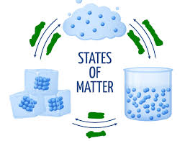
solidify
a solid = noun
to solidify = verb

Slide 14
signify
a sign = noun
to signify = verb

Slide 15
Let’s Teach and Practise

Slide 16
Antonyms and Synonyms

Slide 17
synonyms – same meaning
antonyms – opposite meaning

Slide 18
synonyms and antonyms of ‘hot’
hot = adjective
= all adjectives

Slide 19
scorching
synonym of ‘hot’

Slide 20
searing
synonym of ‘hot’

Slide 21
sizzling
synonym of ‘hot’

Slide 22
scorching
ADJECTIVE
Definition - very hot

Slide 23
searing
ADJECTIVE
Definition - extremely hot or intense

Slide 24
sizzling
ADJECTIVE
Definition - very hot

Slide 25
The sun was scorching in July.
_________

Slide 26
The searing heat of the sun is intense.
_______

Slide 27
The sizzling summer temperatures meant you had to be careful and apply sun cream.
________

Slide 28
New CHALLENGE words.

Slide 29
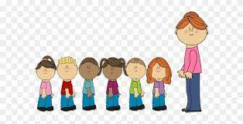
queue
NOUN
Definition - a line or sequence of people or vehicles awaiting their turn to be attended to or to proceed

Slide 30
People joined a queue to get the new book.
_____

Slide 31
recognise
VERB
Definition - identify (someone or something) from having encountered them before; know again

Slide 32
Julia hardly recognised Jill when they met.
__________

Slide 33
sacrifice
NOUN
Definition - an act of slaughtering an animal or person or surrendering a possession as an offering to a deity

Slide 34
They offer a sacrifice to the spirits.
_________

Slide 35
Let’s Practise and Apply.

Slide 36
Water is another precious resource we should not sacrifice. We recognise the need of water to grow crops and yet, sometimes, rains fail and rivers run dry. They can run dry to the scorching sun rays in certain areas of the world. Many rivers have now been dammed, as we try to control the water supply. A dam creates a vast reservoir of water, which prevents flooding further downstream. In sweltering deserts, where there are few rivers, water that collects under the ground is used to irrigate farmland. This provides local people with food, but the ‘greening’ of the desert may cause problems in the future because more groundwater is being used than can be replaced by rain.

Slide 37
Water is another precious resource we should not sacrifice. We recognise the need of water to grow crops and yet, sometimes, rains fail and rivers run dry. They can run dry to the scorching sun rays in certain areas of the world. Many rivers have now been dammed, as we try to control the water supply. A dam creates a vast reservoir of water, which prevents flooding further downstream. In sweltering deserts, where there are few rivers, water that collects under the ground is used to irrigate farmland. This provides local people with food, but the ‘greening’ of the desert may cause problems in the future because more groundwater is being used than can be replaced by rain.

Slide 38
Write this sentence as I dictate it to you.
Notes:
Water is another precious resource we should not sacrifice.

Slide 39
Water is another precious resource we should not sacrifice.
Did you write it correctly?
Edit your work and make sure you have it correct.
Can you underline the spelling word that we have covered in this session?

Slide 40
Year 6 - Summer 1
Week 3 - Tuesday
Notes:
Revisit and review the words from previous teaching and challenge words – I say, we say, you say
Ask children to write words only in their spelling book
Introduce the new spelling rule
Children to write the new spelling rule words and challenge words into books when the sentences are shown with the spelling word missing.
Read the extract with the class as choral reading. Practise model of prosody etc.
Ask children to find the spelling words from the session in the text.
Then read allowed the chosen sentence for children to write fully in their books.
Show the extract and ask children to then edit their work to check they were correct in their dictation.

Slide 42
Let’s Revisit and Review…

Slide 43
Do you remember this challenge word?

Slide 44
yacht
NOUN
Definition - a medium-sized sailing boat equipped for cruising or racing

Slide 45
The red yacht was in the lead.
_____

Slide 46
neighbour
NOUN
Definition - a person living next door to or very near to the speaker or person referred to

Slide 47
Our garden was the envy of the neighbours.
__________

Slide 48
Nouns and adjectives into verbs –fy = to make so -en

Slide 49
Noun – person / place / thing
Adjective – describing a noun
Verb – to do / to be

Slide 50
falsify
false = adjective
to falsify = verb

Slide 51
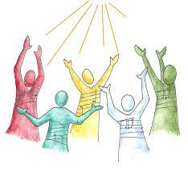
glorify
the glory = noun
to glorify = verb

Slide 52
notify
a note = noun
to notify = verb

Slide 53
Let’s Teach and Practise

Slide 54
Antonyms and Synonyms

Slide 55
synonyms – same meaning
antonyms – opposite meaning

Slide 56
synonyms and antonyms of ‘hot’
hot = adjective
= all adjectives

Slide 57
blistering
synonym of ‘hot’

Slide 58
sweltering
synonym of ‘hot’

Slide 59
blistering
ADJECTIVE
Definition - (of heat) intense

Slide 60
sweltering
ADJECTIVE
Definition - uncomfortably hot

Slide 61
The blistering heat of the desert could be seen on the webcam.
__________

Slide 62
A sweltering English summer was had last year.
__________

Slide 63
New CHALLENGE words.

Slide 64
queue
NOUN
Definition - a line or sequence of people or vehicles awaiting their turn to be attended to or to proceed

Slide 65
People joined a queue to get the new book.
_____

Slide 66
recognise
VERB
Definition - identify (someone or something) from having encountered them before; know again

Slide 67
Julia hardly recognised Jill when they met.
__________

Slide 68
sacrifice
NOUN
Definition - an act of slaughtering an animal or person or surrendering a possession as an offering to a deity

Slide 69
They offer a sacrifice to the spirits.
_________

Slide 70
Let’s Practise and Apply.

Slide 71
Water is another precious resource we should not sacrifice. We recognise the need of water to grow crops and yet, sometimes, rains fail and rivers run dry. They can run dry to the scorching sun rays in certain areas of the world. Many rivers have now been dammed, as we try to control the water supply. A dam creates a vast reservoir of water, which prevents flooding further downstream. In sweltering deserts, where there are few rivers, water that collects under the ground is used to irrigate farmland. This provides local people with food, but the ‘greening’ of the desert may cause problems in the future because more groundwater is being used than can be replaced by rain.

Slide 72
Water is another precious resource we should not sacrifice. We recognise the need of water to grow crops and yet, sometimes, rains fail and rivers run dry. They can run dry to the scorching sun rays in certain areas of the world. Many rivers have now been dammed, as we try to control the water supply. A dam creates a vast reservoir of water, which prevents flooding further downstream. In sweltering deserts, where there are few rivers, water that collects under the ground is used to irrigate farmland. This provides local people with food, but the ‘greening’ of the desert may cause problems in the future because more groundwater is being used than can be replaced by rain.

Slide 73
Write this sentence as I dictate it to you.
Notes:
We recognise the need of water to grow crops and yet, sometimes, rains fail and rivers run dry.

Slide 74
We recognise the need of water to grow crops and yet, sometimes, rains fail and rivers run dry.
Did you write it correctly?
Edit your work and make sure you have it correct.
Can you underline the spelling word that we have covered in this session?

Slide 75
Year 6 - Summer 1
Week 3 - Wednesday
Notes:
Revisit and review the words from previous teaching and challenge words – I say, we say, you say
Ask children to write words only in their spelling book
Introduce the new spelling rule
Children to write the new spelling rule words and challenge words into books when the sentences are shown with the spelling word missing.
Read the extract with the class as choral reading. Practise model of prosody etc.
Ask children to find the spelling words from the session in the text.
Then read allowed the chosen sentence for children to write fully in their books.
Show the extract and ask children to then edit their work to check they were correct in their dictation.

Slide 77
Let’s Revisit and Review…

Slide 78
Do you remember this challenge word?

Slide 79
yacht
NOUN
Definition - a medium-sized sailing boat equipped for cruising or racing

Slide 80
The red yacht was in the lead.
_____

Slide 81
neighbour
NOUN
Definition - a person living next door to or very near to the speaker or person referred to

Slide 82
Our garden was the envy of the neighbours.
__________

Slide 83
Nouns and adjectives into verbs –fy = to make so -en

Slide 84
Noun – person / place / thing
Adjective – describing a noun
Verb – to do / to be

Slide 85
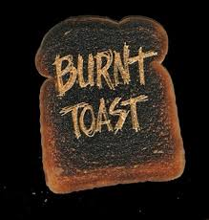
blacken
black = adjective
to blacken = verb

Slide 86
brighten
bright = adjective
to brighten = verb

Slide 87
flatten
flat = adjective
to flatten = verb

Slide 88
Let’s Teach and Practise

Slide 89
Antonyms and Synonyms

Slide 90
synonyms – same meaning
antonyms – opposite meaning

Slide 91
synonyms and antonyms of ‘hot’
hot = adjective
= all adjectives

Slide 92
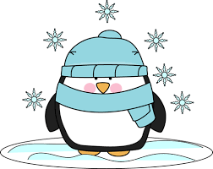
chilly
antonym of ‘hot’

Slide 93
frozen
antonym of ‘hot’

Slide 94
arctic
antonym of ‘hot’

Slide 95
chilly
ADJECTIVE
Definition - uncomfortably or unpleasantly cold

Slide 96
frozen
ADJECTIVE
Definition - (of a liquid) having turned into ice as a result of extreme cold

Slide 97
arctic
ADJECTIVE
Definition - icy cold

Slide 98
It was a chilly February evening.
______

Slide 99
The lake was frozen.
______

Slide 100
The artic wind blew through the house.
______

Slide 101
New CHALLENGE words.

Slide 102
queue
NOUN
Definition - a line or sequence of people or vehicles awaiting their turn to be attended to or to proceed

Slide 103
People joined a queue to get the new book.
_____

Slide 104
recognise
VERB
Definition - identify (someone or something) from having encountered them before; know again

Slide 105
Julia hardly recognised Jill when they met.
__________

Slide 106
sacrifice
NOUN
Definition - an act of slaughtering an animal or person or surrendering a possession as an offering to a deity

Slide 107
They offer a sacrifice to the spirits.
_________

Slide 108
Let’s Practise and Apply.

Slide 109
Water is another precious resource we should not sacrifice. We recognise the need of water to grow crops and yet, sometimes, rains fail and rivers run dry. They can run dry to the scorching sun rays in certain areas of the world. Many rivers have now been dammed, as we try to control the water supply. A dam creates a vast reservoir of water, which prevents flooding further downstream. In sweltering deserts, where there are few rivers, water that collects under the ground is used to irrigate farmland. This provides local people with food, but the ‘greening’ of the desert may cause problems in the future because more groundwater is being used than can be replaced by rain.

Slide 110
Water is another precious resource we should not sacrifice. We recognise the need of water to grow crops and yet, sometimes, rains fail and rivers run dry. They can run dry to the scorching sun rays in certain areas of the world. Many rivers have now been dammed, as we try to control the water supply. A dam creates a vast reservoir of water, which prevents flooding further downstream. In sweltering deserts, where there are few rivers, water that collects under the ground is used to irrigate farmland. This provides local people with food, but the ‘greening’ of the desert may cause problems in the future because more groundwater is being used than can be replaced by rain.

Slide 111
Write this sentence as I dictate it to you.
Notes:
They can run dry to the scorching sun rays in certain areas of the world.

Slide 112
They can run dry to the scorching sun rays in certain areas of the world.
Did you write it correctly?
Edit your work and make sure you have it correct.
Can you underline the spelling word that we have covered in this session?

Slide 113
Year 6 - Summer 1
Week 3 - Thursday
Notes:
Revisit and review the words from previous teaching and challenge words – I say, we say, you say
Ask children to write words only in their spelling book
Introduce the new spelling rule
Children to write the new spelling rule words and challenge words into books when the sentences are shown with the spelling word missing.
Read the extract with the class as choral reading. Practise model of prosody etc.
Ask children to find the spelling words from the session in the text.
Then read allowed the chosen sentence for children to write fully in their books.
Show the extract and ask children to then edit their work to check they were correct in their dictation.

Slide 115
Let’s Revisit and Review…

Slide 116
Do you remember this challenge word?

Slide 117
yacht
NOUN
Definition - a medium-sized sailing boat equipped for cruising or racing

Slide 118
The red yacht was in the lead.
_____

Slide 119
neighbour
NOUN
Definition - a person living next door to or very near to the speaker or person referred to

Slide 120
Our garden was the envy of the neighbours.
__________

Slide 121
Nouns and adjectives into verbs –fy = to make so -en

Slide 122
Noun – person / place / thing
Adjective – describing a noun
Verb – to do / to be

Slide 123
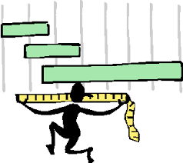
lengthen
the length = noun
to lengthen = verb

Slide 124
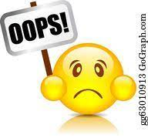
mistaken
a mistake = noun
to mistaken = verb

Slide 125
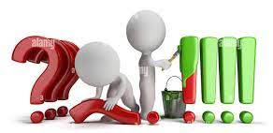
straighten
straight = adjective
to straighten = verb

Slide 126
Let’s Teach and Practise

Slide 127
Antonyms and Synonyms

Slide 128
synonyms – same meaning
antonyms – opposite meaning

Slide 129
synonyms and antonyms of ‘hot’
hot = adjective
= all adjectives

Slide 130
bitter
antonym of ‘hot’

Slide 131
wintry
antonym of ‘hot’

Slide 132
bitter
ADJECTIVE
Definition - (of wind or weather) intensely cold

Slide 133
wintry
ADJECTIVE
Definition - characteristic of winter, especially in feeling or looking very cold and bleak

Slide 134
It was a bitter February night.
______

Slide 135
A wintry landscape appeared in the early morning.
______

Slide 136
New CHALLENGE words.

Slide 137
queue
NOUN
Definition - a line or sequence of people or vehicles awaiting their turn to be attended to or to proceed

Slide 138
People joined a queue to get the new book.
_____

Slide 139
recognise
VERB
Definition - identify (someone or something) from having encountered them before; know again

Slide 140
Julia hardly recognised Jill when they met.
__________

Slide 141
sacrifice
NOUN
Definition - an act of slaughtering an animal or person or surrendering a possession as an offering to a deity

Slide 142
They offer a sacrifice to the spirits.
_________

Slide 143
Let’s Practise and Apply.

Slide 144
Water is another precious resource we should not sacrifice. We recognise the need of water to grow crops and yet, sometimes, rains fail and rivers run dry. They can run dry to the scorching sun rays in certain areas of the world. Many rivers have now been dammed, as we try to control the water supply. A dam creates a vast reservoir of water, which prevents flooding further downstream. In sweltering deserts, where there are few rivers, water that collects under the ground is used to irrigate farmland. This provides local people with food, but the ‘greening’ of the desert may cause problems in the future because more groundwater is being used than can be replaced by rain.

Slide 145
Water is another precious resource we should not sacrifice. We recognise the need of water to grow crops and yet, sometimes, rains fail and rivers run dry. They can run dry to the scorching sun rays in certain areas of the world. Many rivers have now been dammed, as we try to control the water supply. A dam creates a vast reservoir of water, which prevents flooding further downstream. In sweltering deserts, where there are few rivers, water that collects under the ground is used to irrigate farmland. This provides local people with food, but the ‘greening’ of the desert may cause problems in the future because more groundwater is being used than can be replaced by rain.

Slide 146
Write this sentence as I dictate it to you.
Notes:
In sweltering deserts, where there are few rivers, water that collects under the ground is used to irrigate farmland.

Slide 147
In sweltering deserts, where there are few rivers, water that collects under the ground is used to irrigate farmland.
Did you write it correctly?
Edit your work and make sure you have it correct.
Can you underline the spelling word that we have covered in this session?

Slide 148
Year 6 - Summer 1
Week 3 - Friday
Notes:
Click through the slides for all the R+R words for the week (both the focus and the challenge words)
Click through the slides for all the new learning this week

Slide 150
Old challenge words…

Slide 151
yacht

Slide 152
neighbour

Slide 153
Old spelling rule words…

Slide 154
amplify

Slide 155
solidify

Slide 156
signify

Slide 157
falsify

Slide 158
glorify

Slide 159
notify

Slide 160
blacken

Slide 161
brighten

Slide 162
flatten

Slide 163
lengthen

Slide 164
straighten

Slide 165
mistaken

Slide 166
New spelling rule words…

Slide 167
scorching

Slide 168
searing

Slide 169
sizzling

Slide 170
blistering

Slide 171
sweltering

Slide 172
chilly

Slide 173
frozen

Slide 174
arctic

Slide 175
bitter

Slide 176
wintry

Slide 177
New challenge words…

Slide 178
queue

Slide 179
recognise

Slide 180
sacrifice

Slide 181
Quick Quiz time…
Notes:
Say these words for the quiz
Sincere Yacht neighbour amplify falsify Queue recognise sacrifice scorching wintry

Slide 182
Did you get them correct?
Edit your work.
sincere yacht neighbour amplify falsify queue recognise sacrifice scorching wintry

Slide 183
Word class time…

Slide 184
People joined a queue to get the new book.
Noun verb determiner noun verb determiner adjective noun
Notes:
Ask for these words to be classed

Slide 185
Julia hardly recognised Jill when they met.
Noun adverb verb noun preposition pronoun verb
Notes:
Ask for these words to be classed

Slide 186
They offer a sacrifice to the spirits.
Pronoun verb determiner noun determiner noun
Notes:
Ask for these words to be classed

Slide 187
Etymology
The history of a word….

Slide 188
Queue
late 16th century (as a heraldic term denoting the tail of an animal): from French, based on Latin cauda ‘tail’. Compare with cue2. queue (sense 1 of the noun) dates from the late 18th century.
Recognise
late Middle English (earliest attested as a term in Scots law): from Old French reconniss-, stem of reconnaistre, from Latin recognoscere ‘know again, recall to mind’, from re- ‘again’ + cognoscere ‘learn’.
Sacrifice
Middle English: from Old French, from Latin sacrificium ; related to sacrificus ‘sacrificial’, from sacer ‘holy’.

Slide 189
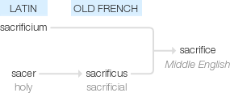

Slide 190
Let’s investigate….
Look at the word origin of the challenge words and find words that are linked to them.

