Slide 1
Spelling Y6
Mastering spellings: building on the foundations of phonics
Summer 1
Week 6

Slide 2
Year 6 - Summer 1
Week 6 - Monday

Slide 3
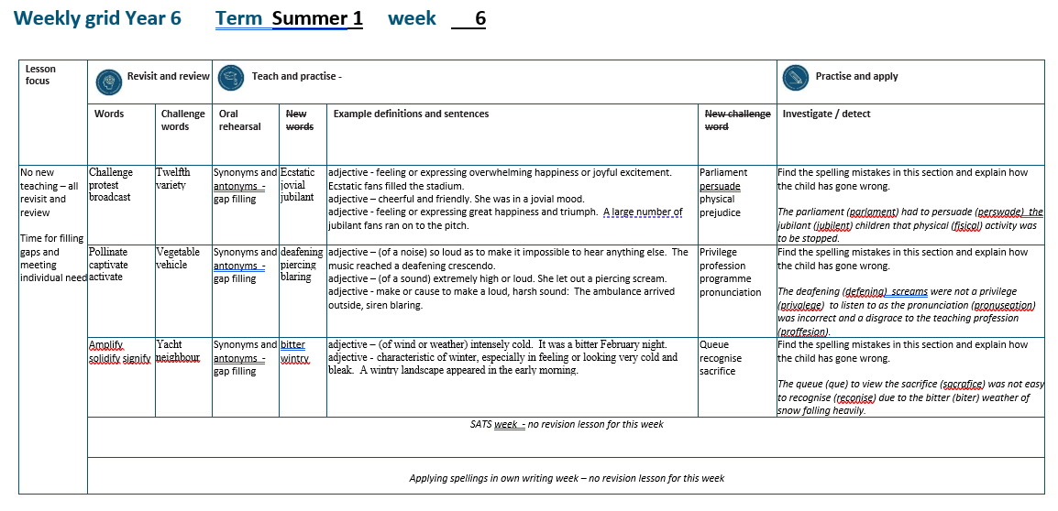

Slide 4
Let’s Revisit and Review…

Slide 5
Do you remember this challenge word?

Slide 6
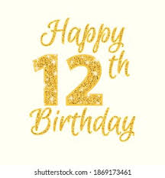
twelfth
NUMBER
Definition - constituting number twelve in a sequence

Slide 7
There is a party on the twelfth of November celebrating my birthday.
_______

Slide 8
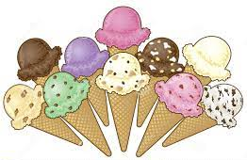
variety
NOUN
Definition - the quality or state of being different or diverse; the absence of uniformity or monotony

Slide 9
It is the variety that makes my job so enjoyable.
_______

Slide 10
Nouns as verbs

Slide 11
Noun – person / place / thing
Verb – to do / to be

Slide 12
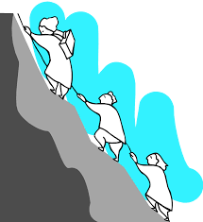
challenge
a challenge = noun
to challenge = verb

Slide 13

protest
a protest = noun
to protest = verb

Slide 14

broadcast
a broadcast = noun
to broadcast = verb

Slide 15
Let’s Teach and Practise

Slide 16
Antonyms and Synonyms

Slide 17
synonyms – same meaning
antonyms – opposite meaning

Slide 18
synonyms and antonyms of ‘happy’
happy = adjective
= all adjectives

Slide 19

ecstatic
synonym of ‘happy’

Slide 20
jovial
synonym of ‘happy’

Slide 21
jubilant
synonym of ‘happy’

Slide 22
ecstatic
ADJECTIVE
Definition - feeling or expressing overwhelming happiness or joyful excitement

Slide 23
jovial
ADJECTIVE
Definition - cheerful and friendly

Slide 24
jubilant
ADJECTIVE
Definition - feeling or expressing great happiness and triumph

Slide 25
Ecstatic fans filled the stadium.
________

Slide 26
She was in a jovial mood.
______

Slide 27
A large number of jubilant fans ran on to the pitch.
________

Slide 28
New CHALLENGE words.

Slide 29
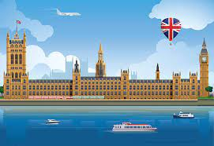
parliament
NOUN
Definition - (in the UK) the highest legislature, consisting of the Sovereign, the House of Lords, and the House of Commons

Slide 30
The minister will lay proposals before Parliament.
__________

Slide 31
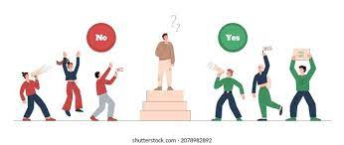
persuade
VERB
Definition - induce (someone) to do something through reasoning or argument

Slide 32
It was easy to persuade you.
________

Slide 33
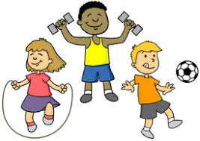
physical
ADJECTIVE
Definition - relating to the body as opposed to the mind

Slide 34
Physical challenges are tough.
________

Slide 35
prejudice
NOUN
Definition - preconceived opinion that is not based on reason or actual experience

Slide 36
Prejudice against people from different backgrounds is wrong.
_________

Slide 37
Let’s investigate.

Slide 38
Can you spot the spelling errors in these sentences?
Write the correct spelling and explain where they went wrong.

Slide 39
The parlament had to perswade the jubilent children that fisical activity was to be stopped.

Slide 40
The parlament had to perswade the jubilent children that fisical activity was to be stopped.

Slide 41
The parlament had to perswade the jubilent children that fisical activity was to be stopped. parliament – ‘i’ missing

Slide 42
The parlament had to perswade the jubilent children that fisical activity was to be stopped. persuade – ‘u’ not ‘w’

Slide 43
The parlament had to perswade the jubilent children that fisical activity was to be stopped. jubilant – ‘a’ not ‘e’

Slide 44
The parlament had to perswade the jubilent children that fisical activity was to be stopped. physical – ‘phy’ not ‘fi’

Slide 45
The parliament had to persuade the jubilant children that physical activity was to be stopped.

Slide 46
Year 6 - Summer 1
Week 6 - Tuesday

Slide 48
Let’s Revisit and Review…

Slide 49
Do you remember this challenge word?

Slide 50
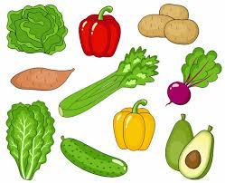
vegetable
NOUN
Definition - a plant or part of a plant used as food, such as a cabbage, potato, turnip, or bean

Slide 51
Fresh fruit and vegetables are required for a healthy diet.
__________

Slide 52
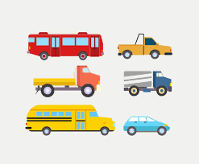
vehicle
NOUN
Definition - a thing used for transporting people or goods, especially on land, such as a car, lorry, or cart

Slide 53
The vehicle was sent skidding across the road.
_______

Slide 54
Nouns and adjectives into verbs – ate / ise

Slide 55
Noun – person / place / thing
Adjective – describing a noun
Verb – to do / to be

Slide 56
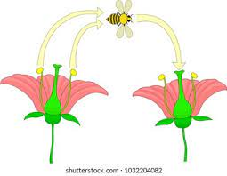
pollinate
the pollen = noun
to pollinate = verb

Slide 57

captivate
a captive = noun
to captivate = verb

Slide 58
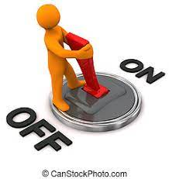
activate
active = adjective
to activate = verb

Slide 59
Let’s Teach and Practise

Slide 60
Antonyms and Synonyms

Slide 61
synonyms – same meaning
antonyms – opposite meaning

Slide 62
synonyms and antonyms of ‘loud’
loud = adjective
= all adjectives

Slide 63
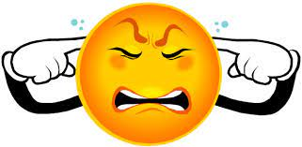
deafening
synonym of ‘loud’

Slide 64
piercing
synonym of ‘loud’

Slide 65
blaring
synonym of ‘loud’

Slide 66
deafening
ADJECTIVE
Definition - (of a noise) so loud as to make it impossible to hear anything else

Slide 67
piercing
ADJECTIVE
Definition - (of a sound) extremely high or loud

Slide 68
blaring
ADJECTIVE
Definition - make or cause to make a loud, harsh sound

Slide 69
The music reached a deafening crescendo.
__________

Slide 70
She let out a piercing scream.
________

Slide 71
The ambulance arrived outside, siren blaring.
_______

Slide 72
New CHALLENGE words.

Slide 73

privilege
NOUN
Definition - a special right, advantage, or immunity granted or available only to a particular person or group

Slide 74
Education is a right, not a privilege.
_________

Slide 75
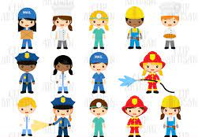
profession
NOUN
Definition - a paid occupation, especially one that involves prolonged training and a formal qualification

Slide 76
This chosen profession of teaching is virtuous.
__________

Slide 77
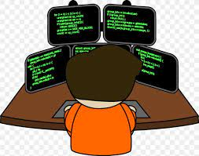
programme
NOUN
Definition - a set of related measures or activities with a particular long-term aim

Slide 78
An extensive programme of reforms was set up.
_________

Slide 79
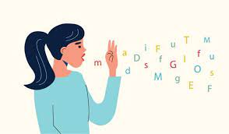
pronunciation
NOUN
Definition - the way in which a word is pronounced

Slide 80
Spelling does not determine pronunciation.
_____________

Slide 81
Let’s investigate.

Slide 82
Can you spot the spelling errors in these sentences?
Write the correct spelling and explain where they went wrong.

Slide 83
The defening screeches were not a privalege to listen to as the pronuseation was incorrect and a disgrace to the singing proffesion.

Slide 84
The defening screeches were not a privalege to listen to as the pronuseation was incorrect and a disgrace to the singing proffesion.

Slide 85
The defening screeches were not a privalege to listen to as the pronuseation was incorrect and a disgrace to the singing proffesion. deafening – ‘a’ missing

Slide 86
The defening screeches were not a privalege to listen to as the pronuseation was incorrect and a disgrace to the singing proffesion. privilege – ‘i’ not ‘a’

Slide 87
The defening screeches were not a privalege to listen to as the pronuseation was incorrect and a disgrace to the singing proffesion. pronunciation – ‘nci’ not ‘se’

Slide 88
The defening screeches were not a privalege to listen to as the pronuseation was incorrect and a disgrace to the singing proffesion.
Profession – double ‘s’ not ‘f’

Slide 89
The deafening screeches were not a privilege to listen to as the pronunciation was incorrect and a disgrace to the singing profession.

Slide 90
Year 6 – Summer 1
Week 6 - Wednesday

Slide 92
Let’s Revisit and Review…

Slide 93
Do you remember this challenge word?

Slide 94
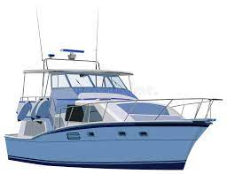
yacht
NOUN
Definition - a medium-sized sailing boat equipped for cruising or racing

Slide 95
The red yacht was in the lead.
_____

Slide 96
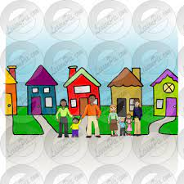
neighbour
NOUN
Definition - a person living next door to or very near to the speaker or person referred to

Slide 97
Our garden was the envy of the neighbours.
__________

Slide 98
Nouns and adjectives into verbs
–fy = to make so
-en

Slide 99
Noun – person / place / thing
Adjective – describing a noun
Verb – to do / to be

Slide 100

amplify
ample = adjective
to amplify = verb

Slide 101
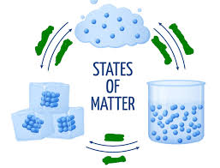
solidify
a solid = noun
to solidify = verb

Slide 102

signify
a sign = noun
to signify = verb

Slide 103
Let’s Teach and Practise

Slide 104
Antonyms and Synonyms

Slide 105
synonyms – same meaning
antonyms – opposite meaning

Slide 106
synonyms and antonyms of ‘hot’
hot = adjective
= all adjectives

Slide 107

scorching
synonym of ‘hot’

Slide 108
searing
synonym of ‘hot’

Slide 109
sizzling
synonym of ‘hot’

Slide 110
scorching
ADJECTIVE
Definition - very hot

Slide 111
searing
ADJECTIVE
Definition - extremely hot or intense

Slide 112
sizzling
ADJECTIVE
Definition - very hot

Slide 113
The sun was scorching in July.
_________

Slide 114
The searing heat of the sun is intense.
_______

Slide 115
The sizzling summer temperatures meant you had to be careful and apply sun cream.
________

Slide 116
New CHALLENGE words.

Slide 117
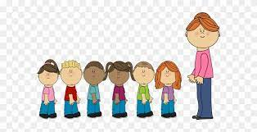
queue
NOUN
Definition - a line or sequence of people or vehicles awaiting their turn to be attended to or to proceed

Slide 118
People joined a queue to get the new book.
_____

Slide 119

recognise
VERB
Definition - identify (someone or something) from having encountered them before; know again

Slide 120
Julia hardly recognised Jill when they met.
__________

Slide 121

sacrifice
NOUN
Definition - an act of slaughtering an animal or person or surrendering a possession as an offering to a deity

Slide 122
They offer a sacrifice to the spirits.
_________

Slide 123
Let’s investigate.

Slide 124
Can you spot the spelling errors in these sentences?
Write the correct spelling and explain where they went wrong.

Slide 125
The que to view the sacrafice was not easy to reconise due to the biter weather of snow falling heavily.

Slide 126
The que to view the sacrafice was not easy to reconise due to the biter weather of snow falling heavily.

Slide 127
The que to view the sacrafice was not easy to reconise due to the biter weather of snow falling heavily. queue – ‘ue’ missing from the end

Slide 128
The que to view the sacrafice was not easy to reconise due to the biter weather of snow falling heavily. sacrifice – ‘i’ not ‘a’

Slide 129
The que to view the sacrafice was not easy to reconise due to the biter weather of snow falling heavily. recognise – ‘g’ missing

Slide 130
The que to view the sacrafice was not easy to reconise due to the biter weather of snow falling heavily. bitter – short vowel sound so double the consonant

Slide 131
The queue to view the sacrifice was not easy to recognise due to the bitter weather of snow falling heavily.

Slide 132
Year 6 - Summer 1
Week 6 - Thursday

Slide 134
Let’s Revisit and Review…

Slide 135
Time to address own, and class, spelling misconceptions.

Slide 136
Year 6 - Summer 1
Week 6 - Friday

Slide 138
Let’s Revisit and Review…

Slide 139
Time to address own, and class, spelling misconceptions.

