Slide 1
Spelling Y6
Mastering spellings: building on the foundations of phonics
Summer 2
Week 1

Slide 2
Year 6 - Summer 2
Week 1 - Monday

Slide 3
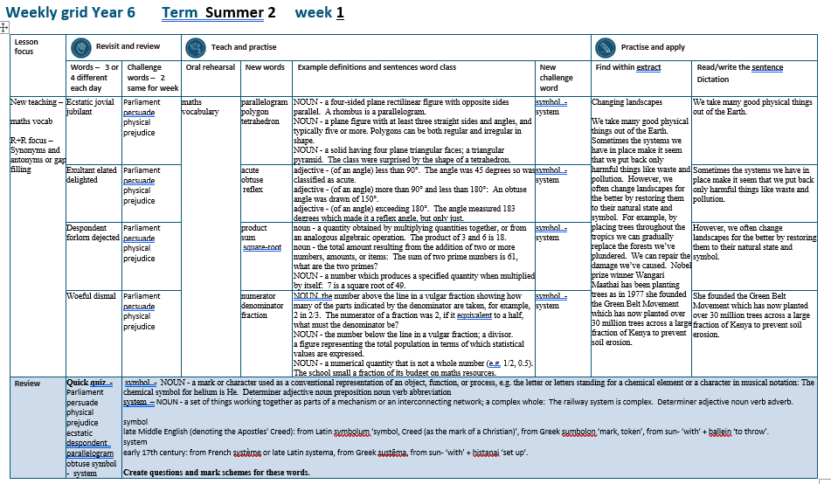

Slide 4
Let’s Revisit and Review…

Slide 5
Do you remember this challenge word?

Slide 6
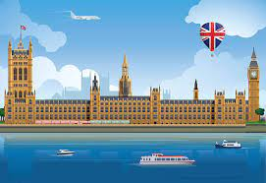
parliament
NOUN
Definition - (in the UK) the highest legislature, consisting of the Sovereign, the House of Lords, and the House of Commons

Slide 7
The minister will lay proposals before Parliament.
__________

Slide 8
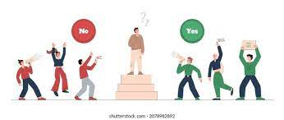
persuade
VERB
Definition - induce (someone) to do something through reasoning or argument

Slide 9
It was easy to persuade you.
________

Slide 10
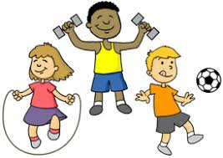
physical
ADJECTIVE
Definition - relating to the body as opposed to the mind

Slide 11
Physical challenges are tough.
________

Slide 12
prejudice
NOUN
Definition - preconceived opinion that is not based on reason or actual experience

Slide 13
Prejudice against people from different backgrounds is wrong.
_________

Slide 14
Antonyms and Synonyms

Slide 15
synonyms – same meaning
antonyms – opposite meaning

Slide 16
synonyms and antonyms of ‘happy’
happy = adjective
= all adjectives

Slide 17
ecstatic
synonym of ‘happy’

Slide 18
jovial
synonym of ‘happy’

Slide 19
jubilant
synonym of ‘happy’

Slide 20
Let’s Teach and Practise

Slide 21
maths vocabulary

Slide 22
parallelogram

Slide 23
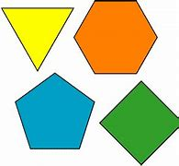
polygon

Slide 24
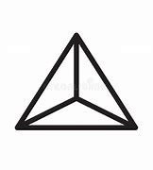
tetrahedron

Slide 25
parallelogram
NOUN
Definition - a four-sided plane rectilinear figure with opposite sides parallel

Slide 26
polygon
NOUN
Definition - a plane figure with at least three straight sides and angles, and typically five or more

Slide 27
tetrahedron
NOUN
Definition - a solid having four plane triangular faces; a triangular pyramid

Slide 28
A rhombus is a parallelogram.
_____________

Slide 29
Polygons can be both regular and irregular in shape.
________

Slide 30
The class were surprised by the shape of a tetrahedron.
___________

Slide 31
New CHALLENGE words.

Slide 32
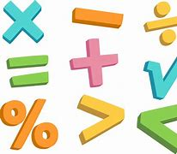
symbol
NOUN
Definition - a mark or character used as a conventional representation of an object, function, or process

Slide 33
The chemical symbol for helium is He
______

Slide 34
system
NOUN
Definition - a set of things working together as parts of a mechanism or an interconnecting network; a complex whole

Slide 35
The railway system is complex.
______

Slide 36
Let’s Practise and Apply.

Slide 37
Changing landscapes We take many good physical things out of the Earth. Sometimes the systems we have in place make it seem that we put back only harmful things like waste and pollution. However, we often change landscapes for the better by restoring them to their natural state and symbol. For example, by placing trees throughout the tropics we can gradually replace the forests we’ve plundered. We can repair the damage we’ve caused. Nobel prize winner Wangari Maathai has been planting trees as in 1977 she founded the Green Belt Movement which has now planted over 30 million trees across a large fraction of Kenya to prevent soil erosion.

Slide 38
Changing landscapes We take many good physical things out of the Earth. Sometimes the systems we have in place make it seem that we put back only harmful things like waste and pollution. However, we often change landscapes for the better by restoring them to their natural state and symbol. For example, by placing trees throughout the tropics we can gradually replace the forests we’ve plundered. We can repair the damage we’ve caused. Nobel prize winner Wangari Maathai has been planting trees as in 1977 she founded the Green Belt Movement which has now planted over 30 million trees across a large fraction of Kenya to prevent soil erosion.

Slide 39
Write this sentence as I dictate it to you.
Notes:
We take many good physical things out of the Earth.

Slide 40
We take many good physical things out of the Earth.
Did you write it correctly?
Edit your work and make sure you have it correct.
Can you underline the spelling word that we have covered in this session?

Slide 41
Year 6 - Summer 2
Week 1 - Tuesday
Notes:
Revisit and review the words from previous teaching and challenge words – I say, we say, you say
Ask children to write words only in their spelling book
Introduce the new spelling rule
Children to write the new spelling rule words and challenge words into books when the sentences are shown with the spelling word missing.
Read the extract with the class as choral reading. Practise model of prosody etc.
Ask children to find the spelling words from the session in the text.
Then read allowed the chosen sentence for children to write fully in their books.
Show the extract and ask children to then edit their work to check they were correct in their dictation.

Slide 43
Let’s Revisit and Review…

Slide 44
Do you remember this challenge word?

Slide 45
parliament
NOUN
Definition - (in the UK) the highest legislature, consisting of the Sovereign, the House of Lords, and the House of Commons

Slide 46
The minister will lay proposals before Parliament.
__________

Slide 47
persuade
VERB
Definition - induce (someone) to do something through reasoning or argument

Slide 48
It was easy to persuade you.
________

Slide 49
physical
ADJECTIVE
Definition - relating to the body as opposed to the mind

Slide 50
Physical challenges are tough.
________

Slide 51
prejudice
NOUN
Definition - preconceived opinion that is not based on reason or actual experience

Slide 52
Prejudice against people from different backgrounds is wrong.
_________

Slide 53
Antonyms and Synonyms

Slide 54
synonyms – same meaning
antonyms – opposite meaning

Slide 55
synonyms and antonyms of ‘happy’
happy = adjective
= all adjectives

Slide 56
exultant
synonym of ‘happy’

Slide 57
elated
synonym of ‘happy’

Slide 58
delighted
synonym of ‘happy’

Slide 59
Let’s Teach and Practise

Slide 60
maths vocabulary

Slide 61
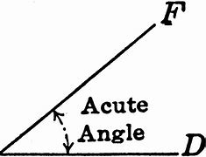
acute

Slide 62
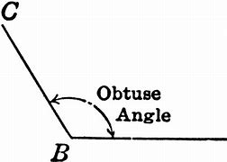
obtuse

Slide 63
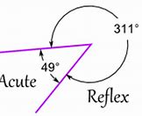
reflex

Slide 64
acute
ADJECTIVE
Definition - (of an angle) less than 90°

Slide 65
obtuse
ADJECTIVE
Definition - (of an angle) more than 90° and less than 180°

Slide 66
reflex
ADJECTIVE
Definition - (of an angle) exceeding 180°

Slide 67
The angle was 45 degrees so was classified as acute.
_____

Slide 68
An obtuse angle was drawn of 150°.
______

Slide 69
The angle measured 183 degrees which made it a reflex angle, but only just.
_____

Slide 70
New CHALLENGE words.

Slide 71
symbol
NOUN
Definition - a mark or character used as a conventional representation of an object, function, or process

Slide 72
The chemical symbol for helium is He
______

Slide 73
system
NOUN
Definition - a set of things working together as parts of a mechanism or an interconnecting network; a complex whole

Slide 74
The railway system is complex.
______

Slide 75
Let’s Practise and Apply.

Slide 76
Changing landscapes We take many good physical things out of the Earth. Sometimes the systems we have in place make it seem that we put back only harmful things like waste and pollution. However, we often change landscapes for the better by restoring them to their natural state and symbol. For example, by placing trees throughout the tropics we can gradually replace the forests we’ve plundered. We can repair the damage we’ve caused. Nobel prize winner Wangari Maathai has been planting trees as in 1977 she founded the Green Belt Movement which has now planted over 30 million trees across a large fraction of Kenya to prevent soil erosion.

Slide 77
Changing landscapes We take many good physical things out of the Earth. Sometimes the systems we have in place make it seem that we put back only harmful things like waste and pollution. However, we often change landscapes for the better by restoring them to their natural state and symbol. For example, by placing trees throughout the tropics we can gradually replace the forests we’ve plundered. We can repair the damage we’ve caused. Nobel prize winner Wangari Maathai has been planting trees as in 1977 she founded the Green Belt Movement which has now planted over 30 million trees across a large fraction of Kenya to prevent soil erosion.

Slide 78
Write this sentence as I dictate it to you.
Notes:
Sometimes the systems we have in place make it seem that we put back only harmful things like waste and pollution.

Slide 79
Sometimes the systems we have in place make it seem that we put back only harmful things like waste and pollution.
Did you write it correctly?
Edit your work and make sure you have it correct.
Can you underline the spelling word that we have covered in this session?

Slide 80
Year 6 - Summer 2
Week 1 - Wednesday
Notes:
Revisit and review the words from previous teaching and challenge words – I say, we say, you say
Ask children to write words only in their spelling book
Introduce the new spelling rule
Children to write the new spelling rule words and challenge words into books when the sentences are shown with the spelling word missing.
Read the extract with the class as choral reading. Practise model of prosody etc.
Ask children to find the spelling words from the session in the text.
Then read allowed the chosen sentence for children to write fully in their books.
Show the extract and ask children to then edit their work to check they were correct in their dictation.

Slide 82
Let’s Revisit and Review…

Slide 83
Do you remember this challenge word?

Slide 84
parliament
NOUN
Definition - (in the UK) the highest legislature, consisting of the Sovereign, the House of Lords, and the House of Commons

Slide 85
The minister will lay proposals before Parliament.
__________

Slide 86
persuade
VERB
Definition - induce (someone) to do something through reasoning or argument

Slide 87
It was easy to persuade you.
________

Slide 88
physical
ADJECTIVE
Definition - relating to the body as opposed to the mind

Slide 89
Physical challenges are tough.
________

Slide 90
prejudice
NOUN
Definition - preconceived opinion that is not based on reason or actual experience

Slide 91
Prejudice against people from different backgrounds is wrong.
_________

Slide 92
Antonyms and Synonyms

Slide 93
synonyms – same meaning
antonyms – opposite meaning

Slide 94
synonyms and antonyms of ‘happy’
happy = adjective
= all adjectives

Slide 95
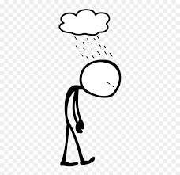
despondent
antonym of ‘happy’

Slide 96
forlorn
antonym of ‘happy’

Slide 97
dejected
antonym of ‘happy’

Slide 98
Let’s Teach and Practise

Slide 99
maths vocabulary

Slide 100
product

Slide 101
sum

Slide 102
square-root

Slide 103
product
NOUN
Definition - a quantity obtained by multiplying quantities together, or from an analogous algebraic operation

Slide 104
sum
NOUN
Definition - the total amount resulting from the addition of two or more numbers, amounts, or items

Slide 105
square-root
NOUN
Definition - a number which produces a specified quantity when multiplied by itself:

Slide 106
The product of 3 and 6 is 18.
_______

Slide 107
The sum of two prime numbers is 61, what are the two primes?
___

Slide 108
7 is a square root of 49.
___________

Slide 109
New CHALLENGE words.

Slide 110
symbol
NOUN
Definition - a mark or character used as a conventional representation of an object, function, or process

Slide 111
The chemical symbol for helium is He
______

Slide 112
system
NOUN
Definition - a set of things working together as parts of a mechanism or an interconnecting network; a complex whole

Slide 113
The railway system is complex.
______

Slide 114
Let’s Practise and Apply.

Slide 115
Changing landscapes We take many good physical things out of the Earth. Sometimes the systems we have in place make it seem that we put back only harmful things like waste and pollution. However, we often change landscapes for the better by restoring them to their natural state and symbol. For example, by placing trees throughout the tropics we can gradually replace the forests we’ve plundered. We can repair the damage we’ve caused. Nobel prize winner Wangari Maathai has been planting trees as in 1977 she founded the Green Belt Movement which has now planted over 30 million trees across a large fraction of Kenya to prevent soil erosion.

Slide 116
Changing landscapes We take many good physical things out of the Earth. Sometimes the systems we have in place make it seem that we put back only harmful things like waste and pollution. However, we often change landscapes for the better by restoring them to their natural state and symbol. For example, by placing trees throughout the tropics we can gradually replace the forests we’ve plundered. We can repair the damage we’ve caused. Nobel prize winner Wangari Maathai has been planting trees as in 1977 she founded the Green Belt Movement which has now planted over 30 million trees across a large fraction of Kenya to prevent soil erosion.

Slide 117
Write this sentence as I dictate it to you.
Notes:
However, we often change landscapes for the better by restoring them to their natural state and symbol.

Slide 118
However, we often change landscapes for the better by restoring them to their natural state and symbol.
Did you write it correctly?
Edit your work and make sure you have it correct.
Can you underline the spelling word that we have covered in this session?

Slide 119
Year 6 - Summer 2
Week 1 - Thursday
Notes:
Revisit and review the words from previous teaching and challenge words – I say, we say, you say
Ask children to write words only in their spelling book
Introduce the new spelling rule
Children to write the new spelling rule words and challenge words into books when the sentences are shown with the spelling word missing.
Read the extract with the class as choral reading. Practise model of prosody etc.
Ask children to find the spelling words from the session in the text.
Then read allowed the chosen sentence for children to write fully in their books.
Show the extract and ask children to then edit their work to check they were correct in their dictation.

Slide 121
Let’s Revisit and Review…

Slide 122
Do you remember this challenge word?

Slide 123
parliament
NOUN
Definition - (in the UK) the highest legislature, consisting of the Sovereign, the House of Lords, and the House of Commons

Slide 124
The minister will lay proposals before Parliament.
__________

Slide 125
persuade
VERB
Definition - induce (someone) to do something through reasoning or argument

Slide 126
It was easy to persuade you.
________

Slide 127
physical
ADJECTIVE
Definition - relating to the body as opposed to the mind

Slide 128
Physical challenges are tough.
________

Slide 129
prejudice
NOUN
Definition - preconceived opinion that is not based on reason or actual experience

Slide 130
Prejudice against people from different backgrounds is wrong.
_________

Slide 131
Antonyms and Synonyms

Slide 132
synonyms – same meaning
antonyms – opposite meaning

Slide 133
synonyms and antonyms of ‘happy’
happy = adjective
= all adjectives

Slide 134
woeful
antonym of ‘happy’

Slide 135
dismal
antonym of ‘happy’

Slide 136
Let’s Teach and Practise

Slide 137
maths vocabulary

Slide 138
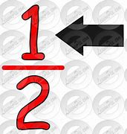
numerator

Slide 139
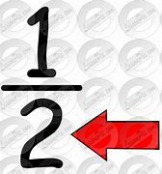
denominator

Slide 140
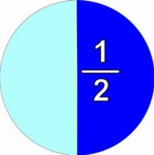
fraction

Slide 141
numerator
NOUN
Definition - the number above the line in a vulgar fraction showing how many of the parts indicated by the denominator are taken

Slide 142
denominator
NOUN
Definition - the number below the line in a vulgar fraction; a divisor.
a figure representing the total population in terms of which statistical values are expressed.

Slide 143
fraction
NOUN
Definition - a numerical quantity that is not a whole number

Slide 144
The numerator of a fraction was 2, if it equivalent to a half, what must the denominator be?
_________

Slide 145
The numerator of a fraction was 2, if it equivalent to a half, what must the denominator be?
__________

Slide 146
The school spent a fraction of its budget on maths resources.
________

Slide 147
New CHALLENGE words.

Slide 148
symbol
NOUN
Definition - a mark or character used as a conventional representation of an object, function, or process

Slide 149
The chemical symbol for helium is He
______

Slide 150
system
NOUN
Definition - a set of things working together as parts of a mechanism or an interconnecting network; a complex whole

Slide 151
The railway system is complex.
______

Slide 152
Let’s Practise and Apply.

Slide 153
Changing landscapes We take many good physical things out of the Earth. Sometimes the systems we have in place make it seem that we put back only harmful things like waste and pollution. However, we often change landscapes for the better by restoring them to their natural state and symbol. For example, by placing trees throughout the tropics we can gradually replace the forests we’ve plundered. We can repair the damage we’ve caused. Nobel prize winner Wangari Maathai has been planting trees as in 1977 she founded the Green Belt Movement which has now planted over 30 million trees across a large fraction of Kenya to prevent soil erosion.

Slide 154
Changing landscapes We take many good physical things out of the Earth. Sometimes the systems we have in place make it seem that we put back only harmful things like waste and pollution. However, we often change landscapes for the better by restoring them to their natural state and symbol. For example, by placing trees throughout the tropics we can gradually replace the forests we’ve plundered. We can repair the damage we’ve caused. Nobel prize winner Wangari Maathai has been planting trees as in 1977 she founded the Green Belt Movement which has now planted over 30 million trees across a large fraction of Kenya to prevent soil erosion.

Slide 155
Write this sentence as I dictate it to you.
Notes:
She founded the Green Belt Movement which has now planted over 30 million trees across a large fraction of Kenya to prevent soil erosion.

Slide 156
She founded the Green Belt Movement which has now planted over 30 million trees across a large fraction of Kenya to prevent soil erosion.
Did you write it correctly?
Edit your work and make sure you have it correct.
Can you underline the spelling word that we have covered in this session?

Slide 157
Year 6 - Summer 2
Week 1 - Friday
Notes:
Click through the slides for all the R+R words for the week (both the focus and the challenge words)
Click through the slides for all the new learning this week

Slide 159
Old challenge words…

Slide 160
parliament

Slide 161
persuade

Slide 162
physical

Slide 163
prejudice

Slide 164
Old spelling rule words…

Slide 165
ecstatic

Slide 166
jovial

Slide 167
jubilant

Slide 168
exultant

Slide 169
elated

Slide 170
delighted

Slide 171
dispondent

Slide 172
forlorn

Slide 173
dejected

Slide 174
woeful

Slide 175
dismal

Slide 176
New spelling rule words…

Slide 177
parallelogram

Slide 178
polygon

Slide 179
tetrahedron

Slide 180
obtuse

Slide 181
acute

Slide 182
reflex

Slide 183
product

Slide 184
sum

Slide 185
square-root

Slide 186
numerator

Slide 187
denominator

Slide 188
fraction

Slide 189
New challenge words…

Slide 190
symbol

Slide 191
system

Slide 192
Quick Quiz time…
Notes:
Say these words for the quiz
Parliament persuade physical prejudice ecstatic despondent parallelogram obtuse symbol - system

Slide 193
Did you get them correct?
Edit your work.
parliament persuade physical prejudice ecstatic despondent parallelogram obtuse symbol system

Slide 194
Word class time…

Slide 195
The chemical symbol for helium is He.
Determiner adjective noun preposition noun verb abbreviation
Notes:
Ask for these words to be classed

Slide 196
The railway system is complex.
Determiner adjective noun verb adverb.
Notes:
Ask for these words to be classed

Slide 197
Etymology
The history of a word….

Slide 198
Symbol
late Middle English (denoting the Apostles' Creed): from Latin symbolum ‘symbol, Creed (as the mark of a Christian)’, from Greek sumbolon ‘mark, token’, from sun- ‘with’ + ballein ‘to throw’.
System
early 17th century: from French système or late Latin systema, from Greek sustēma, from sun- ‘with’ + histanai ‘set up’.

Slide 199
Let’s investigate….
Create questions and mark schemes for these words.

