Slide 1
Spelling Y6
Mastering spellings: building on the foundations of phonics
Summer 2
Week 2

Slide 2
Year 6 - Summer 2
Week 2 - Monday

Slide 3
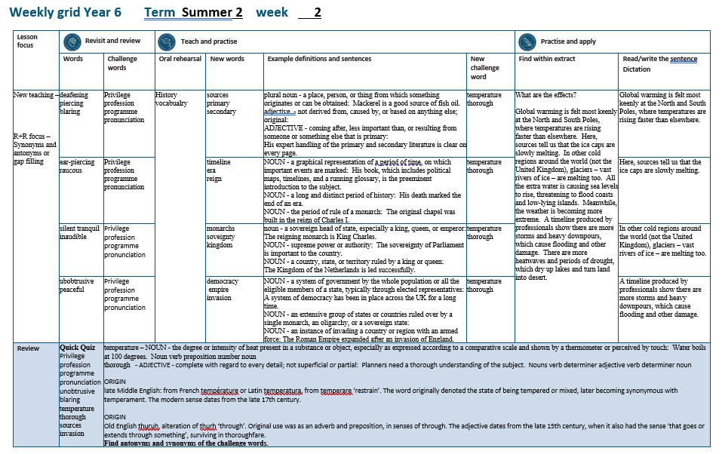

Slide 4
Let’s Revisit and Review…

Slide 5
Do you remember this challenge word?

Slide 6

privilege
NOUN
Definition - a special right, advantage, or immunity granted or available only to a particular person or group

Slide 7
Education is a right, not a privilege.
_________

Slide 8

profession
NOUN
Definition - a paid occupation, especially one that involves prolonged training and a formal qualification

Slide 9
This chosen profession of teaching is virtuous.
__________

Slide 10

programme
NOUN
Definition - a set of related measures or activities with a particular long-term aim

Slide 11
An extensive programme of reforms was set up.
_________

Slide 12

pronunciation
NOUN
Definition - the way in which a word is pronounced

Slide 13
Spelling does not determine pronunciation.
_____________

Slide 14
Antonyms and Synonyms

Slide 15
synonyms – same meaning
antonyms – opposite meaning

Slide 16
synonyms and antonyms of ‘loud’
loud = adjective
= all adjectives

Slide 17

deafening
synonym of ‘loud’

Slide 18
piercing
synonym of ‘loud’

Slide 19
blaring
synonym of ‘loud’

Slide 20
Let’s Teach and Practise

Slide 21
History vocabulary

Slide 22

sources

Slide 23

primary

Slide 24

secondary

Slide 25
sources
NOUN
Definition - a place, person, or thing from which something originates or can be obtained

Slide 26
primary
ADJECTIVE
Definition - not derived from, caused by, or based on anything else; original:

Slide 27
secondary
ADJECTIVE
Definition - coming after, less important than, or resulting from someone or something else that is primary:

Slide 28
Mackerel is a good source of fish oil.
______

Slide 29
His expert handling of the primary and secondary literature is clear on every page.
_______

Slide 30
His expert handling of the primary and secondary literature is clear on every page.
_________

Slide 31
New CHALLENGE words.

Slide 32
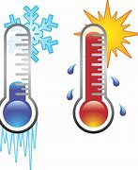
temperature
NOUN
Definition - the degree or intensity of heat present in a substance or object, especially as expressed according to a comparative scale and shown by a thermometer or perceived by touch

Slide 33
Water boils at a temperature of 100 degrees.
___________

Slide 34
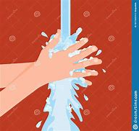
thorough
ADJECTIVE
Definition - complete with regard to every detail; not superficial or partial

Slide 35
Hands need a thorough wash to avoid germs spreading.
________

Slide 36
Let’s Practise and Apply.

Slide 37
What are the effects?
Global warming is felt most keenly at the North and South Poles, where temperatures are rising faster than elsewhere. Here, sources tell us that the ice caps are slowly melting. In other cold regions around the world (not the United Kingdom), glaciers – vast rivers of ice – are melting too. All the extra water is causing sea levels to rise, threatening to flood coasts and low-lying islands. Meanwhile, the weather is becoming more extreme. A timeline produced by professionals show there are more storms and heavy downpours, which cause flooding and other damage. There are more heatwaves and periods of drought, which dry up lakes and turn land into desert.

Slide 38
What are the effects?
Global warming is felt most keenly at the North and South Poles, where temperatures are rising faster than elsewhere. Here, sources tell us that the ice caps are slowly melting. In other cold regions around the world (not the United Kingdom), glaciers – vast rivers of ice – are melting too. All the extra water is causing sea levels to rise, threatening to flood coasts and low-lying islands. Meanwhile, the weather is becoming more extreme. A timeline produced by professionals show there are more storms and heavy downpours, which cause flooding and other damage. There are more heatwaves and periods of drought, which dry up lakes and turn land into desert.

Slide 39
Write this sentence as I dictate it to you.
Notes:
Global warming is felt most keenly at the North and South Poles, where temperatures are rising faster than elsewhere.

Slide 40
Global warming is felt most keenly at the North and South Poles, where temperatures are rising faster than elsewhere.
Did you write it correctly?
Edit your work and make sure you have it correct.
Can you underline the spelling word that we have covered in this session?

Slide 41
Year 6 - Summer 2
Week 2 - Tuesday
Notes:
Revisit and review the words from previous teaching and challenge words – I say, we say, you say
Ask children to write words only in their spelling book
Introduce the new spelling rule
Children to write the new spelling rule words and challenge words into books when the sentences are shown with the spelling word missing.
Read the extract with the class as choral reading. Practise model of prosody etc.
Ask children to find the spelling words from the session in the text.
Then read allowed the chosen sentence for children to write fully in their books.
Show the extract and ask children to then edit their work to check they were correct in their dictation.

Slide 43
Let’s Revisit and Review…

Slide 44
Do you remember this challenge word?

Slide 45
privilege
NOUN
Definition - a special right, advantage, or immunity granted or available only to a particular person or group

Slide 46
Education is a right, not a privilege.
_________

Slide 47
profession
NOUN
Definition - a paid occupation, especially one that involves prolonged training and a formal qualification

Slide 48
This chosen profession of teaching is virtuous.
__________

Slide 49
programme
NOUN
Definition - a set of related measures or activities with a particular long-term aim

Slide 50
An extensive programme of reforms was set up.
_________

Slide 51
pronunciation
NOUN
Definition - the way in which a word is pronounced

Slide 52
Spelling does not determine pronunciation.
_____________

Slide 53
Antonyms and Synonyms

Slide 54
synonyms – same meaning
antonyms – opposite meaning

Slide 55
synonyms and antonyms of ‘loud’
loud = adjective
= all adjectives

Slide 56
ear-piercing
synonym of ‘loud’

Slide 57
raucous
synonym of ‘loud’

Slide 58
ear-piercing
ADJECTIVE
Definition - loud and shrill

Slide 59
Let’s Teach and Practise

Slide 60
History vocabulary

Slide 61

timeline

Slide 62
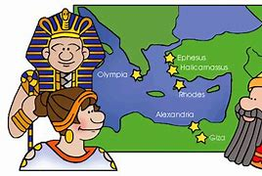
era

Slide 63

reign

Slide 64
timeline
NOUN
Definition - a graphical representation of a period of time, on which important events are marked

Slide 65
era
NOUN
Definition - a long and distinct period of history

Slide 66
reign
NOUN
Definition - the period of rule of a monarch

Slide 67
His book, which includes political maps, timelines, and a running glossary, is the preeminent introduction to the subject.
_________

Slide 68
His death marked the end of an era.
___

Slide 69
The original chapel was built in the reign of Charles I.
_____

Slide 70
New CHALLENGE words.

Slide 71
temperature
NOUN
Definition - the degree or intensity of heat present in a substance or object, especially as expressed according to a comparative scale and shown by a thermometer or perceived by touch

Slide 72
Water boils at a temperature of 100 degrees.
___________

Slide 73
thorough
ADJECTIVE
Definition - complete with regard to every detail; not superficial or partial

Slide 74
Hands need a thorough wash to avoid germs spreading.
________

Slide 75
Let’s Practise and Apply.

Slide 76
What are the effects?
Global warming is felt most keenly at the North and South Poles, where temperatures are rising faster than elsewhere. Here, sources tell us that the ice caps are slowly melting. In other cold regions around the world (not the United Kingdom), glaciers – vast rivers of ice – are melting too. All the extra water is causing sea levels to rise, threatening to flood coasts and low-lying islands. Meanwhile, the weather is becoming more extreme. A timeline produced by professionals show there are more storms and heavy downpours, which cause flooding and other damage. There are more heatwaves and periods of drought, which dry up lakes and turn land into desert.

Slide 77
What are the effects?
Global warming is felt most keenly at the North and South Poles, where temperatures are rising faster than elsewhere. Here, sources tell us that the ice caps are slowly melting. In other cold regions around the world (not the United Kingdom), glaciers – vast rivers of ice – are melting too. All the extra water is causing sea levels to rise, threatening to flood coasts and low-lying islands. Meanwhile, the weather is becoming more extreme. A timeline produced by professionals show there are more storms and heavy downpours, which cause flooding and other damage. There are more heatwaves and periods of drought, which dry up lakes and turn land into desert.

Slide 78
Write this sentence as I dictate it to you.
Notes:
Here, sources tell us that the ice caps are slowly melting.

Slide 79
Here, sources tell us that the ice caps are slowly melting.
Did you write it correctly?
Edit your work and make sure you have it correct.
Can you underline the spelling word that we have covered in this session?

Slide 80
Year 6 - Summer 2
Week 2 - Wednesday
Notes:
Revisit and review the words from previous teaching and challenge words – I say, we say, you say
Ask children to write words only in their spelling book
Introduce the new spelling rule
Children to write the new spelling rule words and challenge words into books when the sentences are shown with the spelling word missing.
Read the extract with the class as choral reading. Practise model of prosody etc.
Ask children to find the spelling words from the session in the text.
Then read allowed the chosen sentence for children to write fully in their books.
Show the extract and ask children to then edit their work to check they were correct in their dictation.

Slide 82
Let’s Revisit and Review…

Slide 83
Do you remember this challenge word?

Slide 84
privilege
NOUN
Definition - a special right, advantage, or immunity granted or available only to a particular person or group

Slide 85
Education is a right, not a privilege.
_________

Slide 86
profession
NOUN
Definition - a paid occupation, especially one that involves prolonged training and a formal qualification

Slide 87
This chosen profession of teaching is virtuous.
__________

Slide 88
programme
NOUN
Definition - a set of related measures or activities with a particular long-term aim

Slide 89
An extensive programme of reforms was set up.
_________

Slide 90
pronunciation
NOUN
Definition - the way in which a word is pronounced

Slide 91
Spelling does not determine pronunciation.
_____________

Slide 92
Antonyms and Synonyms

Slide 93
synonyms – same meaning
antonyms – opposite meaning

Slide 94
synonyms and antonyms of ‘loud’
loud = adjective
= all adjectives

Slide 95

silent
antonym of ‘loud’

Slide 96
tranquil
antonym of ‘loud’

Slide 97
inaudible
antonym of ‘loud’

Slide 98
Let’s Teach and Practise

Slide 99
History vocabulary

Slide 100
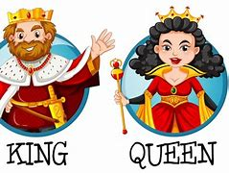
monarchs

Slide 101

sovereignty

Slide 102
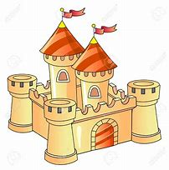
kingdom

Slide 103
monarchs
NOUN
Definition - a sovereign head of state, especially a king, queen, or emperor

Slide 104
sovereignty
NOUN
Definition - supreme power or authority

Slide 105
kingdom
NOUN
Definition - a country, state, or territory ruled by a king or queen

Slide 106
The reigning monarch is King Charles.
_______

Slide 107
The sovereignty of Parliament is important to the country.
___________

Slide 108
The Kingdom of the Netherlands is led successfully.
_______

Slide 109
New CHALLENGE words.

Slide 110
temperature
NOUN
Definition - the degree or intensity of heat present in a substance or object, especially as expressed according to a comparative scale and shown by a thermometer or perceived by touch

Slide 111
Water boils at a temperature of 100 degrees.
___________

Slide 112
thorough
ADJECTIVE
Definition - complete with regard to every detail; not superficial or partial

Slide 113
Hands need a thorough wash to avoid germs spreading.
________

Slide 114
Let’s Practise and Apply.

Slide 115
What are the effects?
Global warming is felt most keenly at the North and South Poles, where temperatures are rising faster than elsewhere. Here, sources tell us that the ice caps are slowly melting. In other cold regions around the world (not the United Kingdom), glaciers – vast rivers of ice – are melting too. All the extra water is causing sea levels to rise, threatening to flood coasts and low-lying islands. Meanwhile, the weather is becoming more extreme. A timeline produced by professionals show there are more storms and heavy downpours, which cause flooding and other damage. There are more heatwaves and periods of drought, which dry up lakes and turn land into desert.

Slide 116
What are the effects?
Global warming is felt most keenly at the North and South Poles, where temperatures are rising faster than elsewhere. Here, sources tell us that the ice caps are slowly melting. In other cold regions around the world (not the United Kingdom), glaciers – vast rivers of ice – are melting too. All the extra water is causing sea levels to rise, threatening to flood coasts and low-lying islands. Meanwhile, the weather is becoming more extreme. A timeline produced by professionals show there are more storms and heavy downpours, which cause flooding and other damage. There are more heatwaves and periods of drought, which dry up lakes and turn land into desert.

Slide 117
Write this sentence as I dictate it to you.
Notes:
In other cold regions around the world (not the United Kingdom), glaciers – vast rivers of ice – are melting too.

Slide 118
In other cold regions around the world (not the United Kingdom), glaciers – vast rivers of ice – are melting too.
Did you write it correctly?
Edit your work and make sure you have it correct.
Can you underline the spelling word that we have covered in this session?

Slide 119
Year 6 - Summer 2
Week 2 - Thursday
Notes:
Revisit and review the words from previous teaching and challenge words – I say, we say, you say
Ask children to write words only in their spelling book
Introduce the new spelling rule
Children to write the new spelling rule words and challenge words into books when the sentences are shown with the spelling word missing.
Read the extract with the class as choral reading. Practise model of prosody etc.
Ask children to find the spelling words from the session in the text.
Then read allowed the chosen sentence for children to write fully in their books.
Show the extract and ask children to then edit their work to check they were correct in their dictation.

Slide 121
Let’s Revisit and Review…

Slide 122
Do you remember this challenge word?

Slide 123
privilege
NOUN
Definition - a special right, advantage, or immunity granted or available only to a particular person or group

Slide 124
Education is a right, not a privilege.
_________

Slide 125
profession
NOUN
Definition - a paid occupation, especially one that involves prolonged training and a formal qualification

Slide 126
This chosen profession of teaching is virtuous.
__________

Slide 127
programme
NOUN
Definition - a set of related measures or activities with a particular long-term aim

Slide 128
An extensive programme of reforms was set up.
_________

Slide 129
pronunciation
NOUN
Definition - the way in which a word is pronounced

Slide 130
Spelling does not determine pronunciation.
_____________

Slide 131
Antonyms and Synonyms

Slide 132
synonyms – same meaning
antonyms – opposite meaning

Slide 133
synonyms and antonyms of ‘loud’
loud = adjective
= all adjectives

Slide 134
unobtrusive
antonym of ‘loud’

Slide 135
peaceful
antonym of ‘loud’

Slide 136
Let’s Teach and Practise

Slide 137
History vocabulary

Slide 138

democracy

Slide 139
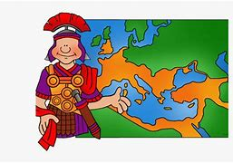
empire

Slide 140
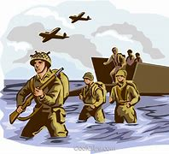
invasion

Slide 141
democracy
NOUN
Definition - - a system of government by the whole population or all the eligible members of a state, typically through elected representatives

Slide 142
empire
NOUN
Definition - an extensive group of states or countries ruled over by a single monarch, an oligarchy, or a sovereign state

Slide 143
invasion
NOUN
Definition - an instance of invading a country or region with an armed force

Slide 144
A system of democracy has been in place across the UK for a long time.
_________

Slide 145
The Roman Empire expanded after an invasion of England.
______

Slide 146
The Roman Empire expanded after an invasion of England.
________

Slide 147
New CHALLENGE words.

Slide 148
temperature
NOUN
Definition - the degree or intensity of heat present in a substance or object, especially as expressed according to a comparative scale and shown by a thermometer or perceived by touch

Slide 149
Water boils at a temperature of 100 degrees.
___________

Slide 150
thorough
ADJECTIVE
Definition - complete with regard to every detail; not superficial or partial

Slide 151
Hands need a thorough wash to avoid germs spreading.
________

Slide 152
Let’s Practise and Apply.

Slide 153
What are the effects?
Global warming is felt most keenly at the North and South Poles, where temperatures are rising faster than elsewhere. Here, sources tell us that the ice caps are slowly melting. In other cold regions around the world (not the United Kingdom), glaciers – vast rivers of ice – are melting too. All the extra water is causing sea levels to rise, threatening to flood coasts and low-lying islands. Meanwhile, the weather is becoming more extreme. A timeline produced by professionals show there are more storms and heavy downpours, which cause flooding and other damage. There are more heatwaves and periods of drought, which dry up lakes and turn land into desert.

Slide 154
What are the effects?
Global warming is felt most keenly at the North and South Poles, where temperatures are rising faster than elsewhere. Here, sources tell us that the ice caps are slowly melting. In other cold regions around the world (not the United Kingdom), glaciers – vast rivers of ice – are melting too. All the extra water is causing sea levels to rise, threatening to flood coasts and low-lying islands. Meanwhile, the weather is becoming more extreme. A timeline produced by professionals show there are more storms and heavy downpours, which cause flooding and other damage. There are more heatwaves and periods of drought, which dry up lakes and turn land into desert.

Slide 155
Write this sentence as I dictate it to you.
Notes:
A timeline produced by professionals show there are more storms and heavy downpours, which cause flooding and other damage.

Slide 156
A timeline produced by professionals show there are more storms and heavy downpours, which cause flooding and other damage.
Did you write it correctly?
Edit your work and make sure you have it correct.
Can you underline the spelling word that we have covered in this session?

Slide 157
Year 6 - Summer 2
Week 2 - Friday
Notes:
Click through the slides for all the R+R words for the week (both the focus and the challenge words)
Click through the slides for all the new learning this week

Slide 159
Old challenge words…

Slide 160
privilege

Slide 161
profession

Slide 162
programme

Slide 163
pronunciation

Slide 164
Old spelling rule words…

Slide 165
deafening

Slide 166
piercing

Slide 167
blaring

Slide 168
ear-piercing

Slide 169
raucous

Slide 170
silent

Slide 171
tranquil

Slide 172
inaudible

Slide 173
unobtrusive

Slide 174
peaceful

Slide 175
New spelling rule words…

Slide 176
sources

Slide 177
primary

Slide 178
secondary

Slide 179
timeline

Slide 180
era

Slide 181
reign

Slide 182
monarchs

Slide 183
sovereignty

Slide 184
kingdom

Slide 185
democracy

Slide 186
empire

Slide 187
invasion

Slide 188
New challenge words…

Slide 189
temperature

Slide 190
thorough

Slide 191
Quick Quiz time…
Notes:
Say these words for the quiz
Privilege profession programme pronunciation unobtrusive blaring temperature thorough sources invasion

Slide 192
Did you get them correct?
Edit your work.
privilege profession programme pronunciation unobtrusive blaring temperature thorough sources invasion

Slide 193
Word class time…

Slide 194
Water boils at a temperature of 100 degrees.
Noun verb preposition determiner noun number noun
Notes:
Ask for these words to be classed

Slide 195
Hands need a thorough wash to prevent germs from spreading.
Nouns verb determiner adjective noun verb noun preposition verb
Notes:
Ask for these words to be classed

Slide 196
Etymology
The history of a word….

Slide 197
ORIGIN
Temperature
late Middle English: from French température or Latin temperatura, from temperare ‘restrain’. The word originally denoted the state of being tempered or mixed, later becoming synonymous with temperament. The modern sense dates from the late 17th century.
ORIGIN
Thorough
Old English thuruh, alteration of thurh ‘through’. Original use was as an adverb and preposition, in senses of through. The adjective dates from the late 15th century, when it also had the sense ‘that goes or extends through something’, surviving in thoroughfare.

Slide 198
Let’s investigate….
Find antonyms and synonyms of the challenge words.

