Slide 1
Spelling Y6
Mastering spellings: building on the foundations of phonics
Summer 2
Week 3

Slide 2
Year 6 - Summer 2
Week 3 - Monday

Slide 3
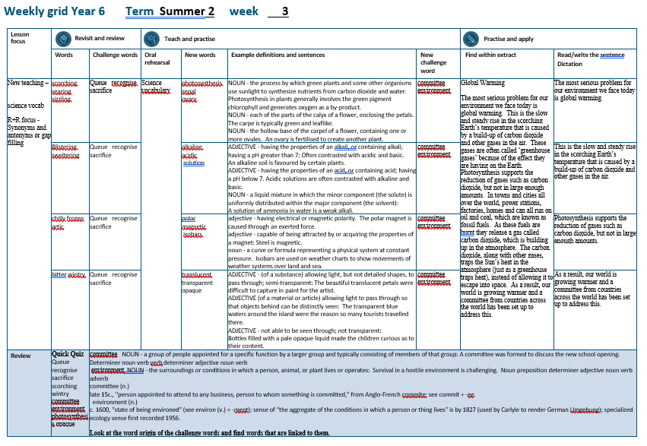

Slide 4
Let’s Revisit and Review…

Slide 5

queue
NOUN
Definition - a line or sequence of people or vehicles awaiting their turn to be attended to or to proceed

Slide 6
People joined a queue to get the new book.
_____

Slide 7

recognise
VERB
Definition - identify (someone or something) from having encountered them before; know again

Slide 8
Julia hardly recognised Jill when they met.
__________

Slide 9

sacrifice
NOUN
Definition - an act of slaughtering an animal or person or surrendering a possession as an offering to a deity

Slide 10
They offer a sacrifice to the spirits.
_________

Slide 11
Do you remember this challenge word?

Slide 12
Antonyms and Synonyms

Slide 13
synonyms – same meaning
antonyms – opposite meaning

Slide 14
synonyms and antonyms of ‘hot’
hot = adjective
= all adjectives

Slide 15

scorching
synonym of ‘hot’

Slide 16
searing
synonym of ‘hot’

Slide 17
sizzling
synonym of ‘hot’

Slide 18
Let’s Teach and Practise

Slide 19
Science vocabulary

Slide 20
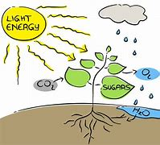
photosynthesis

Slide 21

sepal

Slide 22
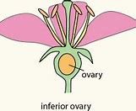
ovary

Slide 23
photosynthesis
NOUN
Definition - the process by which green plants and some other organisms use sunlight to synthesize nutrients from carbon dioxide and water

Slide 24
sepal
NOUN
Definition - each of the parts of the calyx of a flower, enclosing the petals

Slide 25
ovary
NOUN
Definition - the hollow base of the carpel of a flower, containing one or more ovules

Slide 26
Photosynthesis in plants generally involves the green pigment chlorophyll and generates oxygen as a by-product.
______________

Slide 27
The sepal is typically green and leaflike.
_____

Slide 28
An ovary is fertilised to create another plant.
_____

Slide 29
New CHALLENGE words.

Slide 30

committee
NOUN
Definition - group of people appointed for a specific function by a larger group and typically consisting of members of that group

Slide 31
A committee was formed to discuss the new school opening.
________

Slide 32

environment
NOUN
Definition - the surroundings or conditions in which a person, animal, or plant lives or operates

Slide 33
Survival in a hostile environment is challenging.
___________

Slide 34
Let’s Practise and Apply.

Slide 35
Global Warming
The most serious problem for our environment we face today is global warming. This is the slow and steady rise in the scorching Earth’s temperature that is caused by a build-up of carbon dioxide and other gases in the air. These gases are often called ‘greenhouse gases’ because of the effect they are having on the Earth. Photosynthesis supports the reduction of gases such as carbon dioxide, but not in large enough amounts. In towns and cities all over the world, power stations, factories, homes and can all run on oil and coal, which are known as fossil fuels. As these fuels are burnt they release a gas called carbon dioxide, which is building up in the atmosphere. The carbon dioxide, along with other gases, traps the Sun’s heat in the atmosphere (just as a greenhouse traps heat), instead of allowing it to escape into space. As a result, our world is growing warmer and a committee from countries across the world has been set up to address this.

Slide 36
Global Warming
The most serious problem for our environment we face today is global warming. This is the slow and steady rise in the scorching Earth’s temperature that is caused by a build-up of carbon dioxide and other gases in the air. These gases are often called ‘greenhouse gases’ because of the effect they are having on the Earth. Photosynthesis supports the reduction of gases such as carbon dioxide, but not in large enough amounts. In towns and cities all over the world, power stations, factories, homes and can all run on oil and coal, which are known as fossil fuels. As these fuels are burnt they release a gas called carbon dioxide, which is building up in the atmosphere. The carbon dioxide, along with other gases, traps the Sun’s heat in the atmosphere (just as a greenhouse traps heat), instead of allowing it to escape into space. As a result, our world is growing warmer and a committee from countries across the world has been set up to address this.

Slide 37
Write this sentence as I dictate it to you.
Notes:
The most serious problem for our environment we face today is global warming.

Slide 38
The most serious problem for our environment we face today is global warming.
Did you write it correctly?
Edit your work and make sure you have it correct.
Can you underline the spelling word that we have covered in this session?

Slide 39
Year 6 - Summer 2
Week 3 - Tuesday
Notes:
Revisit and review the words from previous teaching and challenge words – I say, we say, you say
Ask children to write words only in their spelling book
Introduce the new spelling rule
Children to write the new spelling rule words and challenge words into books when the sentences are shown with the spelling word missing.
Read the extract with the class as choral reading. Practise model of prosody etc.
Ask children to find the spelling words from the session in the text.
Then read allowed the chosen sentence for children to write fully in their books.
Show the extract and ask children to then edit their work to check they were correct in their dictation.

Slide 41
Let’s Revisit and Review…

Slide 42
queue
NOUN
Definition - a line or sequence of people or vehicles awaiting their turn to be attended to or to proceed

Slide 43
People joined a queue to get the new book.
_____

Slide 44
recognise
VERB
Definition - identify (someone or something) from having encountered them before; know again

Slide 45
Julia hardly recognised Jill when they met.
__________

Slide 46
sacrifice
NOUN
Definition - an act of slaughtering an animal or person or surrendering a possession as an offering to a deity

Slide 47
They offer a sacrifice to the spirits.
_________

Slide 48
Do you remember this challenge word?

Slide 49
Antonyms and Synonyms

Slide 50
synonyms – same meaning
antonyms – opposite meaning

Slide 51
synonyms and antonyms of ‘hot’
hot = adjective
= all adjectives

Slide 52
blistering
synonym of ‘hot’

Slide 53
sweltering
synonym of ‘hot’

Slide 54
blistering
ADJECTIVE
Definition - (of heat) intense

Slide 55
Let’s Teach and Practise

Slide 56
Science vocabulary

Slide 57
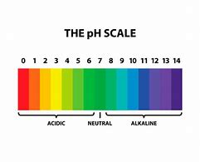
alkaline

Slide 58
acidic

Slide 59
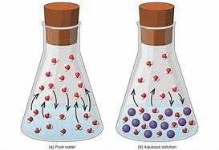
solution

Slide 60
alkaline
ADJECTIVE
Definition - having the properties of an alkali, or containing alkali; having a pH greater than 7

Slide 61
acidic
ADJECTIVE
Definition - having the properties of an acid, or containing acid; having a pH below 7

Slide 62
solution
NOUN
Definition - a liquid mixture in which the minor component (the solute) is uniformly distributed within the major component (the solvent)

Slide 63
An alkaline soil is favoured by certain plants.
________

Slide 64
Acidic solutions are often contrasted with alkaline and basic.
______

Slide 65
A solution of ammonia in water is a weak alkali.
________

Slide 66
New CHALLENGE words.

Slide 67
committee
NOUN
Definition - group of people appointed for a specific function by a larger group and typically consisting of members of that group

Slide 68
A committee was formed to discuss the new school opening.
________

Slide 69
environment
NOUN
Definition - the surroundings or conditions in which a person, animal, or plant lives or operates

Slide 70
Survival in a hostile environment is challenging.
___________

Slide 71
Let’s Practise and Apply.

Slide 72
Global Warming
The most serious problem for our environment we face today is global warming. This is the slow and steady rise in the scorching Earth’s temperature that is caused by a build-up of carbon dioxide and other gases in the air. These gases are often called ‘greenhouse gases’ because of the effect they are having on the Earth. Photosynthesis supports the reduction of gases such as carbon dioxide, but not in large enough amounts. In towns and cities all over the world, power stations, factories, homes and can all run on oil and coal, which are known as fossil fuels. As these fuels are burnt they release a gas called carbon dioxide, which is building up in the atmosphere. The carbon dioxide, along with other gases, traps the Sun’s heat in the atmosphere (just as a greenhouse traps heat), instead of allowing it to escape into space. As a result, our world is growing warmer and a committee from countries across the world has been set up to address this.

Slide 73
Global Warming
The most serious problem for our environment we face today is global warming. This is the slow and steady rise in the scorching Earth’s temperature that is caused by a build-up of carbon dioxide and other gases in the air. These gases are often called ‘greenhouse gases’ because of the effect they are having on the Earth. Photosynthesis supports the reduction of gases such as carbon dioxide, but not in large enough amounts. In towns and cities all over the world, power stations, factories, homes and can all run on oil and coal, which are known as fossil fuels. As these fuels are burnt they release a gas called carbon dioxide, which is building up in the atmosphere. The carbon dioxide, along with other gases, traps the Sun’s heat in the atmosphere (just as a greenhouse traps heat), instead of allowing it to escape into space. As a result, our world is growing warmer and a committee from countries across the world has been set up to address this.

Slide 74
Write this sentence as I dictate it to you.
Notes:
This is the slow and steady rise in the scorching Earth’s temperature that is caused by a build-up of carbon dioxide and other gases in the air.

Slide 75
This is the slow and steady rise in the scorching Earth’s temperature that is caused by a build-up of carbon dioxide and other gases in the air.
Did you write it correctly?
Edit your work and make sure you have it correct.
Can you underline the spelling word that we have covered in this session?

Slide 76
Year 6 - Summer 2
Week 3 - Wednesday
Notes:
Revisit and review the words from previous teaching and challenge words – I say, we say, you say
Ask children to write words only in their spelling book
Introduce the new spelling rule
Children to write the new spelling rule words and challenge words into books when the sentences are shown with the spelling word missing.
Read the extract with the class as choral reading. Practise model of prosody etc.
Ask children to find the spelling words from the session in the text.
Then read allowed the chosen sentence for children to write fully in their books.
Show the extract and ask children to then edit their work to check they were correct in their dictation.

Slide 78
Let’s Revisit and Review…

Slide 79
queue
NOUN
Definition - a line or sequence of people or vehicles awaiting their turn to be attended to or to proceed

Slide 80
People joined a queue to get the new book.
_____

Slide 81
recognise
VERB
Definition - identify (someone or something) from having encountered them before; know again

Slide 82
Julia hardly recognised Jill when they met.
__________

Slide 83
sacrifice
NOUN
Definition - an act of slaughtering an animal or person or surrendering a possession as an offering to a deity

Slide 84
They offer a sacrifice to the spirits.
_________

Slide 85
Do you remember this challenge word?

Slide 86
Antonyms and Synonyms

Slide 87
synonyms – same meaning
antonyms – opposite meaning

Slide 88
synonyms and antonyms of ‘hot’
hot = adjective
= all adjectives

Slide 89

chilly
antonym of ‘hot’

Slide 90
frozen
antonym of ‘hot’

Slide 91
arctic
antonym of ‘hot’

Slide 92
Let’s Teach and Practise

Slide 93
Science vocabulary

Slide 94
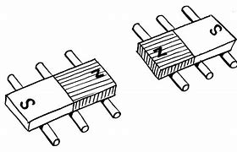
polar

Slide 95
magnetic

Slide 96
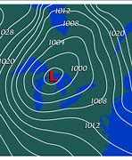
isobars

Slide 97
polar
ADJECTIVE
Definition - having electrical or magnetic polarity

Slide 98
magnetic
ADJECTIVE
Definition - capable of being attracted by or acquiring the properties of a magnet

Slide 99
isobars
NOUN
Definition - a curve or formula representing a physical system at constant pressure

Slide 100
The polar magnet is caused through an exerted force.
_____

Slide 101
Steel is magnetic.
________

Slide 102
Isobars are used on weather charts to show movements of weather systems over land and sea.
_______

Slide 103
New CHALLENGE words.

Slide 104
committee
NOUN
Definition - group of people appointed for a specific function by a larger group and typically consisting of members of that group

Slide 105
A committee was formed to discuss the new school opening.
________

Slide 106
environment
NOUN
Definition - the surroundings or conditions in which a person, animal, or plant lives or operates

Slide 107
Survival in a hostile environment is challenging.
___________

Slide 108
Let’s Practise and Apply.

Slide 109
Global Warming
The most serious problem for our environment we face today is global warming. This is the slow and steady rise in the scorching Earth’s temperature that is caused by a build-up of carbon dioxide and other gases in the air. These gases are often called ‘greenhouse gases’ because of the effect they are having on the Earth. Photosynthesis supports the reduction of gases such as carbon dioxide, but not in large enough amounts. In towns and cities all over the world, power stations, factories, homes and can all run on oil and coal, which are known as fossil fuels. As these fuels are burnt they release a gas called carbon dioxide, which is building up in the atmosphere. The carbon dioxide, along with other gases, traps the Sun’s heat in the atmosphere (just as a greenhouse traps heat), instead of allowing it to escape into space. As a result, our world is growing warmer and a committee from countries across the world has been set up to address this.

Slide 110
Global Warming
The most serious problem for our environment we face today is global warming. This is the slow and steady rise in the scorching Earth’s temperature that is caused by a build-up of carbon dioxide and other gases in the air. These gases are often called ‘greenhouse gases’ because of the effect they are having on the Earth. Photosynthesis supports the reduction of gases such as carbon dioxide, but not in large enough amounts. In towns and cities all over the world, power stations, factories, homes and can all run on oil and coal, which are known as fossil fuels. As these fuels are burnt they release a gas called carbon dioxide, which is building up in the atmosphere. The carbon dioxide, along with other gases, traps the Sun’s heat in the atmosphere (just as a greenhouse traps heat), instead of allowing it to escape into space. As a result, our world is growing warmer and a committee from countries across the world has been set up to address this.

Slide 111
Write this sentence as I dictate it to you.
Notes:
Photosynthesis supports the reduction of gases such as carbon dioxide, but not in large enough amounts.

Slide 112
Photosynthesis supports the reduction of gases such as carbon dioxide, but not in large enough amounts.
Did you write it correctly?
Edit your work and make sure you have it correct.
Can you underline the spelling word that we have covered in this session?

Slide 113
Year 6 - Summer 2
Week 3 - Thursday
Notes:
Revisit and review the words from previous teaching and challenge words – I say, we say, you say
Ask children to write words only in their spelling book
Introduce the new spelling rule
Children to write the new spelling rule words and challenge words into books when the sentences are shown with the spelling word missing.
Read the extract with the class as choral reading. Practise model of prosody etc.
Ask children to find the spelling words from the session in the text.
Then read allowed the chosen sentence for children to write fully in their books.
Show the extract and ask children to then edit their work to check they were correct in their dictation.

Slide 115
Let’s Revisit and Review…

Slide 116
queue
NOUN
Definition - a line or sequence of people or vehicles awaiting their turn to be attended to or to proceed

Slide 117
People joined a queue to get the new book.
_____

Slide 118
recognise
VERB
Definition - identify (someone or something) from having encountered them before; know again

Slide 119
Julia hardly recognised Jill when they met.
__________

Slide 120
sacrifice
NOUN
Definition - an act of slaughtering an animal or person or surrendering a possession as an offering to a deity

Slide 121
They offer a sacrifice to the spirits.
_________

Slide 122
Do you remember this challenge word?

Slide 123
Antonyms and Synonyms

Slide 124
synonyms – same meaning
antonyms – opposite meaning

Slide 125
synonyms and antonyms of ‘hot’
hot = adjective
= all adjectives

Slide 126
bitter
antonym of ‘hot’

Slide 127
wintry
antonym of ‘hot’

Slide 128
Let’s Teach and Practise

Slide 129
Science vocabulary

Slide 130
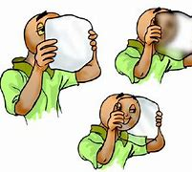
translucent

Slide 131
transparent

Slide 132
opaque

Slide 133
translucent
ADJECTIVE
Definition - (of a substance) allowing light, but not detailed shapes, to pass through; semi-transparent

Slide 134
transparent
ADJECTIVE
Definition - (of a material or article) allowing light to pass through so that objects behind can be distinctly seen

Slide 135
opaque
ADJECTIVE
Definition - not able to be seen through; not transparent

Slide 136
The beautiful translucent petals were difficult to capture in paint for the artist.
___________

Slide 137
The transparent blue waters around the island were the reason so many tourists travelled there.
___________

Slide 138
Bottles filled with a pale opaque liquid made the children curious as to their content.
______

Slide 139
New CHALLENGE words.

Slide 140
committee
NOUN
Definition - group of people appointed for a specific function by a larger group and typically consisting of members of that group

Slide 141
A committee was formed to discuss the new school opening.
________

Slide 142
environment
NOUN
Definition - the surroundings or conditions in which a person, animal, or plant lives or operates

Slide 143
Survival in a hostile environment is challenging.
___________

Slide 144
Let’s Practise and Apply.

Slide 145
Global Warming
The most serious problem for our environment we face today is global warming. This is the slow and steady rise in the scorching Earth’s temperature that is caused by a build-up of carbon dioxide and other gases in the air. These gases are often called ‘greenhouse gases’ because of the effect they are having on the Earth. Photosynthesis supports the reduction of gases such as carbon dioxide, but not in large enough amounts. In towns and cities all over the world, power stations, factories, homes and can all run on oil and coal, which are known as fossil fuels. As these fuels are burnt they release a gas called carbon dioxide, which is building up in the atmosphere. The carbon dioxide, along with other gases, traps the Sun’s heat in the atmosphere (just as a greenhouse traps heat), instead of allowing it to escape into space. As a result, our world is growing warmer and a committee from countries across the world has been set up to address this.

Slide 146
Global Warming
The most serious problem for our environment we face today is global warming. This is the slow and steady rise in the scorching Earth’s temperature that is caused by a build-up of carbon dioxide and other gases in the air. These gases are often called ‘greenhouse gases’ because of the effect they are having on the Earth. Photosynthesis supports the reduction of gases such as carbon dioxide, but not in large enough amounts. In towns and cities all over the world, power stations, factories, homes and can all run on oil and coal, which are known as fossil fuels. As these fuels are burnt they release a gas called carbon dioxide, which is building up in the atmosphere. The carbon dioxide, along with other gases, traps the Sun’s heat in the atmosphere (just as a greenhouse traps heat), instead of allowing it to escape into space. As a result, our world is growing warmer and a committee from countries across the world has been set up to address this.

Slide 147
Write this sentence as I dictate it to you.
Notes:
As a result, our world is growing warmer and a committee from countries across the world has been set up to address this.

Slide 148
As a result, our world is growing warmer and a committee from countries across the world has been set up to address this.
Did you write it correctly?
Edit your work and make sure you have it correct.
Can you underline the spelling word that we have covered in this session?

Slide 149
Year 6 - Summer 2
Week 3 - Friday
Notes:
Click through the slides for all the R+R words for the week (both the focus and the challenge words)
Click through the slides for all the new learning this week

Slide 151
Old challenge words…

Slide 152
queue

Slide 153
recognise

Slide 154
sacrifice

Slide 155
Old spelling rule words…

Slide 156
scorching

Slide 157
searing

Slide 158
sizzling

Slide 159
blistering

Slide 160
sweltering

Slide 161
chilly

Slide 162
frozen

Slide 163
arctic

Slide 164
bitter

Slide 165
wintry

Slide 166
New spelling rule words…

Slide 167
photosynthesis

Slide 168
sepal

Slide 169
ovary

Slide 170
alkaline

Slide 171
acidic

Slide 172
solution

Slide 173
polar

Slide 174
magnetic

Slide 175
isobars

Slide 176
translucent

Slide 177
transparent

Slide 178
opaque

Slide 179
New challenge words…

Slide 180
committee

Slide 181
environment

Slide 182
Quick Quiz time…
Notes:
Say these words for the quiz
Queue recognise sacrifice scorching wintry committee environment photosynthesis opaque

Slide 183
Did you get them correct?
Edit your work.
queue recognise sacrifice scorching wintry committee environment photosynthesis opaque

Slide 184
Word class time…

Slide 185
A committee was formed to discuss the new school opening.
Determiner noun verb verb determiner adjective noun verb
Notes:
Ask for these words to be classed

Slide 186
Survival in a hostile environment is challenging.
Noun preposition determiner adjective noun verb adverb
Notes:
Ask for these words to be classed

Slide 187
Etymology
The history of a word….

Slide 188
Committee (n.)
late 15c., "person appointed to attend to any business, person to whom something is committed," from Anglo-French commite; see commit + -ee.
Environment (n.)
c. 1600, "state of being environed" (see environ (v.) + -ment); sense of "the aggregate of the conditions in which a person or thing lives" is by 1827 (used by Carlyle to render German Umgebung); specialized ecology sense first recorded 1956.

Slide 189
Let’s investigate….
Look at the word origin of the challenge words and find words that are linked to them.

