Slide 1
Spelling Y6
Mastering spellings: building on the foundations of phonics
Summer 2
Week 4

Slide 2
Year 6 - Summer 2
Week 4 - Monday

Slide 3
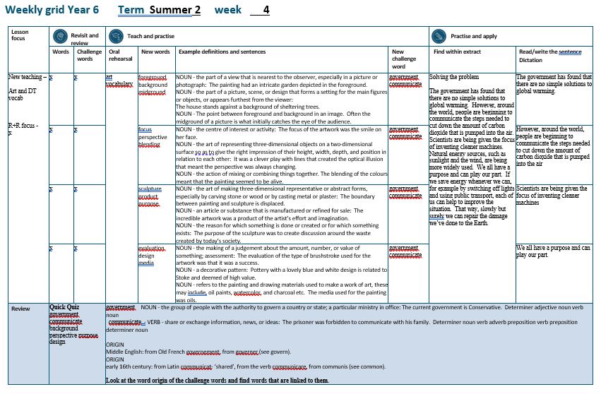

Slide 4
No Revisit and Review…

Slide 5
Let’s Teach and Practise

Slide 6
art vocabulary

Slide 7
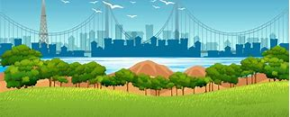
foreground

Slide 8
midground

Slide 9
background

Slide 10
foreground
NOUN
Definition - the part of a view that is nearest to the observer, especially in a picture or photograph

Slide 11
midground
NOUN
Definition - the point between foreground and background in an image

Slide 12
background
NOUN
Definition - the part of a view that is further away from the observer, especially in a picture or photograph

Slide 13
The painting had an intricate garden depicted in the foreground.
__________

Slide 14
Often the midground of a picture is what initially catches the eye of the audience.
_________

Slide 15
The house stands against a background of sheltering trees.
__________

Slide 16
New CHALLENGE words.

Slide 17
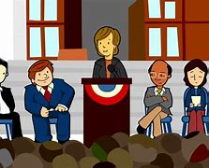
government
NOUN
Definition - the group of people with the authority to govern a country or state; a particular ministry in office

Slide 18
The current government is Conservative.
__________

Slide 19

communicate
VERB
Definition - share or exchange information, news, or ideas

Slide 20
The prisoner was forbidden to communicate with his family.
___________

Slide 21
Let’s Practise and Apply.

Slide 22
Solving the problem
The government has found that there are no simple solutions to global warming. However, around the world, people are beginning to communicate the steps needed to cut down the amount of carbon dioxide that is pumped into the air. Scientists are being given the focus of inventing cleaner machines. Natural energy sources, such as sunlight and the wind, are being more widely used. We all have a purpose and can play our part. If we save energy whenever we can, for example by switching off lights and using public transport, each of us can help to improve the situation. That way, slowly but surely we can repair the damage we’ve done to the Earth.

Slide 23
Solving the problem
The government has found that there are no simple solutions to global warming. However, around the world, people are beginning to communicate the steps needed to cut down the amount of carbon dioxide that is pumped into the air. Scientists are being given the focus of inventing cleaner machines. Natural energy sources, such as sunlight and the wind, are being more widely used. We all have a purpose and can play our part. If we save energy whenever we can, for example by switching off lights and using public transport, each of us can help to improve the situation. That way, slowly but surely we can repair the damage we’ve done to the Earth.

Slide 24
Write this sentence as I dictate it to you.
Notes:
The government has found that there are no simple solutions to global warming.

Slide 25
The government has found that there are no simple solutions to global warming.
Did you write it correctly?
Edit your work and make sure you have it correct.
Can you underline the spelling word that we have covered in this session?

Slide 26
Year 6 - Summer 2
Week 4 - Tuesday
Notes:
Revisit and review the words from previous teaching and challenge words – I say, we say, you say
Ask children to write words only in their spelling book
Introduce the new spelling rule
Children to write the new spelling rule words and challenge words into books when the sentences are shown with the spelling word missing.
Read the extract with the class as choral reading. Practise model of prosody etc.
Ask children to find the spelling words from the session in the text.
Then read allowed the chosen sentence for children to write fully in their books.
Show the extract and ask children to then edit their work to check they were correct in their dictation.

Slide 28
No Revisit and Review…

Slide 29
Let’s Teach and Practise

Slide 30
art vocabulary

Slide 31

focus

Slide 32
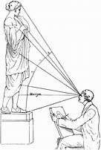
perspective

Slide 33
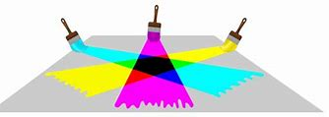
blending

Slide 34
focus
NOUN / VERB
Definition –(n)the centre of interest or activity
Definition – (v) not blurred

Slide 35
perspective
NOUN
Definition - the art of representing three-dimensional objects on a two-dimensional surface so as to give the right impression of their height, width, depth, and position in relation to each other

Slide 36
blending
NOUN
Definition - the action of mixing or combining things together

Slide 37
The focus of the artwork was the smile on her face.
_____

Slide 38
It was a clever play with lines that created the optical illusion that meant the perspective was always changing.
___________

Slide 39
The blending of the colours meant that the painting seemed to be alive.
________

Slide 40
New CHALLENGE words.

Slide 41
government
NOUN
Definition - the group of people with the authority to govern a country or state; a particular ministry in office

Slide 42
The current government is Conservative.
__________

Slide 43
communicate
VERB
Definition - share or exchange information, news, or ideas

Slide 44
The prisoner was forbidden to communicate with his family.
___________

Slide 45
Let’s Practise and Apply.

Slide 46
Solving the problem
The government has found that there are no simple solutions to global warming. However, around the world, people are beginning to communicate the steps needed to cut down the amount of carbon dioxide that is pumped into the air. Scientists are being given the focus of inventing cleaner machines. Natural energy sources, such as sunlight and the wind, are being more widely used. We all have a purpose and can play our part. If we save energy whenever we can, for example by switching off lights and using public transport, each of us can help to improve the situation. That way, slowly but surely we can repair the damage we’ve done to the Earth.

Slide 47
Solving the problem
The government has found that there are no simple solutions to global warming. However, around the world, people are beginning to communicate the steps needed to cut down the amount of carbon dioxide that is pumped into the air. Scientists are being given the focus of inventing cleaner machines. Natural energy sources, such as sunlight and the wind, are being more widely used. We all have a purpose and can play our part. If we save energy whenever we can, for example by switching off lights and using public transport, each of us can help to improve the situation. That way, slowly but surely we can repair the damage we’ve done to the Earth.

Slide 48
Write this sentence as I dictate it to you.
Notes:
However, around the world, people are beginning to communicate the steps needed to cut down the amount of carbon dioxide that is pumped into the air.

Slide 49
However, around the world, people are beginning to communicate the steps needed to cut down the amount of carbon dioxide that is pumped into the air.
Did you write it correctly?
Edit your work and make sure you have it correct.
Can you underline the spelling word that we have covered in this session?

Slide 50
Year 6 - Summer 2
Week 4 - Wednesday
Notes:
Revisit and review the words from previous teaching and challenge words – I say, we say, you say
Ask children to write words only in their spelling book
Introduce the new spelling rule
Children to write the new spelling rule words and challenge words into books when the sentences are shown with the spelling word missing.
Read the extract with the class as choral reading. Practise model of prosody etc.
Ask children to find the spelling words from the session in the text.
Then read allowed the chosen sentence for children to write fully in their books.
Show the extract and ask children to then edit their work to check they were correct in their dictation.

Slide 52
No Revisit and Review…

Slide 53
Let’s Teach and Practise

Slide 54
art vocabulary

Slide 55
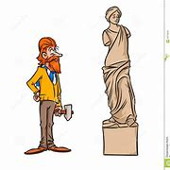
sculpture

Slide 56
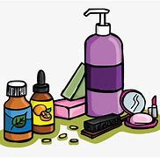
product

Slide 57
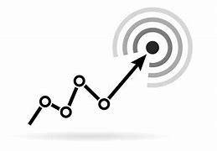
purpose

Slide 58
sculpture
NOUN
Definition - the art of making three-dimensional representative or abstract forms, especially by carving stone or wood or by casting metal or plaster

Slide 59
product
NOUN
Definition - an article or substance that is manufactured or refined for sale

Slide 60
purpose
NOUN
Definition - the reason for which something is done or created or for which something exists

Slide 61
The boundary between painting and sculpture is displaced.
_________

Slide 62
The incredible artwork was a product of the artist’s effort and imagination.
_______

Slide 63
The purpose of the sculpture was to create discussion around the waste created by today’s society.
_______

Slide 64
New CHALLENGE words.

Slide 65
government
NOUN
Definition - the group of people with the authority to govern a country or state; a particular ministry in office

Slide 66
The current government is Conservative.
__________

Slide 67
communicate
VERB
Definition - share or exchange information, news, or ideas

Slide 68
The prisoner was forbidden to communicate with his family.
___________

Slide 69
Let’s Practise and Apply.

Slide 70
Solving the problem
The government has found that there are no simple solutions to global warming. However, around the world, people are beginning to communicate the steps needed to cut down the amount of carbon dioxide that is pumped into the air. Scientists are being given the focus of inventing cleaner machines. Natural energy sources, such as sunlight and the wind, are being more widely used. We all have a purpose and can play our part. If we save energy whenever we can, for example by switching off lights and using public transport, each of us can help to improve the situation. That way, slowly but surely we can repair the damage we’ve done to the Earth.

Slide 71
Solving the problem
The government has found that there are no simple solutions to global warming. However, around the world, people are beginning to communicate the steps needed to cut down the amount of carbon dioxide that is pumped into the air. Scientists are being given the focus of inventing cleaner machines. Natural energy sources, such as sunlight and the wind, are being more widely used. We all have a purpose and can play our part. If we save energy whenever we can, for example by switching off lights and using public transport, each of us can help to improve the situation. That way, slowly but surely we can repair the damage we’ve done to the Earth.

Slide 72
Write this sentence as I dictate it to you.
Notes:
Scientists are being given the focus of inventing cleaner machines.

Slide 73
Scientists are being given the focus of inventing cleaner machines.
Did you write it correctly?
Edit your work and make sure you have it correct.
Can you underline the spelling word that we have covered in this session?

Slide 74
Year 6 - Summer 2
Week 4 - Thursday
Notes:
Revisit and review the words from previous teaching and challenge words – I say, we say, you say
Ask children to write words only in their spelling book
Introduce the new spelling rule
Children to write the new spelling rule words and challenge words into books when the sentences are shown with the spelling word missing.
Read the extract with the class as choral reading. Practise model of prosody etc.
Ask children to find the spelling words from the session in the text.
Then read allowed the chosen sentence for children to write fully in their books.
Show the extract and ask children to then edit their work to check they were correct in their dictation.

Slide 76
No Revisit and Review…

Slide 77
Let’s Teach and Practise

Slide 78
art vocabulary

Slide 79

evaluation

Slide 80
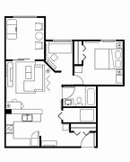
design

Slide 81
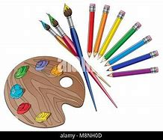
media

Slide 82
evaluation
NOUN
Definition - the making of a judgement about the amount, number, or value of something; assessment

Slide 83
design
NOUN
Definition - a decorative pattern; an image or plan of something before it is created

Slide 84
media
NOUN
Definition - refers to the painting and drawing materials used to make a work of art, these may include, oil paints, watercolor, and charcoal etc.

Slide 85
The evaluation of the type of brushstroke used for the artwork was that it was a success.
__________

Slide 86
Pottery with a lovely blue and white design is related to Stoke and deemed of high value.
______

Slide 87
The media used for the painting was oils.
_____

Slide 88
New CHALLENGE words.

Slide 89
government
NOUN
Definition - the group of people with the authority to govern a country or state; a particular ministry in office

Slide 90
The current government is Conservative.
__________

Slide 91
communicate
VERB
Definition - share or exchange information, news, or ideas

Slide 92
The prisoner was forbidden to communicate with his family.
___________

Slide 93
Let’s Practise and Apply.

Slide 94
Solving the problem
The government has found that there are no simple solutions to global warming. However, around the world, people are beginning to communicate the steps needed to cut down the amount of carbon dioxide that is pumped into the air. Scientists are being given the focus of inventing cleaner machines. Natural energy sources, such as sunlight and the wind, are being more widely used. We all have a purpose and can play our part. If we save energy whenever we can, for example by switching off lights and using public transport, each of us can help to improve the situation. That way, slowly but surely we can repair the damage we’ve done to the Earth.

Slide 95
Solving the problem
The government has found that there are no simple solutions to global warming. However, around the world, people are beginning to communicate the steps needed to cut down the amount of carbon dioxide that is pumped into the air. Scientists are being given the focus of inventing cleaner machines. Natural energy sources, such as sunlight and the wind, are being more widely used. We all have a purpose and can play our part. If we save energy whenever we can, for example by switching off lights and using public transport, each of us can help to improve the situation. That way, slowly but surely we can repair the damage we’ve done to the Earth.

Slide 96
Write this sentence as I dictate it to you.
Notes:
We all have a purpose and can play our part.

Slide 97
We all have a purpose and can play our part.
Did you write it correctly?
Edit your work and make sure you have it correct.
Can you underline the spelling word that we have covered in this session?

Slide 98
Year 6 - Summer 2
Week 4 - Friday
Notes:
Click through the slides for all the R+R words for the week (both the focus and the challenge words)
Click through the slides for all the new learning this week

Slide 100
New spelling rule words…

Slide 101
foreground

Slide 102
midground

Slide 103
background

Slide 104
focus

Slide 105
perspective

Slide 106
blending

Slide 107
sculpture

Slide 108
product

Slide 109
purpose

Slide 110
evaluation

Slide 111
design

Slide 112
media

Slide 113
New challenge words…

Slide 114
government

Slide 115
communicate

Slide 116
Quick Quiz time…
Notes:
Say these words for the quiz
government communicate background perspective purpose design

Slide 117
Did you get them correct?
Edit your work.
government communicate background perspective purpose design

Slide 118
Word class time…

Slide 119
The current government is Conservative.
Determiner adjective noun verb noun
Notes:
Ask for these words to be classed

Slide 120
The prisoner was forbidden to communicate with his family.
Determiner noun verb adverb preposition verb preposition determiner noun
Notes:
Ask for these words to be classed

Slide 121
Etymology
The history of a word….

Slide 122
Government
ORIGIN
Middle English: from Old French governement, from governer (see govern).
Communicate
ORIGIN
early 16th century: from Latin communicat- ‘shared’, from the verb communicare, from communis (see common).

Slide 123
Let’s investigate….
Look at the word origin of the challenge words and find words that are linked to them.

