Slide 1
Spelling Y6
Mastering spellings: building on the foundations of phonics
Summer 2
Week 5

Slide 2
Year 6 - Summer 2
Week 5 - Monday

Slide 3
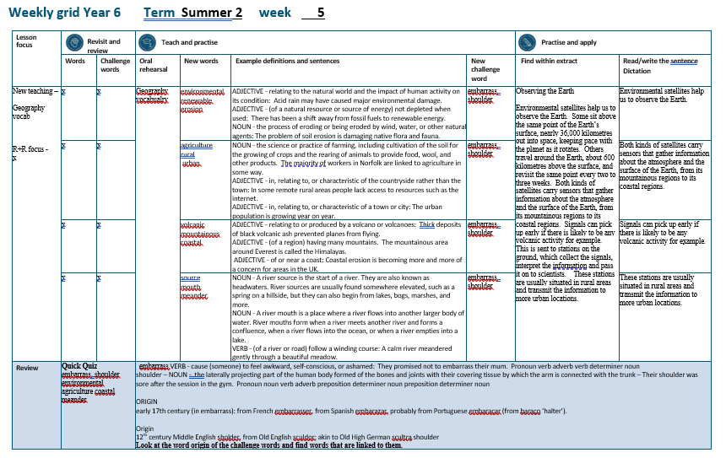

Slide 4
No Revisit and Review…

Slide 5
Let’s Teach and Practise

Slide 6
geography vocabulary

Slide 7
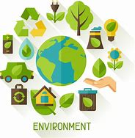
environmental

Slide 8
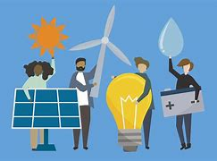
renewable

Slide 9
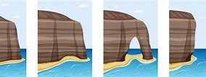
erosion

Slide 10
environmental
ADJECTIVE
Definition - relating to the natural world and the impact of human activity on its condition

Slide 11
renewable
ADJECTIVE
Definition - (of a natural resource or source of energy) not depleted when used

Slide 12
erosion
NOUN
Definition - the process of eroding or being eroded by wind, water, or other natural agents

Slide 13
Acid rain may have caused major environmental damage.
______________

Slide 14
There has been a shift away from fossil fuels to renewable energy.
_________

Slide 15
The problem of soil erosion is damaging native flora and fauna.
_______

Slide 16
New CHALLENGE words.

Slide 17

embarrass
VERB
Definition - cause (someone) to feel awkward, self-conscious, or ashamed

Slide 18
They promised not to embarrass their mum.
_________

Slide 19
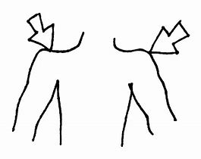
shoulder
NOUN
Definition - the laterally projecting part of the human body formed of the bones and joints with their covering tissue by which the arm is connected with the trunk

Slide 20
Their shoulder was sore after the session in the gym.
________

Slide 21
Let’s Practise and Apply.

Slide 22
Observing the Earth
Environmental satellites help us to observe the Earth. Some sit above the same point of the Earth’s surface, nearly 36,000 kilometres out into space, keeping pace with the planet as it rotates. Others travel around the Earth, about 600 kilometres above the surface, and revisit the same point every two to three weeks. Both kinds of satellites carry sensors that gather information about the atmosphere and the surface of the Earth, from its mountainous regions to its coastal regions. Signals can pick up early if there is likely to be any volcanic activity for example. This is sent to stations on the ground, which collect the signals, interpret the information and pass it on to scientists. These stations are usually situated in rural areas and transmit the information to more urban locations.

Slide 23
Observing the Earth
Environmental satellites help us to observe the Earth. Some sit above the same point of the Earth’s surface, nearly 36,000 kilometres out into space, keeping pace with the planet as it rotates. Others travel around the Earth, about 600 kilometres above the surface, and revisit the same point every two to three weeks. Both kinds of satellites carry sensors that gather information about the atmosphere and the surface of the Earth, from its mountainous regions to its coastal regions. Signals can pick up early if there is likely to be any volcanic activity for example. This is sent to stations on the ground, which collect the signals, interpret the information and pass it on to scientists. These stations are usually situated in rural areas and transmit the information to more urban locations.

Slide 24
Write this sentence as I dictate it to you.
Notes:
Environmental satellites help us to observe the Earth.

Slide 25
Environmental satellites help us to observe the Earth.
Did you write it correctly?
Edit your work and make sure you have it correct.
Can you underline the spelling word that we have covered in this session?

Slide 26
Year 6 - Summer 2
Week 5 - Tuesday
Notes:
Revisit and review the words from previous teaching and challenge words – I say, we say, you say
Ask children to write words only in their spelling book
Introduce the new spelling rule
Children to write the new spelling rule words and challenge words into books when the sentences are shown with the spelling word missing.
Read the extract with the class as choral reading. Practise model of prosody etc.
Ask children to find the spelling words from the session in the text.
Then read allowed the chosen sentence for children to write fully in their books.
Show the extract and ask children to then edit their work to check they were correct in their dictation.

Slide 27
geography vocabulary

Slide 28
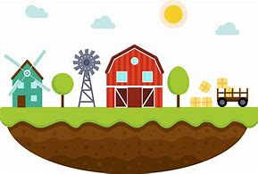
agriculture

Slide 29
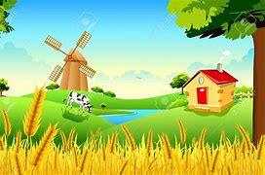
rural

Slide 30
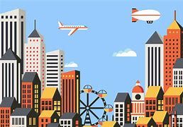
urban

Slide 31
agriculture
NOUN
Definition - the science or practice of farming, including cultivation of the soil for the growing of crops and the rearing of animals to provide food, wool, and other products

Slide 32
rural
ADJECTIVE
Definition - in, relating to, or characteristic of the countryside rather than the town

Slide 33
urban
ADJECTIVE
Definition - in, relating to, or characteristic of a town or city

Slide 34
The majority of workers in Norfolk are linked to agriculture in some way.
___________

Slide 35
In some remote rural areas people lack access to resources such as the internet.
_____

Slide 36
The urban population is growing year on year.
_____

Slide 37
New CHALLENGE words.

Slide 38
embarrass
VERB
Definition - cause (someone) to feel awkward, self-conscious, or ashamed

Slide 39
They promised not to embarrass their mum.
_________

Slide 40
shoulder
NOUN
Definition - the laterally projecting part of the human body formed of the bones and joints with their covering tissue by which the arm is connected with the trunk

Slide 41
Their shoulder was sore after the session in the gym.
________

Slide 42
Let’s Practise and Apply.

Slide 43
Observing the Earth
Environmental satellites help us to observe the Earth. Some sit above the same point of the Earth’s surface, nearly 36,000 kilometres out into space, keeping pace with the planet as it rotates. Others travel around the Earth, about 600 kilometres above the surface, and revisit the same point every two to three weeks. Both kinds of satellites carry sensors that gather information about the atmosphere and the surface of the Earth, from its mountainous regions to its coastal regions. Signals can pick up early if there is likely to be any volcanic activity for example. This is sent to stations on the ground, which collect the signals, interpret the information and pass it on to scientists. These stations are usually situated in rural areas and transmit the information to more urban locations.

Slide 44
Observing the Earth
Environmental satellites help us to observe the Earth. Some sit above the same point of the Earth’s surface, nearly 36,000 kilometres out into space, keeping pace with the planet as it rotates. Others travel around the Earth, about 600 kilometres above the surface, and revisit the same point every two to three weeks. Both kinds of satellites carry sensors that gather information about the atmosphere and the surface of the Earth, from its mountainous regions to its coastal regions. Signals can pick up early if there is likely to be any volcanic activity for example. This is sent to stations on the ground, which collect the signals, interpret the information and pass it on to scientists. These stations are usually situated in rural areas and transmit the information to more urban locations.

Slide 45
Write this sentence as I dictate it to you.
Notes:
Both kinds of satellites carry sensors that gather information about the atmosphere and the surface of the Earth, from its mountainous regions to its coastal regions.

Slide 46
Both kinds of satellites carry sensors that gather information about the atmosphere and the surface of the Earth, from its mountainous regions to its coastal regions.
Did you write it correctly?
Edit your work and make sure you have it correct.
Can you underline the spelling word that we have covered in this session?

Slide 47
Year 6 - Summer 2
Week 5 - Wednesday
Notes:
Revisit and review the words from previous teaching and challenge words – I say, we say, you say
Ask children to write words only in their spelling book
Introduce the new spelling rule
Children to write the new spelling rule words and challenge words into books when the sentences are shown with the spelling word missing.
Read the extract with the class as choral reading. Practise model of prosody etc.
Ask children to find the spelling words from the session in the text.
Then read allowed the chosen sentence for children to write fully in their books.
Show the extract and ask children to then edit their work to check they were correct in their dictation.

Slide 48
geography vocabulary

Slide 49
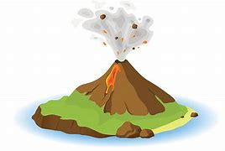
volcanic

Slide 50
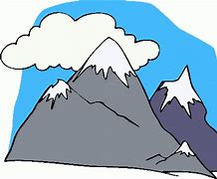
mountainous

Slide 51
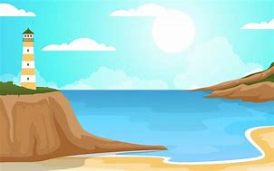
coastal

Slide 52
volcanic
ADJECTIVE
Definition - relating to or produced by a volcano or volcanoes

Slide 53
mountainous
ADJECTIVE
Definition - (of a region) having many mountains

Slide 54
coastal
ADJECTIVE
Definition - of or near a coast

Slide 55
Thick deposits of black volcanic ash prevented planes from flying.
________

Slide 56
The mountainous area around Everest is called the Himalayas.
___________

Slide 57
Coastal erosion is becoming more and more of a concern for areas in the UK.
_______

Slide 58
New CHALLENGE words.

Slide 59
embarrass
VERB
Definition - cause (someone) to feel awkward, self-conscious, or ashamed

Slide 60
They promised not to embarrass their mum.
_________

Slide 61
shoulder
NOUN
Definition - the laterally projecting part of the human body formed of the bones and joints with their covering tissue by which the arm is connected with the trunk

Slide 62
Their shoulder was sore after the session in the gym.
________

Slide 63
Let’s Practise and Apply.

Slide 64
Observing the Earth
Environmental satellites help us to observe the Earth. Some sit above the same point of the Earth’s surface, nearly 36,000 kilometres out into space, keeping pace with the planet as it rotates. Others travel around the Earth, about 600 kilometres above the surface, and revisit the same point every two to three weeks. Both kinds of satellites carry sensors that gather information about the atmosphere and the surface of the Earth, from its mountainous regions to its coastal regions. Signals can pick up early if there is likely to be any volcanic activity for example. This is sent to stations on the ground, which collect the signals, interpret the information and pass it on to scientists. These stations are usually situated in rural areas and transmit the information to more urban locations.

Slide 65
Observing the Earth
Environmental satellites help us to observe the Earth. Some sit above the same point of the Earth’s surface, nearly 36,000 kilometres out into space, keeping pace with the planet as it rotates. Others travel around the Earth, about 600 kilometres above the surface, and revisit the same point every two to three weeks. Both kinds of satellites carry sensors that gather information about the atmosphere and the surface of the Earth, from its mountainous regions to its coastal regions. Signals can pick up early if there is likely to be any volcanic activity for example. This is sent to stations on the ground, which collect the signals, interpret the information and pass it on to scientists. These stations are usually situated in rural areas and transmit the information to more urban locations.

Slide 66
Write this sentence as I dictate it to you.
Notes:
Signals can pick up early if there is likely to be any volcanic activity for example.

Slide 67
Signals can pick up early if there is likely to be any volcanic activity for example.
Did you write it correctly?
Edit your work and make sure you have it correct.
Can you underline the spelling word that we have covered in this session?

Slide 68
Year 6 - Summer 2
Week 5 - Thursday
Notes:
Revisit and review the words from previous teaching and challenge words – I say, we say, you say
Ask children to write words only in their spelling book
Introduce the new spelling rule
Children to write the new spelling rule words and challenge words into books when the sentences are shown with the spelling word missing.
Read the extract with the class as choral reading. Practise model of prosody etc.
Ask children to find the spelling words from the session in the text.
Then read allowed the chosen sentence for children to write fully in their books.
Show the extract and ask children to then edit their work to check they were correct in their dictation.

Slide 69
geography vocabulary

Slide 70
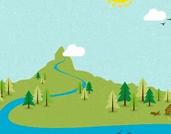
source

Slide 71
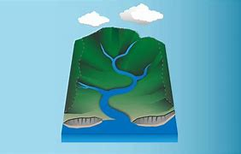
mouth

Slide 72
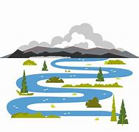
meander

Slide 73
source
NOUN
Definition - river source is the start of a river

Slide 74
mouth
NOUN
Definition - river mouth is a place where a river flows into another larger body of water

Slide 75
meander
VERB
Definition – (of a river or road) follow a winding course

Slide 76
River sources are usually found somewhere elevated, such as a spring on a hillside, but they can also begin from lakes, bogs, marshes, and more.
_______

Slide 77
River mouths form when a river meets another river and forms a confluence, when a river flows into the ocean, or when a river empties into a lake.
______

Slide 78
A calm river meandered gently through a beautiful meadow.
_________

Slide 79
New CHALLENGE words.

Slide 80
embarrass
VERB
Definition - cause (someone) to feel awkward, self-conscious, or ashamed

Slide 81
They promised not to embarrass their mum.
_________

Slide 82
shoulder
NOUN
Definition - the laterally projecting part of the human body formed of the bones and joints with their covering tissue by which the arm is connected with the trunk

Slide 83
Their shoulder was sore after the session in the gym.
________

Slide 84
Let’s Practise and Apply.

Slide 85
Observing the Earth
Environmental satellites help us to observe the Earth. Some sit above the same point of the Earth’s surface, nearly 36,000 kilometres out into space, keeping pace with the planet as it rotates. Others travel around the Earth, about 600 kilometres above the surface, and revisit the same point every two to three weeks. Both kinds of satellites carry sensors that gather information about the atmosphere and the surface of the Earth, from its mountainous regions to its coastal regions. Signals can pick up early if there is likely to be any volcanic activity for example. This is sent to stations on the ground, which collect the signals, interpret the information and pass it on to scientists. These stations are usually situated in rural areas and transmit the information to more urban locations.

Slide 86
Observing the Earth
Environmental satellites help us to observe the Earth. Some sit above the same point of the Earth’s surface, nearly 36,000 kilometres out into space, keeping pace with the planet as it rotates. Others travel around the Earth, about 600 kilometres above the surface, and revisit the same point every two to three weeks. Both kinds of satellites carry sensors that gather information about the atmosphere and the surface of the Earth, from its mountainous regions to its coastal regions. Signals can pick up early if there is likely to be any volcanic activity for example. This is sent to stations on the ground, which collect the signals, interpret the information and pass it on to scientists. These stations are usually situated in rural areas and transmit the information to more urban locations.

Slide 87
Write this sentence as I dictate it to you.
Notes:
These stations are usually situated in rural areas and transmit the information to more urban locations.

Slide 88
These stations are usually situated in rural areas and transmit the information to more urban locations.
Did you write it correctly?
Edit your work and make sure you have it correct.
Can you underline the spelling word that we have covered in this session?

Slide 89
Year 6 - Summer 2
Week 5 - Friday
Notes:
Click through the slides for all the R+R words for the week (both the focus and the challenge words)
Click through the slides for all the new learning this week

Slide 91
New spelling rule words…

Slide 92
environmental

Slide 93
renewable

Slide 94
erosion

Slide 95
agriculture

Slide 96
rural

Slide 97
urban

Slide 98
volcanic

Slide 99
mountainous

Slide 100
coastal

Slide 101
source

Slide 102
mouth

Slide 103
meander

Slide 104
New challenge words…

Slide 105
embarrass

Slide 106
shoulder

Slide 107
Quick Quiz time…
Notes:
Say these words for the quiz
embarrass shoulder environmental agriculture coastal meander

Slide 108
Did you get them correct?
Edit your work.
embarrass shoulder environmental agriculture coastal meander

Slide 109
Word class time…

Slide 110
They promised not to embarrass their mum.
Pronoun verb adverb verb determiner noun
Notes:
Ask for these words to be classed

Slide 111
Their shoulder was sore after the session in the gym.
Pronoun noun verb adverb preposition determiner noun preposition determiner noun
Notes:
Ask for these words to be classed

Slide 112
Etymology
The history of a word….

Slide 113
Embarrass
ORIGIN
early 17th century (in embarrass): from French embarrasser, from Spanish embarazar, probably from Portuguese embaraçar (from baraço ‘halter’).
Shoulder
Origin
12th century Middle English sholder, from Old English sculdor; akin to Old High German scultra shoulder

Slide 114
Let’s investigate….
Look at the word origin of the challenge words and find words that are linked to them.

