Slide 1
Spelling Y6
Mastering spellings: building on the foundations of phonics
Summer 2
Week 6

Slide 2
Year 6 - Summer 2
Week 6 - Monday

Slide 3
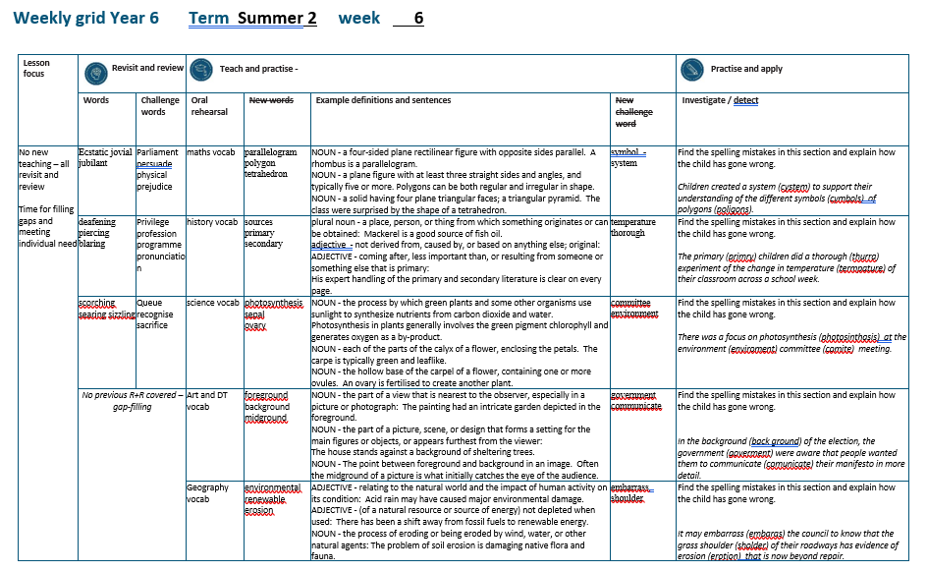

Slide 4
Let’s Revisit and Review…

Slide 5
Do you remember this challenge word?

Slide 6
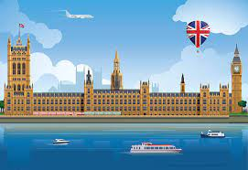
parliament
NOUN
Definition - (in the UK) the highest legislature, consisting of the Sovereign, the House of Lords, and the House of Commons

Slide 7
The minister will lay proposals before Parliament.
__________

Slide 8
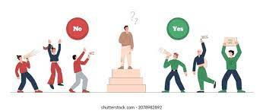
persuade
VERB
Definition - induce (someone) to do something through reasoning or argument

Slide 9
It was easy to persuade you.
________

Slide 10
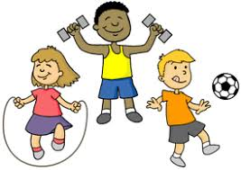
physical
ADJECTIVE
Definition - relating to the body as opposed to the mind

Slide 11
Physical challenges are tough.
________

Slide 12
prejudice
NOUN
Definition - preconceived opinion that is not based on reason or actual experience

Slide 13
Prejudice against people from different backgrounds is wrong.
_________

Slide 14
Antonyms and Synonyms

Slide 15
synonyms – same meaning
antonyms – opposite meaning

Slide 16
synonyms and antonyms of ‘happy’
happy = adjective
= all adjectives

Slide 17
ecstatic
synonym of ‘happy’

Slide 18
jovial
synonym of ‘happy’

Slide 19
jubilant
synonym of ‘happy’

Slide 20
Let’s Teach and Practise

Slide 21
maths vocabulary

Slide 22
parallelogram

Slide 23
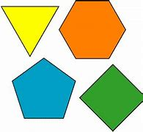
polygon

Slide 24
tetrahedron

Slide 25
parallelogram
NOUN
Definition - a four-sided plane rectilinear figure with opposite sides parallel

Slide 26
polygon
NOUN
Definition - a plane figure with at least three straight sides and angles, and typically five or more

Slide 27
tetrahedron
NOUN
Definition - a solid having four plane triangular faces; a triangular pyramid

Slide 28
A rhombus is a parallelogram.
_____________

Slide 29
Polygons can be both regular and irregular in shape.
________

Slide 30
The class were surprised by the shape of a tetrahedron.
___________

Slide 31
New CHALLENGE words.

Slide 32
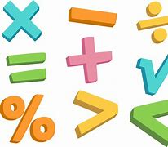
symbol
NOUN
Definition - a mark or character used as a conventional representation of an object, function, or process

Slide 33
The chemical symbol for helium is He
______

Slide 34
system
NOUN
Definition - a set of things working together as parts of a mechanism or an interconnecting network; a complex whole

Slide 35
The railway system is complex.
______

Slide 36
Let’s investigate.

Slide 37
Can you spot the spelling errors in these sentences? Write the correct spelling and explain where they went wrong.

Slide 38
Children created a cistem to support their understanding of the different cimbols of poligons.

Slide 39
Children created a cistem to support their understanding of the different cimbols of poligons.

Slide 40
Children created a cistem to support their understanding of the different cimbols of poligons. system – ‘sy’ not ‘ci’

Slide 41
Children created a cistem to support their understanding of the different cimbols of poligons. symbols – ‘sy’ not ‘ci’

Slide 42
Children created a cistem to support their understanding of the different cimbols of poligons. polygons – ‘y’ not ‘i’

Slide 43
Children created a system to support their understanding of the different symbols of polygons.

Slide 44
Year 6 - Summer 2
Week 6 - Tuesday

Slide 46
Let’s Revisit and Review…

Slide 47
Do you remember this challenge word?

Slide 48
privilege
NOUN
Definition - a special right, advantage, or immunity granted or available only to a particular person or group

Slide 49
Education is a right, not a privilege.
_________

Slide 50
profession
NOUN
Definition - a paid occupation, especially one that involves prolonged training and a formal qualification

Slide 51
This chosen profession of teaching is virtuous.
__________

Slide 52
programme
NOUN
Definition - a set of related measures or activities with a particular long-term aim

Slide 53
An extensive programme of reforms was set up.
_________

Slide 54
pronunciation
NOUN
Definition - the way in which a word is pronounced

Slide 55
Spelling does not determine pronunciation.
_____________

Slide 56
Antonyms and Synonyms

Slide 57
synonyms – same meaning
antonyms – opposite meaning

Slide 58
synonyms and antonyms of ‘loud’
loud = adjective
= all adjectives

Slide 59
deafening
synonym of ‘loud’

Slide 60
piercing
synonym of ‘loud’

Slide 61
blaring
synonym of ‘loud’

Slide 62
Let’s Teach and Practise

Slide 63
History vocabulary

Slide 64
sources

Slide 65
primary

Slide 66
secondary

Slide 67
sources
NOUN
Definition - a place, person, or thing from which something originates or can be obtained

Slide 68
primary
ADJECTIVE
Definition - not derived from, caused by, or based on anything else; original:

Slide 69
secondary
ADJECTIVE
Definition - coming after, less important than, or resulting from someone or something else that is primary:

Slide 70
Mackerel is a good source of fish oil.
______

Slide 71
His expert handling of the primary and secondary literature is clear on every page.
_______

Slide 72
His expert handling of the primary and secondary literature is clear on every page.
_________

Slide 73
New CHALLENGE words.

Slide 74
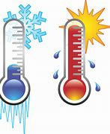
temperature
NOUN
Definition - the degree or intensity of heat present in a substance or object, especially as expressed according to a comparative scale and shown by a thermometer or perceived by touch

Slide 75
Water boils at a temperature of 100 degrees.
___________

Slide 76
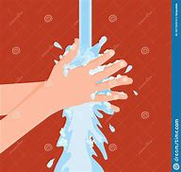
thorough
ADJECTIVE
Definition - complete with regard to every detail; not superficial or partial

Slide 77
Hands need a thorough wash to avoid germs spreading.
________

Slide 78
Let’s investigate.

Slide 79
Can you spot the spelling errors in these sentences? Write the correct spelling and explain where they went wrong.

Slide 80
The primry children did a thurra experiment of the change in tempature of their classroom across a school week.

Slide 81
The primry children did a thurra experiment of the change in tempature of their classroom across a school week.

Slide 82
The primry children did a thurra experiment of the change in tempature of their classroom across a school week. primary – ‘a’ missing

Slide 83
The primry children did a thurra experiment of the change in tempature of their classroom across a school week. thorough – ‘orough’ not ‘urra’

Slide 84
The primry children did a thurra experiment of the change in tempature of their classroom across a school week. temperature – ‘er’ missing

Slide 85
The primary children did a thorough experiment of the change in temperature of their classroom across a school week.

Slide 86
Year 6 – Summer 2
Week 6 - Wednesday

Slide 88
Let’s Revisit and Review…

Slide 89
Do you remember this challenge word?

Slide 90
queue
NOUN
Definition - a line or sequence of people or vehicles awaiting their turn to be attended to or to proceed

Slide 91
People joined a queue to get the new book.
_____

Slide 92
recognise
VERB
Definition - identify (someone or something) from having encountered them before; know again

Slide 93
Julia hardly recognised Jill when they met.
__________

Slide 94
sacrifice
NOUN
Definition - an act of slaughtering an animal or person or surrendering a possession as an offering to a deity

Slide 95
They offer a sacrifice to the spirits.
_________

Slide 96
Do you remember this challenge word?

Slide 97
Antonyms and Synonyms

Slide 98
synonyms – same meaning
antonyms – opposite meaning

Slide 99
synonyms and antonyms of ‘hot’
hot = adjective
= all adjectives

Slide 100
scorching
synonym of ‘hot’

Slide 101
searing
synonym of ‘hot’

Slide 102
sizzling
synonym of ‘hot’

Slide 103
Let’s Teach and Practise

Slide 104
Science vocabulary

Slide 105
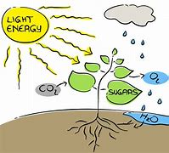
photosynthesis

Slide 106
sepal

Slide 107
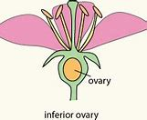
ovary

Slide 108
photosynthesis
NOUN
Definition - the process by which green plants and some other organisms use sunlight to synthesize nutrients from carbon dioxide and water

Slide 109
sepal
NOUN
Definition - each of the parts of the calyx of a flower, enclosing the petals

Slide 110
ovary
NOUN
Definition - the hollow base of the carpel of a flower, containing one or more ovules

Slide 111
Photosynthesis in plants generally involves the green pigment chlorophyll and generates oxygen as a by-product.
______________

Slide 112
The sepal is typically green and leaflike.
_____

Slide 113
An ovary is fertilised to create another plant.
_____

Slide 114
New CHALLENGE words.

Slide 115
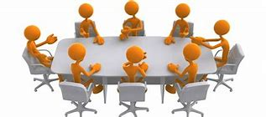
committee
NOUN
Definition - group of people appointed for a specific function by a larger group and typically consisting of members of that group

Slide 116
A committee was formed to discuss the new school opening.
________

Slide 117
environment
NOUN
Definition - the surroundings or conditions in which a person, animal, or plant lives or operates

Slide 118
Survival in a hostile environment is challenging.
___________

Slide 119
Let’s investigate.

Slide 120
Can you spot the spelling errors in these sentences? Write the correct spelling and explain where they went wrong.

Slide 121
There was a focus on photosinthasis at the enviroment comite meeting.

Slide 122
There was a focus on photosinthasis at the enviroment comite meeting.

Slide 123
There was a focus on photosinthasis at the enviroment comite meeting. photosynthesis – ‘y’ not ‘i’ and ‘e’ not ‘a’

Slide 124
There was a focus on photosinthasis at the enviroment comite meeting. environment – ‘n’ missing

Slide 125
There was a focus on photosinthasis at the enviroment comite meeting. Committee – double ‘m’ ‘t’ ‘e’

Slide 126
There was a focus on photosynthesis at the environment committee meeting.

Slide 127
Year 6 - Summer 2
Week 6 - Thursday

Slide 129
Let’s Revisit and Review…

Slide 130
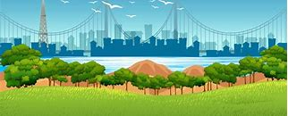
foreground

Slide 131
midground

Slide 132
background

Slide 133
foreground
NOUN
Definition - the part of a view that is nearest to the observer, especially in a picture or photograph

Slide 134
midground
NOUN
Definition - the point between foreground and background in an image

Slide 135
background
NOUN
Definition - the part of a view that is further away from the observer, especially in a picture or photograph

Slide 136
The painting had an intricate garden depicted in the foreground.
__________

Slide 137
Often the midground of a picture is what initially catches the eye of the audience.
_________

Slide 138
The house stands against a background of sheltering trees.
__________

Slide 139
New CHALLENGE words.

Slide 140
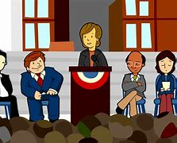
government
NOUN
Definition - the group of people with the authority to govern a country or state; a particular ministry in office

Slide 141
The current government is Conservative.
__________

Slide 142
communicate
VERB
Definition - share or exchange information, news, or ideas

Slide 143
The prisoner was forbidden to communicate with his family.
___________

Slide 144
Can you spot the spelling errors in these sentences? Write the correct spelling and explain where they went wrong.

Slide 145
In the back ground of the election, the goverment were aware that people wanted them to comunicate their manifesto in more detail.

Slide 146
In the back ground of the election, the goverment were aware that people wanted them to comunicate their manifesto in more detail.

Slide 147
In the back ground of the election, the goverment were aware that people wanted them to comunicate their manifesto in more detail. background – one word

Slide 148
In the back ground of the election, the goverment were aware that people wanted them to comunicate their manifesto in more detail. government – ‘n’ missing

Slide 149
In the back ground of the election, the goverment were aware that people wanted them to comunicate their manifesto in more detail. communicate – double ‘m’

Slide 150
In the background of the election, the government were aware that people wanted them to communicate their manifesto in more detail.

Slide 151
Year 6 - Summer 2
Week 6 - Friday

Slide 153
Let’s Revisit and Review…

Slide 154
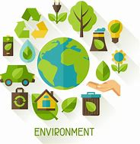
environmental

Slide 155
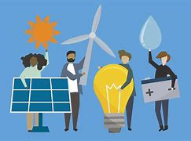
renewable

Slide 156
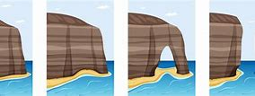
erosion

Slide 157
environmental
ADJECTIVE
Definition - relating to the natural world and the impact of human activity on its condition

Slide 158
renewable
ADJECTIVE
Definition - (of a natural resource or source of energy) not depleted when used

Slide 159
erosion
NOUN
Definition - the process of eroding or being eroded by wind, water, or other natural agents

Slide 160
Acid rain may have caused major environmental damage.
______________

Slide 161
There has been a shift away from fossil fuels to renewable energy.
_________

Slide 162
The problem of soil erosion is damaging native flora and fauna.
_______

Slide 163
New CHALLENGE words.

Slide 164
embarrass
VERB
Definition - cause (someone) to feel awkward, self-conscious, or ashamed

Slide 165
They promised not to embarrass their mum.
_________

Slide 166
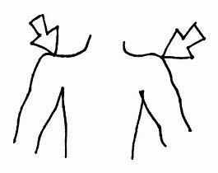
shoulder
NOUN
Definition - the laterally projecting part of the human body formed of the bones and joints with their covering tissue by which the arm is connected with the trunk

Slide 167
Their shoulder was sore after the session in the gym.
________

Slide 168
Can you spot the spelling errors in these sentences? Write the correct spelling and explain where they went wrong.

Slide 169
It may embaras the council to know that the grass sholder of their roadways has evidence of erotion that is now beyond repair.

Slide 170
It may embaras the council to know that the grass sholder of their roadways has evidence of erotion that is now beyond repair.

Slide 171
It may embaras the council to know that the grass sholder of their roadways has evidence of erotion that is now beyond repair. embarrass – double ‘r’ and ‘s’

Slide 172
It may embaras the council to know that the grass sholder of their roadways has evidence of erotion that is now beyond repair. shoulder – missing ‘u’

Slide 173
It may embaras the council to know that the grass sholder of their roadways has evidence of erotion that is now beyond repair. erosion – ‘sion’ not ‘tion’

Slide 174
It may embarrass the council to know that the grass shoulder of their roadways has evidence of erosion that is now beyond repair.

