Slide 1
Spelling Y4
Mastering spellings: building of the foundations of phonics
Autumn 1
Week 2
(Duplicate of Year 3 summer 2 week 2)

Slide 2
Year 4 - Autumn 1
Week 2 - Monday

Slide 3
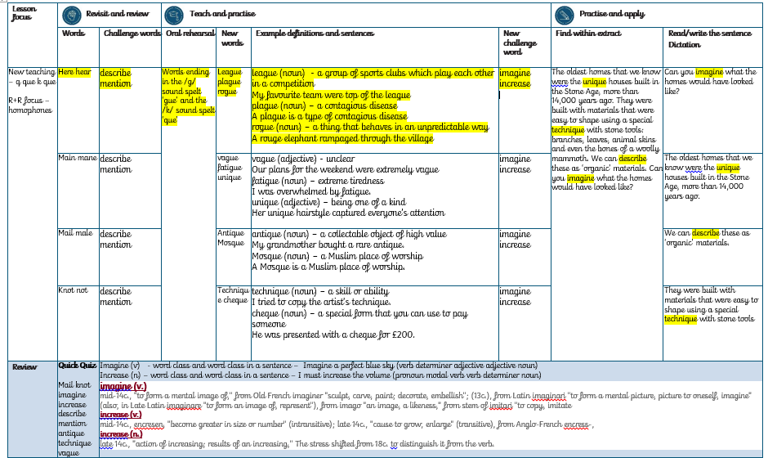

Slide 4
Let’s Revisit and Review…

Slide 5
Do you remember this challenge word?

Slide 6
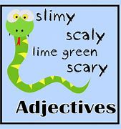
Definition – give a detailed account in words of
describe
VERB

Slide 7
Could you describe what it looked like?
________

Slide 8

Definition – refer to something briefly without going into detail
mention
VERB

Slide 9
He forgot to mention it.
_______

Slide 10
Homophones

Slide 11
Homophones
Words which sound the same but have different spellings, meanings or origins

Slide 12
here

Slide 13
hear

Slide 14
Let’s Teach and Practise

Slide 15
Words ending in the /g/ sound spelt ‘gue’

Slide 16
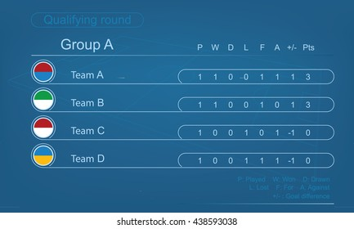
league

Slide 17
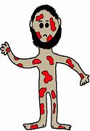
plague

Slide 18

rogue

Slide 19
Definition - a group of sports clubs which play each other in a competition
league
(noun)

Slide 20
Definition - a contagious disease
plague
(noun)

Slide 21
Definition - a thing that behaves in an unpredictable way
rogue
(adjective)

Slide 22
My favourite team were top of the league.
______

Slide 23
A plague is a type of contagious disease.
______

Slide 24
A rogue elephant rampaged through the village.
_____

Slide 25
New CHALLENGE words.

Slide 26

Definition - believe (something unreal or untrue) to exist or be so
imagine
VERB

Slide 27
Imagine a perfect blue sky.
_______

Slide 28
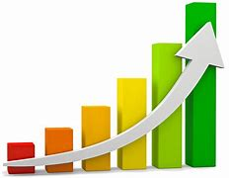
Definition - become or make greater in size, amount, or degree
increase
VERB

Slide 29
I must increase the volume
________

Slide 30
Let’s Practise and Apply.

Slide 31
Can you spot the spelling rule words and the challenge words?

Slide 32
The oldest homes that we know were the unique houses built in the Stone Age, more than 14,000 years ago. They were built with materials that were easy to shape using a special technique with stone tools: branches, leaves, animal skins and even the bones of a woolly mammoth. We can describe these as ‘organic’ materials. Can you imagine what the homes would have looked like?

Slide 33
The oldest homes that we know were the unique houses built in the Stone Age, more than 14,000 years ago. They were built with materials that were easy to shape using a special technique with stone tools: branches, leaves, animal skins and even the bones of a woolly mammoth. We can describe these as ‘organic’ materials. Can you imagine what the homes would have looked like?

Slide 34
Write this sentence as I dictate it to you.
Notes:
We can describe these as ‘organic’ materials.

Slide 35
We can describe these as ‘organic’ materials.
Did you write it correctly?
Edit your work and make sure you have it correct.
Can you underline the spelling words that we have covered in this session?

Slide 36
Year 4 - Autumn 1
Week 2 - Tuesday
Notes:
Revisit and review the words from Y3 with homophones and challenge words – I say, we say, you say
Ask children to write words only in their spelling book
Introduce the new spelling rule of Words ending in the /g/ sound spelt ‘gue’ and the /k/ sound spelt ‘que’
Children to write the new spelling rule words and challenge words into books when the sentences are shown with the spelling word missing.
Read the extract with the class as choral reading. Practise model of prosody etc.
Ask children to find the spelling words from the session in the text.
Then read allowed the chosen sentence for children to write fully in their books.
Show the extract and ask children to then edit their work to check they were correct in their dictation.

Slide 37
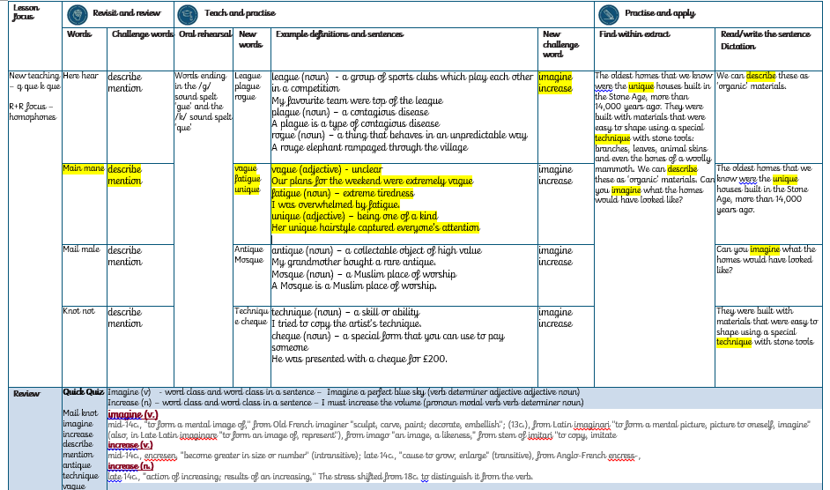

Slide 38
Let’s Revisit and Review…

Slide 39
Do you remember this challenge word?

Slide 40
Definition – give a detailed account in words of
describe
VERB

Slide 41
Could you describe what it looked like?
________

Slide 42
Definition – refer to something briefly without going into detail
mention
VERB

Slide 43
He forgot to mention it.
_______

Slide 44
Homophones

Slide 45
Homophones
Words which sound the same but have different spellings, meanings or origins

Slide 46
main

Slide 47
mane

Slide 48
Let’s Teach and Practise

Slide 49
Words ending in the /g/ sound spelt ‘gue’

Slide 50

vague

Slide 51
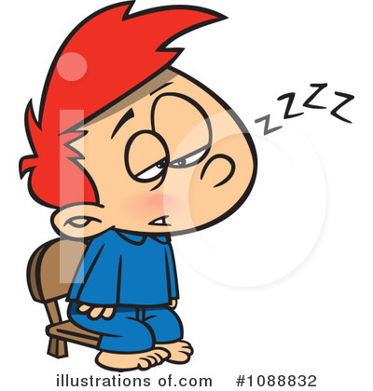
fatigue

Slide 52

unique

Slide 53
Definition - unclear
vague
(noun)

Slide 54
Definition - extreme tiredness
fatigue
(noun)

Slide 55
Definition – being one of a kind
unique
(adjective)

Slide 56
Our plans for the weekend were extremely vague.
_____

Slide 57
I was overwhelmed by fatigue.
_______

Slide 58
Her unique hairstyle captured everyone’s attention.
______

Slide 59
New CHALLENGE words.

Slide 60
Definition - believe (something unreal or untrue) to exist or be so
imagine
VERB

Slide 61
Imagine a perfect blue sky.
_______

Slide 62
Definition - become or make greater in size, amount, or degree
increase
VERB

Slide 63
I must increase the volume
________

Slide 64
Let’s Practise and Apply.

Slide 65
Can you spot the spelling rule words and the challenge words?

Slide 66
The oldest homes that we know were the unique houses built in the Stone Age, more than 14,000 years ago. They were built with materials that were easy to shape using a special technique with stone tools: branches, leaves, animal skins and even the bones of a woolly mammoth. We can describe these as ‘organic’ materials. Can you imagine what the homes would have looked like?

Slide 67
The oldest homes that we know were the unique houses built in the Stone Age, more than 14,000 years ago. They were built with materials that were easy to shape using a special technique with stone tools: branches, leaves, animal skins and even the bones of a woolly mammoth. We can describe these as ‘organic’ materials. Can you imagine what the homes would have looked like?

Slide 68
Write this sentence as I dictate it to you.
Notes:
The oldest homes that we know were the unique houses built in the Stone Age, more than 14,000 years ago.

Slide 69
The oldest homes that we know were the unique houses built in the Stone Age, more than 14,000 years ago.
Did you write it correctly?
Edit your work and make sure you have it correct.
Can you underline the spelling words that we have covered in this session?

Slide 70
Year 4 - Autumn 1
Week 2 - Wednesday
Notes:
Revisit and review the words from Y3 with homophones and challenge words – I say, we say, you say
Ask children to write words only in their spelling book
Introduce the new spelling rule of Words ending in the /g/ sound spelt ‘gue’ and the /k/ sound spelt ‘que’
Children to write the new spelling rule words and challenge words into books when the sentences are shown with the spelling word missing.
Read the extract with the class as choral reading. Practise model of prosody etc.
Ask children to find the spelling words from the session in the text.
Then read allowed the chosen sentence for children to write fully in their books.
Show the extract and ask children to then edit their work to check they were correct in their dictation.

Slide 71
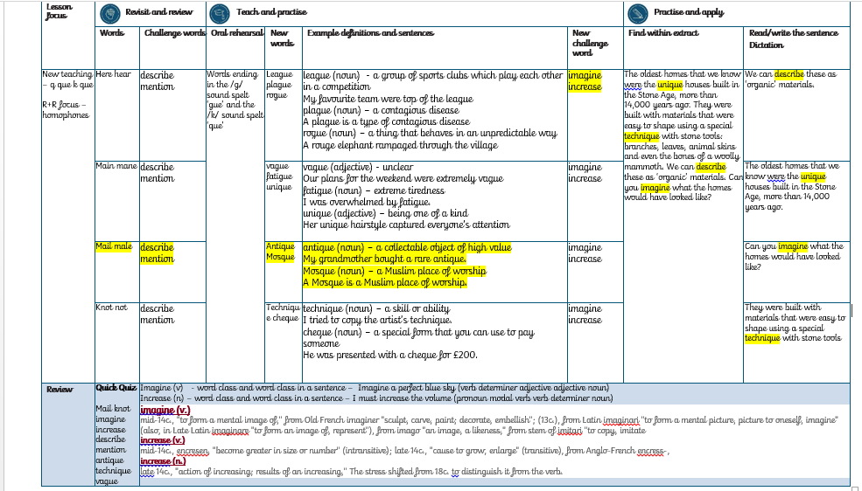

Slide 72
Let’s Revisit and Review…

Slide 73
Do you remember this challenge word?

Slide 74
Definition – give a detailed account in words of
describe
VERB

Slide 75
Could you describe what it looked like?
________

Slide 76
Definition – refer to something briefly without going into detail
mention
VERB

Slide 77
He forgot to mention it.
_______

Slide 78
Homophones

Slide 79
Homophones
Words which sound the same but have different spellings, meanings or origins

Slide 80
mail

Slide 81
male

Slide 82
Let’s Teach and Practise

Slide 83
Words ending in the /k/ sound spelt ‘que’

Slide 84
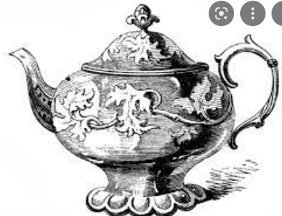
antique

Slide 85

mosque

Slide 86
Definition - a collectable object of high valuable
antique
(noun)

Slide 87
Definition - a Muslim place of worship
mosque
(noun)

Slide 88
My grandmother bought a rare antique.
_______

Slide 89
A mosque is a Muslim place of worship.
_______

Slide 90
New CHALLENGE words.

Slide 91
Definition - believe (something unreal or untrue) to exist or be so
imagine
VERB

Slide 92
Imagine a perfect blue sky.
_______

Slide 93
Definition - become or make greater in size, amount, or degree
increase
VERB

Slide 94
I must increase the volume
________

Slide 95
Let’s Practise and Apply.

Slide 96
Can you spot the spelling rule words and the challenge words?

Slide 97
The oldest homes that we know were the unique houses built in the Stone Age, more than 14,000 years ago. They were built with materials that were easy to shape using a special technique with stone tools: branches, leaves, animal skins and even the bones of a woolly mammoth. We can describe these as ‘organic’ materials. Can you imagine what the homes would have looked like?

Slide 98
The oldest homes that we know were the unique houses built in the Stone Age, more than 14,000 years ago. They were built with materials that were easy to shape using a special technique with stone tools: branches, leaves, animal skins and even the bones of a woolly mammoth. We can describe these as ‘organic’ materials. Can you imagine what the homes would have looked like?

Slide 99
Write this sentence as I dictate it to you.
Notes:
Can you imagine what the homes would have looked like?

Slide 100
Can you imagine what the homes would have looked like?
Did you write it correctly?
Edit your work and make sure you have it correct.
Can you underline the spelling words that we have covered in this session?

Slide 101
Year 4 - Autumn 1
Week 2 - Thursday

Slide 102
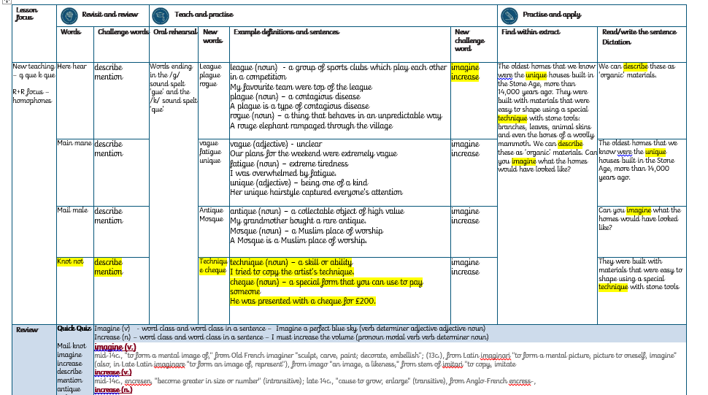

Slide 103
Let’s Revisit and Review…

Slide 104
Do you remember this challenge word?

Slide 105
Definition – give a detailed account in words of
describe
VERB

Slide 106
Could you describe what it looked like?
________

Slide 107
Definition – refer to something briefly without going into detail
mention
VERB

Slide 108
He forgot to mention it.
_______

Slide 109
Homophones

Slide 110
Homophones
Words which sound the same but have different spellings, meanings or origins

Slide 111
knot

Slide 112
not

Slide 113
Let’s Teach and Practise

Slide 114
Words ending in the /k/ sound spelt ‘que’

Slide 115
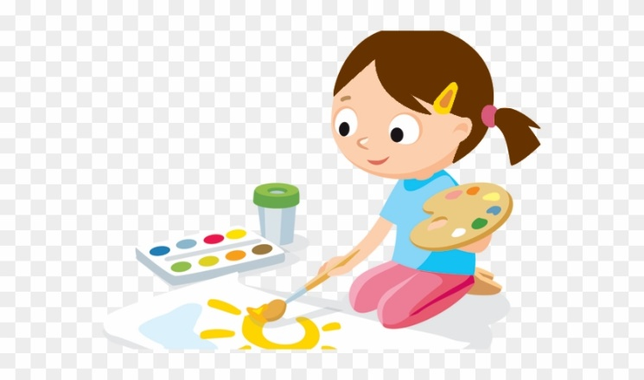
technique

Slide 116

cheque

Slide 117
Definition - a skill or ability
technique
(noun)

Slide 118
Definition – a special form that you can use to pay someone
cheque
(noun)

Slide 119
I tried to copy the artist’s technique.
_________

Slide 120
He was presented with a cheque for £200.
______

Slide 121
New CHALLENGE words.

Slide 122
Definition - believe (something unreal or untrue) to exist or be so
imagine
VERB

Slide 123
Imagine a perfect blue sky.
_______

Slide 124
Definition - become or make greater in size, amount, or degree
increase
VERB

Slide 125
I must increase the volume
________

Slide 126
Let’s Practise and Apply.

Slide 127
Can you spot the spelling rule words and the challenge words?

Slide 128
The oldest homes that we know were the unique houses built in the Stone Age, more than 14,000 years ago. They were built with materials that were easy to shape using a special technique with stone tools: branches, leaves, animal skins and even the bones of a woolly mammoth. We can describe these as ‘organic’ materials. Can you imagine what the homes would have looked like?

Slide 129
The oldest homes that we know were the unique houses built in the Stone Age, more than 14,000 years ago. They were built with materials that were easy to shape using a special technique with stone tools: branches, leaves, animal skins and even the bones of a woolly mammoth. We can describe these as ‘organic’ materials. Can you imagine what the homes would have looked like?

Slide 130
Write this sentence as I dictate it to you.
Notes:
They were built with materials that were easy to shape using a special technique with stone tools

Slide 131
They were built with materials that were easy to shape using a special technique with stone tools
Did you write it correctly?
Edit your work and make sure you have it correct.
Can you underline the spelling words that we have covered in this session?

Slide 132
Year 4 - Autumn 1
Week 1 - Friday
Notes:
Click through the slides for all the R+R words for the week (both the focus and the challenge words)
Click through the slides for all the new learning this week

Slide 133
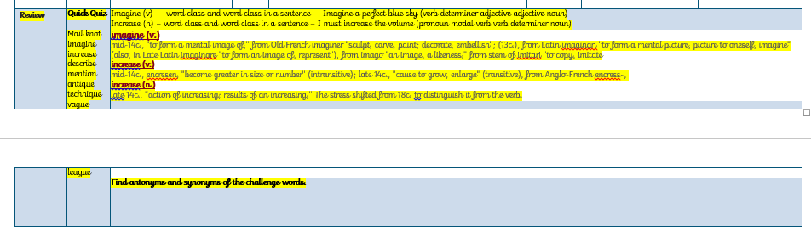

Slide 134
Old challenge words…

Slide 135
describe

Slide 136
mention

Slide 137
Old spelling rule words… (homophones)

Slide 138
here

Slide 139
hear

Slide 140
main

Slide 141
mane

Slide 142
mail

Slide 143
male

Slide 144
knot

Slide 145
not

Slide 146
league

Slide 147
plague

Slide 148
rogue

Slide 149
vague

Slide 150
fatigue

Slide 151
unique

Slide 152
antique

Slide 153
mosque

Slide 154
technique

Slide 155
cheque

Slide 156
New challenge words…

Slide 157
imagine

Slide 158
increase

Slide 159
Quick Quiz time…
Notes:
Say these words for the quiz:
Mail knot imagine increase describe mention antique technique vague league

Slide 160
Did you get them correct?
Edit your work.
mail knot imagine increase describe mention antique technique vague league
Notes:
Say these words for the quiz
Mail knot imagine increase describe mention antique technique vague league

Slide 161
Word class time…

Slide 162
Imagine a perfect blue sky.
Notes:
Ask for these words to be classed

Slide 163
Imagine a perfect blue sky.
Verb determiner adjective adjective noun
Notes:
Ask for these words to be classed

Slide 164
Imagine a perfect blue sky.
Verb determiner adjective adjective noun
Notes:
Ask for these words to be classed

Slide 165
I must increase the volume
Notes:
Ask for these words to be classed

Slide 166
I must increase the volume
Pronoun modal verb verb determiner noun
Notes:
Ask for these words to be classed

Slide 167
I must increase the volume
Pronoun modal verb verb determiner noun
Notes:
Ask for these words to be classed

Slide 168
Etymology
The history of a word….

Slide 169
imagine (v.)
mid-14c., "to form a mental image of," from Old French imaginer "sculpt, carve, paint; decorate, embellish"; (13c.),
from Latin imaginari "to form a mental picture, picture to oneself, imagine" (also, in Late Latin imaginare "to form an image of, represent"),
from imago "an image, a likeness," from stem of imitari "to copy, imitate

Slide 170
increase (v.)
mid-14c., encresen, "become greater in size or number" (intransitive); late 14c., "cause to grow, enlarge" (transitive), from Anglo-French encress-,
increase (n.)
late 14c., "action of increasing; results of an increasing,"
The stress shifted from 18c. to distinguish it from the verb.

Slide 171
Let’s investigate….
Can you find synonyms?
Can you find antonyms?

Slide 172
Synonyms of imagine…
visualise
dream
picture

Slide 173
Antonyms of imagine…
ignore
Break
disregard

Slide 174
Synonyms of increase…
grow
enlarge
expand

Slide 175
Antonyms of increase…
decrease
reduce
lessen

