Slide 1
Spelling Y4
Mastering spellings: building of the foundations of phonics
Autumn 1
Week 3
(Duplicate of Year 3 summer 2 week 3)

Slide 2
Year 4 - Autumn 1
Week 3 - Monday

Slide 3
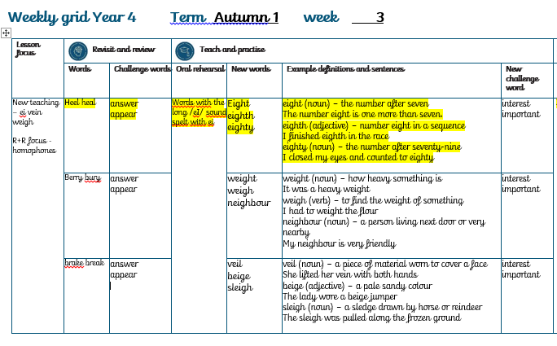

Slide 4
Let’s Revisit and Review…

Slide 5
Do you remember this challenge word?

Slide 6
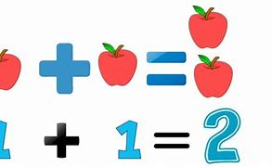
Definition – a thing that is said, written or done in response to a question
answer
NOUN

Slide 7
I put my hand up to answer the question.
______

Slide 8

Definition – come into sight
appear
VERB

Slide 9
The class waited for their teacher to appear.
______

Slide 10
Homophones

Slide 11
Homophones
Words which sound the same but have different spellings, meanings or origins

Slide 12
heel

Slide 13
heal

Slide 14
Let’s Teach and Practise

Slide 15
Words with the long /eI/ sound spelt with ei

Slide 16

eight

Slide 17

eighth

Slide 18

eighty

Slide 19
Definition- the number after seven
eight
(noun)

Slide 20
Definition – coming after 7th in the race
eighth
(adjective)

Slide 21
Definition - the number after seventy-nine
eighty
(noun)

Slide 22
The number eight is one more than seven.
_____

Slide 23
I finished eighth in the race.
______

Slide 24
I closed my eyes and counted to eighty.
______

Slide 25
New CHALLENGE words.

Slide 26

Definition - the feeling of wanting to know or learn about something or someone
interest
NOUN

Slide 27
I have an interest in music.
________

Slide 28

Definition - of great significance or value
important
ADJECTIVE

Slide 29
She went to an important meeting
__________

Slide 30
Let’s Practise and Apply.

Slide 31
Can you spot the spelling rule words and the challenge words?

Slide 32
Wood has been the answer to housing for over eight hundred years. The Tudors would build timber-framed houses for themselves and neighbours. These homes are still standing today over 500 years later. The wood freight has been moved in different ways over the years. Homes were built near rivers so that the weight of the logs could be carried on barges. In countries with snow and ice covering the ground, a sleigh is used to transport the wood for building the homes.

Slide 33
Wood has been the answer to housing for over eight hundred years. The Tudors would build timber-framed houses for themselves and neighbours. These homes are still standing today over 500 years later. The wood freight has been moved in different ways over the years. Homes were built near rivers so that the weight of the logs could be carried on barges. In countries with snow and ice covering the ground, a sleigh is used to transport the wood for building the homes.

Slide 34
Write this sentence as I dictate it to you.
Notes:
Wood has been the answer to housing for over eight hundred years.

Slide 35
Wood has been the answer to housing for over eight hundred years.
Did you write it correctly?
Edit your work and make sure you have it correct.
Can you underline the spelling words that we have covered in this session?

Slide 36
Year 4 - Autumn 1
Week 2 - Tuesday

Slide 37
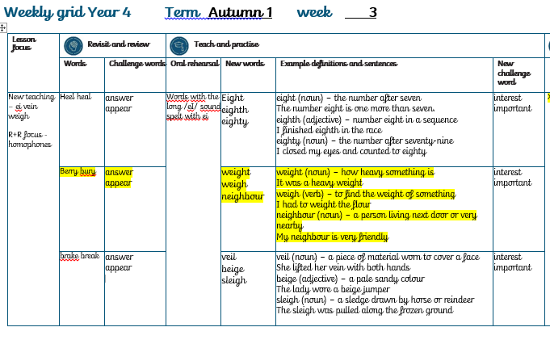

Slide 38
Let’s Revisit and Review…

Slide 39
Do you remember this challenge word?

Slide 40
Definition – a thing that is said, written or done in response to a question
answer
NOUN

Slide 41
I put my hand up to answer the question.
______

Slide 42
Definition – come into sight
appear
VERB

Slide 43
The class waited for their teacher to appear.
______

Slide 44
Homophones

Slide 45
Homophones
Words which sound the same but have different spellings, meanings or origins

Slide 46
berry

Slide 47
bury

Slide 48
Let’s Teach and Practise

Slide 49
Words with the long /eI/ sound spelt with ei

Slide 50
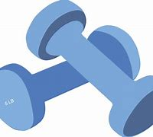
weight

Slide 51

weigh

Slide 52
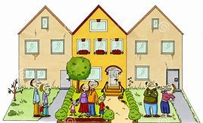
neighbour

Slide 53
Definition - how heavy something is
weight
(noun)

Slide 54
Definition - to find the weight of something
weigh
(verb)

Slide 55
Definition - a person living next door or very nearby
neighbour
(noun)

Slide 56
It was a heavy weight.
______

Slide 57
I had to weigh the flour.
______

Slide 58
My neighbour is very friendly.
_________

Slide 59
New CHALLENGE words.

Slide 60
Definition - the feeling of wanting to know or learn about something or someone
interest
NOUN

Slide 61
I have an interest in music.
________

Slide 62
Definition - of great significance or value
important
ADJECTIVE

Slide 63
She went to an important meeting
__________

Slide 64
Let’s Practise and Apply.

Slide 65
Can you spot the spelling rule words and the challenge words?

Slide 66
Wood has been the answer to housing for over eight hundred years. The Tudors would build timber-framed houses for themselves and neighbours. These homes are still standing today over 500 years later. The wood freight has been moved in different ways over the years. Homes were built near rivers so that the weight of the logs could be carried on barges. In countries with snow and ice covering the ground, a sleigh is used to transport the wood for building the homes.

Slide 67
Wood has been the answer to housing for over eight hundred years. The Tudors would build timber-framed houses for themselves and neighbours. These homes are still standing today over 500 years later. The wood freight has been moved in different ways over the years. Homes were built near rivers so that the weight of the logs could be carried on barges. In countries with snow and ice covering the ground, a sleigh is used to transport the wood for building the homes.

Slide 68
Write this sentence as I dictate it to you.
Notes:
The Tudors would build timber-framed houses for themselves and neighbours. These homes are still standing today over 500 years later.

Slide 69
The Tudors would build timber-framed houses for themselves and neighbours. These homes are still standing today over 500 years later.
Did you write it correctly?
Edit your work and make sure you have it correct.
Can you underline the spelling words that we have covered in this session?

Slide 70
Year 4 - Autumn 1
Week 3 - Wednesday

Slide 71
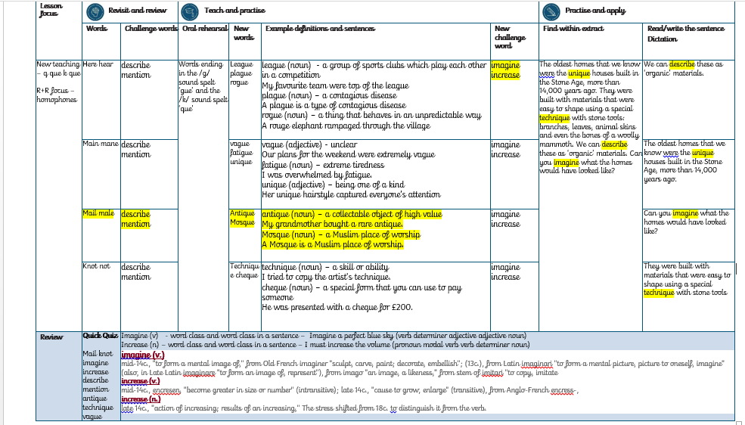

Slide 72
Let’s Revisit and Review…

Slide 73
Do you remember this challenge word?

Slide 74
Definition – a thing that is said, written or done in response to a question
answer
NOUN

Slide 75
I put my hand up to answer the question.
______

Slide 76
Definition – come into sight
appear
VERB

Slide 77
The class waited for their teacher to appear.
______

Slide 78
Homophones

Slide 79
Homophones
Words which sound the same but have different spellings, meanings or origins

Slide 80
brake

Slide 81
break

Slide 82
Let’s Teach and Practise

Slide 83
Words ending in the /k/ sound spelt ‘que’

Slide 84
Words with the long /eI/ sound spelt with ei

Slide 85

veil

Slide 86
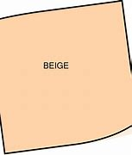
beige

Slide 87
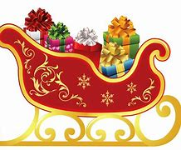
sleigh

Slide 88
Definition - a piece of material worn to cover a face
veil
(noun)

Slide 89
Definition - a pale sandy colour
beige
(adjective)

Slide 90
Definition - a sledge drawn by horse or reindeer
sleigh
(noun)

Slide 91
She lifted her veil with both hands to reveal her face.
____

Slide 92
The lady wore a beige jumper.
______

Slide 93
The sleigh was pulled along the frozen ground.
______

Slide 94
New CHALLENGE words.

Slide 95
Definition - the feeling of wanting to know or learn about something or someone
interest
NOUN

Slide 96
I have an interest in music.
________

Slide 97
Definition - of great significance or value
important
ADJECTIVE

Slide 98
She went to an important meeting
__________

Slide 99
Let’s Practise and Apply.

Slide 100
Can you spot the spelling rule words and the challenge words?

Slide 101
Wood has been the answer to housing for over eight hundred years. The Tudors would build timber-framed houses for themselves and neighbours. These homes are still standing today over 500 years later. The wood freight has been moved in different ways over the years. Homes were built near rivers so that the weight of the logs could be carried on barges. In countries with snow and ice covering the ground, a sleigh is used to transport the wood for building the homes.

Slide 102
Wood has been the answer to housing for over eight hundred years. The Tudors would build timber-framed houses for themselves and neighbours. These homes are still standing today over 500 years later. The wood freight has been moved in different ways over the years. Homes were built near rivers so that the weight of the logs could be carried on barges. In countries with snow and ice covering the ground, a sleigh is used to transport the wood for building the homes.

Slide 103
Write this sentence as I dictate it to you.
Notes:
The wood freight has been moved in different ways over the years.

Slide 104
The wood freight has been moved in different ways over the years.
Did you write it correctly?
Edit your work and make sure you have it correct.
Can you underline the spelling words that we have covered in this session?

Slide 105
Year 4 - Autumn 1
Week 3 - Thursday

Slide 106
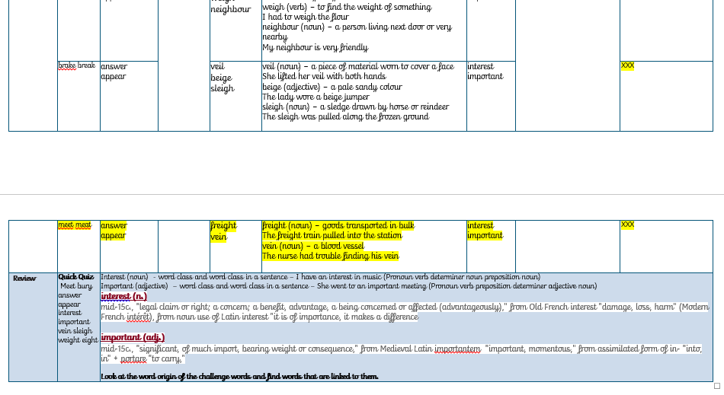

Slide 107
Let’s Revisit and Review…

Slide 108
Do you remember this challenge word?

Slide 109
Definition – a thing that is said, written or done in response to a question
answer
NOUN

Slide 110
I put my hand up to answer the question.
______

Slide 111
Definition – come into sight
appear
VERB

Slide 112
The class waited for their teacher to appear.
______

Slide 113
Homophones

Slide 114
Homophones
Words which sound the same but have different spellings, meanings or origins

Slide 115
meet

Slide 116
meat

Slide 117
Let’s Teach and Practise

Slide 118
Words with the long /eI/ sound spelt with ei

Slide 119
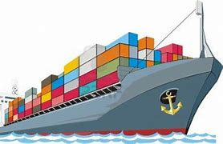
freight

Slide 120
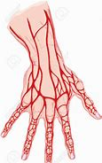
vein

Slide 121
Definition - goods transported in bulk
freight
(noun)

Slide 122
Definition – a blood vessel
vein
(noun)

Slide 123
The freight was being transported by rail.
_______

Slide 124
The nurse had trouble finding his vein.
____

Slide 125
New CHALLENGE words.

Slide 126
Definition - the feeling of wanting to know or learn about something or someone
interest
NOUN

Slide 127
I have an interest in music.
________

Slide 128
Definition - of great significance or value
important
ADJECTIVE

Slide 129
She went to an important meeting
__________

Slide 130
Let’s Practise and Apply.

Slide 131
Can you spot the spelling rule words and the challenge words?

Slide 132
Wood has been the answer to housing for over eight hundred years. The Tudors would build timber-framed houses for themselves and neighbours. These homes are still standing today over 500 years later. The wood freight has been moved in different ways over the years. Homes were built near rivers so that the weight of the logs could be carried on barges. In countries with snow and ice covering the ground, a sleigh is used to transport the wood for building the homes.

Slide 133
Wood has been the answer to housing for over eight hundred years. The Tudors would build timber-framed houses for themselves and neighbours. These homes are still standing today over 500 years later. The wood freight has been moved in different ways over the years. Homes were built near rivers so that the weight of the logs could be carried on barges. In countries with snow and ice covering the ground, a sleigh is used to transport the wood for building the homes.

Slide 134
Write this sentence as I dictate it to you.
Notes:
In countries with snow and ice covering the ground, a sleigh is used to transport the wood for building the homes.

Slide 135
In countries with snow and ice covering the ground, a sleigh is used to transport the wood for building the homes.
Did you write it correctly?
Edit your work and make sure you have it correct.
Can you underline the spelling words that we have covered in this session?

Slide 136
Year 4 - Autumn 1
Week 3 - Friday

Slide 137
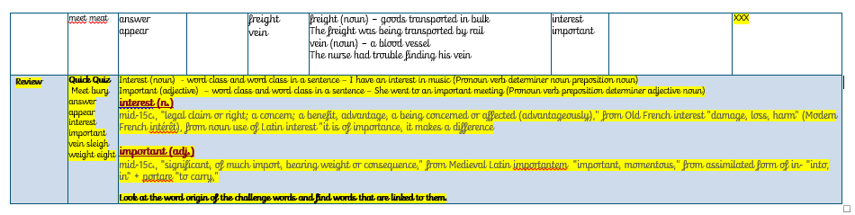

Slide 138
Old challenge words…

Slide 139
answer

Slide 140
appear

Slide 141
Old spelling rule words… (homophones)

Slide 142
heel

Slide 143
heal

Slide 144
berry

Slide 145
bury

Slide 146
break

Slide 147
brake

Slide 148
meet

Slide 149
meat

Slide 150
New spelling rule words…

Slide 151
eight

Slide 152
eighty

Slide 153
eighth

Slide 154
weight

Slide 155
weigh

Slide 156
neighbour

Slide 157
veil

Slide 158
beige

Slide 159
sleigh

Slide 160
freight

Slide 161
vein

Slide 162
New challenge words…

Slide 163
interest

Slide 164
important

Slide 165
Quick Quiz time…
Notes:
Say these words for the quiz:
meet bury answer appear interest important vein sleigh weight eight

Slide 166
Did you get them correct?
Edit your work.
meet bury answer appear interest important vein sleigh weight eight
Notes:
Say these words for the quiz
Meet bury answer appear interest important vein sleigh weight eight

Slide 167
Word class time…

Slide 168
I have an interest in music.

Slide 169
I have an interest in music.
Pronoun verb determiner noun preposition noun
Notes:
Ask for these words to be classed

Slide 170
I have an interest in music.
Pronoun verb determiner noun preposition noun
Notes:
Ask for these words to be classed

Slide 171
She went to an important meeting.
Notes:
Ask for these words to be classed

Slide 172
She went to an important meeting.
Pronoun verb preposition determiner adjective noun
Notes:
Ask for these words to be classed

Slide 173
She went to an important meeting.
Pronoun verb preposition determiner adjective noun
Notes:
Ask for these words to be classed

Slide 174
Etymology
The history of a word….

Slide 175
interest (n.)
mid-15c., "legal claim or right; a concern; a benefit, advantage, a being concerned or affected (advantageously),“
from Old French interest "damage, loss, harm" (Modern French intérêt),
from noun use of Latin interest "it is of importance, it makes a difference”

Slide 176
important (adj.)
mid-15c., "significant, of much import, bearing weight or consequence,"
from Medieval Latin importantem "important, momentous,"
from assimilated form of in- "into, in" + portare "to carry,"

Slide 177
Let’s investigate….
Explain what has gone wrong

Slide 178
intrest

Slide 179
enterest

Slide 180
interesd

Slide 181
Let’s investigate….
Explain what has gone wrong

Slide 182
inportant

Slide 183
importent

Slide 184
impotant

